Slide 1
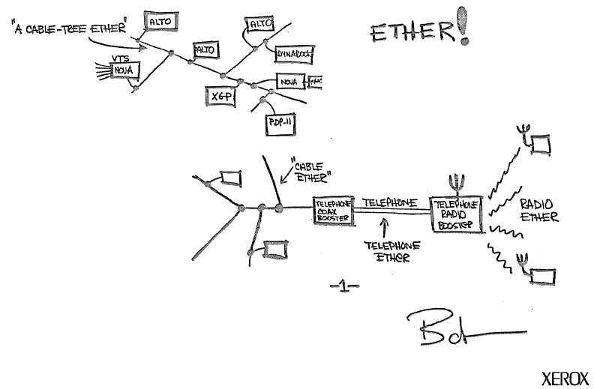







Wallace A. Chase
Technical Engagement Manager
wallace.chase@reannz.co.nz
@bmtfr

Slide 3
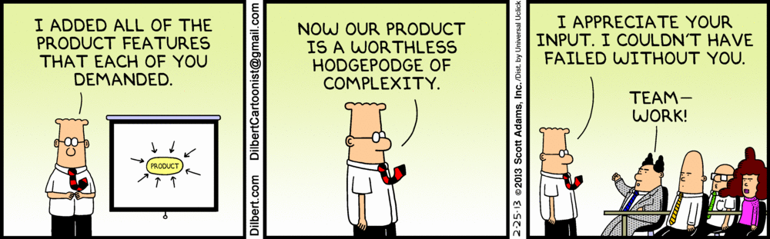
So what makes this so complex anyway?

Slide 4
Lets use the university campus network as an example…

Slide 5
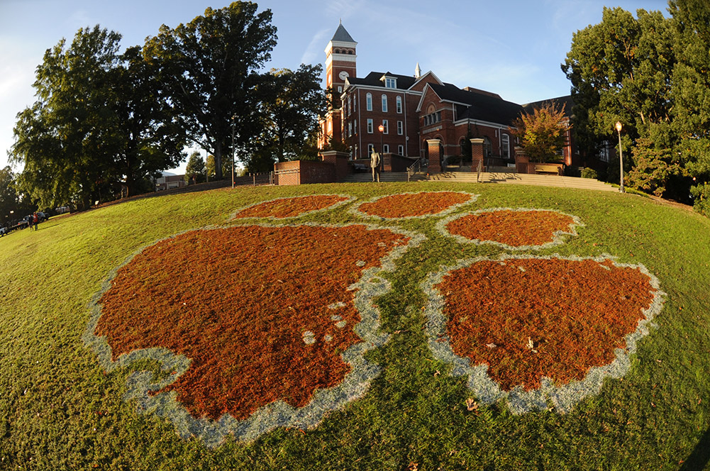
The academic network

Slide 6

What makes up an academic network?
Student
access

Slide 7

What makes up an academic network?
Student
access
Intellectual
Property

Slide 8

What makes up an academic network?
Student
access
Intellectual
Property
Payroll &
Accounting

Slide 9

What makes up an academic network?
Student
access
Intellectual
Property
Payroll &
Accounting
Business
systems

Slide 10

What makes up an academic network?
Student
access
Intellectual
Property
Payroll &
Accounting
Business
systems
Firewall all the things!
Notes:
All of these environments have controls around them. Some more stringent than others such as PCI standards for credit card processing or HIPPA for student records…
Then there is the student access environment…

Slide 11


Slide 12
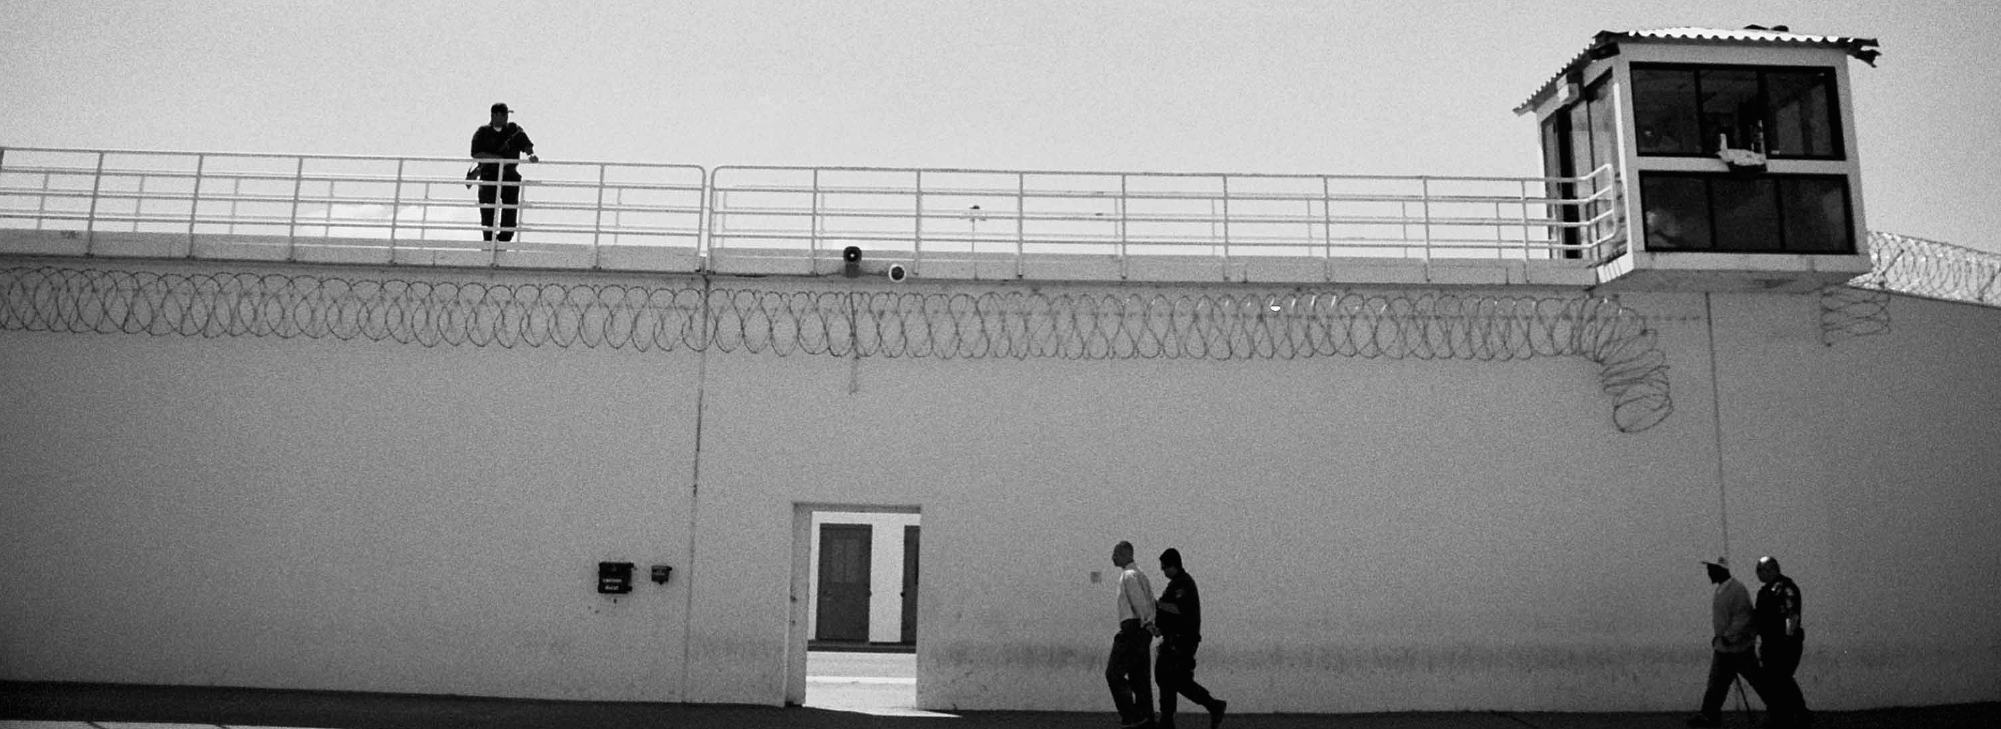
The academic network…

Slide 13
The academic network…
“WAN”
Notes:
Here we have the “WAN”, basically the external connectivity for the academic network

Slide 14
The academic network…
“Firewall”
“WAN”
Notes:
Here we have the “WAN”, basically the external connectivity for the academic network

Slide 15
The academic network…
Intrusion
Prevention
“Firewall”
“WAN”
Notes:
Here we have the “WAN”, basically the external connectivity for the academic network

Slide 16
The academic network…
Bureaucracy
(aka “Paperwork”)
Intrusion
Prevention
“Firewall”
“WAN”
Notes:
Here we have the “WAN”, basically the external connectivity for the academic network

Slide 17
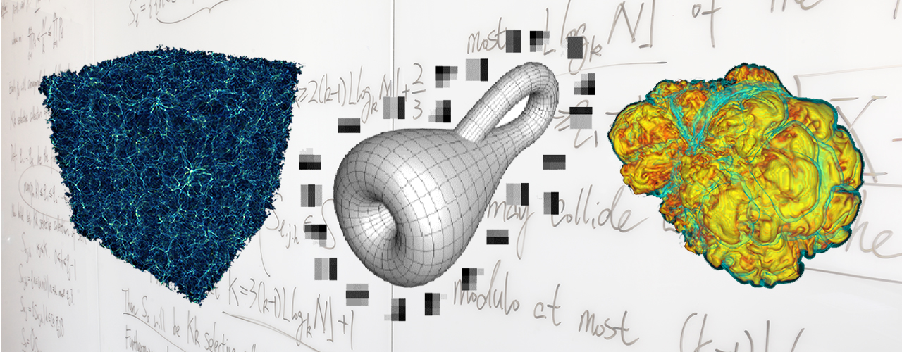
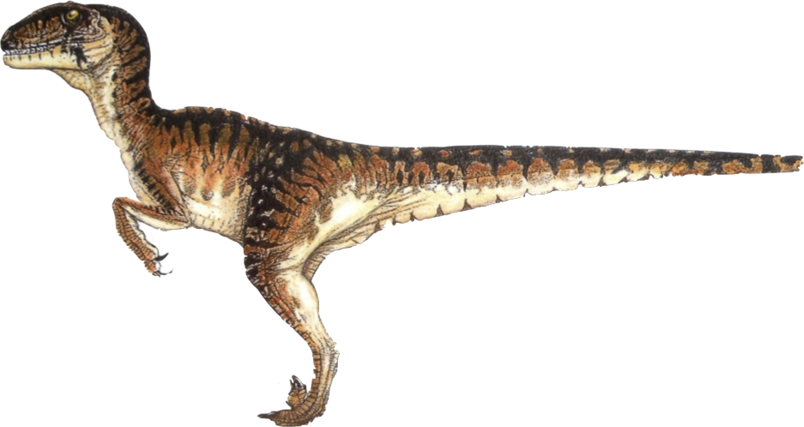
Computational Research, an analogy…
=
Computational Research
Velociraptor

Slide 18
Computational Research, an analogy…
~
=
Computational Research
Velociraptor
Notes:
Well, “approximately”…

Slide 19
Computational Research, an analogy…
Irrefutable proof the analogy is valid…
Notes:
As proof that this analogy holds true…

Slide 20
Computational Research, an analogy…
Notes:
We will use a Venn diagram!

Slide 21
Computational Research, an analogy…
Agile
Notes:
Both computational research and velociraptors are agile. Each of them need to change their behavior to match environmental constraints.

Slide 22
Computational Research, an analogy…
Agile
Moves Rapidly
Notes:
Both tend to move rapidly!

Slide 23
Computational Research, an analogy…
Agile
Moves Rapidly
More Effective
In Groups
Notes:
Both work more effectively as a group.

Slide 24
Computational Research, an analogy…
Agile
Moves Rapidly
More Effective
In Groups
Consumes All
Available Resources
Notes:
And both will consume any (and all) available resources that are presented to them.

Slide 25
Computational Research, an analogy…
Agile
Moves Rapidly
More Effective
In Groups
Consumes All
Available Resources
Cool!
Notes:
And both are really, really cool!

Slide 26
Computational Research, an analogy…
Agile
Moves Rapidly
More Effective
In Groups
Is not reptile
Is reptile
Consumes All
Available Resources
Cool!
Notes:
And both are really, really cool!

Slide 27
When Computational Science Meets Traditional Networks
Notes:
Back to our network…

Slide 28
When Computational Science Meets Traditional Networks
Pardon me good sirs…

Slide 29
When Computational Science Meets Traditional Networks
Yes?

Slide 30
When Computational Science Meets Traditional Networks
I have some important research data…

Slide 31
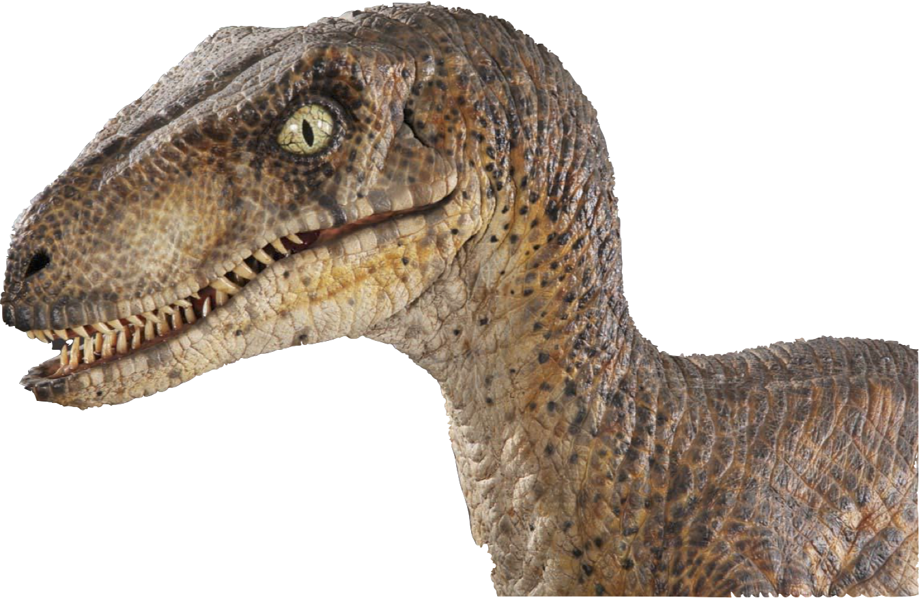
When Computational Science Meets Traditional Networks
…that is highly important to myself, the educational community, and all of mankind as a whole. It is imperative that this data be reasonably secured; yet, available to my research peers. The datasets are rather large, and they may need to be shared across institutions.

Slide 32
When Computational Science Meets Traditional Networks
Would it be possible to place this in a secure, reliable, flexible, accessible, as well as high performing infrastructure?

Slide 33
When Computational Science Meets Traditional Networks
Ummm…

Slide 34
When Computational Science Meets Traditional Networks
Lemme check…

Slide 35
When Computational Science Meets Traditional Networks
Hey, Jim!

Slide 36
When Computational Science Meets Traditional Networks
Yo!

Slide 37
When Computational Science Meets Traditional Networks
Gotta guy here. Says he needs stuff.

Slide 38
When Computational Science Meets Traditional Networks
What kinda stuff?

Slide 39
When Computational Science Meets Traditional Networks
Something about security and connectivity I think…

Slide 40
When Computational Science Meets Traditional Networks
We got plenty of that! Send ‘em in.

Slide 41
When Computational Science Meets Traditional Networks

Slide 42
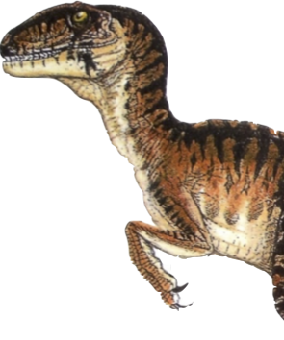
When Computational Science Meets Traditional Networks
ROAR!!!

Slide 43
When Computational Science Meets Traditional Networks
Ye gads!

Slide 44

When Computational Science Meets Traditional Networks
AHHHH!!
Ye gads!

Slide 45

When Computational Science Meets Traditional Networks
AHHHH!!
THE INHUMANITY!!!
Ye gads!

Slide 46
When Computational Science Meets Traditional Networks
AHHHH!!
THE INHUMANITY!!!
Ye gads!
HOM! NOM! NOM!

Slide 47
When Computational Science Meets Traditional Networks
OBSERVATION: The requirements of the computational researcher and the service profile of the traditional campus computer network (or other ”commodity” networks) do not always align!
Ya’ think?!
Notes:
The requirements of the computational researcher simply do not align easily with the traditional capabilities of regular networks.

Slide 48
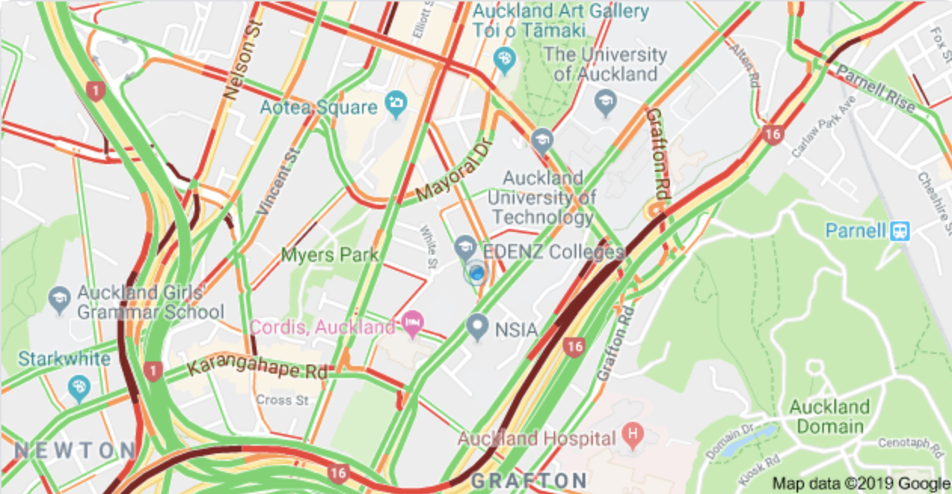
When Computational Science Meets Traditional Networks
This can result in adverse consequences:
  Network performance issues for the researcher
  Network performance issues for everyone else
  Frustration for the researcher
  Frustration for IT staff
  General grumbling and complaining

Slide 49
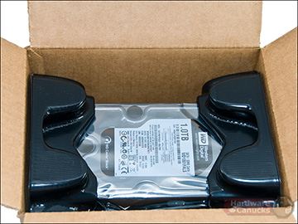
When Computational Science Meets Traditional Networks
Sigh. I guess cancer cures can wait.

Slide 50
When Computational Science Meets Traditional Networks
But how do we overcome this? I can’t stop my research just because the network can’t keep up! Being able to collaborate is the future!

Slide 51
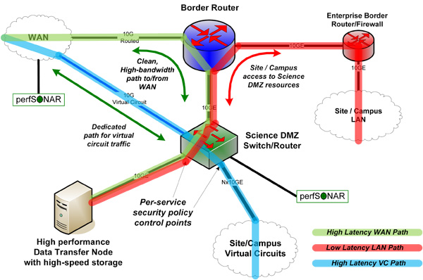
SciDMZ – a history
2010

Slide 53
All hosts are connected by a 10G NIC, and no paths were congested. The MTU was set to 9000bytes.
Note the with default MTUs of 1500, the impact of packet loss is even greater.
https://fasterdata.es.net/network-tuning/tcp-issues-explained/packet-loss/
https://dl.acm.org/citation.cfm?id=264023

Slide 55
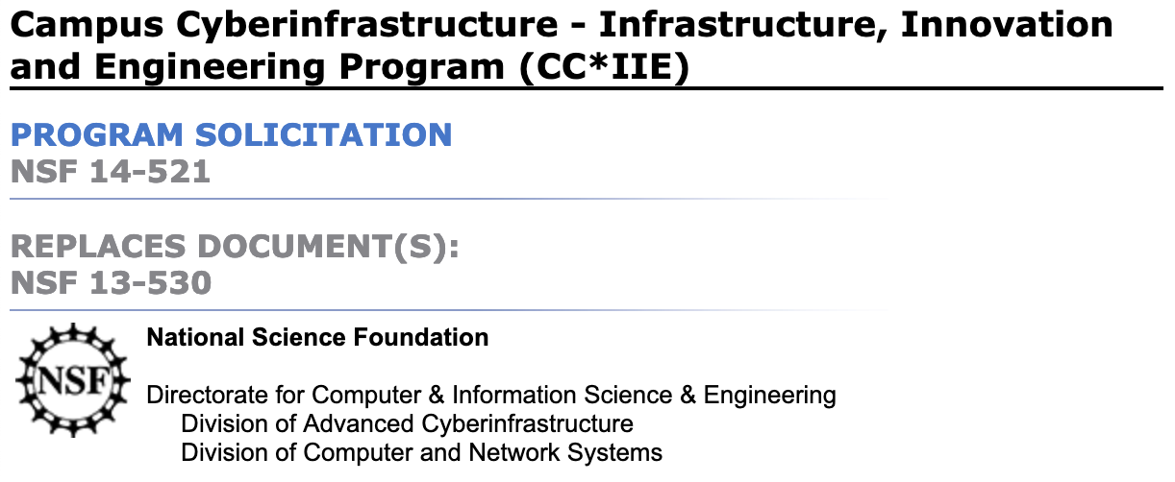
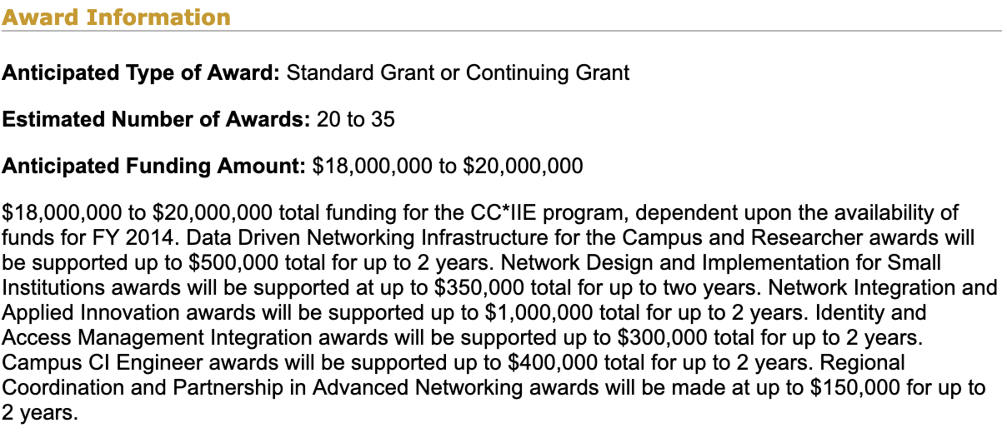

Slide 56
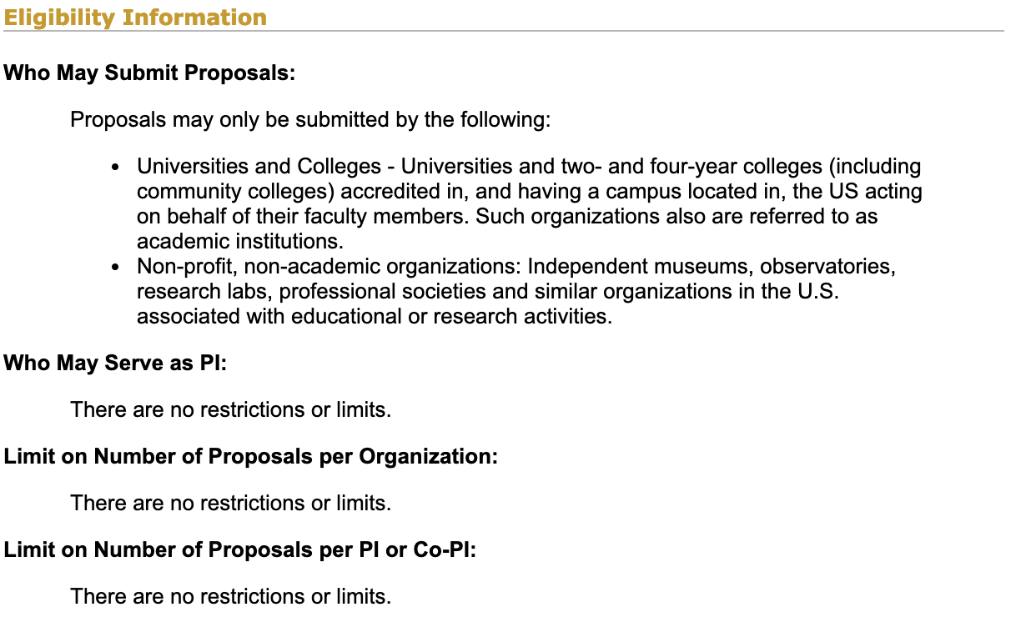

Slide 57
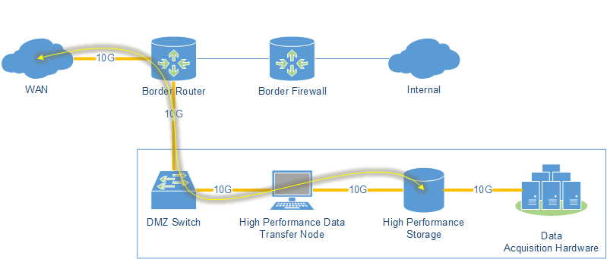
Notes:
Simply put a DTN is a computer that can move data from disk to network at speed.

Slide 59
Does everyone need one?

Slide 60
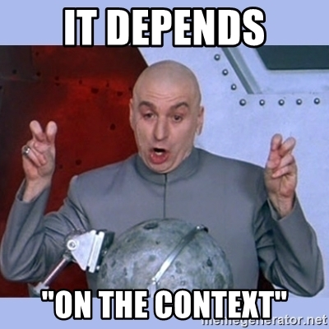
Different SciDMZ architectures
Brute force method
Apply money method
Help me help you method
Get fancy method
Special snowflake method
Come to me method

Slide 61
Brute force method…
Fiber to the end user
Build to demand
Sustainability issues
Bang for buck issues
Looong lead time issues
You expect me to wait for how long?

Slide 62
Apply money…
Full hardware designs
Sometimes just to the buildings
Sometimes all the way to the jacks
Sustainability issues
Bang for buck issues
Loop anyone?
You expect me to fund what? Some kind of tubes?

Slide 63
Help me help you…
Replacement of border routers with more powerful boxes
Often a L2 switch in a central location
Good starting point
Is the science driver located where the DMZ is?
What about the labs?
Only a start

Slide 64
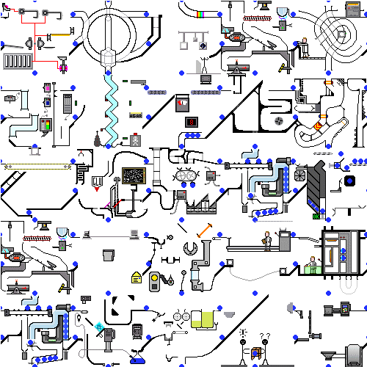
Get fancy…
Virtualize all the things
VRF or other such segmentation of existing network gear
At its most basic – VLANs
Low cost – as sustainable as the network is
Can be is complex
Will IT set this up in a reasonable amount of time?
Congestion still an issue for large flows
More readily sustainable

Slide 65
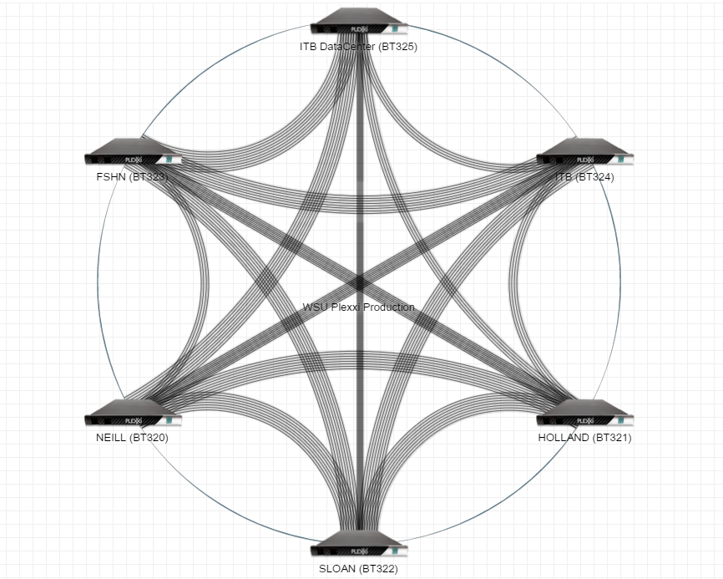
Special snowflake method…
Unique design
Can be overly complex
Will IT set this up in a reasonable amount of time?
Is it sustainable?
Supporting research or doing research?
Ice ages have not gone well for my kind…

Slide 66
Come to me method…
Centralization!
Less hardware and complexity
Must have trust
Will IT set this up in a reasonable amount of time?
Is it sustainable?
Start with one

Slide 67
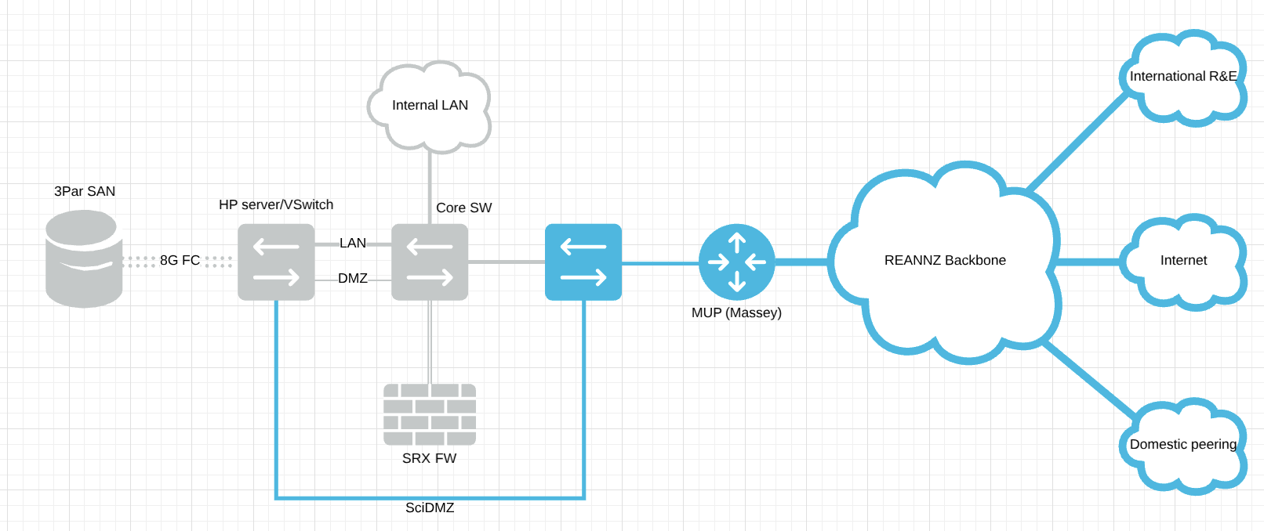

Slide 68
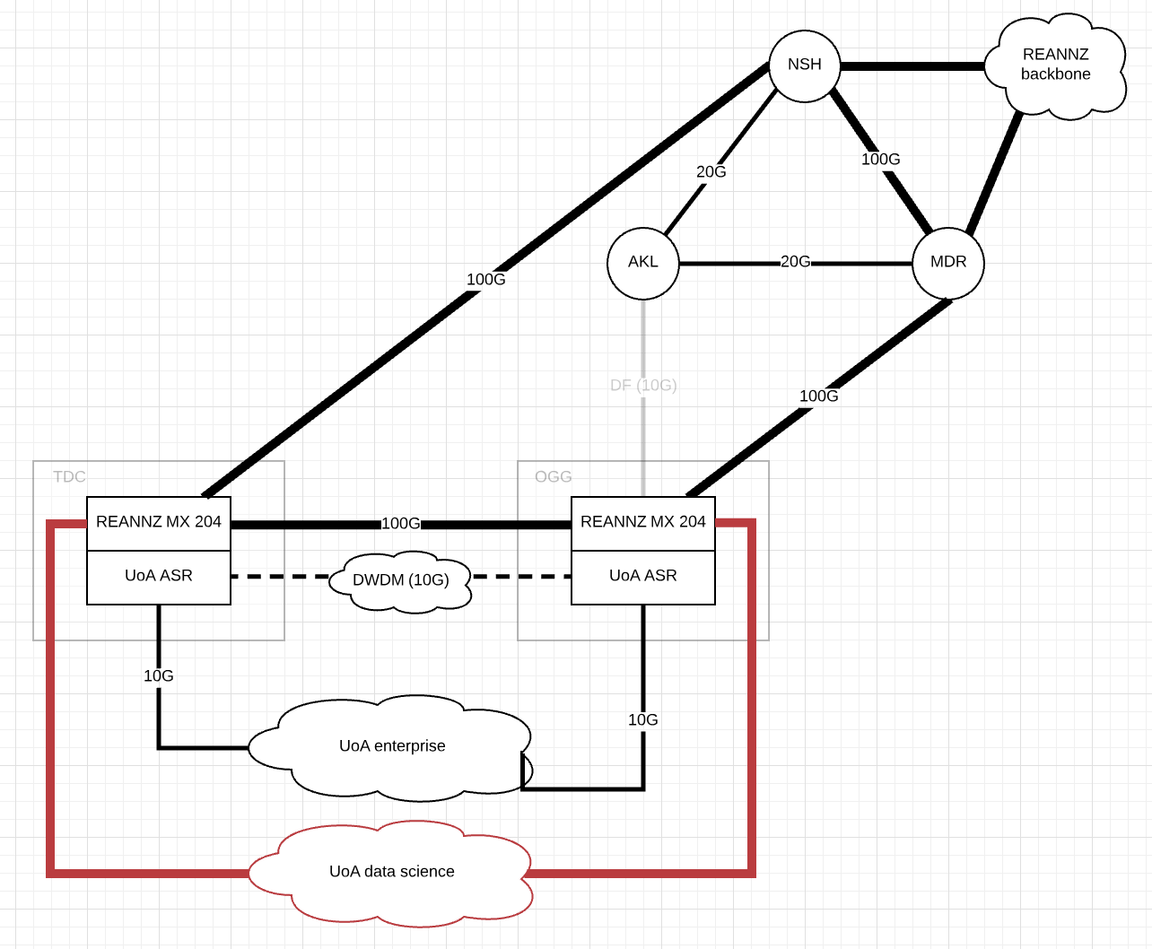

Slide 69
Build yourself a picture of the landscape
  What are your resources? Who are your resources?
  How well do you know your business?
  Who are your researchers? Where are they? Where is their data?
  If you don’t know, how will your researchers know what the possibilities are?
  REANNZ has FREE resources to help you!

Slide 70
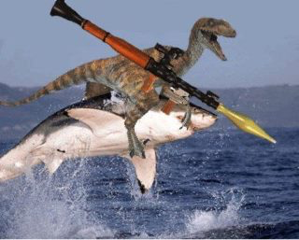
REANNZ supplies the shark, can you get your researchers on board?
* RPG sold separately. May not ship to New Zealand, check with your courier company for details

Slide 71

Wallace A. Chase
wallace.chase@reannz.co.nz
@bmtfr
A very special thanks to Matt Younkins at OU, as the raptors are on loan from him!

