Slide 1
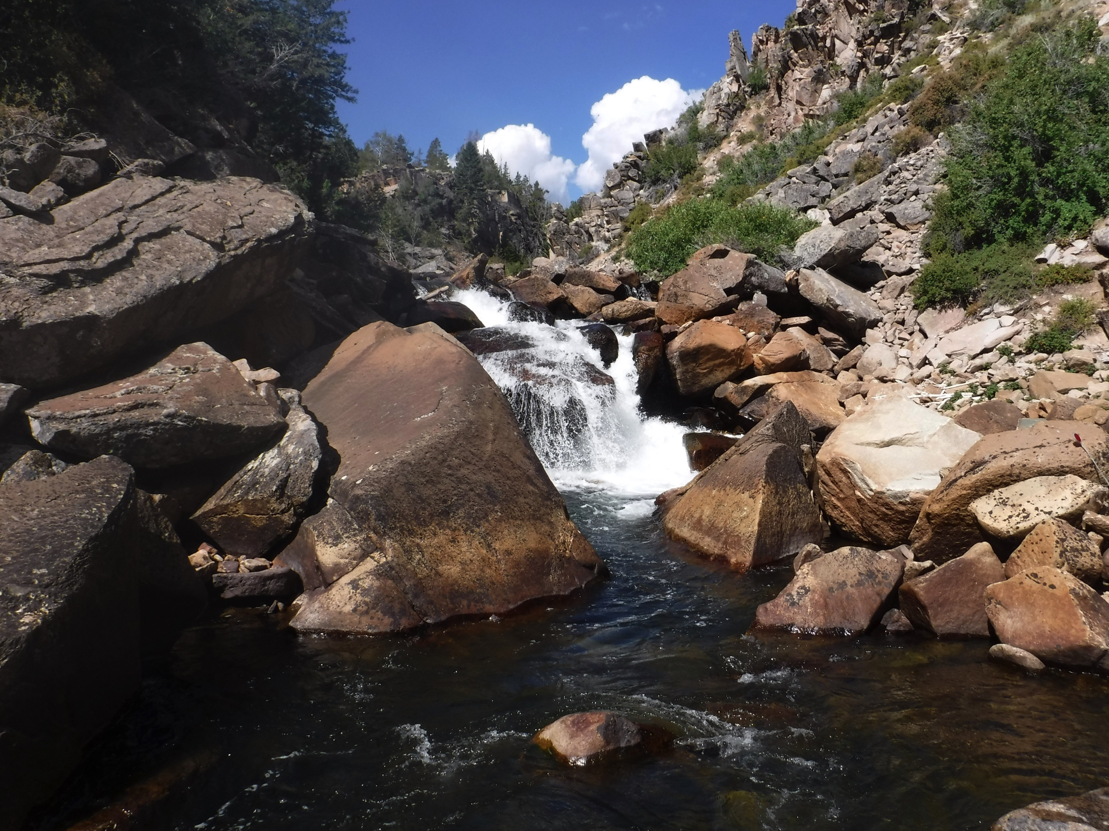
Big blocks and river incision:
A numerical modeling perspective
Charlie Shobe
Greg Tucker
Bob Anderson

Slide 2
Larger grains are found in higher-slope channel reaches
Flow Competence
Flow Competence
Attal et al., 2015, ESurf

Slide 3
Larger blocks are found in higher-slope channel reaches
70
60
50
40
30
20
10
0
Total long axis [m]
Shobe et al., in revision, GRL

Slide 4
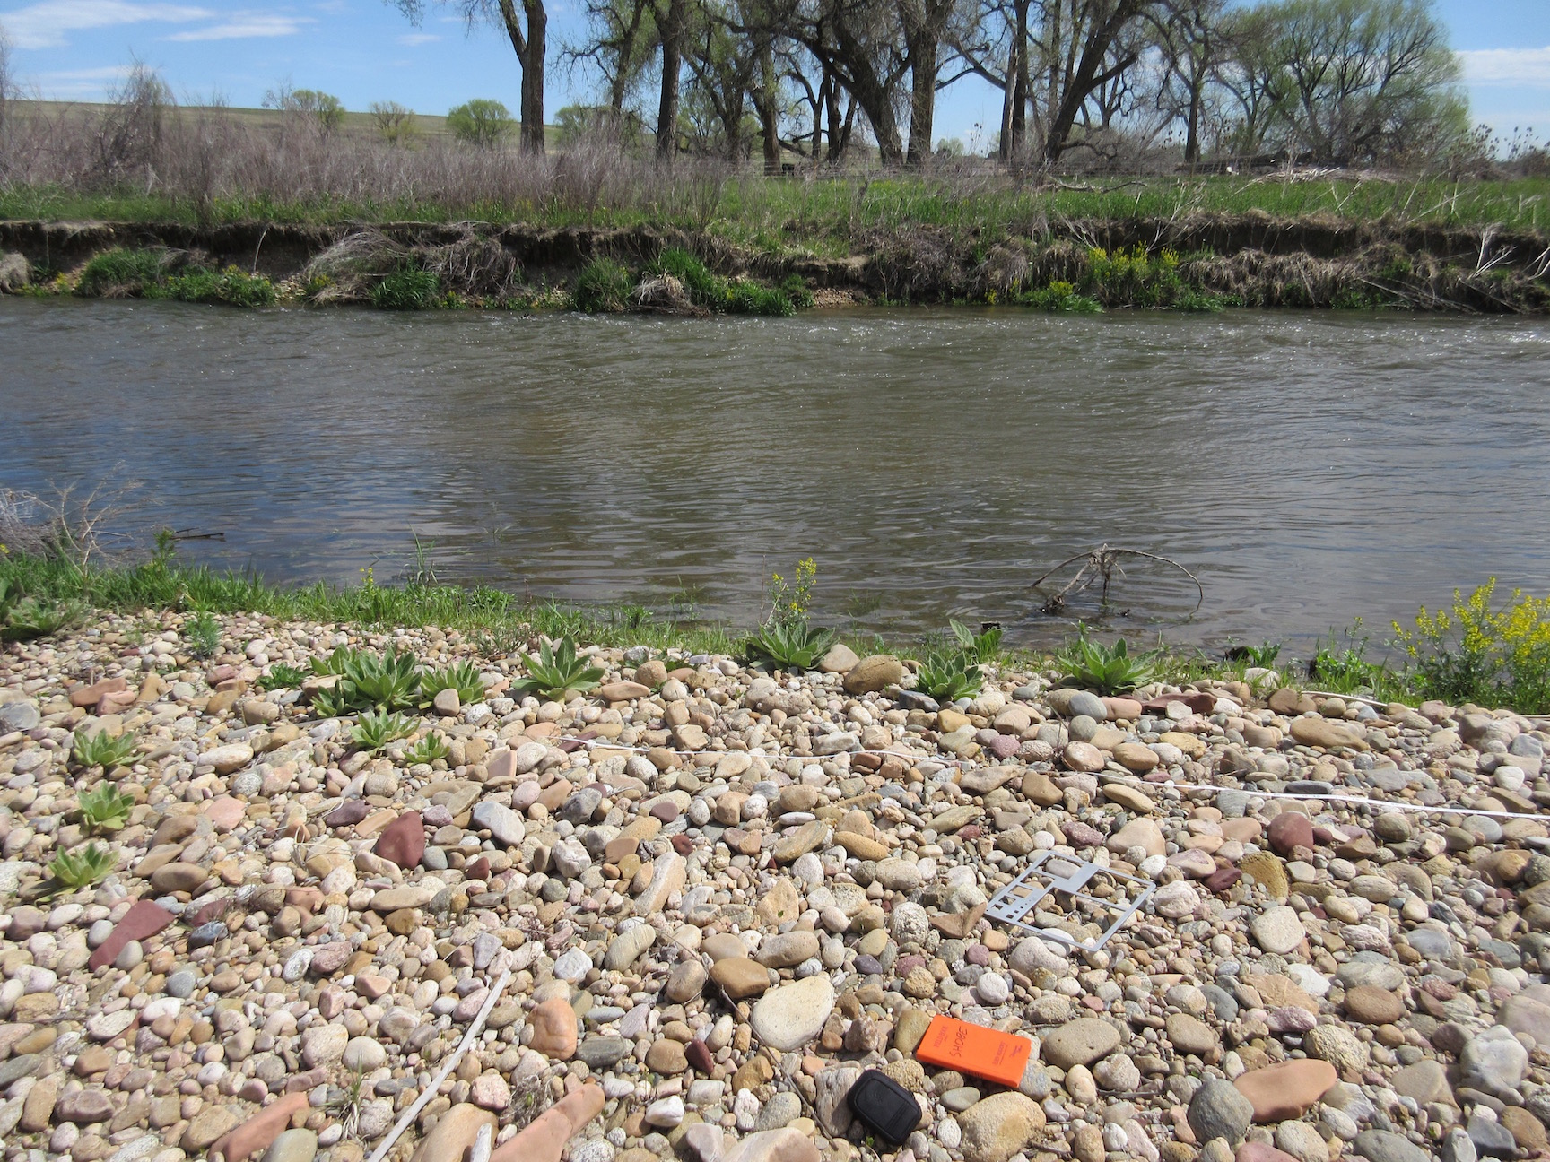
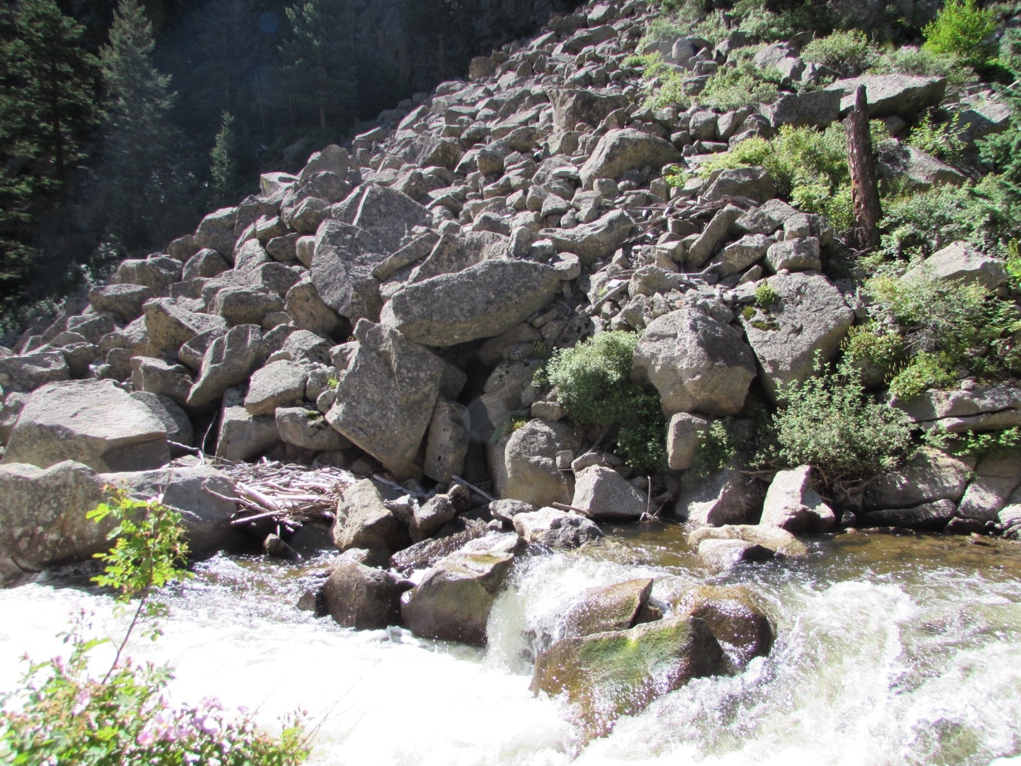
Blocks must be hillslope-derived
Large blocks in steep reaches suggest a channel-hillslope feedback that retards river incision

Slide 5

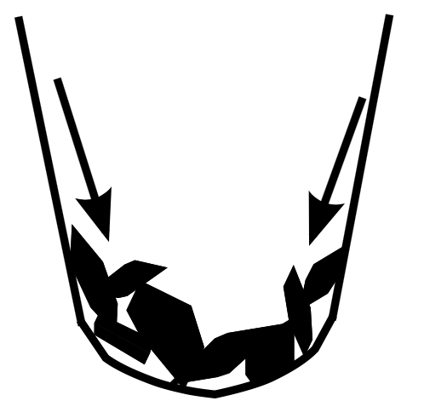
Conceptual model
Rapid river incision steepens adjacent hillslopes, causing an influx of large, immobile grains that in turn inhibit incision

Slide 6
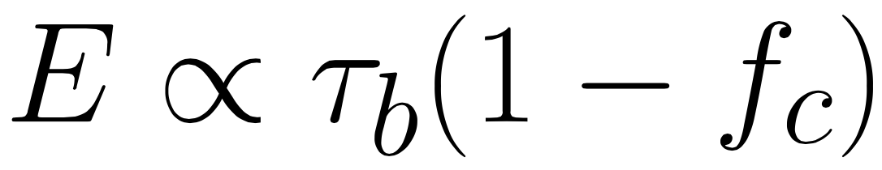
Model setup:
Fluvial erosion
Shobe et al., in revision, GRL
1-D channel reach with shear stress bedrock erosion:
Blocks cover the bed, reduce bed shear stress

Slide 7
Model setup:
Block dynamics
Shobe et al., in revision, GRL
Treated as a Poisson process dependent on channel erosion rate
Faster channel incision results in greater block supply
Blocks are eroded by excess shear stress

Slide 8
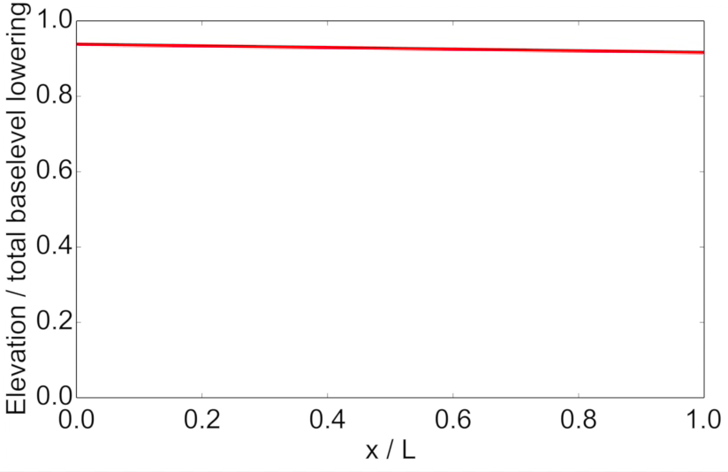
Control case: No block delivery

Slide 9
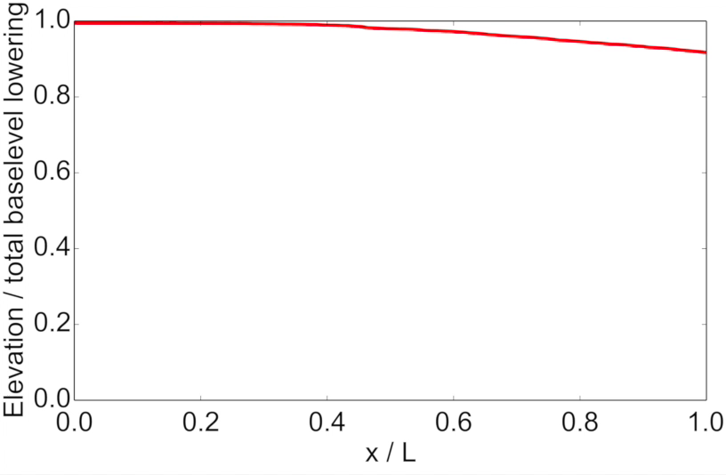
Responsive hillslopes

Slide 10
Control case
Responsive hillslopes

Slide 11
1-D Model Observations
Responsive hillslopes slow channel evolution
Block feedbacks autogenically generate knickzones from constant baselevel drop
Results cast doubt on stream profile analysis as a tool for extracting landscape forcings

Slide 12
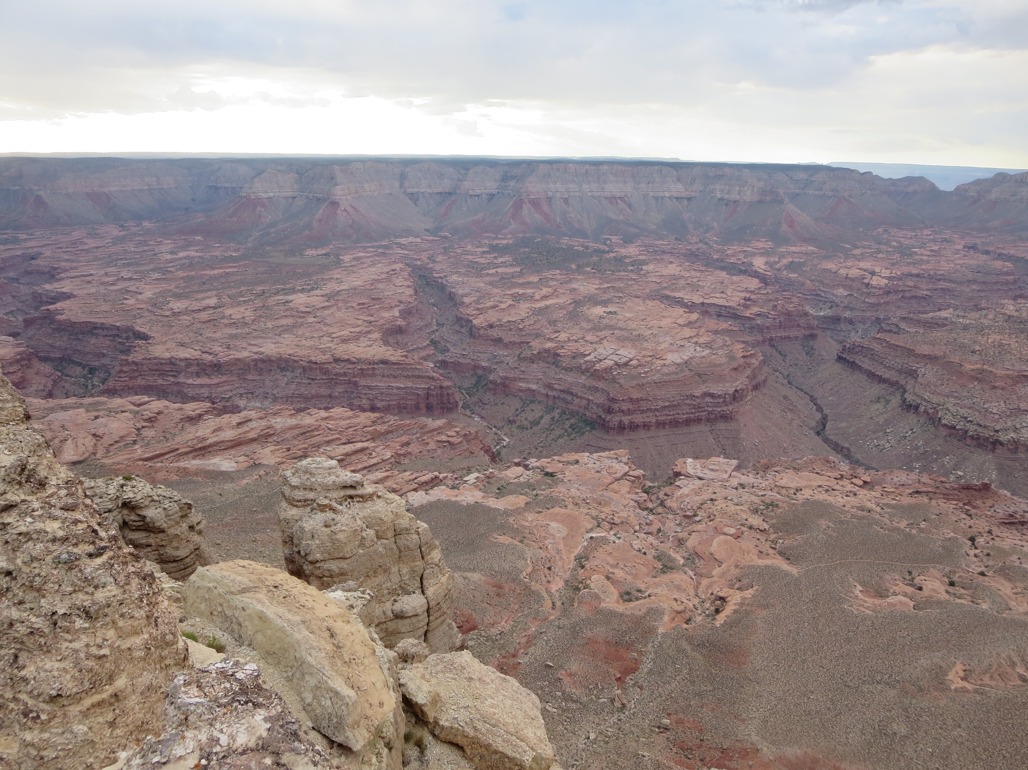
Blocks, Rivers, and
Landscape Evolution

Slide 13
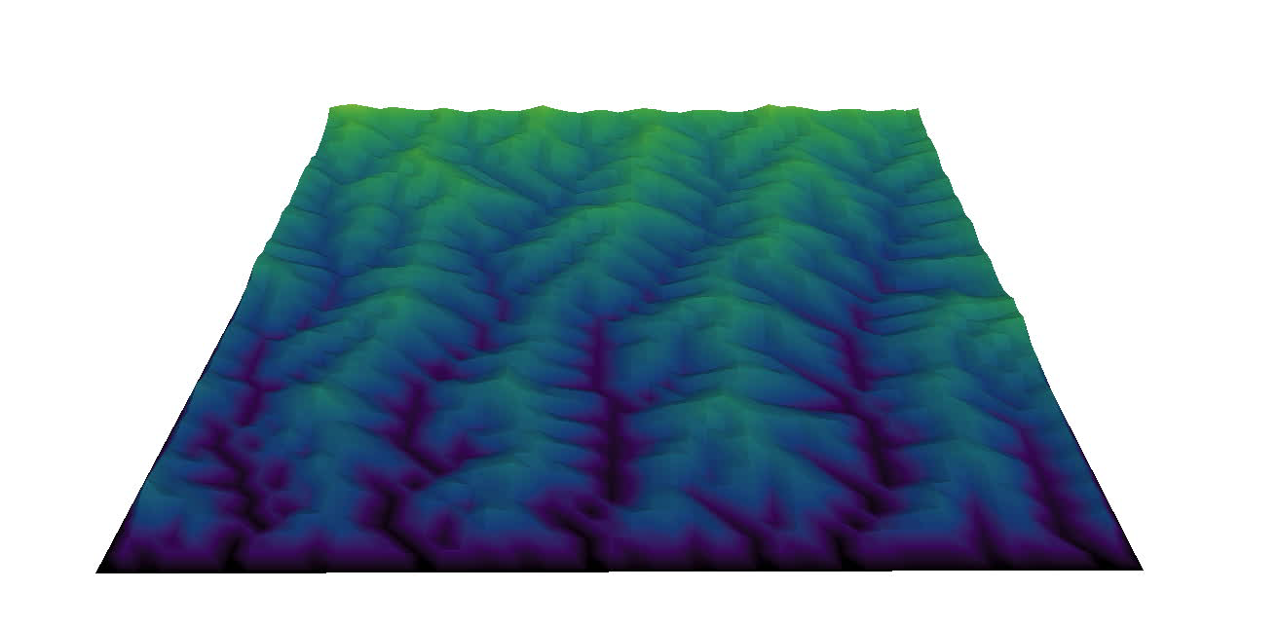

Control case: No block delivery

Slide 14
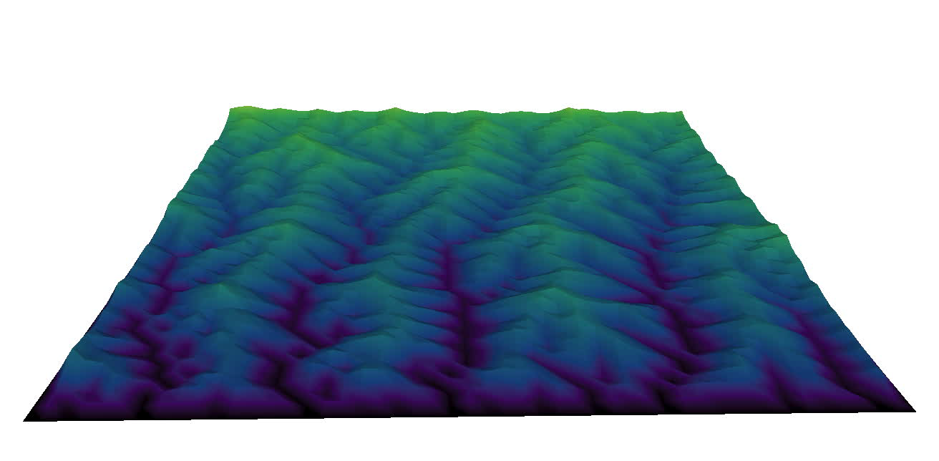
Responsive hillslopes
Reduced erosion in low-order channels

Slide 15
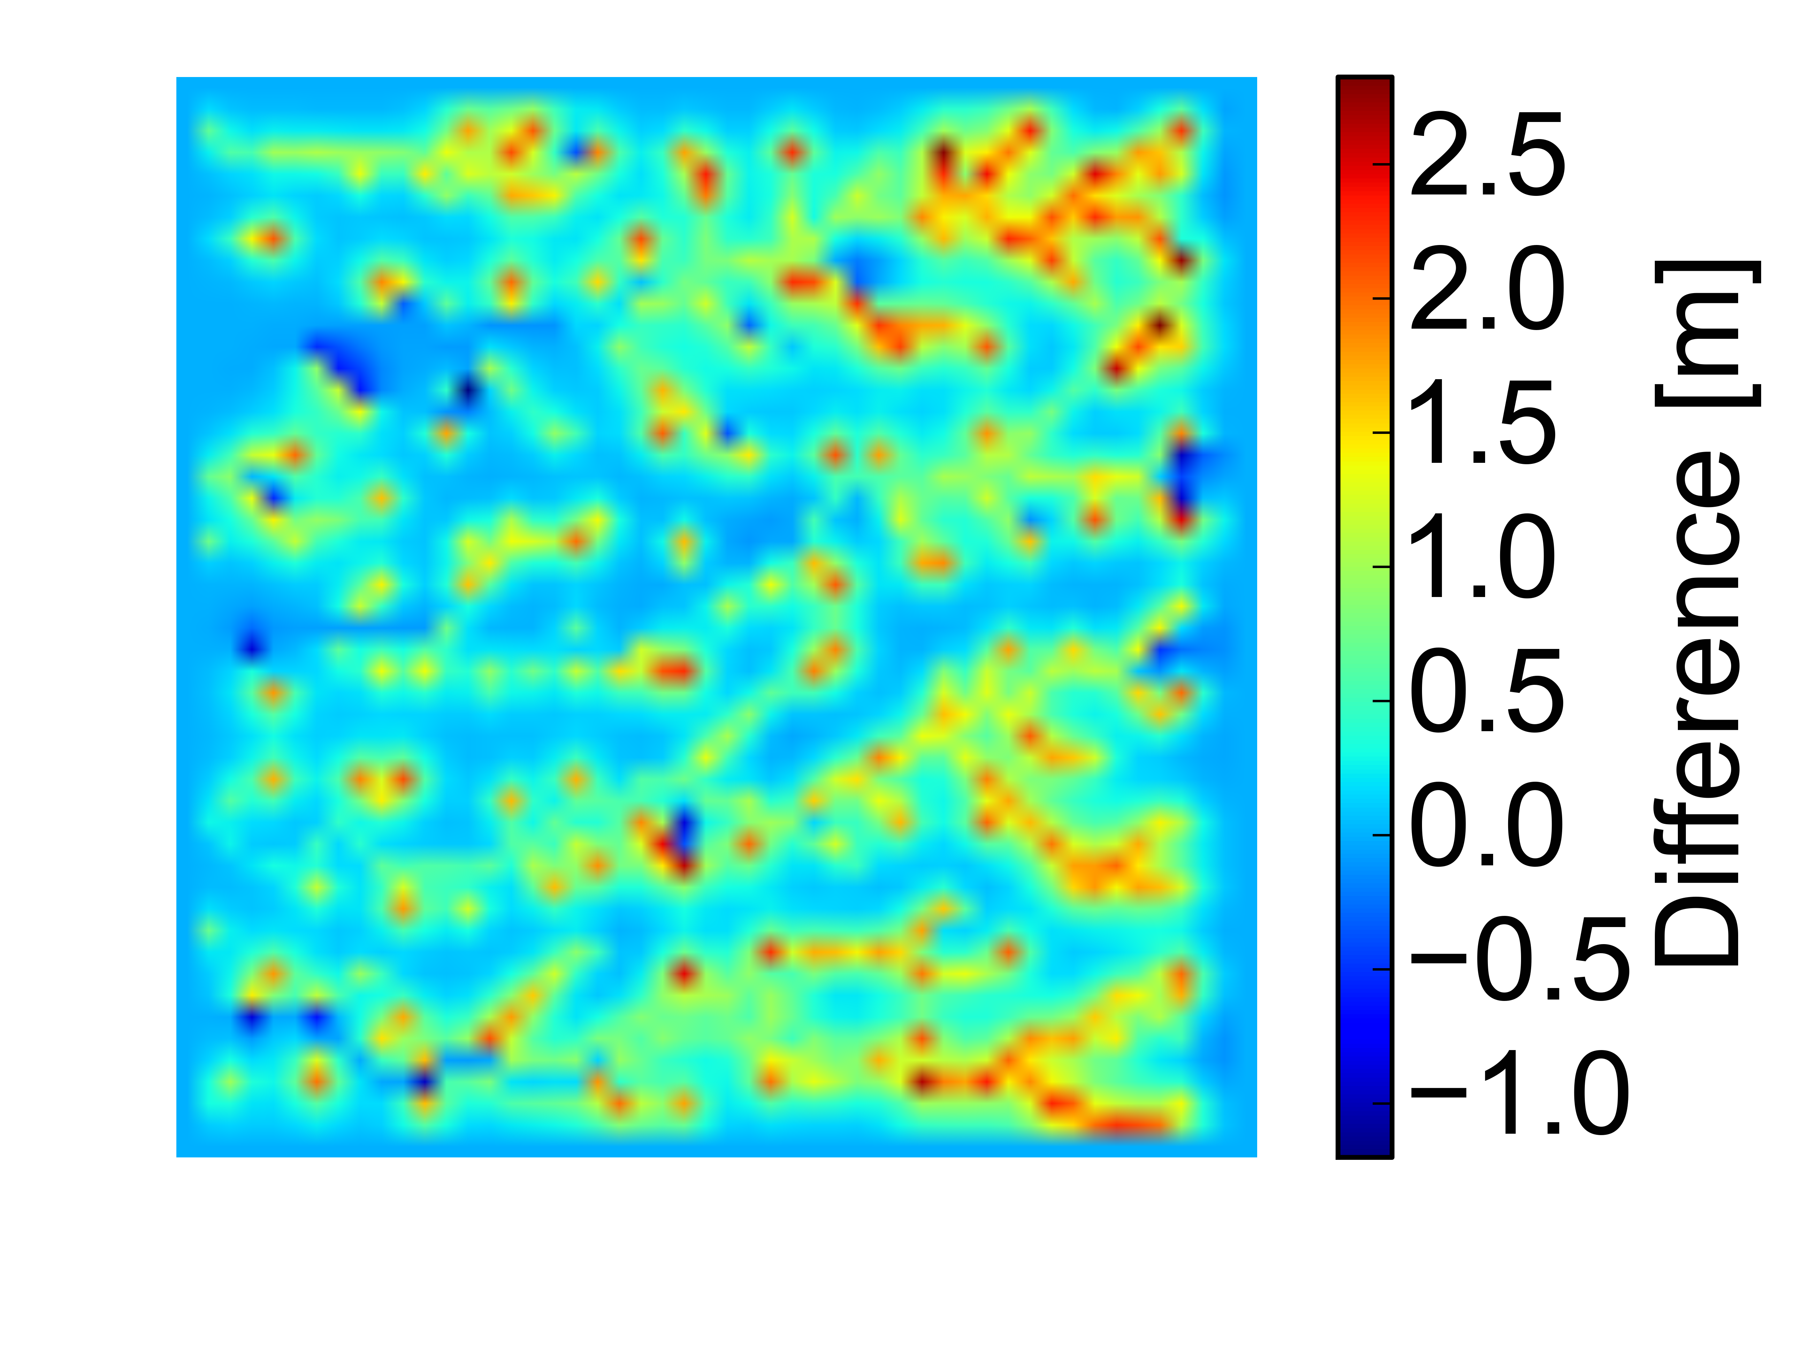
Block feedbacks preserve high elevation, low relief topography

Slide 16
Conclusions: Rivers can…
inhibit their own erosion through channel-hillslope sediment size feedbacks
“shred” baselevel signals, preventing extraction of climatic and tectonic information from river profiles
stall landscape evolution by preventing upstream propagation of boundary conditions

