Slide 1
Slides for Open Science Barcamp Berlin 2020 Session: Mentorship and community building for open science communities
Based on a slidedeck by Anita Eerland and Loek Brinkman
Adopted by Zsuzsika Sjoerds and Loek Brinkman

Slide 3
Overview
The ‘why, what and how’ of Open Science Communities
What works and what doesn’t
New formats
Mentorship program?
MOOC?

Slide 4
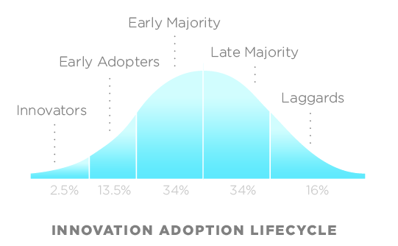
How does OS become the norm?

Slide 5
“We should all adopt OS practices”
“I’m already practising OS”
Policy makers
“Yes, but …”
Researchers
……..

Slide 6
“We should all adopt OS practices”
“I’m already practising OS”
Policy makers
“Yes, but …”
Researchers
……..

Slide 7
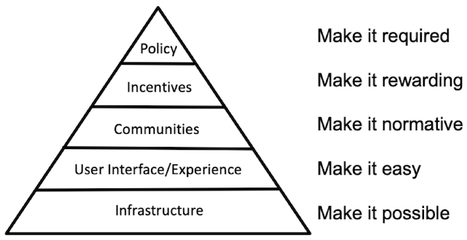
One of the major burdens scientists face is keeping up with the evolution in standards and resources.
Piramid from Brian Nosek’s “Strategy for Culture Change” COS Blog, 2019
7
Notes:
So you see, the possibilities to make your research more open are endless, and again, just take babysteps, and start with the practice you feel best about. And even then, I can assure you, you are not alone in this. It is very common that researchers struggle with keeping up with the changes, and the fact that now policy makers also expect of us all to apply specific Open Science practices, might further increase the pressure.
In fact, just policy change by itself will not make the difference. Brian Nosek recenlty wrote a very good blog about how systemic changes such as Open Science can be approached according to cultural change theories, and he presented this piramid showing all parties involved in a systems change, and the role they play in it.
In order for us to make these changes, we need the requirement, which is covered by the policy makers.
It should ofcourse also be rewarding, which is why scientists should be appreciated and acknowledged for their Open Science practices. This is the role of the universities and PI’s, but also of peers.
Ofcourse we also need the infrastructure and interface to be able to apply these changes in our work, which is where the libraries and supporting departments come in.
In the middle, you see the perty that helps make the change normative, and these are the communities.
Therefore, since the summer of last year, more and more Open Science communities have been popping up in the Netherlands.
Almost every University in the Netherlands now has an open science community. Maastricht was the latest to open, in fact, te Open Science Community Maastricht officially launched last Friday! Importantly, these communities are bottom-up communities, so started by researchers themselves. Some already have some top-down support, but the fact that they are initiated from a bottom-up initiative is important here for them to last.

Slide 8
Goals of the Open Science Community (OSC)
What
Reach beyond the ‘OS bubble’
Behavioural change (open workflows)
How
Make Open Science more visible
Promote knowledge exchange
Inspire and enable researchers to take the next small step
identify obstacles and need for support, inform policy makers
Notes:
Hier moet ik nog even naar kijken

Slide 9
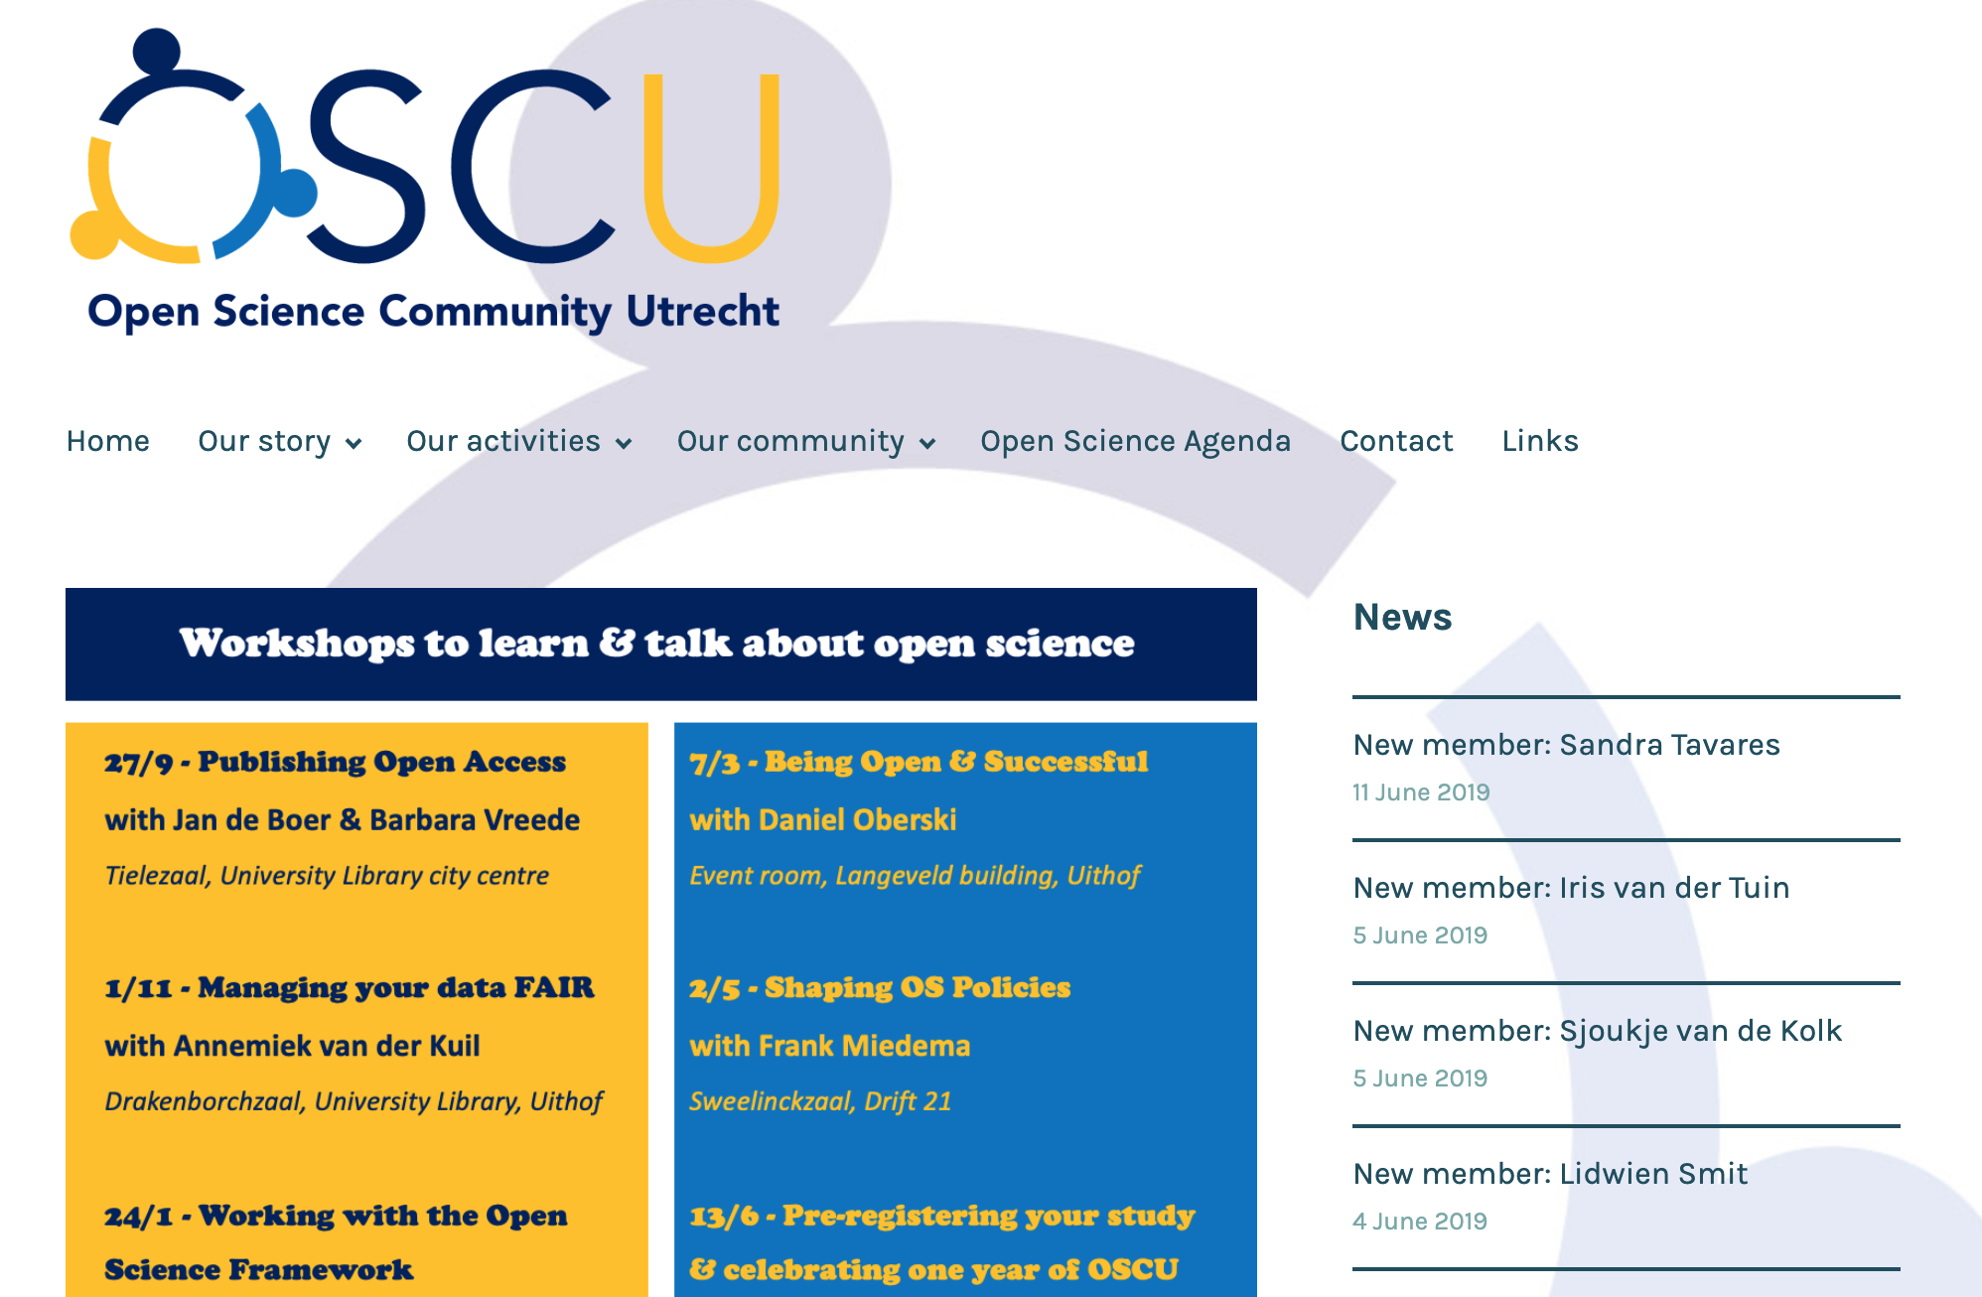
Our formats
Website
Notes:
collaboration with RDM support / library
most successful: small concrete steps!

Slide 10
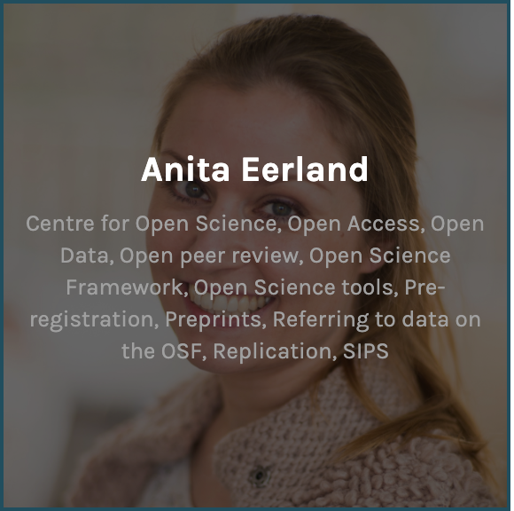
Our formats
Website
Membership
250 members from ALL faculties
Notes:
collaboration with RDM support / library
most successful: small concrete steps!

Slide 11
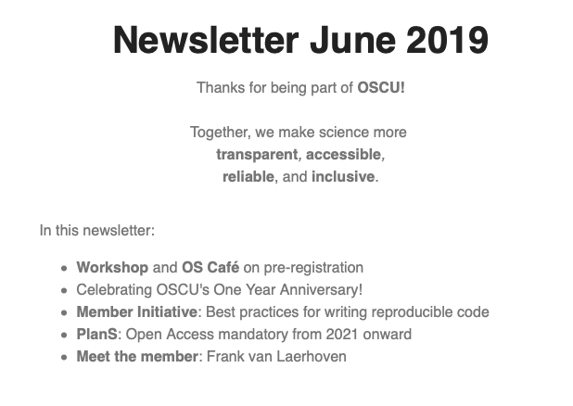
Our formats
Website
Membership
Newsletter
Notes:
collaboration with RDM support / library
most successful: small concrete steps!

Slide 12
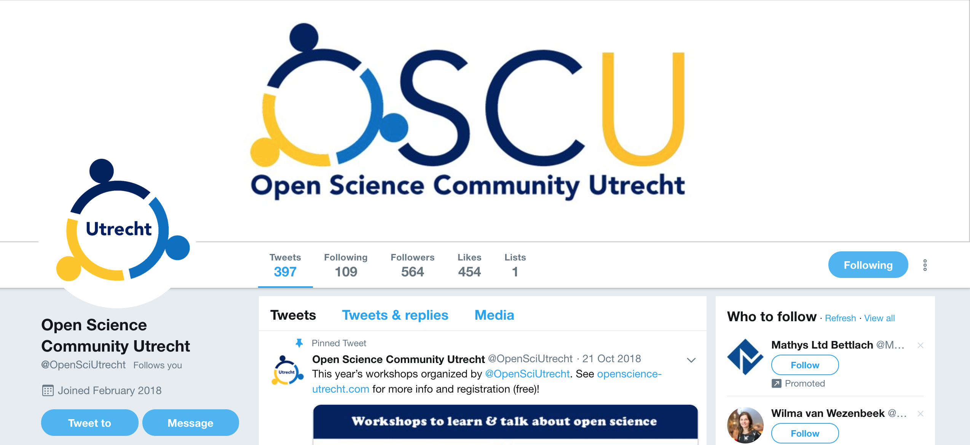
Our formats
Website
Membership
Newsletter
Social media
Notes:
collaboration with RDM support / library
most successful: small concrete steps!

Slide 13
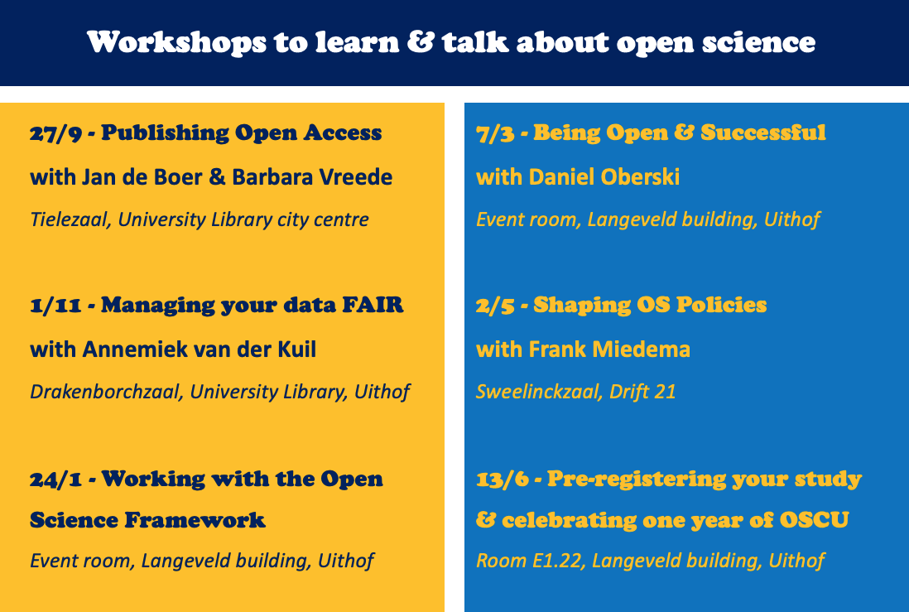
Our formats
Website
Membership
Newsletter
Social media
Workshops
Notes:
collaboration with RDM support / library
most successful: small concrete steps!

Slide 14
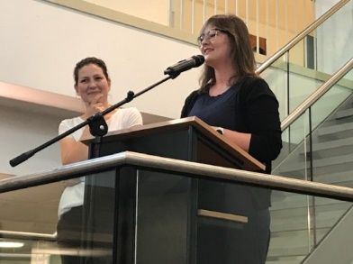
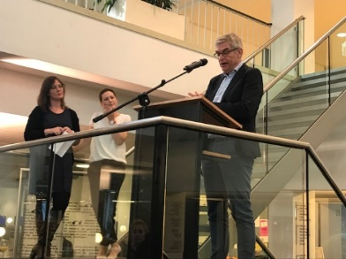
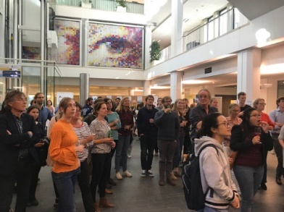
OSCL workshops & events
Photo’s: Eveline Crone
Past:
September 20th: OPENing drinks
October 1st: Open Science lunch. Every first Tuesday of the month, bring your ideas, questions and lunch.
October 1st: Getting started with preregistration. This workshop intended to give everybody practical advice on where to start when preregistering research.
October 8th: Sharing and storing MRI data hackathon. The ins and outs of sharing and storing MRI data at our university were discussed, and we have worked on templates
October 17th: ReproducibiliTea Leiden. Open Science Journal Club. Join the mailing list: http://eepurl.com/gFfJoj

Slide 15
OSCL events
November 5th: Open Science lunch (FSW 3rd floor common room, 12-13h)
November 30th: ReproHack: make your code reproducible (an OSCL member initiative supported by LIACS and DSRP) → More info for registration on the OSCL website
Wanna fight the reproducibility crisis? Join our Reproducibility Hackathon on November 30th 2019 – a hackathon organised for you to: learn about tools to share code, gain hands-on experience by reproducing #opendata #opencode papers, meet other open science fanatics 🤝
December 3rd: Open Science lunch (FSW 3rd floor common room, 12-13h)
December 19th: ReproducibiliTea Leiden (FSW, SA07, 16h~18h) Interdisciplinary journal club meeting. We read and discuss papers methodology and open science. Get all latest info by signing up to the mailing list or following @LeidenTea.
→ Your member initiative? Member initiatives supported by OSCL

Slide 16
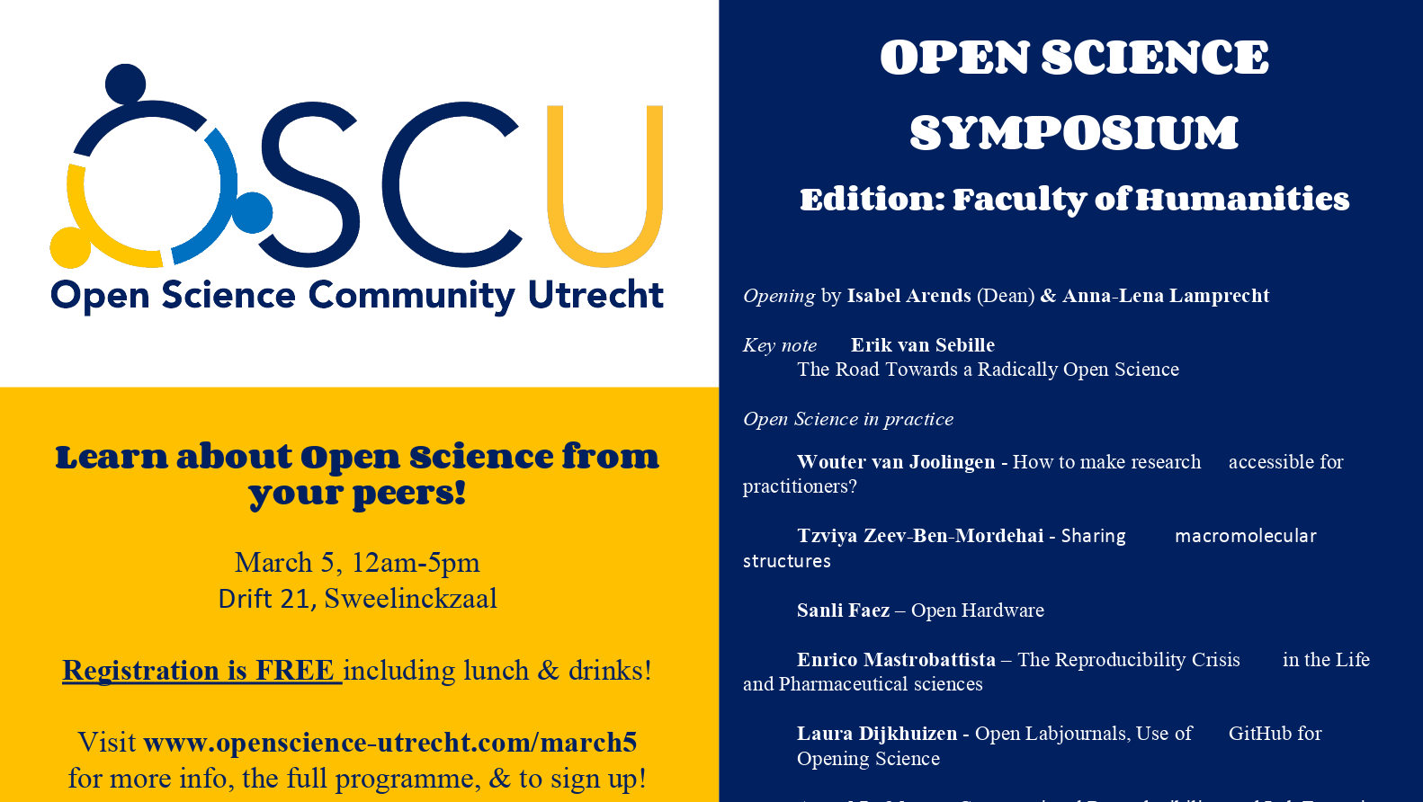

Slide 17
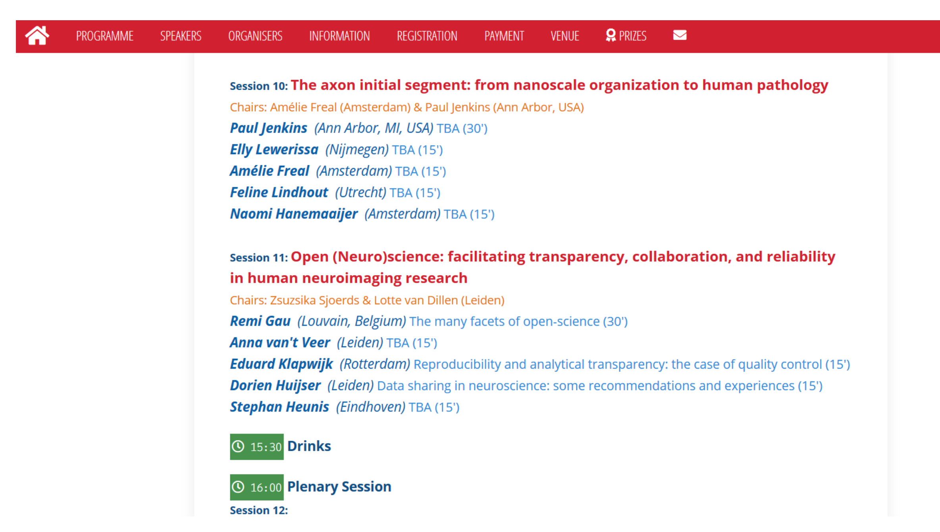
Open Science Satellites

Slide 18
Mentorship program
Cohorts of 5-6 people with a mentor
Your first open dataset
Your first pre-print
Your first Registered Report
Your first pre-registration
…
Recognition for mentors

Slide 19
MOOC
…

