Slide 1
What should you know about what do we know ….?
Chris Grey FAcSS
Professor of Organization Studies, Royal Holloway, University of London
Series Editor

Slide 2
What is it?
A series of short (25-30K words) books on topical/ controversial social science issues
For general readers, journalists, policymakers - not (especially) academics or students
Written by credible, leading academics
Written in an accessible style, backgrounding theory and methodology
Standardised format, up to date and updateable
Combining description (what do we know?) with prescription (what should we do?)
Actively edited

Slide 3
Why?
There are so many pressing issues where social scientists have something to say
Expertise is under threat
There are multiple voices and a flood of information
How does social science get heard?

Slide 4
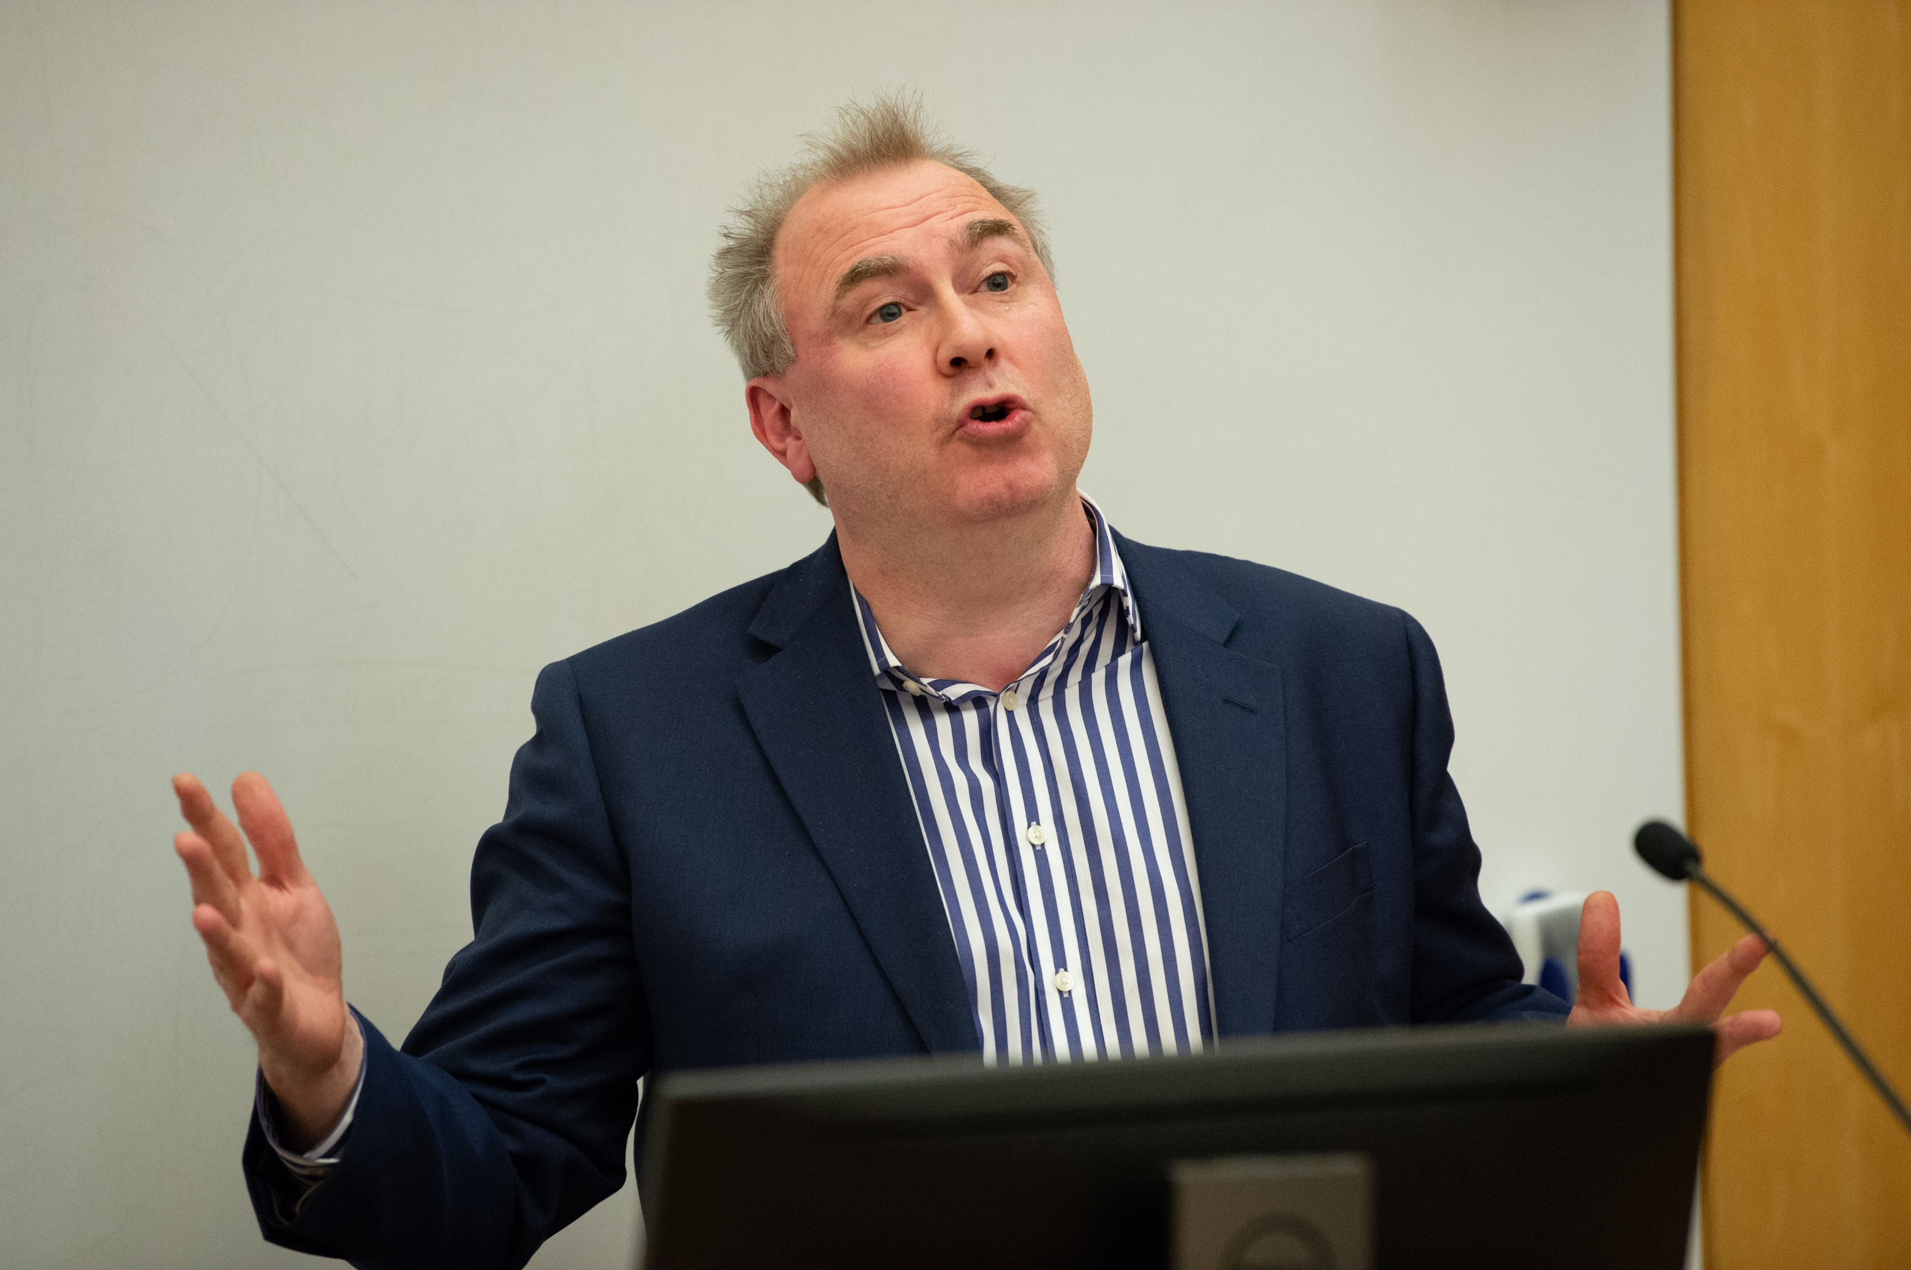
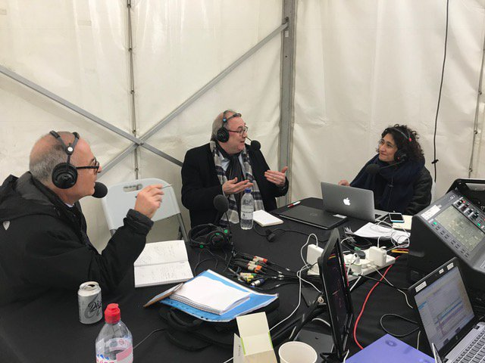
Why me?
Eclectic background in economics, politics, sociology
Founded VSFIRC series at SAGE
Fellow of the Academy of Social Sciences
Experience of working with policymakers
Extensive experience of public engagement, journalism etc.

Slide 5
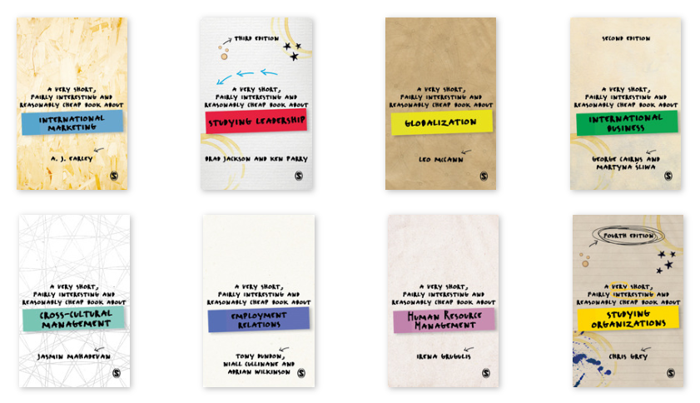
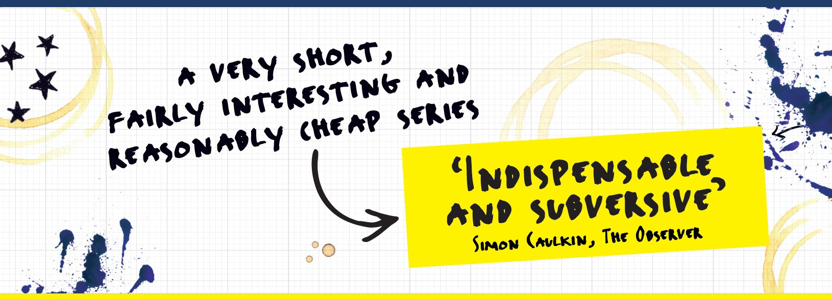

Slide 6
Barriers – academics can be their worst enemy
Career tracks favour academic publication
Theoreticism – theory as an end in itself
Preoccupation with methodology and statistical data
Relativism – reluctance to ‘privilege’ facts/ views
Academicism – reluctance to commit
Snobbery – disdain for popularising
Terrible writing styles
Unprofessionalism e.g. meeting deadlines
Lack of outlets lying between media and academic forms

Slide 7
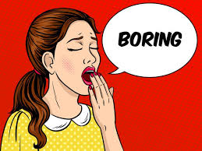
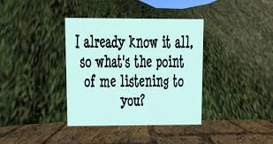
Barriers from users
Unwillingness to engage with complexity
Short attention spans
Naivety about what social science can do
Everyone’s a social scientist

Slide 8
What’s the dream?
You’re at an airport or train station
You browse the bookshop
You see a WDK on something that interests you and buy it
It fits in your pocket
You read it on your journey
You reach your destination
You’re pretty expert on the topic
You recommend to a friend …
… or your MP

