Slide 1
Figshare : a proof of concept implementation
Jane Miller Director, Digital Libraries and Repositories
Deakin University

Slide 2
Deakin University: Research Data and Repository Landscape
ReDBox (Footprints) :
Current tool used for data management plan creation and dataset registration/description
Symplectic Elements: Current platform/s for publications management
Fez/Fedora (DRO):
Current Institutional Repository platform

Slide 3
Rationale
Data
Perception that Footprints (ReDBox) is not intuitive for end users describing datasets
Current Footprints workflow does not automatically link to data storage – separate processes
Doesn’t facilitate presentation of data
Facilitates description of data
Renewed emphasis on the importance of research data management tools University-wide

Slide 4
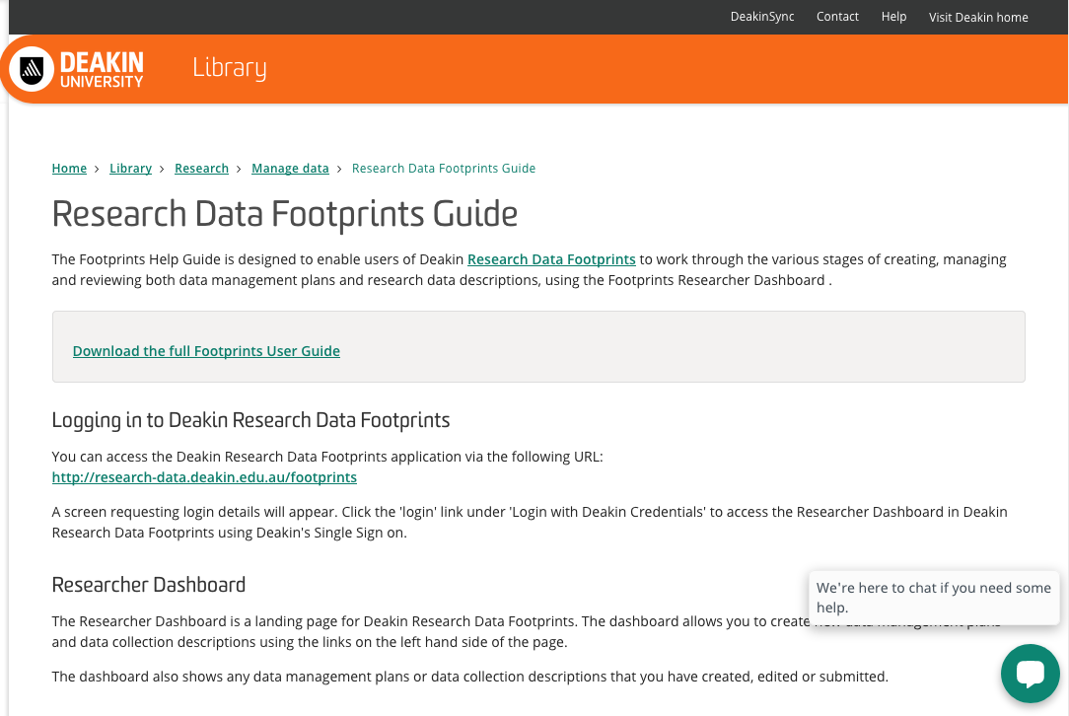

Slide 5
Rationale
Publications
Deakin Research Online (DRO) a Fez/Fedora based repository has been in place since 2008
Key platform in our ability to make research outputs accessible and discoverable
Legacy platform now unable to take full advantage of Symplectic Elements functionality

Slide 6
Scope
Decided to undertake six month proof of concept implementation of Figshare
Testing the functionality related to data the primary aim
Opportunity to explore its potential as a publication repository platform
Genuine proof of concept

Slide 7
Implementation
Understanding the way groups work an initial challenge
The association of the custom fields with groups and how inheritance works
Made more complex by our requirement to test publications
For Deakin, the group hierarchy was a major milestone
The user and project quotas also took time to understand and configure

Slide 8
Implementation
For Research publications testing the integration with Elements a key aspect
Experienced delays in establishing this
Our version of Elements and Repository Tools required updating
The crosswalk examples not as detailed in regard to depositing publications
The documentation slightly less comprehensive for publications than for data

Slide 9
The Journey So Far…
Data
Feedback so far has indicated that the user experience is positive
We have had some continuing issues around engagement and identifying researchers to work with us on the pilot
This is due to a range of factors not related to Figshare
The timing of the pilot
The ongoing work to promote the principles of RDM as part of the business as usual of research

Slide 10
The Journey So Far…
Publications
The deposit from Elements functionality works well
The pilot has provided an opportunity for us to question steps in our current workflow
Digital Science have addressed a number our queries around functionality in their immediate roadmaps
The ability to output custom fields in OAI-PMH is an area that needs development in terms of the publications functionality

Slide 11
The Journey So Far…
The proof of concept has around six weeks left to run
The built in applications to handle image/video/audio content make the platform flexible for a range of content
Exploring how it might work for showcasing other collections eg. Archives
There is potential in the access to APIs
the ORDA data repository at Sheffield is an interesting example

Slide 12
Insights
Basecamp is good, but opportunities to meet are even better
In the current Research and Academic landscape, there are no “quiet times” anymore
Implementing any new application or platform is an opportunity to question workflows and processes
why
how
Integrating an existing platform with a new one is always a learning experience

Slide 13
Thank you

