Slide 1
Federation.figshare: from wishful thinking to business as usual
Kay Steel, Manager Research & Strategic Projects, Library Services, Federation University February 20 2020

Slide 2
Overview
Background
Project implementation
RDM and OA
Federation University RDM POlicy & Procedure
Challenges & successes post-implementation
Thanks & questions
Notes:
Go live to Orcid

Slide 3
Background
Impetus from researchers on University Research Committee
April 2016 eResearch Advisory Committee proposal to RC
August 2016 Research Data Storage WG
February 2017: RDS WG recommends purchase figshare for Institutions
March 2017 – Business Case

Slide 4
Project Implementation
June 2017 - POG & Library figshare WG
June 2017 – Library submits proposal to become Business Manager
July 2017 – procurement
Oct 2017 – start implementation work
August 2018 - User Acceptance Testing
October 2018 - Launch/es
Products: flyers, subject guide, RDS chart, RDS flowchart
Positives: Basecamp, responsivity, data storage options chart & flowchart
Challenges: HR feed, authentication

Slide 5
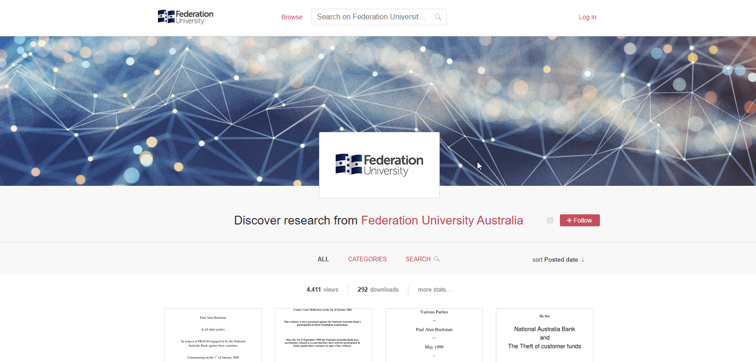

Slide 7
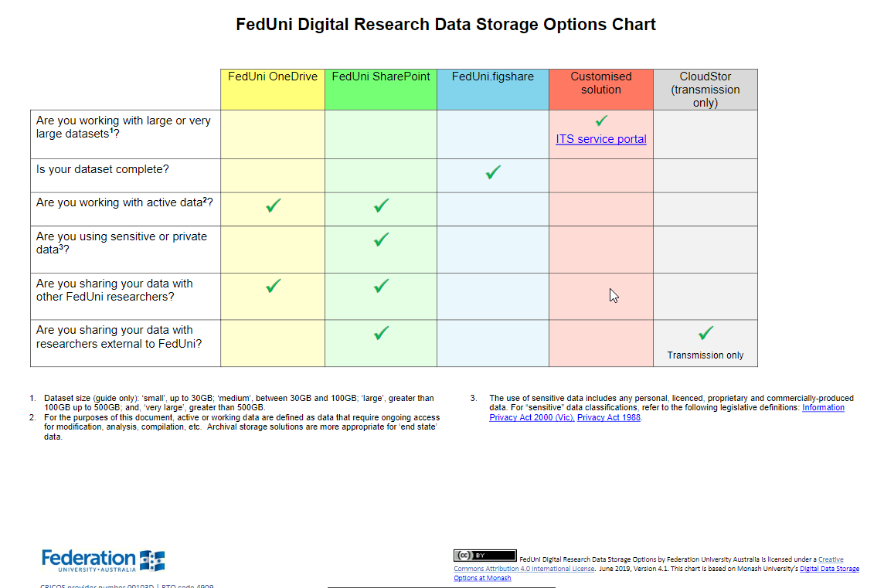

Slide 8
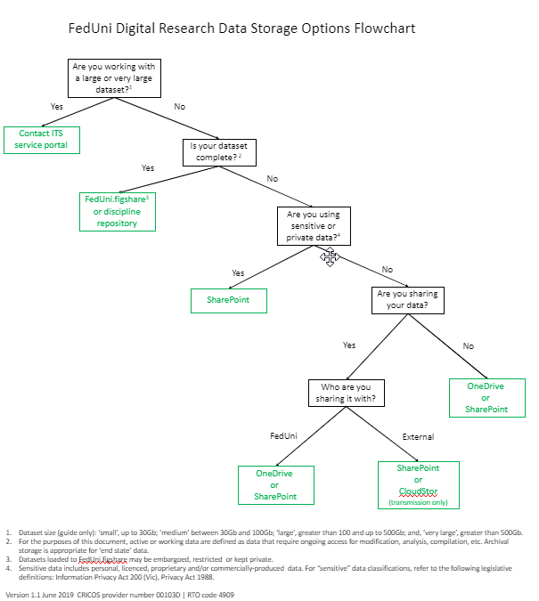

Slide 9
Federation.figshare and RDM / OA
Researchers recognised a need
Provides a University-endorsed research data solution
Retains and showcases university research data
Conversations around FAIR data
A range of licence options:
Encourages compliance with University policy and expectations
Facilitates compliance with funder requirements

Slide 10
RDM Policy June 2019
Federation University Australia endorses the use of FAIR Data Principles as described by the Australian Research Data Commons. That is, data that is findable, accessible, interoperable and reusable.
Research data and primary materials will be made available for use by other researchers for further research unless precluded by the conditions under which they were obtained, or privacy and confidentiality matters.
Research data created by staff of the University in the course of their employment is owned by the University; Intellectual property rights in research data created by students of the University are also retained by the University.
When collaborative research projects are undertaken ownership of data must be established and agreed to in writing before a project begins.
The University will develop and maintain a centralised research data register.

Slide 11
RDM Procedure June 2019 (1)
Federation University Australia is required to retain sufficient data and materials to justify the outcomes of research, and to defend such outcomes should they be challenged.
The University shoud also consider the potential value of data and material for further research, particularly where the research would be difficult or impossible to repeat.
The University will provide secure storage for research data and research data records.
Specifically: Deans and Directors/Heads of Research Centres (or equivalent) are responsible for providing advice on relevant data repositories; maintaining a register of where research data and primary materials are stored;
And, Completing a research data audit in an exit interview when a researcher leaves the University or School

Slide 12
RDM Procedure June 2019 (2)
Specifically, Individual researchers are required to
create and maintain full and accurate records of the research methods and data sources used,
retain research data where practicable, including electronic data, in a durable, indexed and retrievable form
maintain a catalogue of their research data in an accessible form in (1) Federation.figshare or (2) linked to their ORCiD account or (3) on a public copy of their CV;
ensure that where projects span several institutions an agreement is made at the outset covering the storage and retention of research data and primary materials within each institution
Working data sets: During the active research phase (data collection and analysis) researchers must use University endorsed corporate storage (refer to FedUni Digital Research Data Storage Options chart Appendix A and FedUni Digital Research Data Storage Options flowchart Appendix B).
Completed datasets: A School or Centre research data storage facility; or a central University research data storage facility; or an approved disciplinary repository

Slide 13
RDM Procedure June 2019 (3)
Researchers should (1) share their data, where possible, with interested parties through Federation.figshare and (2) link their research datasets in Federation.figshare to research publications and other outputs and (3) to provide a link in research outputs to the underlying dataset stored in Federation.figshare.
Research data should normally be made available under open access by use of appropriate Creative Commons or equivalent licences, or by mediated negotiable or controlled access.
ISSUE: Disposal/destruction of research data: All research data and primary research materials are considered University records and must be stored, disposed of, or transferred in accordance with University policies and procedures, and legislative requirements. Disposal of research data and primary research materials should be planned and deliberate, using secure disposal mechanisms so they cannot be used or reconstructed in unauthorised ways.

Slide 14
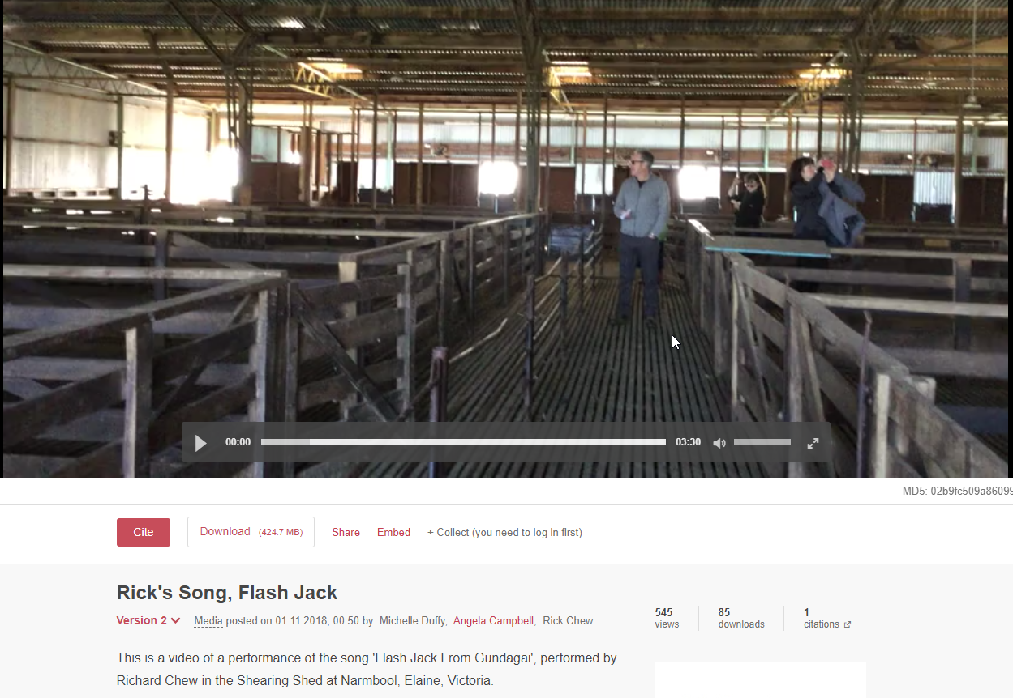

Slide 15
Successes post-implementation
Easier discoverability of Federation University research
RDM opportunities
Graduate Research School initiative/s
Potential to host a graduate student journal
increased OA readiness

Slide 16
Challenges post-implementation
Name- is it a barrier?
OA awareness & suspicion around data re-use
Champions are committed but may have own solution
Destruction/disposal of research data
Promotion!!!! - tie in with ‘significant’ dates – Love
Data week, Data Science Week, OA week

Slide 17
Future opportunities
Federation domain
Targeted promotion
How do we better link SharePoint & Federation.figshare?
RDM in practice – how do we know what data exists?
DMPlans

Slide 18
Thanks & Questions?
So many thanks!
Thanks to Stephanie (Digital Science) for starting the ball rolling.
Thanks to Megan (Digital Science) for comms plan and ongoing liaison and follow up.
Thanks to university colleagues who answered my relentless stream of enquiries during our fact finding and implementation stages including – Mary O’Connor and Jason Dahlenburg (Adelaide); David Groenewegen, Neil Dickson & Patrick Splawa-Neyman (Monash), Eva Fisch (LaTrobe).
Thanks to Sharon Kitt (Director, Research Services, Federation University) for initial funding.

