Slide 1
Use of the Work Skill Development (WSD) framework with fourth year Occupational Therapy students
2019 AALL Conference
Paula Todd - Subject Librarian
Nastaran Khoshsabk – Learning Skills Adviser
Annette Peart – Lecturer
Peninsula Campus
Monash University
Notes:
Good morning: thank you for coming
My name is Paula and I will be presenting with my colleague Nasi and we work together at the Peninsula campus of Monash University in the library
Subject Librarians and LSAs work together in the library to develop a response to the work skills curriculum (the 3 of us work together. co-teaching, co-designing etc.)
- unfortunately Annette the academic, couldn’t attend but we will explain how the three of us worked together to use a framework called the Work Skills Development framework
to prepare students for clinical placement

Slide 2
Aim: Developing work-ready students: Linking the library to the curriculum
Outline
Work Skill Development framework
Occupational Therapy Competency Standards
Making work skills explicit to develop Occupational Therapy students’ awareness of autonomy
Data collection (survey and feedback form)
Forthcoming book chapter
Notes:
This presentation will describe the collaboration between the Library and the Department of OT at Monash University using the work skill development framework (the WSD)
to prepare the students for their final clinical placement and future professional work.
We will show how we linked the framework to the profession’s competency standards and
We will also show how we used a series of activities within a workshop and tested the students self evaluation of work readiness using a pre and post survey
Bonus – book chapter about the experience is being written

Slide 3
What we do in the library:
At Monash library we contribute to developing the skills that students need for learning by working with the academics to embed skills into the curriculum; this includes:
Research skills
Digital skills
Work skills
Three frameworks sharing the same parameters and are underpinned by educational theory
Notes:
Librarians and learning skills advisers work together to develop these skills in collaboration with the faculty
Research skills are different from employability skills so we introduced a framework to address the importance of WIL
Monash is also using a research skills framework and a digital skills framework but they all use the same type of recognizable format and have been developed using educational theory principles

Slide 4
Work Skill Development (WSD) framework
Monash Library introduced the WSD and is currently working at engaging academic staff with the framework
Goal: Integrate key employability skills into work integrated learning
What is the WSD – framework?
Why is the WSD framework used?
How is it used at Monash University?
Notes:
Background to WSD – Developed by James Cook University and University of Adelaide
WHAT = a Conceptual model for work skills and has been adopted and revised by Monash University in 2019
WHY = Work skills are those core skills that students have or need to develop in order to operate effectively and efficiently in the workplace and the framework is used to conceptualise those skills in the curriculum.
HOW = The WSD is presented by the library at Monash in key units at relevant points in the curriculum that highlight the purpose of developing and nurturing these skills; usually before placements or other Work integrated learning activities.

Slide 5
Notes:
Print in framework to hand in to the audience before we start
the tool and how to apply it
The WSD is a conceptual model to make work skills explicit that can be adapted to different contexts.
The WSD is made up of 2 guiding parameters – work skill ‘FACETS’ capturing employability skills (informed by Patrick’s national WIL learning report published in 2008).
Each Work Skill Facet is also represented with a guiding question from the students’ perspective. For example: INITIATIVE and GOAL ORIENTED, the first Work Skill Facet, has the guiding question: “What is my role”.
A corresponding verb capturing the Affective Domain (from Bloom’s Taxonomy of Learning) captures a corresponding work skill disposition. For example MOTIVATED.
Each skill facet is described across the WSD's learning continuum called - The Scope for Learner Autonomy.
This learning continuum is informed by Bloom's Taxonomy of Learning and Vygotsy's Zone of Proximal Development (which is about scaffolding learning –
what a learner can with guidance, to what a learner can do without guidance
Therefore, the WSD is a sophisticated pedagogical tool. It guides educators in making works skills explicit and visible in the curriculum.
It also guides educators in how to develop these skills incrementally and is especially useful as a reflective tool for preparing students for WIL contexts.

Slide 6
Emerging skills agenda
Monash is promoting the integration of academic learning with workplace experience.
Occupational Therapy
Fieldwork education within a
4 year UG (honours) course
2nd year – 3 weeks
3rd year – 6 weeks
4th year – 9 weeks (WSD workshop pilot)
Notes:
Occupational Therapy course is at Peninsula campus of Monash University during which they undertake 3 placements of increasing length to prepare them for practice.
After talking to Annette the lecturer around student readiness for clinical placements and feedback from clinical placement supervisors, we discussed trialling the framework with 4th year undergraduate Occupational Therapy students. Typically around 130+ students - third of cohort is international students (mainly from Hong Kong).
This was the first time the WSD has been used in a workshop to prepare students for placement at Monash.

Slide 7
OCC4081 – Preparation for Practice
Connecting unit learning outcomes to the WSD:
Analyse and reflect upon students’ capacity to practice
Professionalism; ongoing professional development and learning
Learning outcomes of the WSD workshop:
Develop an awareness of work skills required for placement and working life beyond university.
Awareness of different levels of autonomy
Pre and post evaluation of student’s self awareness of their work skills development and level of autonomy
Notes:
Unit outcomes included students ability to analyse and reflect on their own level of placement and work readiness and
highlights the OT profession’s commitment to lifelong learning.
Using the WSD meant that students also were exposed to the idea that autonomy needs to be relevant to the situation presented.
It is not the case that while on placement they necessarily work within prescribed or bounded direction or once they graduate into clinical practice it is necessarily unbounded,
is very situation based.
We applied and received ethics approval from Monash to conduct a pre and post student self evaluation.

Slide 8
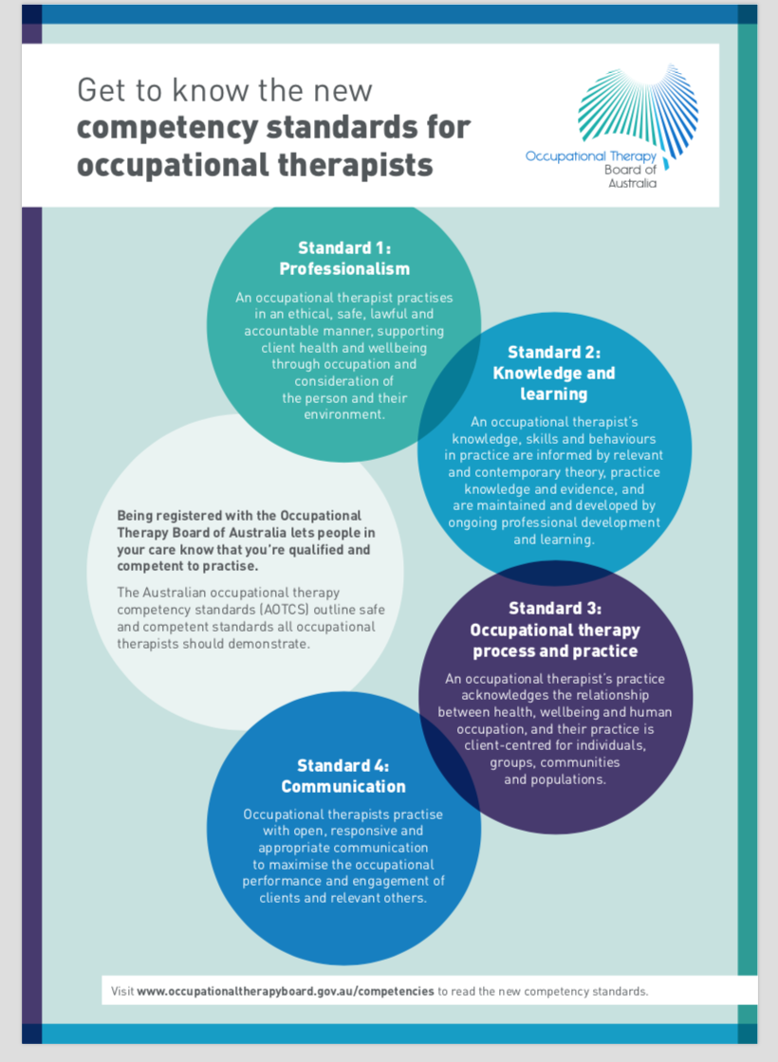
Analyse and reflect upon their capacity to practice with regard to the Australian Occupational Therapy Competency Standards
4 Competency Standards with 52 examples of practice behaviour
Notes:
OT competency standards were central to the teaching practice in this unit and have been recently updated in January 2019. 4 overarching competency standards
Professionalism
Knowledge and learning
OT process and practice
Communication
encompassing 52 examples of practice behaviour:

Slide 9
How we applied the elements of the WSD
The pedagogy underpinning the workshop design and activities
Work skills and learner autonomy
Informing the pre / post student self-evaluation survey
Mapping the OT competency standards to the WSD skills facets
Contextualising the OT to the facets
Notes:
By mapping the OT competency standards to the WSD facets, this helped inform both the student self evaluation and the workshop design.
We were able to see which competency standards we could apply to the facets to make the skills explicit and relevant to the students

Slide 10
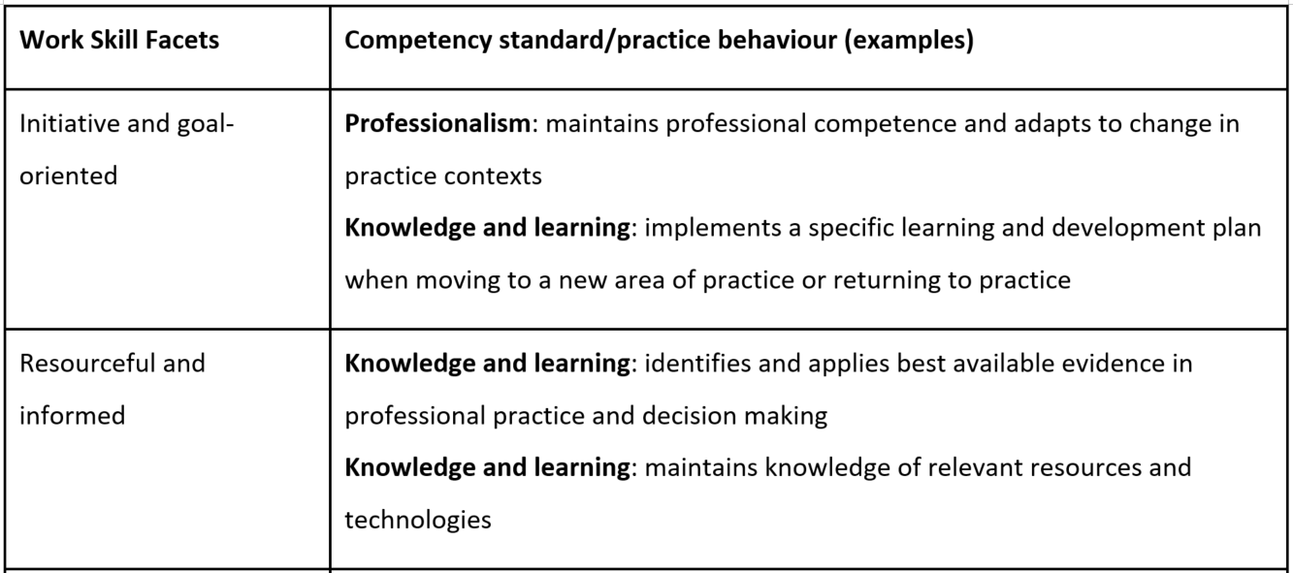
Mapping OT standards with WSD skill facets
Notes:
On the next three slides we will show you the competency standards’ examples selected by Annette that show how we mapped them to the work skills facets.
We have highlighted some of the examples with the little stars to talk about.
the WSD facets on the left are explicitly mapped to the OT competency and practice behaviour on the right.
Annette, the lecturer, selected OT standards and practice behaviour examples that she thought specifically related to the work skill facets.

Slide 11
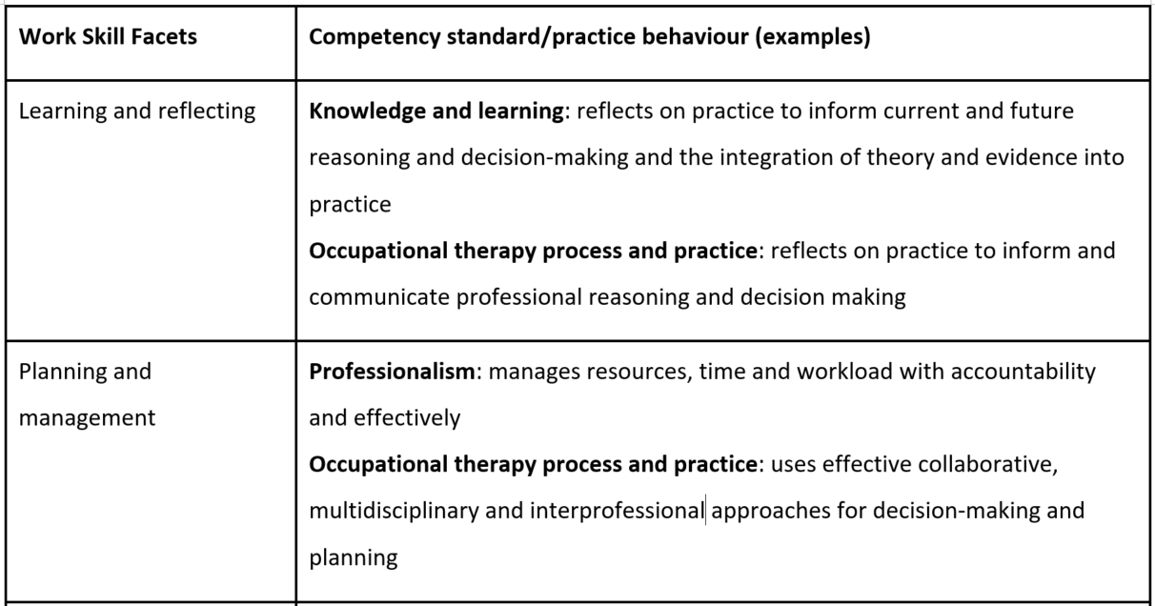

Slide 12
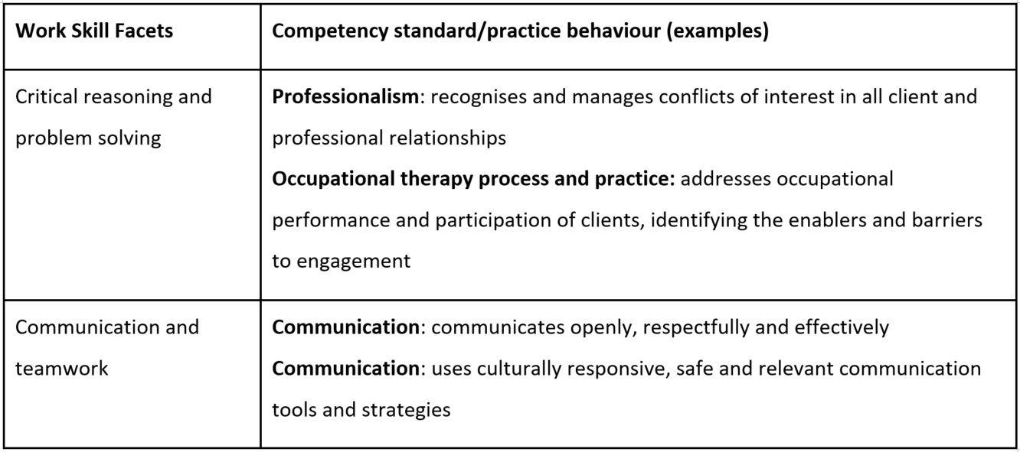
Notes:
inter-professional element to health practice requires the ongoing negotiation, communication and teamwork to effectively work with other clinicians

Slide 13
Workshop overview - activities
Students exposed to a variety of activities that unpacked the work skills and levels of autonomy using the WSD
Each activity building on previous throughout the workshop
Facilitators included library staff and academic
Types of activities:
Activities to unpack skills
Activities to develop awareness of levels of autonomy
Notes:
Nasi from here:
The workshop involved a series of activities, each activity was designed to build on the previous (a learning continuum) in order to raise the students’ awareness of their skills and the levels of autonomy.
We implemented the discovery learning approach to get the students to explore and become engaged
(Discovery learning is an inquiry-based, constructivist learning theory that takes place in problem solving situations where the learner draws on their own past experience and existing knowledge to discover facts and relationships and new truths to be learned.)
We will show some examples of our activities

Slide 14
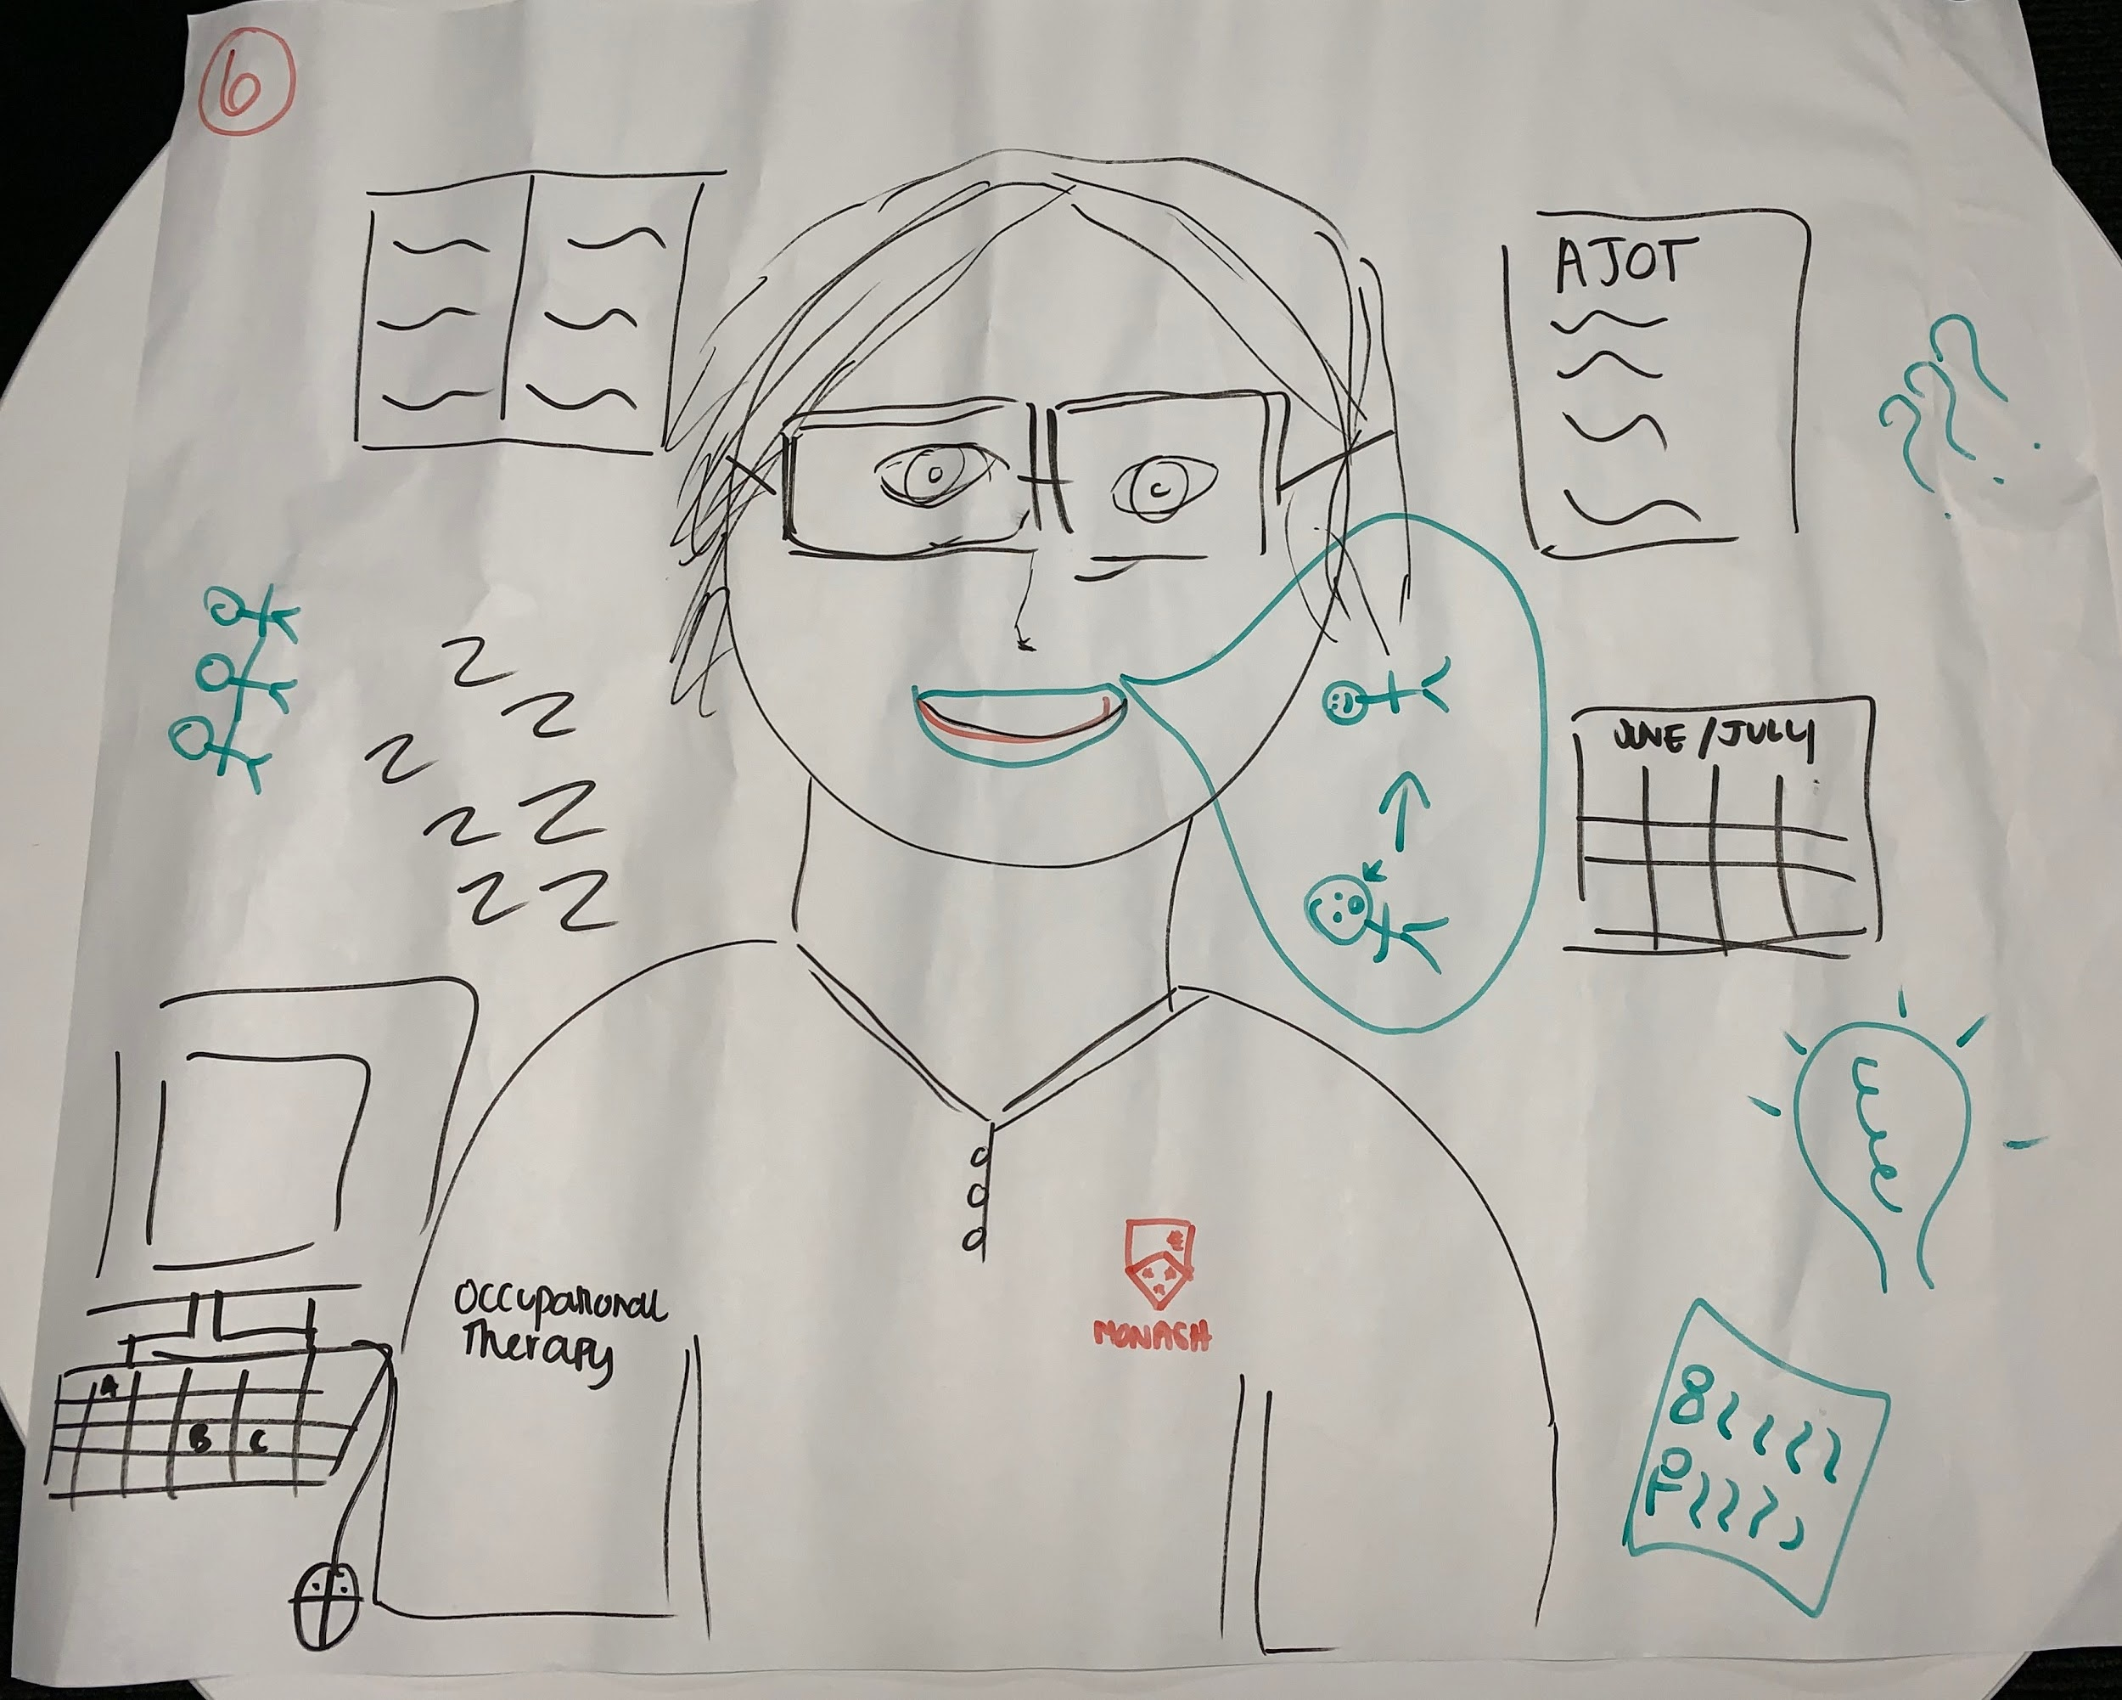
Picture this: What does a work ready student look like?
Notes:
There were a variety of activities: drawing, groupwork, card matching, watching some videos, discussions
An actual pic – start to scope 4th year students – to visualize it as a group activity - Icebreaker as well
Picture - what they know and why?
was a powerful starting to explore
we returned to this activity at the end of the workshop to see if there is any additions or changes

Slide 15
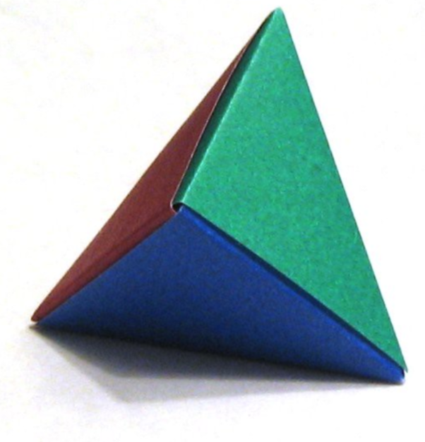
Paper folding activity
Instructions: Working individually, construct a pyramid by folding the paper on the lines. Fold the paper in one direction only.
Put your hand up when you finish.
https://www.flickr.com/photos/omegatron/438272146/in/photostream/
Activating the students’ affective domain (emotional response to learning)
An opportunity to reflect when they do something at the workplace for the first time
Notes:
We gave them a piece of paper to fold
Limited instructions; not allowed to talk; some copied each other (rightly or not); was difficult to stop them when the time was up

Slide 16
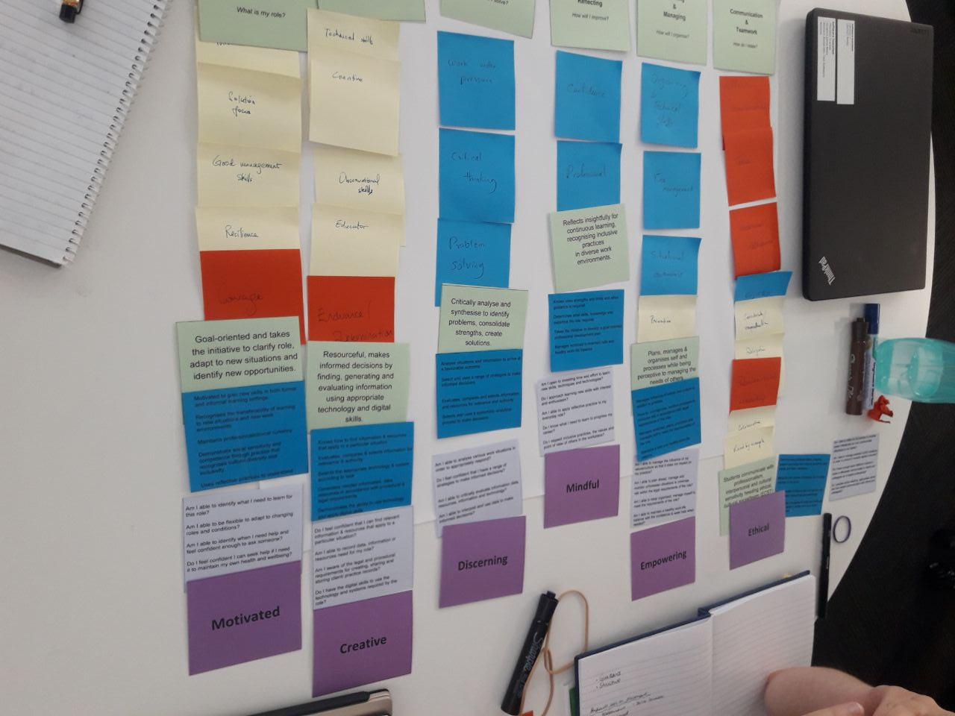
WSD card matching activity
Notes:
Card matching group activity showing the WSD
the mapping allowed us to create flash cards (statements and questions) and to create connections between the work skills and facets - a stimulus activity of a workplace situation - students watched the video and wrote the skills and then mapped them to the competency standards
Card matching activity initiated a lot of discussions about the work skills
the purple: affective domain

Slide 17
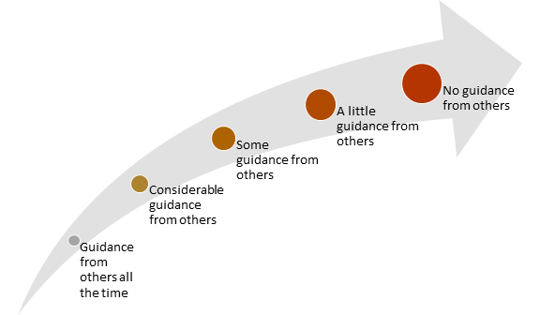
The guidance level - based on the WSD
Notes:
the WSD provides you with a learning continuum
The same way like the WSD (prescribed direction to unbounded)
Benefit of using WSD – students are able to reflect on their skill development through the lens of learner autonomy. Learner autonomy takes a developmental view of learning, it is not a competency framework, it is a pedagogical tool.
students looked at aspects of the framework throughout the course and autonomy was the new concept
competency (what is in their course) - I have reached this level and can move to the next to build the skills over time
learner autonomy - a developmental view of learning
WSD is a tool to activate the competency standard or to take a developmental approach - to activate the competency standard in the curriculum so educators can design the curriculum

Slide 18
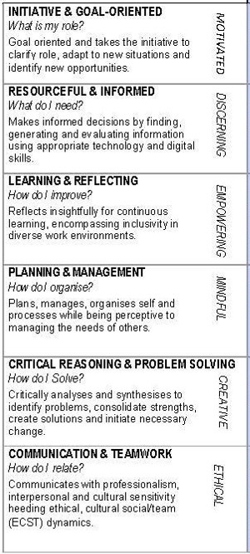
Workshop design based on learner autonomy
Drawing
General
WSD cards
Paper folding
Video
Workplace scenarios
Specific
Notes:
each activity was aligned to different facets and levels of autonomy in the WSD
As we were designing the workshop we looked at the facets – each activity is referring to one or more facets of the framework and it is not in a linear format
Where the drawing activity and paper folding sit in the WSD f?
designing a workshop that moves from the general to the specific – moving between the levels of autonomy through different activities – to make them aware of the levels of autonomy based on the work situation
Becoming more specific
Awareness of the levels of autonomy
OT specific workplace scenarios and they had to say what they would do if they need to handle the same problem in work situation (about professionalism
how the WSD was applied to the workshop
what happened to the students
The triangle of the WSD - Showing the levels of autonomy: limited autonomy to more autonomy - inverted V
The inverted triangle of Workshop Learning Activities (different phases): more guidance to less – (the funnel - general to specific – autonomy) - V shape
Apollo 13: teamwork and levels of autonomy
case studies: to put themselves in the situation of a person and what they would do
Skills development through the lens of learner autonomy

Slide 19
Notes:
The yellow: the drawing activity – the red: paper folding activity
The activities moved around the levels of autonomy
the tool and how to apply it

Slide 20
Pre/post students’ self-evaluation
Notes:
shows a developmental view
(screen shot of the first q) – showing the drop down options
27 questions – about 4 questions for each facet
WSD was useful for designing a survey that incorporated learner autonomy
Students can reflect on the skill & level of autonomy (the scale of the instrument), rather than whether they do have / not have the skill
How much guidance do I need.

Slide 21
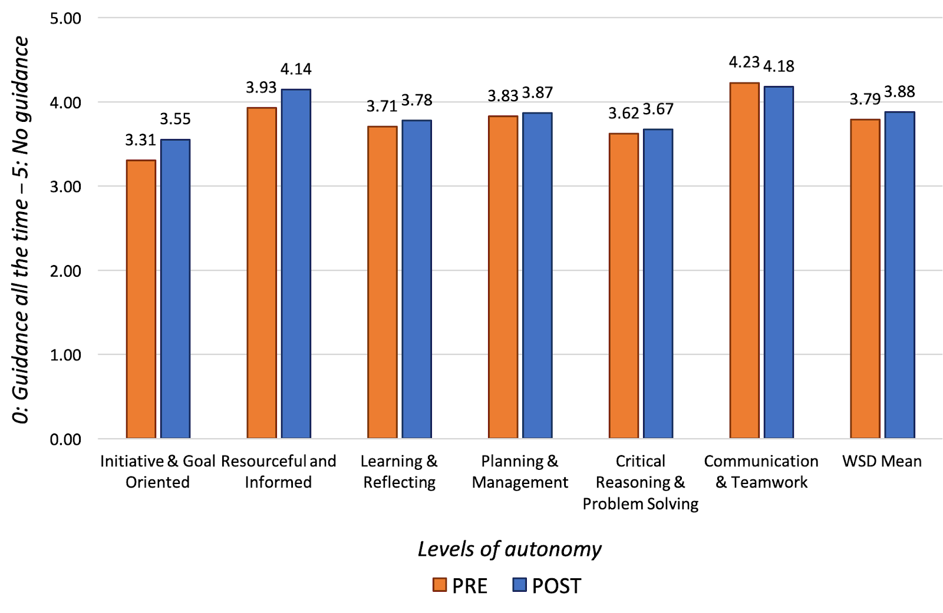
Outcome
Pre/post students’
self-evaluation analysis
initiative and goal oriented (0.25)
resourceful and informed (0.22)
Mean results of each of the WSD Framework facets
(Pre/post students’ self-evaluation)
Notes:
Outcome
analysing the pre/post survey showed
Students had
Awareness of the skills they have for placement
Skills they will develop in placement
Skills they need to develop for placement (skill gaps identified)
the curriculum cover the others not enough chance for the first two - it’s conent heavy and not much about the employability
What this pre and post self evaluation has shown us is that the students are already developing work skills within the curriculum. So by using the WSD we were able to demonstrate that the OT curriculum was meeting the learning outcomes of the course and preparing students for placement. However the workshop was able to give the students an improvement in the first 2 – initiative and goal oriented & resourceful and informed.

Slide 22
Workshop evaluation
How the students articulated their experience:
“there are definitely skills that are crucial to placements that we take for granted"
”the workshop helped to identify attributes which I possibly wouldn’t have thought about myself before placement”
Notes:
skills that are usually invisible and the worksop made them visible
it’s very important that it made it visible for students

Slide 23
Reflections
Benefits of using the WSD
A pedagogical tool to inform the design of the workshop and make the connection between curriculum and work placement
Pre-post student self-evaluation identified students’ self awareness of work skills developed through curriculum and previous placements
Strengthening library collaboration with faculty by connecting skills that the library is already teaching using the other frameworks and making links with employability skills
Notes:
the benefits of using this was that connection between the curriculum and placement
Connecting the skills that the library is already teaching, making the connection with employability skills.
Cultural sensitivity, interpersonal skills (affective domain), technical / digital skills – resonate for current skill agendas.
2019 version of WSD – Monash was responsible for developing.
Reflecting on my experience with the other faculties
RSD – DSF have been used for a number of years

Slide 24
https://www.monash.edu/library/skills/rsd
Notes:
They are not intended to be… An assessment rubric
Part of the MELT (models of engaged learning and teaching) (RSD, Digital skills and WSD) – link in references to the other models – uses the same guiding parameters and pedagogical underpinnings.
All available in the link
Summary:
Conceptual models
Pedagogical tools
A tool to inform assessment and curriculum design
Flexible, adaptable, dependent on context
A learning continuum
Ref:
Vygotsky
Bloom’s taxonomy

Slide 25
References and further information
Bandaranaike, Suniti, From Research Skill Development to Work Skill Development, Journal of University Teaching & Learning Practice, 15(4), 2018. Available at:https://ro.uow.edu.au/jutlp/vol15/iss4/7
Bandaranaike, S., & Willison, J. (2010). Work Skill Development Framework: An innovative assessment for Work Integrated Learning. Paper presented at the 2010 ACEN National Conference, (pp. 1-18), Perth, September 29-October 1, 2010.
Occupational Therapy Board of Australia (2019). "Australian occupational therapy competency standards." Retrieved from https://www.occupationaltherapyboard.gov.au
Patrick, C., Peach, D., Pocknee, C., Webb, F., Fletcher, M., & Pretto, G. (2008, December). The WIL [Work Integrated Learning] report: A national scoping study [Australian Learning and Teaching Council (ALTC) Final report]. Brisbane: Queensland University of Technology. Retrieved from http://eprints.qut.edu.au/44065/http://www.uws.edu.au/community/in_the_community/oue
Torres, L., Bandaranaike, S., & Yates, S. (2014). What Skills Do I Have? What Skills Will I Need? - Building an Employability Skills Profile through an online Reflective and Learning Program, in Symposium Proceedings of WACE 10th International Symposium on Cooperative & Work Integrated Education, University West, Trollhattan, Sweden, 2-4 June, viewed 23 July 2018. Available at: https://www.waceinc.org/uwest2014/proceedings/Australia/Lyn%20Torres%20-%20Australia.pdf
Vygotsky, L.S. (1978). Mind in society. Cambridge, MA: Harvard University Press.
Notes:
Part of the MELT (models of engaged learning and teaching) (RSD, Digital skills and WSD) – link in references to the other models – uses the same guiding parameters and pedagogical underpinnings.
All available in the link
Ref:
Vygotsky
Bloom’s taxonomy

Slide 26
Writing a book chapter on the experience
Book – Introduces the different frameworks
Title: Connecting the library to the Curriculum: transformative approaches that enhance skills for learning
Publisher: Springer
Book chapter title: Developing work-ready students with the WSD
Publication due: Mid 2020
Notes:
Introduction to the book – collection of chapters discussing the use of different frameworks including RSD, DSF, WSD and others
Our chapter is the use of the WSD by looking at the project and data from different perspectives and lenses: subject librarian / learning skills adviser (previous MNHS and current BusEco / Edu LSA) / the OT academic/ unit coordinator
3 voices from the library and faculty with different expertise but aiming to give a holistic view

Slide 27
Any questions?
Notes:
Questions and comments?
It was not used as an assessment tool but makes the skills explicit to the students and the relevant level of autonomy required for specific tasks dependent on the role performed or activity undertaken.
we wanted to make explicit direct links between the WSD and the OT competency standards to emphasise the work skill element of practice to the students,

Slide 28
THANK YOU!
Nasi.khoshsabk@monash.edu
Paula.todd@monash.edu

