Slide 1
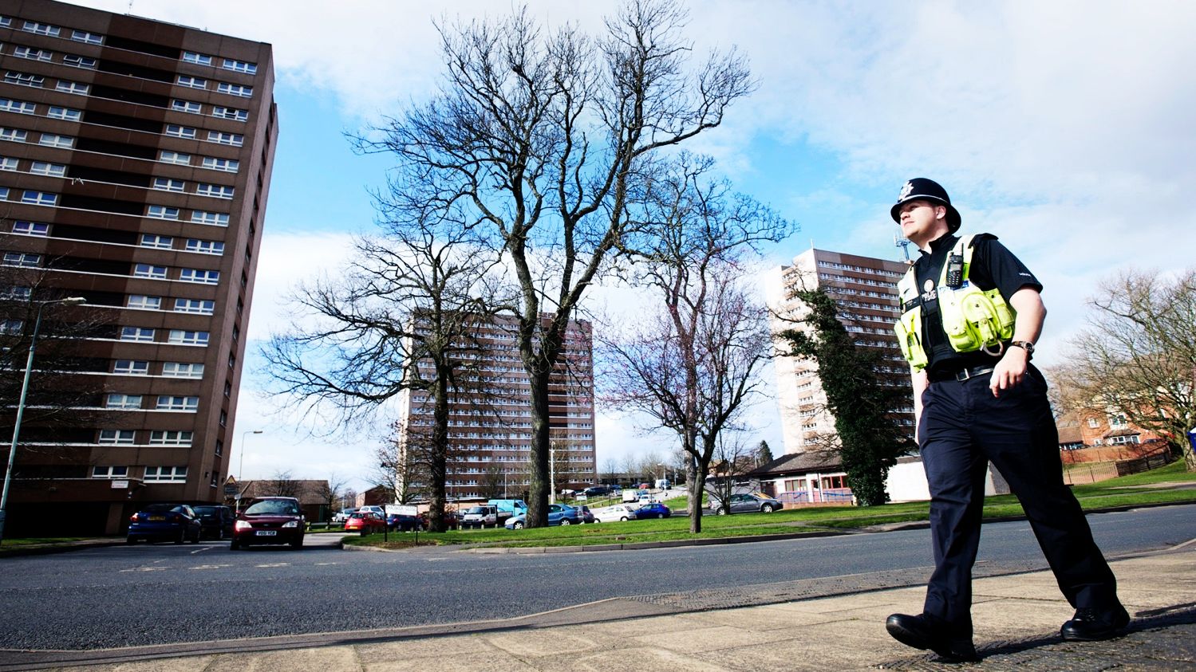
Problem solving at hotspots Dr Matt Ashby
JILL DANDO INSTITUTE OF SECURITY & CRIME SCIENCE
Image: West Midlands Police

Slide 2
Where do crimes happen?

Slide 3
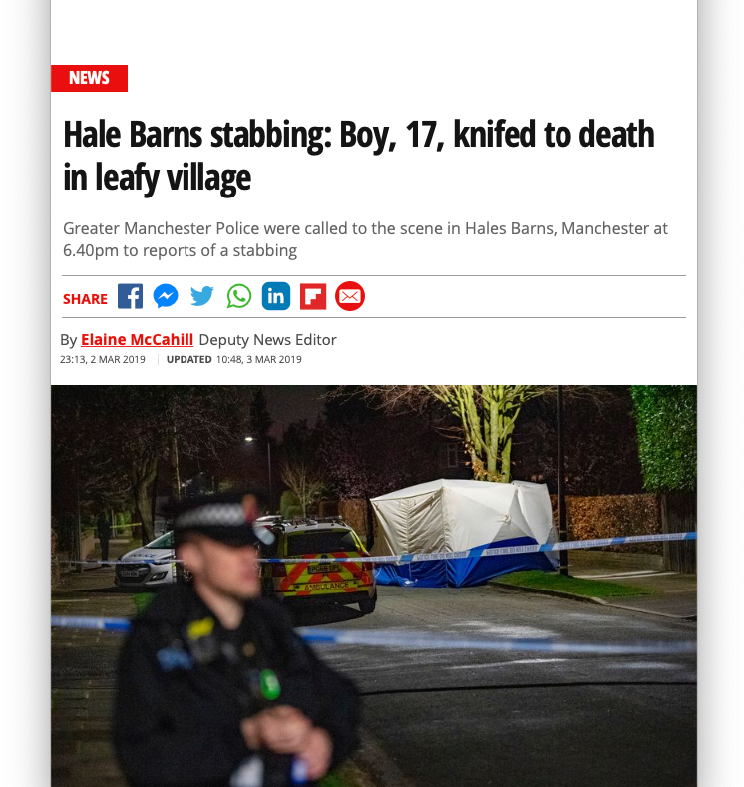
Crimes can happen anywhere …
3

Slide 4
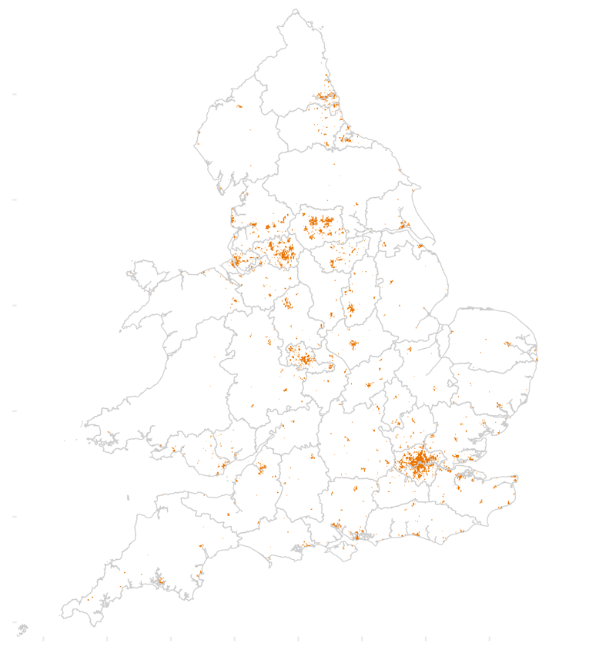
… but they usually happen in the same few places

Slide 5
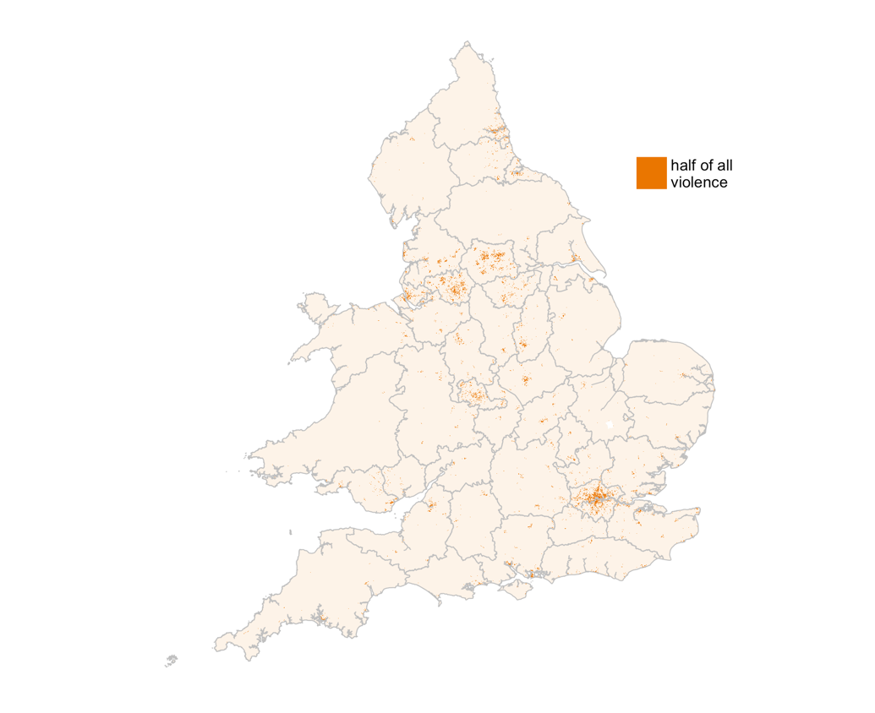
England & Wales
Half of violent and sexual crime recorded by police happens in 1% of areas
Data: www.police.uk, 2018

Slide 6
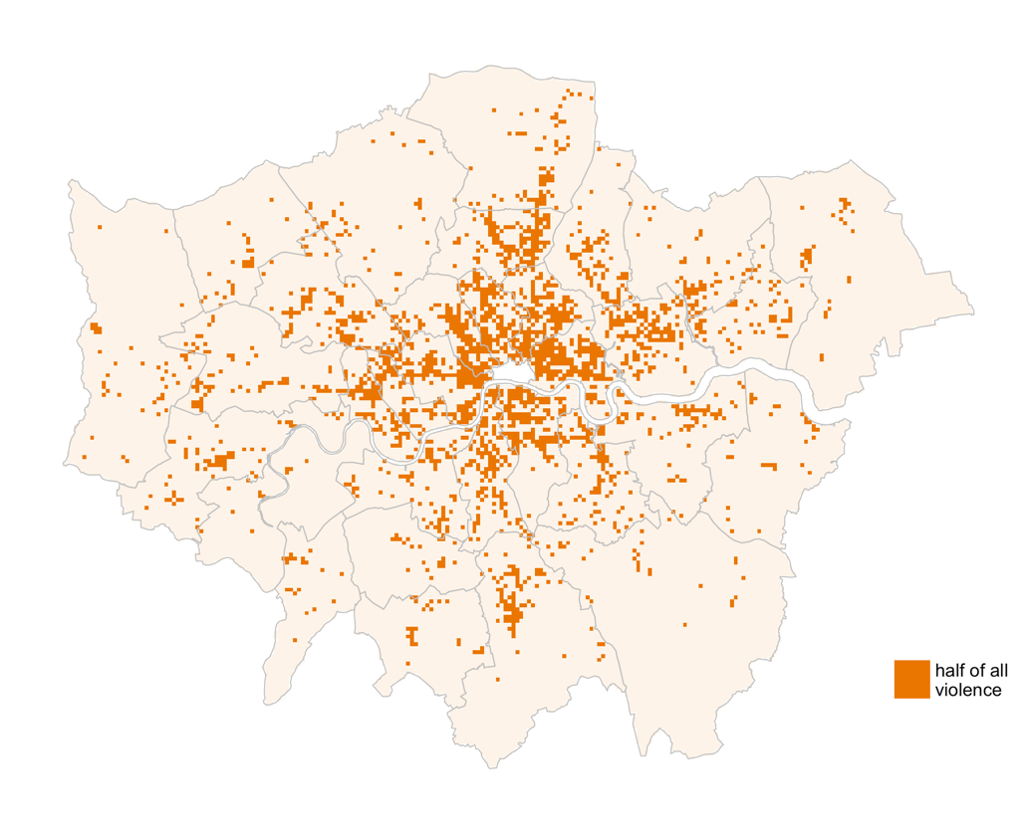
London
Half of violent and sexual crime recorded by police happens in 10% of areas
Data: www.police.uk, 2018

Slide 7
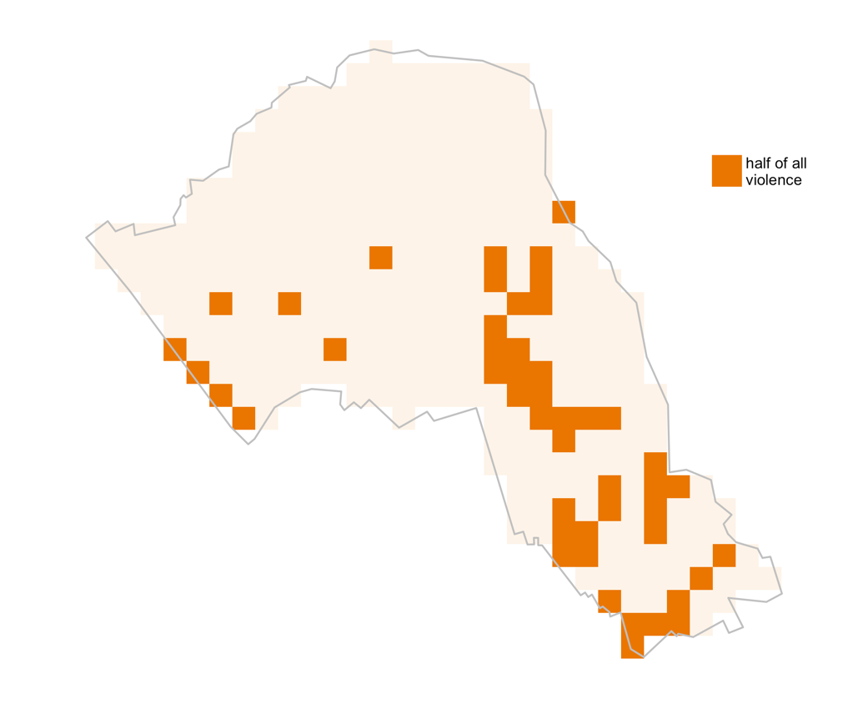
Camden
Half of violent and sexual crime recorded by police happens in 13% of areas
Data: www.police.uk, 2018

Slide 8
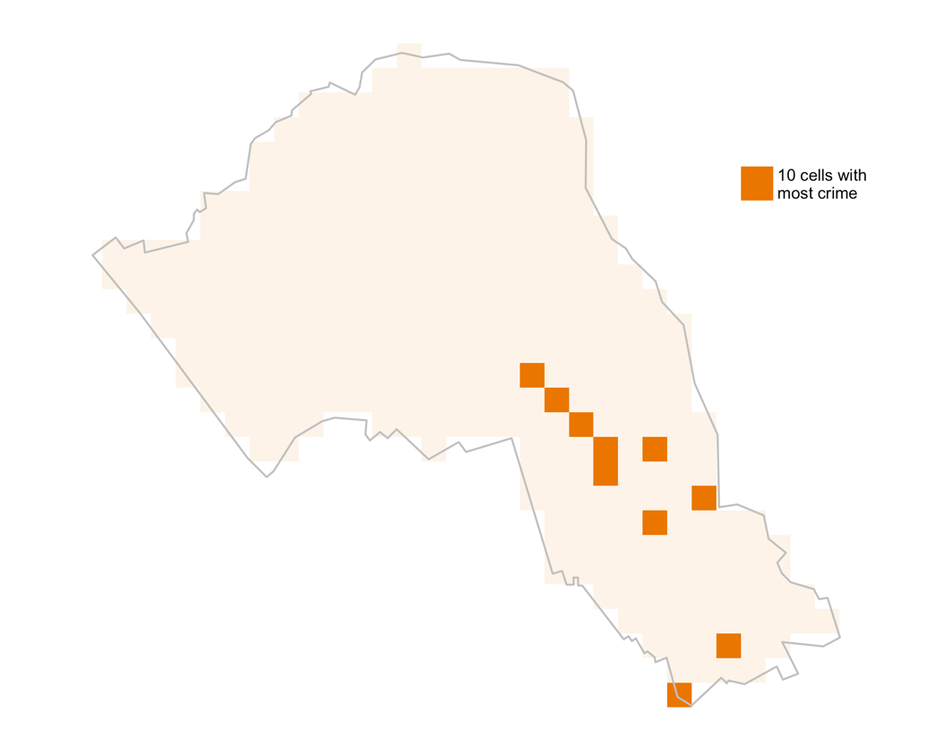
Camden
The top 10 grid cells contain 23% of all violent and sexual crime recorded by police
Data: www.police.uk, 2018

Slide 9
Half of incidents occur in ~5% of street segments
Study | Area | Half of incidents in …
Andresen & Linning (2012) | Ottawa, Canada | 1.7%
Weisburd et al. (2012) | Seattle, USA | 4.7–6.1%
Weisburd & Amran (2014) | Tel Aviv, Israel | 4.5%
Weisburd et al. (2014) | New York, USA | 5%
de Melo et al. (2015) | Campinas, Brazil | 3.7%
Steenbeek & Weisburd (2016) | The Hague, Netherlands | 6.3–7.3%
Gill et al. (2017) | Brooklyn Park, USA | 2%
Source: C W Telep & D Weisburd. 2018. Crime concentrations at places. In: Oxford Handbook of Environmental Criminology.

Slide 10
“Hotspot” = “place”
“Places … can be as small as the area immediately next to an automatic teller machine or as large as a block face, a strip shopping center, or an apartment building.”
Source: J Eck and D. Weisburd. 1995. Crime places in crime theory. In Crime and Place, edited by J Eck and D Weisburd. Monsey, NY: Criminal Justice Press. p 3.

Slide 11
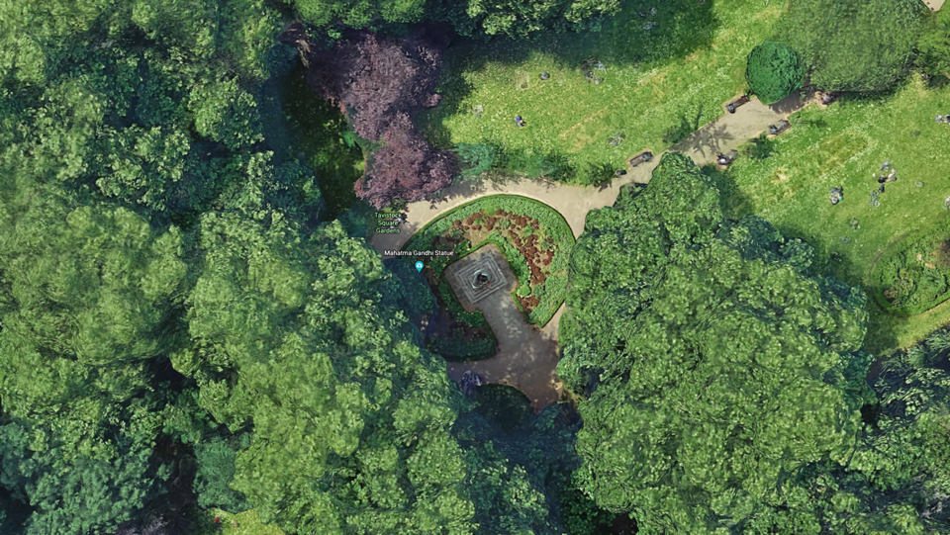
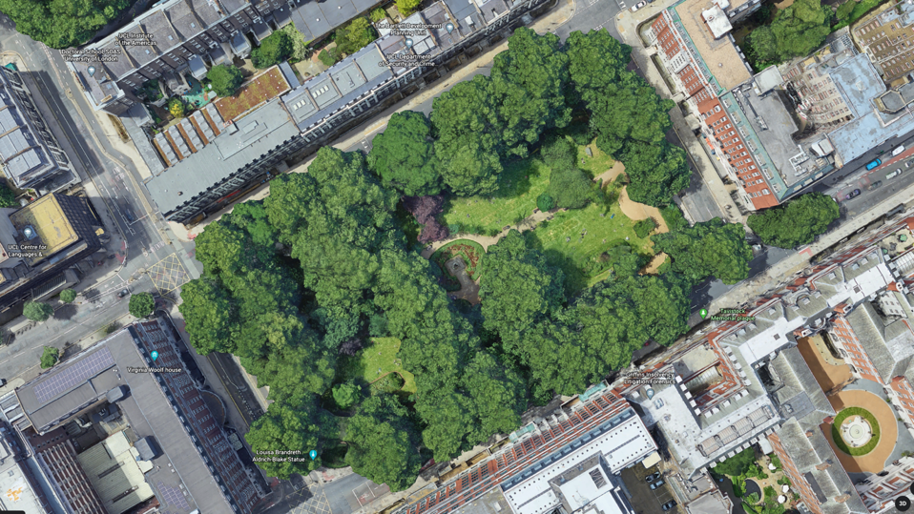
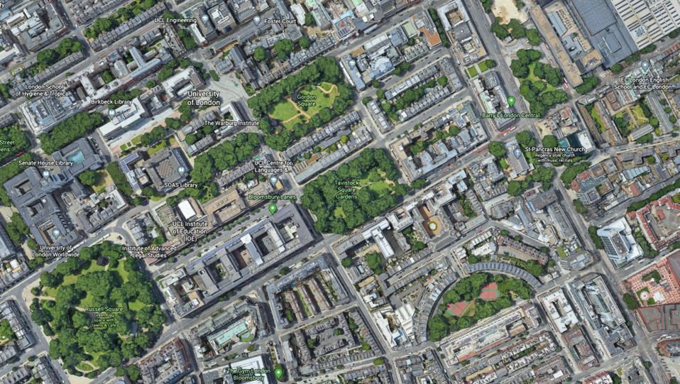
Map data: Google

Slide 12
Does patrolling reduce crime?

Slide 13
“Patrol is considered the backbone of police work”
“The assumption underlying such deployment has been that the presence or potential presence of officers patrolling the streets in marked police cars deters people from committing crime.”
Source: National Police Foundation. n.d. The Kansas City Preventive Patrol Experiment.

Slide 14
How effective do you think general police patrol is at reducing crime?

Slide 15
Kansas City Preventative Patrol Experiment
Patrol beats divided into three groups for one year
“proactive”
2–3 times normal level of patrol
“reactive”
emergency response only
“control”
normal level of patrol
Source: National Police Foundation. n.d. The Kansas City Preventive Patrol Experiment.

Slide 16
Kansas City Preventative Patrol Experiment
no change in recorded crime
no change in fear of crime
no change in perceptions of police
offenders didn’t notice the change …
… and neither did anyone else
Source: National Police Foundation. n.d. The Kansas City Preventive Patrol Experiment.

Slide 17
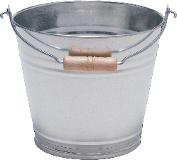
“It is not surprising that less than 1% of offenses end with the offender caught in the act by police on patrol.
“Doubling the number of police in a US metropolis is like doubling a drop in the bucket.”
Source: M Felson. Crime and Everyday Life. 3rd Ed. Thousand Oaks: Sage. p. 5

Slide 18
There can never be enough police to patrol everywhere
7,200 Met Police patrol officers
7,200 ÷ 5ish ≈ 1,400 patrol officers on duty now
205,400 ÷ 1,400 ≈ 140 street segments per patrol officer
Source: Home Office. 2018. Police workforce, England and Wales: 31 March 2018.
Notes:
This assumes no calls are being answered, prisoners handled etc.
MPS responds to about 1,200 immediate-grade calls per day
Source for calls data: https://www.met.police.uk/SysSiteAssets/foi-media/metropolitan-police/disclosure_2017/august_2017/information-rights-unit---volume-of-999-calls-in-london-boroughs-on-any-given-day-in-the-first-six-months-of-2017

Slide 19
Does patrolling in hotspots reduce crime?

Slide 20
Source: A Braga, A Papachristos & D Hureau. 2014. The Effects of Hot Spots Policing on Crime: An Updated Systematic Review and Meta-Analysis. Justice Quarterly 31(4):633–663.
Notes:
Explain forest plot
Overall, significant decrease in crime
13 studies found significant decrease in crime
No studies found significant increase in crime

Slide 21
Displacement: won’t the crime just move?
“Displacement is the relocation of a crime from one place, time, target, offense, tactic, or offender to another as a result of some crime-prevention initiative.”
surrounding area
(no intervention)
intervention area
Source: R Guerette & K Bowers. 2009. Assessing the extend of crime displacement and diffusion of benefits: a review of situational crime prevention evaluations. Criminology 47(4):1331–1368.

Slide 22
Diffusion of benefit
“Diffusion occurs when reductions of crime … are achieved in areas that are close to crime-prevention interventions, even though those areas were not actually targeted by the intervention itself”
surrounding area
(no intervention)
intervention area
Source: R Guerette & K Bowers. 2009. Assessing the extend of crime displacement and diffusion of benefits: a review of situational crime prevention evaluations. Criminology 47(4):1331–1368.

Slide 23
Which do you think is more likely: displacement or diffusion of benefit?

Slide 24
Source: A Braga, A Papachristos & D Hureau. 2014. The Effects of Hot Spots Policing on Crime: An Updated Systematic Review and Meta-Analysis. Justice Quarterly 31(4):633–663.
Notes:
Overall, significant diffusion of benefits
One study found significant displacement
Seven studies found significant diffusion of benefits

Slide 25
But …
“Three months after the experiment, the statistically significant differences in violent crime between the experimental and control areas could no longer be detected.”
Source: E Sorg, C Haberman, J Ratcliffe & E Groff. 2013. Foot patrol in violent crime hot spots: the longitudinal impact of deterrence and posttreatment effects of displacement. Criminology 51(1):65–101.

Slide 26
What other effects do hotspot patrols have?

Slide 27
Police officers may not like rigid hotspot patrols
Officers assigned to hotspots were …
… less likely to say hotspot patrols are useful
… less likely to believe hotspot policing effective
… more likely to say hotspot patrols restrict discretion
… even though the hotspot patrols reduced crime
Source: N Wain, B Ariel & J Tankebe. The collateral consequences of GPS-LED supervision in hot spots policing. Police Practice and Research 18(4):376–390.

Slide 28
Officers and communities may want different things
“[hotspots patrols are] good for the community but can be boring for the police. Rather than preventing crime by keeping hot spots cool, most police would prefer to catch criminals … Prevention lacks glamour”
Source: L Sherman & D Weisburd. 1995. General deterrent effects of police patrol in crime “hot spots”: A randomized, controlled trial. Justice Quarterly 12(4):625–648.

Slide 29
But does hotspot policing damage legitimacy? Possibly
“short-term negative effects on procedural justice and potentially on police legitimacy among hot spot residents …
“[but] the effects are small, and … they are not sustained … once treatment concludes.”
Source: T Kochel & D Weisburd. 2017. Assessing community consequences of implementing hot spots policing in residential areas: findings from a randomized field trial. Journal of Experimental Criminology 13(2):143–170.
Notes:
Study in St Louis, MO
Hotspots randomly allocated to additional patrol or not
Survey of residents before, during and six-months after

Slide 30
But does hotspot policing damage legitimacy? Possibly not
“we compared residents’ perceptions of procedural justice and police effectiveness as well as their trust in the police and fear of crime … we found no statistically significant difference between … the control [and] experimental [areas]”
Source: S Bennett, M Newman & M Sydes. 2017. Mobile police community office: a vehicle for reducing crime, crime harm and enhancing police legitimacy? Journal of Experimental Criminology 13(3):417–428.
Notes:
Study in Queensland
Hotspots randomly allocated to get a mobile police station visit or not
No difference in survey results between groups, but no change in crime either

Slide 31
Using hotspot policing to help solve problems

Slide 32
“problem-oriented policing programs produced a larger overall mean effect size … twice the size of the increased traditional policing”
Source: A Braga, A Papachristos & D Hureau. 2014. The Effects of Hot Spots Policing on Crime. Justice Quarterly 31(4):633–663.

Slide 33
Source: A Braga, A Papachristos & D Hureau. 2014. The Effects of Hot Spots Policing on Crime. Justice Quarterly 31(4):633–663.

Slide 34
What do we know?
Patrols outside hotspots won’t reduce crime
Patrols in hotspots can suppress crime
When the patrols stop, crime will return

Slide 35
Hotspot-based problem identified: public/partners/chiefs want action now
Patrols in hotspot to suppress problem
Analysis to understand problem in detail
Sustainable, analysis-based action to solve problem
Patrols no longer required

Slide 36
Do …
Don’t …
Use patrols in hotspots to suppress crime in the short term
Stop patrols once sustainable measures as in place
Rely on patrols as the main response to a problem
Ignore the potential consequences of hotspot patrols

Slide 37
Slides: lesscrime.info/talk/pop-hotspots Contact: matthew.ashby@ucl.ac.uk or @lesscrime
JILL DANDO INSTITUTE OF SECURITY & CRIME SCIENCE
Image: West Midlands Police

