Slide 1
‘Mind Blowing and Game-Changing’* How ACU have used Altmetric as an engagement tool
Stephanie McGlinchey
Library Manager Research Services
Digital Science Showcase
*Douglas Russell, 6th January 2020

Slide 2
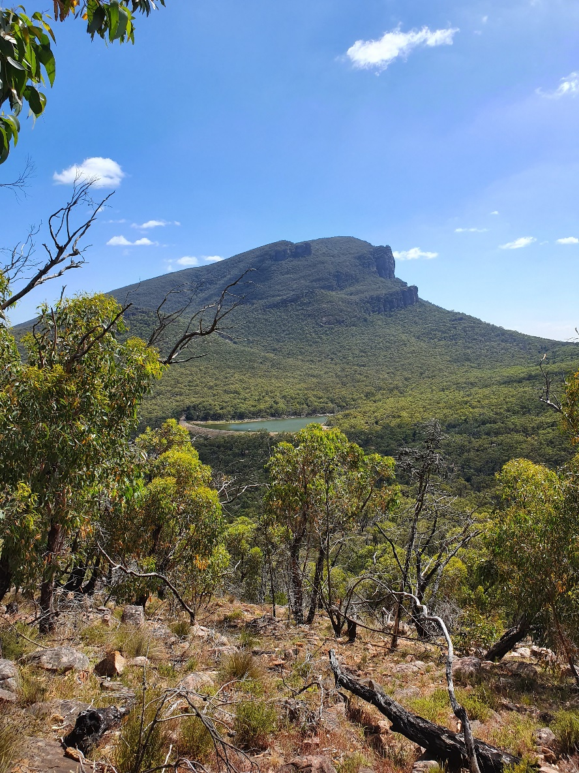
Overview
Digital Science Showcase
Implementation
Challenges
A-ha! Moment
Engagement

Slide 3
Implementation
Digital Science Showcase
Adopted Altmetric in 2016
CSV upload initially
Institutional Repository feed
Implemented the donut into our IR
Great to see how active our researchers were in mentioning their research in social Media
Great talking point with researchers to see how their research was tracking

Slide 4
Challenges
Digital Science Showcase
Why is my book chapter not getting mentioned?
The perils of print journals
Advocating Altmetric Explorer to the Research Office

Slide 5
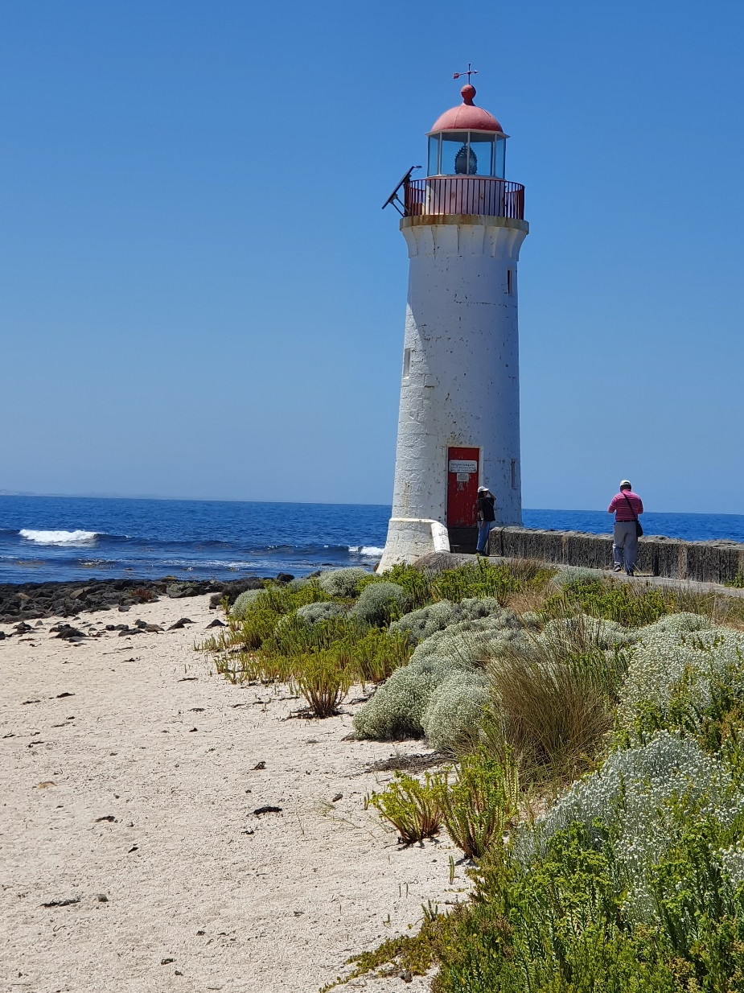
Aha! Moment
Digital Science Showcase
Digital Science Showcase 2018
More granular breakdown of our departments
4 Faculties- added Schools and Institutes, Research Data and Theses
Targeted, focused data

Slide 6
Engagement
Digital Science Showcase
Engagement and Impact- identify research and researchers to develop narratives
Institute level- demonstrating engagement, especially Policy Mentions
Encouraging researchers to deposit in Institutional Repository
“Elevator Pitch”

Slide 7
Thank you!
Photo credits
1. Mt Abrupt, Gariwerd, December 2019
2. Port Fairy Lighthouse, December 2019
All images by Stephanie McGlinchey CC-BY-ND

