Slide 1
An idealist in a non-ideal world
moving towards openness
Lesley D Mostert

Slide 2
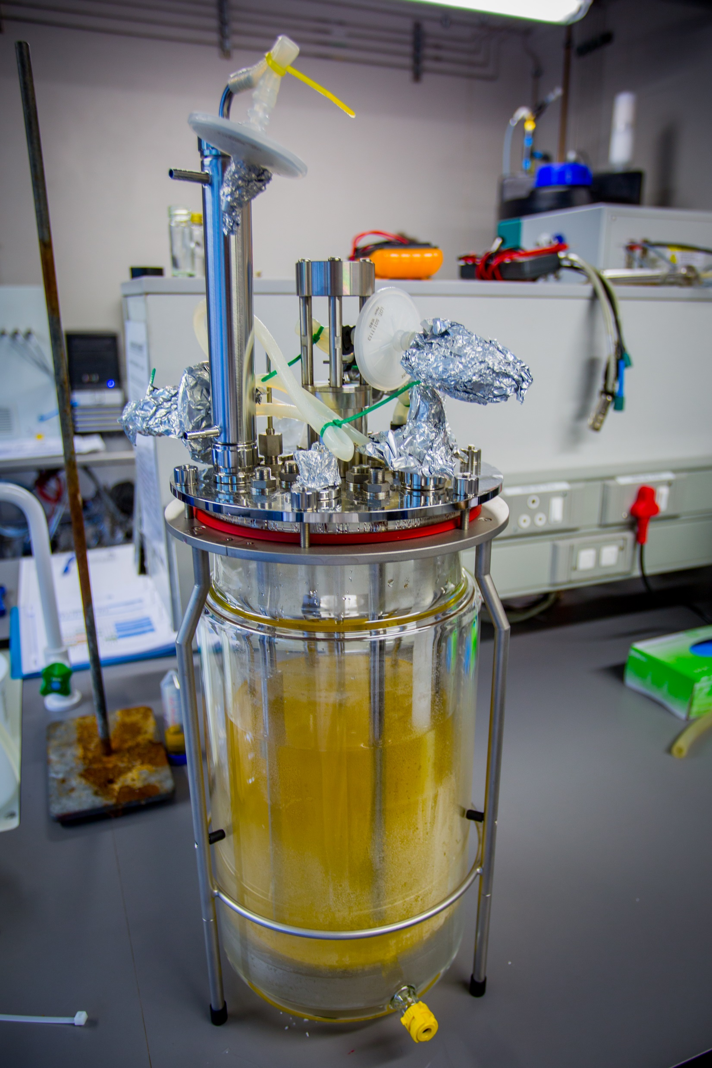
Easy for me
I am not invested in the academic “game”
cc BY CeBER | by Your Name
cc BY CeBER | by Candice Lowin

Slide 3
… but it is hard for most
it’s all new …
when will I fit it in …
I might still use it …
I might be scooped …
but it’s mine!
Martin Mostert 2019

Slide 4
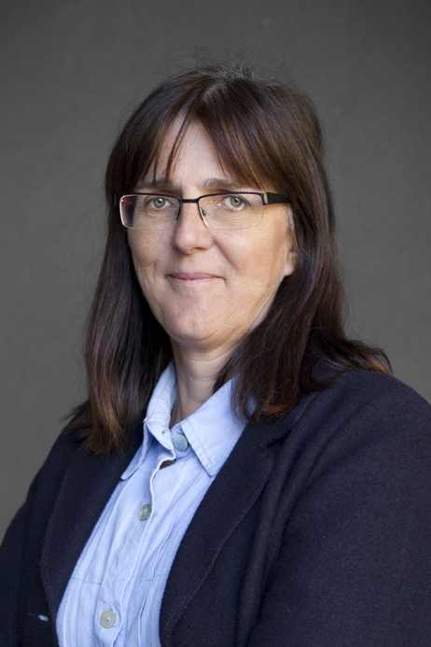
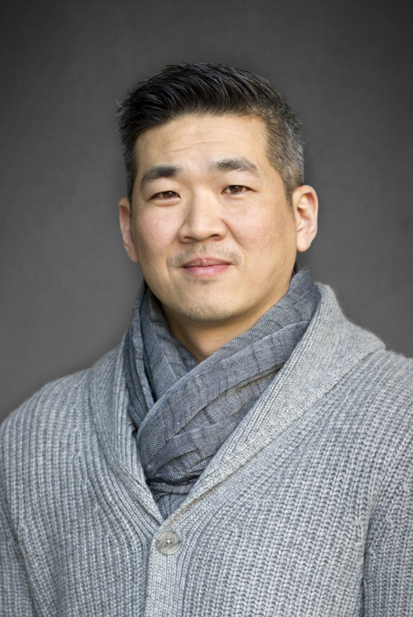
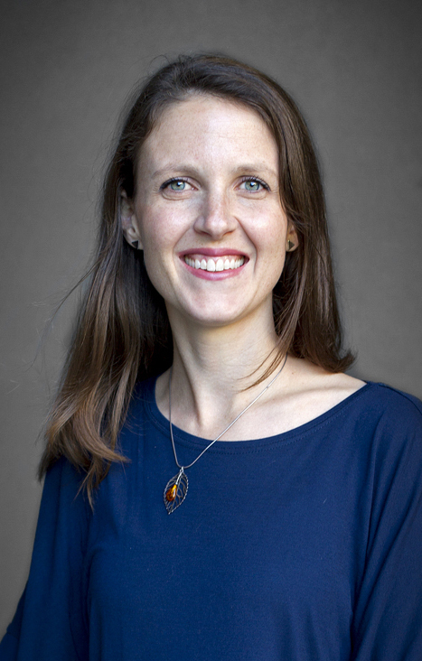
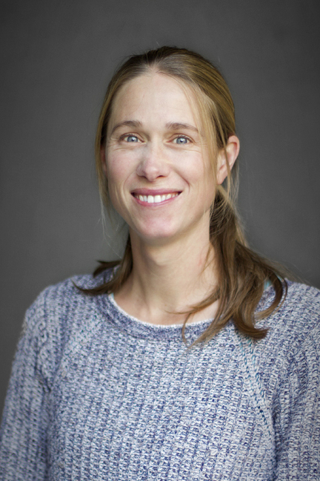
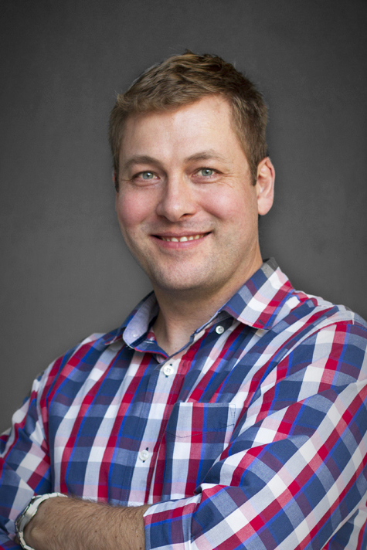
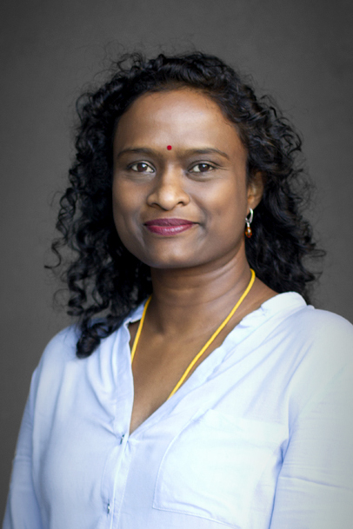
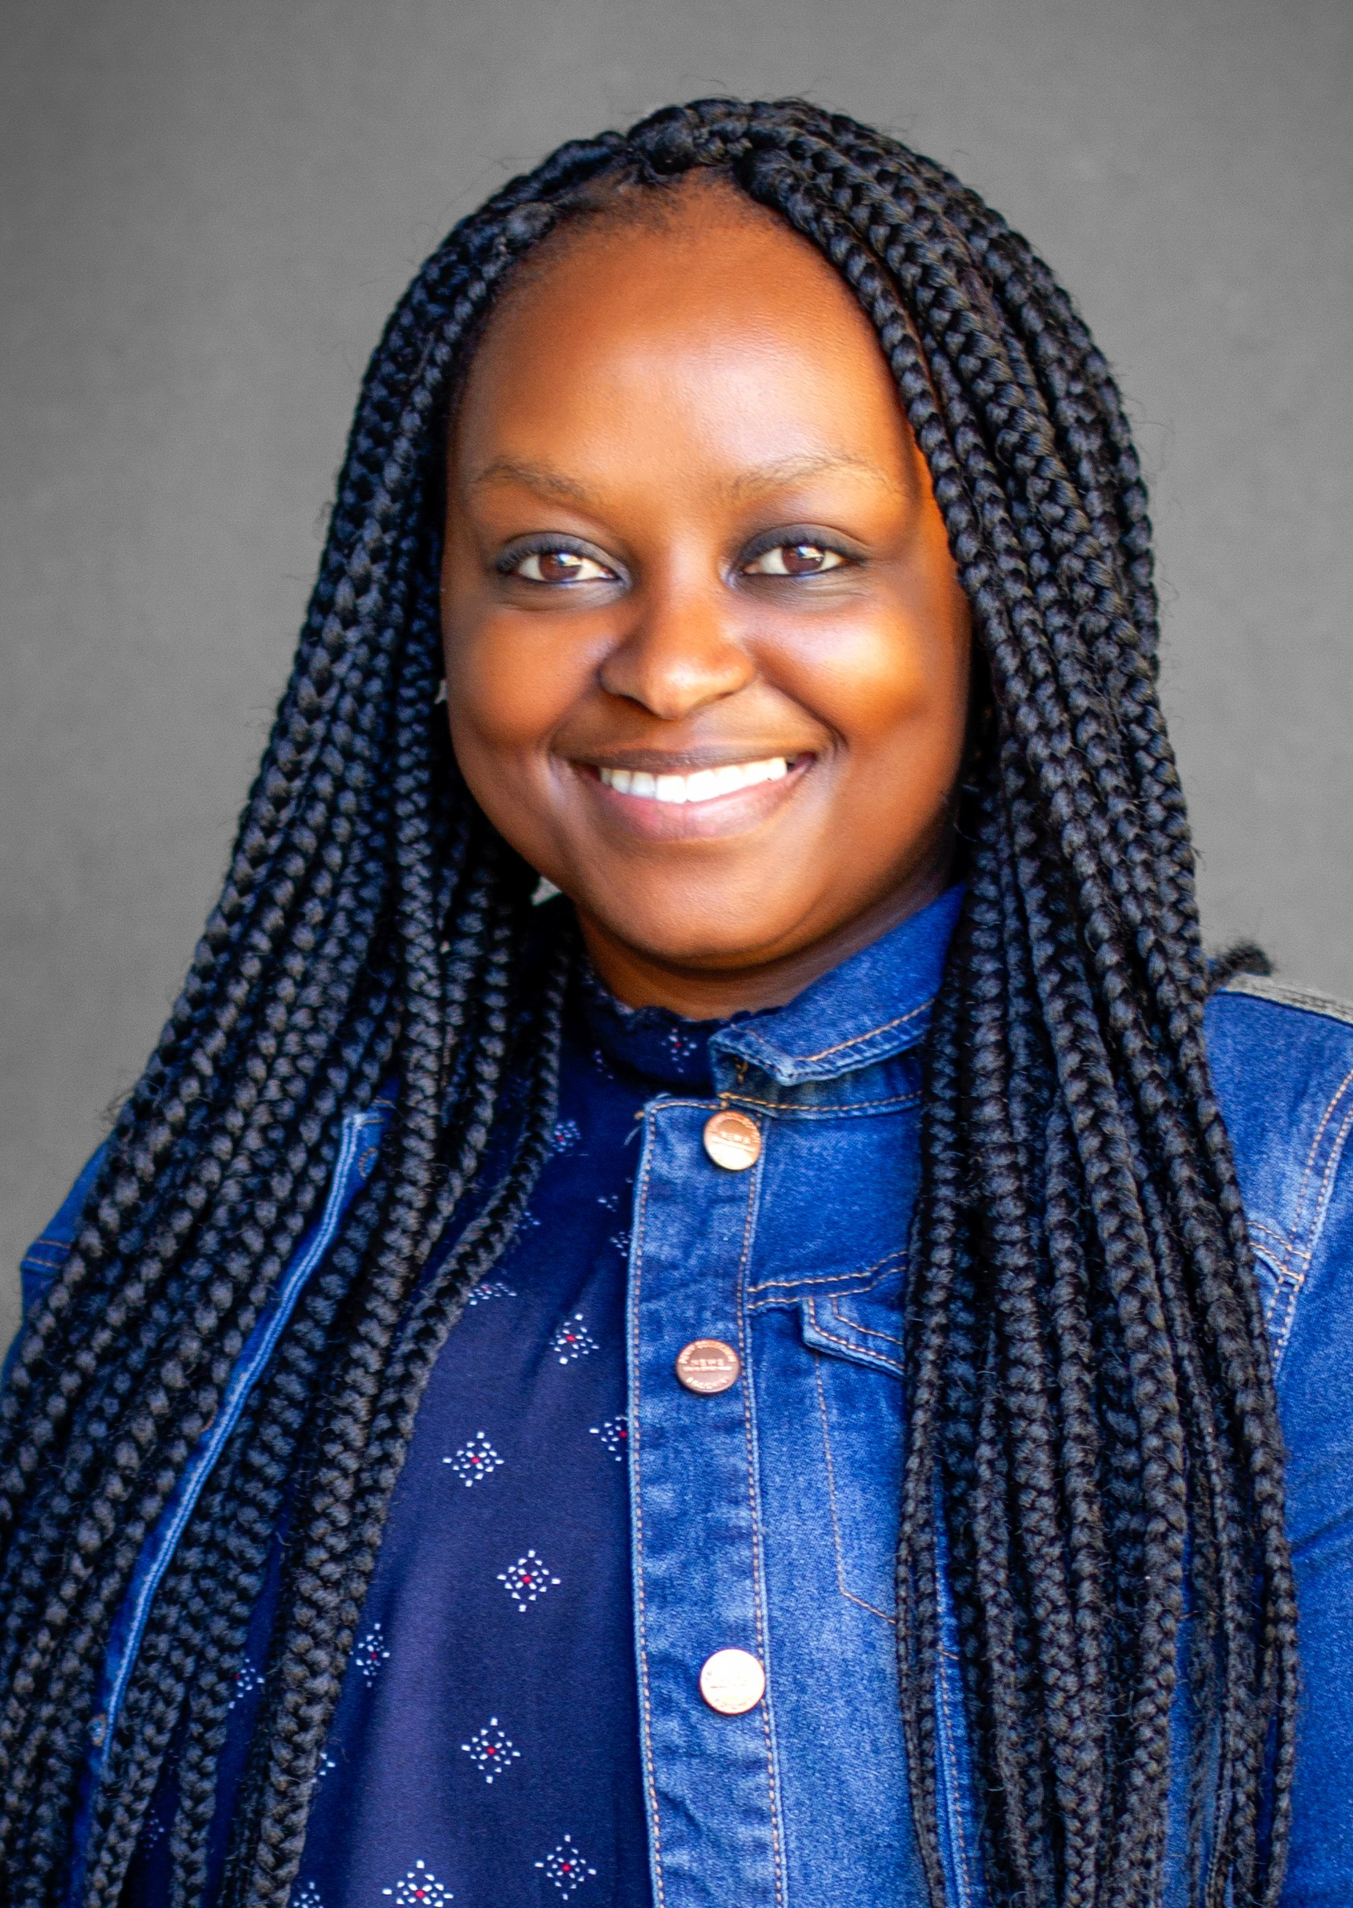
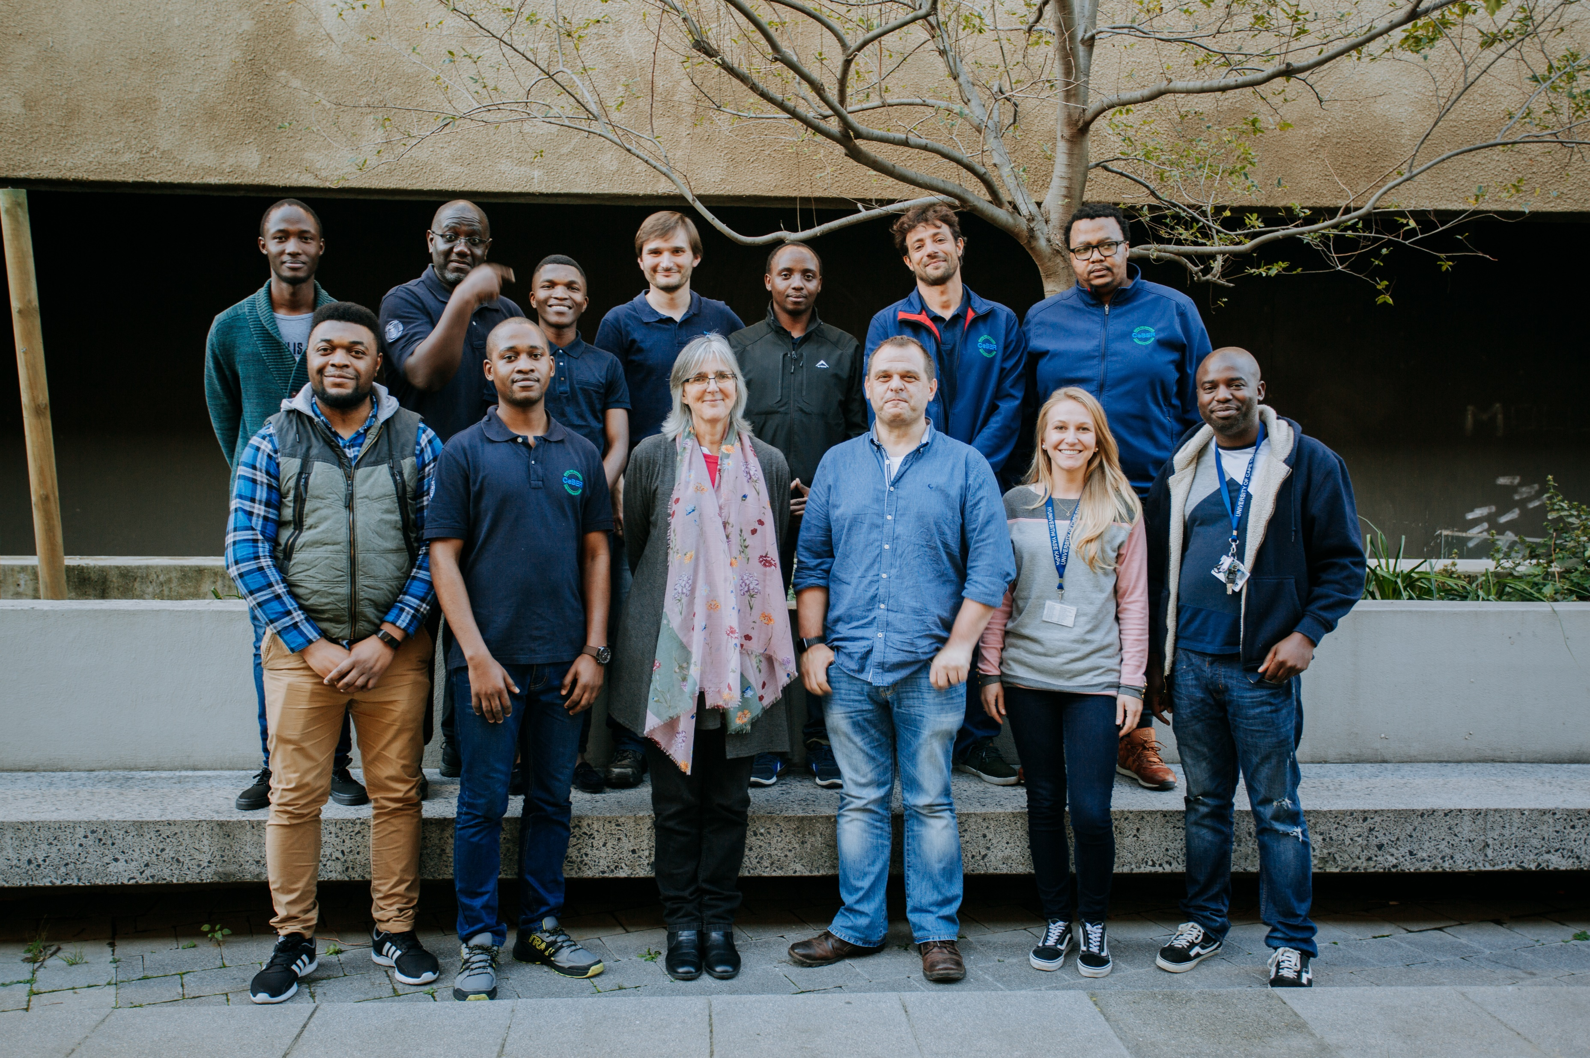
The CeBER academic team … anxious and overwhelmed, but supportive
Prof Sue Harrison
Dr Thanos Kotsiopoulos
Dr Siew Tai
Dr Marijke Fagan-Endres
Dr Mariette Smart
Dr Rob Huddy
Dr Elaine Govender-Opitz
Dr Nodumo Zulu

Slide 5
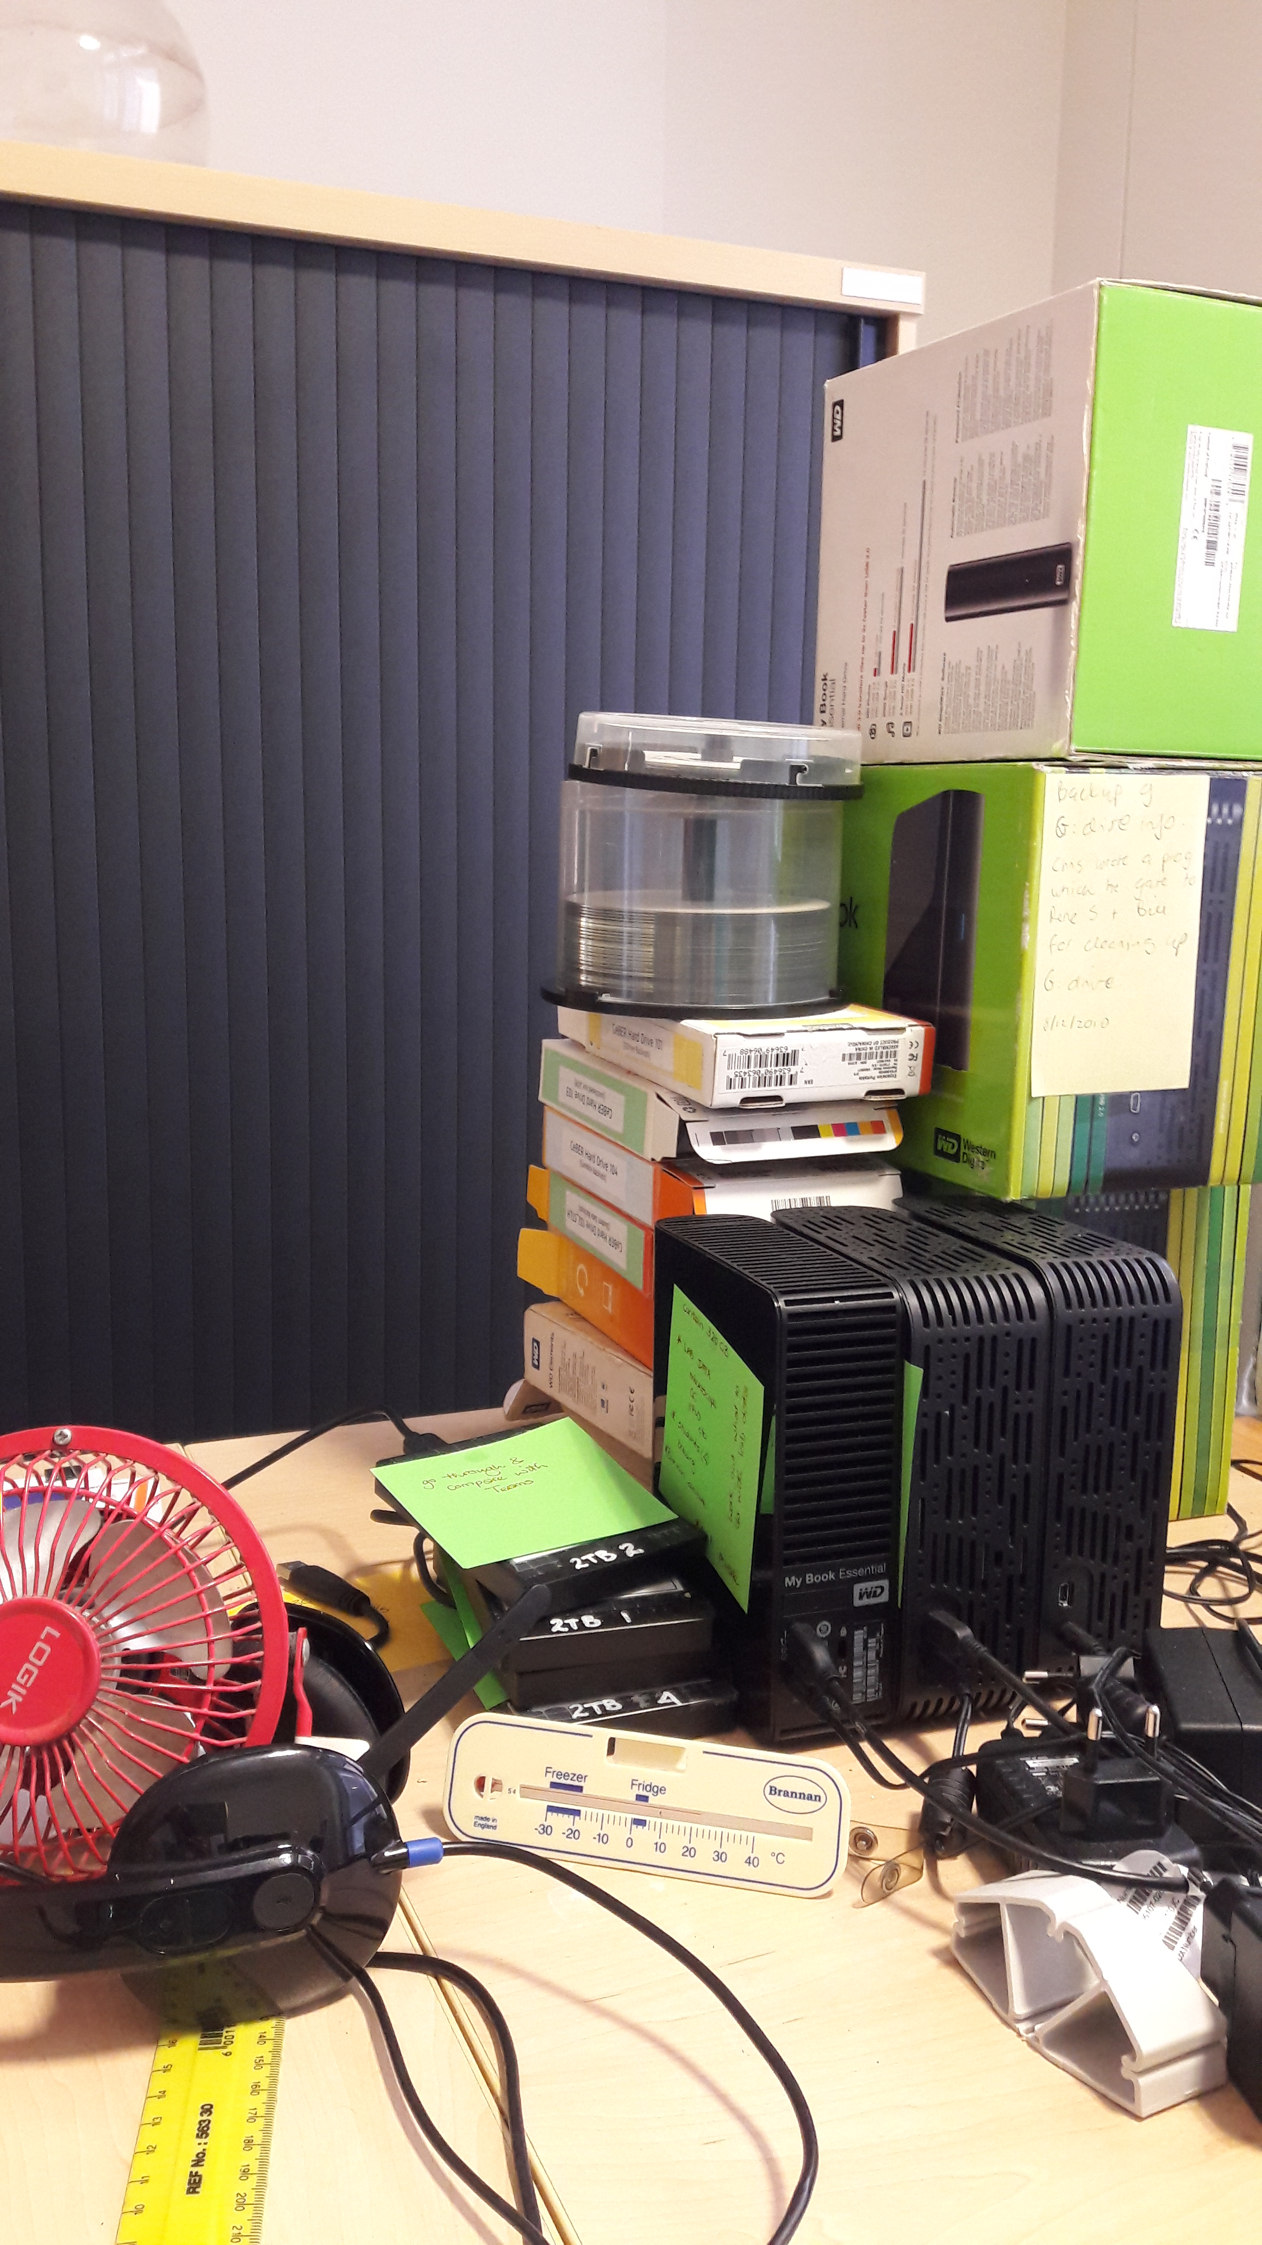
Data retrieved
making existing data available
cc BY CeBER | by Lesley Mostert

Slide 6
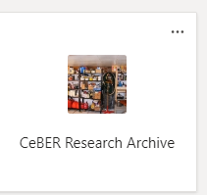
… accessible storage

Slide 7
communal spaces …

Slide 8
… existing achievements

Slide 9
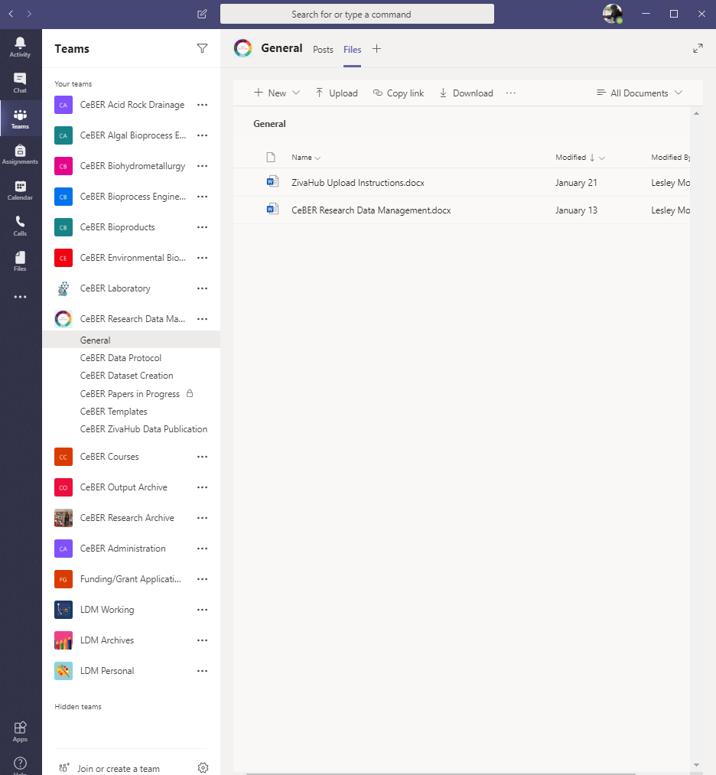
Data revalued
changing data culture
cc BY CeBER | by Your Name
cc BY CeBER | by Candice Lowin

Slide 10
ease in …
talk about it
trial it
thesis-linked
new students

Slide 11
… multiply
make your effort worthwhile
do you believe yourself
can other people believe you
other people might see new things

Slide 12
… career trajectory
where’s your data?
citations
linked datasets
presentations
posters
keep copyright (CC-BY) on seminal figures

Slide 13
… community
who has paid
who has worked
who should know

Slide 14
… respect
ask permission
if you didn’t do it, say who did
https://www.aiche.org/chenected/2018/11/advice-young-managers-r-e-s-p-e-c-t

Slide 15
Data reimagined
changing data space
cc BY CeBER | by Lesley Mostert

Slide 16
Store …

Slide 17
Share …

Slide 18
Share …
Student Folder
Student Folder
all the
staff
have
access
Student Folder
Student Folder
student given access to their folder

Slide 19
Create …

Slide 20
Publish …

Slide 21
Thank you … and watch this space!

Slide 22
Acknowledgements
CeBER has paid my salary even when I was saying things no one really wanted to hear. That is possibly the highest praise!
Particular thanks to Dr Thanos Kotsiopoulos who has walked the road with me.
The people at DLS found me when I was battling away alone. Special thanks to Niklas Zimmer for this.
The eResearch and ICTS people have been endlessly patient answering weird questions.

Slide 23
contact us
http://www.ceber.uct.ac.za/
Chemical Engineering Building, UCT
CeBER@uct.ac.za
@CeBER_UCT

