Slide 1
Japanese Collection on Women in Asia
at Monash University Library
- social and gender issues
Ayako Hatta
Japanese Studies Librarian
Monash University Library

Slide 2
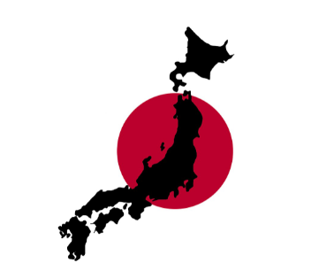
Total number of labour force population in Japan (2016)
Population of Japan:
126,933,000 (2016)
126,435,000 (2019)
+ 410,000
+ 0.3%
28,830,000
43.4%
“Labour force survey” from the Ministry of Internal Affairs and Communications (2016)

Slide 3
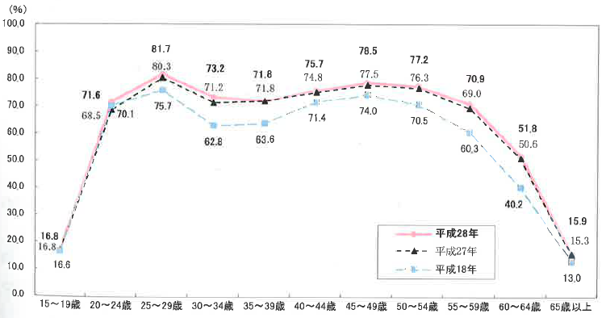
Labour force rate by women’s age in Japan (2006, 2015, 2016)
2016
2015
2006
Age range
“Labour force survey” from the Ministry of Internal Affairs and Communications (2016)

Slide 4
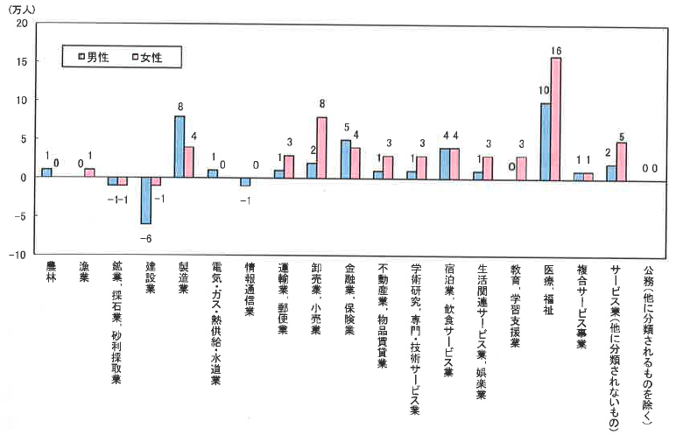
Comparison in the number of employees by industry (2016)
(10,000 people)
men women
Other official business
Other service industry
Combined service business
Medical, Welfare
Education, Learning support
Life related service industry,
Entertainment business
Accommodation, Food service industry
Academic research,
Professional technical service
Real estate business, Goods lending industry
Financial industry, Insurance business
Wholesale business, Retail business
Transportation business, Postal business
Information and
communication industry
Electricity, gas, heat supply, water service
Manufacturing
Construction industry
Mining, Quarrying industry,
Sandy industry
Fishery
Forestry
“Labour force survey” (2016)

Slide 5
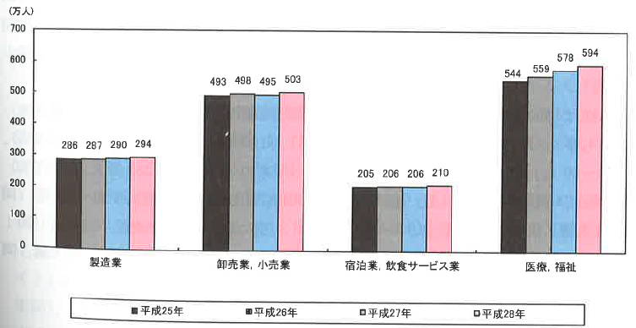
Changes in the number of women’s employees by major industries in Japan (2013-2016)
(10,000 people)
Manufacturing
Wholesale business, Retail business
Accommodation, Food service industry
Medical, Welfare
2013 2014 2015 2016
“Labour force survey” from the Ministry of Internal Affairs and Communications (2016)

Slide 6
Topics in the interests around subject unit “Contemporary Japan” at Monash University
Is Japan today a multicultural society?
Why have Japanese popular cultural products been so successful internationally?
How has the position of women in Japanese society changed in the postwar period? Are there still areas of discrimination?
The proportion of children (0-14) in the Japanese population has fallen from 30% in 1960 to around 13% today. Why? And why is the decline a cause for concern? What is being done (or could be done) to halt it?

Slide 7
Topics in the interests around the collection
Workplace
Employment
Language
Contemporary Japanese society
Literature
Young people
Women
Linguistics
Population
Elderly, Disabled, Foreign workers
History
Music
Poverty, Career gap
Culture

Slide 8
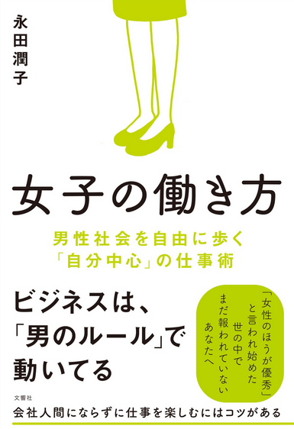
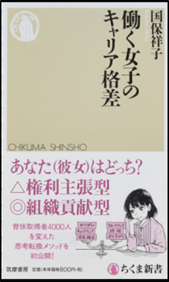
Cover titles from the collection
Power of women/girls (2015)
Destiny of working women/girls (2015)
Employment is a contract (2018)
Sociology of culture of post-kawaii (2017)
Career disparity of working women (2018)
How women/girls work (2017)
Don’t say that I am a temporary worker! (2016)
Why women/girls quit jobs (2015)
Curse of “women/girls”
(2018)

Slide 9
Researching at Monash University
Finding social networking tools and profiles in Japan
Grants-in-Aid for Scientific Research (KAKEN) https://nrid.nii.ac.jp/index/
Includes information on adopted projects, assessment, and research achievements from the Grants-in-Aid for Scientific Research(KAKENHI) Program.
Institutional Repositories DataBase (IRDB) https://irdb.nii.ac.jp/
A database service that provides metadata contents that has registered at the institutional repositories in Japan.
Researchmap https://researchmap.jp/
Enables users to create personalized websites, manage their research information, and network and collaborate with other researchers.
J-GLOBAL https://jglobal.jst.go.jp/en
Researchers (Researchmap), institutions, articles, research projects, etc.

Slide 10
Reference
21-seiki Shokugyō Zaidan publisher. (2017). Josei rōdō no bunseki. 2016-nen: chiikibetsu ni mita josei no shūgyō jōkyō [Analysis of women’s’workforce. 2016: women’s employment situation from different geographical areas]. Tōkyō : Nijūisseiki Shokugyō Zaidan.
Hataraku Koto to Seisabetsu o Kangaeru Santama no Kai. (1991). Onna 6500-nin no shōgen: hataraku onna no mune no uchi [Testimony of 6500 women: inner feelings of working women]. Tōkyō : Gakuyō Shobō.

