Slide 1
Research and Learning Services in Academic Libraries: the Monash University Library Case
Jung-Sim Kim
2019 KSAA Conference
University of Western Australia, Perth

Slide 2
Overview
Research and Learning Skills
Research life cycle
How to find Resources on Korean language
Korean Studies Library Internship
Korean Studies Library Guide

Slide 3
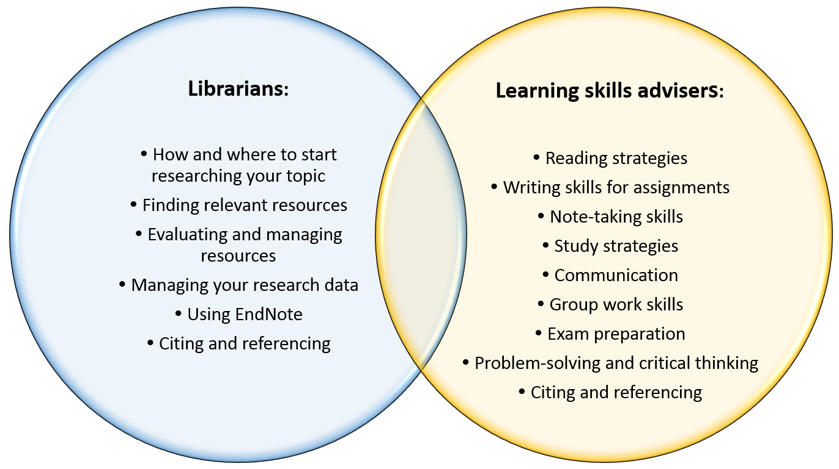
Research and Learning Skills - what services are provided?

Slide 4
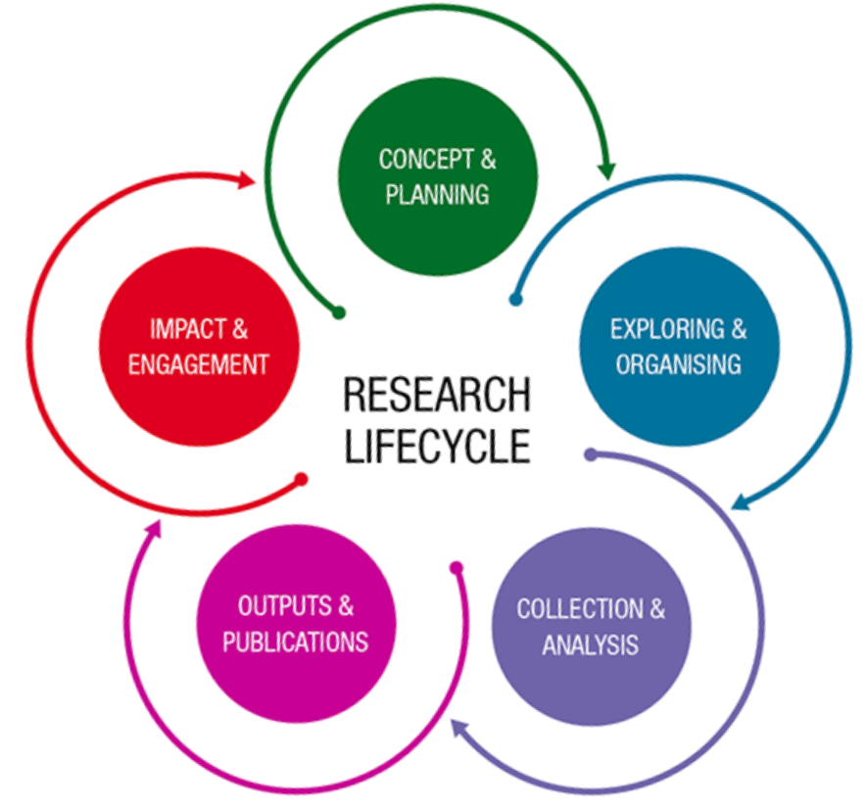
Research Lifecycle https://www.monash.edu/library/researchers/research-lifecycle

Slide 5
How to find Resources on Korean language

Slide 6
Related terms on “Korean language”
Hangugo (diacritics ignored) – MR Romanisation System
한국어 or 韓國語 – Korean character
Korean language – English

Slide 7
Finding relevant resources on Korean language
Library Search (https://monash.edu/library/search)
Korean databases (https://guides.lib.monash.edu/korean/databases)
Databases by subject (https://guides.lib.monash.edu/subect-databases)

Slide 8
Acquiring: Online access, Available at from the Library Search
Select “Online access” to access online resources
Select “Available at or Not available” to locate or request physical items

Slide 9
Acquiring: Online access, Available at from the Library Search
Select “Online access” to access online resources
Select “Available at or Not available” to locate or request physical items
Does the record have a PDF or HTML full-text?
Yes – View PDF or HTML full-text
No – Use Document Delivery, if eligible. If not eligible, ask the Korean Studies Librarian for help

Slide 10
Korean Studies Library Internship
Collaboration between MUL and Korean Studies, Faculty of Arts
Specific position description for the internship
Discuss with Work Integrated Learning Coordinator for Faculty of Arts
6 credit points unit
2 interns (S2, 2018), 1 intern (winter semester, 2019)
We treated them as professional staff members
Allocated desks, they contributed in work meetings, a Korean Studies conference and seminar, and attended a professional development training session (funded by AKS project)
We had weekly catch-ups (interns and host supervisors)

Slide 11
Korean Studies Library Guide
The Korean Studies Library Guide at Monash University (https://guides.lib.monash.edu/korean/) helps its users on the following areas:
Event
Finding Korean Resources
Databases
Korean Language & Studies
Literature/Translations
Newspapers & Media
Korean Studies @ Monash
Postgraduates & Honours
Undergraduates
Useful Links.

Slide 12
If you have questions,
please feel free to ask me.
Thank you.
jung.sim.kim@monash.edu

