Slide 1
Effects of Bitter Crab Disease on gene expression in Alaska Tanner Crabs
Grace Crandall, MS student
Roberts Lab, UW SAFS
AMSS 2020
NPRB Grant 1705
Notes:
Today I’ll talk about small part of bigger project
PIs: Dr. Pam Jensen and Dr. Steven Roberts
NPRB grant 1705: Tanner crab response to temperature change and Hematodinium

Slide 2
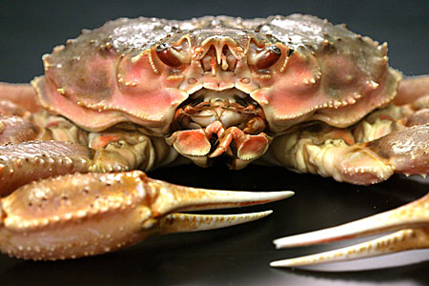
Tanner Crab (Chionoecetes bairdi )
Notes:
Range from AK to coastal OR

Slide 3
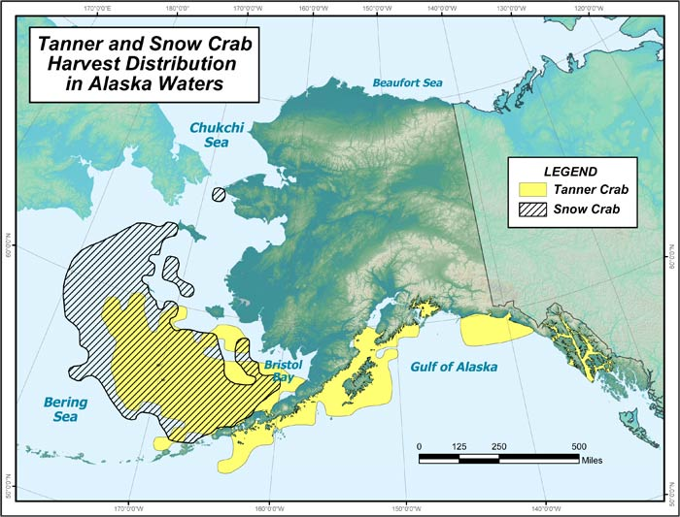
AK range and economic importance
SE population: $21million fishery (2014)
Often marketed under “snow crab”
Market sized males: 7-9 years old, 2-4 lbs
Image: ADF&G
Notes:
This project will focus on AK Tanner crabs, and more specifically, SE AK tanner crabs, whose populations supported a …
https://www.adfg.alaska.gov/index.cfm?adfg=tannercrab.main

Slide 4
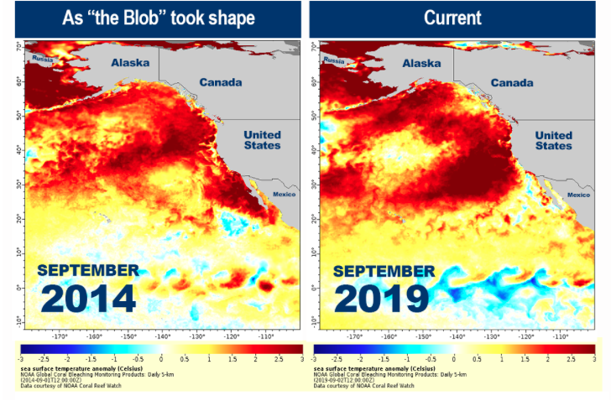
Threats to fishery
1. Bitter Crab Disease (“Principle Threat” - ADF&G)
Prevalence ( SE Alaska vs. Bering Sea)
2. Warming oceans
Increase BCD prevalence?
NOAA Fisheries
Notes:
Many threats to fishery – 2 major ones are: …
On average, lower prev. In SE compared to Bering Sea populations
https://www.fisheries.noaa.gov/feature-story/new-marine-heatwave-emerges-west-coast-resembles-blob

Slide 5
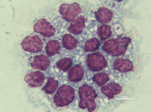
What is bitter crab disease (BCD)?
Parasitic dinoflagellate Hematodinium spp.
Takes over hemol spaces in crab
Outcompetes host for nutrients + oxygen
Transmission: unknown
Molting?
Ingestion? (water column; cannibalism)
Hemolymph smear: Hematodinium → purple
Notes:
Refer to image when intro. Hemato.

Slide 6
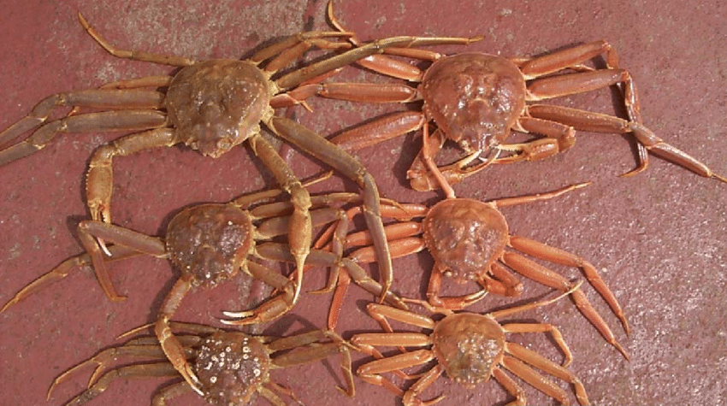
BCD signs: red/cooked looking carapace

Slide 7
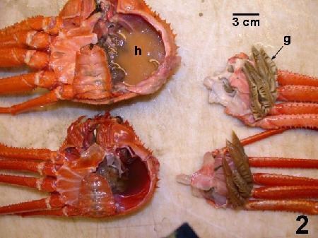
BCD signs: milky hemolymph

Slide 8
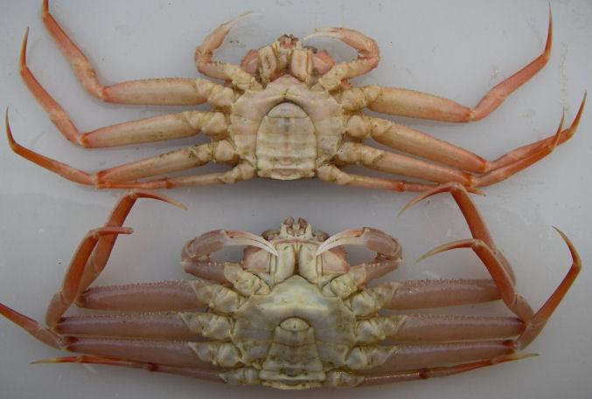
BCD signs: opaque legs and joints

Slide 9
BCD signs: lethargy
Notes:
Droopy; slow moving

Slide 10
BCD signs: bitter, chalky meat
Notes:
When cooked

Slide 11
Diagnosis
Gross signs
PCR
Hemolymph smears
Histology
Notes:
Other infections can have similar manifestations – want to also do PCR, etc.

Slide 12
Diagnosis Prognosis
Gross signs
PCR
Hemolymph smears
Histology
Death…?
Chronic…?
Death from secondary factors…?
Suffocation; starvation; etc.

Slide 13
Goals of project
Understand interactions between temperature, infection, and crab physiology
Understand unknowns
Mortality; transmission
Notes:
Help inform fishery management
Look into these by looking at expressed genes

Slide 14
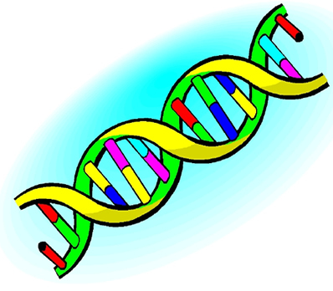
Genes
Unbiased
Basic functionality in organism
Differential abundance
how conditions affect organism
Notes:
Unbiased: either genes are present or not; the ones that are present will tell us what biological processes are taking place

Slide 15
Transcriptomics

Slide 16
Transcriptomics
DNA → RNA → Protein
transcribe
translate
Collection of mRNA sequence = transcriptome
Notes:
Up next: experimental design

Slide 17
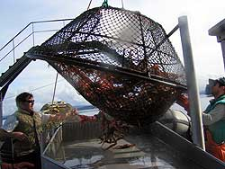
Crab sampling and acclimation
~400 immature, male crabs sampled from Juneau by ADF&G fall 2017
cPCR at NOAA lab for initial infection status
Crabs acclimate for 9 days to tanks
Notes:
Immature males because thought that intermediate age are most susceptible - especially during molting when they are most vulnerable
Mature determined by ratio of carapace to cheliped length
After 9 days acclimation, hemolymph sampled from every crab

Slide 18
Experimental Design
10
10
10
10
10
10
10
10
10
10
10
10
10
10
10
10
10
10
Cold: 4˚C
Ambient: 6˚C
Warm: 10˚C
Notes:
180 crabs chosen to continue (90 infected, 90 uninfected)
then they were separated in to tanks for temp. Treatment.
10 infected/10 uninfected per tank

Slide 19
Sampling scheme
Hemolymph sampled
pre-temp. treatments
Hemolymph sampled from all treatments
Hemolymph sampled from all treatments
Day 0
Day 3
Day 17

Slide 20
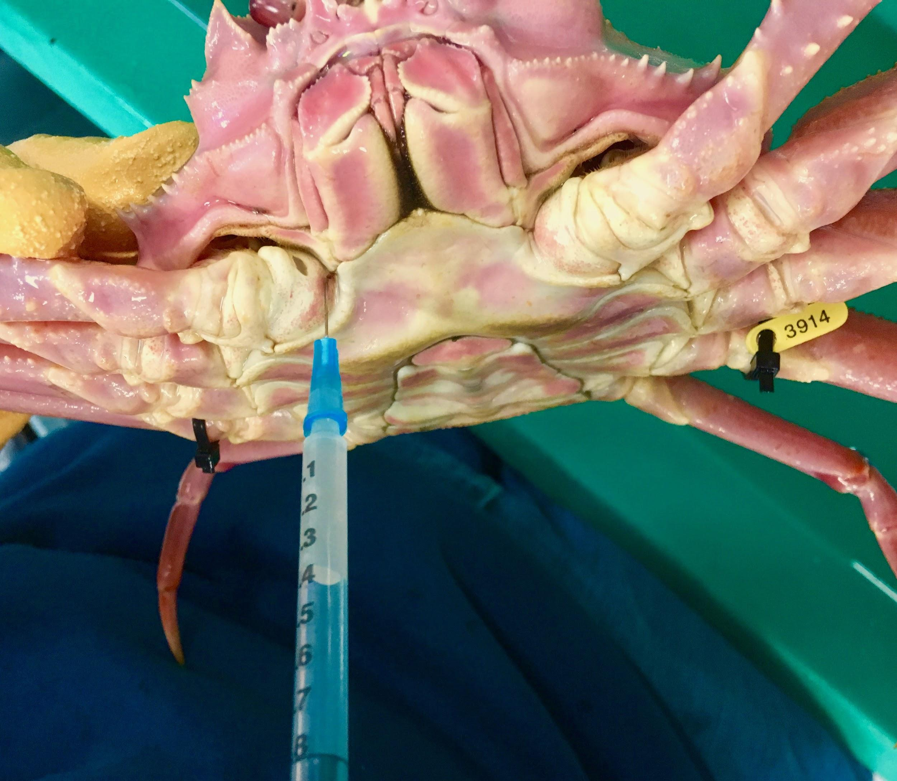
How did we sample hemolymph?
Stored in RNAlater for RNA extraction

Slide 21
INFECTED
UNINFECTED
Day 3
Day 17
Notes:
Have a lot of information and routes to go down with our samples, but today I’ll just be presenting some NEW DATA: not final.
Just comparing infected and uninfected

Slide 22
How are the infected and uninfected crabs different?
Notes:
What is the difference between the infected and uninfected crabs?

Slide 23
How are the infected and uninfected crabs different?
What genes are differentially expressed in the infected crabs compared to the uninfected crabs?
Notes:
I’ll be talking about DEGs from here on out:
DEG = differentially expressed gene
Only possible in comparisons
Either more or less abundant in one group than in another (others)
How conditions affect an organism

Slide 24
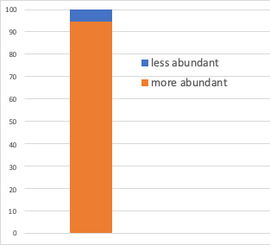
How many DEGs did we find?
58468 DEGs total
3062 less abundant in infected
55406 more abundant in infected
Notes:
EXCITING! Talk about how there are a lot more of the more abundant genes than less abundant.
Quite a lot more DEGs between infected and uninfected than we were expecting! Talk about how there are a lot more of the more abundant genes than less abundant.
Expected to see an increase in abundance of genes in response to the infection, but this is a much more dramatic difference than expected!
It turns out, a lot of these genes are from the Hematodinium!!
http://htmlpreview.github.io/?https://github.com/sr320/nb-2019/blob/master/C_bairdi/11-Deseq2.html
Positive (“up”) are in uninfected
Negative (“down”) are in infected
https://www.bioconductor.org/packages/devel/bioc/vignettes/DESeq2/inst/doc/DESeq2.html#standard-workflow

Slide 25
What are these DEGs doing?

Slide 26
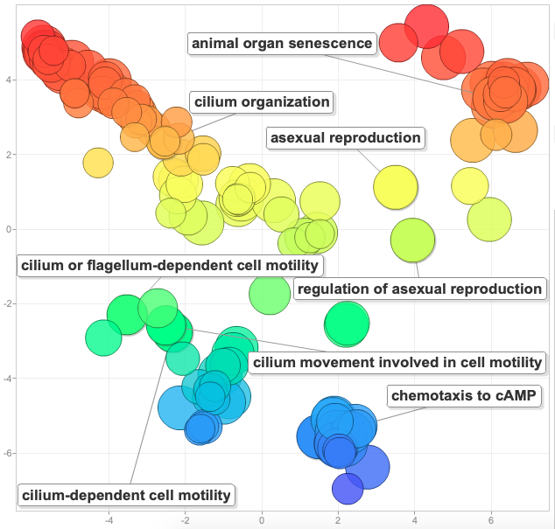
High abundance in infected group
Notes:
Orient audience with the figure!!!!
scatterplot
Larger the dot, the more abundant process is in the infected
Color is just to make it pretty → doesn’t have to do with functioning
298 enriched genes

Slide 27
High abundance in infected group
Some Hematodinium genes:
Movement:
- Cilia motility
- Cilia organization
Reproduction
- Asexual reproduction
Notes:
Talk about some cool things:
Movement: Cilia (dinoflagellates move with flagella/cilia)
Asexual reproduction (dinoflagellates reproduce asexually)

Slide 28
High abundance in infected group
Some crab immune genes:
- Interleukin-1 receptor associated kinase 4 (IRAK-4)
- Serine protease persephone
- Leukocyte elastase inhibitor A (Serpine B1a)
Notes:
Don’t show up in the figure because so many Hematodinium genes. We have lists of genes and these are some of crab ones we found.
Interleukin-1 receptor-associated kinase 4 (IRAK-4) (EC 2.7.11.1) → plays a critical role in initiating innate immune response against foreign pathogens
Serine protease persephone (EC 3.4.21.-) → role in innate immunity in response
Leukocyte elastase inhibitor A (Serine protease inhibitor EIA) (Serpin B1a) → innate immunity
Others:
High mobility group protein DSP1 (Protein dorsal switch 1)
Toll-like receptor Tollo (Toll-like receptor 8)
Matrix metalloproteinase-2 (Dm2-MMP) (EC 3.4.24.-)
Autophagy protein 5 (APG5-like)
Leukocyte elastase inhibitor A (Serine protease inhibitor EIA) (Serpin B1a)
Serine protease persephone (EC 3.4.21.-)
Toll-interacting protein
Complement component 1 Q subcomponent-binding protein,
Interleukin-1 receptor-associated kinase 4 (IRAK-4) (EC 2.7.11.1)
Putative serine protease K12H4.7 (EC 3.4.-.-)
Protein toll
Interleukin enhancer-binding factor 2 homolog

Slide 29
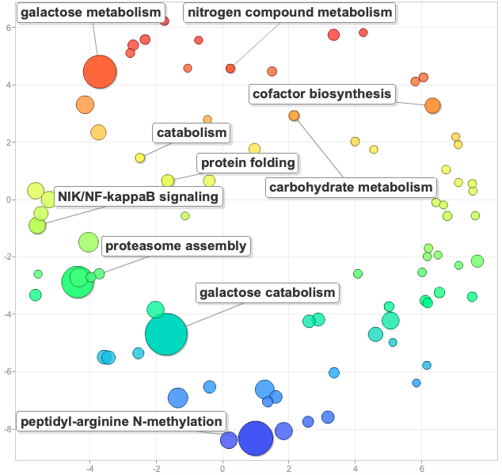
Low abundance in infected group
Crab metabolism genes:
- Carbohydrate metabolism
- Galactose metabolism
- Nitrogen compound metabolism
- Proteasome assembly
Notes:
Brand new data!!
Less abundant genes involved in infected normal metabolism.
Tells us that the crabs normal metabolic functioning are negatively impacted by Hematodinium.
That they are stressed by the infection.
Makes sense since it’s known that the parasite takes over the crabs hemol spaces and outcompetes the host for nutrients and oxygen
CAVEAT
Currently, this is likely a biased comparison between the infected crab genes and the uninfected crab genes. Infected group has much more Hematodinium genes than it does crab genes, while the uninfected group only has crab genes, and the RNAseq data was normalized for the number of reads in each sample. This means that we are making a bit of an unfair comparison between the crab genes in these two groups.
Currently working to tease apart the Hemat. and crab genes to see if this apparent decrease in crab metabolism in the infected group is not confounded by the effect and presence of Hemat. genes.

Slide 30
Summary
Identified genes in crab immune response
Identified genes in Hematodinium
Motility; reproduction
Saw negative impact on general crab metabolism
Lower abundance of metabolic functions in infected crabs
Notes:
Keep in mind caveat I mentioned a minute ago- that last bullet point may change.
Have markers of neg. Impact on metabolism and of infection
Can look for them in samples

Slide 31
Next steps
10
10
10
10
10
10
10
10
10
10
10
10
10
10
10
10
10
10
Infected
Uninfected
Day 0
Day 3
Day 17
Notes:
Have samples from crabs at all of these time points, infection statuses and temperature treatments.
In addition to teasing apart the crab and Hematodinium genes- also will be looking at differences between all these different treatments and how they change in response to condition and temperature treatment and time in both the crab and hematodinium
Will use qPCR to look at individual crab expressions

Slide 32
Tying it all together
Better estimate crab population numbers
Temp. and infection impacts on crab immunity
Temp. impacts on Hematodinium virulence
Resources for other researchers
Genes as markers - comparison between different stocks
Use data we publish to test other hypotheses
Better protect against future outbreaks
Inform fishery management: protect crabs and fishery
Notes:
Data we produce can be used to better est. crab pop numbers
Can be used by other researchers to investigate a multitude of hypotheses
- Will stocks respond differently?
Better protect against future outbreaks; understand how different populations will respond
All together and future work can inform fishery management – protect crabs and the fishery

Slide 33
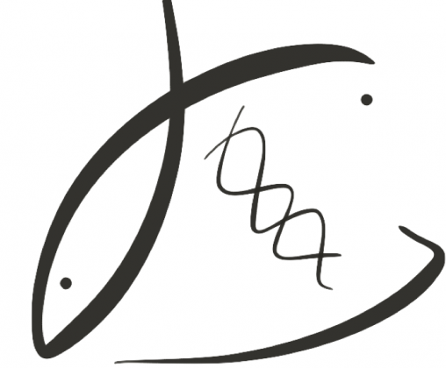
THANK YOU!
P.I.s:
Dr. Steven Roberts
Dr. Pam Jensen
Roberts Lab:
Jay Dimond
Laura Spencer
Shelly Trigg
Brent Vadopalas
Yaamini Venkataraman
Sam White
UW NWGC
bittercrab.science
grace-ac.github.io
Podcast: DecaPod

