Slide 1
Archiving and Sharing Qualitative Data
University of Georgia, QUAL8150 – Kathy Roulston
February 14, 2020
Sebastian Karcher (Qualitative Data Repository)

Slide 2

LDW 2020
#LoveData20
#LoveDataWeek

Slide 3
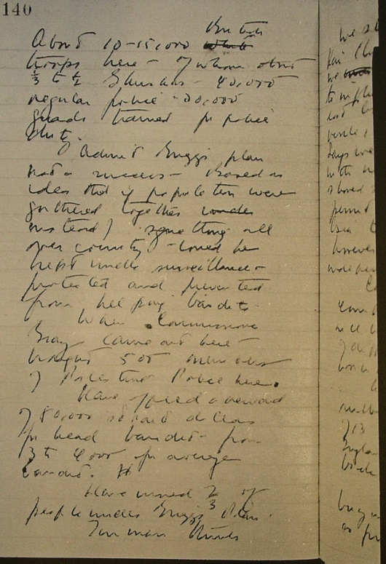
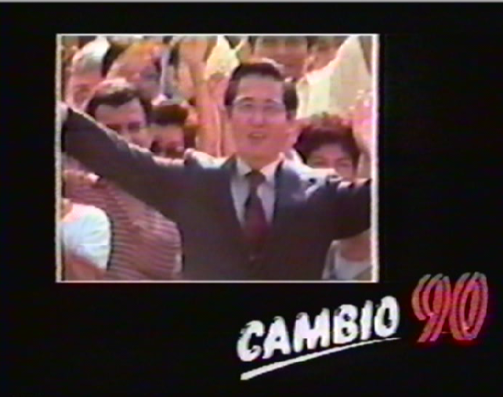
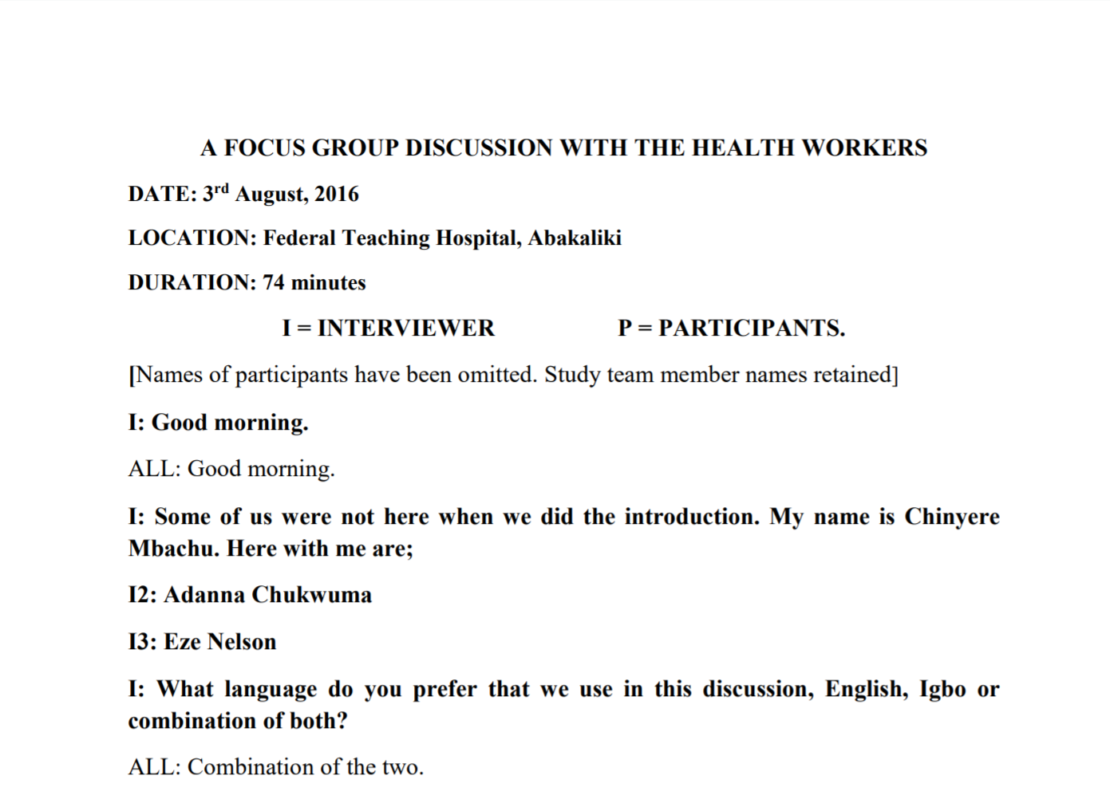
What Is QDR?
Online since 2014: qdr.syr.edu, NSF funded
QDR curates, stores, preserves, publishes, and enables the download of digital data generated through qualitative and multi-method research in the social sciences.
HQ at Syracuse; other team members at Georgetown and UW Seattle
Originated in political science: International and interdisciplinary
Currently 72 data projects published

Slide 4
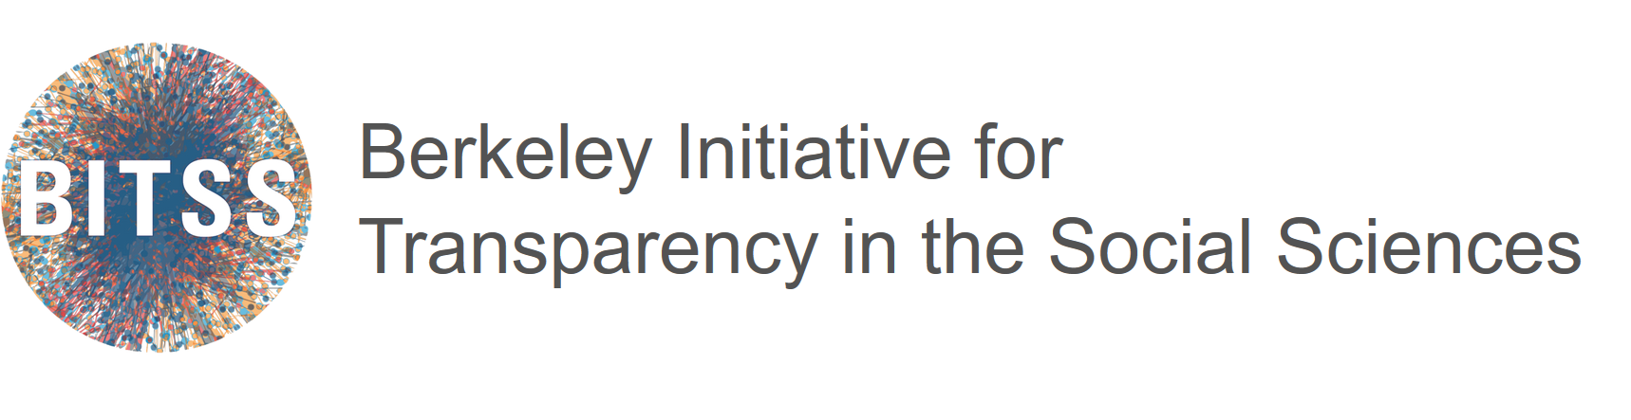
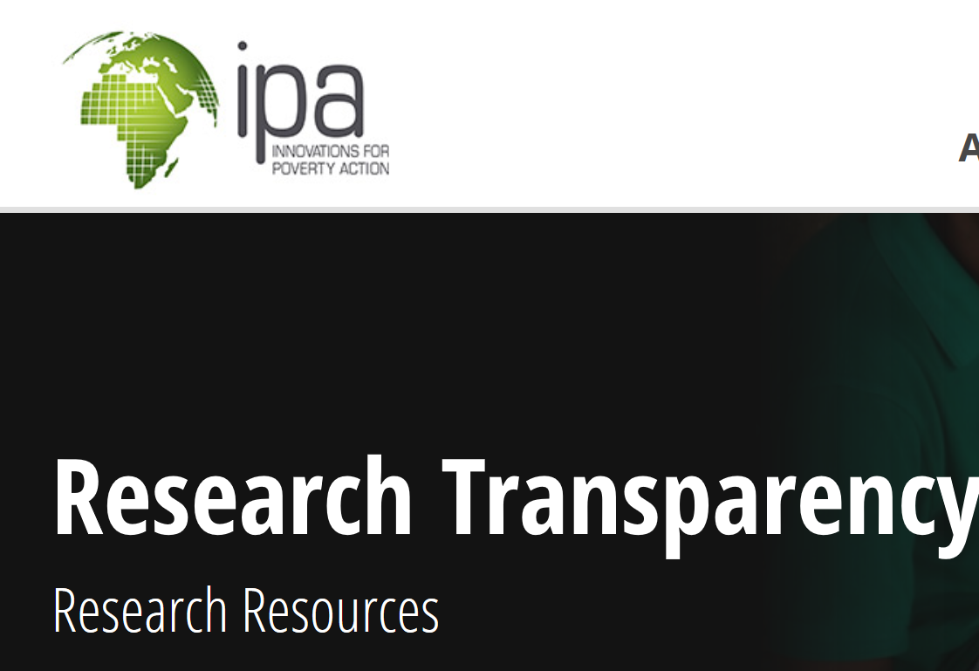
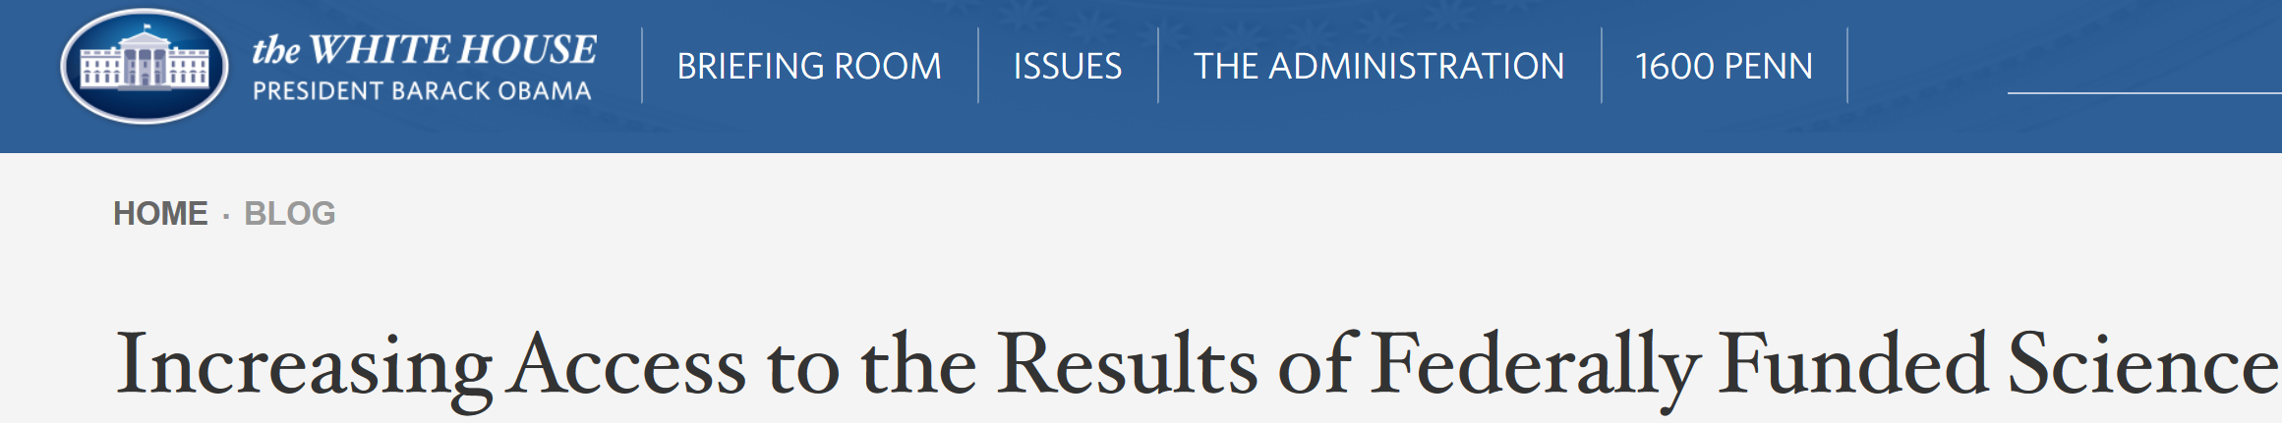
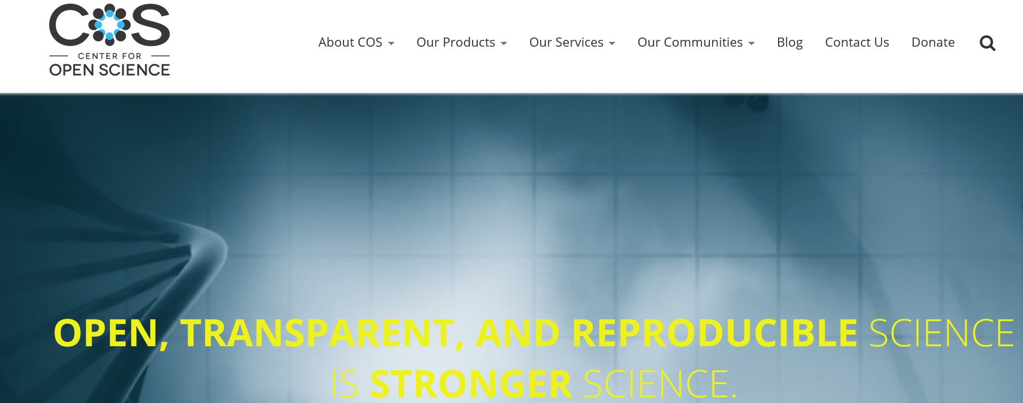
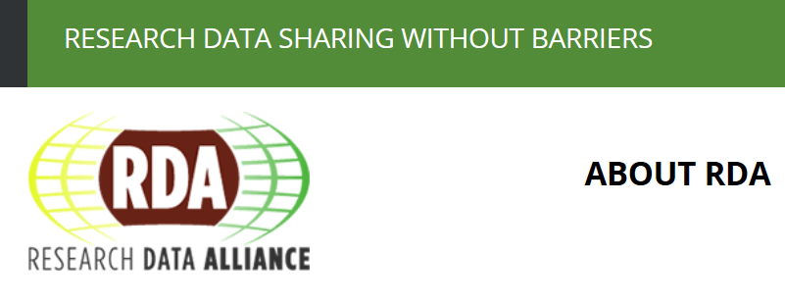
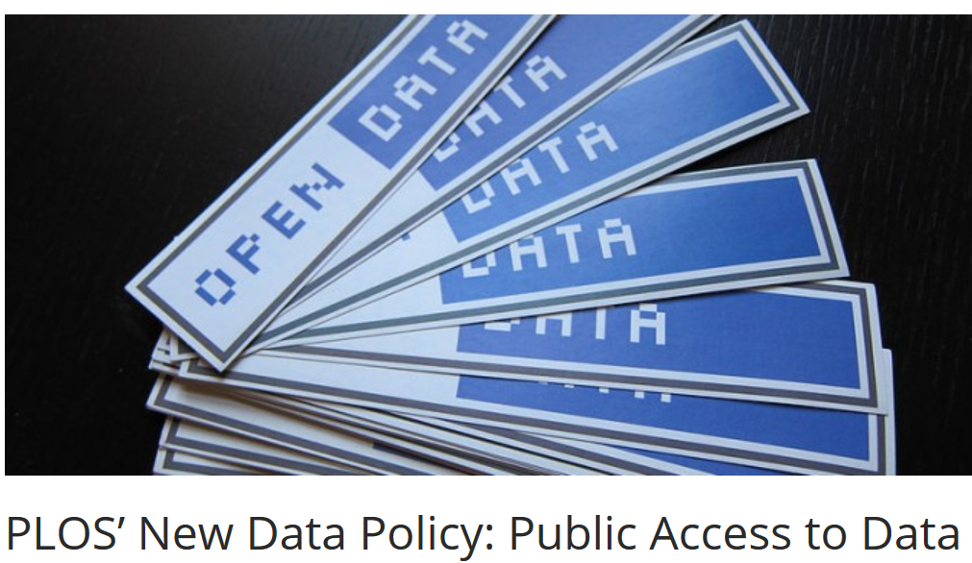
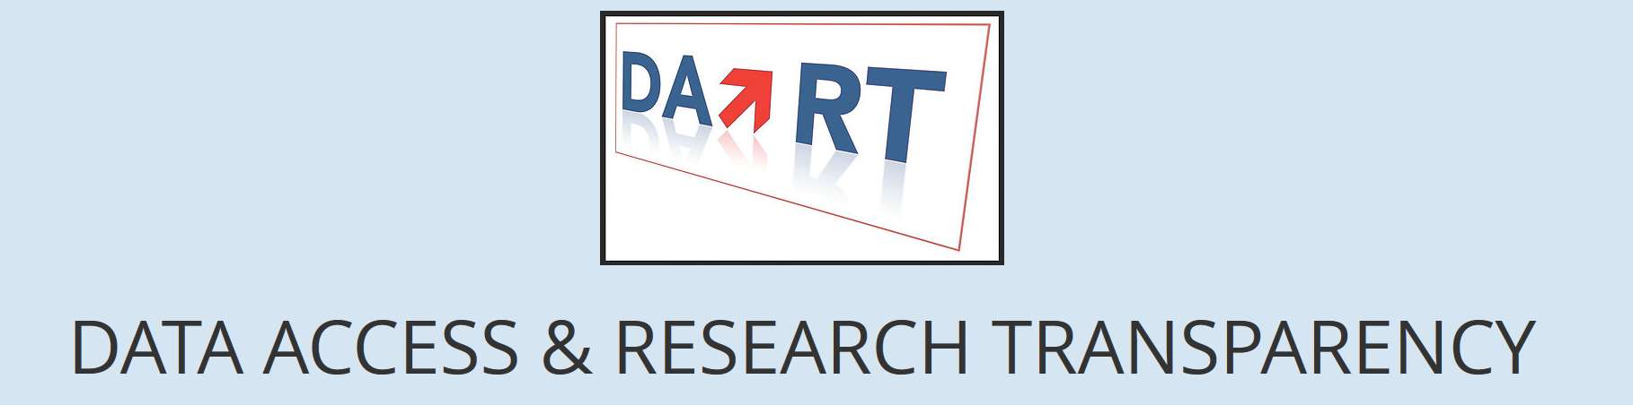
Everyone Talks about Open Data and Transparency

Slide 5
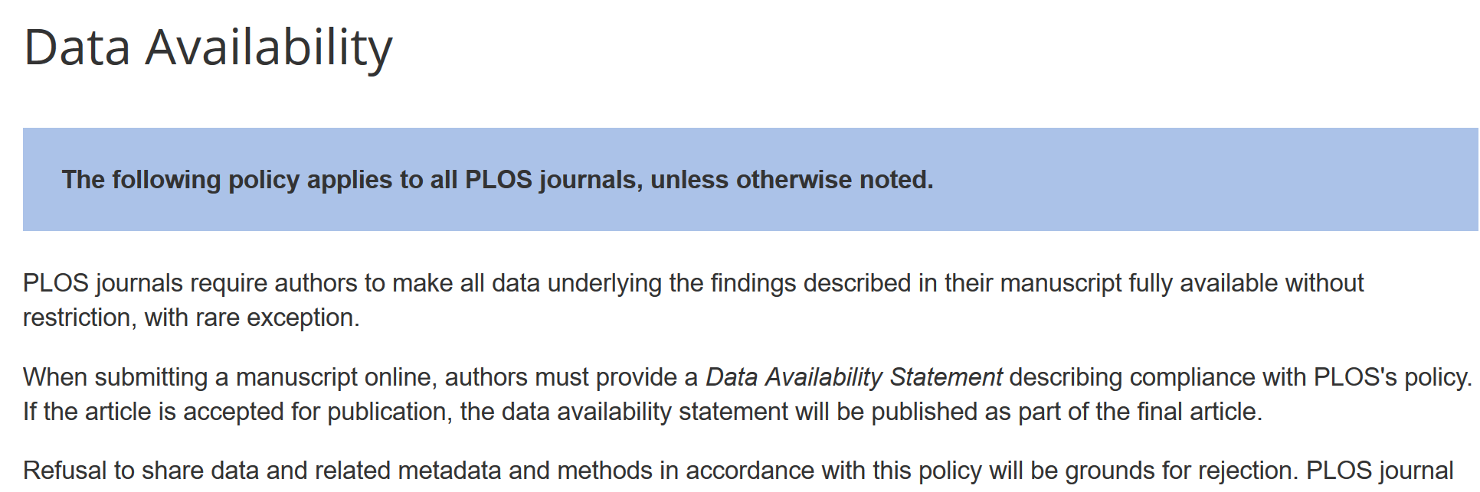
Transparency: Journals
http://journals.plos.org/plosone/s/data-availability

Slide 6
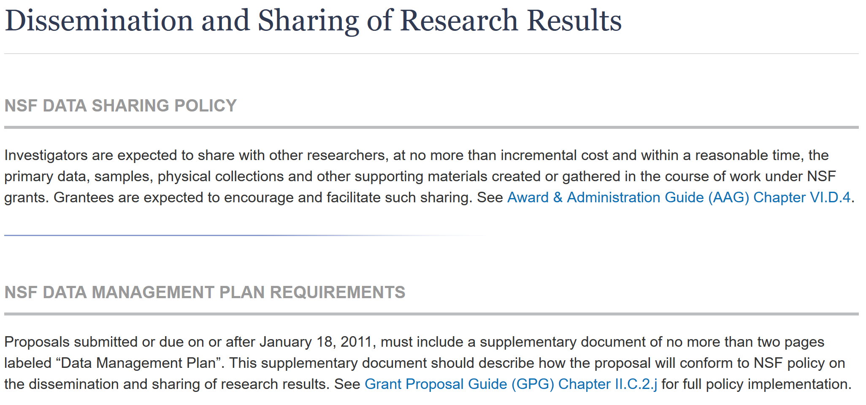
Transparency: Funders
https://www.nsf.gov/bfa/dias/policy/dmp.jsp

Slide 7
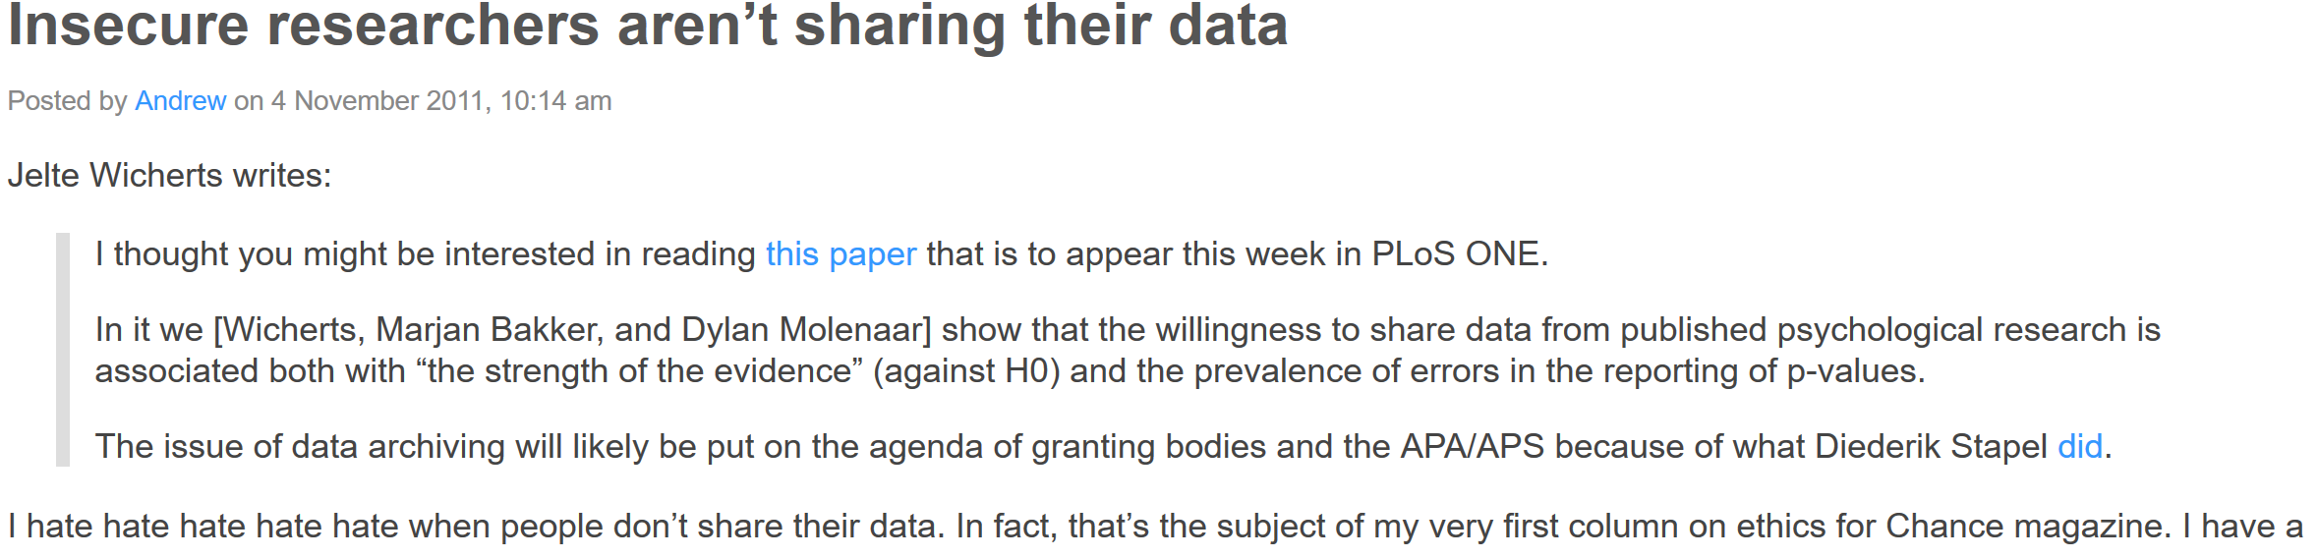
Transparency: Norms
http://andrewgelman.com/2011/11/04/insecure-researchers-arent-sharing-their-data/

Slide 8
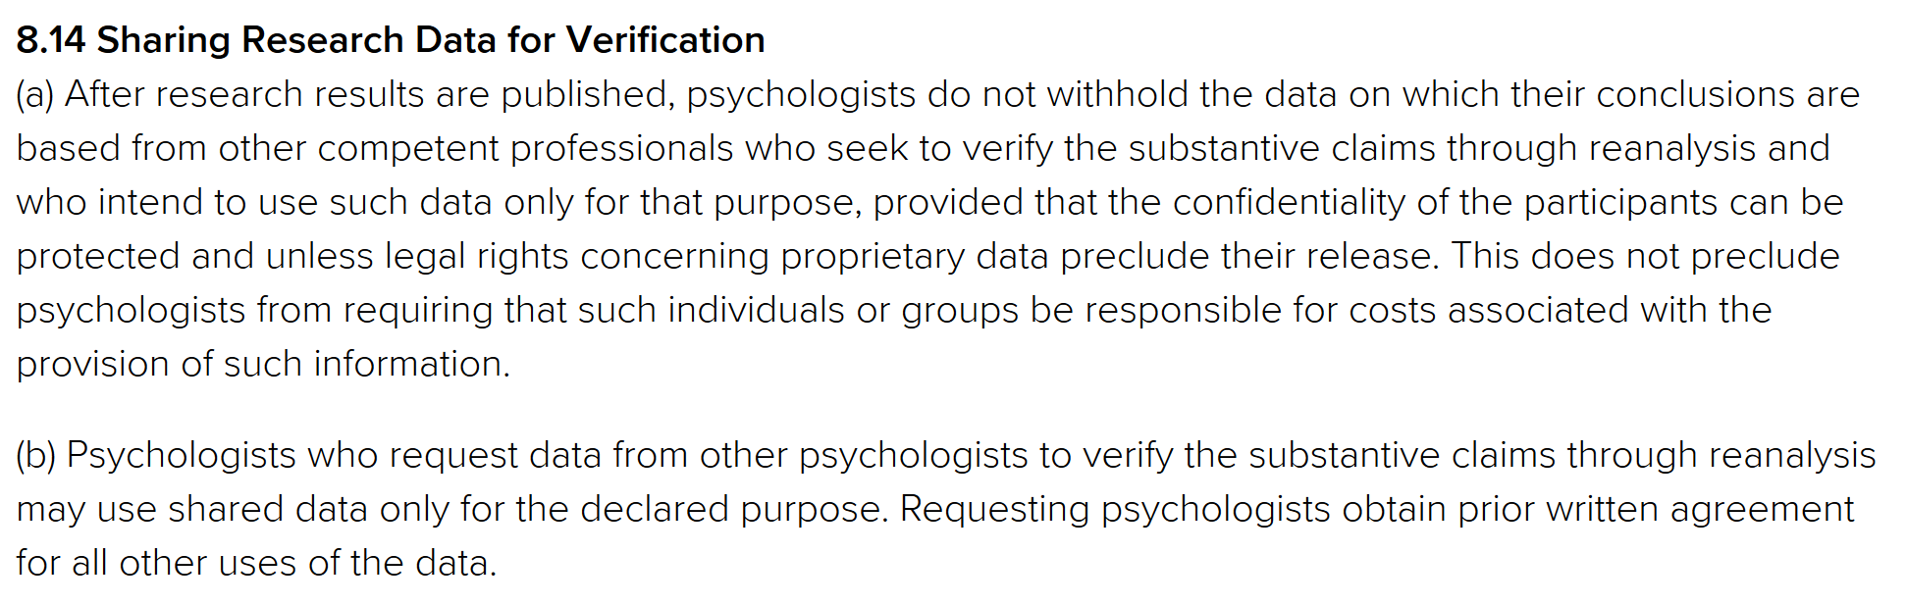
Mandating Transparency:
Academic Organizations
APA Ethics Code: http://www.apa.org/ethics/code/

Slide 9
But What about Sharing Qualitative Data?
Costs / Logistics
Ethical / Legal
Epistemic / Ontological

Slide 10
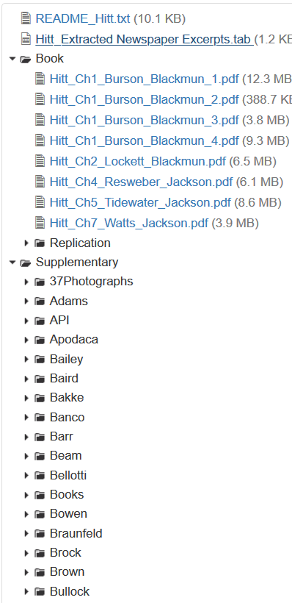
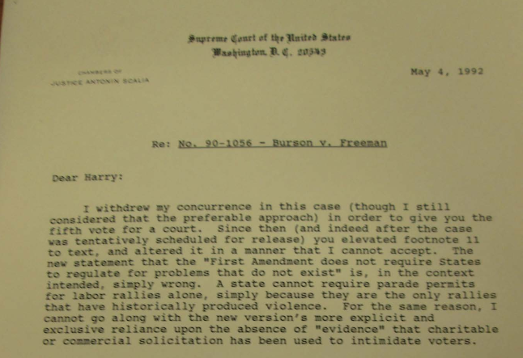
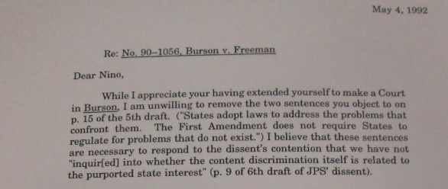
Sharing Archival Data: An Example
Hitt, Matthew. 2019. "Replication Data for: Inconsistency and Indecision in the United States Supreme Court". Qualitative Data Repository. https://doi.org/10.5064/F6W7QRSX

Slide 11
Data Sharing and Copyright
COPYRIGHT – an intellectual property right assigned automatically to the creators of “original works of authorship” (title 17, U.S. Code), which prevents unauthorized copying and publishing of an original product
Who owns copyright?
Copyright and research materials
Interviews and copyright
Clearing copyright – before reproduction, sharing, SDA
Data repositories hold no copyright
Copyright versus Licenses

Slide 12
Fair Use and Public Domain
Fair use exemption = key part of copyright law that permits the unlicensed use of copyrighted material under some circumstances
Fair use claims in research/scholarship
  Transformative
  Not involving a large amount
  Not likely to affect the potential market value of items
  Is used for academic / non-commercial purposes
Public Domain
  US: Government documents
  Copyright has run out:
    unpublished works created before 1898 (i.e., 120 or more years ago) are in the public domain and
    works published before 1923 (i.e., 95 or more years ago) are in the public domain.

Slide 13
Licenses: Beyond Copyright
Gale’s International License:
“The subscribing institutes (“Customer”) and their authorized users, may make a single print, non-electronic copy of a permitted portion of the content for personal, non-commercial, educational purposes only.”
Electronic databases can restrict you from sharing data even when it is in the public domain otherwise

Slide 14
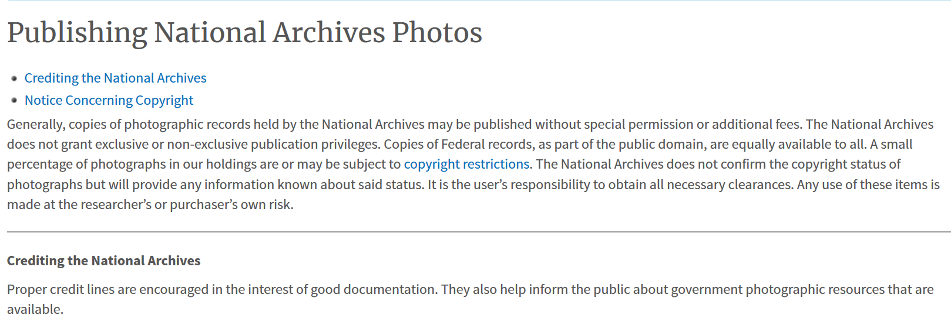
Archives and Sharing Digital Copies
Other archives are much more restrictive

Slide 15
When in Doubt, Ask!
Requesting Permission to Share Archival Materials
(from qdr.syr.edu/guidance/templates )
To whom it may concern,
I am writing to inquire about any rules that [ARCHIVE] may have regarding disseminating documents that I collected there during my research work in [TIME PERIOD].
I am preparing to share, through a trusted data repository, digital copies of some of the documents that I [COPIED / SCANNED / PHOTOGRAPHED] while working at your institution. The documents in questions are from the following collections: [LIST]
Full bibliographic information will be associated with each document when it is shared through the data repository, and credit will be given to the archive as the provider of the original materials. My goals in sharing the documents are (1) to allow other scholars to see the evidence I cite in my [DISSERTATION / ARTICLE / BOOK] and understand better the claims I make based on that evidence, and (2) to provide other scholars an opportunity to use the valuable materials contained in your archive.
Could you please let me know your rules for distribution for the kinds of documents mentioned above, and whether it is necessary for me to obtain formal permission from your institution in order to share digital copies of the documents in the manner described here?

Slide 16
Sharing Data in a Repository
Stable links (Digital Object Identifiers – DOIs)
Longterm digital preservation
Institutional Requirements
Can help you with sharing data well (curation)
Makes data more visible/easier for others to discover, access, cite
Interoperability across disciplines
Access Controls

Slide 17
Types of Data Repositories
Institutional repositories
  E.g. UGA Athenaeum: https://athenaeum.libs.uga.edu/
  Mainly designed for publications, though some take data
Self-deposit repositories
  E.g. Harvard Dataverse, Zenodo, OpenICPSR
  No-cost for access/deposit
  No or minimal curation
Domain repositories
  E.g. QDR, ICPSR
  Curation and assistance

Slide 18
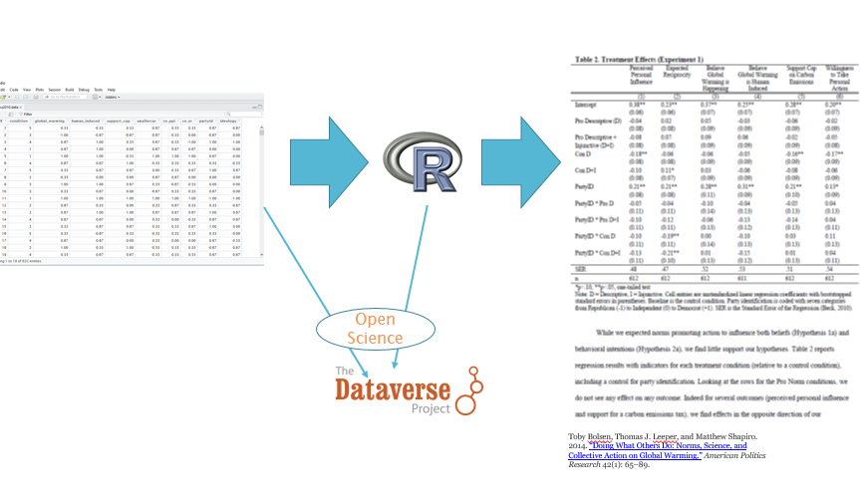
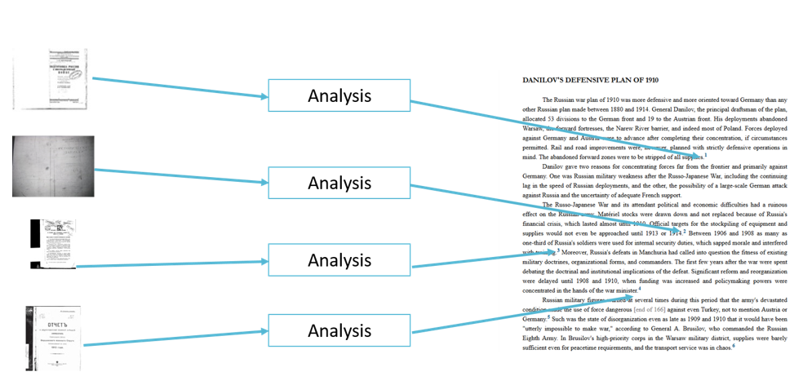
Integrating Shared Data with Publications: The Problem
Quantitative Research
Qualitative Research

Slide 19
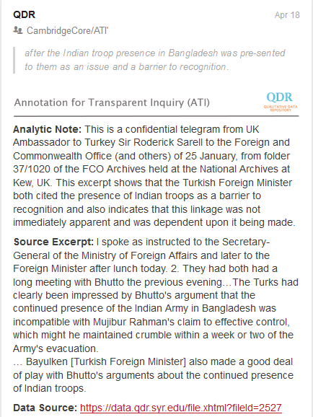
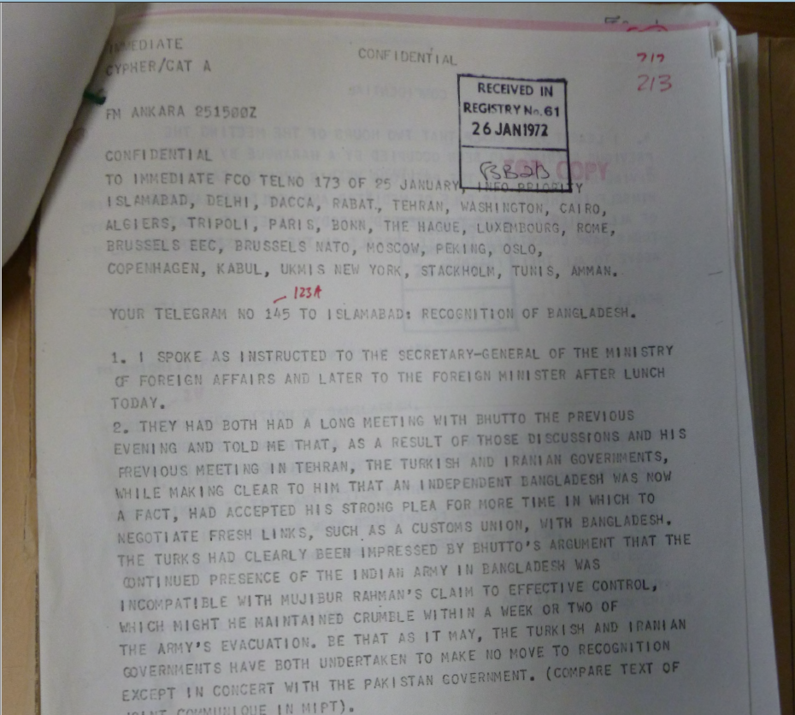
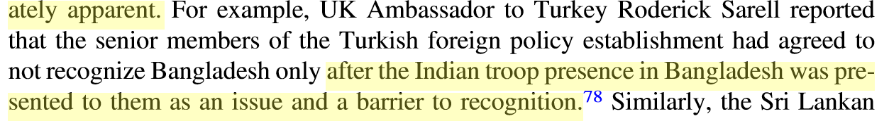
Annotation for Transparent Inquiry (ATI)
Source document
Annotation
Publication
Link: http://bit.do/ati-historical

Slide 20
Some Resource
QDR: https://qdr.syr.edu
Course on Managing Qualitative Research Data
  https://managing-qualitative-data.org
DMPTool for writing data management plans
  https://dmptool.org
QDR Zotero collection with literature
  https://www.zotero.org/groups/487712/qdr_resources

Slide 21
Questions? Stay in Touch
skarcher@syr.edu
Twitter: @qdrepository
Blog: https://qdr.syr.edu/qdr-blog
Available for “one-off” curation, consultation, and pricing for DMPs

