Slide 1
Dashboards for VIVO with Kibana
Qazi Asim Ijaz Ahmad
ahmad.asim@tib.eu Open Science Lab, TIB, Hanover
29 November 2019

Slide 2
Motivation
Data Visualization
Graphical depiction of data
answers “what” kind of questions…
How many publications were published in the last year?
Limited interactivity for dashboards and reports
Visual analytics
Dynamic process where one can quickly build different views to explore infinite paths of “whats,” and the “whys” behind them.
Beyond initial insights
Helps explore, find answers, and build stories in your data
Why visual analytics? Nancy Matthew, Technical Writer, et al.
Notes:
They are good for answering a finite set of questions, and can be static
It even goes beyond those initial insights, so everyone who sees the visualization can ask questions and make unexpected discoveries

Slide 3
Motivation
“On average, between 60% and 73% of all data within an enterprise goes unused for analytics” – Forrester
“Up to 73 Percent of Company Data Goes Unused for Analytics” – INC
Benrattray | Wikimedia Commons
Vector Open Stock - http://www.vectoropenstock.com/
[CC BY-SA 3.0 (https://creativecommons.org/licenses/by-sa/3.0)]
Notes:
Research organizations continuously accumulate huge collections of varied formatted data stored in heterogeneous forms within its organization and partner institutes for different purposes. However, it is uncommon that analytics on the collected data sets are readily available.
According to surveys conducted by different organizations between 60% to 73% of the data within organizations goes unused for analytics.

Slide 4
Motivation
Difficult for researchers or research administration to analyze or generate reports
Insights into the actual output of a research institution are increasingly important for
Funders
Research administration
Policy makers
Third parties
How institutes handle it?
Get data into a commercial product
Build their own system
Manual analysis & reporting
Notes:
This makes it extremely difficult for researchers or research administration to analyze or even filter the data into subsets. Often researchers might end up spending weeks or months of working hours on repeating similar pre-processing steps to answer simple analytical questions.

Slide 5
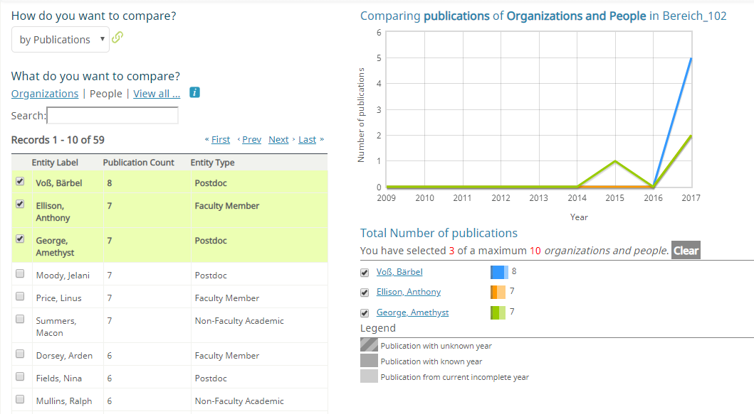
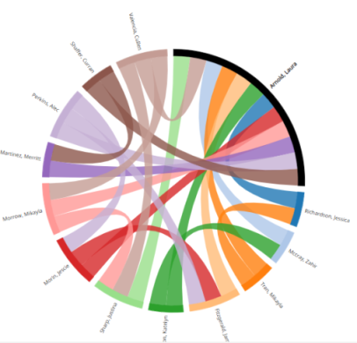
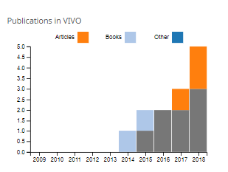
Data Visualization and Reporting in VIVO
Temporal Graph
Publications in VIVO
Co-Author Network
Co-Investigator Network
Capability Map
SPARQL Query
– not sufficient for making comprehensive reports and analytics
Notes:
VIVO by default offers some data visualizations, which might be limited or lacking user needs in the scope of analytics and reporting

Slide 6
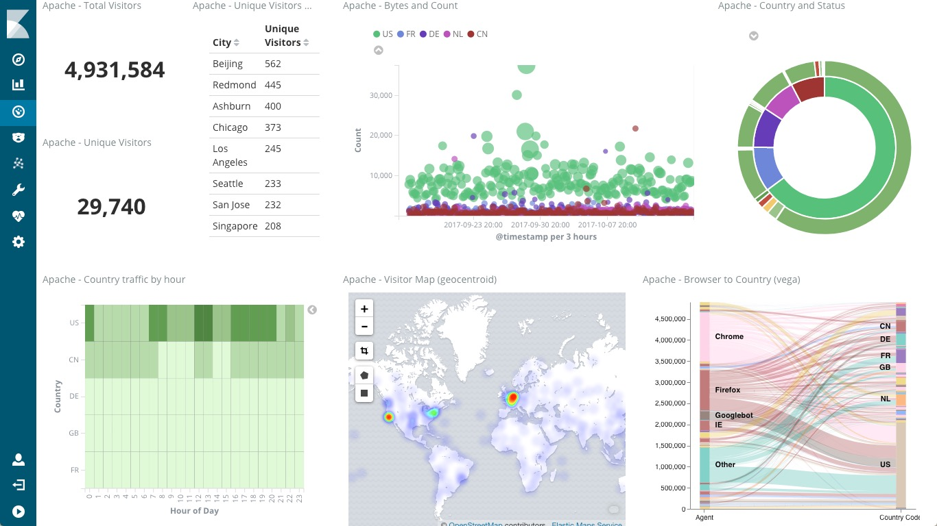
Kibana for Visual Analytics
Open source data analytics and search dashboard for Elasticsearch
Capabilities:
Searching
Analytics
Visualization
Monitoring
Alerts
Machine learning
Why Kibana?
Out-of-the-box data analytics and visualization features
Setup different dashboards within seconds
Notes:
Open source data analytics and search dashboard for Elasticsearch
It provides visualization capabilities on top of the content indexed on an Elasticsearch.
ES is am open source search engine based on Lucene.

Slide 7
VIVO to Kibana
Data Export to Elasticsearch
Externalize the data export process
SPARQL API
Data Distribution API
Extend the VIVO search index
VIVO2Kibana Tool
VIVO
Data export
Elasticsearch
Data visualization
Kibana
Notes:
Open source data analytics and search dashboard for Elasticsearch
It provides visualization capabilities on top of the content indexed on an Elasticsearch.
ES is am open source search engine based on Lucene.
Searching
Analytics
Visualization
Monitoring
Alerts
Machine learning

Slide 8
VIVO to Kibana
Steps towards externalization of data export process
Based on your VIVO ontology formulate
SPARQL queries
Query VIVO
Transform the results to ES friendly JSON
Create an appropriate ES mapping
Index the results
Import the Index in Kibana
Create visualization and dashboards
If data in VIVO is updated, repeat
VIVO
Map/export required data
Elasticsearch
Query, filter, visualize data
Kibana

Slide 9
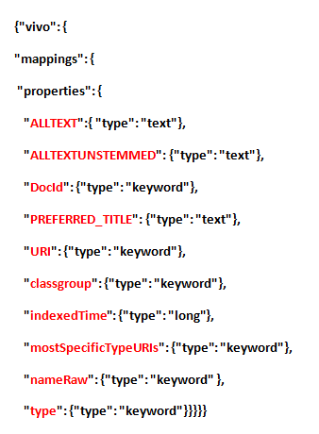
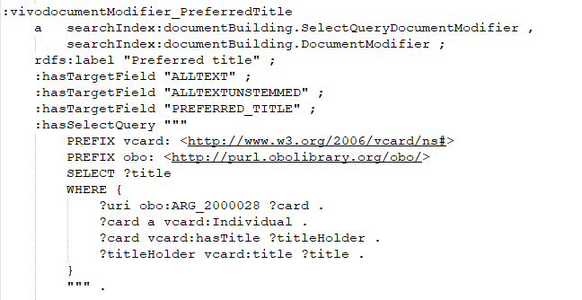
VIVO to Kibana
2. Extend the VIVO Search Index
VIVO
Search Index
Configuration
ES Search Index

Slide 10
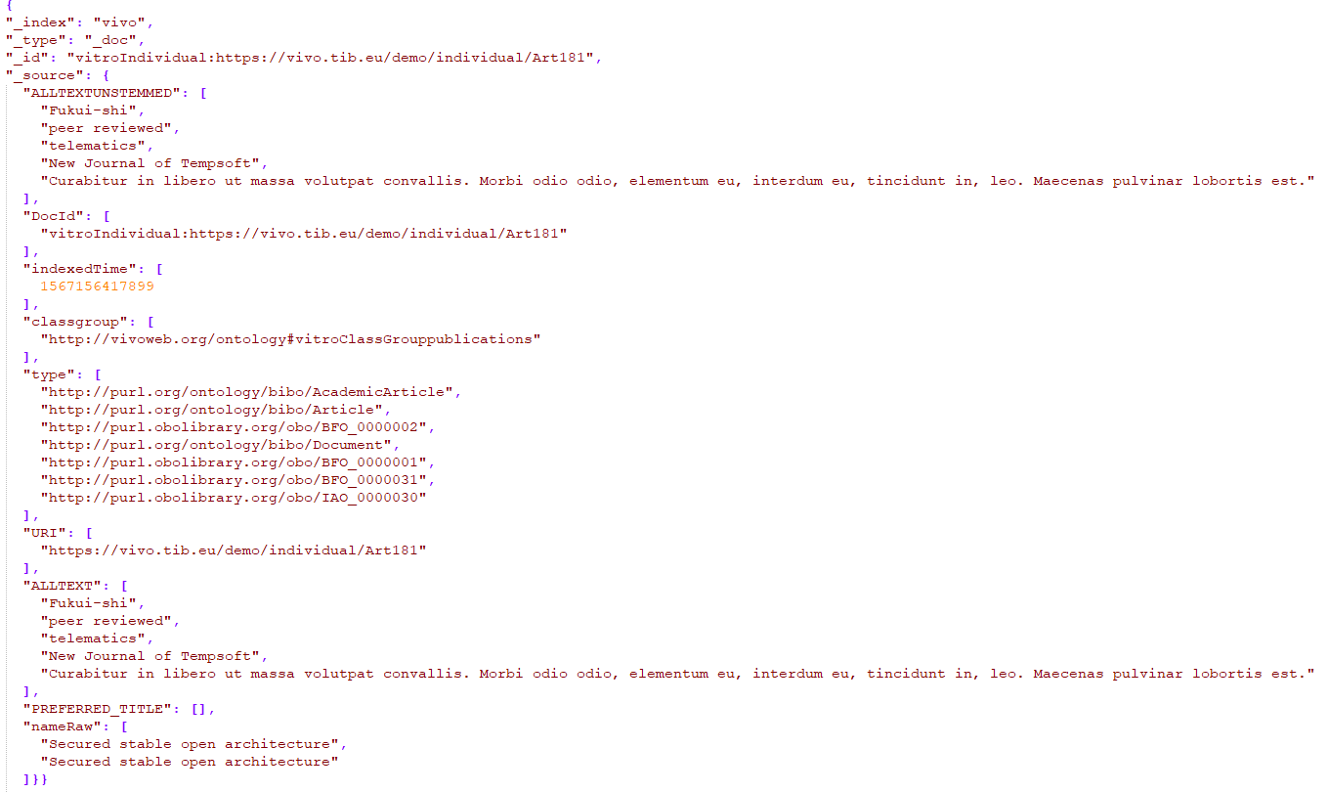
VIVO to Kibana
Extending Search Index

Slide 11
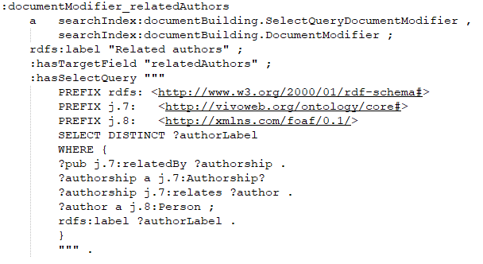
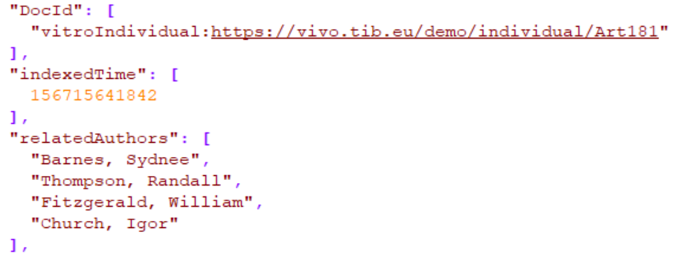
VIVO to Kibana
2. Extend the VIVO Search Index

Slide 12
VIVO2Kibana Tool
VIVO
SPARQL API/Data Distribution API
VIVO2Kibana Tool
Scheduler
SPARQL Queries
Transformer & ES Services
JEST Services
Elasticsearch

Slide 13
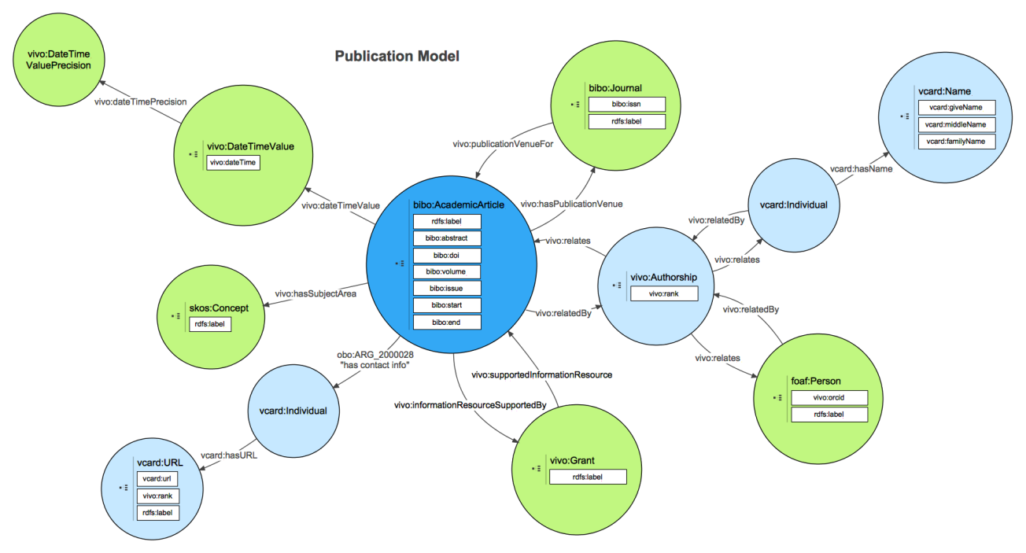
VIVO2Kibana Tool
SPARQL Query Templates
Queries are based on the standard VIVO ontology
Modify queries or create personalized queries
Save all your queries in the specified file
####Publications####
SELECT ?publ ?title ?access ?status ?venueLabel
?date ?authorLabel
WHERE {
?publ a tib-vivo:TIBPublikation ;
bibo:status ?status ;
kdsf-vivo:hatZugriffsrechte ?access ;
vivo:hasPublicationVenue ?venue ;
vivo:dateTimevalue ?dtv ;
vivo:relatedBy ?authorship ;
rdfs:label ?title .
?venue rdfs:label ?venueLabel .
?dtv a vivo:DateTimeValue ;
vivo:dateTime ?date .
?authorship a vivo:Authorship ;
vivo:relates ?author .
?author a foaf:Person ;
rdfs:label ?authorLabel .
}
####
https://wiki.duraspace.org/display/VIVODOC111x/Ontology+Diagrams

Slide 14
VIVO2Kibana Tool
Elasticsearch Map Templates
Mapping templates, for ES 7.1 and onwards, based on the template queries output
Templates can be adopted to previous versions of ES
with some changes
####Publications####
{"mapping":{"properties":{"access":{"type":"text","fields":{"keyword":{"type":"keyword","ignore_above":256}}},"authors":{"properties":{"author":{"type":"text","fields":{"keyword":{"type":"keyword","ignore_above":256}}}}},"pubID":{"type":"text","fields":{"keyword":{"type":"keyword","ignore_above":256}}},"pubType":{"type":"text","fields":{"keyword":{"type":"keyword","ignore_above":256}}},"publications":{"type":"keyword"},"publisher":{"type":"text","fields":{"keyword":{"type":"keyword","ignore_above":256}}},"publisherLabel":{"type":"text","fields":{"keyword":{"type":"keyword","ignore_above":256}}},"status":{"type":"text","fields":{"keyword":{"type":"keyword","ignore_above":256}}},"title":{"type":"text","fields":{"keyword":{"type":"keyword","ignore_above":256}}},"venue":{"type":"text","fields":{"keyword":{"type":"keyword","ignore_above":256}}},"venueLabel":{"type":"text","fields":{"keyword":{"type":"keyword","ignore_above":256}}}}}}
####

Slide 15
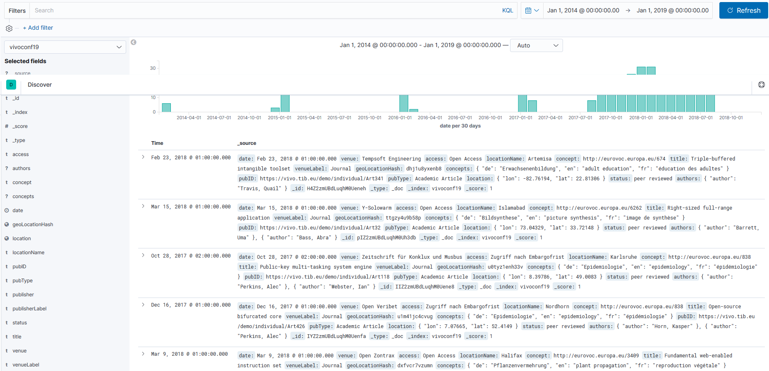
Kibana Visualization & Reporting

Slide 16
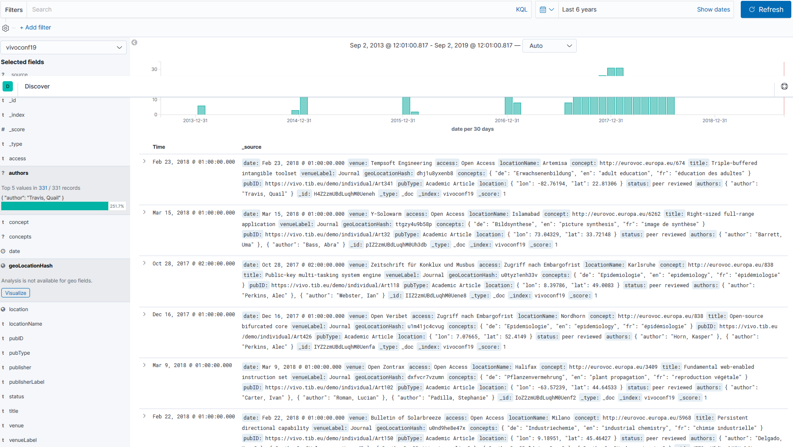
Kibana Visualization & Reporting

Slide 17
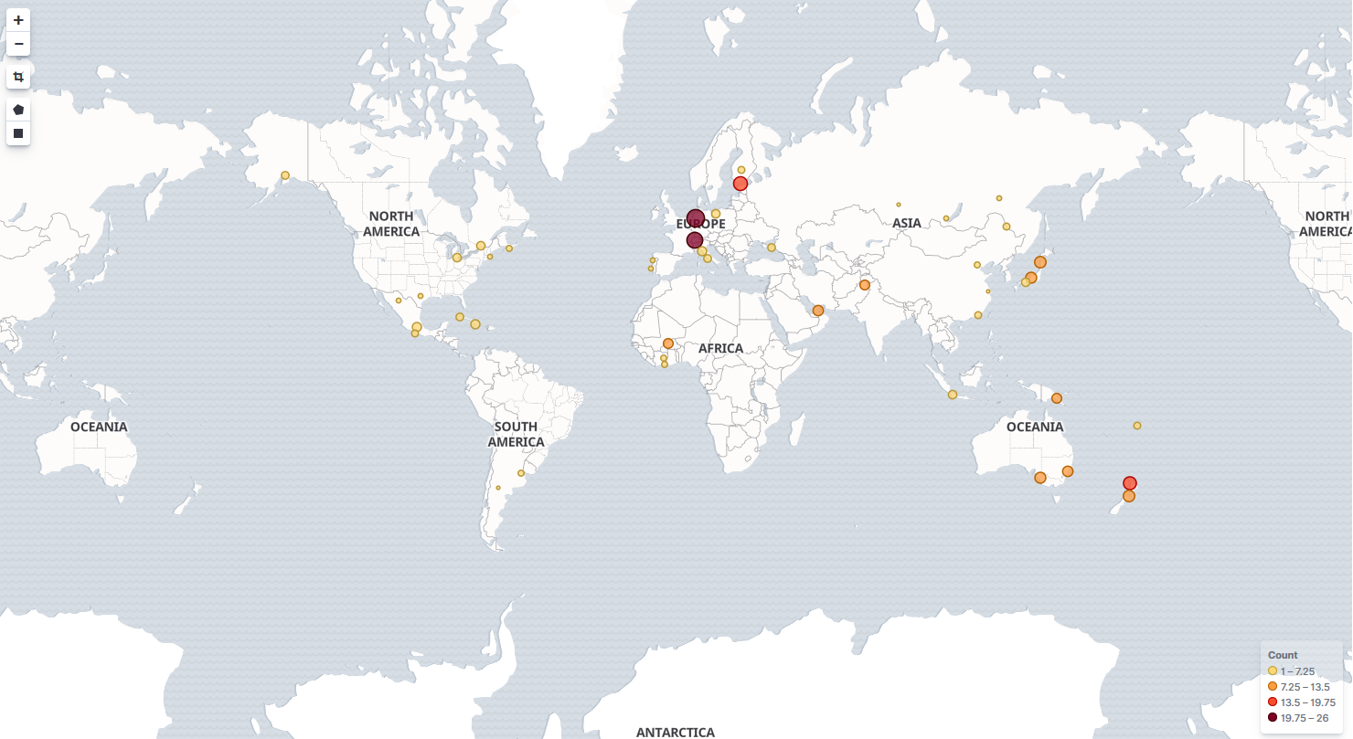
Kibana Visualization & Reporting

Slide 18
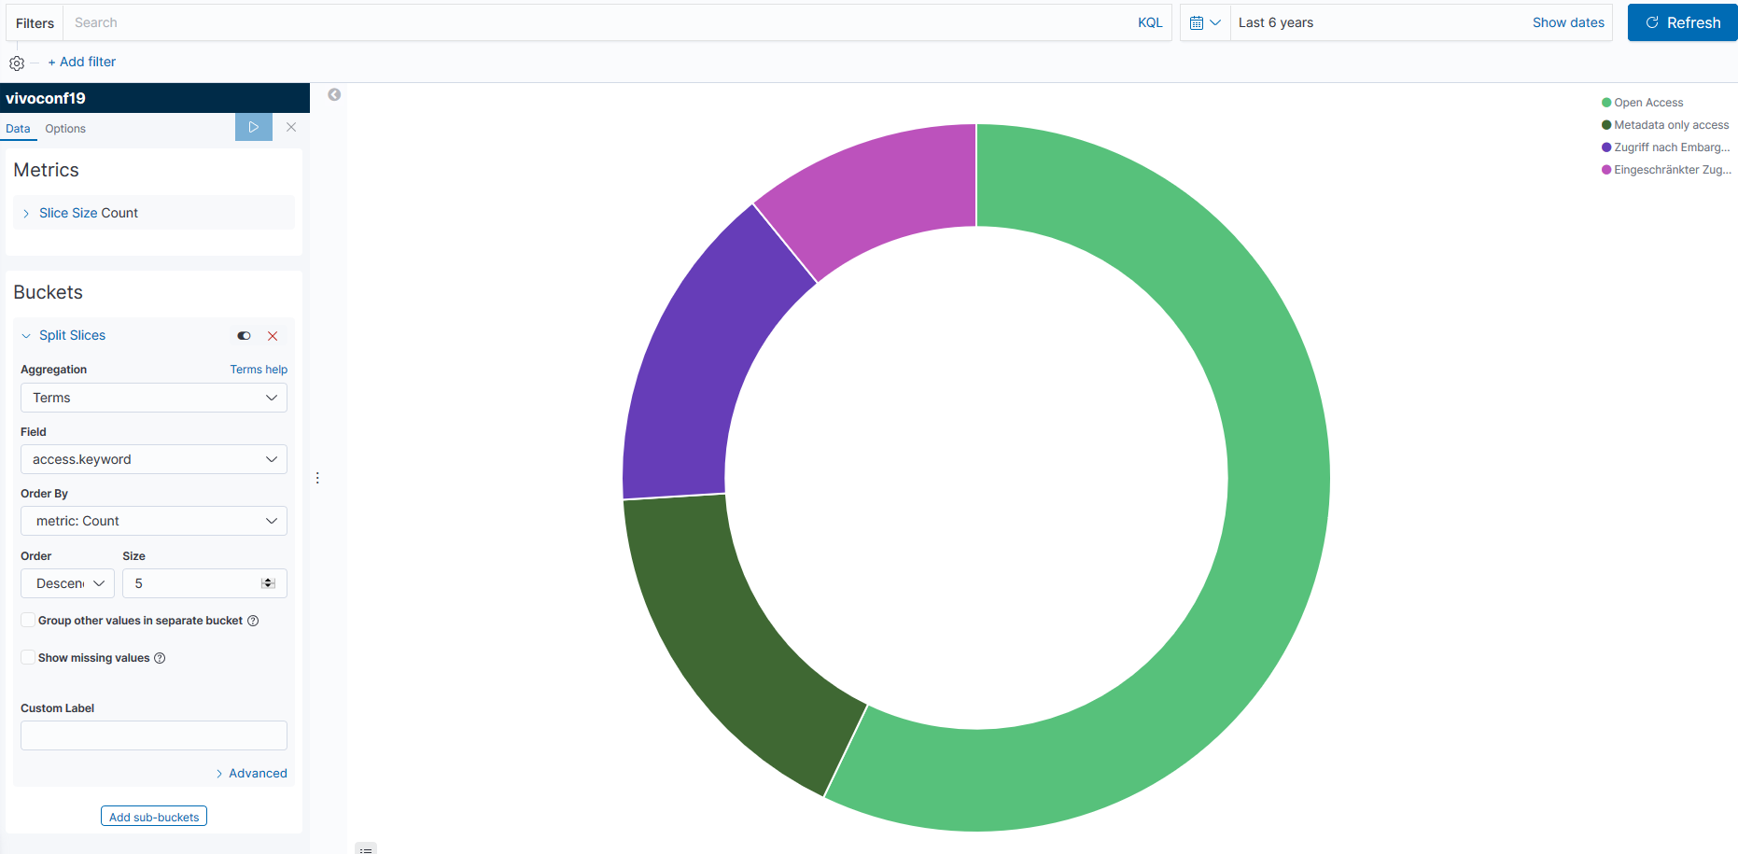
Kibana Visualization & Reporting

Slide 19
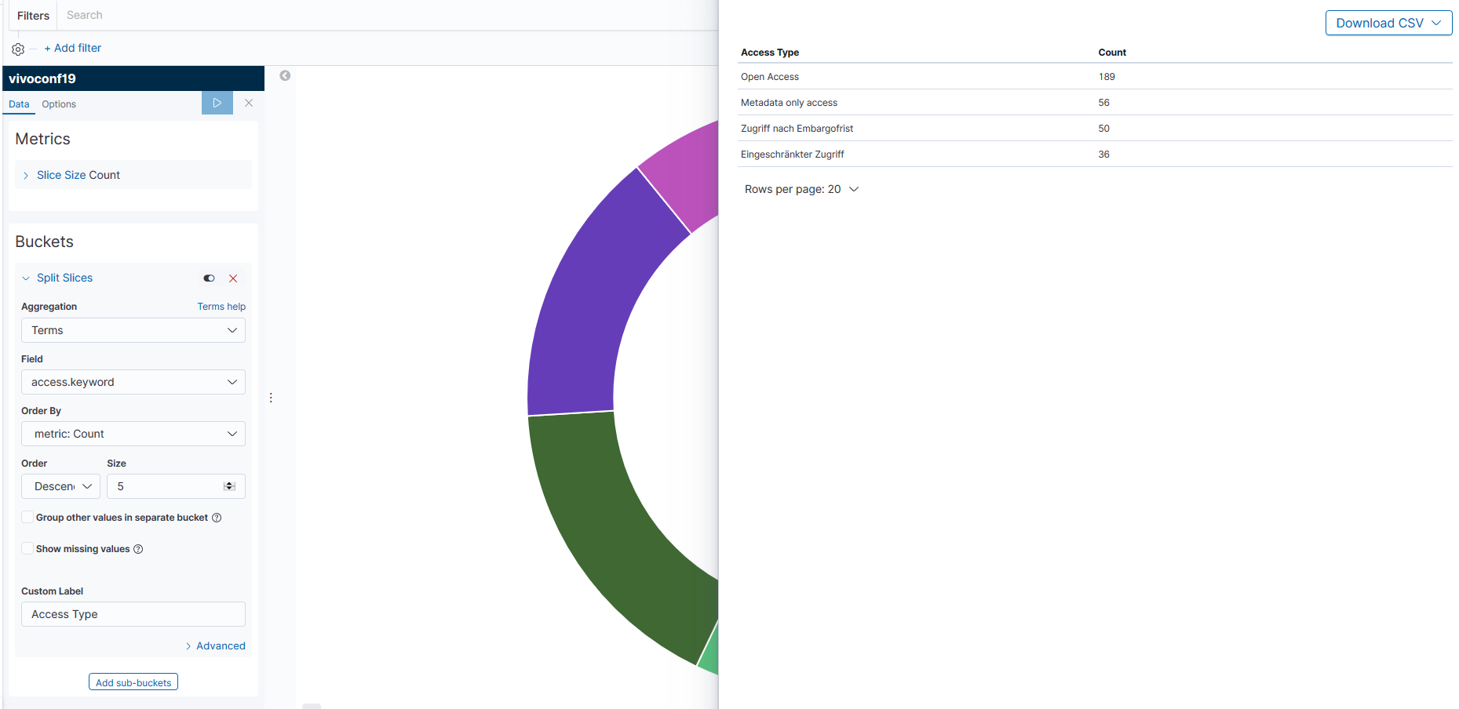
Kibana Visualization & Reporting

Slide 20
Kibana Visualization & Reporting
Example Query: Get me the title of all open access publications, which were published in Hanover, Germany between Feb 2016 and Jan 2019.
Rosaleonie / Wikimedia Commons
Publications
[CC BY-SA 4.0 (https://creativecommons.org/licenses/by-sa/4.0)]
Chris 73 / Wikimedia Commons
Blick vom Maschteich auf die Freitreppe der Gartenfassade, Neues Rathaus, Hannover, Germany
Creative Commons Attribution-Share Alike 3.0 Unported
Nina / Wikimedia Commons
art designer at PLoS, I converted a pdf into svg
CC BY-SA 3.0 (https://creativecommons.org/licenses/by-sa/3.0)

Slide 21
Kibana Visualization & Reporting
Elasticsearch query:
{ "aggs": { „publications":
{ "terms": { "field": "title.keyword", "size": 10,
"order": { "_count": "desc" } } } },
"_source": { "excludes": [] }, "stored_fields": [ "*" ], "script_fields": {}, "docvalue_fields": [ { "field": "date", "format": "date_time" } ],
"query": { "bool": { "must": [
{ "match_phrase": { "access": { "query": "open Access" } } }, {
"range": { "date": { "format": "strict_date_optional_time", "gte": "2016-09-02T00:19:54.175Z", "lte": "2019-01-02T01:19:54.175Z" } } }],
"filter": [ { "bool": {
"should": [ { "match": { "locationName": "Hannover" } } ], "minimum_should_match": 1 } }], "should": [], "must_not": [] } } }

Slide 22
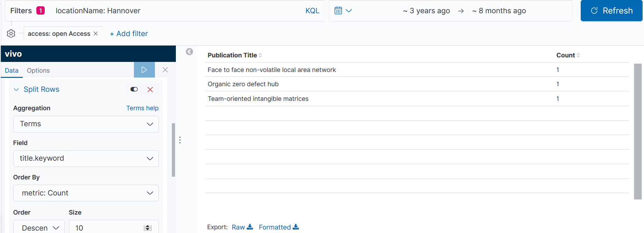
Kibana Visualization & Reporting

Slide 23
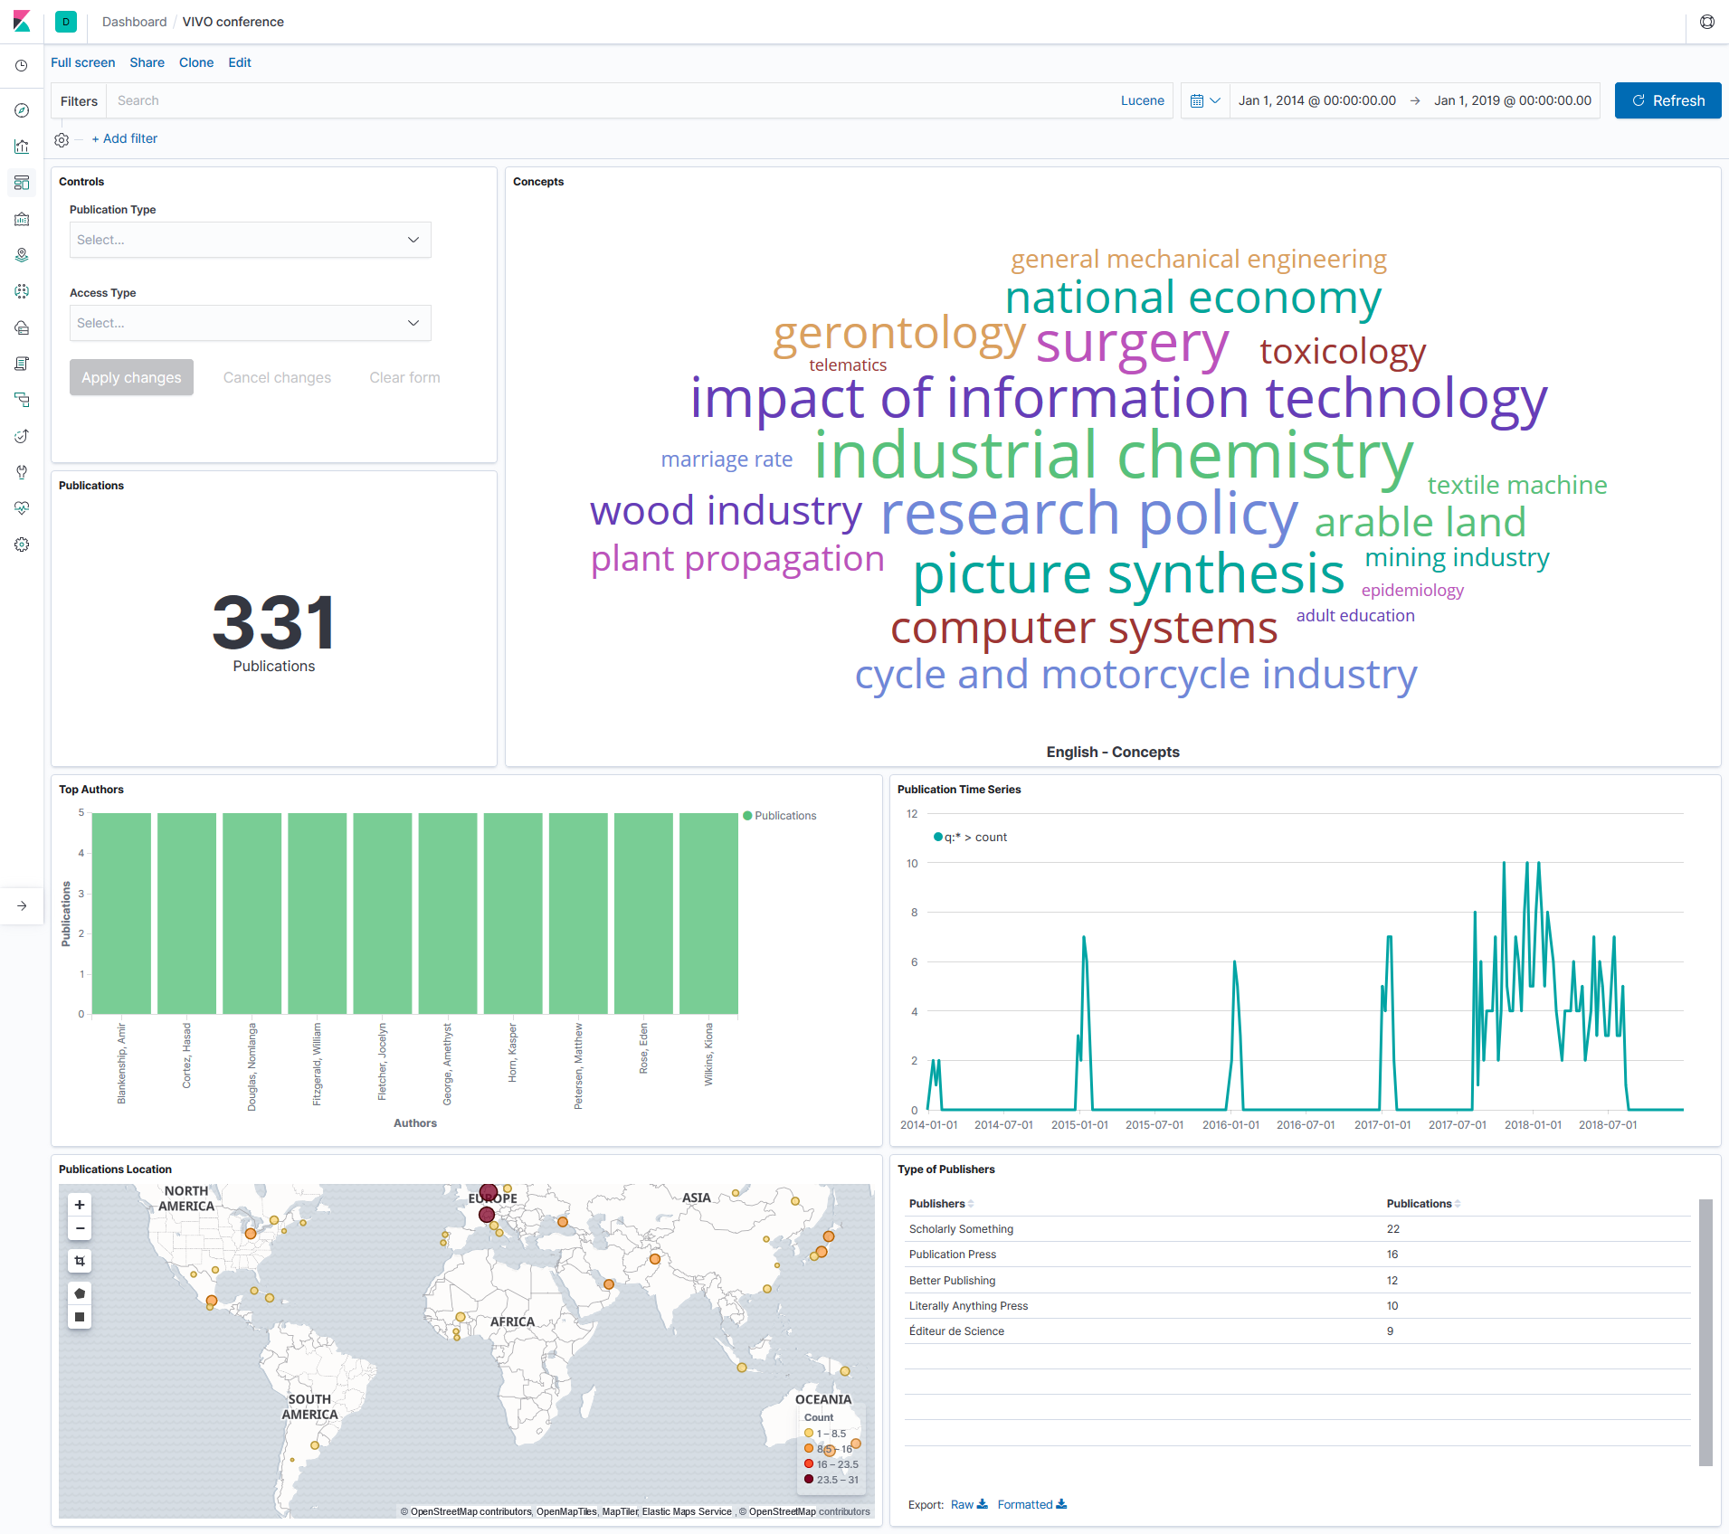
Kibana Visualization & Reporting

Slide 24
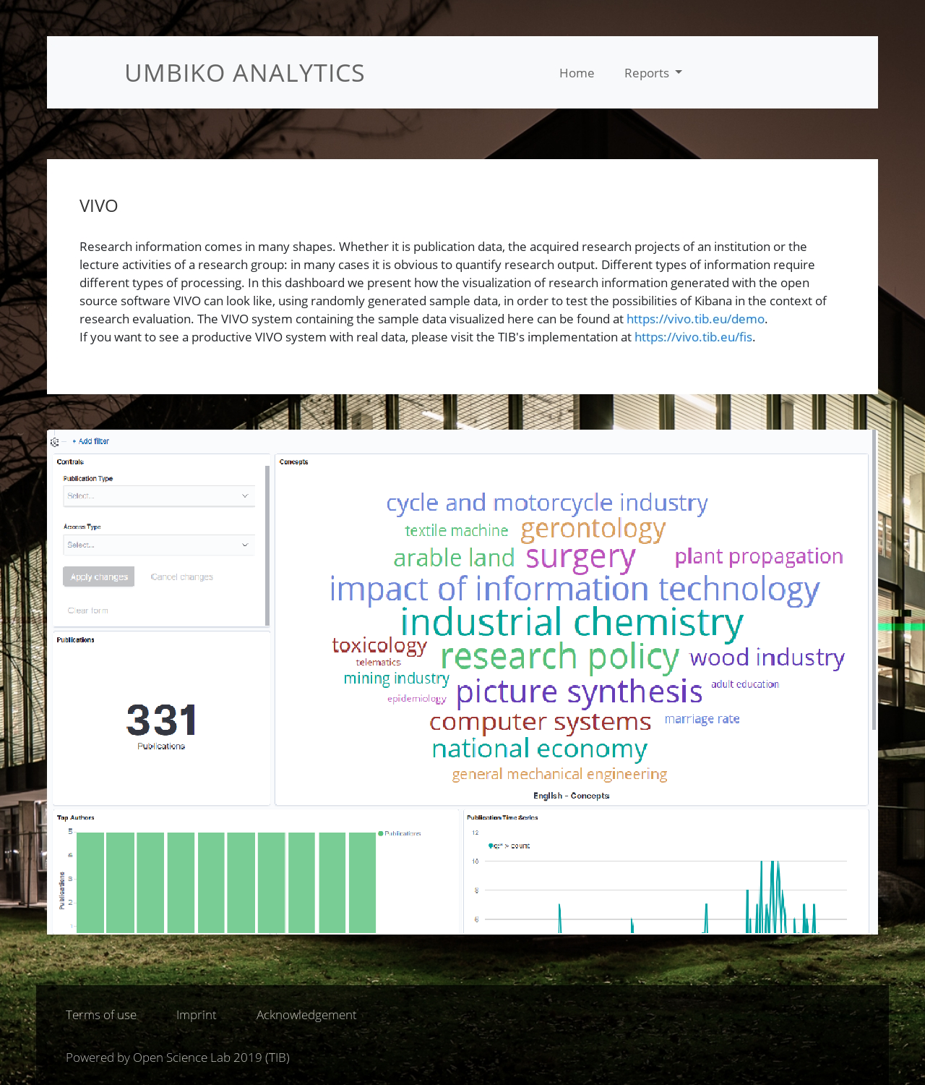
Export and Embed Dashboards
https://labs.tib.eu/umbiko/

Slide 25
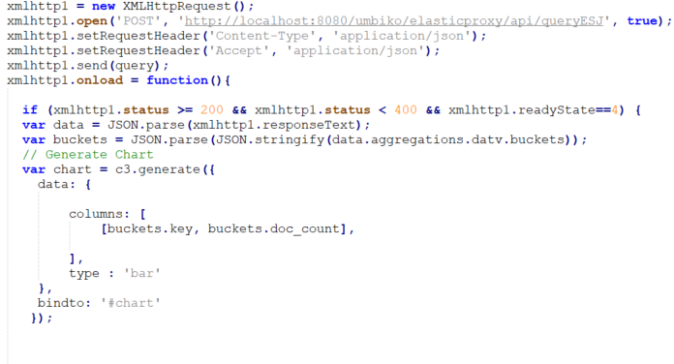
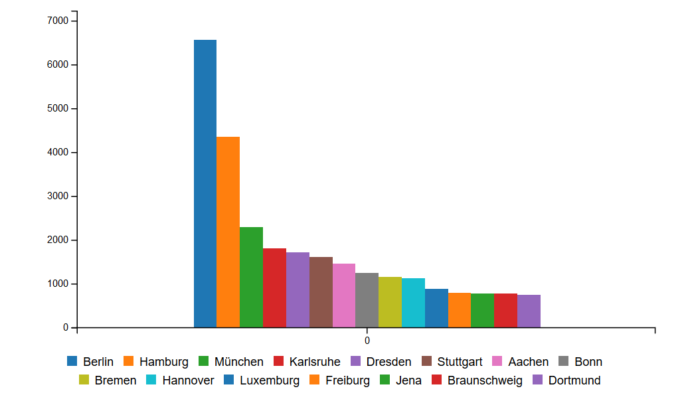
What more?
Include Kibana Plugins
Use any visualization library, e.g., the JavaScript D3, C3 library, to create your own visualization or create tables
Example using C3 - JavaScript

Slide 26
Querying Elasticsearch
Elasticsearch Proxy:
Java Tomcat application
Allows querying via API
Returns results from Elasticsearch
User/App
Query
Publically hosted Elasticsearch Proxy
Returns results
Only allow search
queries
Locally hosted Elasticsearch
{"index":"Index_Name","q":{Elasticsearch_Query}}
https://github.com/Asimq/elasticwebproxy

Slide 27
VIVO2Kibana Tool
Your ideas for the tool?
What would you prefer?
What else should be included in the tool?
Configuration UI vs editing files?
SPARQL API setup
Elasticsearch settings
Access to template queries and mappings
Template Kibana dashboards and visualizations?

Slide 28
Thanks!
Qazi Asim Ijaz Ahmad
ahmad.asim@tib.eu
https://labs.tib.eu/umbiko/

