Slide 1
Mark Hahnel, CEO
@MarkHahnel

Slide 2
About Figshare
Figshare is a cloud-based platform for storing, sharing, and discovering research outputs.
Figshare.com
Notes:
Trusted by over 100 institutions, publishers, funders, and labs all over the world.

Slide 3
Figshare’s beliefs https://knowledge.figshare.com/articles/item/mission-statement-and-core-beliefs
Academic research outputs should be as open as possible, as closed as necessary
Academic research outputs should never be behind a paywall
Academic research outputs should be human and machine readable/query-able
Academic infrastructure should be interchangeable
Academic researchers should never have to put the same information into multiple systems at the same institution
Identifiers for everything
The impact of research is independent of where it is published and what type of output it is

Slide 4
The State of Open Data

Slide 5
This year’s survey received a record number of survey participants with around 8,500 responses from the research community.
While most trends are encouraging around the adoption and acceptance of open data, the research community is now demanding more enforcement of the mandates that have been adopted by many governments, funders, publishers and institutions around the world.
https://doi.org/10.6084/m9.figshare.9980783.v2
Notes:
Figshare open data survey

Slide 6
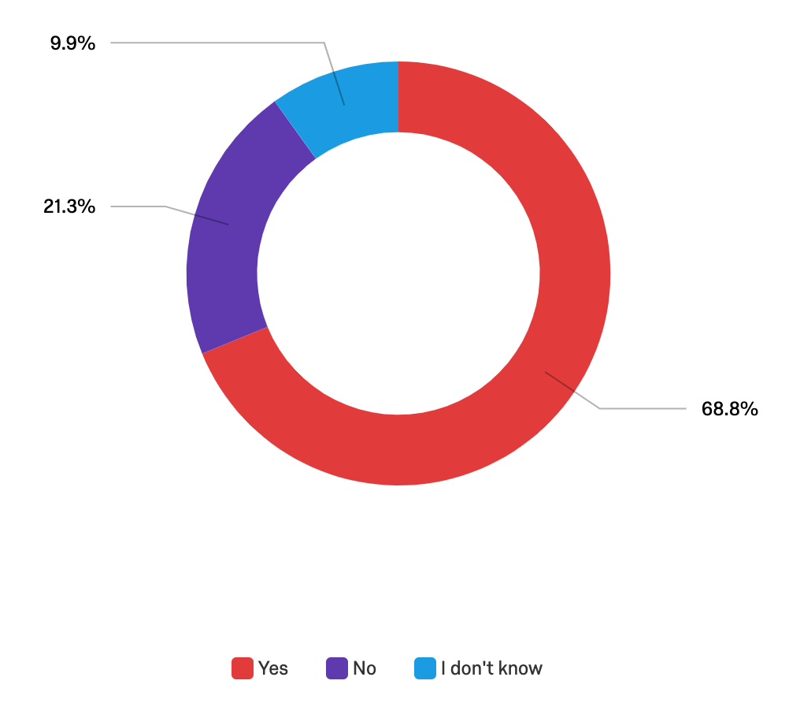
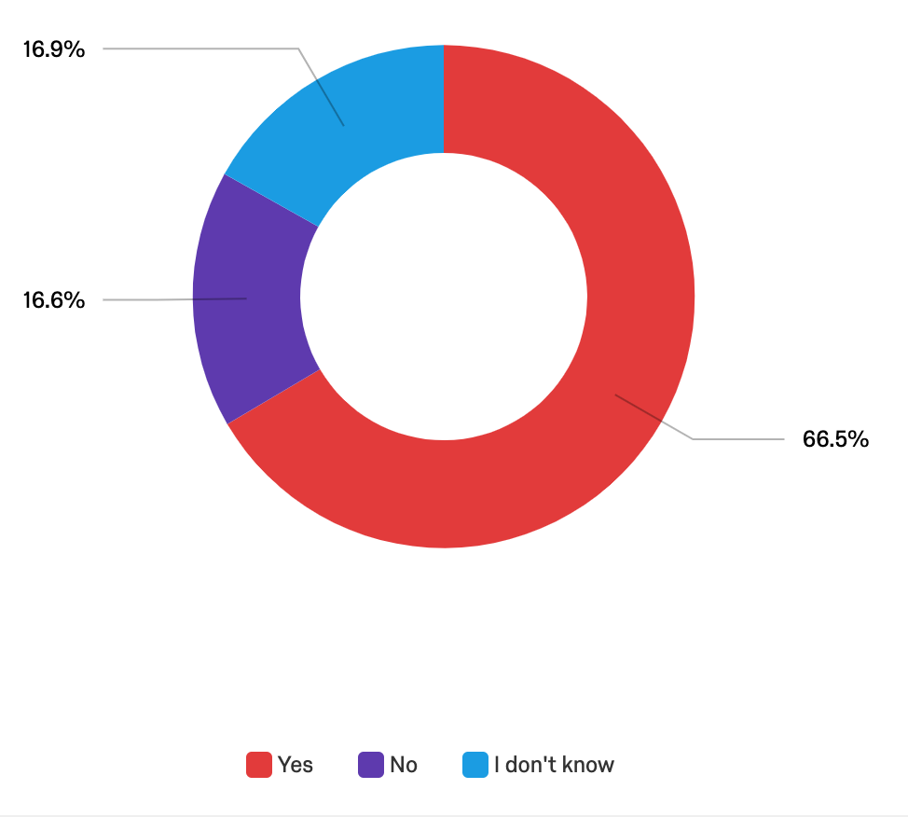
Should funders make the sharing of research data part of their requirements for awarding grants?
Should funders withhold funding from (or penalise in other ways) researchers who do not share their data if the funder has mandated that they do so?
Notes:
test

Slide 7
+
=
Notes:
Publishers
Institutions
Funders
Now figshare is a managed infrastructure for different types of research data publishing and management.

Slide 8
+
=
+
Notes:
Publishers
Institutions
Funders
Now figshare is a managed infrastructure for different types of research data publishing and management.

Slide 9
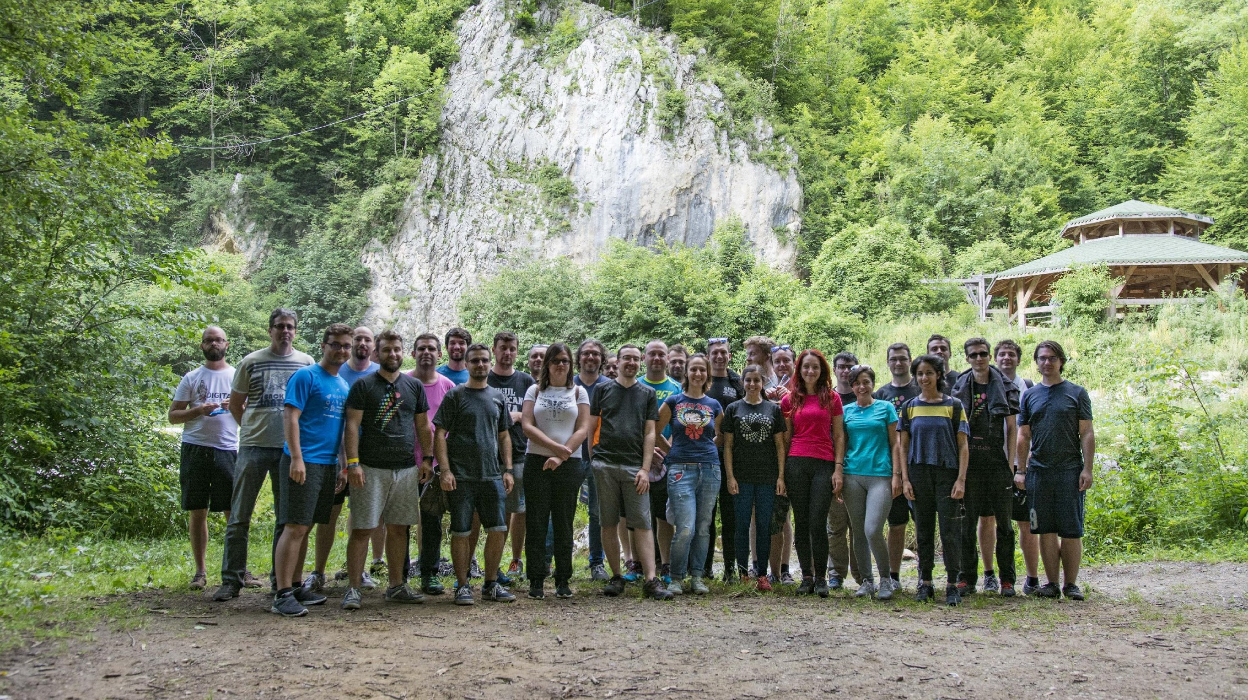
Notes:
Who build Figshare
Librarians
Data Curators
Developers
Life Science PhDs

Slide 10
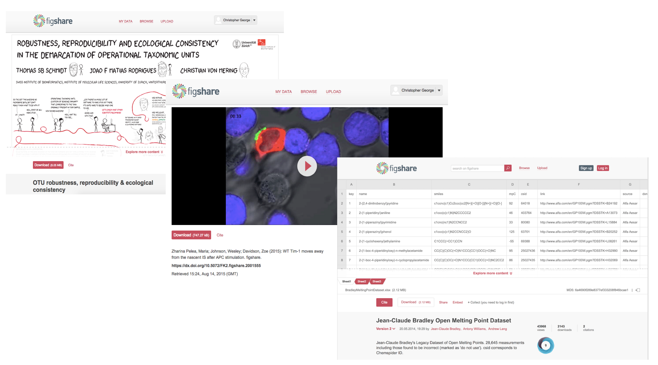

Slide 11
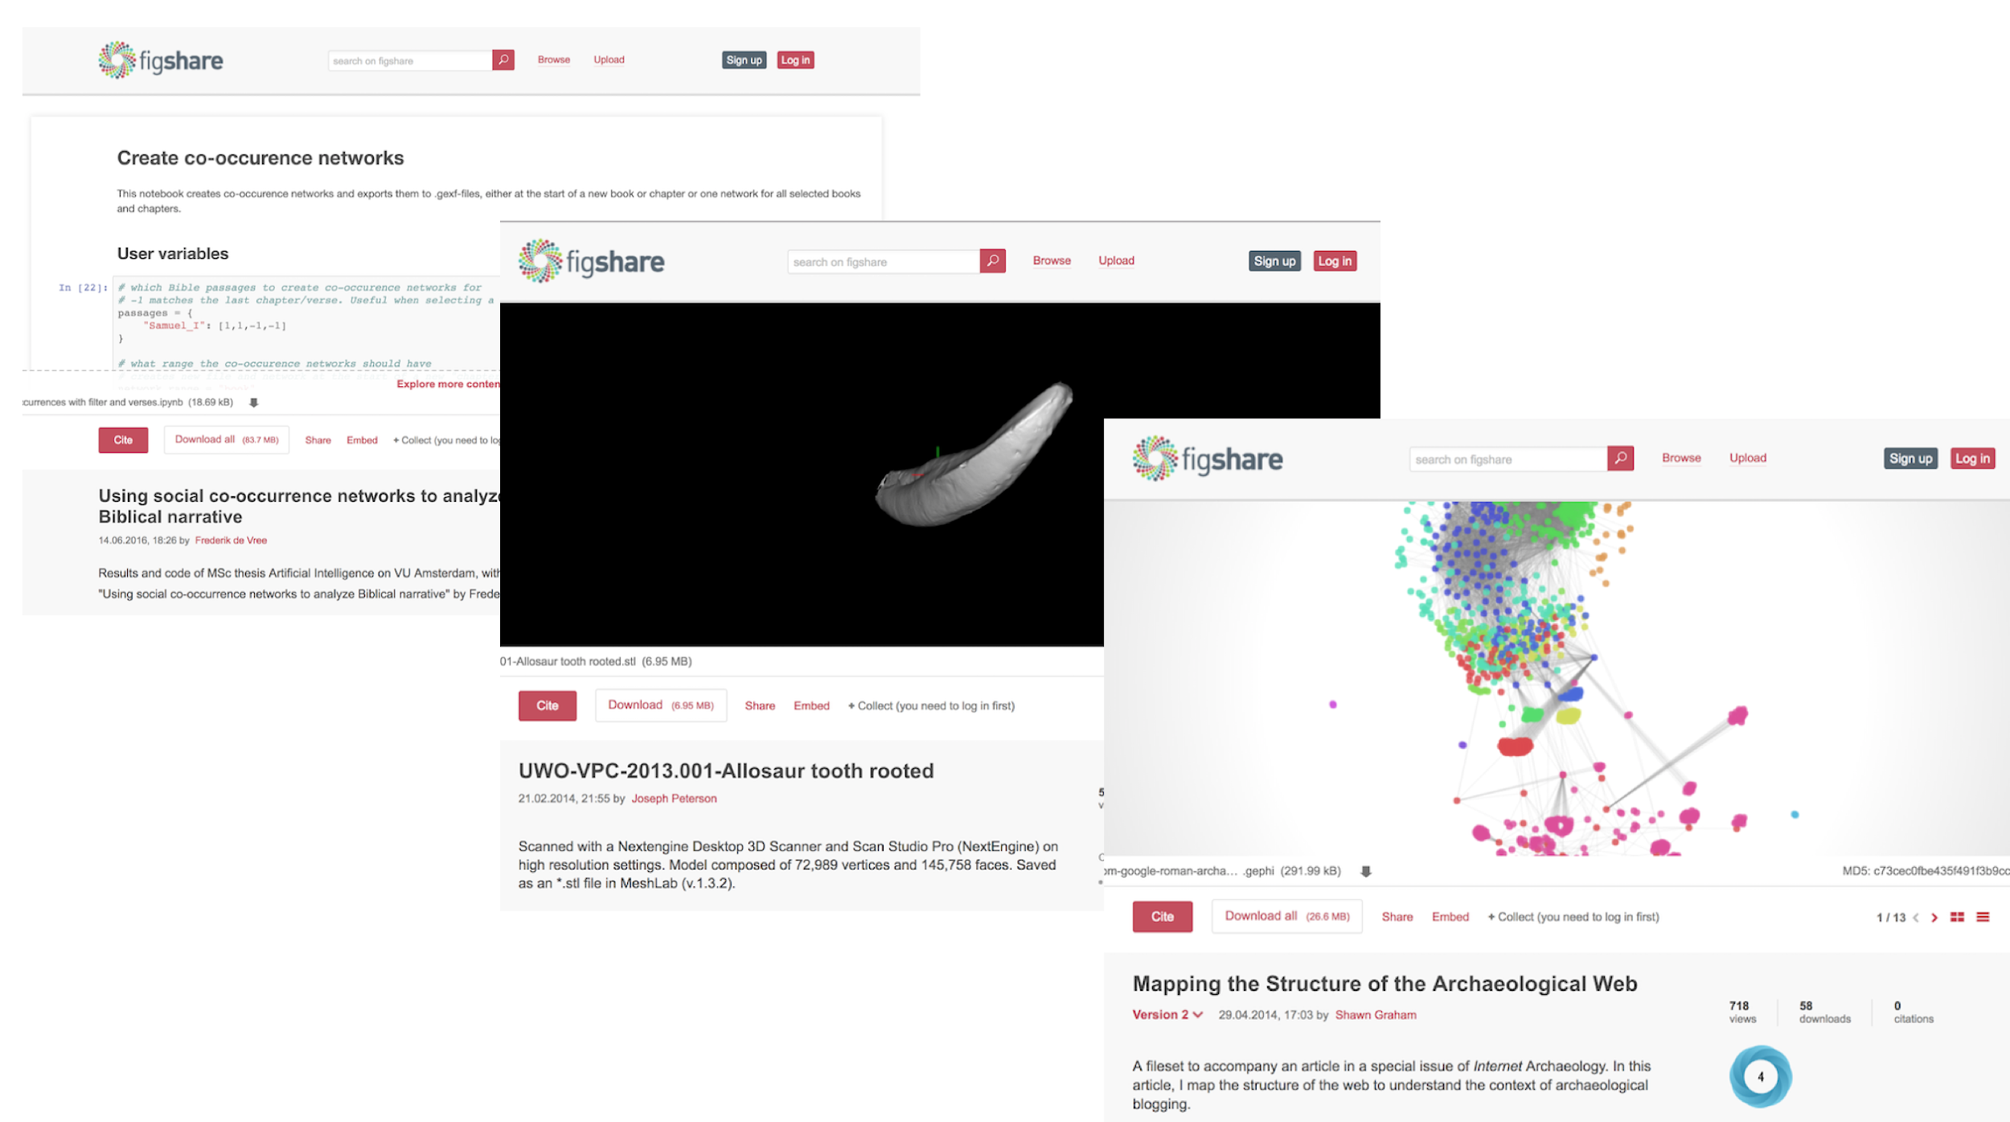

Slide 12
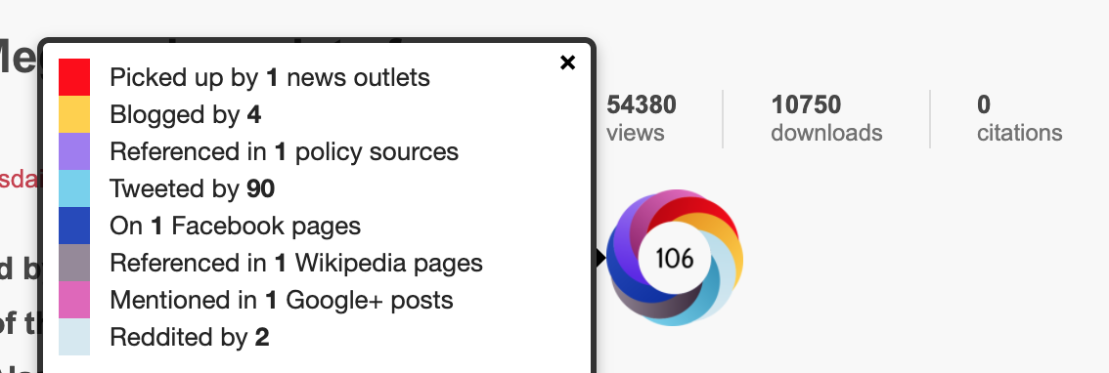
Citations
Altmetrics

Slide 13
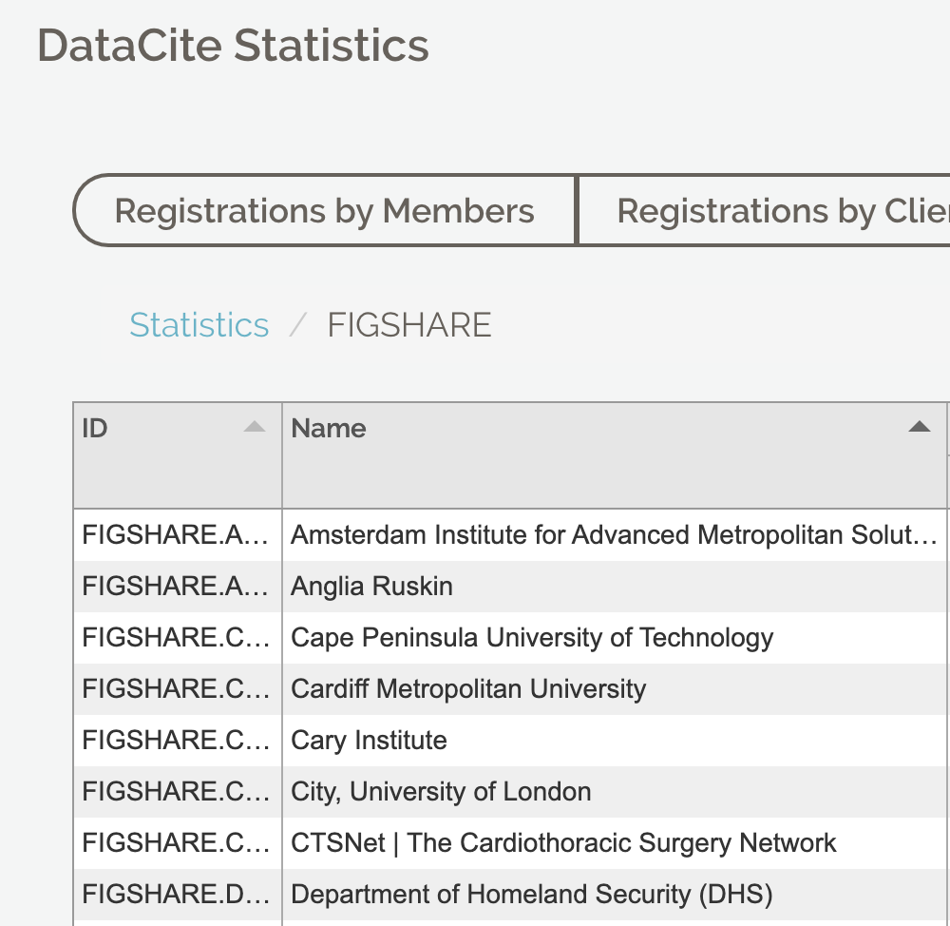
Identity (DOI)

Slide 14
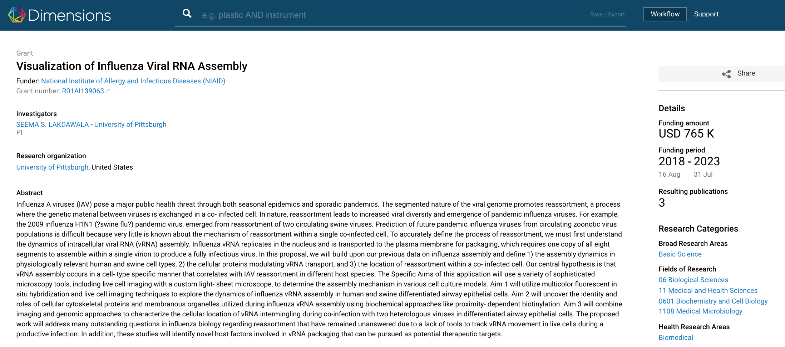
Notes:
Version control, pausable, resumable, chunkable uploads

Slide 15
Some Numbers
Launched in 2011
Team of 40
27 Developers
Outputs - 1.5m DOIs minted through DataCite
Over 20,000 citations of Figshare DOIs in peer reviewed journals
44% growth yoy of citations to outputs
17,161 outputs have an Altmetric score
78 Ambassadors from 27 countries
Researcher accounts 100s of thousands
Hundreds of TBs not PBs
175 million API hits in last year

Slide 16
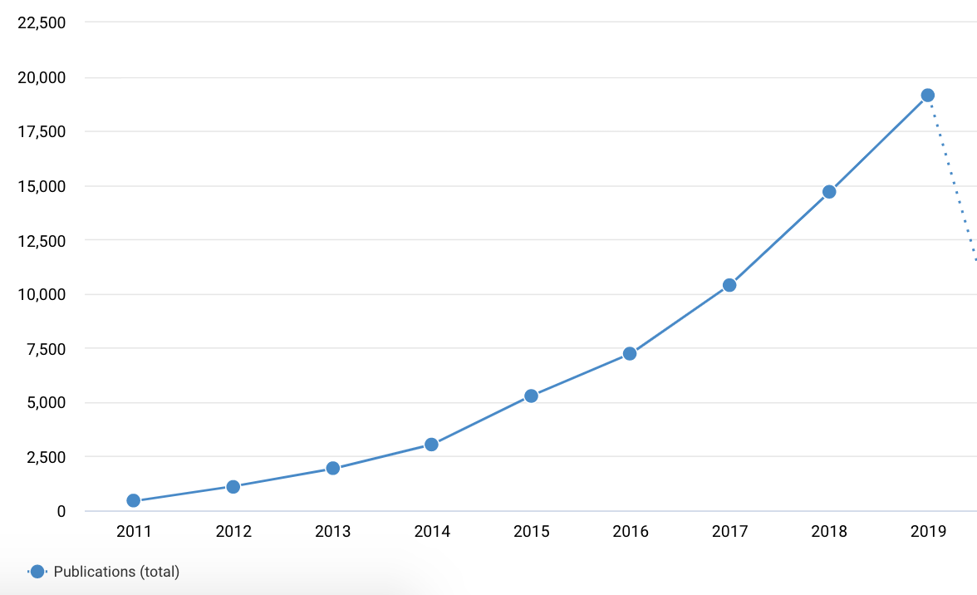
Notes:
test

Slide 17
Repository Basics

Slide 18
Sustainability
System Integrity
Accessibility
Preservation

Slide 19
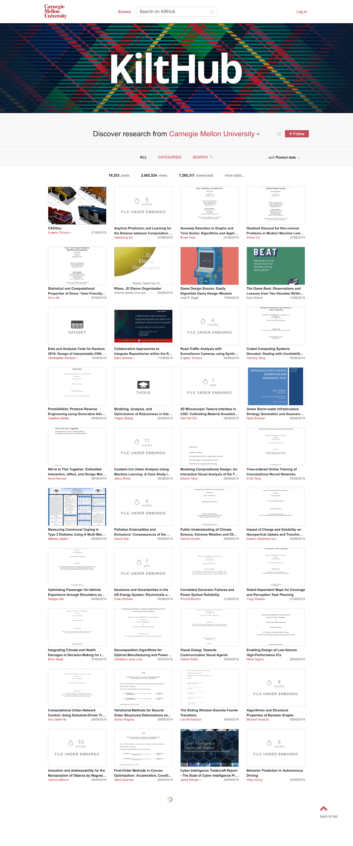
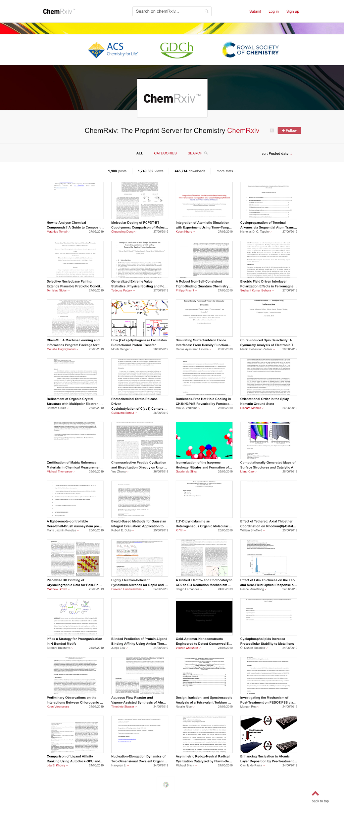
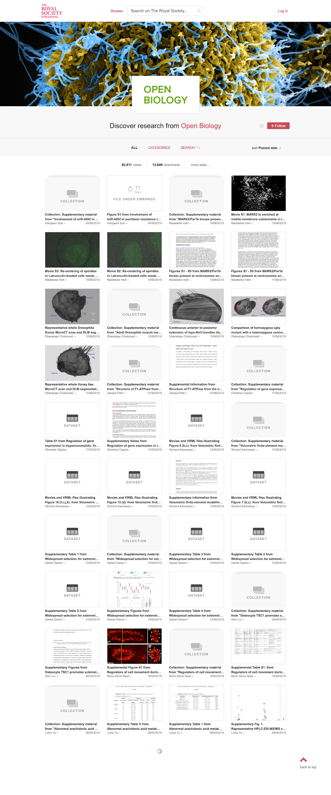
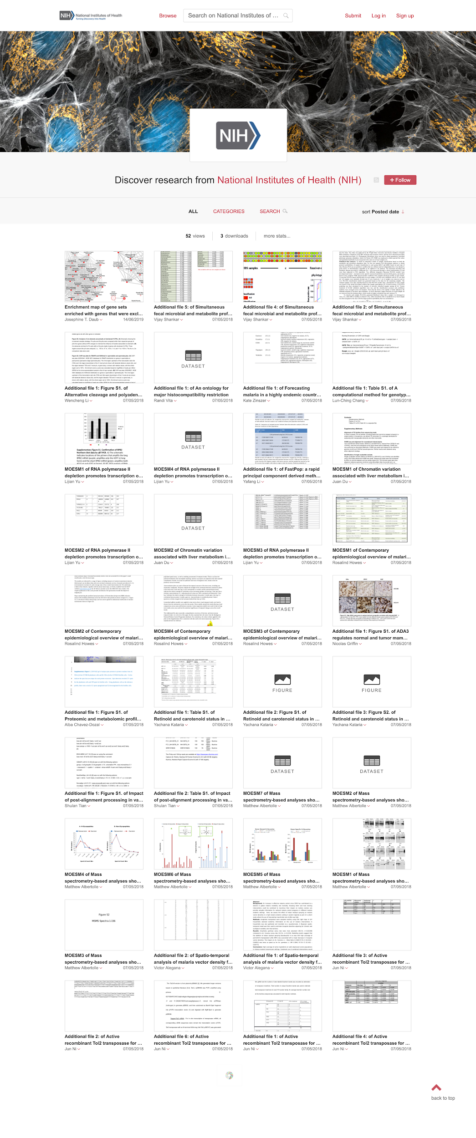

Slide 21
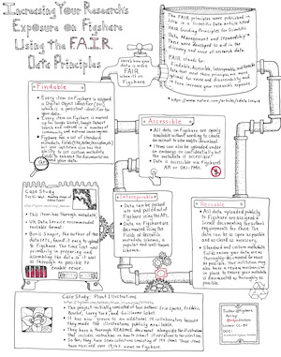
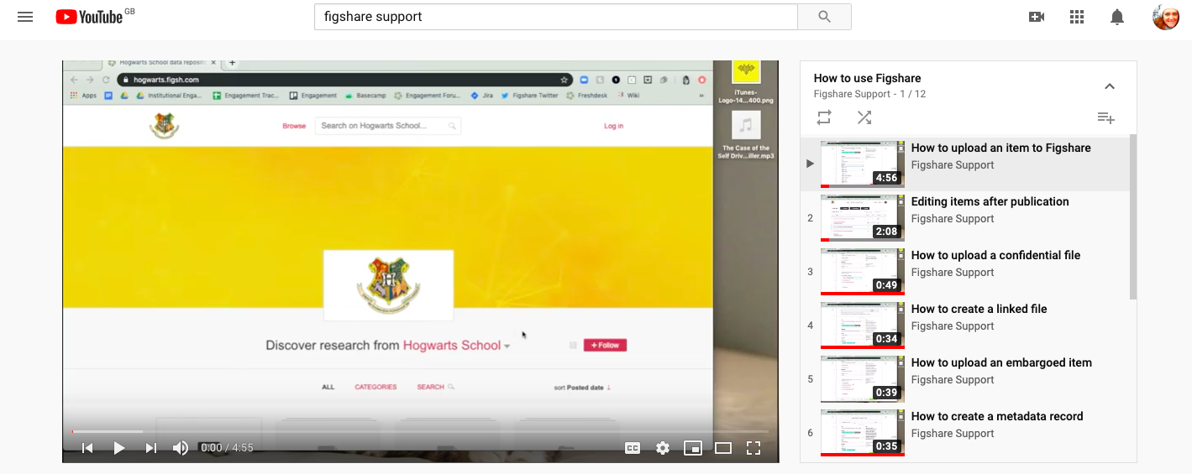
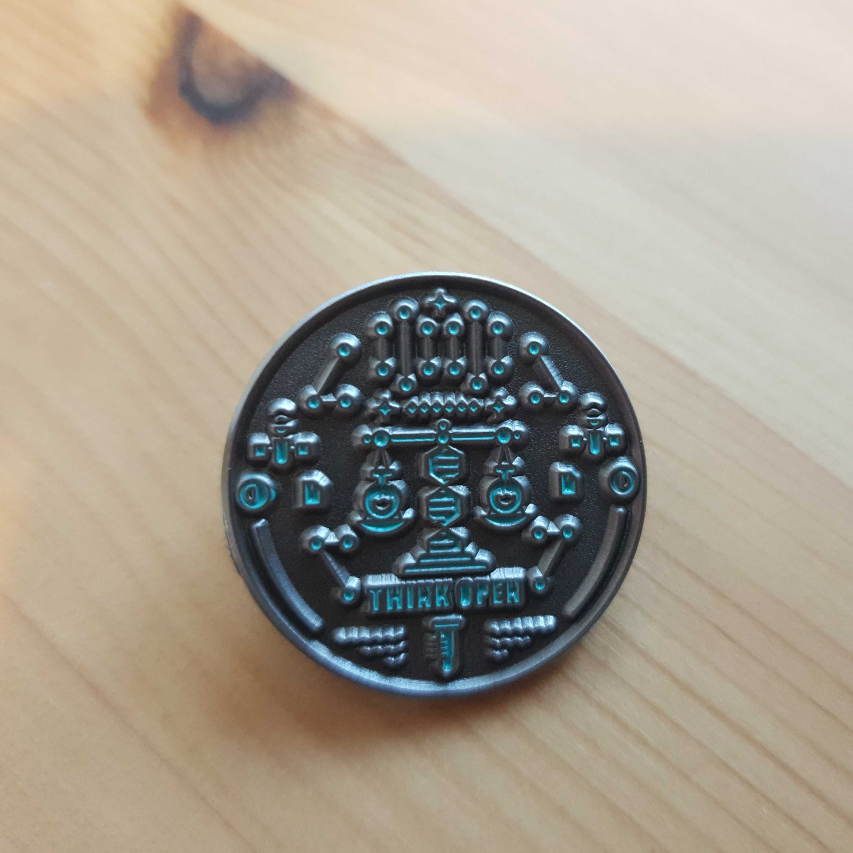
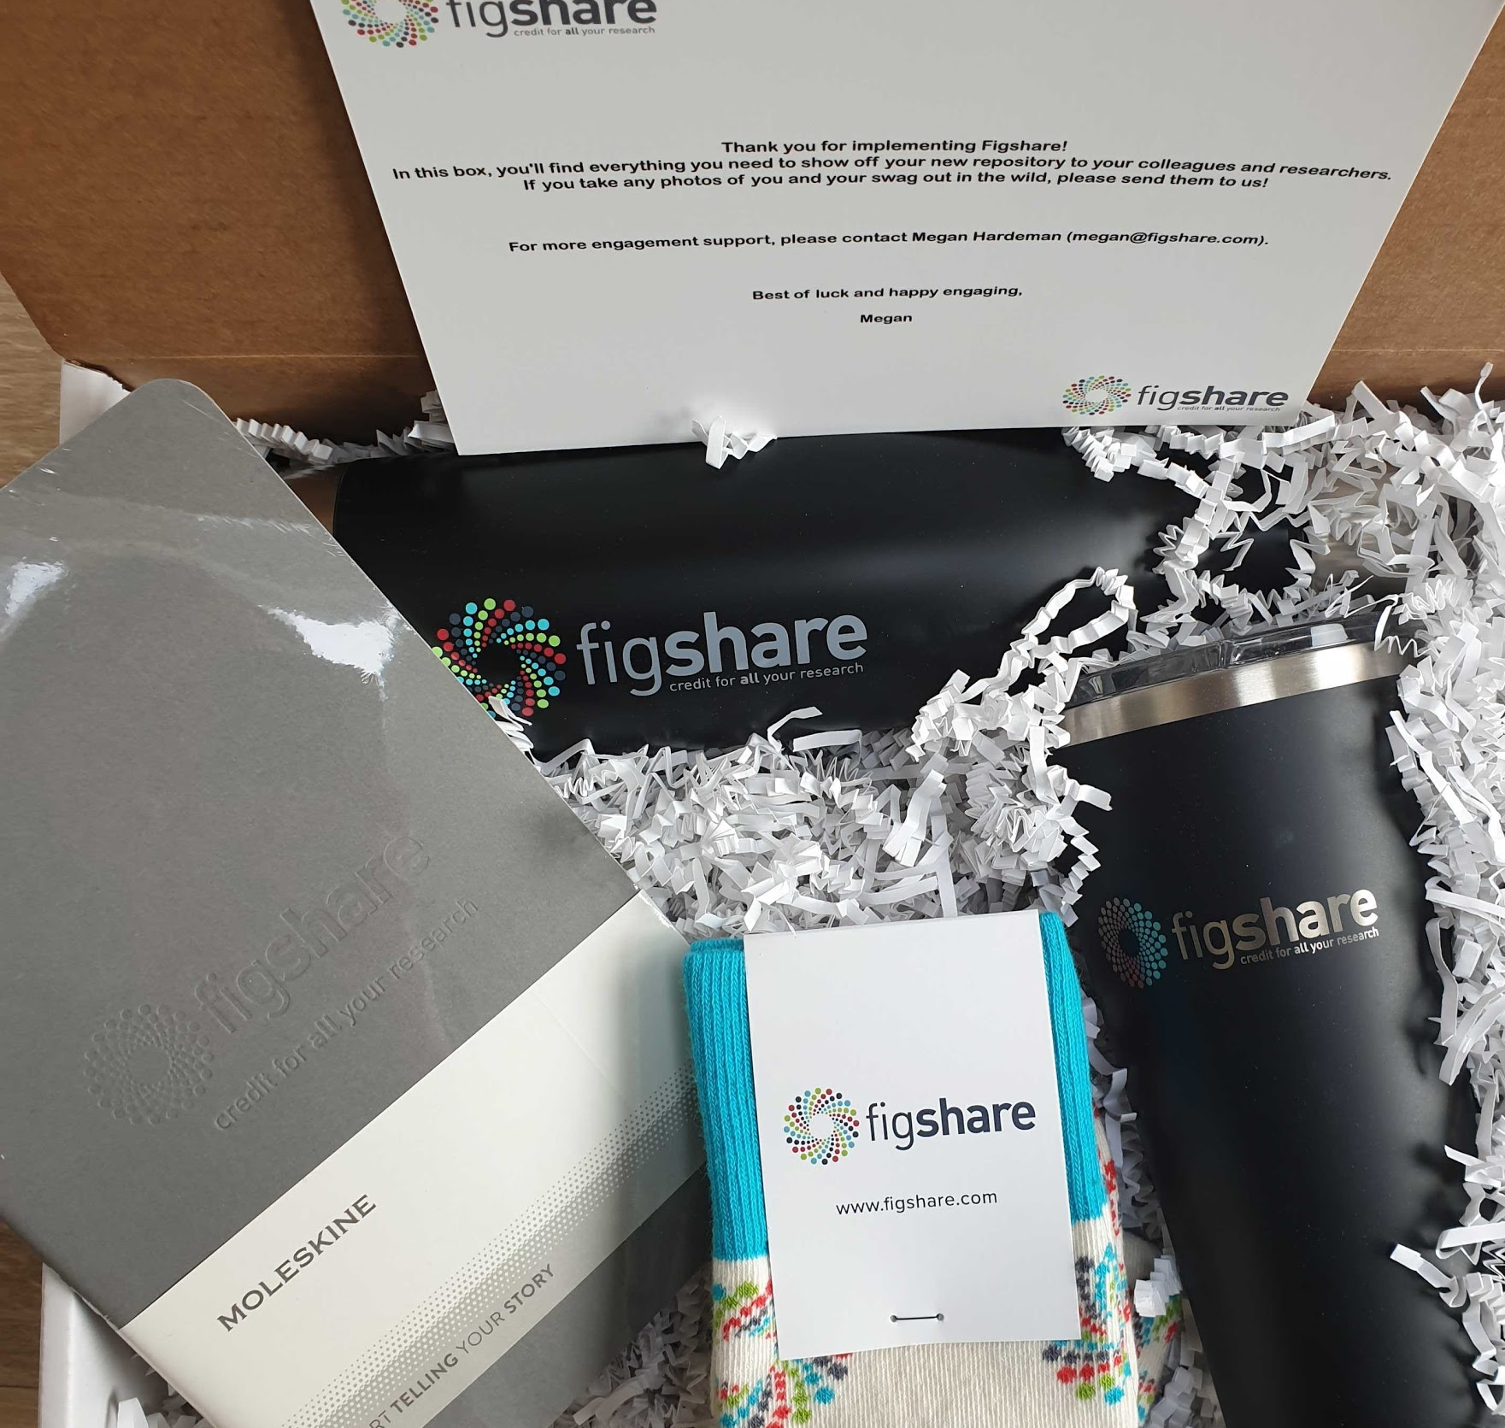
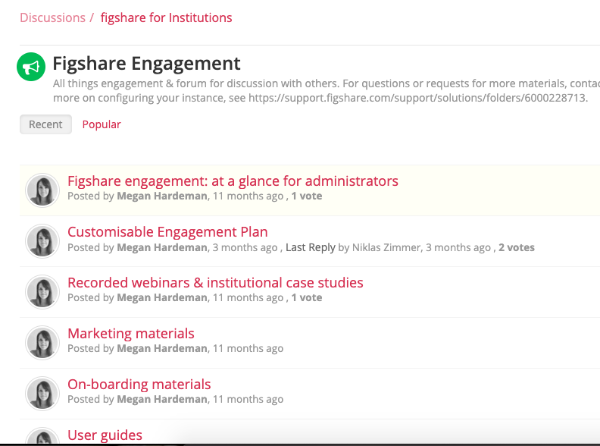
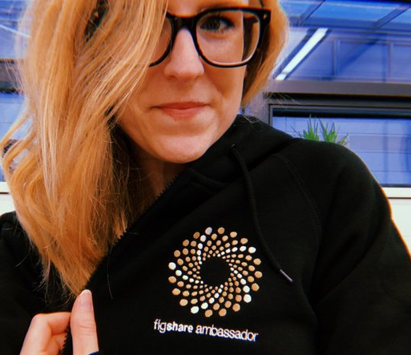
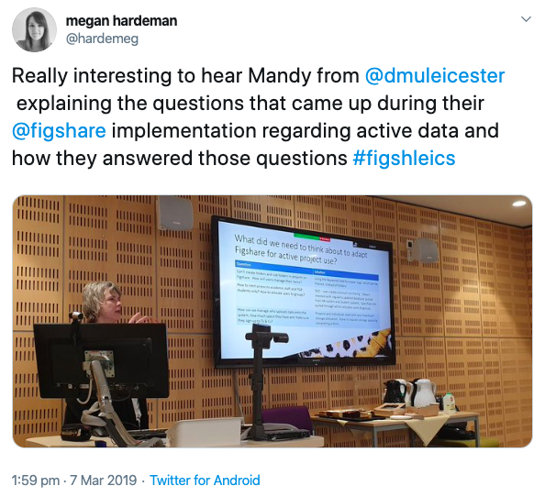
Engagement
Notes:
FAIR infographic (How data on Figshare is FAIR)
Updated YouTube channel videos
New swag (pins) and swag packs for new customers
New engagement forum including case studies, user guides, marketing materials, and an example engagement plan
October upload competition - over 600 uploads and 13 institutions participating
Ambassadors page on website and ambassador appreciation week
Figshare Field Trip to Leicester
13 case studies on ambassadors, institutions, and researchers
12 press releases

Slide 22
System Integrity
Figshare have been awarded ISO 27001 and the following best practices and security controls are implemented and monitored in order to ensure the security of the systems and data:
Application security:
security for data in transit (TLS/SSL)
security for data at rest (storage encryption)
data access control / logical access (user ACLs, tiered admin roles, private by default approach, data isolation)
Development security:
continuous integration and continuous delivery
multiple segregated environment: development, QA, staging, production regular internal and 3rd party penetration testing for figshare managed applications and services
Auditing:
application level user actions audit trail
AWS CloudTrail
database access audit trail
HIDS software installed on all production, staging and QA machines technical vulnerability management external monitoring of public services
Physical and network security controls to prevent unauthorized access to data:
access control system
video surveillance
storage encryption for development stations
network access based on MAC and IP whitelisting
802.1x Security Authentication for wireless network
NIDS software for monitoring development network traffic
antivirus software installed on development stations
Cloud security:
2FA authentication on all cloud based services in use
TLS (SSL) only services to secure in transit data
Storage encryption for data at rest
VPN connections for accessing cloud infrastructure
defense in depth approach for cloud infrastructure network security: security groups (firewalls), network level ACLs, VMs launched in VPC private networks, use or ELBs to expose public services, HIDS

Slide 23
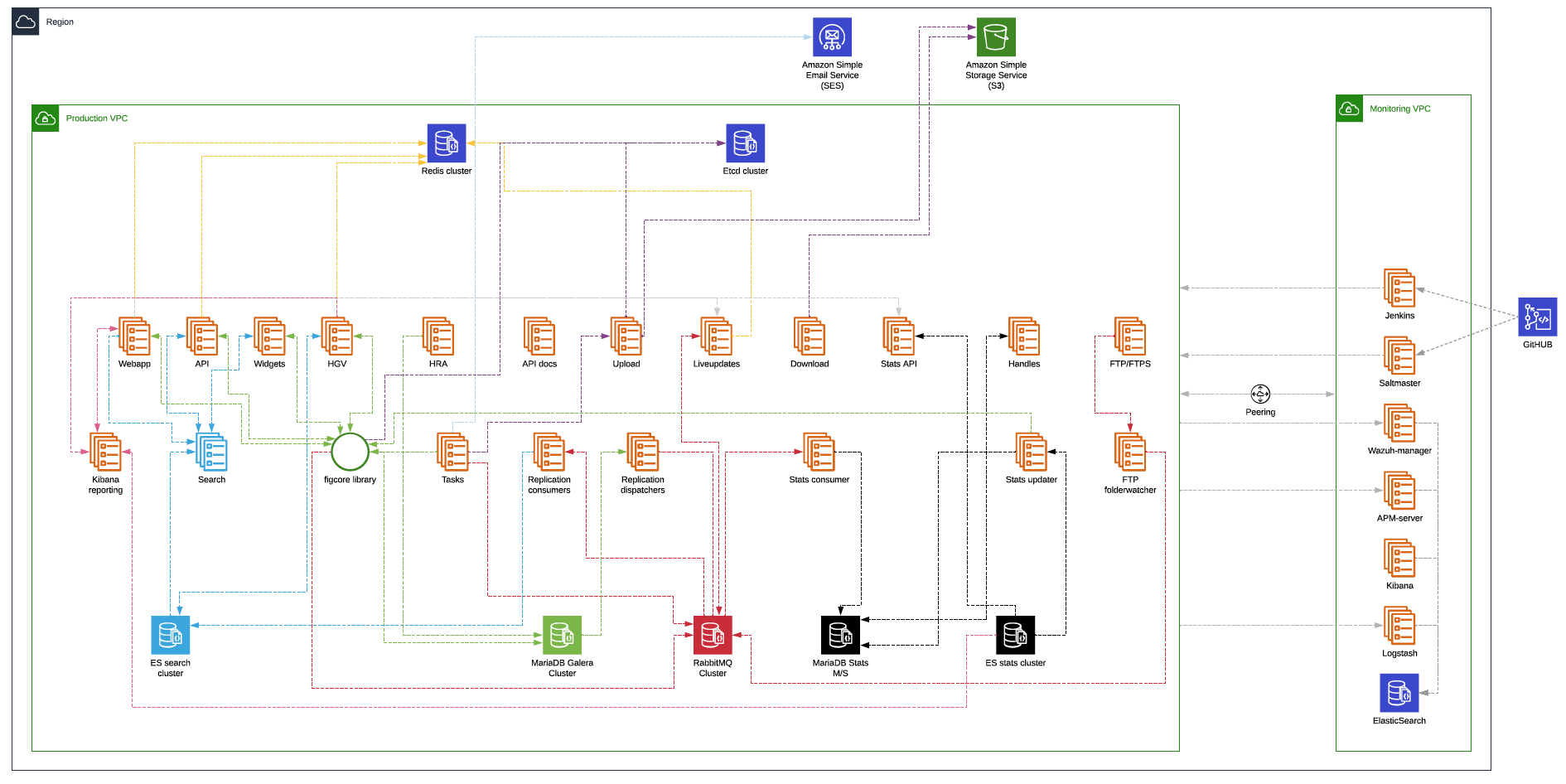
Globally Deployed

Slide 24
Web Accessibility
We’re currently engaged in an extensive program of works with the primary goal of achieving 100% compliance with a number of accessibility standards:
European accessibility standard EN 301 549
WCAG 2.1 AAA with a fallback to AA where necessary
Section 508

Slide 25
Preservation
Figshare.com
Integrations

Slide 26
Human & Machine Readable

Slide 27
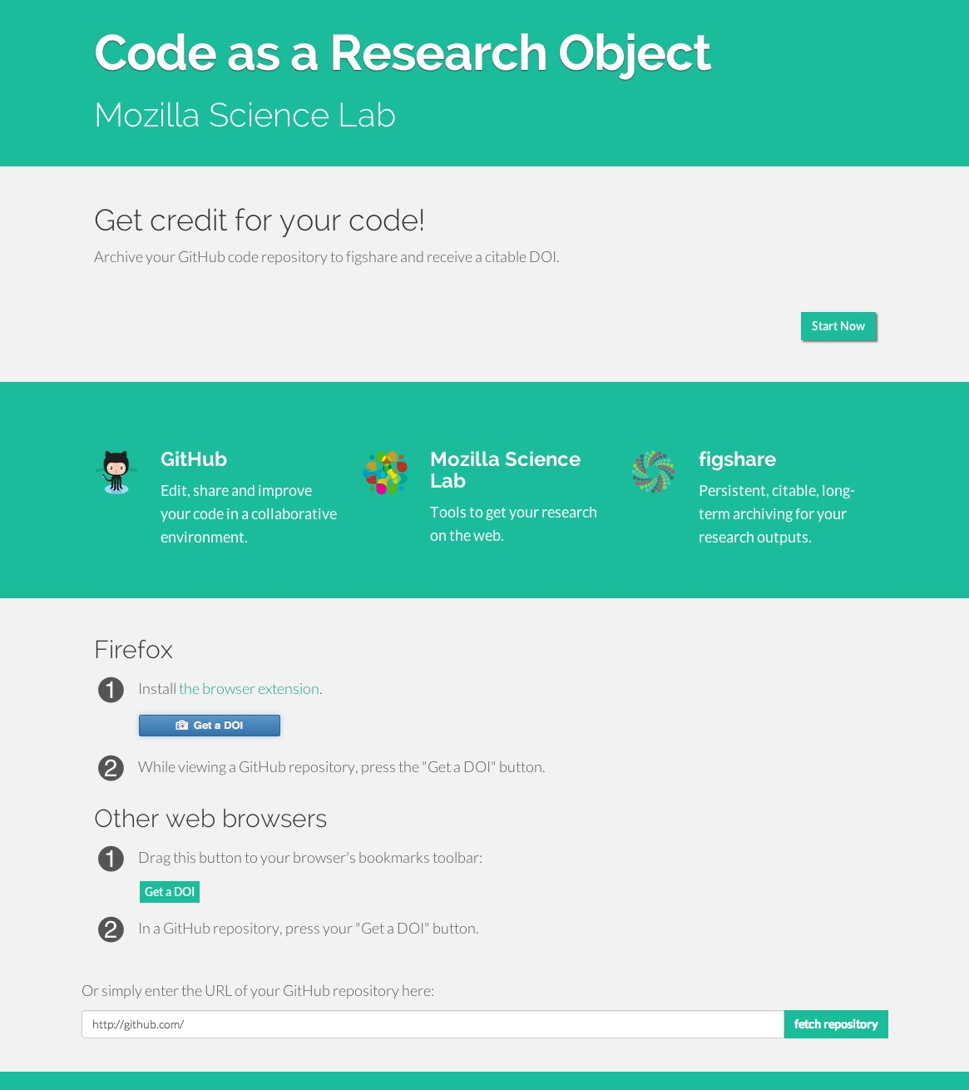
Indexing
Google Dataset Search
Google Scholar
Dimensions
OpenAire
SHARE
Clarivate Data Citation Index
Pubmed
National metadata Registries. Eg. Research data Australia

Slide 28
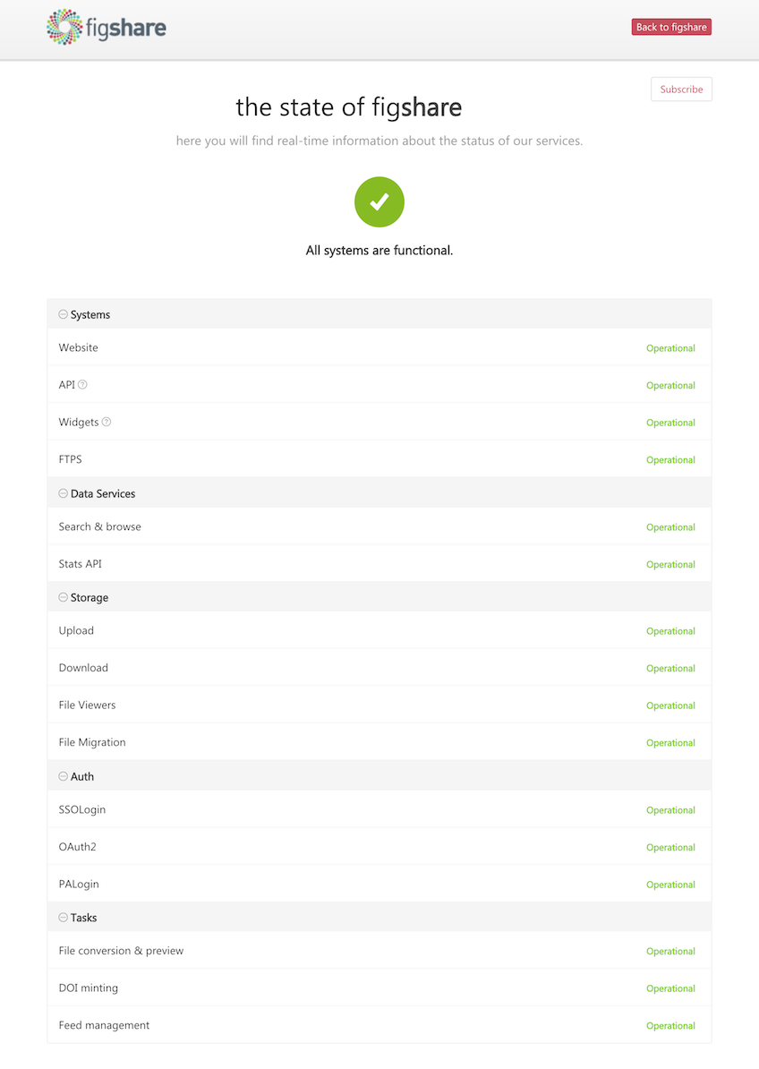
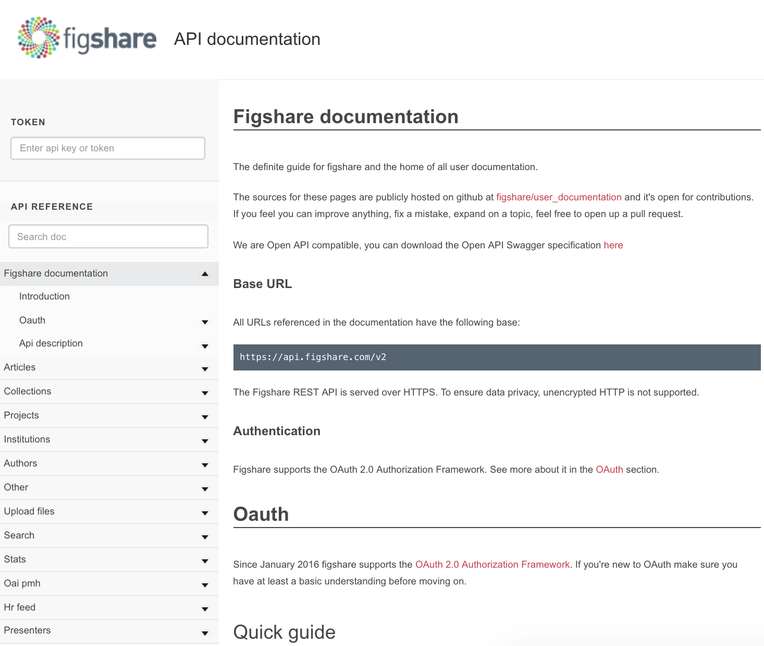
Notes:
Everything that can be done via the UI can be done via the API. The most common use-cases are automated uploads and queries of published datasets - The API lives at docs.figshare.com

Slide 29
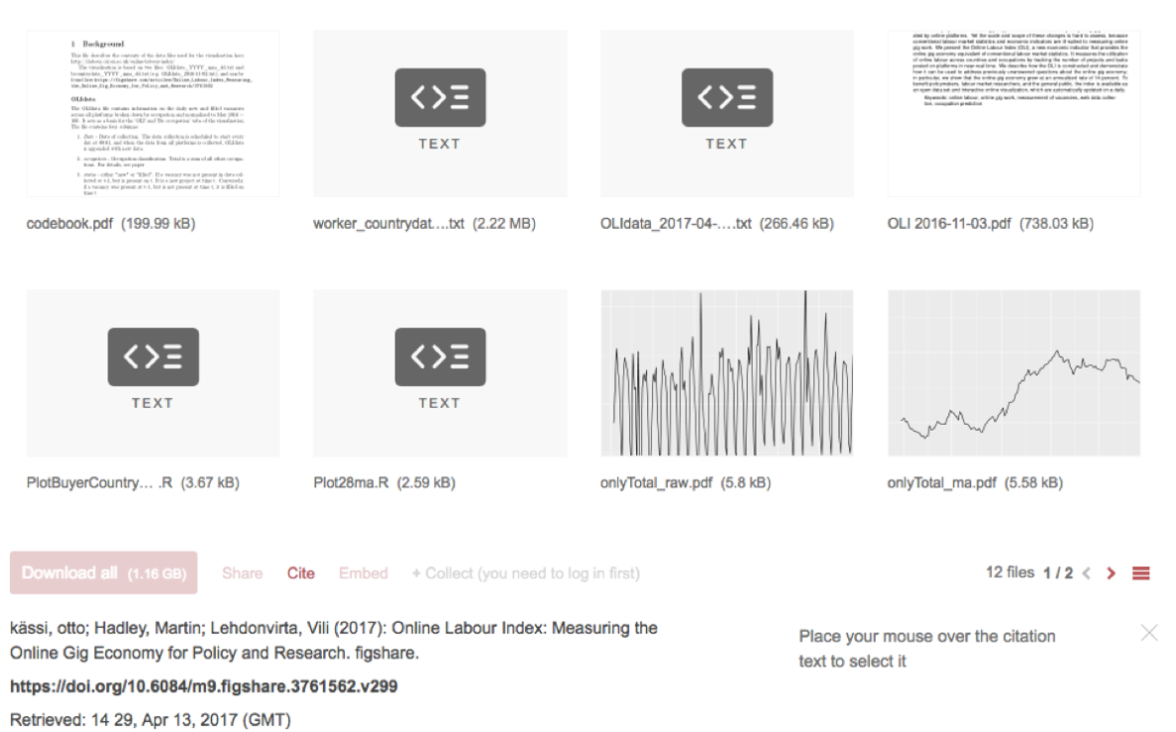
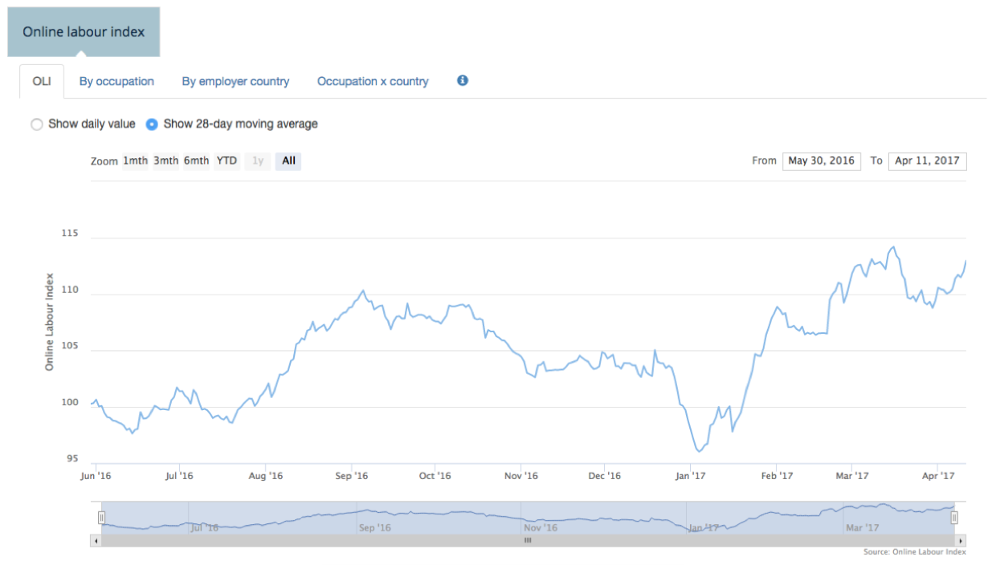
Notes:
Here is an example of a live query of datasets on Figshare. We support version control. Here the authors publish daily datasets. Those datasets are queried by a different website to provide a dynamic graph.

Slide 30
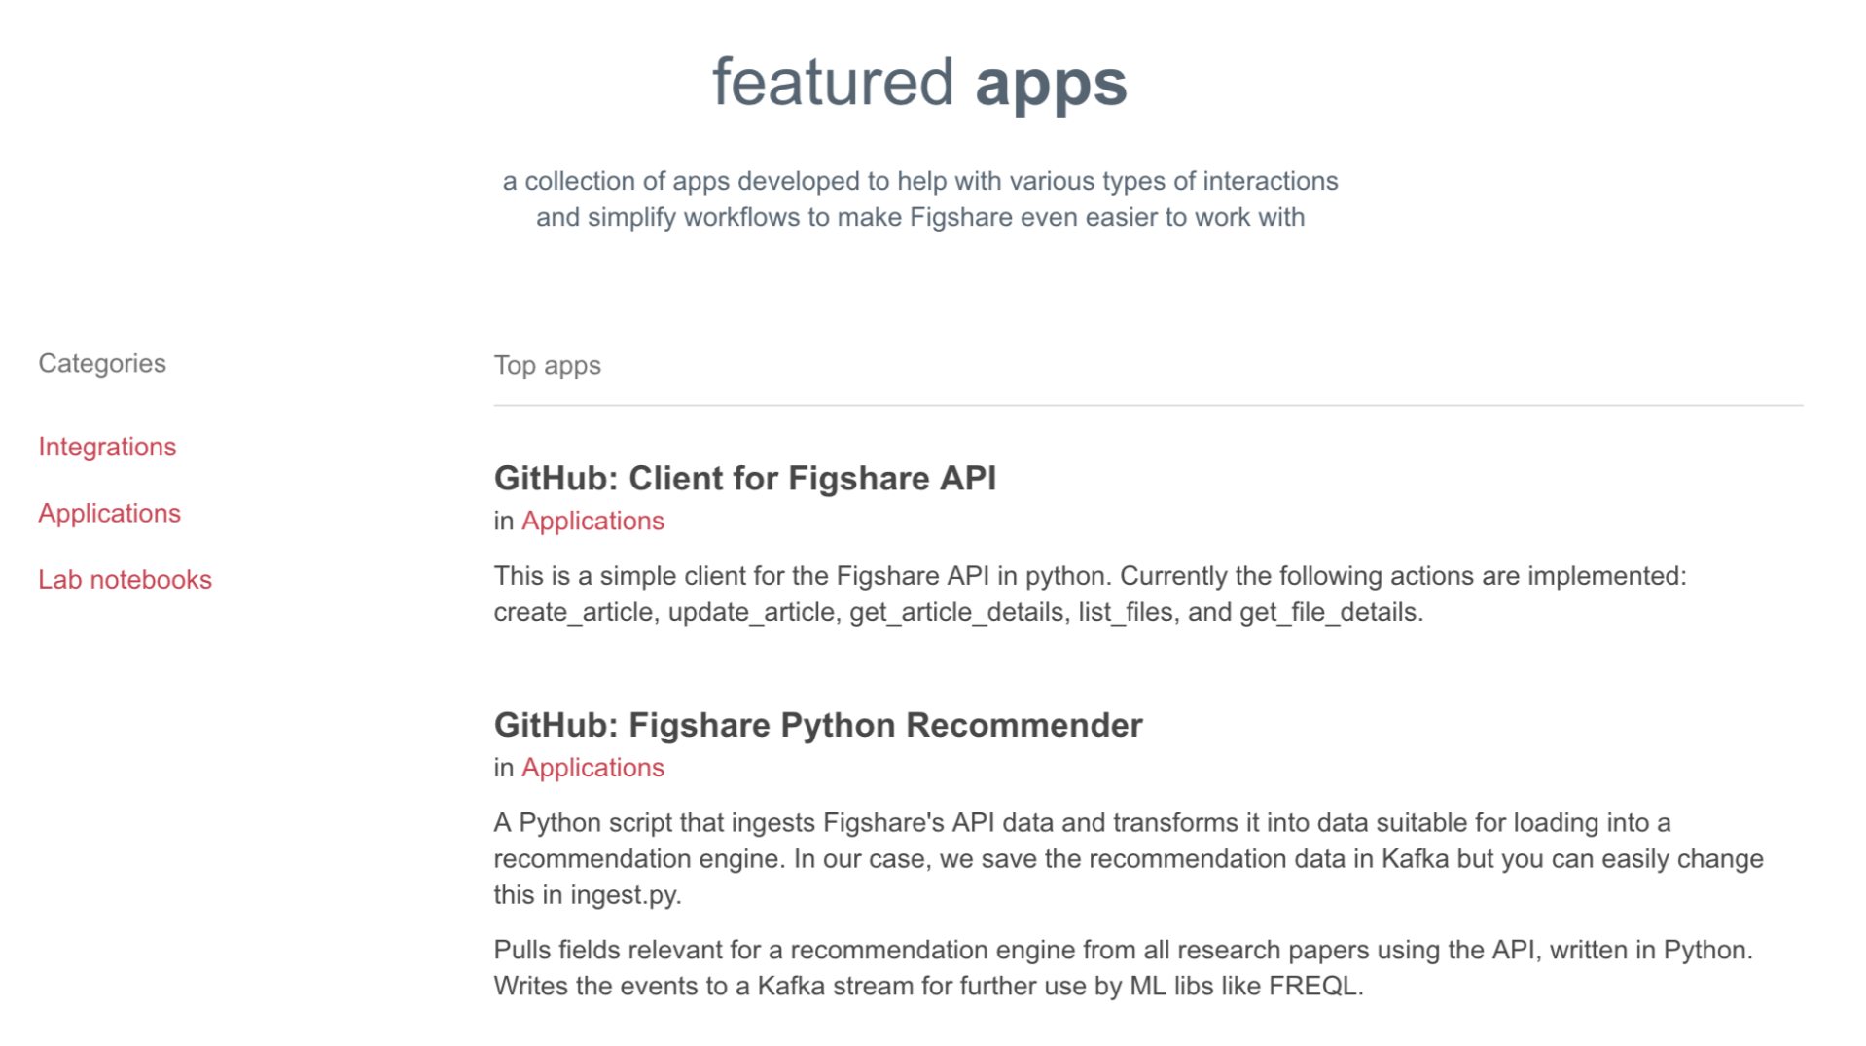
Notes:
Binder, Overleaf, OSF

Slide 31
Opportunities

Slide 32
Opportunities
Cross repository checks – Pre and post publication
Cross repository back-up (LOCKSS)
Consistent Identifiers
Consistent Metrics (Make Data Count)
Generalist Repository Schema Definitions
Training and engagement
Best practice policy
Define Layers of Checking/Curation
Notes:
Executable files

Slide 33
Mark Hahnel
Function: CEO
Email: mark@figshare.com

Slide 34
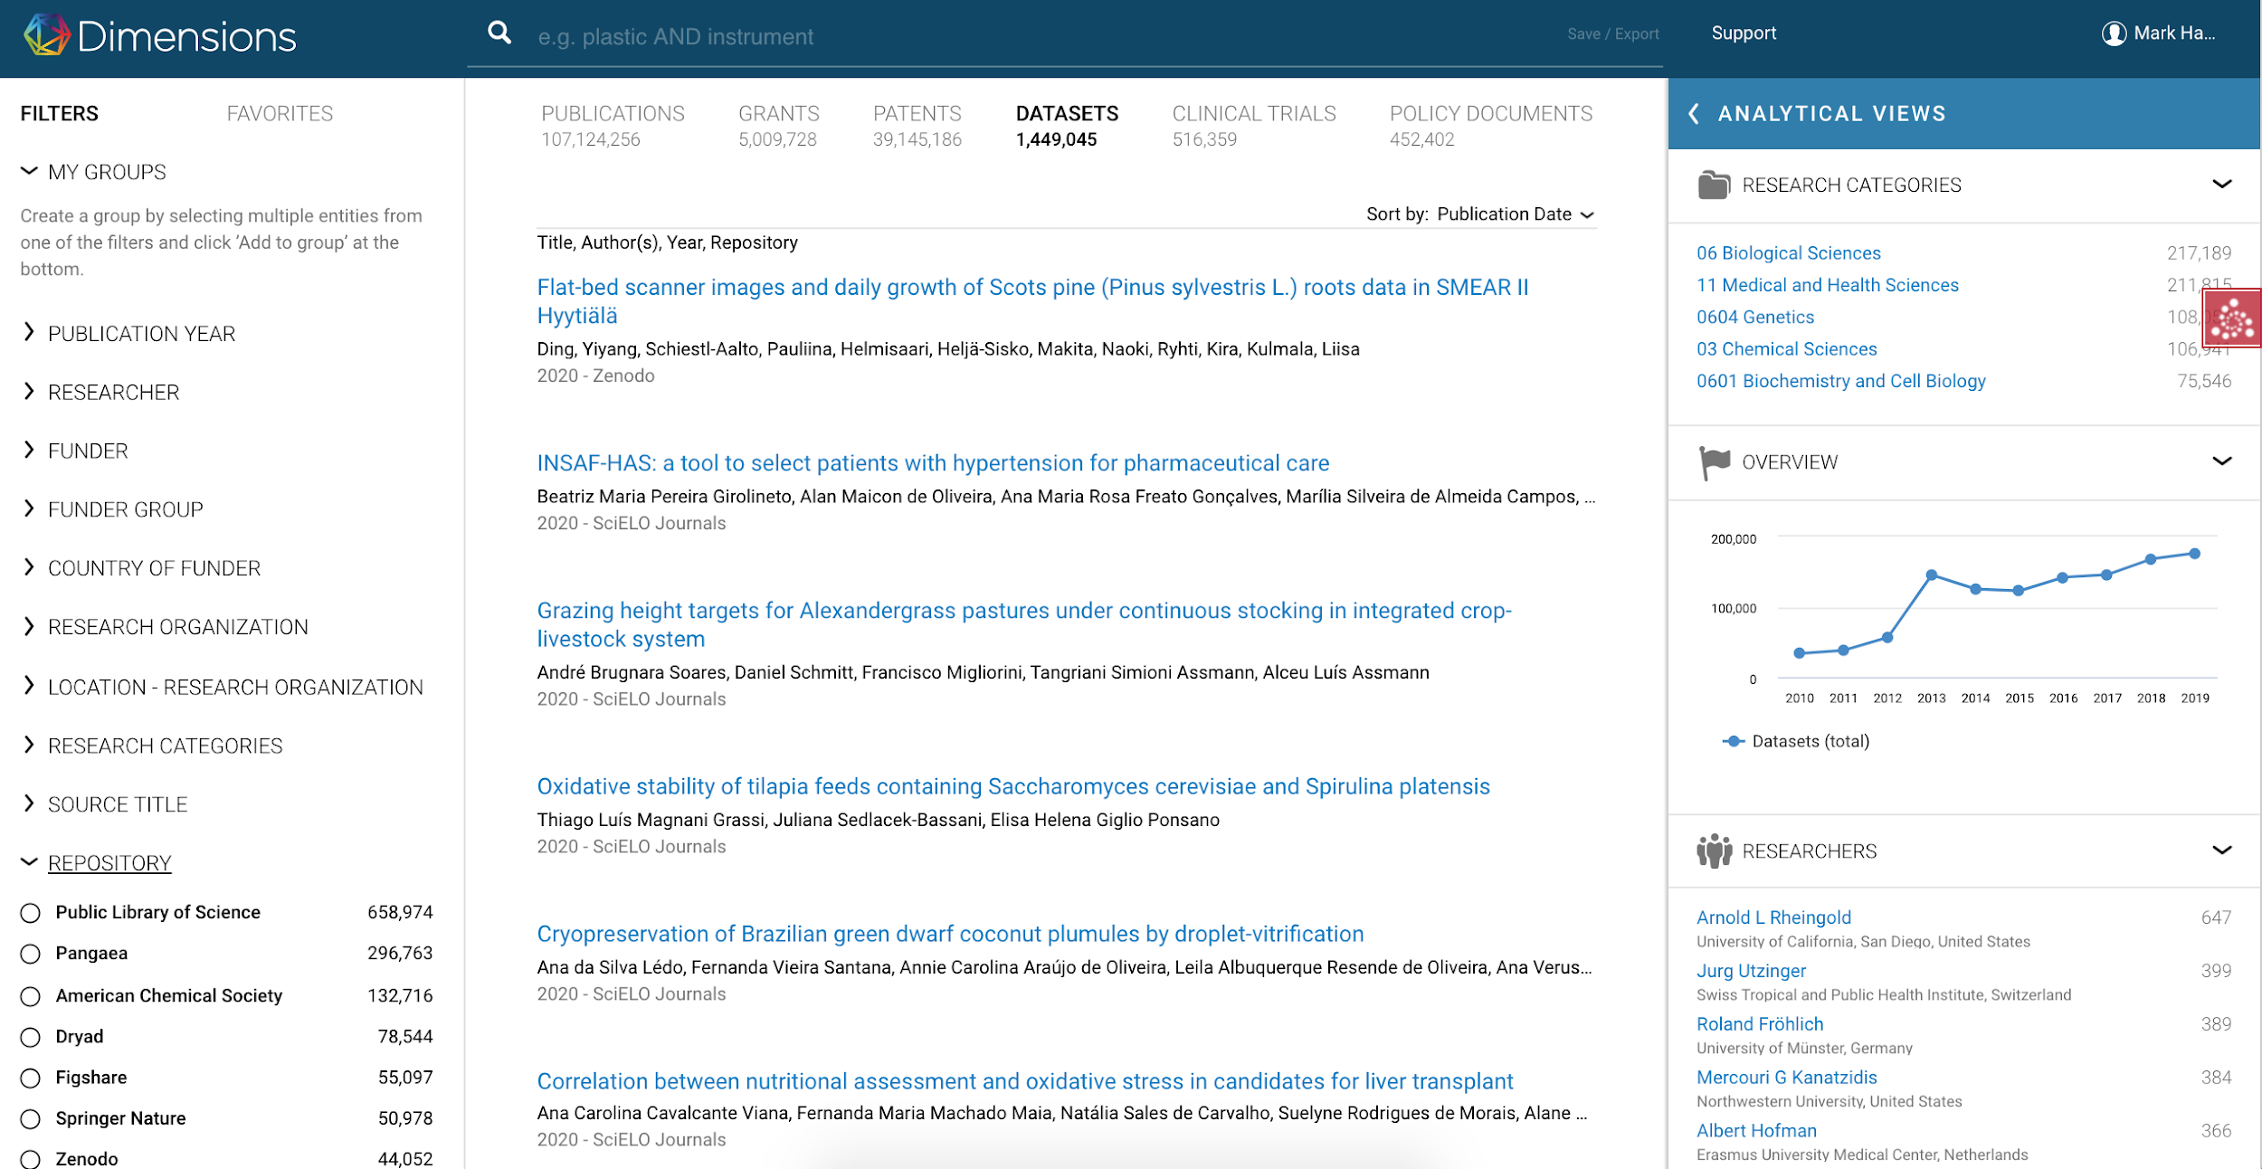

Slide 35
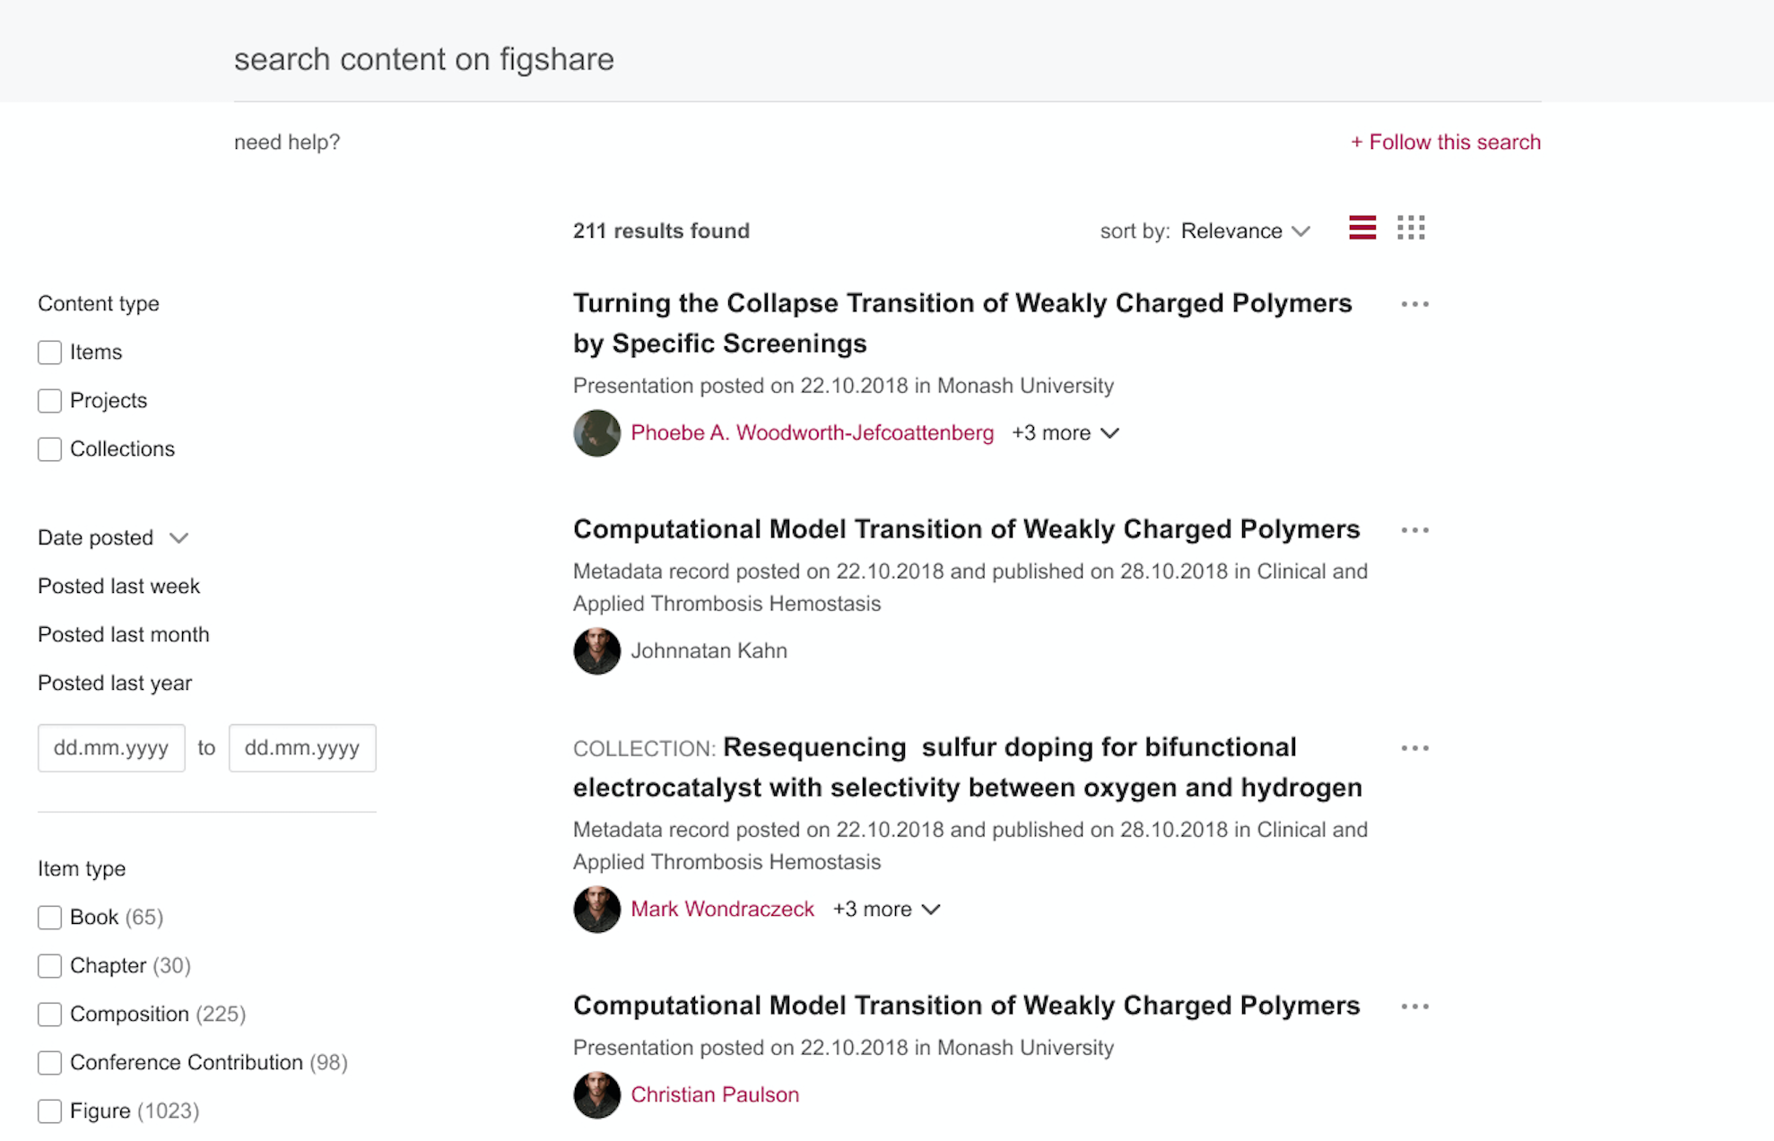

Slide 36
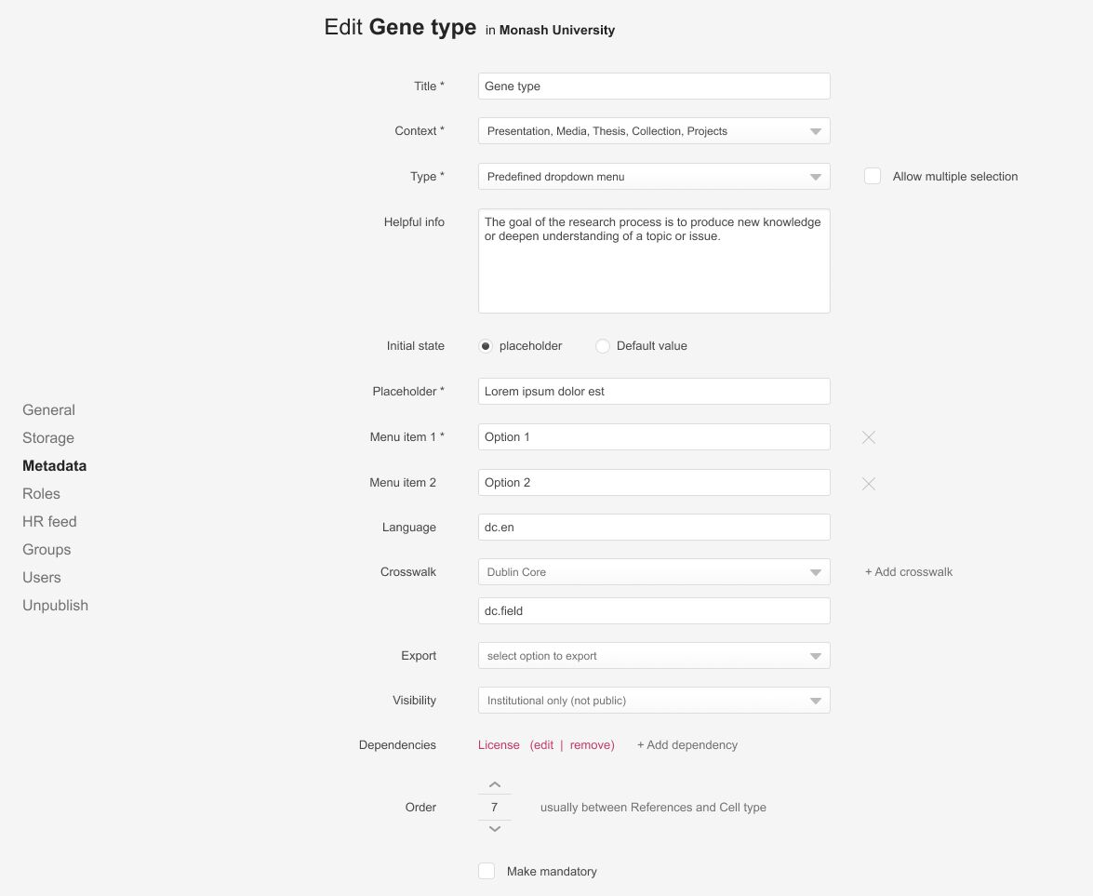

Slide 37
