Slide 1
Academic integrity –
a university-wide collaboration
Amy Han, Lachlan Condon, Melissa Santoso, Nicole Scoble, Steven Yates
Digital Learning and Teaching team
Monash University Library
4 July 2019

Slide 2
Outline
Background
The process
Statistics
Lessons and tools

Slide 3
Background and timeline
2011 - need of a resource explaining academic integrity and terminologies
2012 - development and launch of version 1
2017 - review of version 1
2018 - development and launch of version 2

Slide 4
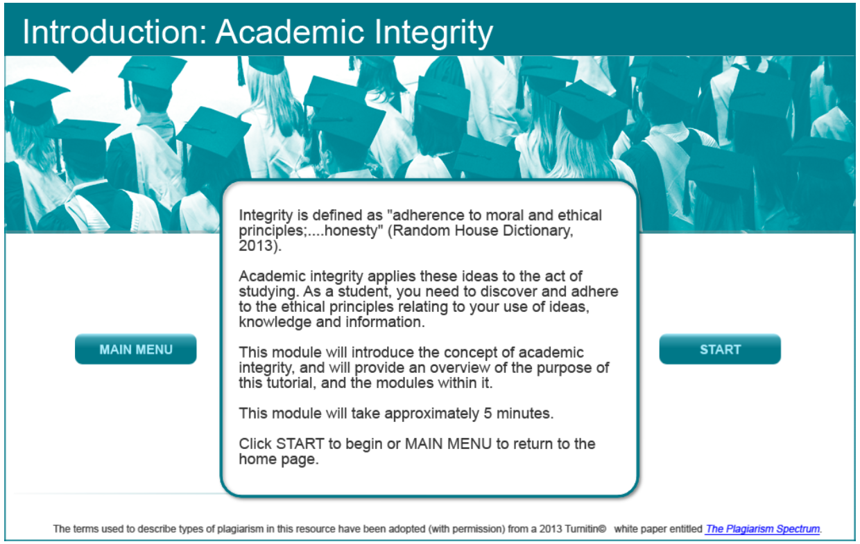
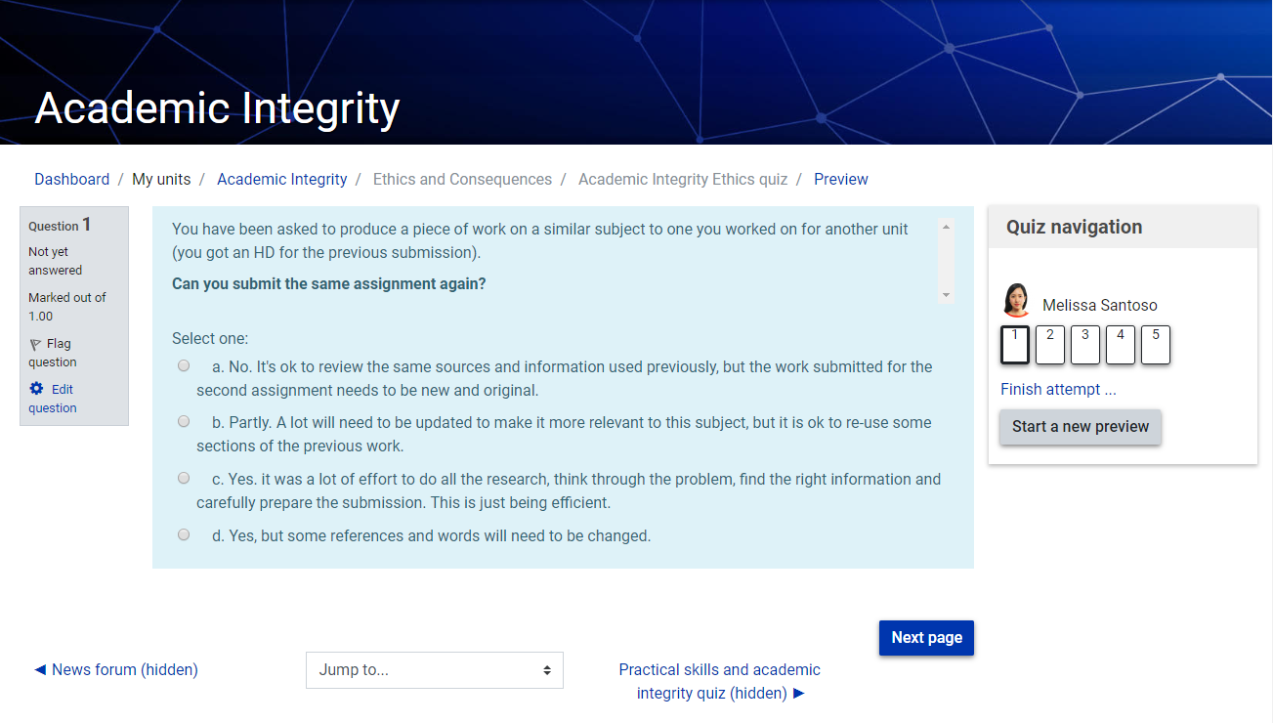
Academic integrity modules - version 1
Modules [index]
Quiz

Slide 5
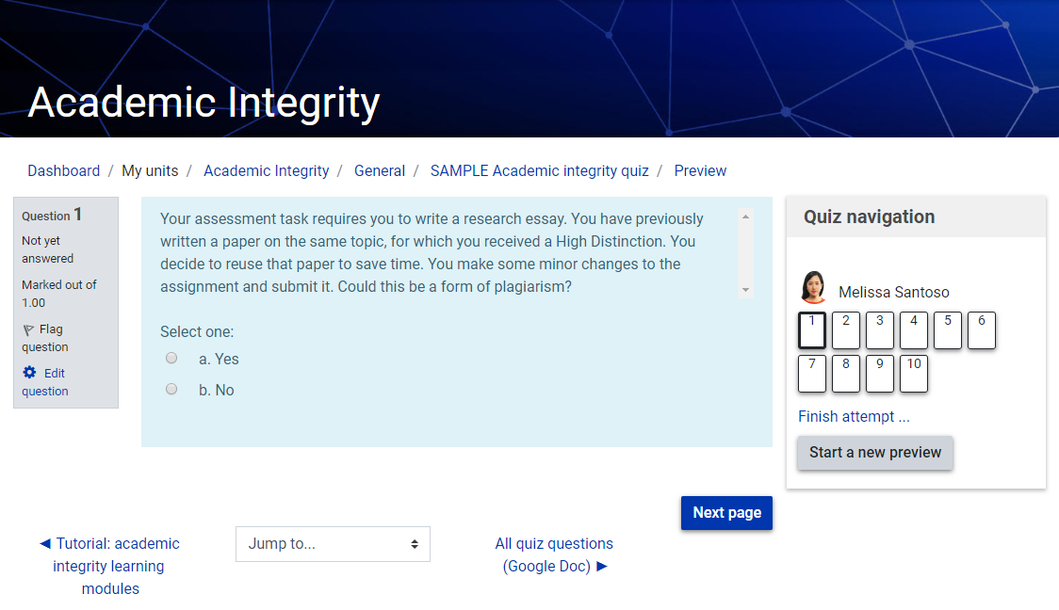
Academic integrity modules - version 2
Modules [index] [M2] [M2]
Quiz

Slide 6
Pre-planning
Old modules needed to be updated:
policy
look
terminology
technology
Redevelopment was Library-led by the Digital Learning and Teaching team
Practical formative evaluation approach
Call of interest – July 2017

Slide 7
Engage & collaborate
Students
Library staff
Monash University International Student Society
Core project team
Library Digital Learning and Teaching Team
Content writers
Communications team
Faculty academics
Educational designers
Monash Postgraduate Student Association
Monash University Assessment Working Group
Monash Education Innovation
Monash Malaysia Library
Deputy Vice-Chancellor and Vice-President (Education)
Policy experts

Slide 8
Pre-design
Meetings with stakeholders.
Meetings with students including international students.
Student focus group 26 October 2017
Results
clear definitions of AI and related terminology
clear connection to citing and referencing
easy access to modules

Slide 9
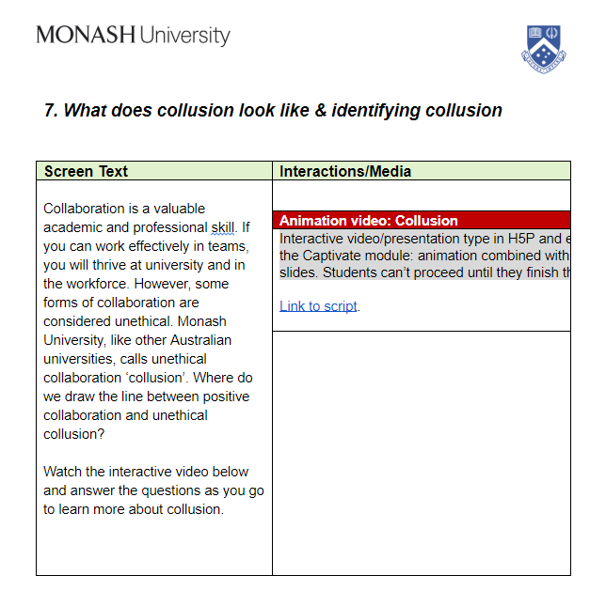
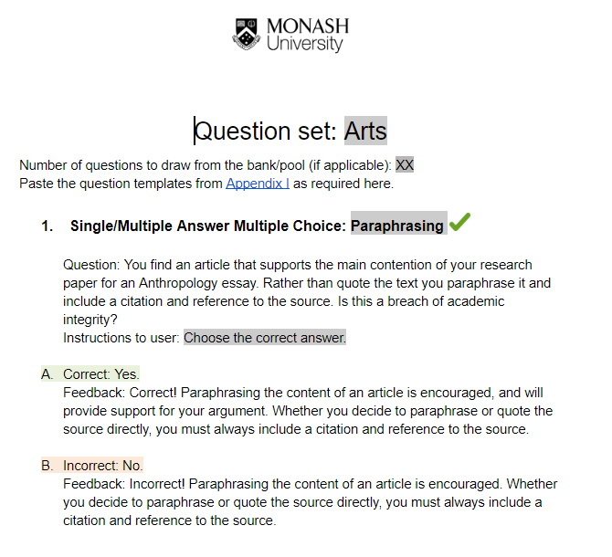
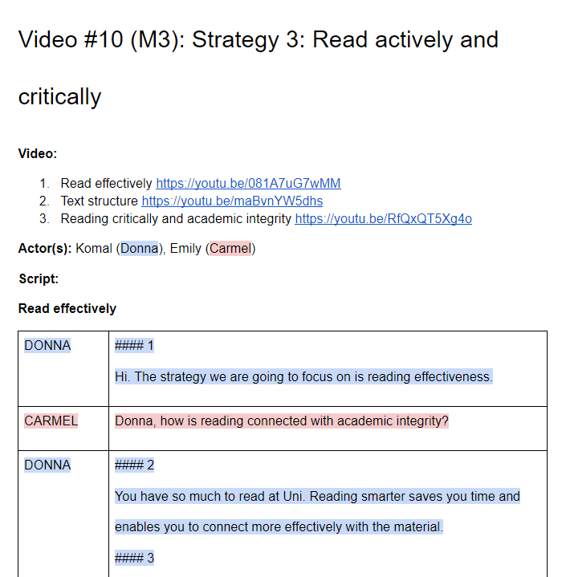
Storyboard
Module storyboards
Quiz storyboard
Video & audio script

Slide 10
Build
Built by the Digital Learning and Teaching team
Building tools
Collaboration tool

Slide 11
1 mins
Post-build focus groups
Staff focus group 24 October 2018
testing on more devices
breaking up of text heavy screens
clearer signposting within modules
Student focus group 13 November 2018
add wrong options/red herrings to questions
clearer link to other modules and Citing & Referencing
more noticeable menu and buttons
Used collaboration tool Notion to arrange logistics of focus groups.

Slide 12
Post-feedback build
Incorporated feedback from focus groups.
Fixed identified bugs.
Recorded and edited student and staff video and audio footage.
Continued to use collaboration tool – Notion.

Slide 13
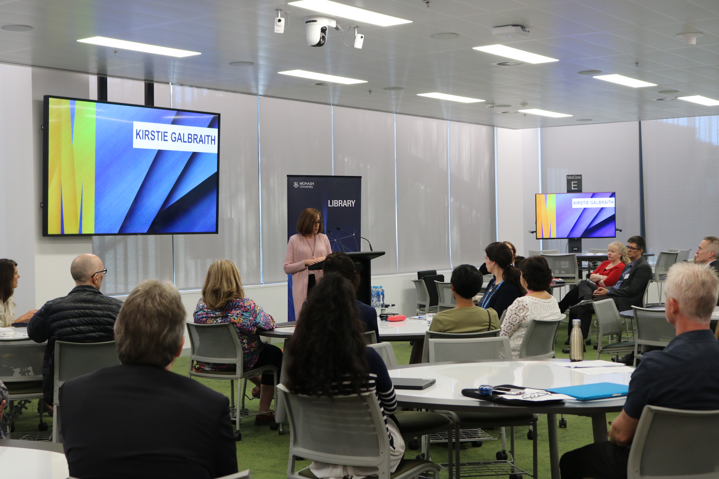
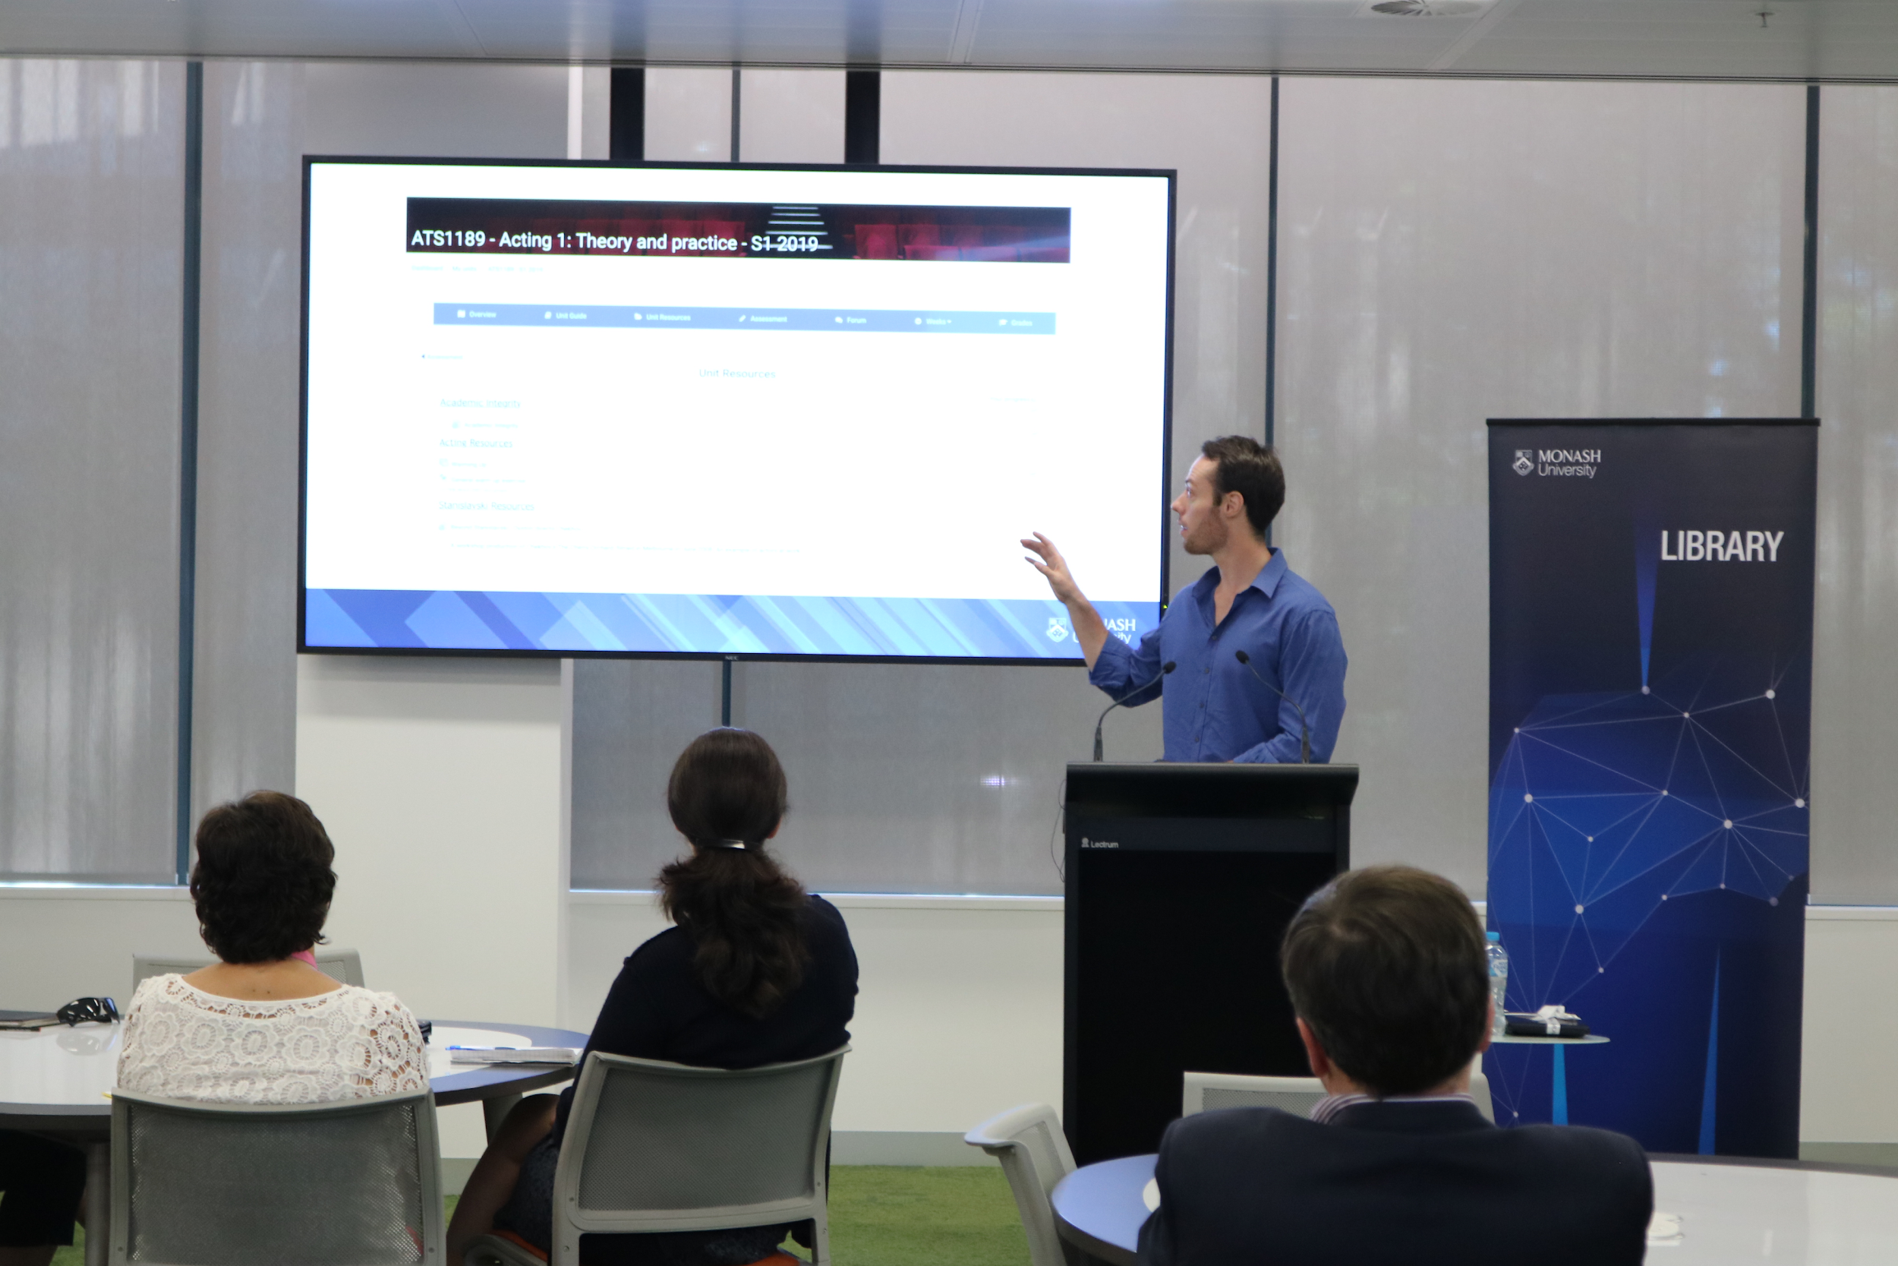
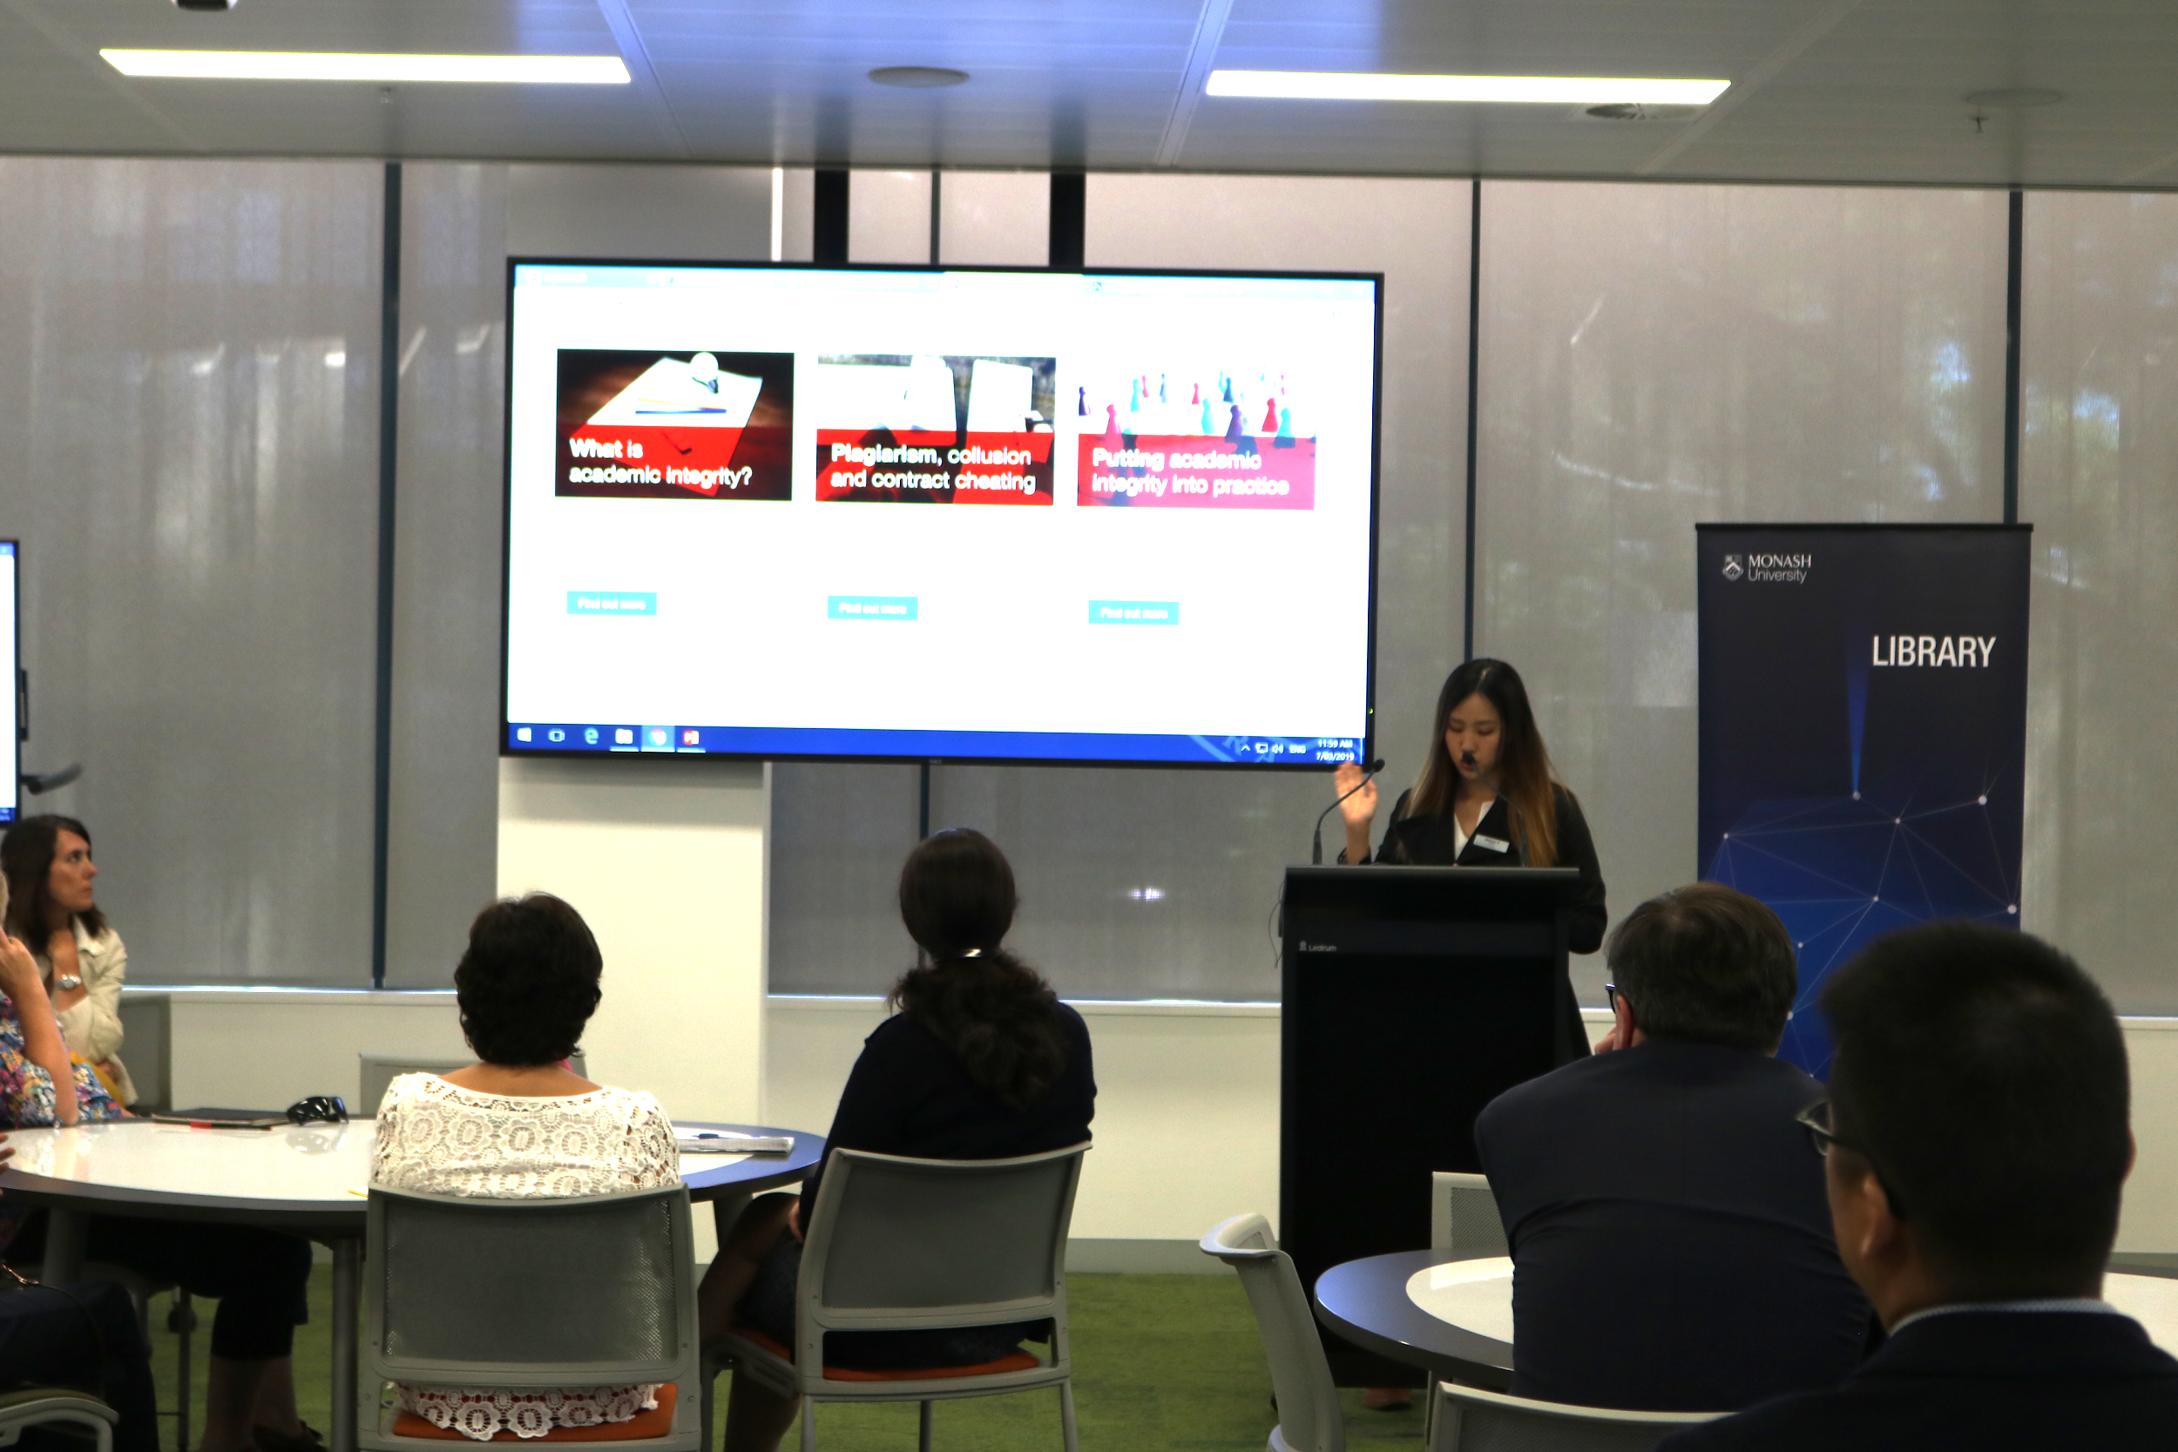
Launch
Publicly available on the Library Research and Learning Online site - monash.edu/rlo
Embedded version and quiz available on Learning Management System
Launch event on 7 Mar 2019, attended by academics and stakeholders

Slide 14
Statistics
Version 1, 1 January - 1 June 2018
Version 2, 1 January - 1 June 2019
28,166 total unique page views (14 modules)
44,437 total unique page views (3 modules)
Version 2 Moodle, 1 February - 1 June 2019
2,059 unique page views since unit release on 1 Feb 2019 (3 modules)

Slide 15
Review & future plans
Build stage 2/improvements scheduled for July 2019
Development of university-wide mandatory module
Research on effectiveness and impact of modules

Slide 16
Lessons and tools
Collaboration at all stages.
Connect
create connections and relationships
Have a clear vision
stick to it!
Have a realistic but firm timeline
communicate and chase people up!
Promote
let people know!
involve the communications/marketing team
Essential tools
Notion
Slack
Google docs
Google drive

Slide 17
tinyurl.com/MonashAI
tinyurl.com/MonashCR
Monash University Library
Digital Learning and Teaching Team
lib-dlt-l@monash.edu
melissa.santoso@monash.edu
melissa.santoso@monash.edu

