Slide 1

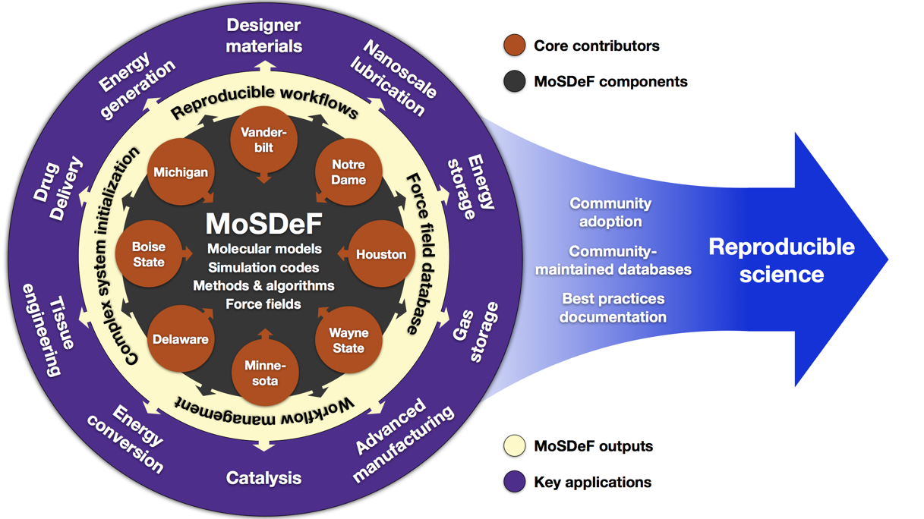
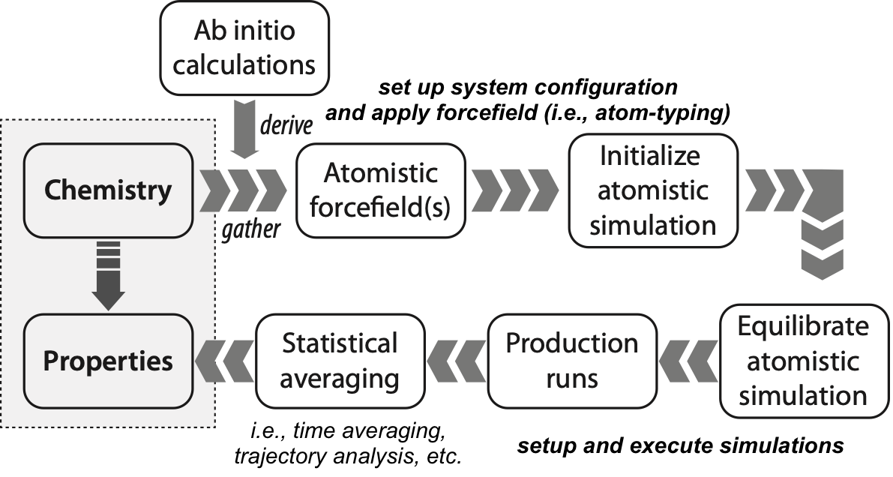
Software for Building a Community-Based Molecular Modeling Capability Around the Molecular Simulation Design Framework (MoSDeF)
PI: Peter Cummings Co-PIs: Clare M^{c}Cabe, Chris Iacovella, Akos Ledeczi
Institutions: Vanderbilt University
Award #: 1835874
Molecular simulation of soft materials (polymers, liquids, biological systems) is notoriously irreproducible
  Multiple complex steps, each prone to error
  Forcefield parameters and other simulation details often not reported
  Frequent use of in-house scripts that are not made available
MoSDeF addresses reproducibility (by automation, by sharing of data, scripts and forcefields, byt providing scriptable tools) and large-scale screening of soft material systems
mBuild: system initialization
foyer: force field parametrization
signac: data and workflow management
Completely scriptable, enabling TRUE simulations
  Transparent, Reproducible,
  Usable by others, Extensible
NSF CSSI PI Meeting, Seattle, WA, Feb. 13-14, 2020
Notes:
AUTOMATION

