Slide 1
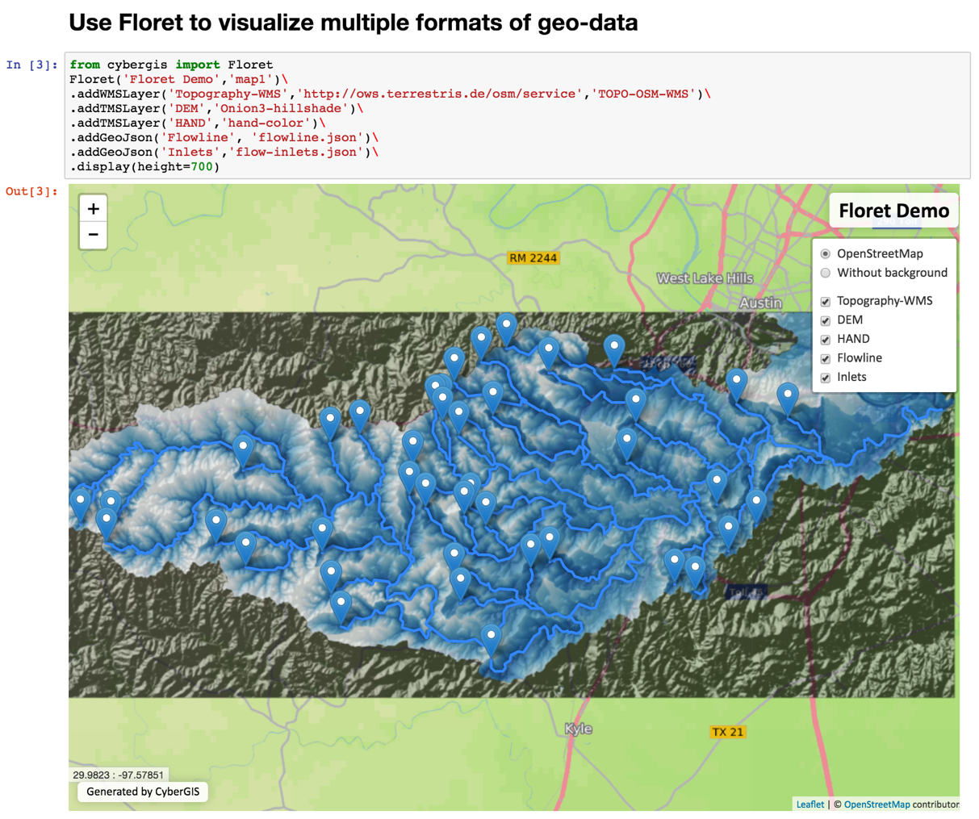
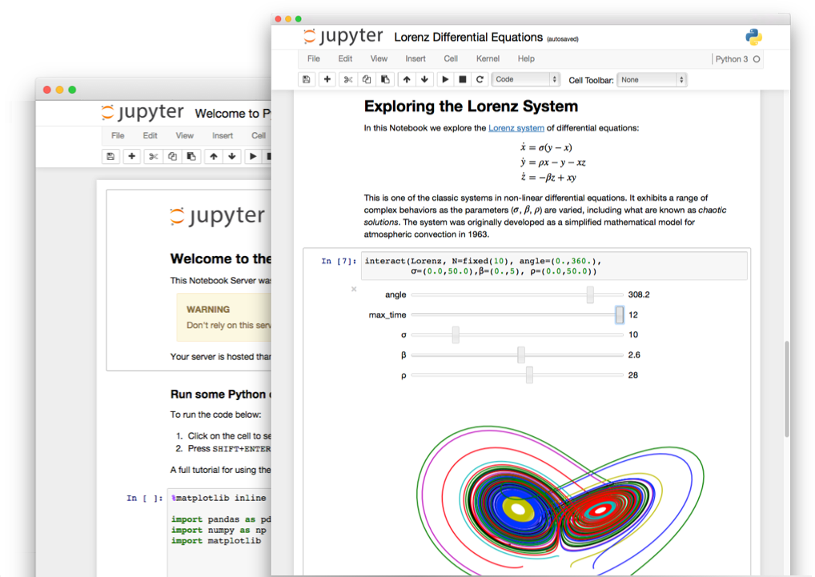
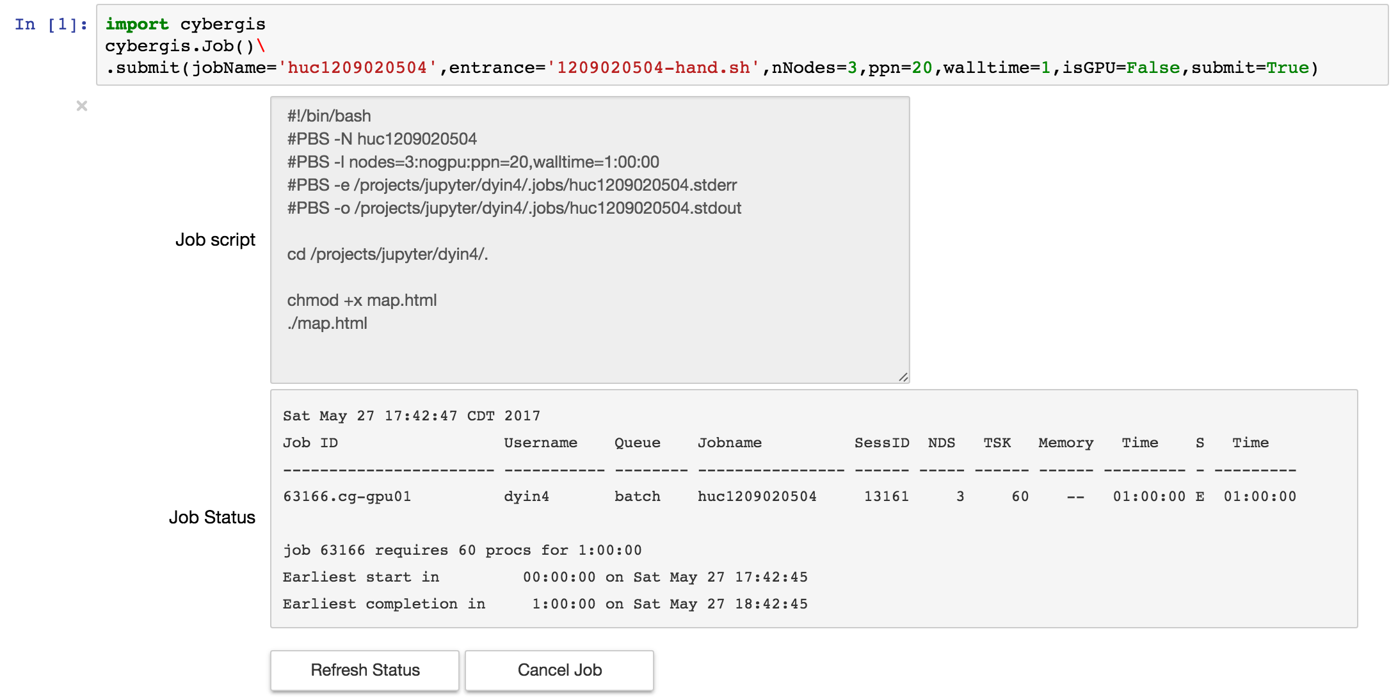
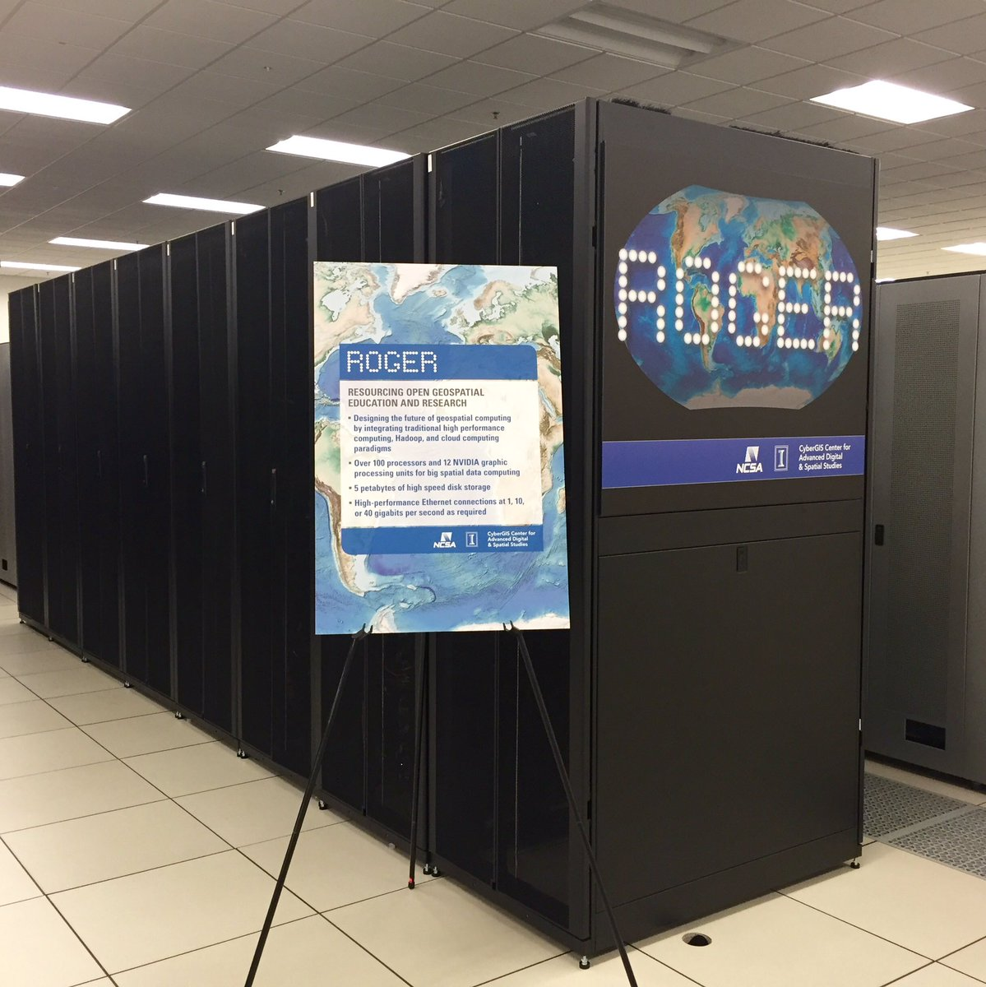
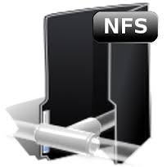
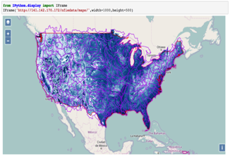
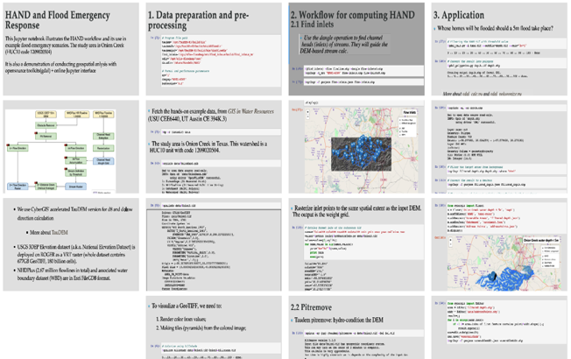
CIF21 DIBBs: Scalable Capabilities for Spatial Data Synthesis PI: Shaowen Wang¹, Co-PIs: Katarzyna Keahey², Anand Padmanabhan¹ Institutions: ¹University of Illinois at Urbana Champaign; ²University of Chicago
NSF CSSI PI Meeting, Seattle, WA, Feb. 13-14, 2020
Award #: 1443080
Project Goals
Establish core spatial data synthesis capabilities to enable data-intensive geospatial problem solving and decision making
Integrate the data synthesis capabilities on an online platform to ensure open and broad access to the capabilities
Develop novel education and training materials for a large number of users to learn and contribute to the capabilities
Spatial Data Synthesis Capabilities
Spatial Data Processing: For handling spatial big data streams (both vector and raster)
Spatial Data Integration: Integration of different types of spatial data
Spatial Data Presentation: Interactively visualize geospatial data and relations (e.g., geospatial flows and spatial interactions)
Data Retrieval and Storage: Efficient and scalable access of geospatial big data (e.g., fast geohash-based indexing for handling rich geometries and varying spatial resolutions)
CyberGISX Platform
CyberGISX Platform (http://cybergisx.org) is established as an innovative cyberGIS framework for achieving data-intensive, reproducible, and scalable geospatial analytics using Jupyter Notebook.
Purposes
Achieve data-intensive, reproducible, and scalable geospatial analytics using Jupyter Notebooks
- Provide a holistic solution
Reduce the barrier to accessing advanced cyberinfrastructure and cyberGIS capabilities
- Exploit JupyterHub, cloud and high-performance computing resources
Capabilities
Provision notebook servers with cyberGIS libraries and many geospatial software packages well configured
Built-in cyberGIS capabilities to accelerate application development
Data, analytics, and workflow runtime environments are encapsulated into application packages
Deployment can be elastically scaled to accommodate computational loads
Seamless scaling between Virtual ROGER and XSEDE JetStream
Geovisualization
Interactive map generation inside notebooks
Support multiple formats of geospatial data
Layer management, transparency and styles
Using Floret to Visualize Geospatial Data
Architecture and Technologies
HPC and Cloud Resources
Virtual ROGER
HPC; VMWare Cloud
XSEDE
Jetstream; Comet
Architecture layers
User layer
Application layer
Cloud resources
HPC resources
Batch Job management
Cloud-based architecture
User’s interaction with cyberinfrastructure
Logging into CyberGISX and accessing notebooks that seamlessly use local and national resources
Submitting computationally intensive jobs that leverage HPC resources locally and on XSEDE
Data/storage synchronization
CyberGISX Technologies
Case Studies and Results
Map Flood Inundation at Continental Scale
AAG-UCGIS 2019 Summer School
Compute Height Above Nearest Drainage (HAND) at 10m for the continental US
Flood analysis map derived from the 10m USGS 3DEP national elevation dataset (180 billion cells) and National Hydrography Dataset (2.67 million stream reaches, raw data size: 5.2TB )
Week-long summer school on Reproducible Problem Solving with CyberGIS and Geospatial Data Science
Over 35 students and 10 mentors engaged for collaborative problem solving using CyberGISX
Guided by mentors, students developed notebooks for solving interdisciplinary problems
HAND data visualized for the continental US
Objectives
Collaborative methodology development
Scalable data analytics
Deliver methodology and data products to different communities: collaborators, researchers, decision makers, and students
HAND Notebook in CyberGISX
Participants presenting their work based on CyberGISX

