Slide 1
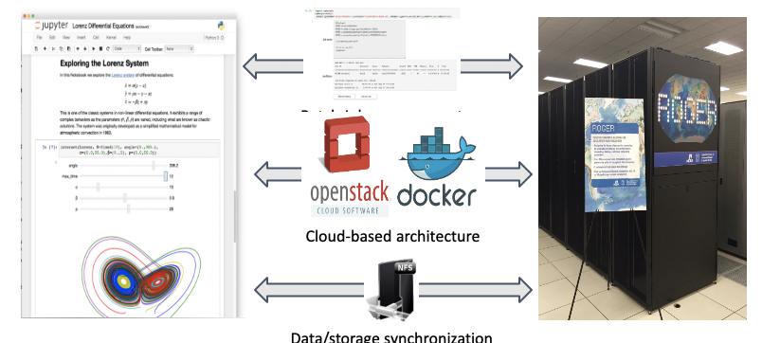
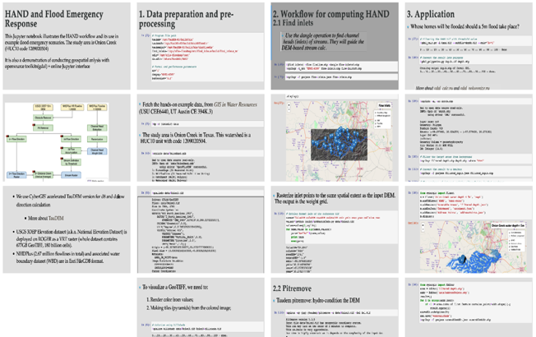
CIF21 DIBBs: Scalable Capabilities for Spatial Data Synthesis PI: Shaowen Wang¹, Co-PIs: Katarzyna Keahey², Anand Padmanabhan¹ Institutions: ¹University of Illinois at Urbana Champaign; ²University of Chicago
Award #: 1443080
Objectives
Establish core spatial data synthesis capabilities to enable data-intensive geospatial problem solving and decision making
Integrate the data synthesis capabilities on an online platform to ensure open and broad access to the capabilities
Develop novel education and training materials for a large number of users to learn and contribute to the capabilities
Data Synthesis Capabilities
Spatial Data Processing; Spatial Data Integration; Spatial Data Presentation; Data Retrieval and Storage
Platform
CyberGISX Platform (http://cybergisx.org) is established as an innovative cyberGIS framework for achieving reproducible and scalable spatial data synthesis based on CyberGIS-Jupyter
Case Study: Map Flood Inundation at Continental Scale
AAG UCGIS 2019 Summer School
* Week-long summer school on Reproducible Problem Solving with CyberGIS and Geospatial Data Science
* Over 35 students and 10 mentors engaged for collaborative problem solving using CyberGISX
* Guided by mentors, students developed CyberGIS-Jupyter notebooks for solving interdisciplinary problems
NSF CSSI PI Meeting, Seattle, WA, Feb. 13-14, 2020

