Slide 1
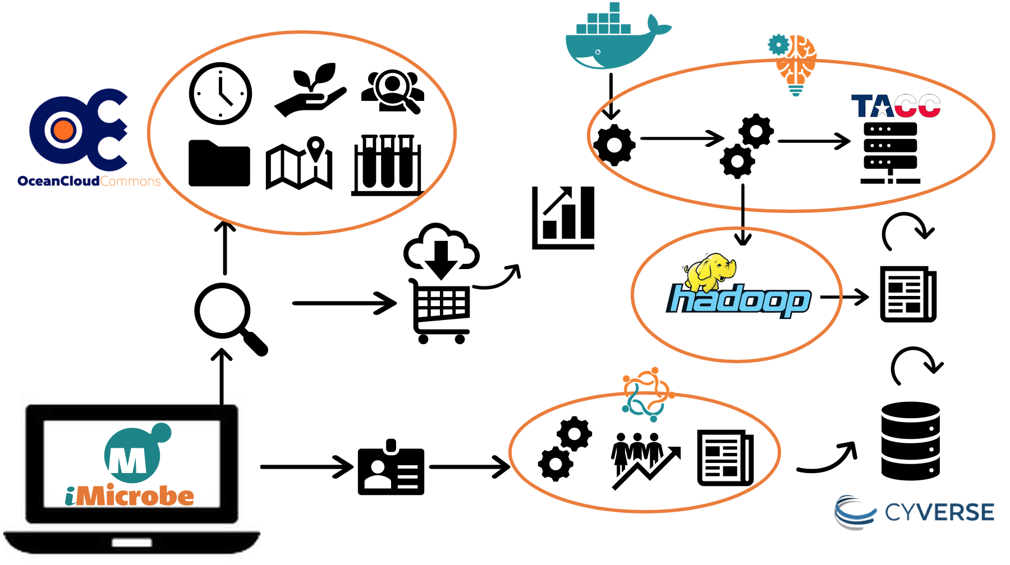
CSSI Element: Accelerating Comparative Metagenomics through an Ocean Cloud Commons PI: Bonnie Hurwitz, Co-PI: John Hartman, University of Arizona
Award #: 1640775
NSF CSSI PI Meeting, Seattle, WA, Feb. 13-14, 2020

