Slide 1
Wikimedia
Ingrid Thomson
UCT Libraries

Slide 2
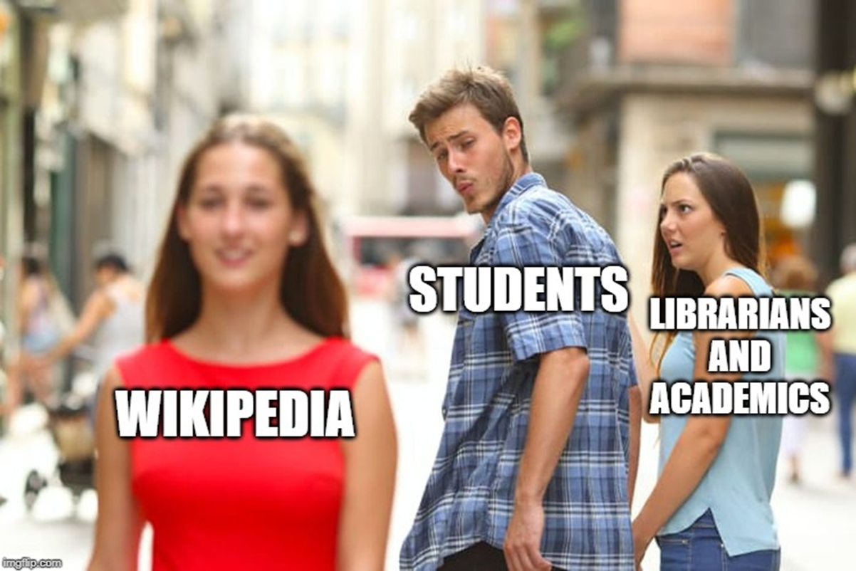

Slide 3
WIKIMEDIA
Global movement whose mission is to bring free educational content to the world
This is supported by the non-profit Wikimedia Foundation through various projects and 37 chapters across the world
Wikipedia is the best-known of the Wikimedia wikis. But not all Wikis are Wikimedia.

Slide 4
WIKIMEDIA PROJECTS

Slide 5
WIKI EDUCATION

Slide 6
STUDENTS WORKING ON WIKIPEDIA WRITING ASSIGNMENTS SAY:
Great for expanding writing and research skills
Writing for a large audience builds confidence in one’s own voice
Satisfying to contribute to a resource used worldwide
Understanding how Wikipedia works is a necessary digital literacy learning
It’s gratifying that all that hard work lives on.
https://wikiedu.org/blog/2020/02/03/what-do-students-think-of-adding-to-wikipedia-as-an-assignment/

Slide 7
WE NEED TO KNOW HOW WIKIMEDIA WORKS
This media is available in the holdings of the National Archives and Records Administration, cataloged under the National Archives Identifier (NAID) 557858.

Slide 8
A short video interlude
Emmanuella Goes to School
https://www.youtube.com/watch?v=2qDH4bPvfMw

Slide 9
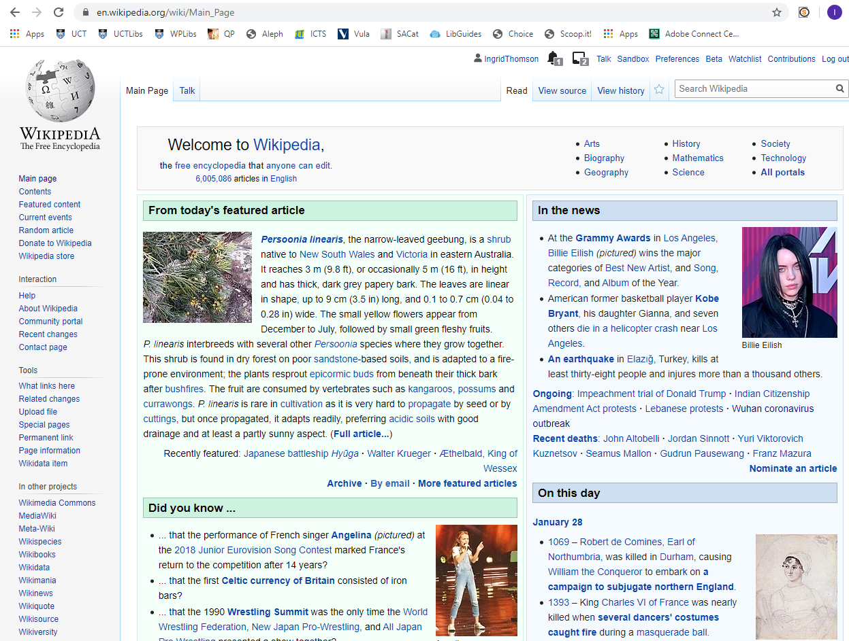

Slide 10
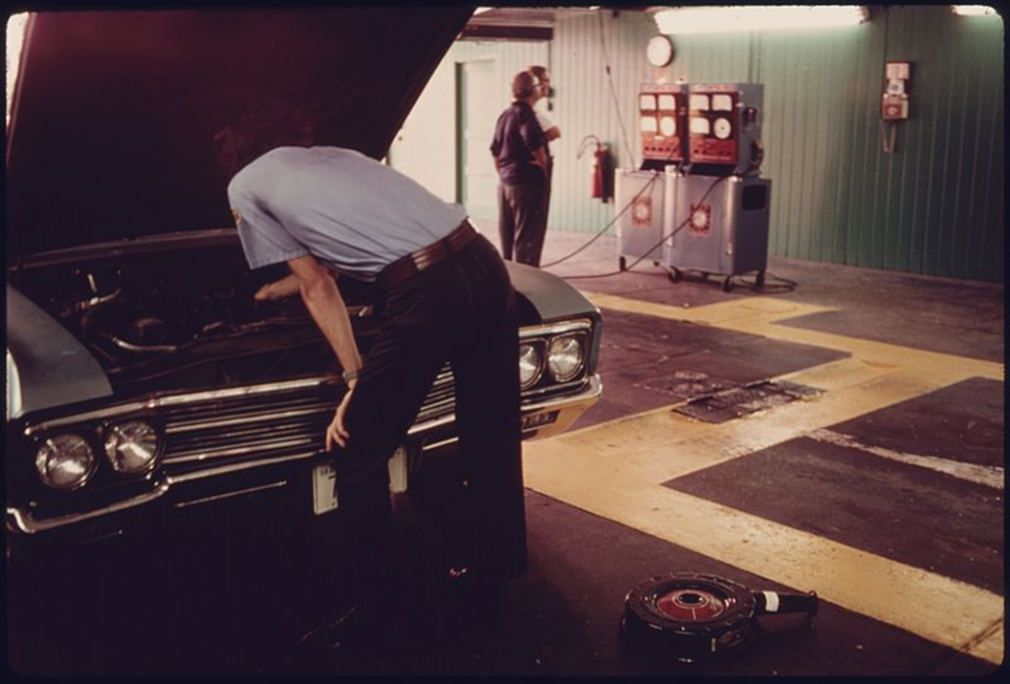
WIKIPEDIA
Wikipedia is a multilingual web-based free-content encyclopaedia, based on a model of openly editable content, written collaboratively by anonymous volunteers
For librarians and educators to use and understand Wikipedia as a pedagogical tool, we need to be familiar with this resource.
We need to know how Wikipedia formats, collects and disseminates information.
We need to understand the components of a Wikipedia article (the notable topic, neutral point of view, no original research, references to solid, reliable, secondary sources and links to other Wikipedia articles

Slide 11
WIKIPEDIA
One of the top five most heavily used websites in the world.
Wikipedia is available in 309 languages
More than 50 million encyclopaedic articles curated by around 200 000 regular editors and viewed on about 1,4 billion devices monthly
(Often) Readers don’t understand how Wikipedia is created and how to use in within a research process and other critical thinking and digital research skills
Yes, there are problems (like the thinking that it is a one-stop shop for all information needs; that anyone can edit and add content; and that vandals deliberately change entries; that there is a western bias, that there is a gender gap; that not all knowledges are represented)
But there are opportunities to add local (South African and African) content; to add content in our official languages (not just English) either by writing in the languages or translating
Adding local content to the sister projects (photographs)

Slide 12
SOUTH AFRICAN LANGUAGES ON WIKIPEDIA (as of 28 Jan 2020)
English 6 005 086
Afrikaans 88 533
Northern Sotho 8 174
isiZulu 1 378
isiXhosa 1 044
Tswana 710
Tsonga 680
Sesotho 663
SiSwati 502
Venda 367
Southern Ndebele in the Wikipedia Incubator
https://meta.wikimedia.org/wiki/List_of_Wikipedias

Slide 13
CORE POLICIES ABOUT CONTENT: VERIFIABLE
All article content has to be VERIFIABLE.
A RELIABLE source must be able to support the material
All quotations must include an inline citation to a source that directly supports the material
Must be a RELIABLE, PUBLISHED secondary source (or to a lesser extent tertiary or primary sources)
Readers must be able to check that any of the information within Wikipedia articles is not just made up. This means all material must be attributable to reliable, published sources. Additionally, quotations and any material challenged or likely to be challenged must be supported by inline citations. https://en.wikipedia.org/wiki/Wikipedia:Verifiability

Slide 14
CORE POLICIES ABOUT CONTENT: NO ORIGINAL RESEARCH
Articles must NOT CONTAIN ORIGINAL RESEARCH.
“original research” (facts, allegations, and ideas) for which no reliable published sources exist.
Wikipedia does not publish original thought. All material in Wikipedia must be attributable to a reliable, published source. Articles may not contain any new analysis or synthesis of published material that serves to reach or imply a conclusion not clearly stated by the sources themselves. https://en.wikipedia.org/wiki/Wikipedia:No_original_research

Slide 15
CORE POLICIES ABOUT CONTENT: NEUTRAL POINT OF VIEW
All articles must be written from a NEUTRAL POINT OF VIEW.
Means representing fairly, proportionately and as far as possible without editorial bias, all the significant views published by reliable sources on a topic
Bottom Line: Articles must not take sides, but should explain the sides, fairly and without editorial bias. This applies to both what you say and how you say it. https://en.wikipedia.org/wiki/Wikipedia:Neutral_point_of_view
ARTICLES MUST ALSO COMPLY WITH COPYRIGHT https://en.wikipedia.org/wiki/Wikipedia:Copyrights

Slide 17
WHAT IS COVERED IN WIKIPEDIA: NOTABILITY
Wikipedia articles cover notable topics—those that have gained sufficiently significant attention by the world at large and over a period of time.
The notability guideline does not determine the content of articles, but only whether the topic should have its own article.
Bottom Line: If no reliable independent sources can be found on a topic, Wikipedia should not have an article on it.

Slide 18
WHAT MAKES A GOOD ARTICLE?

Slide 19
DIFFERENT CLASSES OF ARTICLES (1/2)

Slide 20
DIFFERENT CLASSES OF ARTICLES (2/2)
Most Wikipedia readers never see ratings

Slide 21
WHAT MAKES A GOOD SOURCE TO ADD AS A REFERENCE IN WIKIPEDIA?
https://en.wikipedia.org/wiki/Wikipedia_talk:Reliable_sources
“Source” refers to the piece of work, the creator and the publisher.
Published: in a source with a reputation for editorial quality, and peer-reviewed if possible.
Reliable: it's a source you'd point a patron to if they wanted to know more.
Supports the text: the source should back up what is stated. Context matters.
If it doesn't back up what is stated, but is a good general resource for the topic (such as a specialty encyclopaedia), consider adding the source to a "further reading" section.
Though Wikipedia favours open-access or publicly available sources, this is not a requirement: using appropriate offline, rare, or hard to access sources might be the best option.

Slide 22
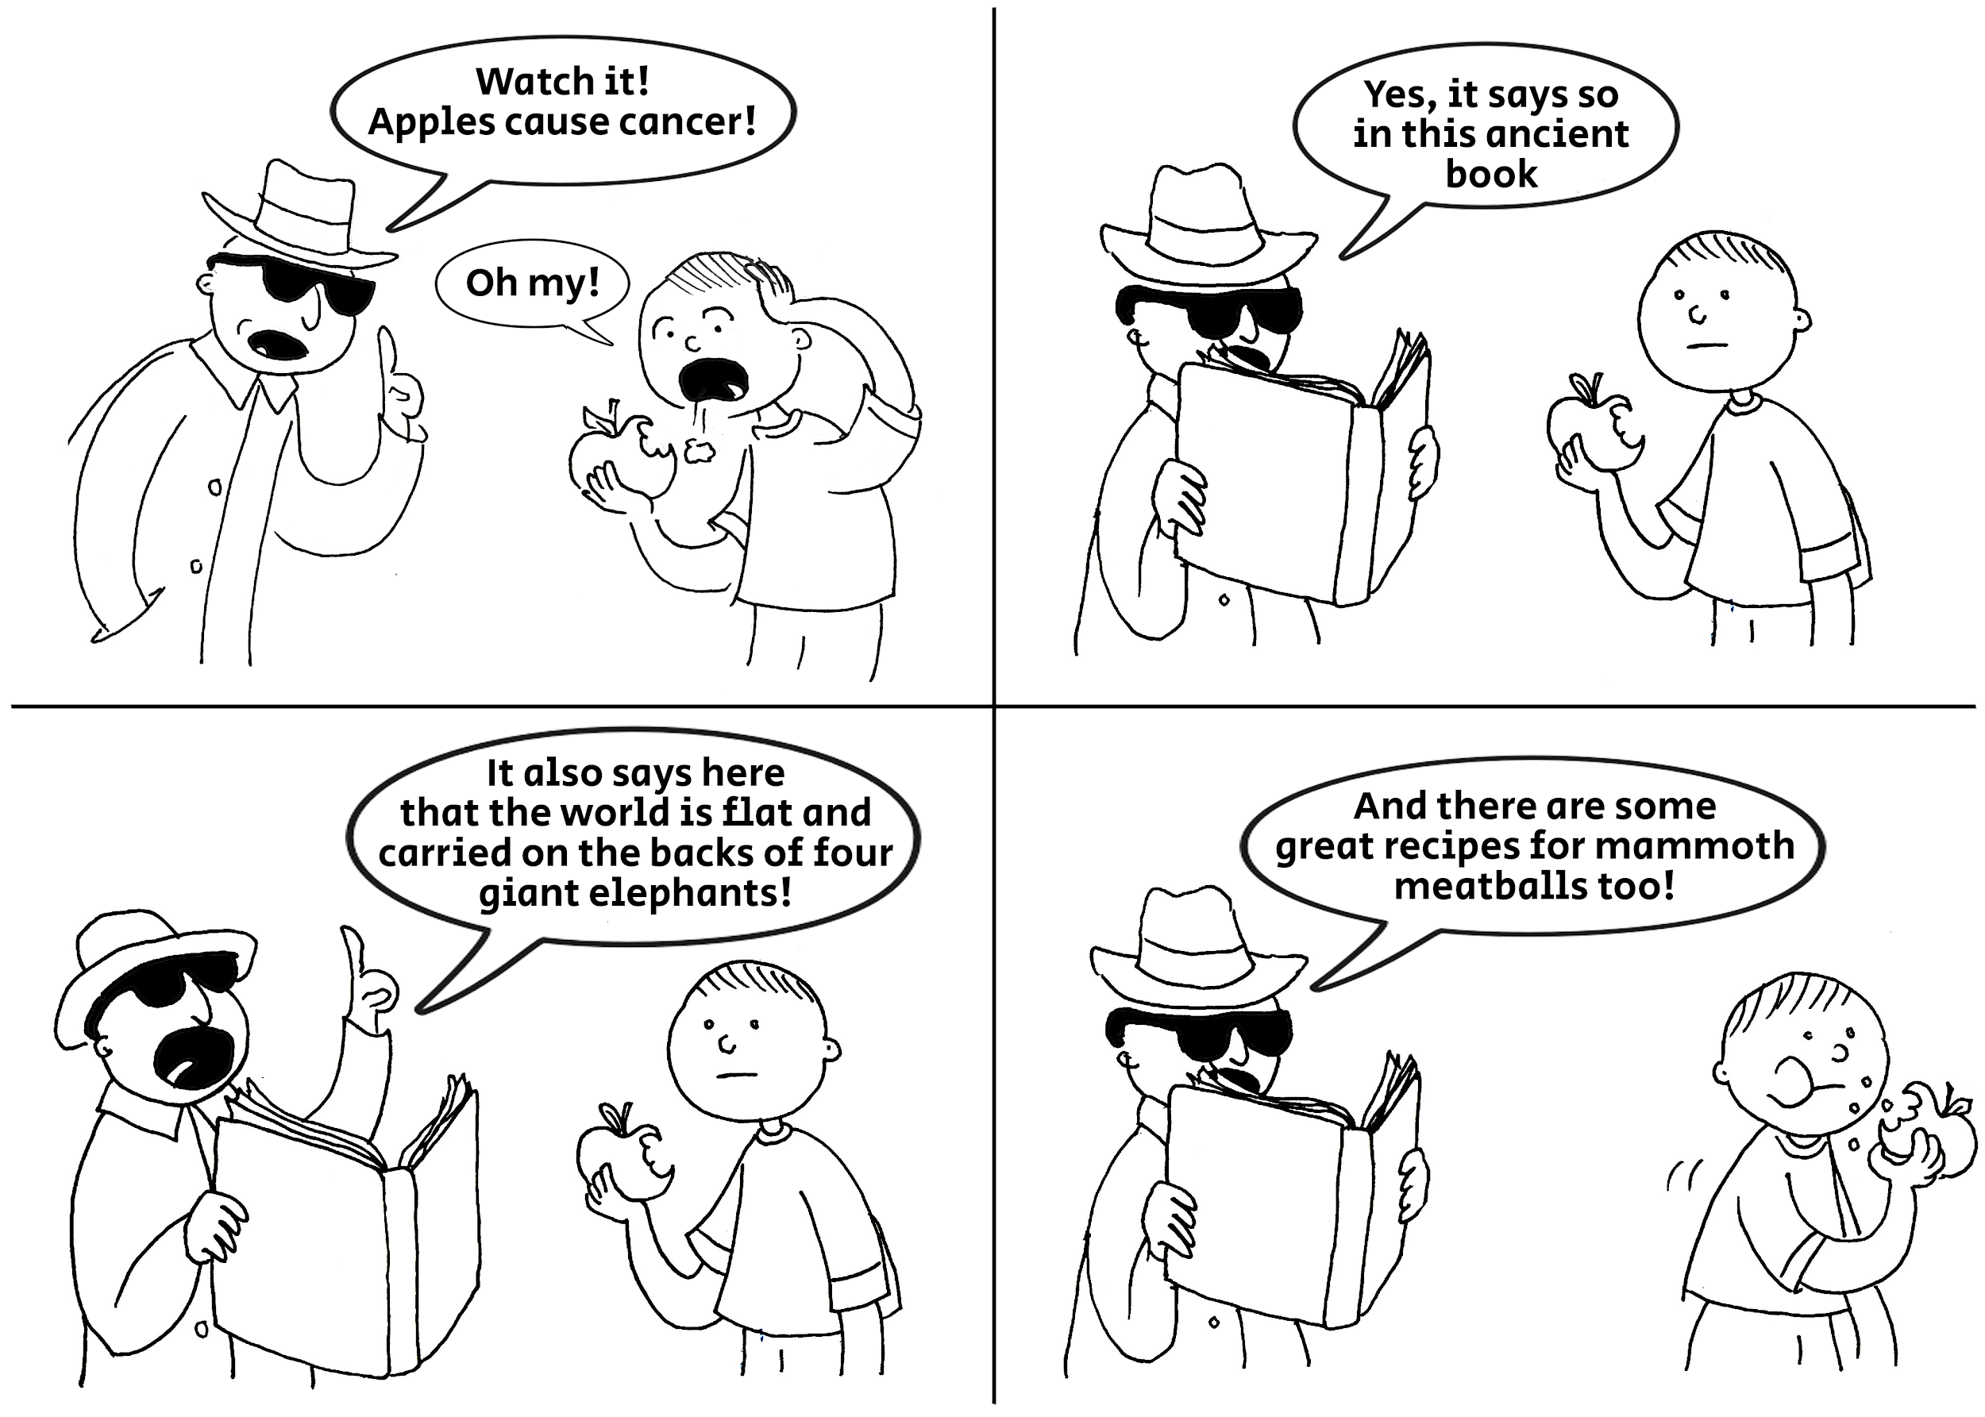
WHAT ELSE MAKES A GOOD SOURCE (2/3)
Age matters
Older sources may be inaccurate because there
is new information, new theories or vocabulary
changed.
Or too new to use (like breaking news
when later reports could be more accurate)
https://commons.wikimedia.org/wiki/File:Comics_About_Reliable_Sources_English_1.png

Slide 23
WHAT ELSE ABOUT GOOD SOURCES (3/3)
https://en.wikipedia.org/wiki/Wikipedia:Reliable_sources/Perennial_sources
Most reliable sources (in general)
Peer Review journals; Books published by university presses; University level textbooks
Magazines, journals and books published by respected publishing houses; Mainstream newspapers

Slide 24
Anatomy of a Wikipedia entry

Slide 25
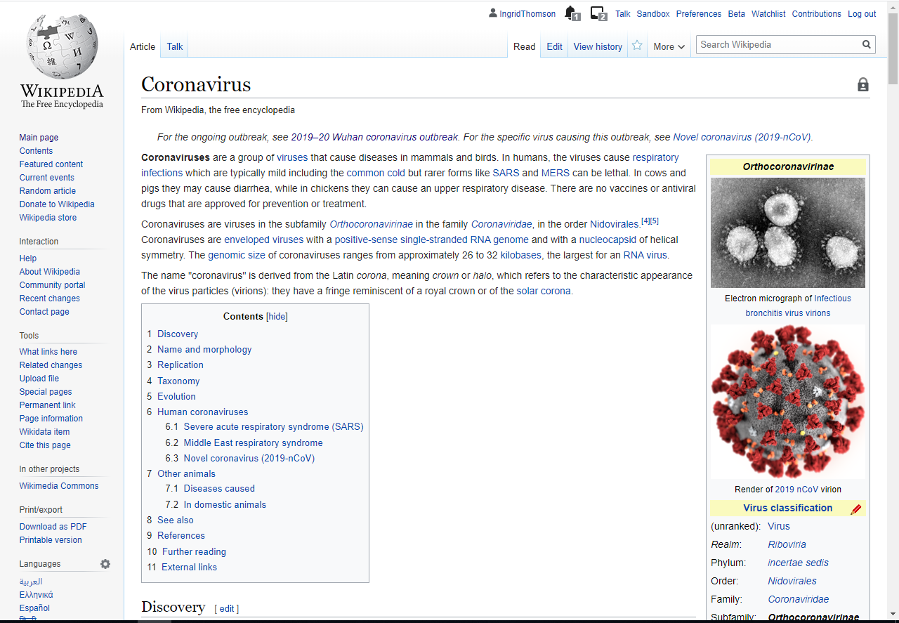
Discussions
History
hyperlinks
Citations/References

Slide 26
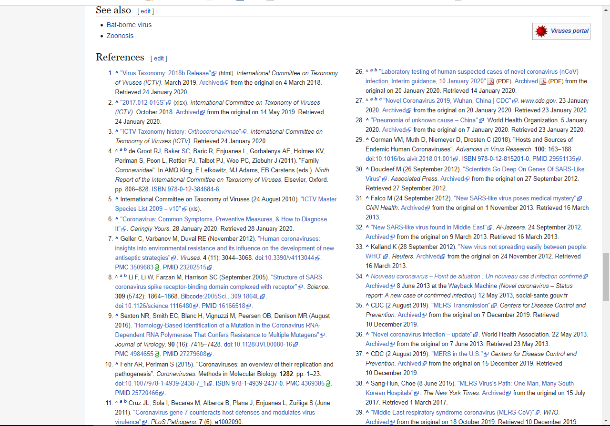
Links to other entries
References to the citations

Slide 27
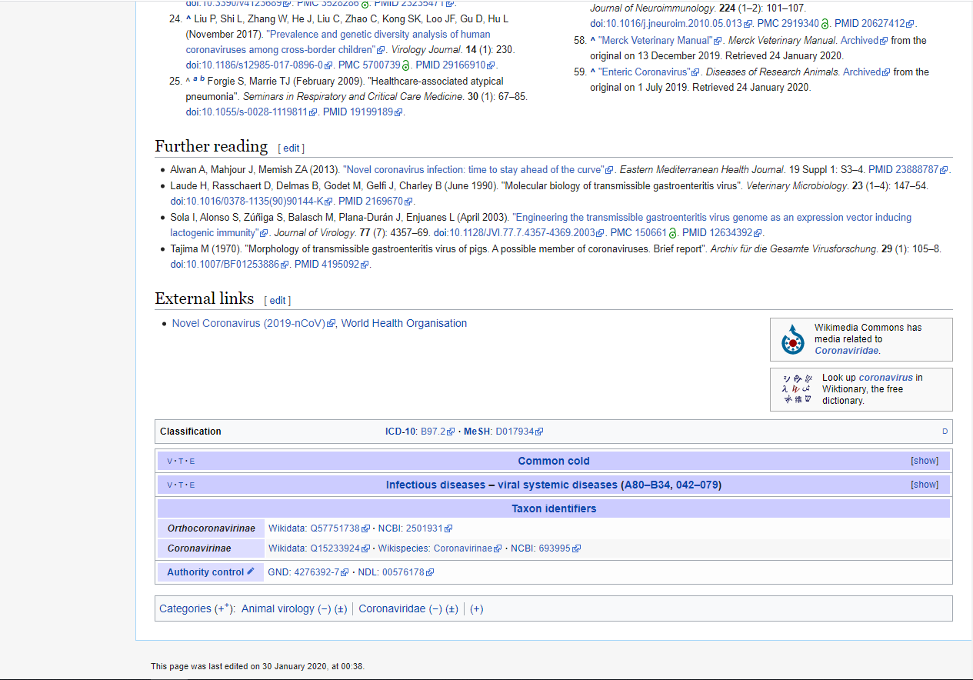

Slide 28
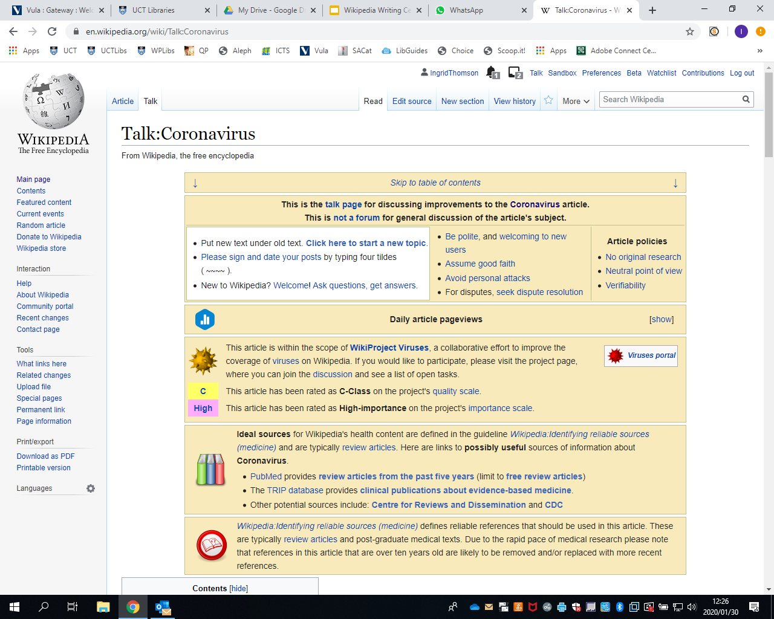

Slide 29
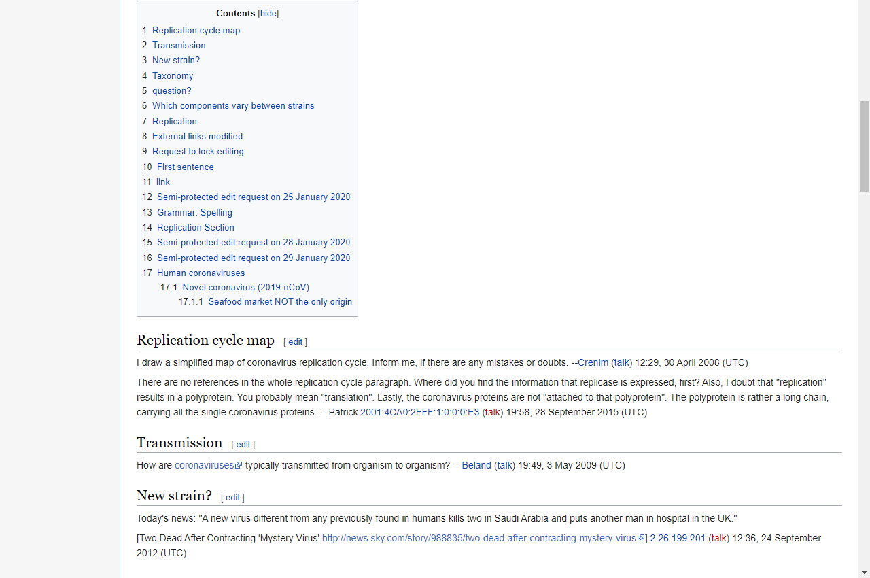
Discussion about changes to the article

Slide 30
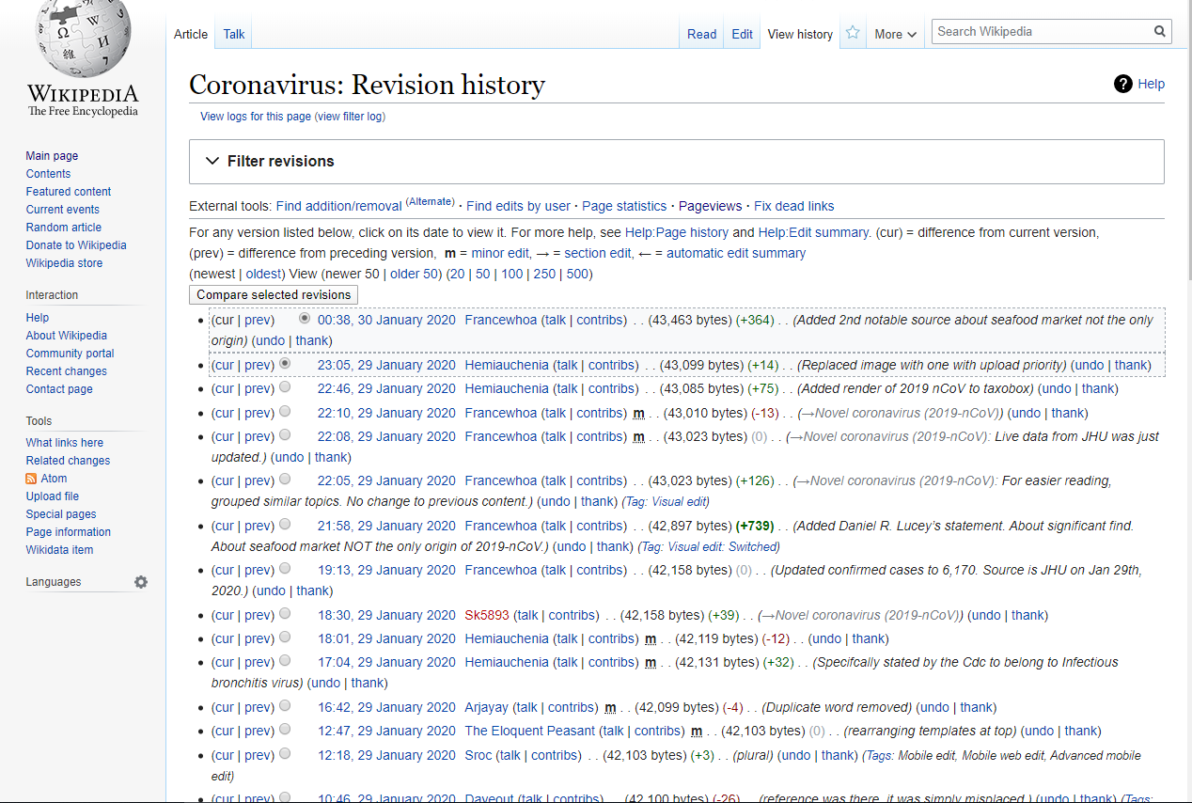
Who has added content and what they have added

Slide 31
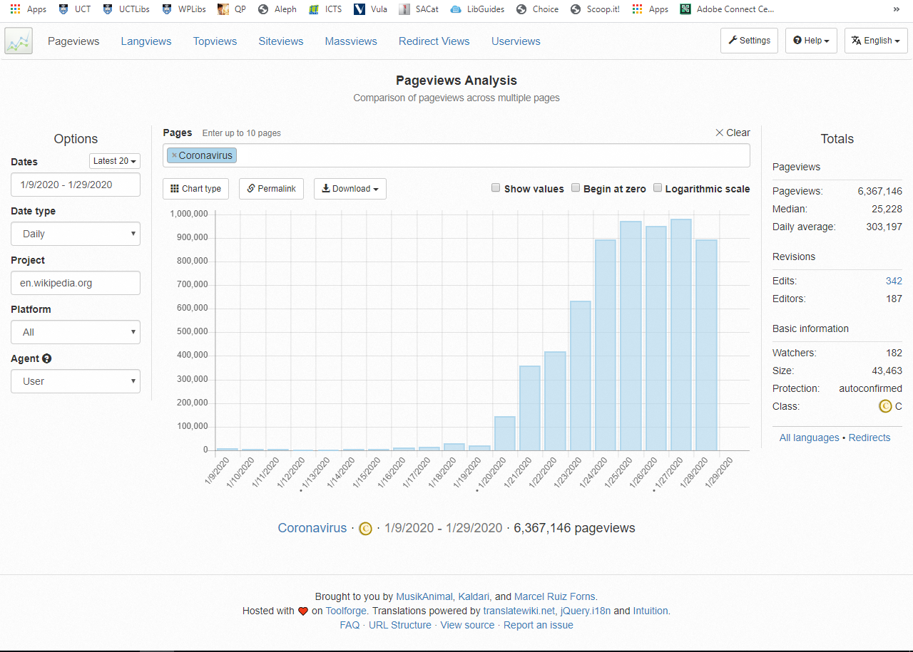

Slide 32
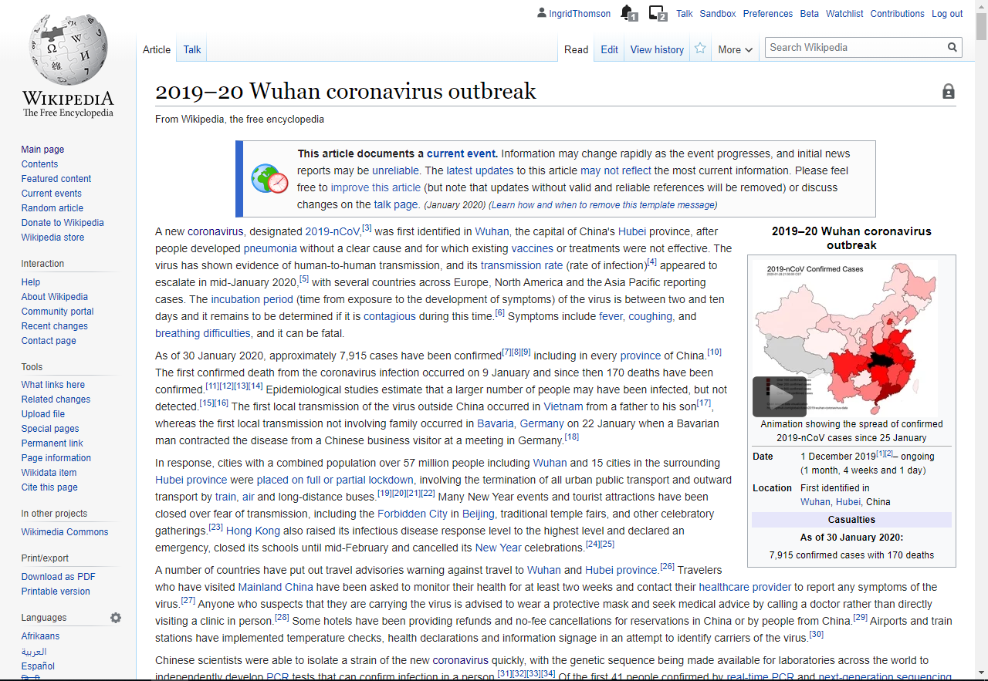

Slide 33
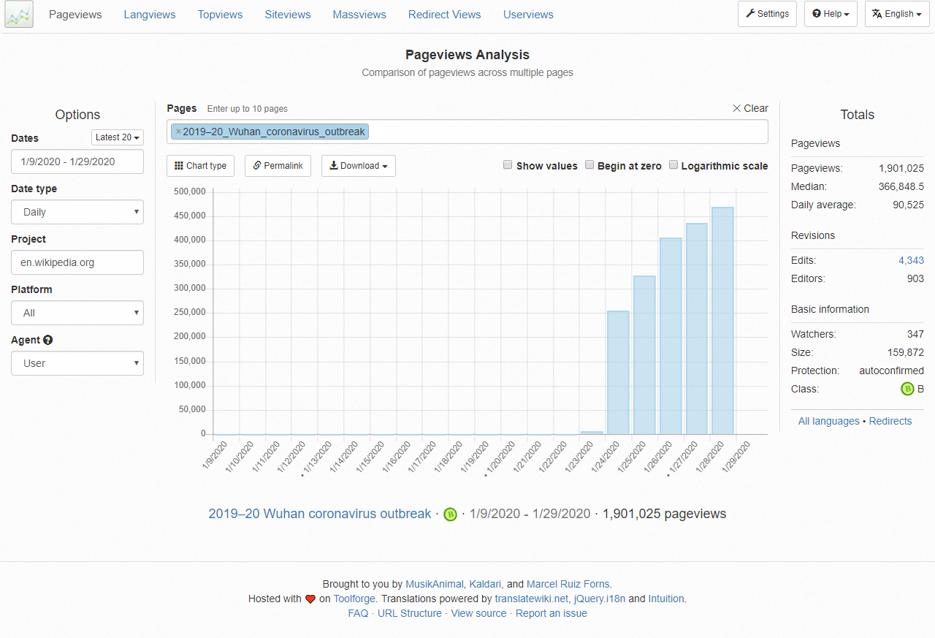

Slide 34
COMBATTING VANDALISM
Bots: In many cases, the vandalism is automatically detected and reverted by a bot. The vandal is always warned with no human intervention.
Recent changes patrol: Wikipedia has a special page that lists all the most recent changes. Some editors will monitor these changes for possible vandalism
Watchlists: Any registered user can watch a page that they have created or edited or that they otherwise have an interest in. This functionality also enables users to monitor a page for vandalism
Incidental discovery: Any reader who comes across vandalism by chance can revert it. In 2008 it was reported that the rarity of such incidental discovery indicated the efficacy of the other methods of vandalism removal
Locking articles so only established users, or in some cases, only administrators can edit. Look for the padlock on the article page.
https://en.wikipedia.org/wiki/Vandalism_on_Wikipedia

Slide 35
SOME STRATEGIES TO CONSIDER
Teach students how to evaluate Wikipedia, within its editorial standards
Teach students how to use Wikipedia as a starting point for research, showing how to use information, footnotes and external links to guide searches in library resources
Show students how to use article histories and discussion pages to evaluate the articles’ current status within the Wikipedia community.

Slide 36
MORE REASONS ....
Encourages creativity and critical thinking in research and writing online, and requires students to write with a neutral point of view.
Fills gaps in Wikipedia’s content, giving more exposure to typically underrepresented groups and content areas.
Wikipedia gives students first-hand experience with the peer-review process
Allows students to participate in a strong global community and practice effective public engagement.
It gives students the opportunity to “give back” to a resource they’ve benefitted from
Wikipedia editing promotes active-learning, motivation and engagement with research and course content.

Slide 37
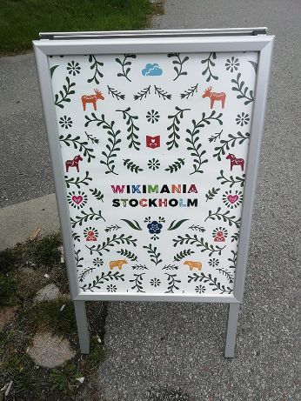
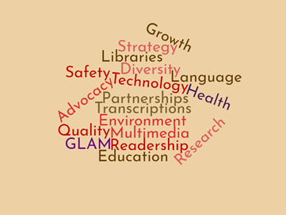
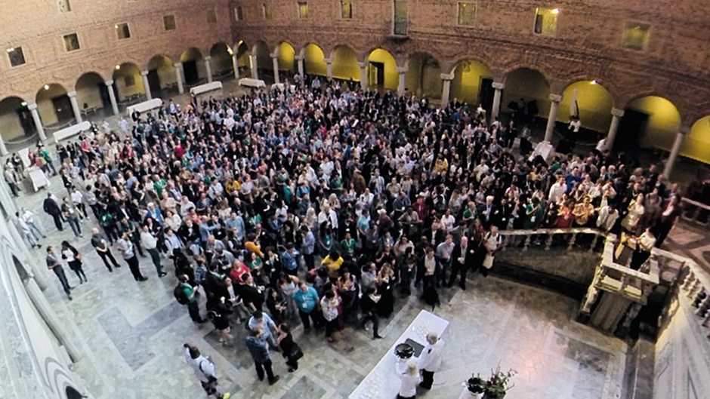
WIKIMANIA 2019
The theme of the conference was “Stronger together: Wikimedia, Free Knowledge and the Sustainable Development Goals”. The questions that were posed were around how does free knowledge relate to sustainable development? Can the Wikimedia movement contribute to a better world? What role can free knowledge play in the work to fulfil Agenda 2030?
Programme, Recordings, Slides: https://wikimania.wikimedia.org/wiki/2019:Program

Slide 38
#1lib1ref
By adding a footnote
to a reliable source in any Wikipedia article, you help Wikipedia readers worldwide.

Slide 39
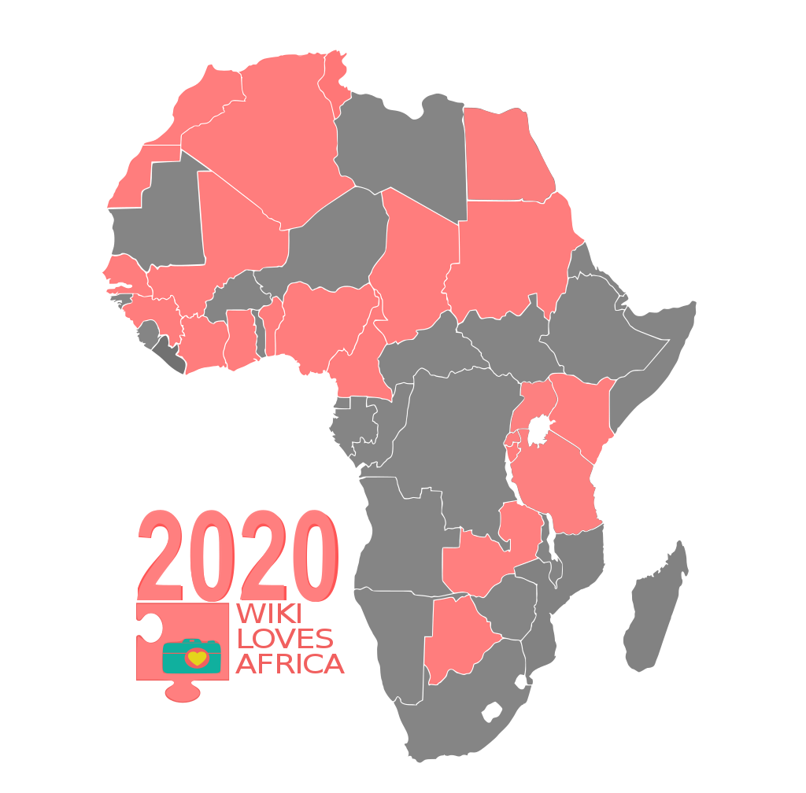
WikiLovesAfrica
https://meta.wikimedia.org/wiki/Wiki_Loves_Africa_2020
Wiki Loves Africa (WLA) is an annual contest where anyone across Africa can contribute media that is relevant to their experience to Wikimedia Commons for use on Wikipedia and other project websites of the Wikimedia Foundation. Runs from 15 Feb to March 31st.
Notes:
T

Slide 40
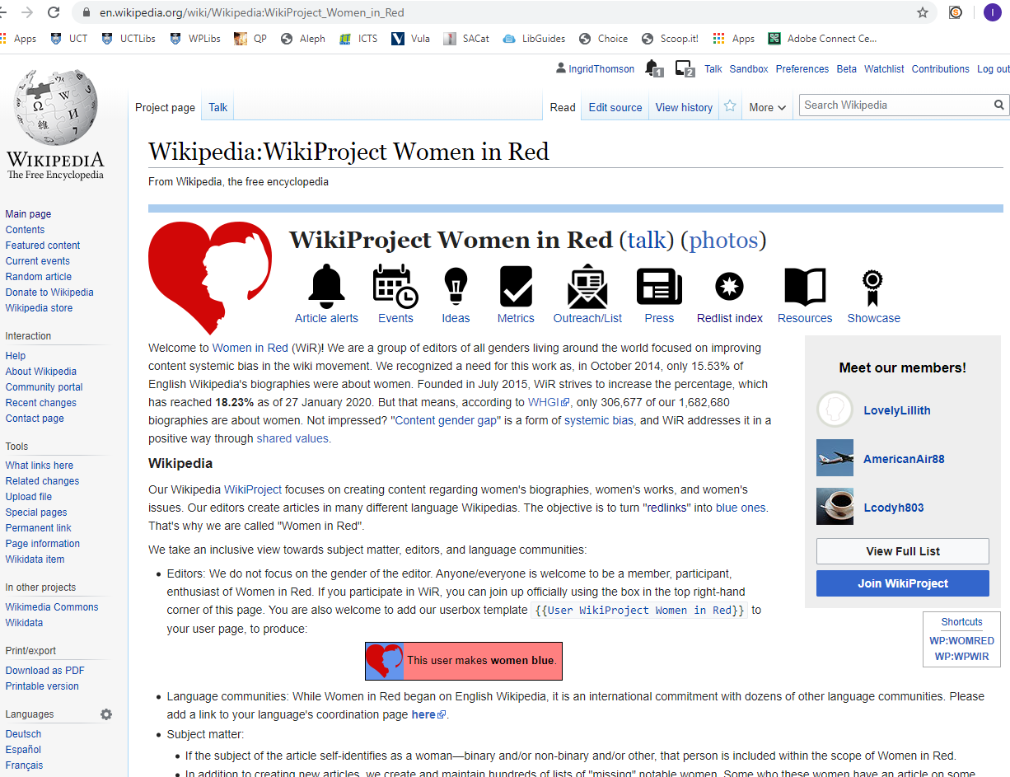
WOMEN IN RED WIKIPROJECT

Slide 41
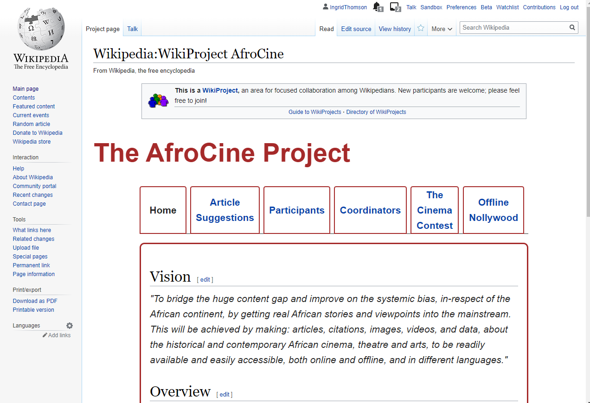
AFROCINE PROJECT

Slide 42
FURTHER READING/REFERENCES
Becker, B, W (2015) Research Faux Pas: The Stigma of Wikipedia, Behavioral & Social Sciences Librarian, 34:3, 165-169, DOI: 10.1080/01639269.2015.1062587
Davis, L. (2017) Writing Wikipedia articles teaches information literacy skills, study finds https://blog.wikimedia.org/2017/06/19/wikipedia-information-literacy-study/
Dawe, L. and Robinson, A. (2017), "Wikipedia editing and information literacy: a case study", Information and Learning Sciences, Vol. 118 No. 1/2, pp. 5-16. https://doi.org/10.1108/ILS-09-2016-0067
Di Lauro, F & Jahinke, R. (2017) Employing Wikipedia for good not evil: innovative approaches to collaborative writing assessment, Assessment & Evaluation in Higher Education,42:3, 478-491, DOI: 10.1080/02602938.2015.1127322
Dowell, M L & Bridges, L.M. (2019) A Perspective on Wikipedia: Your Students Are Here, Why Aren’t You? Journal of Academic Librarianship, 45:2, 81-83, DOI: 10.1016/j.acalib.2019.01.003
Dowell, M L & Bridges, L.M. (2020) A Perspective on Wikipedia: Approaches for educational use. Journal of Academic Librarianship, 46:1, https://doi.org/10.1016/j.acalib.2019.102090
Emmanuella Goes to School https://www.youtube.com/watch?v=2qDH4bPvfMw
Evaluating Wikipedia: Tracing the evolution and evaluating the quality of articles https://en.wikipedia.org/wiki/File:Evaluating_Wikipedia_brochure.pdf
Jennings, E. (2008) Using Wikipedia to Teach Information Literacy, College & Undergraduate Libraries, 15:4, 432-437, DOI: 10.1080/10691310802554895
Lubbock, J. (2018). Wikipedia and libraries. Alexandria, 28(1), 55–68. https://doi.org/10.1177/0955749018794968
Oliver, J. (2015), "One-shot Wikipedia: an edit-sprint toward information literacy", Reference Services Review, Vol. 43 No. 1, pp. 81-97. https://doi.org/10.1108/RSR-10-2014-0043
Proffitt, M. (2018). Leveraging Wikipedia: connecting communities of knowledge. Chicago: ALA Editions, the American Library Association
Wikipedia:Research help/Librarians and Teachers https://en.wikipedia.org/wiki/Wikipedia:Research_help/Librarians_and_Teachers

