Slide 1
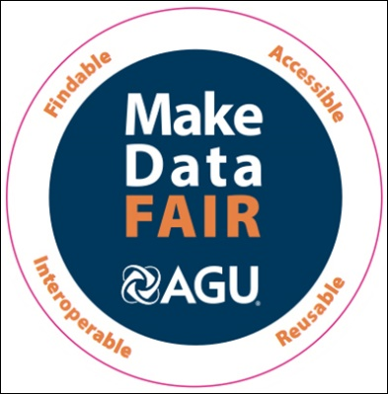
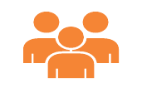
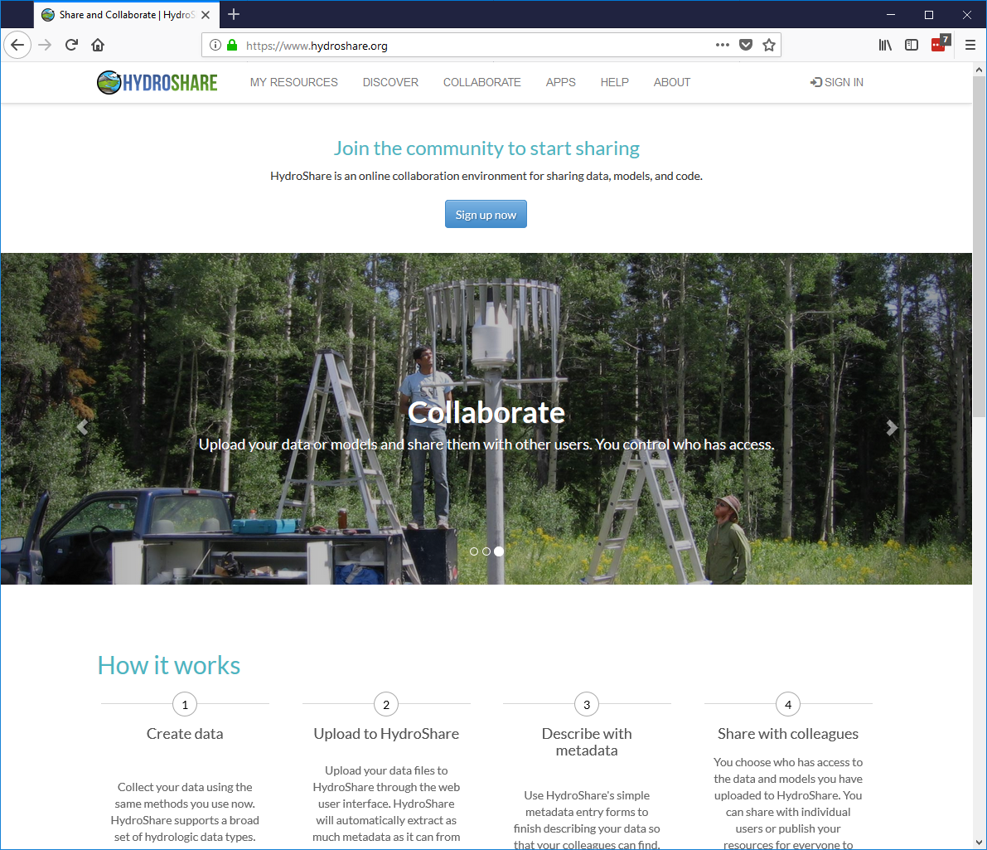
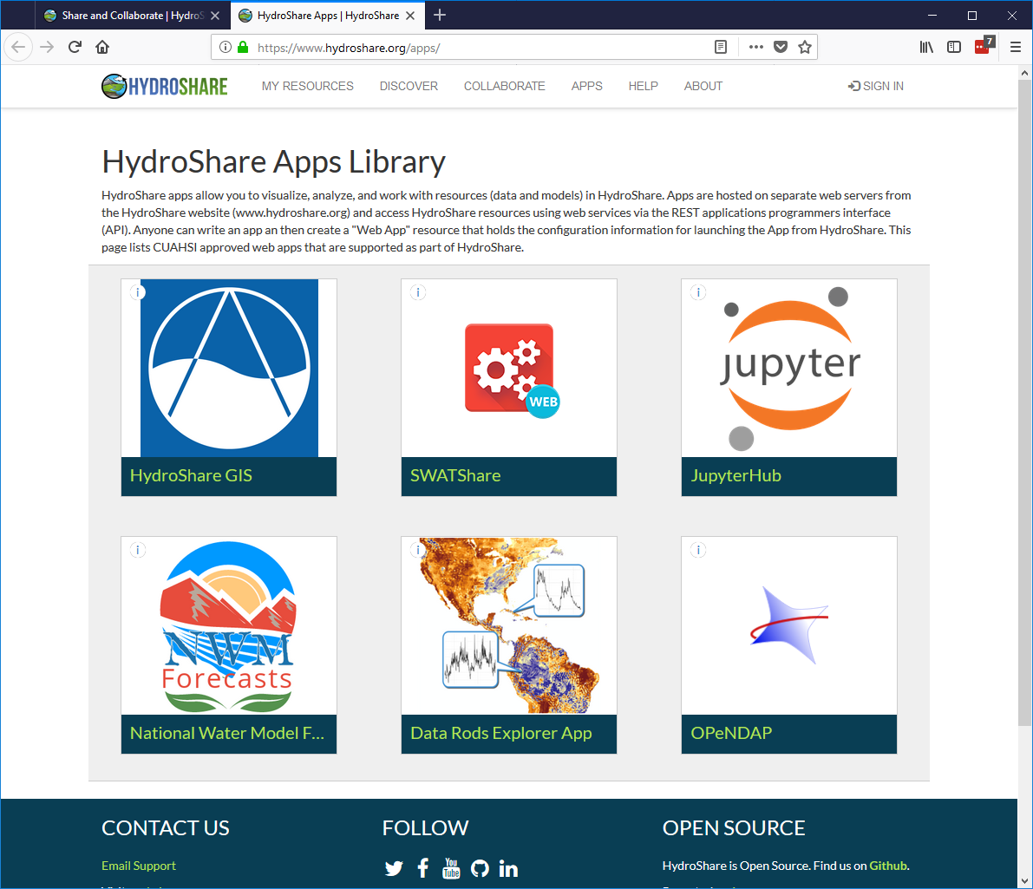
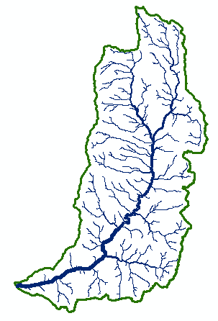
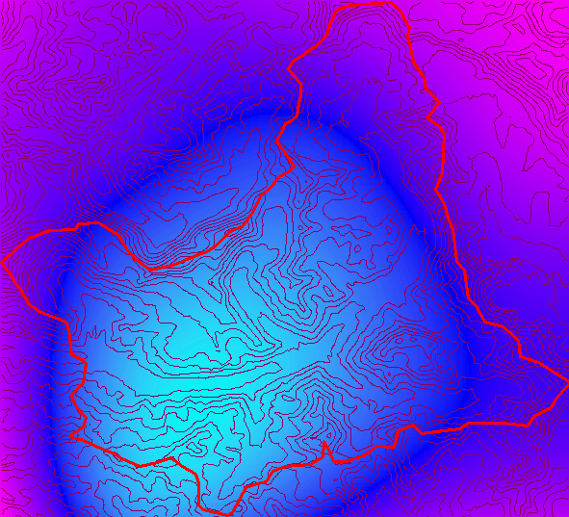
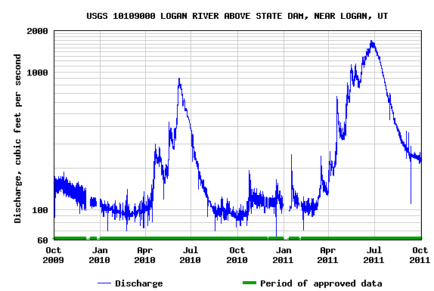
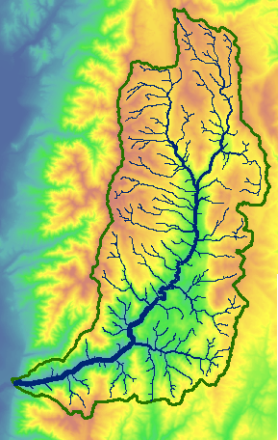
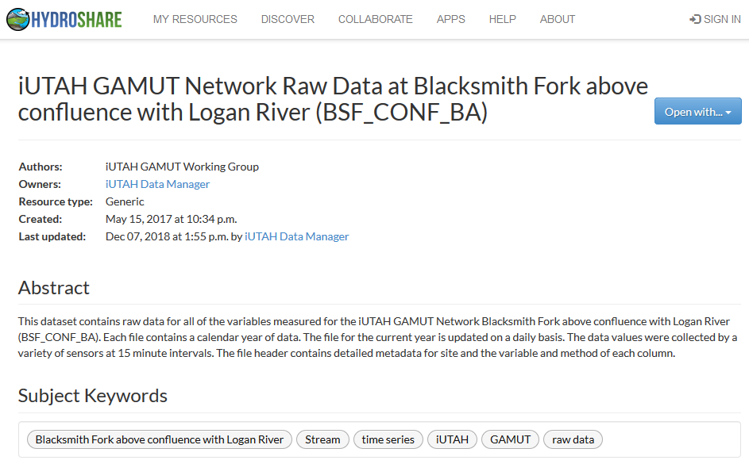
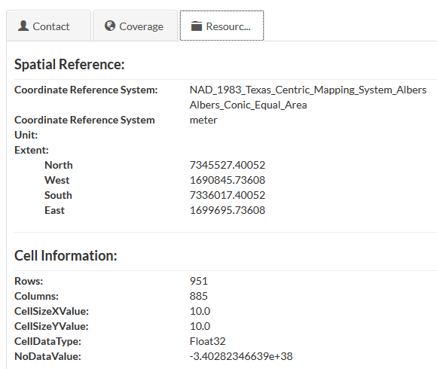
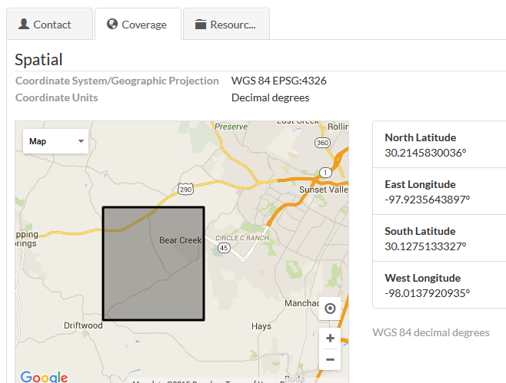
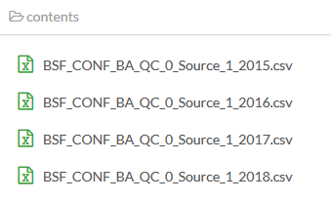
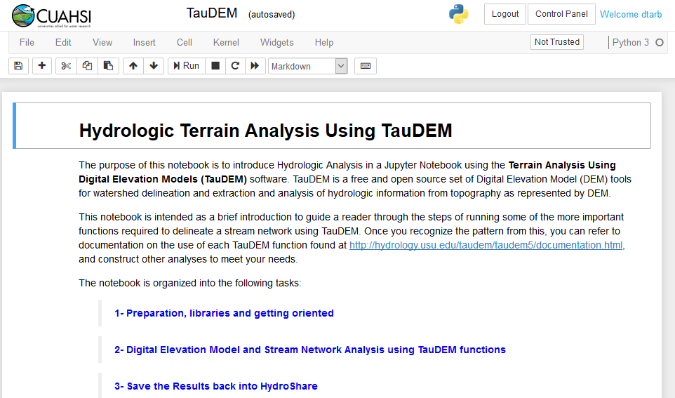
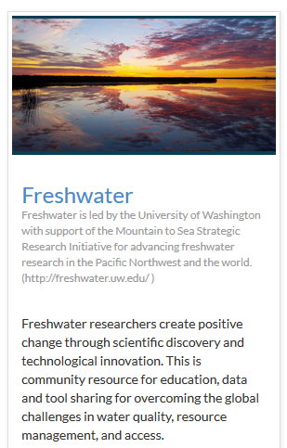
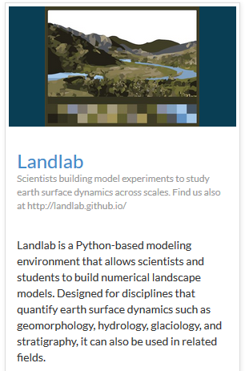
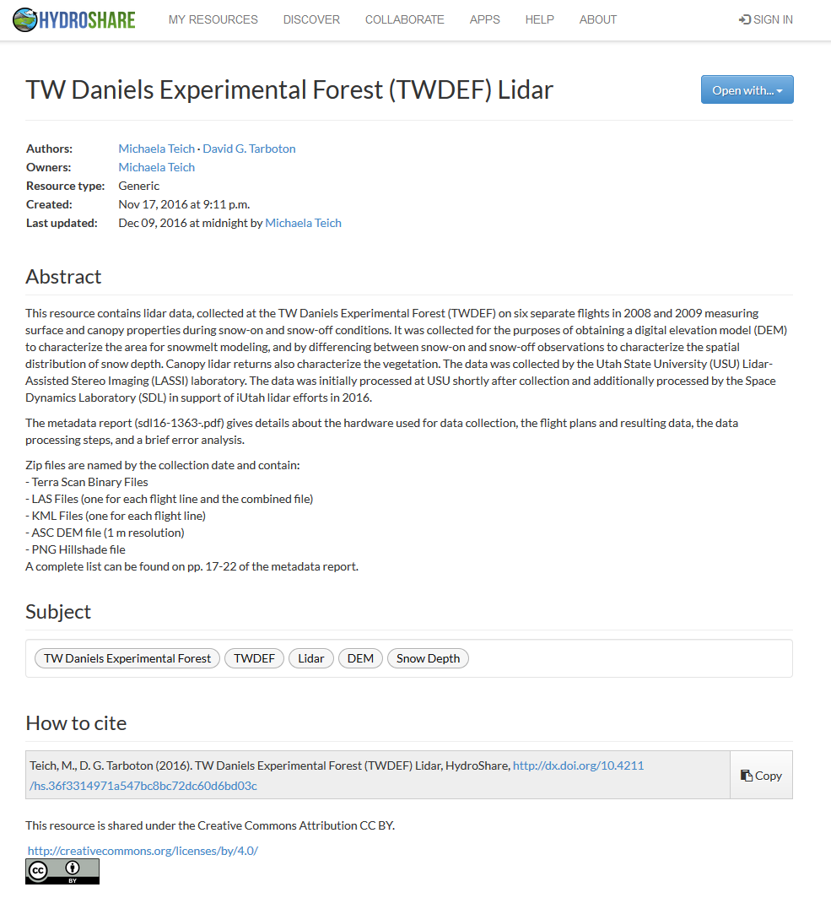
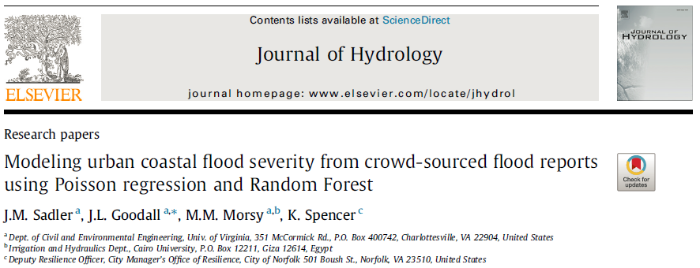
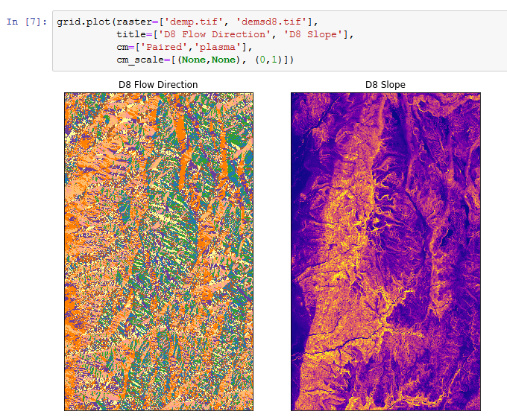
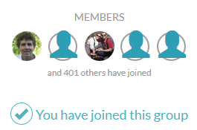
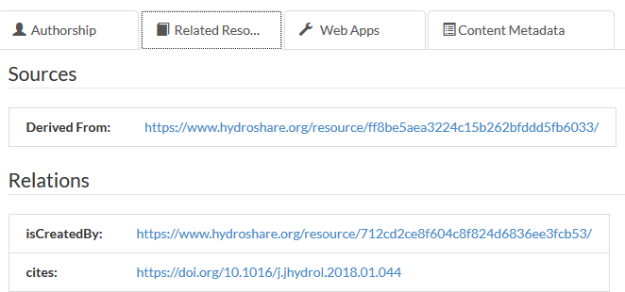
CSSI Framework: HydroShare: Cyberinfrastructure for Advancing Hydrologic Knowledge through Collaborative Integration of Data Science, Modeling and Analysis David Tarbotonª, Ray Idaszak^{b}, Shaowen Wang^{c}, Jeffery Horsburghª, Dan Ames^{d}, Jon Goodall^{f}, Alva Couch^{e}, Hong Yi^{b} ªUtah State University, ^{b}RENCI University of North Carolina, ^{c}University of Illinois, ^{d}Brigham Young University, ^{e}Tufts, ^{f}University of Virginia
Award #: 1664061
NSF CSSI PI Meeting, Seattle, WA, Feb. 13-14, 2020
What is HydroShare ?
Why HydroShare ?
An online hydrologic information system for sharing data, models and code to enable more rapid advances in hydrologic understanding through collaborative research, analysis and modeling.
Collaboration: Share your data and model files; integrate information from multiple sources; organize individual, team, and group work.
Reproducibility, transparency and trust: Publish your work in any format, including data and models with a citable digital object identifier (DOI).
Do Science: Run Apps and models from a browser without installing software; access computational services for your big data and model analysis.
Learning: Use a platform where all students have access to the same functionality regardless of their computer.
HydroShare is a system to advance hydrologic science by enabling the community to more easily and freely share products resulting from their research, not just the scientific publication summarizing a study, but also the data and models used to create the scientific publication.
Findable
Accessible
Interoperable
Reusable
Design
Exploration and Content Management
Django Website
Actions on and working with Resources
www.hydroshare.org
Collaboration, Reproducibility, Credit, Transparency, Trust
Apps
Server/Cloud Computation
Platform independence
Big (ish) data
Reproducibility
Reduce needs for software installation and configuration
Scalable Analytics
Extensibility
Anyone can set up a server/app platform (software service) to launch from (“Open with”) HydroShare and operate on content through API
API
What can you store in HydroShare ?
API
OAuth
API
In HydroShare, data and model files are stored as resources.
HydroShare supports any file, including several specific data formats.
Content “aggregations” hold data formats common in hydrology and support description with additional content specific metadata. Apps can act on specific content types.
Collections group together multiple resources related to a project or study.
Model Programs and Model Instances hold specific hydrologic models and associated data for application at a location.
Storage
Resource Storage
Integrated Rule Oriented Data System (iRODS)
General trend towards interoperating software elements connected using a services oriented architecture and evolving fully web based (hydrologic) innovation environment
OAI-ORE standard based Resource Data Model
Dublin Core machine readable metadata and data model to make data in HydroShare, Findable, Accessible, Interoperable, Reusable
Geographic Feature
t
Input Data
Executed by
Model Engine
Documen-tation
Resources, comprised of data and models, are framed as social objects, the basis for collaboration and interaction
y
x
Horsburgh, J. S., et al., (2016), "Hydroshare: Sharing Diverse Environmental Data Types and Models as Social Objects with Application to the Hydrology Domain," JAWRA, http://dx.doi.org/10.1111/1752-1688.12363.
Multidimensional
Output Data
Model GUI
Utilities Software
Model Instance
Model program
Web App Connector
Time Series
Geographic Raster
Anybody can create a web app on any web server and configure a web app Connector for it to be launched from HydroShare
Key Functionality
HydroShare Resource Catalog
Web App #1 Metadata
Web App #1
Web App Metadata
Data streamed into HydroShare as soon as it is collected
Metadata harvested automatically or captured via simple web page editing
Web App #2 Metadata
Web App #2
Predefined URL Launch Parameters:
Resource ID: ${HS_RES_ID}
Resource Type: ${HS_RES_TYPE}
HydroShare username: ${HS_USR_NAME}
Web App Connector Resource
Web App #3 Metadata
Tethys Platform Apps
Examples:
https://apps.hydroshare.org/apps/ hydroshare-gis/?res_id= ${HS_RES_ID}
https://mygeohub.org/.../?res_id= ${HS_RES_ID}&usr=${HS_USR_NAME}&src=hs
http://hyrax.hydroshare.org/ opendap/${HS_RES_ID}/data/ contents/
Content files updated daily as data streams in
Web App #3
HydroShare Python REST API
3rd Party Apps
JupyterHub App Analysis
Groups
Publishing data and models
Publication with Citable Digital Object Identifier (DOI)
Link publications to their supporting data
Write and execute code in a Jupyter Notebook, acting on content of HydroShare resources and saving results back to HydroShare Repository
Reproducibility
Collaboration
Access to enhanced computation
Paper cites HydroShare resources
HydroShare resources link back to paper

