Slide 1
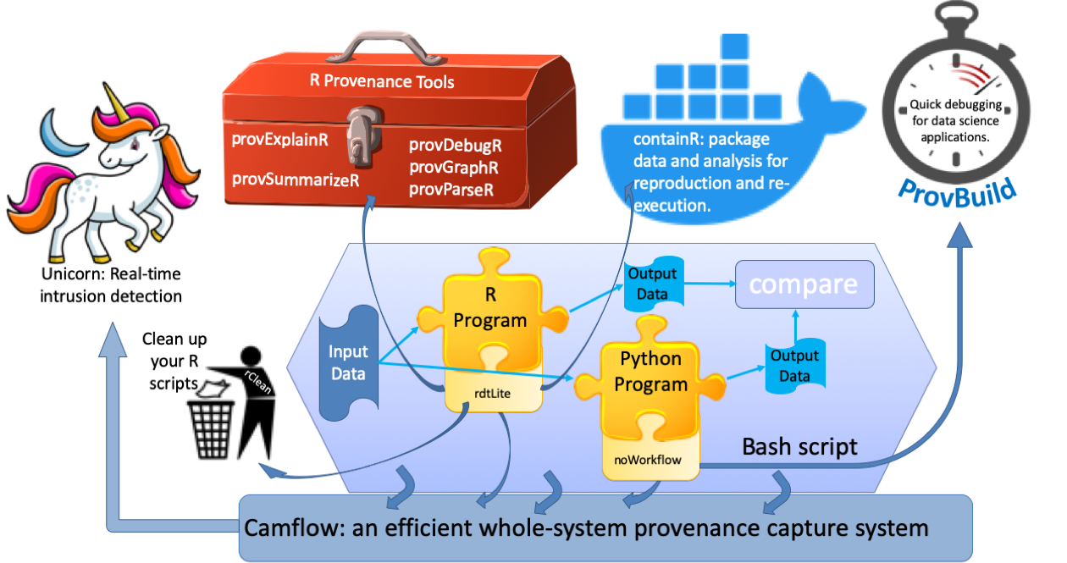
CSSI Element: End to End Provenance PI: Margo Seltzer¹, Co-Pis: Aaron Ellison², Barbara Lerner³, Emery Boose² Institutions: ¹The University of British Columbia, ²Harvard University, ³Mt. Holyoke College
Award #: SSI-1450277
NSF CSSI PI Meeting, Seattle, WA, Feb. 13-14, 2020

