Slide 1
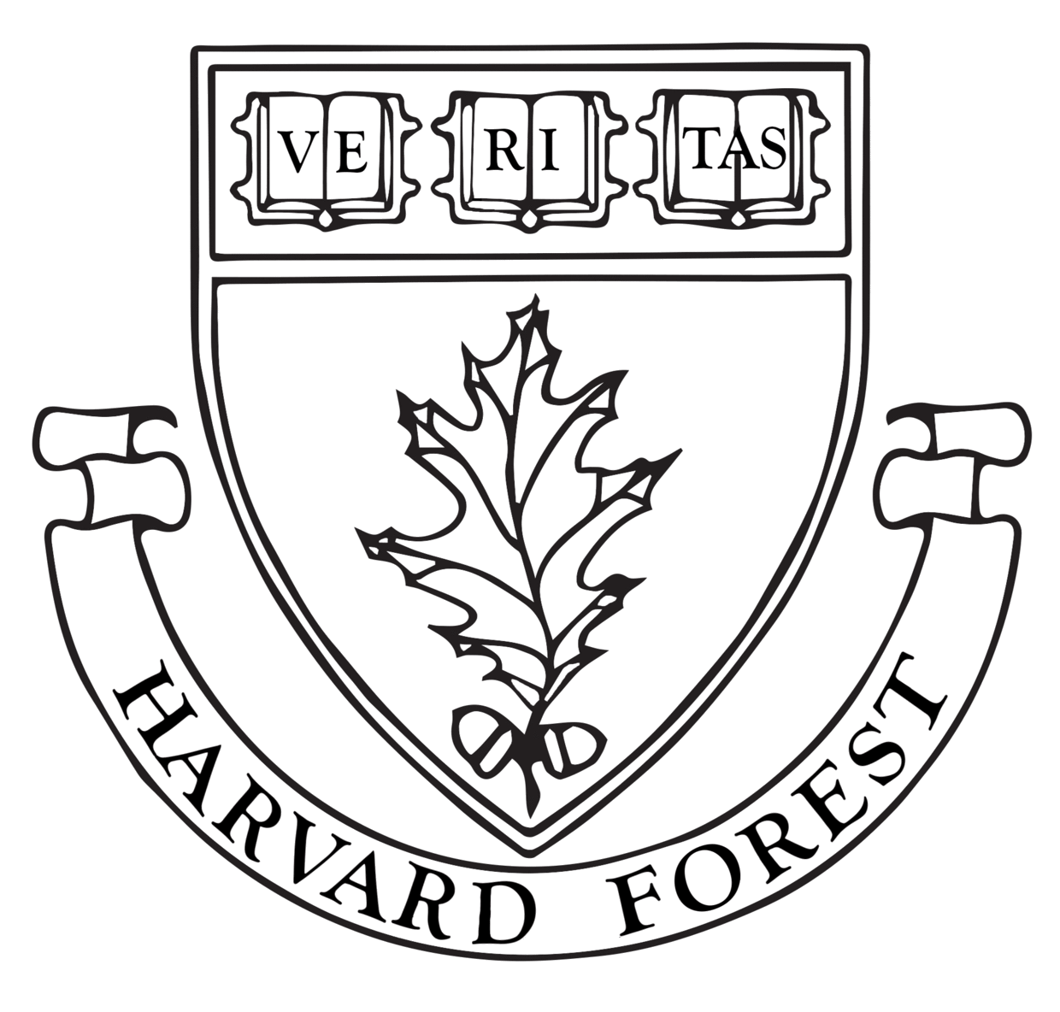










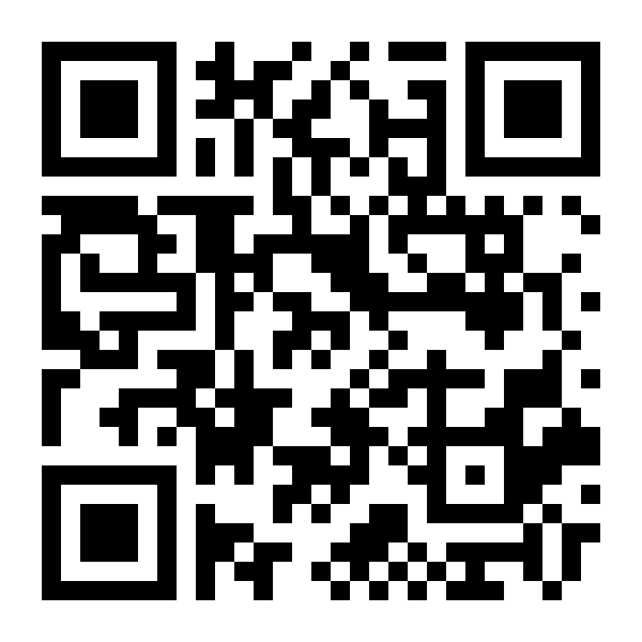
End to End Provenance
Emery R. Boose¹, Aaron M. Ellison¹, Elizabeth Fong², Xueyuan Han¹,
Jingmei Hu¹, Barbara S. Lerner ², Thomas Pasquier³, Margo Seltzer⁴
¹Harvard University ²Mount Holyoke College ³Bristol University ⁴The University of British Columbia
R Provenance Tools
Quick debugging
for data science
applications.
provExplainR
provDebugR
containR: package data and analysis for reproduction and re-execution.
provSummarizeR
provGraphR
ProvBuild
provParseR
Bash script
Unicorn: Real-time intrusion detection
Output Data
compare
R
Program
Input Data
Clean up your R scripts
Output Data
Python
Program
rClean
rdtLite
noWorkflow
Camflow: an efficient whole-system provenance capture system
Acknowledgements
The authors acknowledge intellectual contributions from the following students: Shaylyn Adams, Orenna Brand, Anna Calderon, Vasco Carinhas, Christopher Chen, Marios Dardas, Andrew Galdunski, Mark Goldstein, Nicole Hoffler, Siqing (Alex) Liu, Khahn Ngo, Erick Oduniyi, Jackson Okuhn, Antonia Oprescu, Luis Perez, Moe Pwint Phyu, Katerina Poulos, Narun Raman, Mohammed Hafeezul Rahman, Garrett Rosenblatt, Cory Teshera-Sterne, Sofiya Toskova, Morgan Vigil, Joseph Wonsil, and Yujia Zhou.
This work was supported by NSF grants DEB-1237491, DBI-1459519, and SSI-1450277, the Charles Bullard Fellowship at Harvard University, and a faculty fellowship from Mount Holyoke College, and is a contribution from the Harvard Forest Long-Term Ecological Research (LTER) program.
http://end-to-end-provenance.github.io/
Tools
on GitHub

