Slide 1
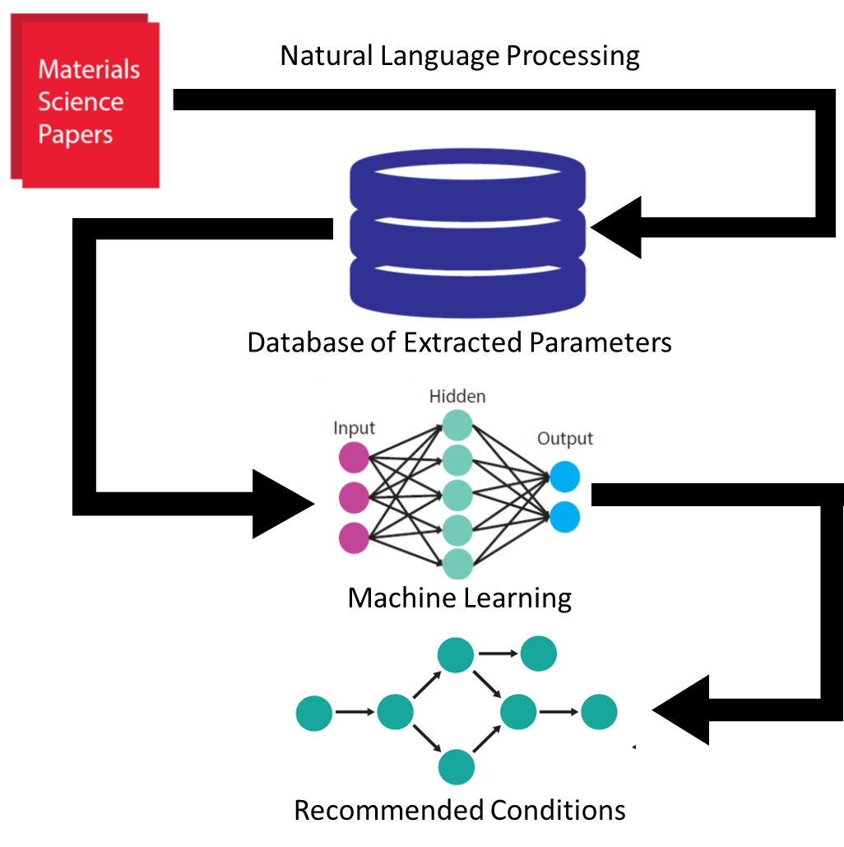
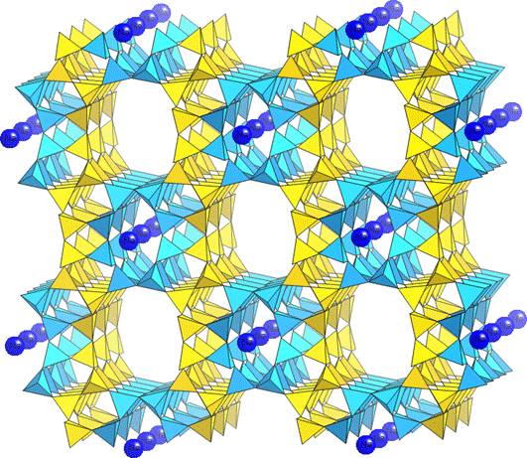
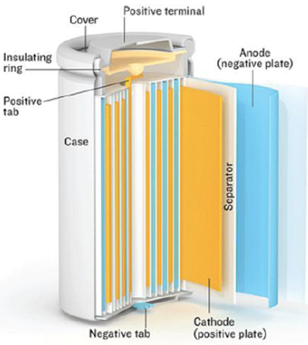
CSSI Element: The Synthesis Genome: Data Mining for Synthesis of New Materials PI: Olivetti, Ceder, and McCallum Institutions: Massachusetts Institute of Technology; UCalifornia, Berkeley; UMass, Amherst
Award #: DMREF 1922311, 1922372, and 1922090
Objectives
Automatically curate the descriptions of materials synthesis from research articles and patents into structured, human-readable representations of known target materials with their physical properties;
Analyze these to identify common synthesis subroutines which correspond to desired target properties, and;
Develop approaches that suggest hypotheses of synthesis driving conditions and models that may generate new, executable synthesis approaches given a target material (or material properties).
Inorganic materials synthesis
Directing zeolite crystallization
Solid state electrolyte
devices
NSF CSSI PI Meeting, Seattle, WA, Feb. 13-14, 2020

