Slide 1




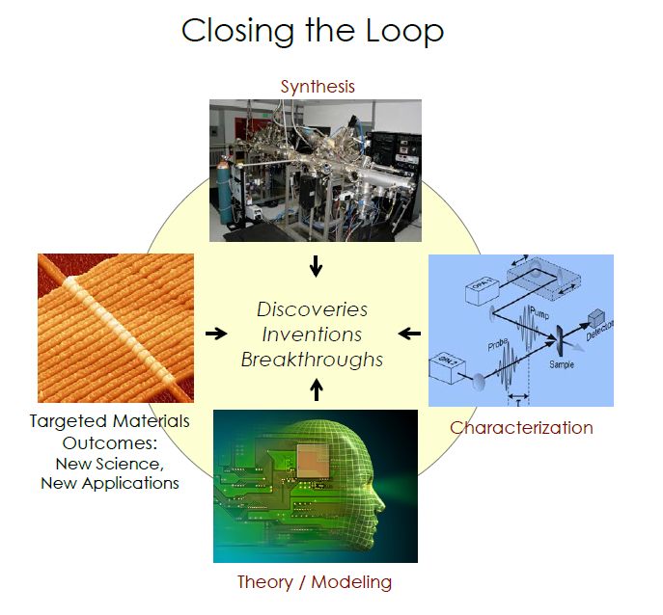





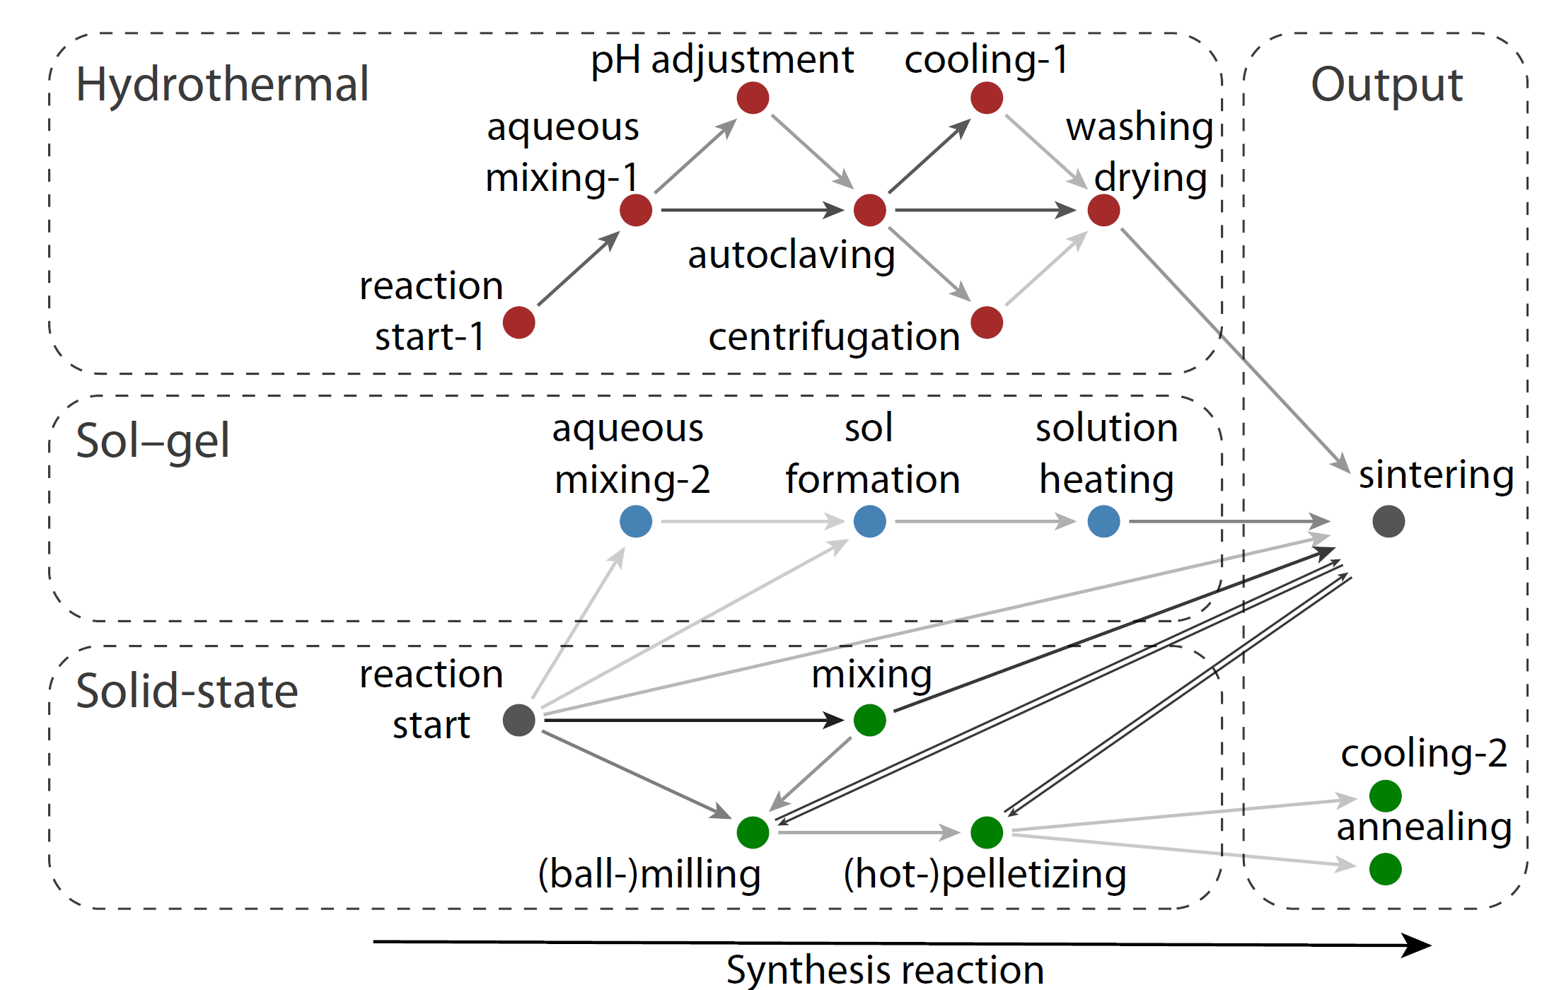

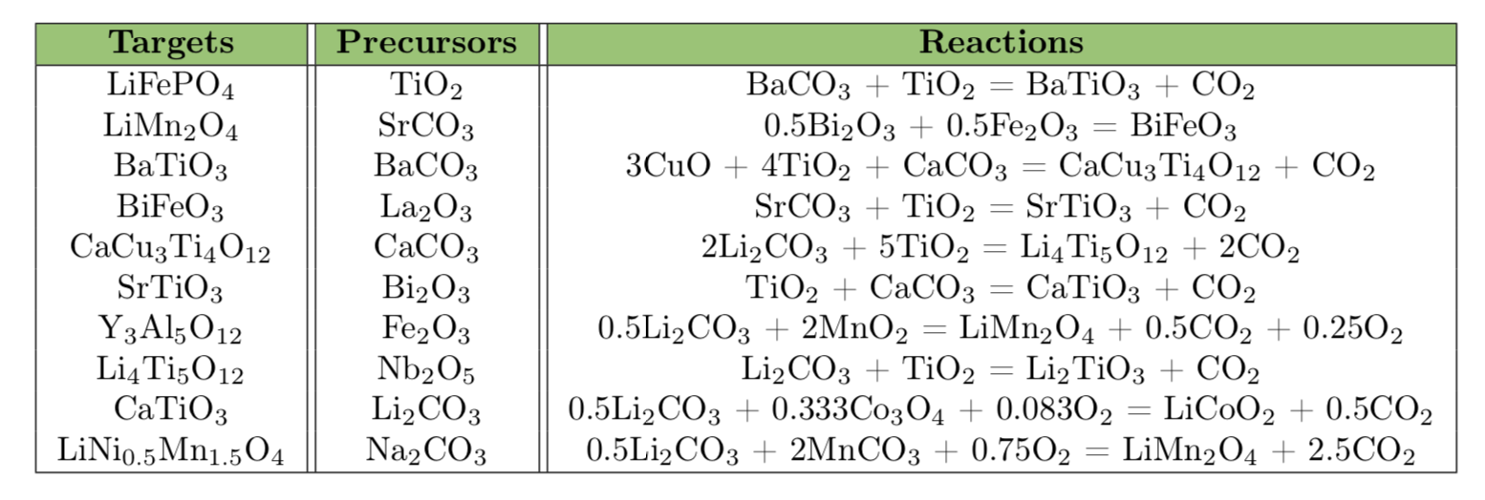
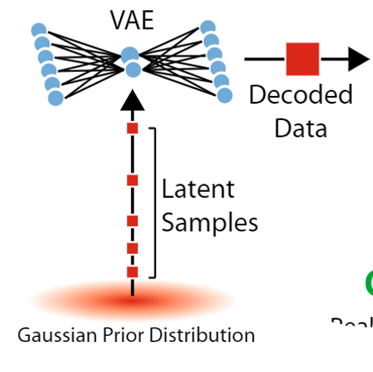

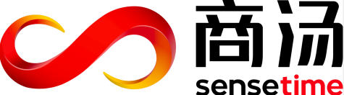
CSSI Element: The Synthesis Genome:
Data Mining for Synthesis of New Materials
PI: Olivetti, Ceder, and McCallum
Institutions: Massachusetts Institute of Technology; UCalifornia, Berkeley; UMass, Amherst
NSF CSSI PI Meeting, Seattle, WA, Feb. 13-14, 2020
Award #: 1922311, 1922372, and 1922090
Project Motivation and Opportunity
Project Goal:
Comprehensive searchable record of recipes for inorganic materials; Mine data for patterns to inform new syntheses and materials design
Relevance to MGI:
Materials development now gated by trial-and-error synthesis
Key challenge: “How do we design and perfect atom- and energy-efficient synthesis of revolutionary new forms of matter with tailored properties?”
Progress in accelerated materials design has moved the bottleneck in materials development toward the synthesis of novel compounds; the process is gated by trial and error synthesis techniques. Accordingly, our project seeks to build predictive tools via natural language processing, algorithm development, and first principles validation so that targeted compounds can be synthesized more rapidly. We hypothesize that comprehensive data mining of the experimental literature will enable us to identify ways to synthesize novel compounds.
“In other words, we are ‘discovering’ exciting new materials we are unable to produce.” –BESAC 2015
“current understanding of synthetic factors and the resulting solid state materials structure is largely achieved on a case-by-case basis”
– MPSAC 2014
Content acquisition
Methodology
Named Entity Recognition
Publisher | Amount
Elsevier | ~3.2million
RSC | ~395k
Nature | ~224k
Wiley | ~205k
Springer | ~173k
ACS | ~141k
APS | ~132k
ECS | ~33k
Journal Articles & Patents
Annotated
Paragraphs
Annotated
Sentences
Entity | F1 score
Materials
Targets | 0.97
Precursors | 0.99
Operations | 0.90
Heating conditions
Temperature | 0.86
Time | 0.89
Atmosphere | 0.87
Mixing conditions
Media | 0.64
Device | 0.66
Reactions | 0.95
Word
Embeddings
Desired
Text
Word
Embeddings
Named
Entities
Natural language processing pipeline involves semi-supervised learning approaches including word embeddings and bi-directional GRU recurrent neural network
Machine-learned flowchart showing the transition between experimental steps for different types of synthesis.
Results
Automated extraction from over four million published scientific articles
First demonstration of text extraction focused on synthesis of inorganic materials using primarily machine learning approaches
Cases include: energy materials, zeolites, solid state electrolytes, and cement
Most common Targets, Precursors, and Reactions
Predicting synthesis pathways for low framework density zeolites
Synthesis conditions pulled from 70,000 manuscripts
Time-based literature holdouts predict recently-reported perovskites and complement
existing screening methods
Li-ion battery materials
More determinant synthetic variables: Si/Ge; H₂O/T; OSDA volume
Perovskites
Target material | Suggested precursors | Synthesis method
InWO₃ | In₂O₃+WO₂ | Solid state
 | InCl₃+Na₂WO₄ | Solution
PbMoO₃ | PbSO₄+MoCl₂ | Solution
 | PbO+MoO₂ | Solid state
OSDA = Organic Structure Directing Agent
References
Kim, E., et al., Scientific Data. 4, 170127, 2017
Kim, E., et al., Chemistry of Materials, 29, 9436-9444, 2017
Kim, E., et al., npj Computational Materials, 3, 53, 2017
Mysore, S., et al. NIPS Workshop, 2017
Jensen, Z., et al., ACS Central Science. 5, 892-899, 2019
Schwalbe-Koda, D., et al., Nature Materials, 1-5. 2019
Kim E., et al., Matter. 2019
Huo, H., et al., Npj Comput. Mater, 2019
Kononova, O., et al., Scientific Data 6:203, 2019
Acknowledgements

