Slide 1
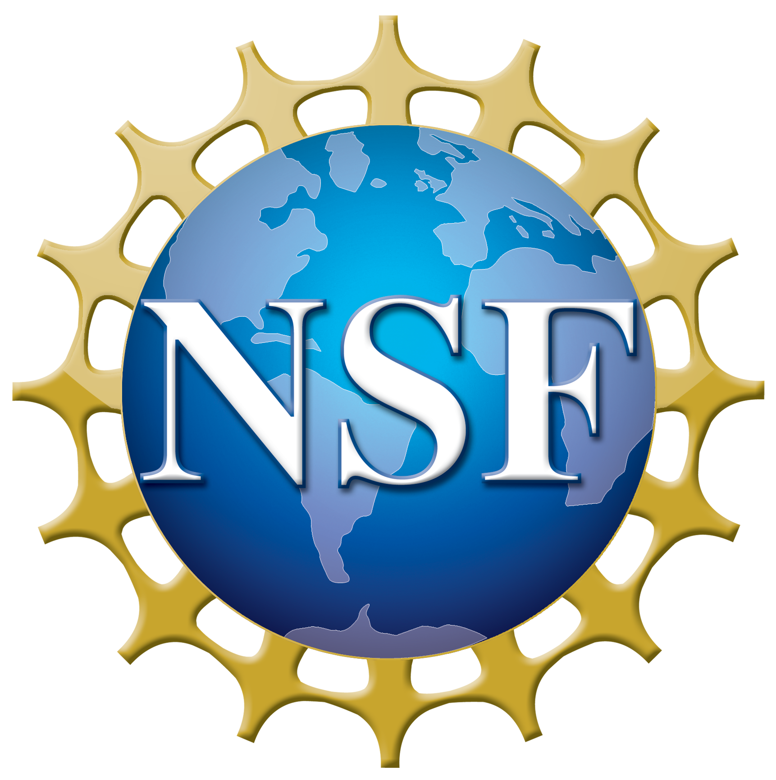
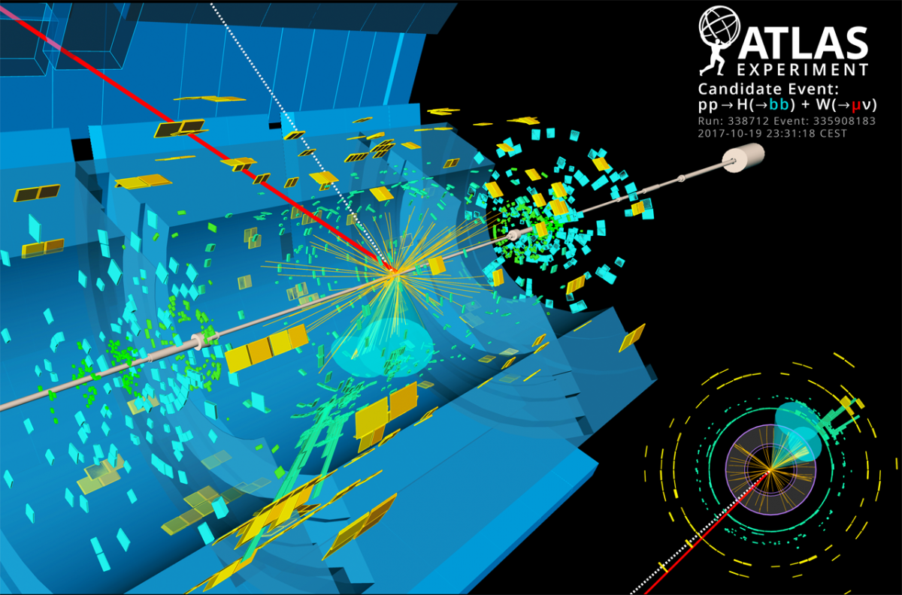
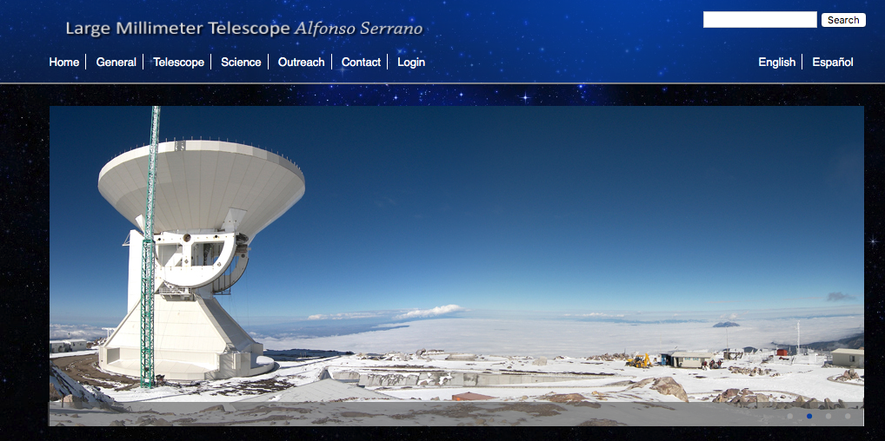
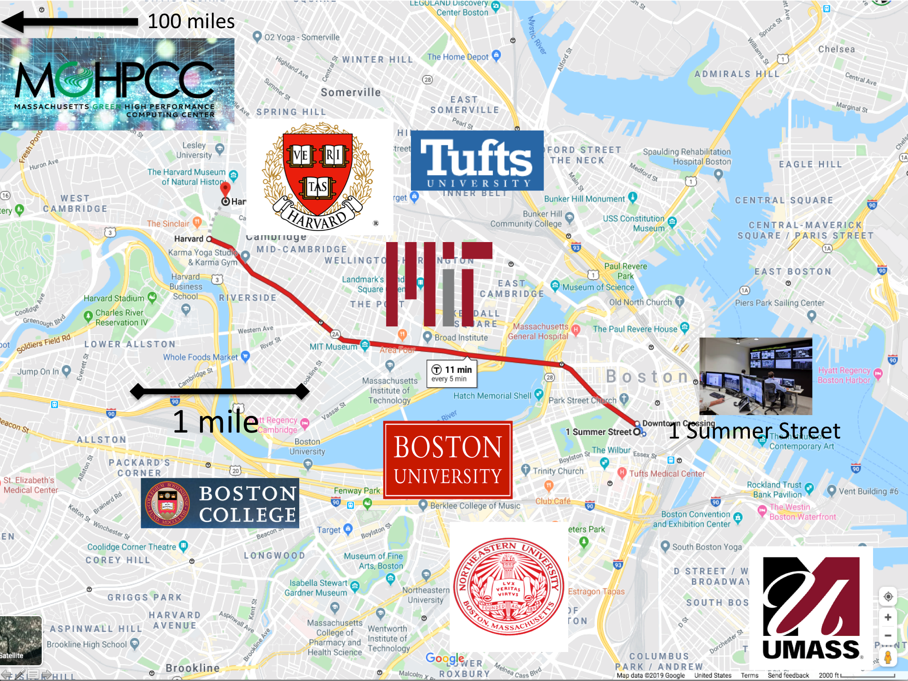
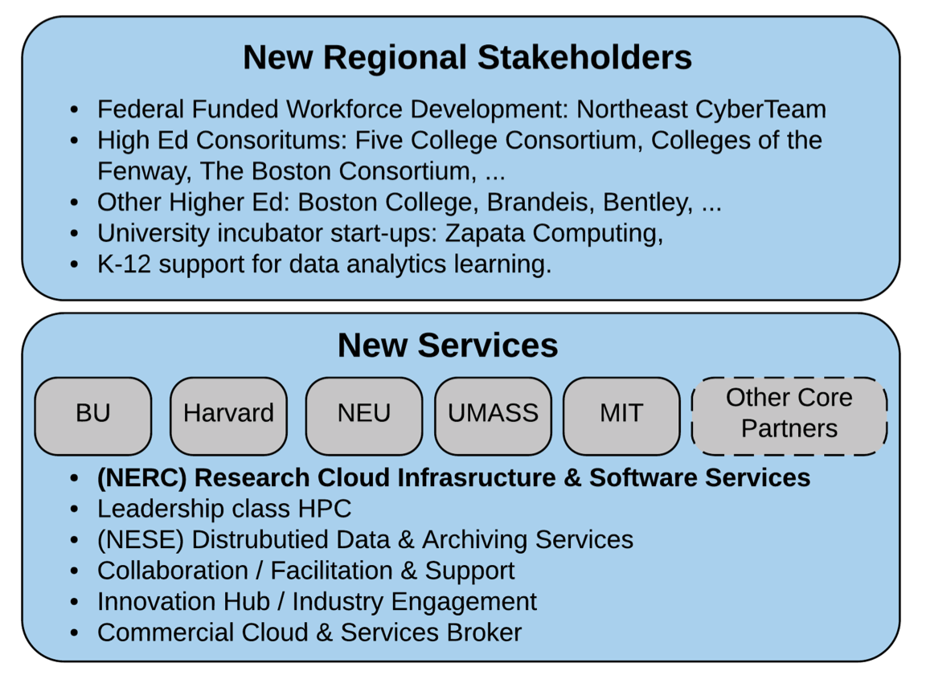
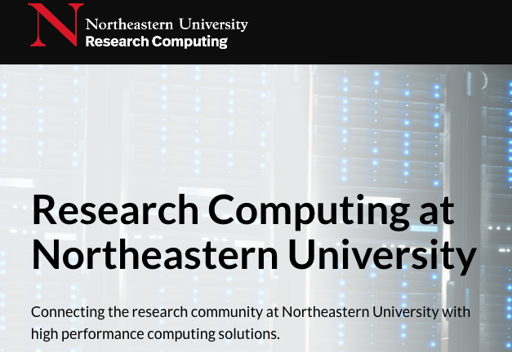
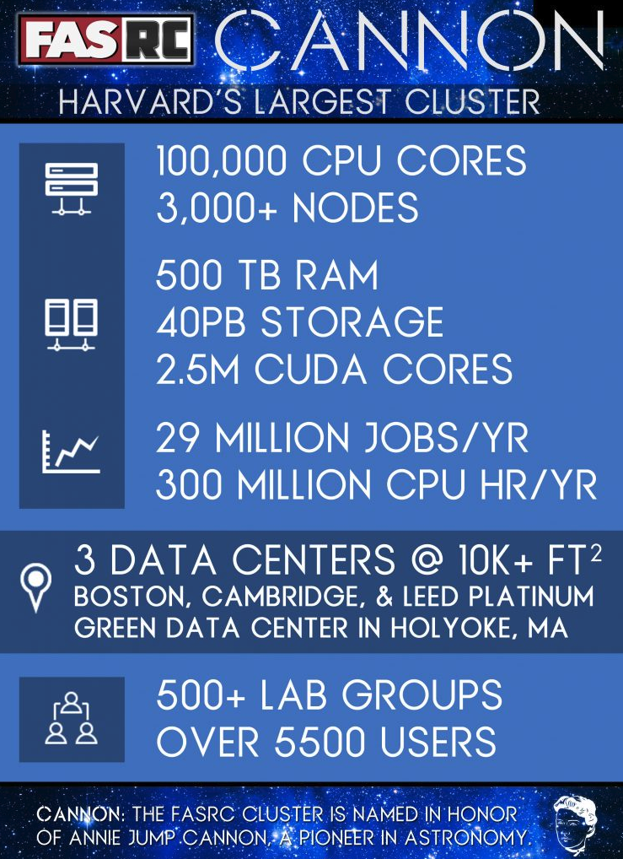
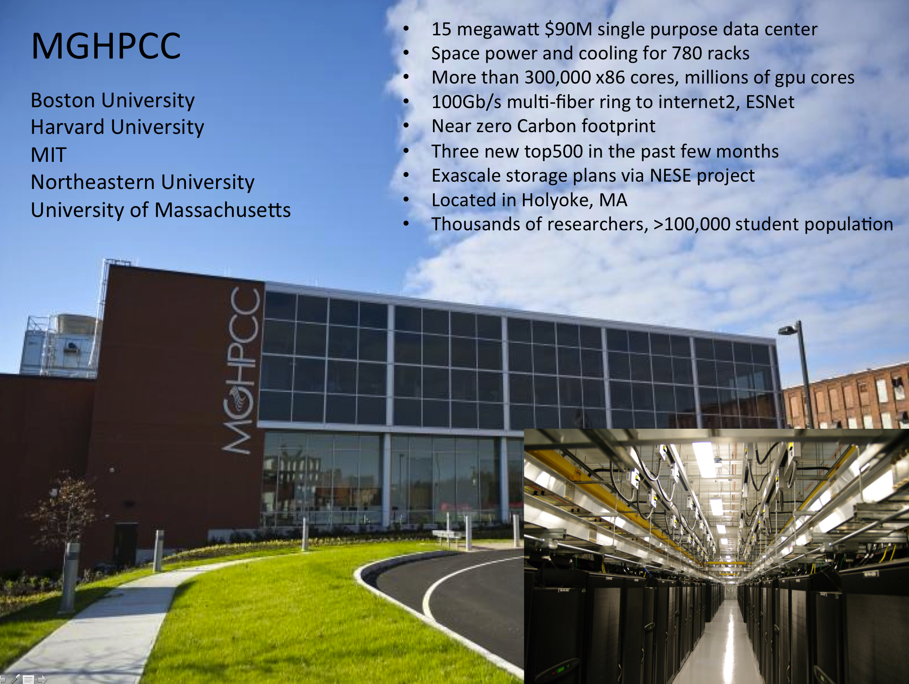
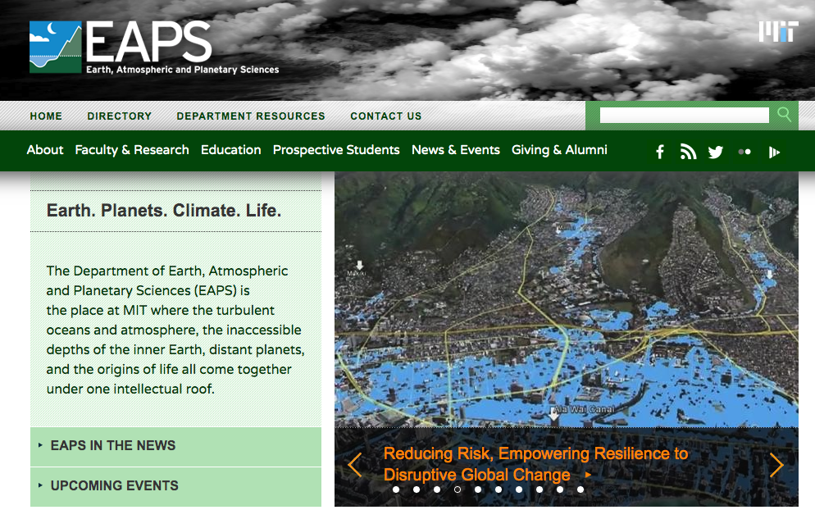
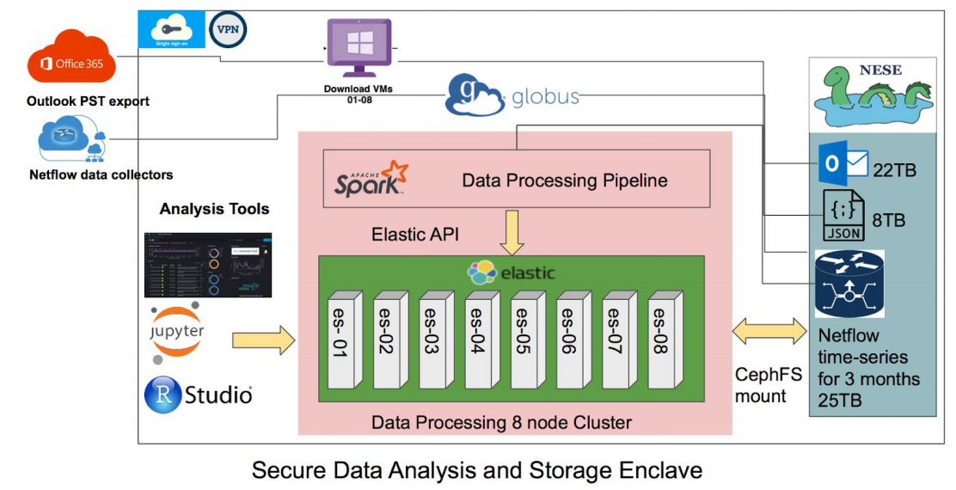
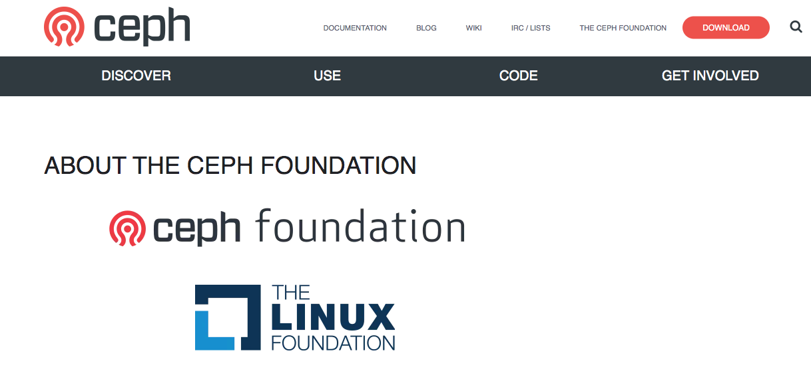
DIBBS: Northeast Storage Exchange PI: Saul Youssef, Co-PIs: Scott Yockel, Chris Hill, John Goodhue, Devesh Tiwari, Mike Zink Boston University, Harvard University, MIT, MGHPCC, Northeastern University, UMass, RedHat
Award #: 1753840
New England Research Cloud (NERC)
Large Hadron Collider, NSF, DoE
Northeastern University Research Computing
CASA at UMass/Amherst is NSF funded
Proposal to Mass. Technology Council
Large Millimeter Telescope, NSF
Boston area research: 7 universities, 15 hospitals, dozens of major biotech companies, Intel, RedHat, IBM, Google, Amazon, Microsoft, Math Works, Wolfram, NVIDIA, many startups. NESE “posix cloud” deployment from 1 Summer Street.
NESE
Fast, cost-effective, sustainable shared storage.
Long term commitment from Harvard operations team.
24 PB Ceph, expanding rapidly with 70% buy-in so far.
Adding tape libraries for massive long term storage.
NESE main deployment at
MGHPCC, Holyoke, MA
Harvard Research Computing
MIT Earth, Atmospheric and Planetary Sciences
Harvard Data Science
Open Cloud Testbed, Massachusetts Open Cloud, NSF
Open Storage Network, NSF
Massachusetts Life Sciences Center
RedHat/IBM

