Slide 1
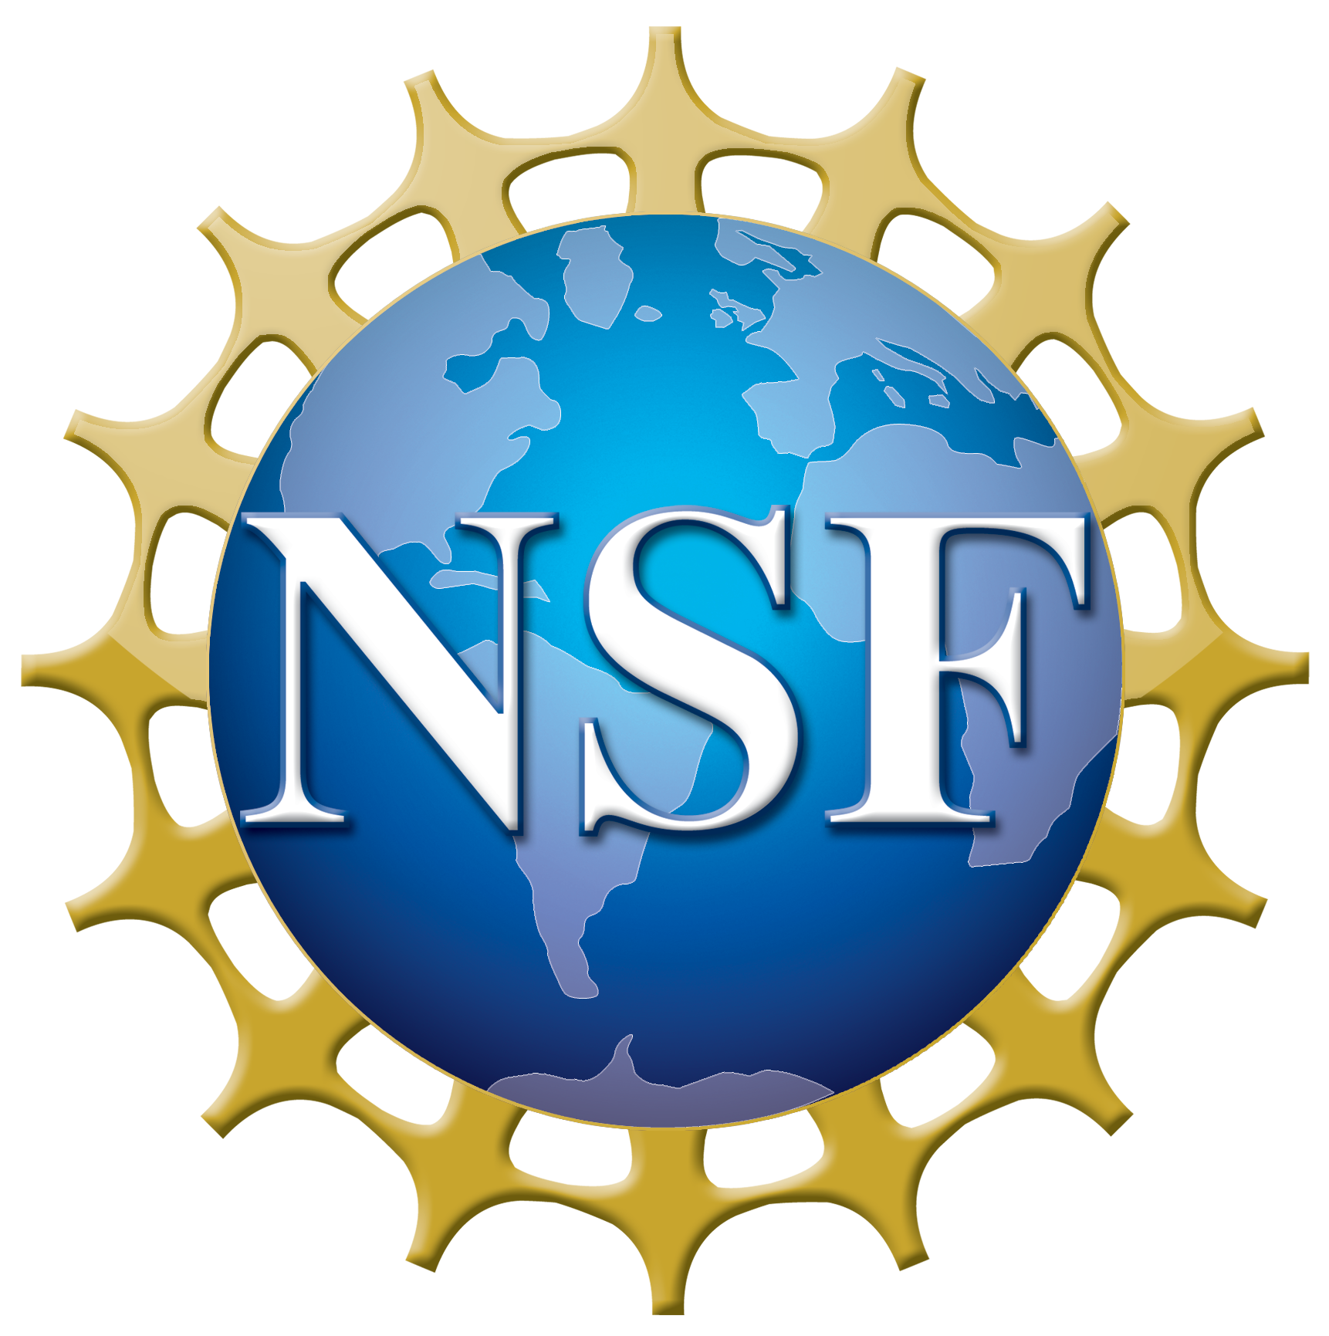
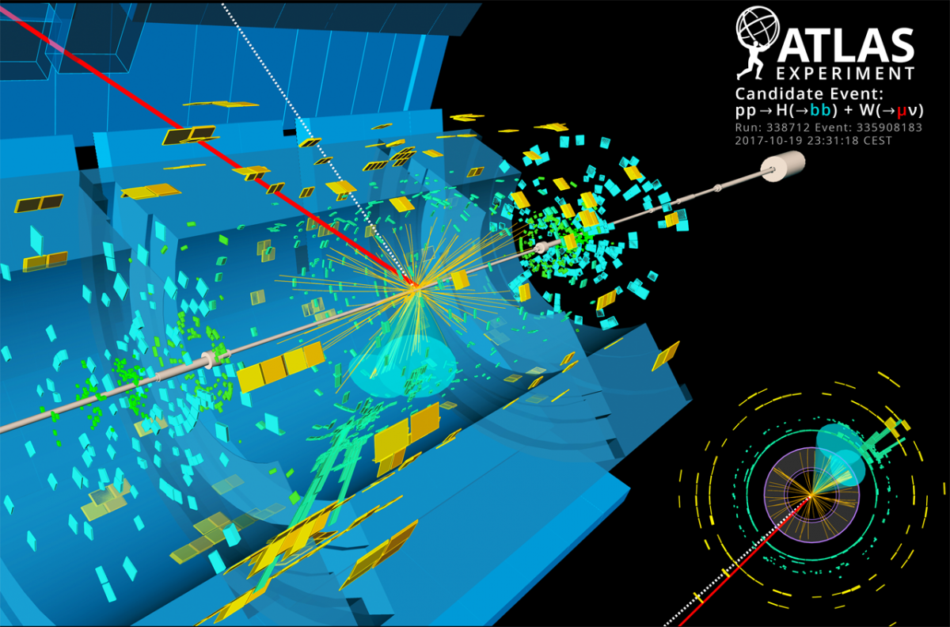
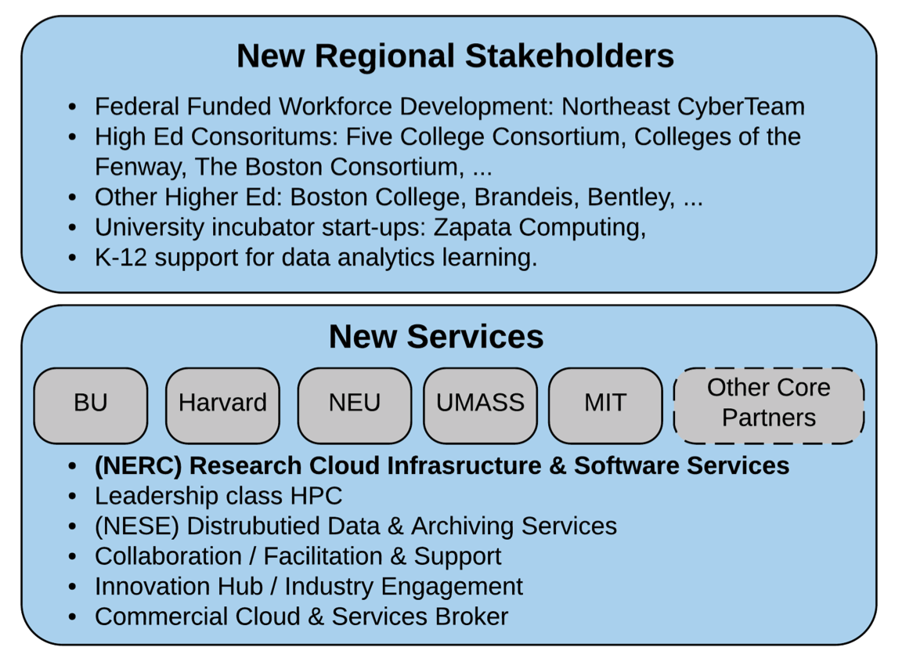
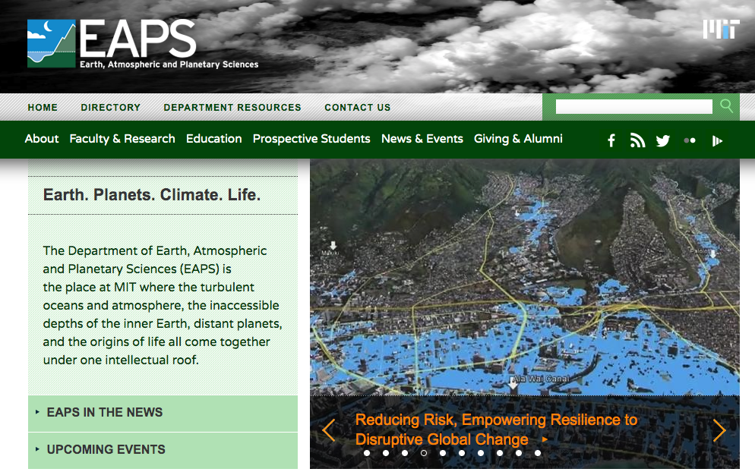
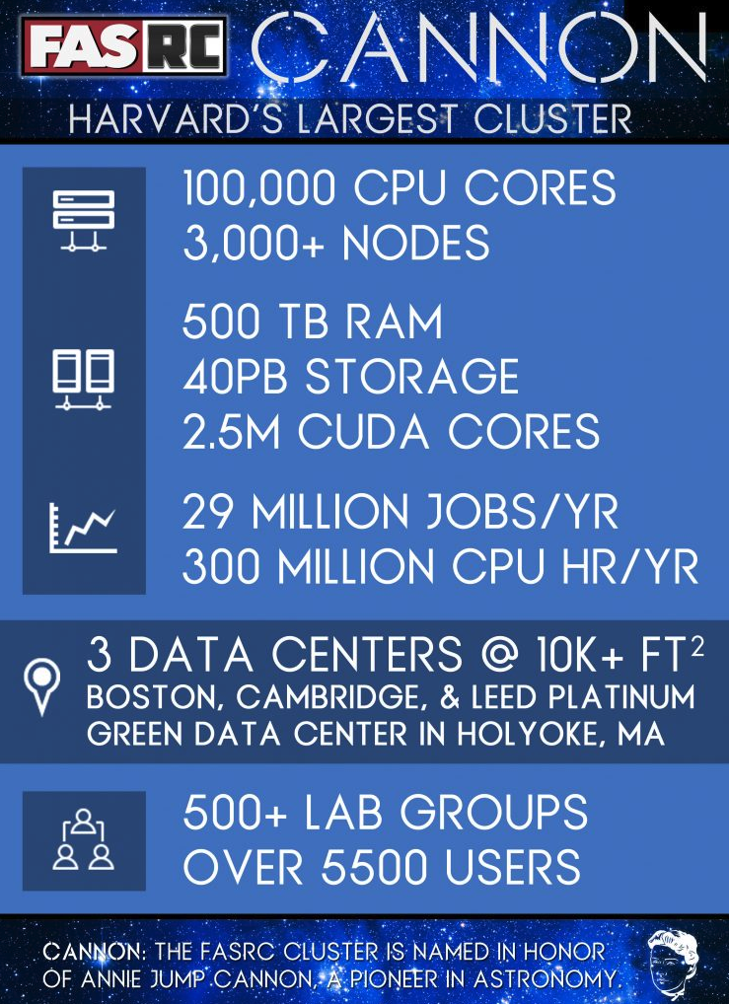
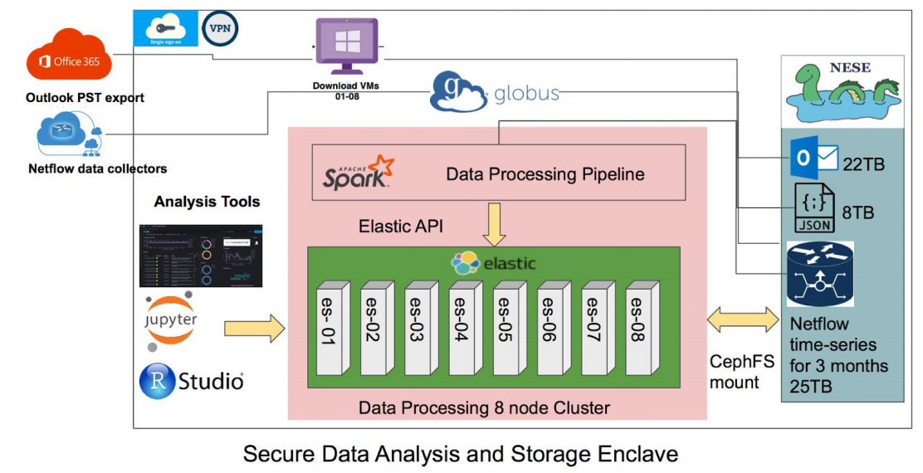
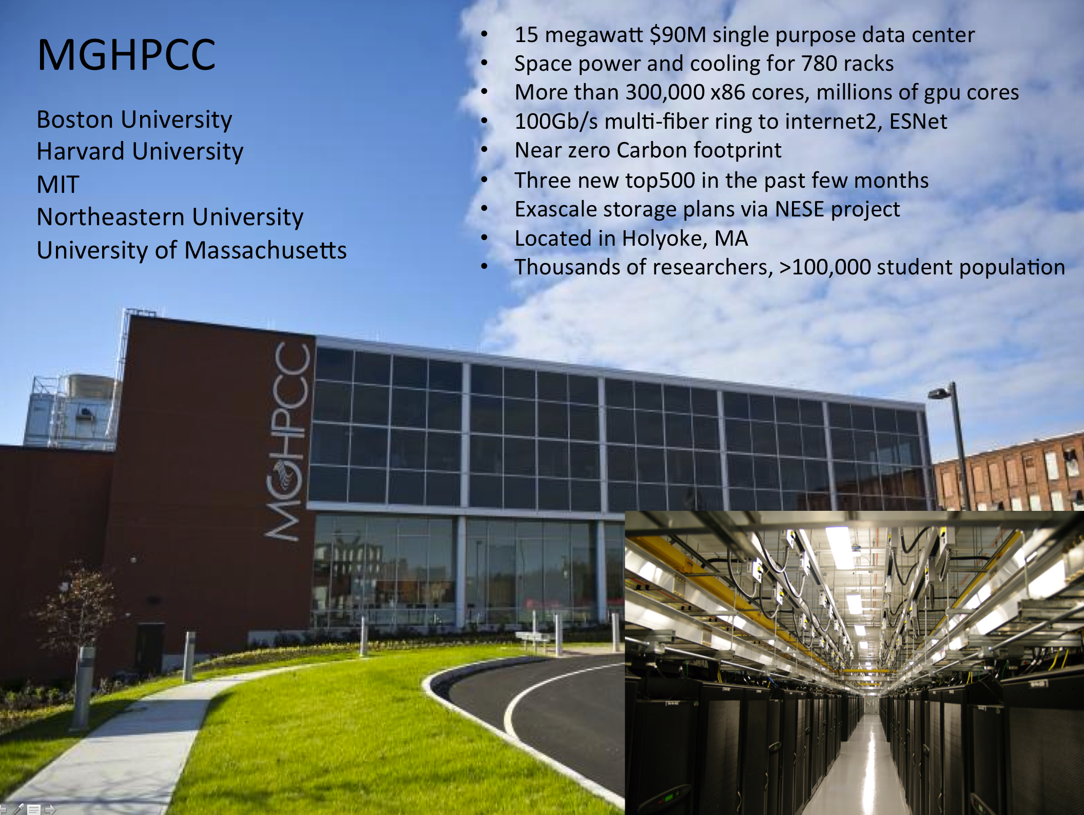
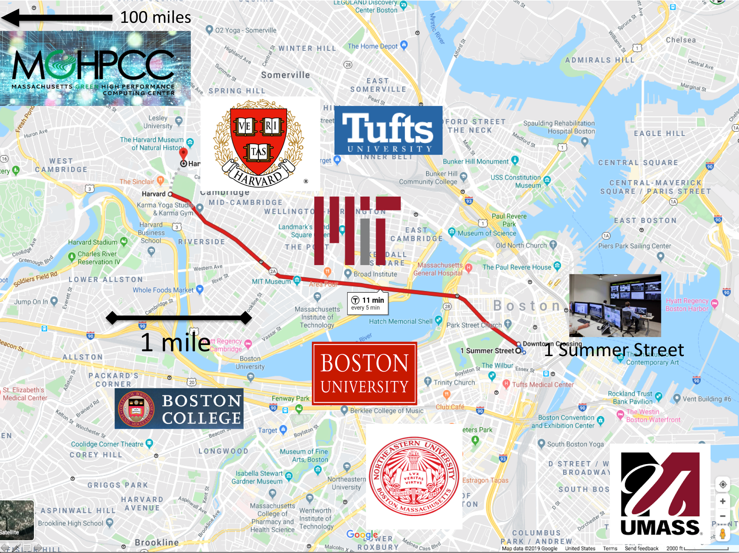
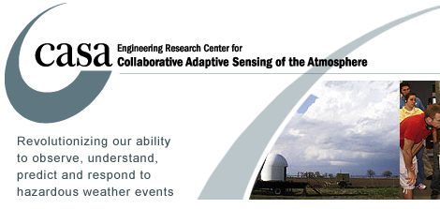
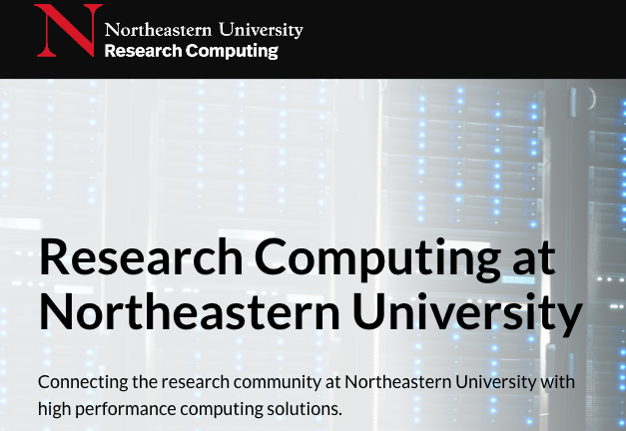
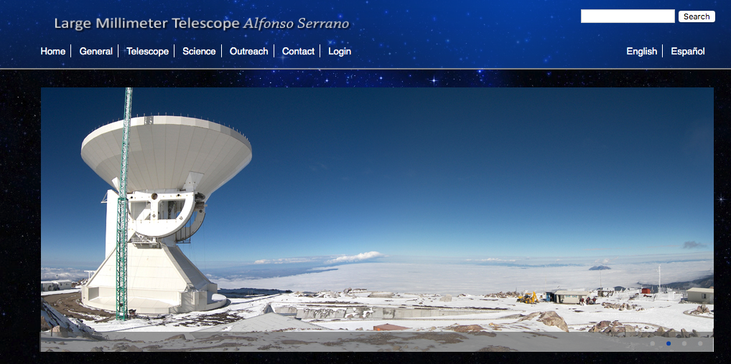
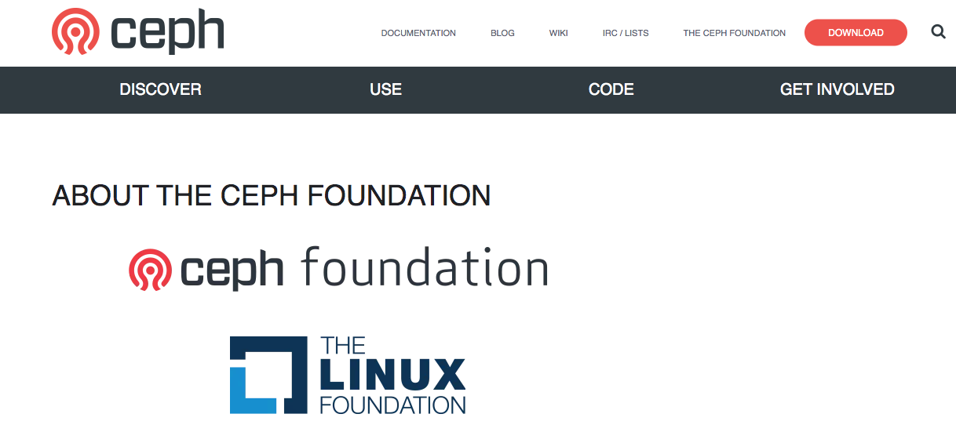
DIBBS: Northeast Storage Exchange PI: Saul Youssef, Co-PIs: Scott Yockel, Chris Hill, John Goodhue, Devesh Tiwari, Mike Zink Boston University, Harvard University, MIT, MGHPCC, Northeastern University, UMass
NSF CSSI PI Meeting, Seattle, WA, Feb. 13-14, 2020
Award #: 1753840
New England Research Cloud (NERC)
NESE provides the main storage for the U.S. ATLAS Northeast Tier 2 Center, one of four such centers in the U.S. for the Large Hadron Collider.
Large Hadron Collider, NSF, DoE
Large Millimeter Telescope, NSF
MIT Earth, Atmospheric and Planetary Sciences uses NESE storage, coordinated by Chris Hill of MIT.
Join project between Boston University and Harvard University Research computing. Proposal to the Massachusetts Technology Council.
Harvard Research Computing
MIT Earth, Atmospheric and Planetary Sciences
Harvard Data Science
A secure enclave for Harvard Data Science, David C. Parkes group.
NESE will provide storage for the newly NSF funded Open Cloud Testbed project, PI Mike Zink of UMass/Amherst with Orran Krieger of Boston University and the Massachusetts Open Cloud team.
NESE
Fast, cost-effective, sustainable shared storage.
Long term commitment from Harvard operations team.
24 PB Ceph, expanding rapidly with 70% buy-in.
Add tape libraries for massive long term storage.
Main NESE deployment is at MGHPCC.
15 megawatt essentially zero Carbon footprint data center.
Jointly operated by BU, Harvard, MIT, Northeastern and Umass.
Three new top500 systems installed in the past year
Interoperability with the NSF funded Open Storage Network by the MGHPCC team as reported at the annual OSN workshop at TACC.
Open Cloud Testbed, Massachusetts Open Cloud, NSF
The Umass/Amherst work in CASA is funded by the NSF.
Boston area research: 7 universities, 15 hospitals, dozens of major biotech companies, Intel, RedHat, IBM, Google, Microsoft, Amazon, MathWorks, Wolfram, NVIDIA, DELL. NESE “posix cloud” deployment to campus laboratories from the NESE 1 Summer Street deployment.
UMass Amherst Institute for Applied Life Sciences is funded by the Massachusetts Life Sciences Center.
NESE Collaborate with Sage Weil’s team at RedHat via a $5M Boston University/RedHat “Collaboratory” agreement. Harvard and BU are founding members of the Ceph foundation.
Umass/Amherst collaboration on the NSF funded Large Millimeter Telescope.

