Slide 1
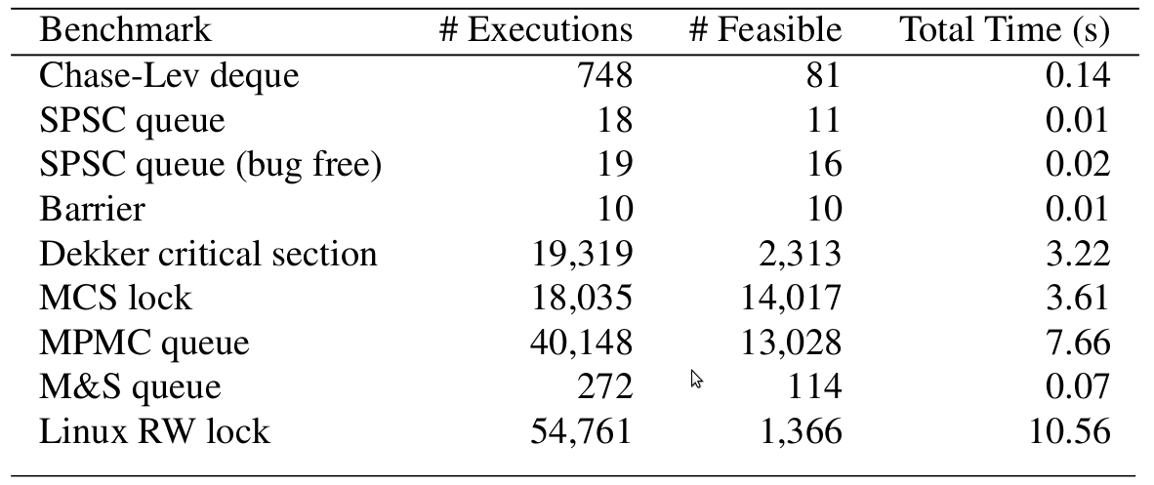
C11Tester: Scaling Testing of C/C++11 Atomics to Real-World Systems
Brian Demsky
University of California, Irvine
Motivation
Other Approaches
Modification Order
C11Tester Overview
Specially-designed data structures scale better
Support multiple concurrent readers
Less serialization
Reduce cache contention
Require low-level platform knowledge
Assembly
Architecture memory models? (x86-TSO)
Non-portable
C/C++ 2011 Language Support
✓ Language memory model
✓ Exposes relaxation to the developer
✓ Portably supports high performance
✘ Really difficult to use correctly
Traditional Testing
Difficult or impossible to reliably trigger concurrency bugs
Once triggered, hard to reproduce to understand what went wrong
CDSChecker (our previous work)
Model checker for concurrent data structures
Used by several other researchers
Complete within bounds
Works well for unit tests on data structures
Does not scale beyond unit tests on data structures
Other Model Checking Tools
Similar limitations in scalability
Adversarial Memory
Limited coverage of behaviors that trigger bugs
(modification of a single variable)
Initially, x = 0
C/C++ Source Code for Application
C11Tester Header Files
Thread 1 | Thread 2
x.store(1, relaxed); x.store(2, relaxed); | r1 = x.load(relaxed); r2 = x.load(relaxed);
Does NOT allow r1 = 2, r2 = 1
Similar to cache coherence, plus a few other constraints
Clang
Any C/C++ Compiler
Constraint-based MO
LLVM Instrumentation pass
C/C++ 2011 Basics
Choosing a modification order eagerly constrains behaviors and limits fuzzing choices
Solution:
MO is not (directly) observable
MO and reads-from are interdependent
Testing only requires some consistent MO
Maintain MO as a set of constraints & as long as constraints have a solution there is some execution with same observable behaviors
Orderings:
Happens before (release/acquire synchronization)
Modification order (cache coherence)
Sequential Consistency
“Reads-from” relationship
Atomic Operations:
Load/Store w/ memory order
RMW Operations (atomic CAS, increment, decrement, …)
Memory Orders:
Relaxed, Release/Acquire, Seq. Cst.
Trades off performance vs. guarantees
LLVM Compilation
Annotated, Compiled C/C++ linked into the C11Tester Library
Execution Exploration Framework
Impact
Execution Strategy Plugin
Analysis/Checker Plugin
C11Tester
C++ Synchronization
Target Impacts of Project Include:
Provide a new framework for researchers to develop software testing tools for concurrent software that uses relaxed memory models
Help both researchers and practitioners debug concurrent software
Support development of runtime systems used in many research projects such as parallel programming frameworks
(release/acquire pairs)
Many bugs arise in the usage of data structures or integration of data structures
Data structures can intentionally expose clients to relaxed behaviors
Need to test large applications
Give up completeness to achieve this goal
Build on CDSChecker techniques and infrastructure
Initially, x = y = 0
Bugs
Thread 1 | Thread 2
y.store(42, relaxed); ... x.store(1, release); | while (x.load(acquire) == 0) /* wait */ ; ... r1 = y.load(relaxed);
r1 = 42
happens before
Acknowledgements:
This work is support by NSF grant OAC-1740210. CDSChecker is supported by NSF grant CCF-1319786.

