Slide 1

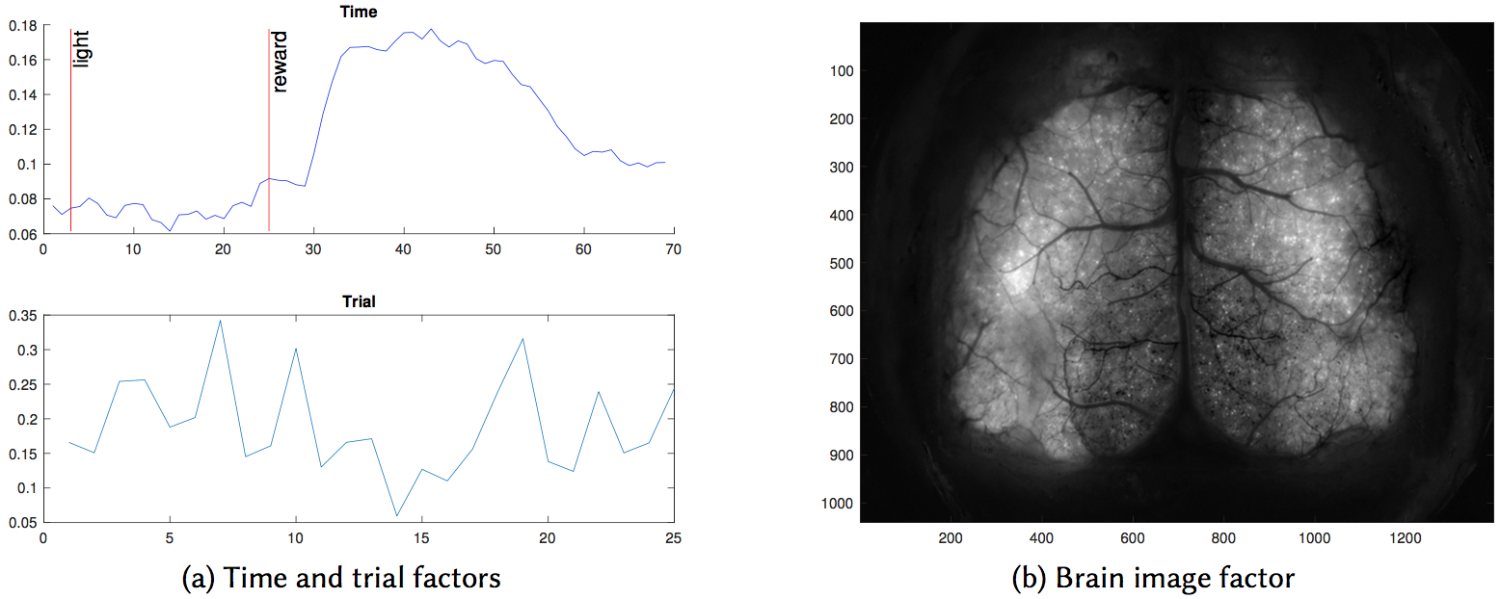
CSSI Element: High Performance Low Rank Approximation for Scalable Data Analytics
PI: Grey Ballard, Haesun Park Co-PIs: Ramakrishnan Kannan
Institutions: Wake Forest University and Georgia Tech
Award #: 1642385
PLANC: Parallel Low Rank Approximations
with Non-negativity Constraints
Software library for solving large-scale unsupervised learning problems, such as
  document clustering
  video background subtraction
  pattern discovery in brain imaging
Written in C++/MPI, scalable to
  thousands of nodes
  terabytes of data
Designed for matrix (2D) and tensor (N-D) data
  uses high-performance libraries for both dense and sparse data
  Minimizes inter-processor communication
Provides flexibility of optimization algorithm
NSF CSSI PI Meeting, Seattle, WA, Feb. 13-14, 2020

