Slide 1
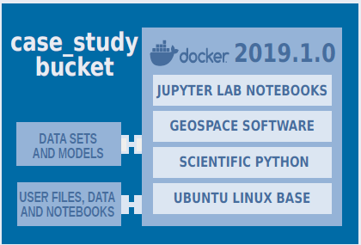
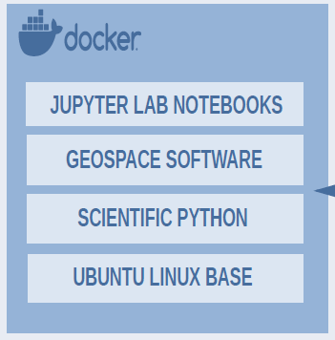
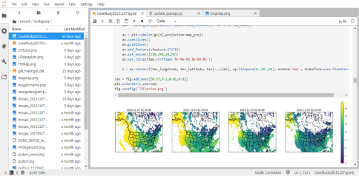
CSSI Elements: Software: The Integrated Geoscience Observatory (InGeO)
PI: Asti Bhatt, Co-PI: Russell Cosgrove
InGeO team: Todd Valentic, Ashton Reimer, Leslie Lamarche, Pablo Reyes
Institution: SRI International, Menlo Park, CA
Award #: 1835573
The Foundation
resen-core Docker Image
The Bucket
A software, data and platform bundle
The Workflow
Export bundle and share
[resen]>>> list
[resen]>>> start case_study
[resen]>>> export case_study
[resen]>>> import
Contains community developed open-sourced software
case_study JupyterLab interface
[resen]>>> create
Enter bucket name: case_study
Select a version: 2019.1.0
Mount storage? yes
DockerHub: earthcubeingeo/resen-core
Resen: The Reproducible Software Environment
A tool to enable reproducibility and
Collaboration In the geospace
http://ingeo.datatransport.org
https://github.com/EarthCubeInGeo
https://resen.readthedocs.io
NSF CSSI PI Meeting, Seattle, WA, Feb. 13-14, 2020

