Slide 1

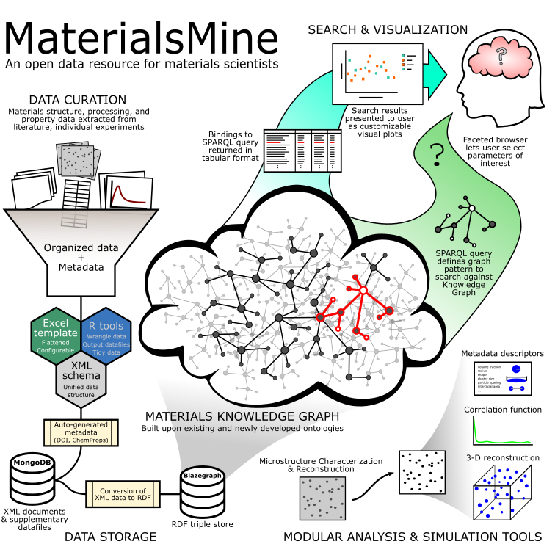
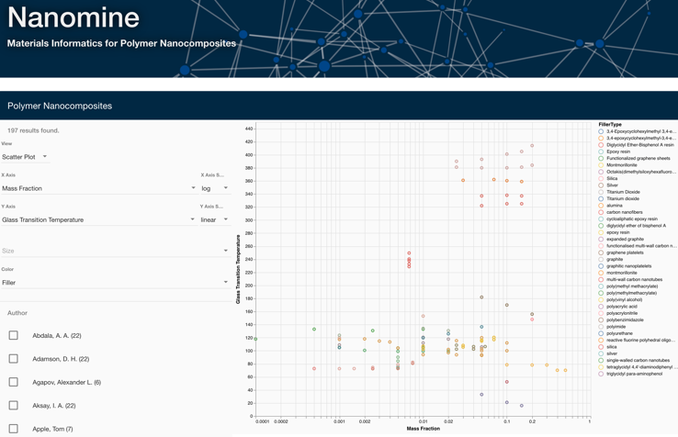
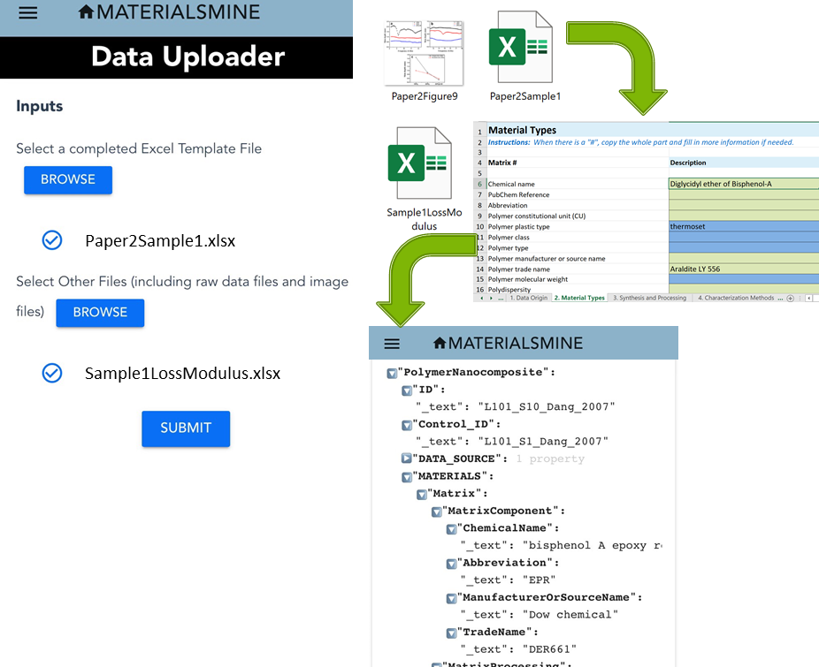
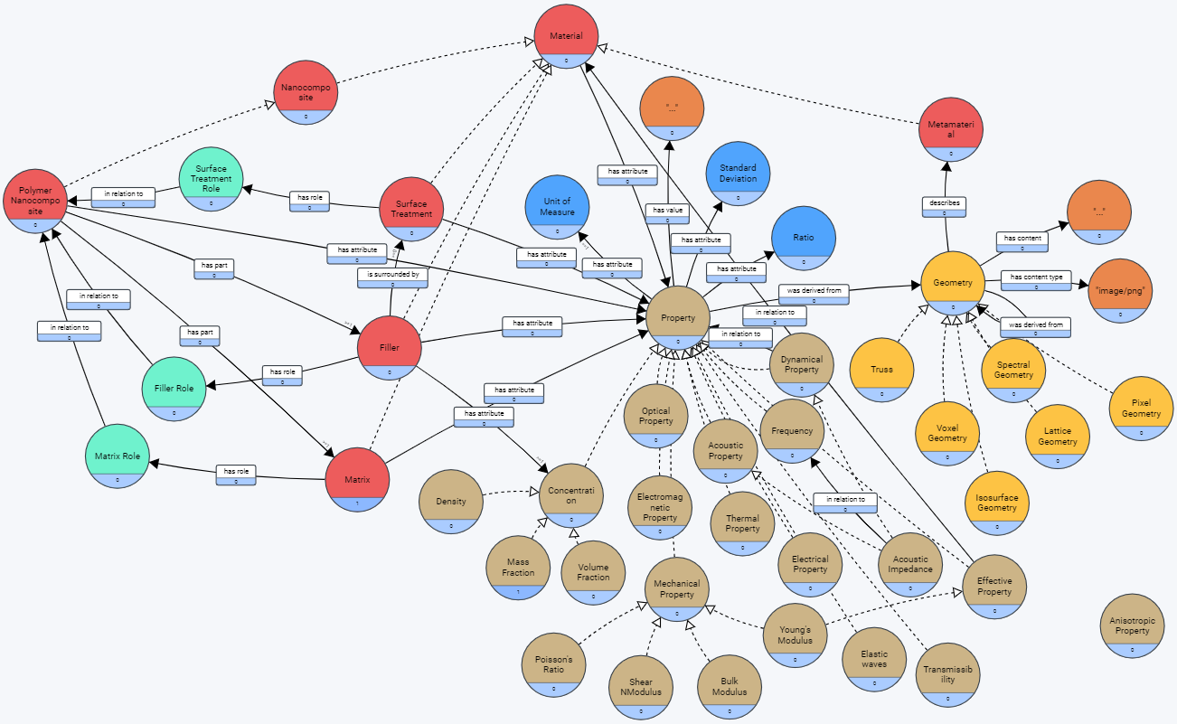
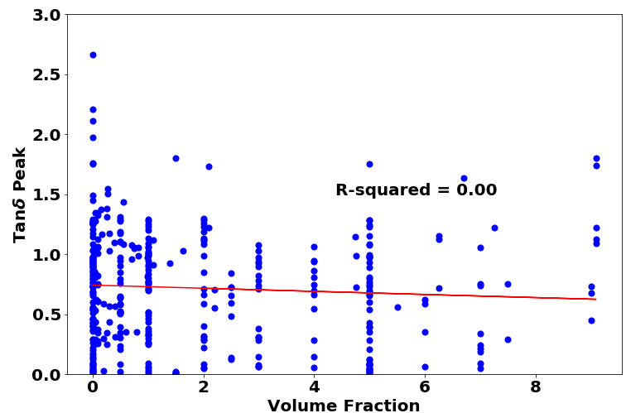
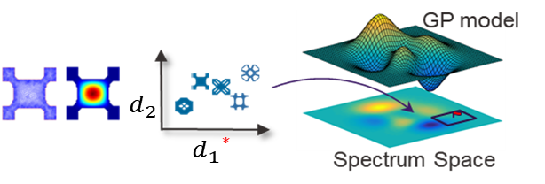
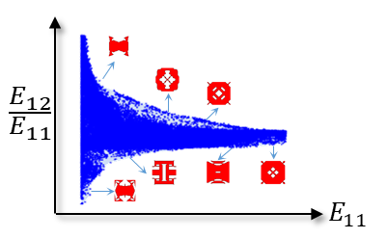
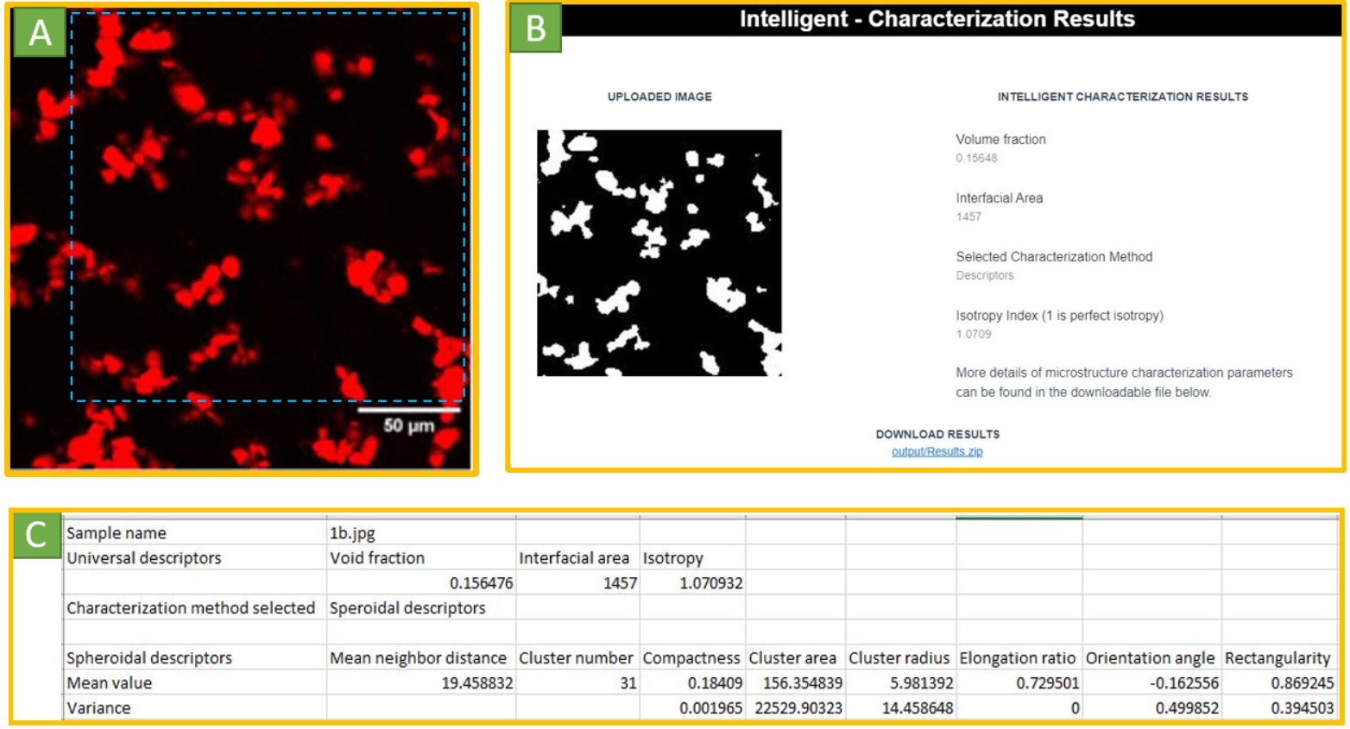
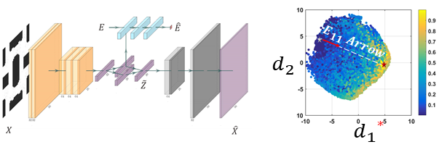
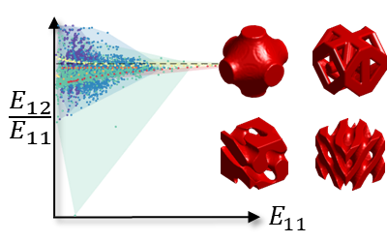
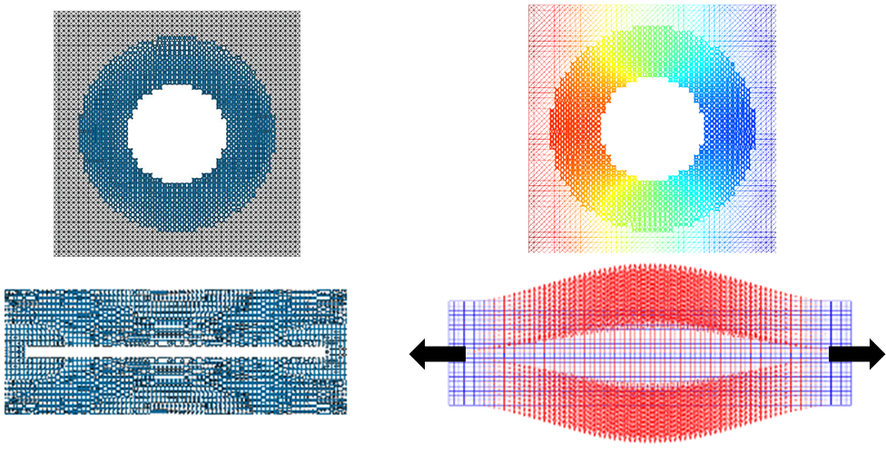

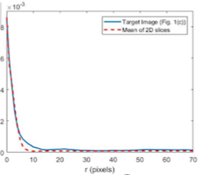






CSSI Element: Nanocomposites to Metamaterials: A Knowledge Graph Framework
PI: L. C. Brinson,¹ Co-PIs: C. Rudin,¹ W. Chen,² D. McGuinness,³ C. Daraio,⁴ L. Schadler⁵
Institutions: ¹Duke University, ²Northwestern, ³Rensselaer Polytech. Inst., ⁴Caltech, ⁵Univ. Vermont
NSF CSSI PI Meeting, Seattle, WA, Feb. 13-14, 2020
Award #: OAC-1835677
MaterialsMine enables materials discovery and design via an extensible digital toolkit for sharing and visualizing materials research data.
Nanocomposites to Metamaterials: A Knowledge Graph Framework
This work aims to produce an organized, searchable, extensible repository of data on polymer nanocomposites and structural meta- materials complete with a suite of analytical and predictive tools to help spur the discovery of new materials.
How to interact with the data?
Search & Visualization
How to ingest data?
Data Curation
Using a prototype faceted browser based on the ontology, enable complex querying, aggregation and filtering of datasets from the literature
Capture data “from the wild” and apply metadata that make datasets searchable and interoperable
As of {date}, {n} papers from the literature and {m} total experimental samples
MS Excel-based template contains all parameters within XML schema
Custom-configured Excel templates facilitate entry of many samples
Conversion tool maps data from Excel templates into corresponding fields in XML database
Excel template and data uploader are extensible and have been shared with NIST for use in other data resources
Example visualization of property data, with filler type encoded by color
How to represent materials knowledge?
Ontology
Metadata include materials information, composition, processing, measured properties, microstructure, and data provenance.
Property and structure characteristics stored as a directed graph
What can be learned from the data?
NanoMine Data Case Study
MetaMine Data Case Study
Machine learning structure-property models
Microstructure Characterization & Reconstruction (MCR)
Nanomine Data
New insights about the interplay of interphase, volume fraction and dispersion, explaining tan d trend in experimental data within NanoMine
Data generation over a wide range of shapes & properties
Intelligent Characterization
88,000 2D unit cells
Deep learning latent shape space
Demonstrated the interpretation of the model by modifying the inputs and correlated the learning with physical understanding
8,000 3D unit cells
Data-driven metamaterials design
Help users select the appropriate MCR technique and achieve microstructure information following the NanoMine data schema.
Strain cloaking
Statistical Reconstruction
Target displacement
Take a picture to
download the full poster

