Slide 1
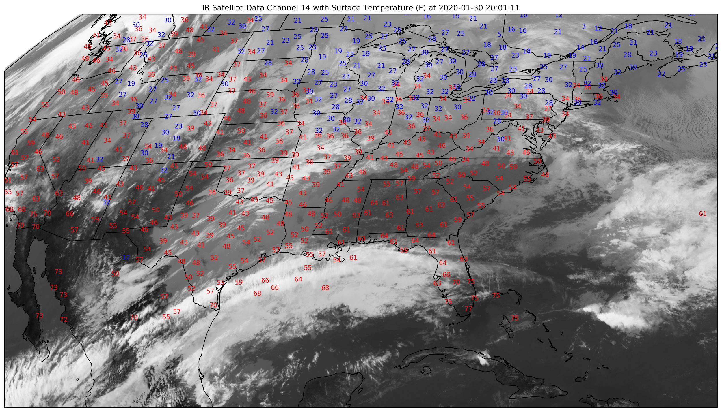
SI2-SSE:A Python GEMPAK Replacement for Meteorological Data Analysis PI: Ryan May, Co-Pis: Kevin Goebbert, John Leeman
University Corporation for Atmospheric Research/Unidata, Valparaiso University
Award #: OAC-1740315
MetPy is a Python toolkit for meteorological and atmospheric science applications
Trying to make Python a reasonable migration path for legacy scripted weather analysis tools, like GEMPAK
Build up reusable, sustainable infrastructure for the science
Don’t reinvent the wheel
NSF CSSI PI Meeting, Seattle, WA, Feb. 13-14, 2020

