Slide 1



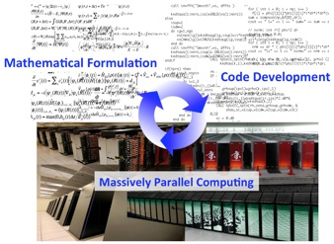
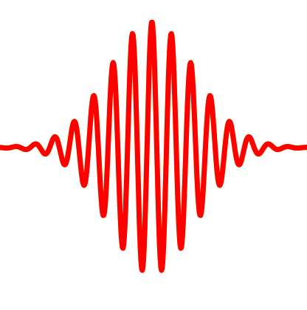
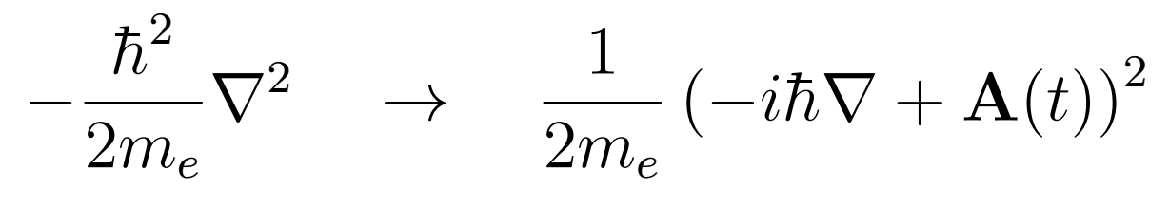
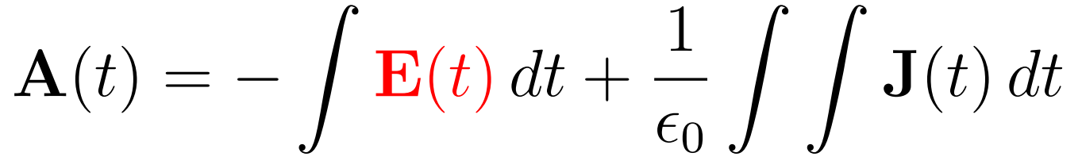
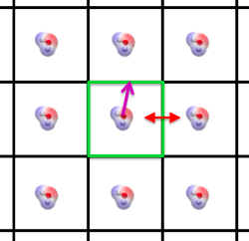

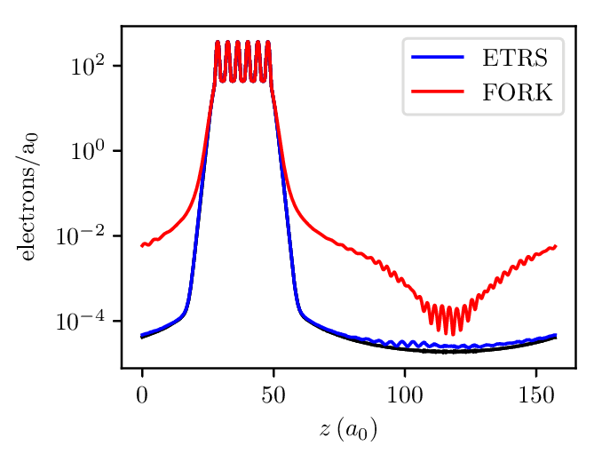
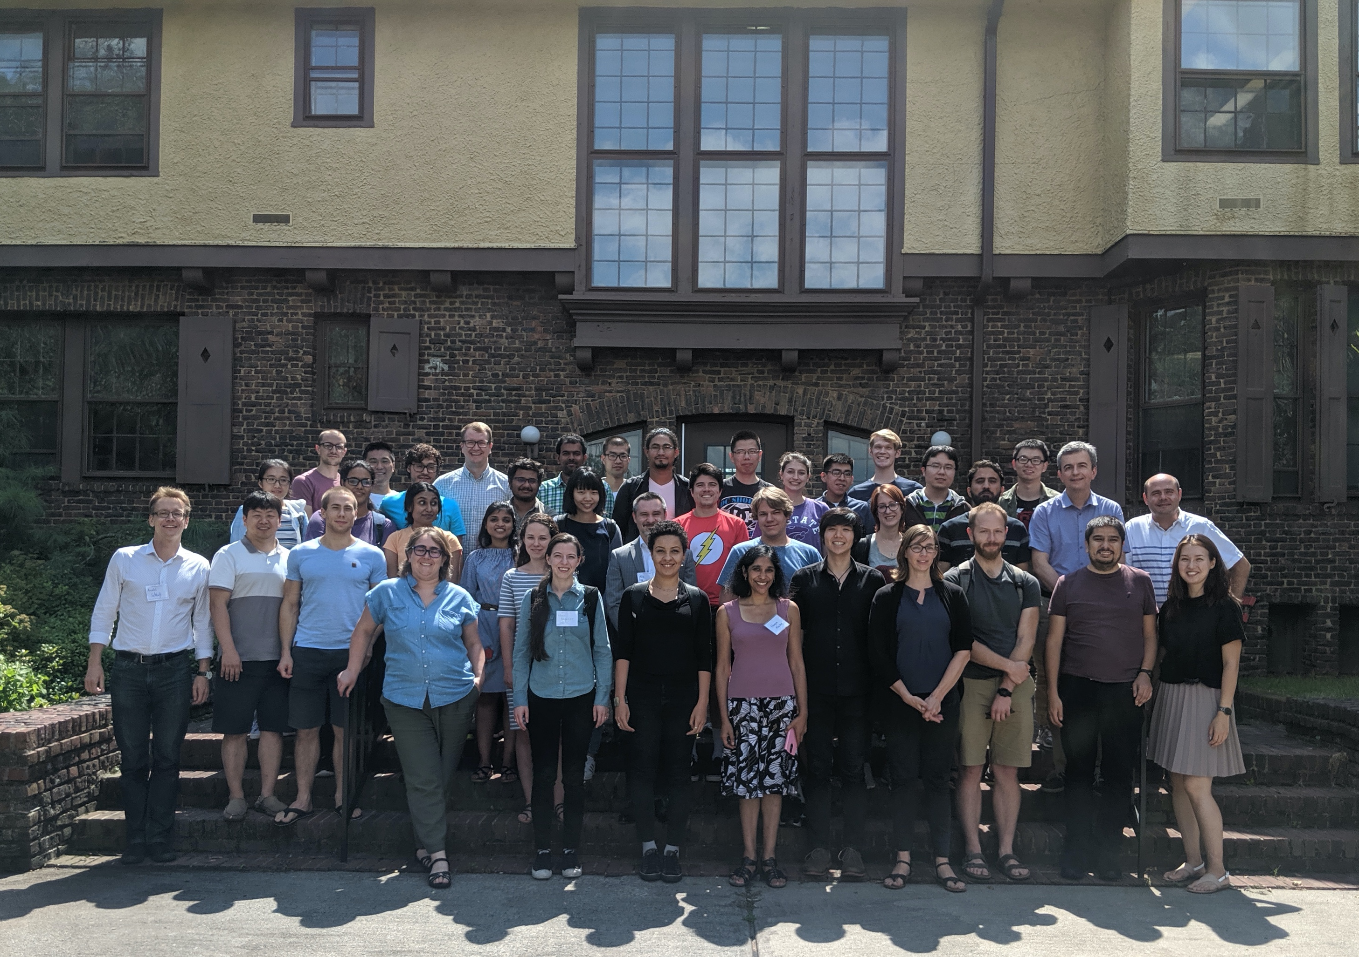
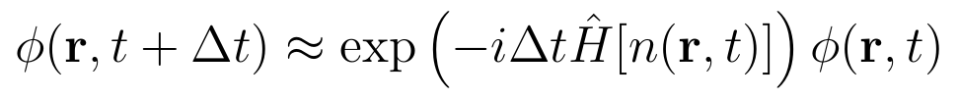
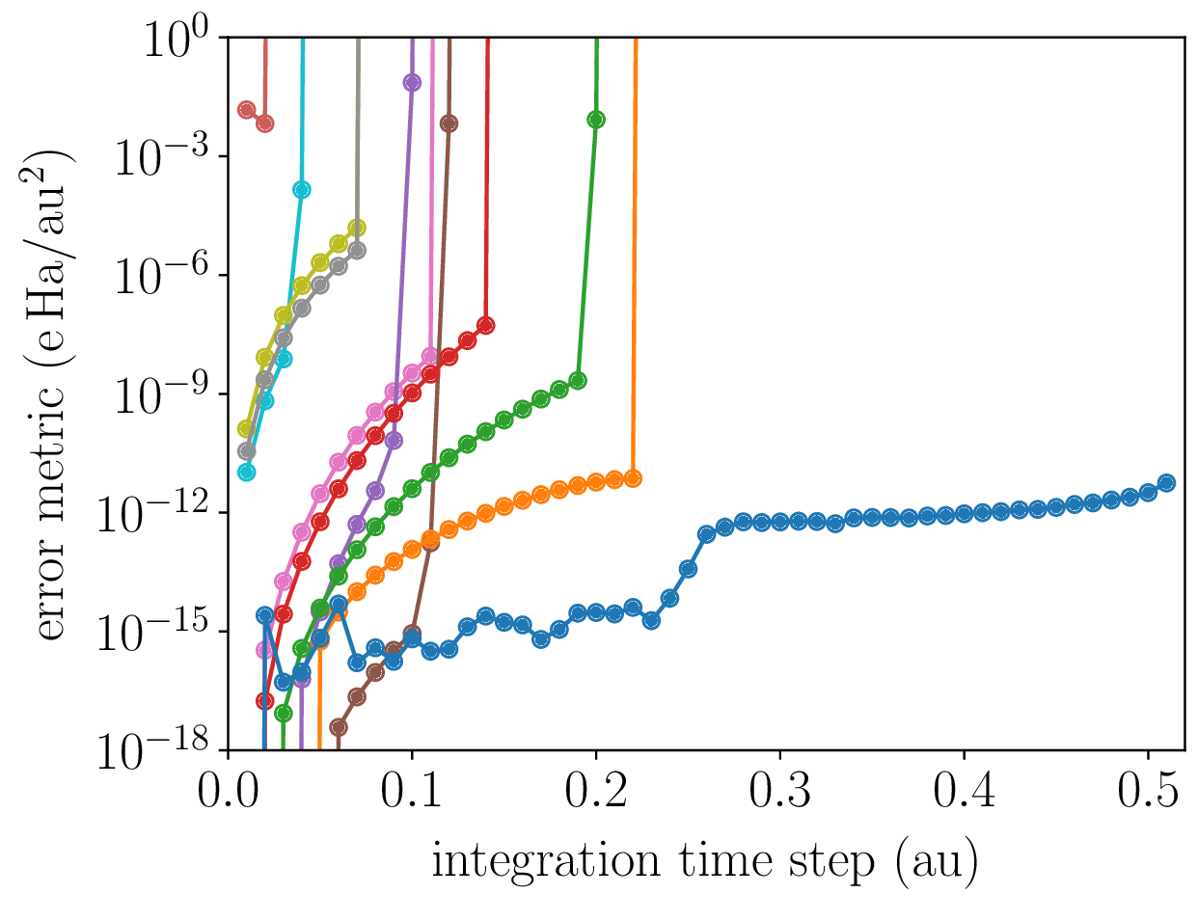
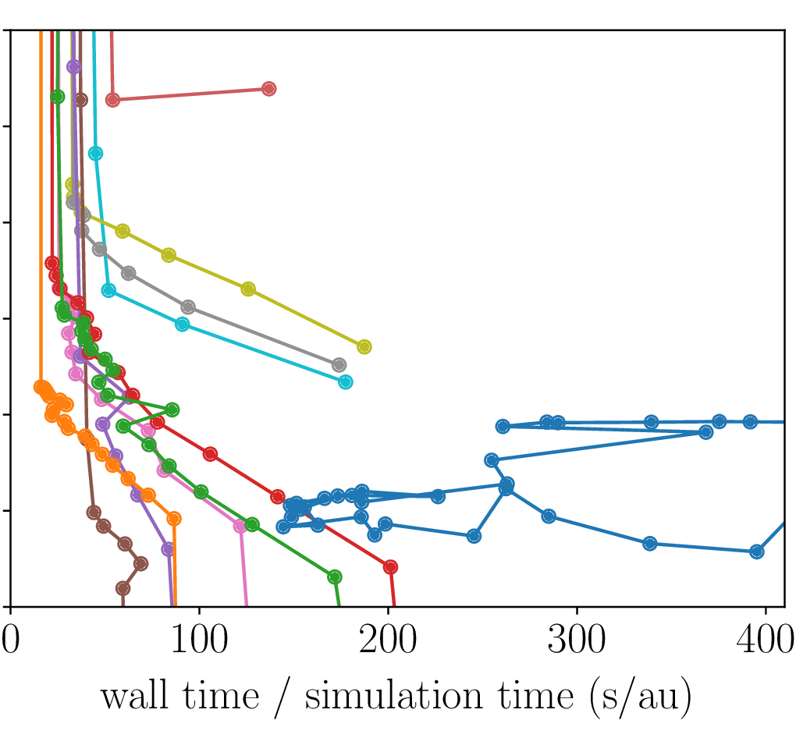
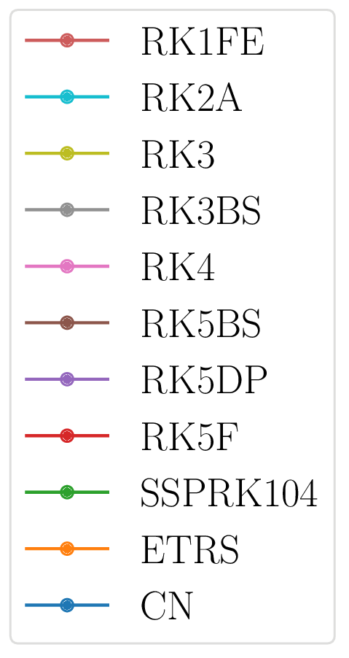
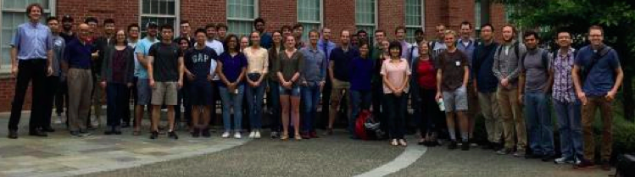
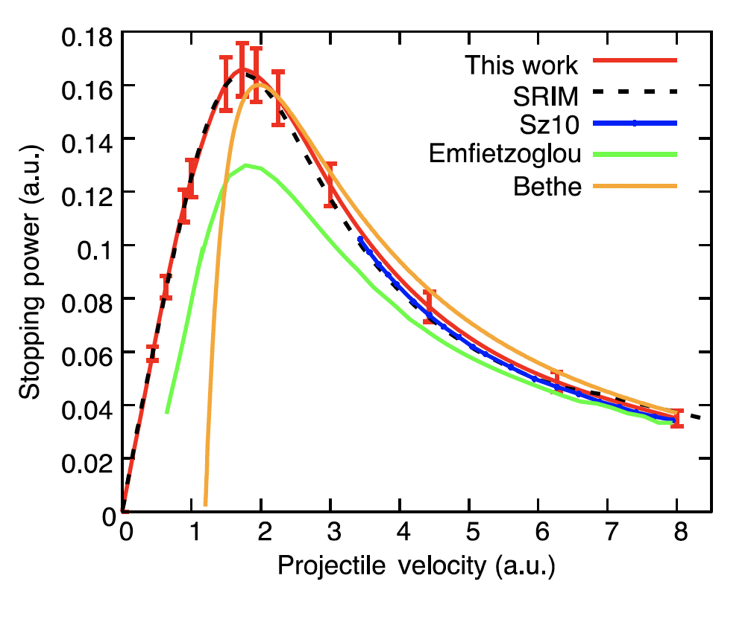
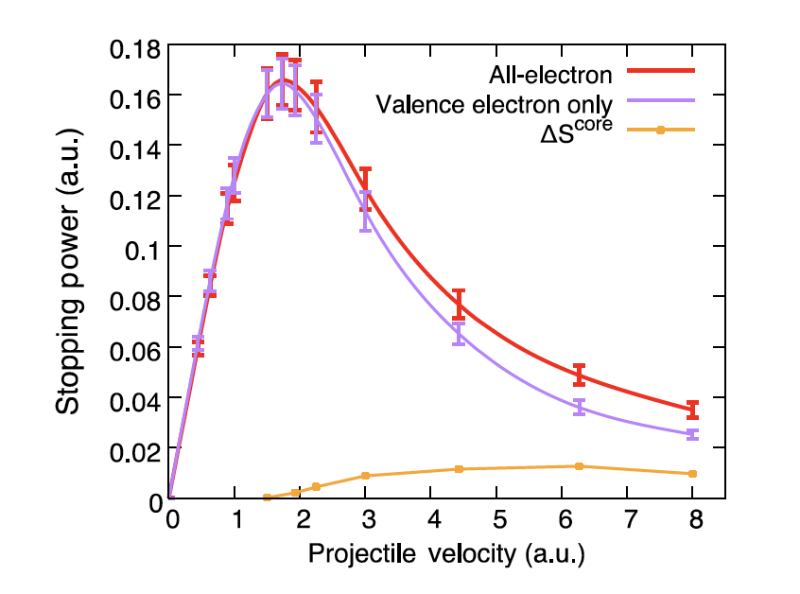
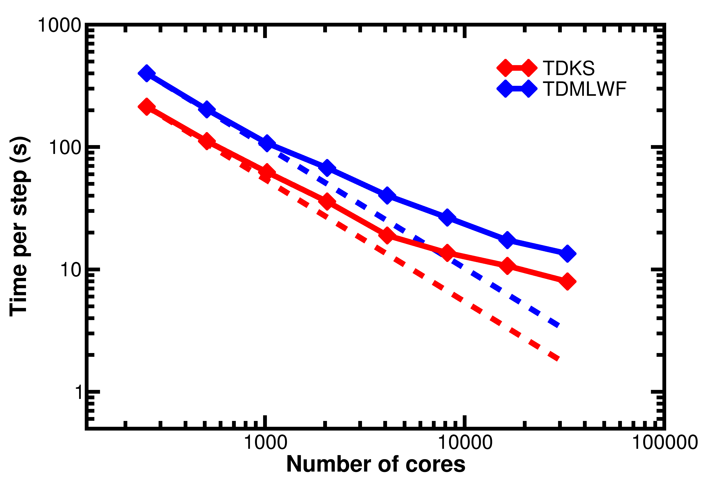
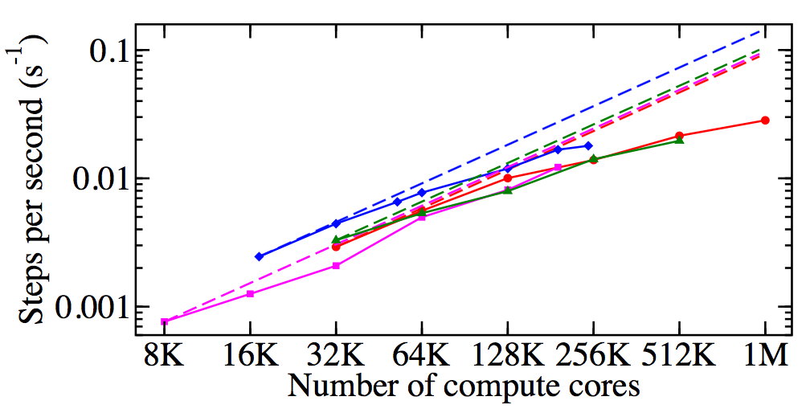
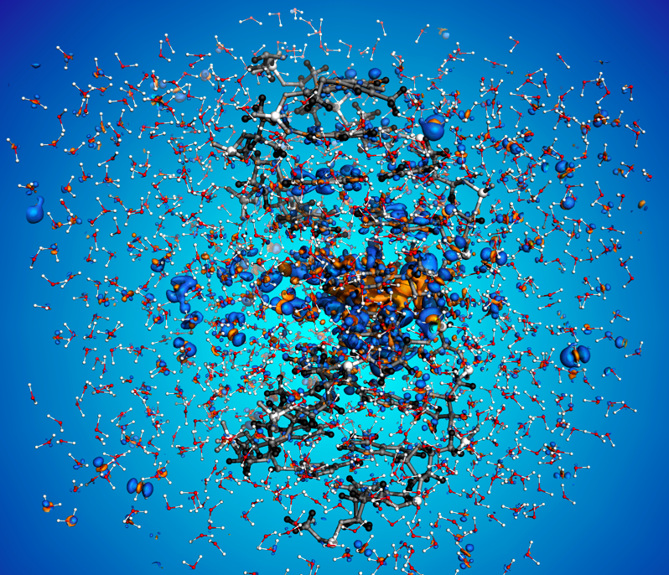


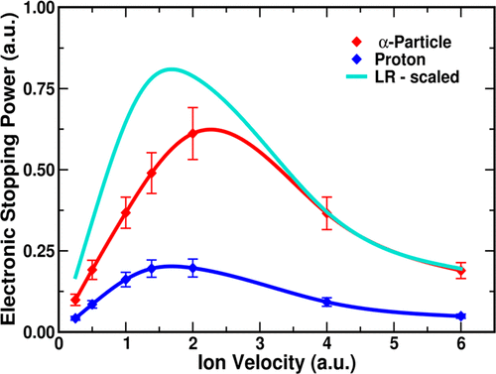
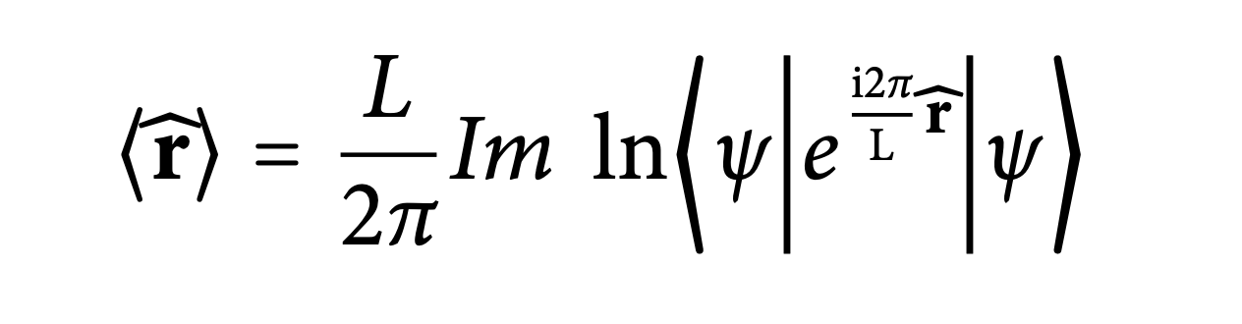
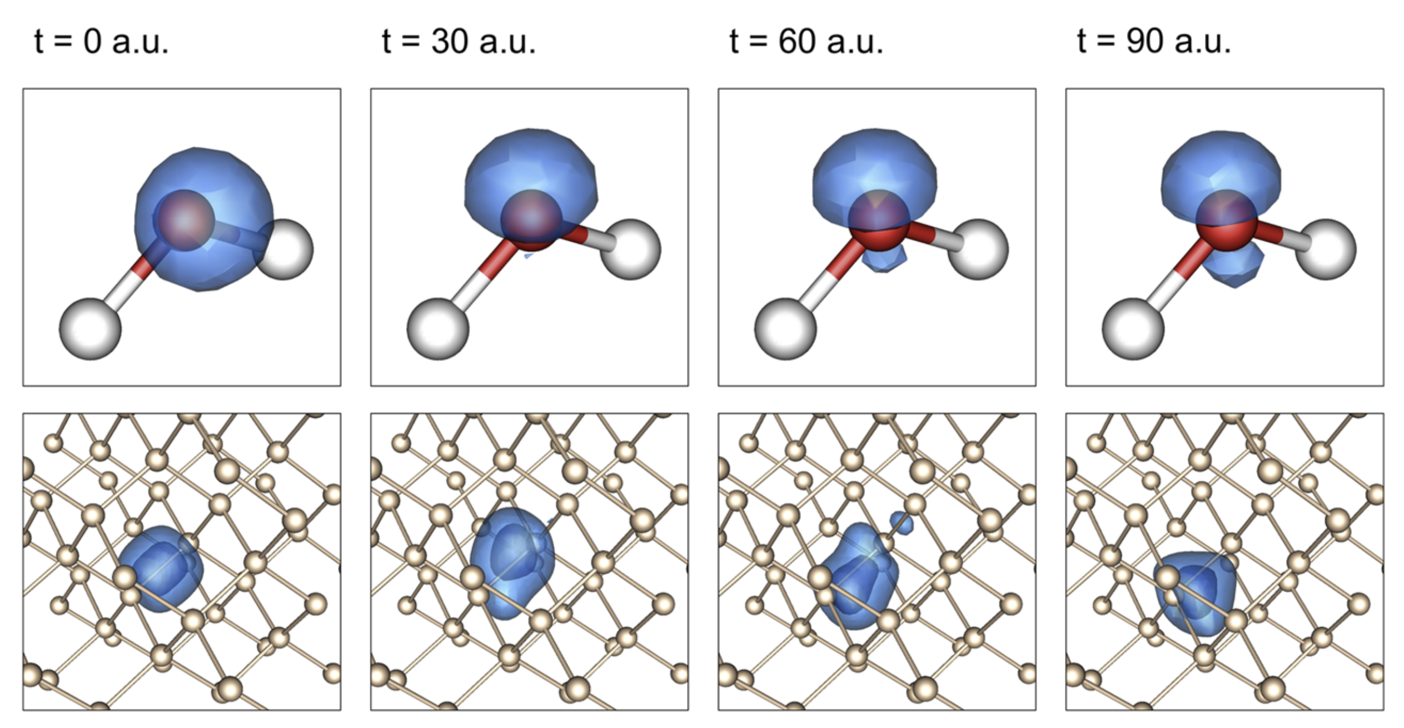
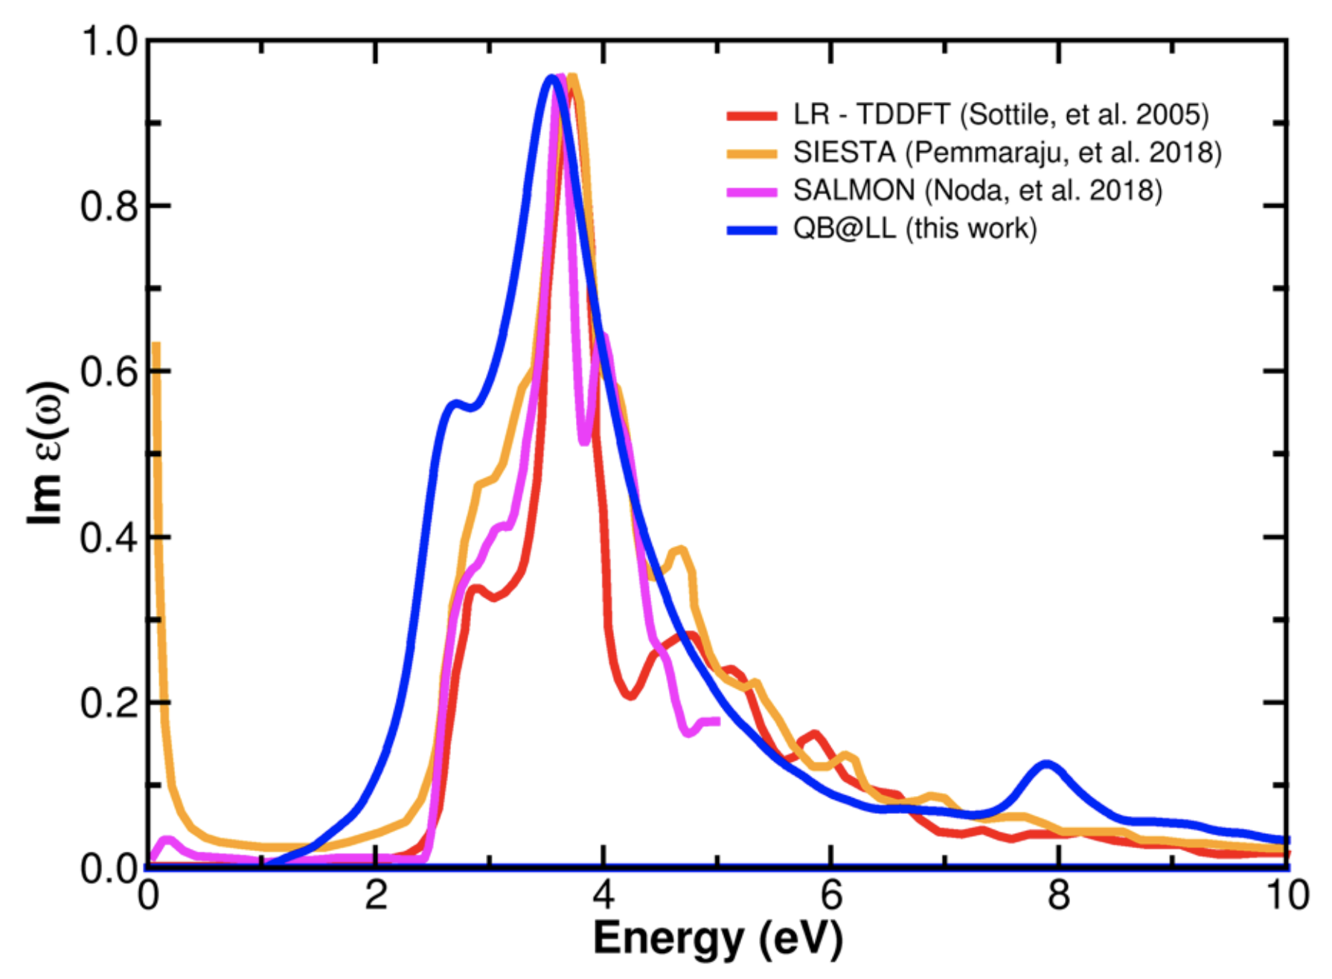
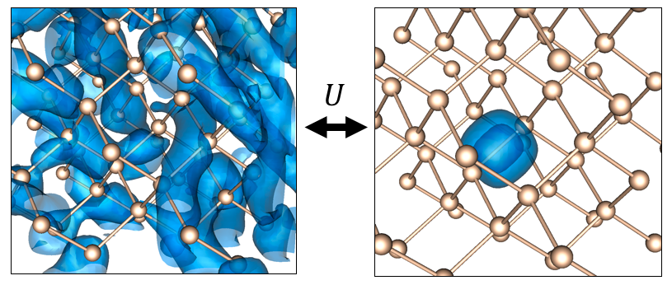
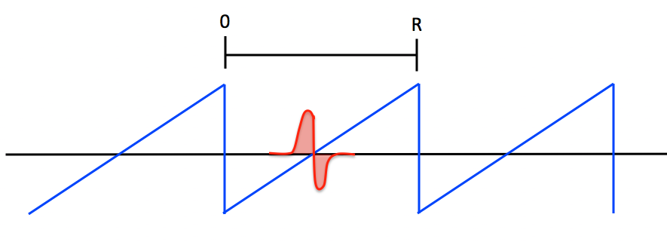
SI2-SSE: Massively-Parallel Real-Time TDDFT Modules for Non-Equilibrium Electron Dynamics
Yi Yao¹, Alina Kononov², Dillon Yost¹, Xavier Andrade⁴, Erik Draeger⁴, Andre Schleife³, Yosuke Kanai¹
1. Dept. of Chemistry, University of North Carolina at Chapel Hill
2. Dept. of Physics, University of Illinois at Urbana-Champaign
3. Dept. of Materials Science and Engineering, University of Illinois at Urbana-Champaign
4. Center for Applied Scientific Computing, Lawrence Livermore National Laboratory
Our goal is to build, test, and broadly disseminate new software capabilities for the RT-TDDFT simulations in the massively parallel open-source Qb@ll code, via mitigating two pressing limitations: (i) Large computational cost due to small time steps needed to control the numerical error of real-time integration. (ii) Limited accuracy of the electronic structure computed by commonly used exchange-correlation approximations. We will address this through developing
(1) New modules for improved numerical integration of the underlying non-linear partial differential equations via strong stability-preserving Runge Kutta methods, allowing for larger time steps and higher numerical accuracy.
(2) New modules that compute the electronic structure through a modern implementation of an advanced meta-generalized-gradient approximation (meta-GGA) exchange-correlation functional and beyond.
Our second objective is to disseminate these developments by building an academic-research HPC community with the Qb@ll code
(3) Development of convenient interfaces between the Qb@ll and other main-stream electronic-structure codes (e.g. quantum-espresso code) for data conversion.
(4) Engagement of early scientists (PhDs and post-docs) by incorporating the hands-on training on RT-TDDFT using the Qb@ll code during TDDFT summer schools and HPC workshops.
Real-Time Time-Dependent Density Functional Theory (RT-TDDFT) Simulations
Isolated Systems and High-energy excitations in PW-PP formulation: PBC issue
Kohn-Sham Ansatz: Electron Density and Kohn-Sham wavefunctions
H₂O molecule / L³ cubic cell / E_{cut}= 40 Ryd
L N_{pw}
15 a.u. 15,092 (large enough for most g.s. properties)
20 a.u. 35,112
25 a.u. 68,200
30 a.u. 116,952
50 a.u. 535,936 (“reasonably” converged absorption spectrum)
80 a.u. 2,196,348
100 a.u. 4,286,568 (completely converged!)
Spurious field (ω≥0) could be induced due to its periodic images for polarized system?
Fourier series expression is modified such
that correct behavior is satisfied (i.e. G(g)=1/g²)
in the reciprocal space.
electron density ρ: sum of Kohn-Sham
single-particle wavefunctions ɸ_{i}
time-dependent
Kohn-Sham equations
TDDFT Hamiltonian depends on ɸ_{i}(t)
Martyna and Tuckerman
J. Chem. Phys, 110, 2810 (1999)
Modeling Excitations:
    Ion radiation: A moving ion leads to a time-dependent V_{ext}.
    Electric field: We implemented a time-dependent vector potential A(t).
moving ion
L=15 a.u.
w/ MT correction
w/o MT correction
L=25 a.u.
w/ MT correction
w/o MT correction
L = 100 a.u.
L = 15 a.u.
Very similar
Identical
Challenges:
1. Numerical integration of time-dependent Kohn-Sham equations (non-linear PDE) with millions of plane-waves as basis functions on massively-parallel high-performance computers (HPCs) with various architectures.
2. Physical accuracy of the model provided by RT-TDDFT simulation, specifically by the exchange-correlation (XC) functional/potential.
“Ejected” electrons could “hit” the boundary, interfering with their periodic images ?
A small region near the boundary for absorbing electrons is added with complex absorbing potential (CAP).
Integrators for Time-Dependent Kohn-Sham (TDKS) Equations
Yabana, et al, Phys. Stat. Sol., 243, 1121 (2006)
Scaling: O (N_{step}N_{n+k}N_{pw}logN_{pw})
N_{pw} : 15,092 PWs ➔ 4,286,568 PWs
~451 times more expensive!
L=100 a.u. (converged)
L=20 a.u. w/o CAP
L=20 a.u. w/ CAP
L=100 a.u. (converged)
L=30 a.u. w/o CAP
L=30 a.u. w/ CAP
Trade-off between accuracy and computational cost is a practical issue, especially for large systems with many plane-waves.
Legacy integrators accumulate unacceptable errors in interesting systems recently made accessible by HPC advancements.
We interfaced Qb@ll with the PETSc library [1] for seamless access to many time-stepping methods:
ɸ_{i}(t), Hɸ_{i}(t) → PETSc → ɸ_{i}(t+Δt)
Compared many RK based techniques and a CN-based approach, but so far, ETRS achieves lowest time-to-solution at acceptable accuracy.
Currently, we are investigating implicit methods and adaptive time-stepping.
Can we make the calculation converged at more affordable cost?
Two potential sources of error from adapting the PBC.
plane-wave
expansion:
Similar, some wiggles
Identical
[1] Abhyankar, Brown, et al., arXiv:1806.01437, (2018)
Community Development, HPC adaptation, and Scientific Impacts
ETRS integrator:
Workshops and Tutorials
ETRS
RK4
1.
Qb@ll code hands-on tutorial was held as part of the HybriD3 Theory Training Workshop at Duke in Sept, 2018 (with 60 participants).
Two TDDFT summer schools were held in 2019, one in Sao Paulo (with about 30 students) and one at Rutgers (with 34 students) with Qb@ll code tutorials.
Al
“vacuum”
cheap
2.
accurate
accurate
Scientific Impacts
Electronic Stopping of Protons in Liquid Water
1 a.u. = 24.2 attosec
Electron density profile after a ground state aluminum sheet (black) containing 3300 electrons is propagated for 2.9 fs using two different integrators: fourth-order Runge-Kutta (RK4) and enforced-time reversal symmetry (ETRS). Integration error can cause a fictitious electron density in the vacuum region.
Merit of various integrators for the TDKS equations. The error metric is taken as the product of the average errors in net charge and total energy per simulation time. Integrators tested include all Runge-Kutta (RK) schemes available in PETSc, strong-stability preserving Runge-Kutta (SSPRK), enforced time-reversal symmetry (ETRS), and Crank-Nicolson (CN).
Propagation of Maximally Localized Wannier Functions: J. Chem. Phys. 150, 194113 (2019)
Adaptation to various HPCs
Core-electron excitation contribution is important in velocity range beyond the stopping power maximum. Phys. Rev. Lett. 123, 066401 (2019)
TDKS equations can be propagated in the MLWF gauge.
Error vs. Δt⁻¹
Computational Cost : Scaling
4th RK - KS
4th RK - MLWF
ETRS - KS
ETRS - MLWF
ETRS - KS
ETRS - MLWF
DNA and Role of Solvation in Electronic Stopping
Dynamic polarization via Berry Phase or MLWF centers:
512-atom silicon
BG/Q : MPI-only
~ 2 times more expensive
Bloch
MLWF
For calculating photo-absorption spectrum, homogeneous electric field is used with the linear potential centered around each w_{i}(t).
Results for a 1600 atom cell of gold (27,200 electrons) obtained on the IBM BG/Q Sequoia (red circles), BG/Q Mira (green triangles), Cray Blue Waters (blue diamonds), and KNL Theta (magenta squares) are shown.
~13,000 electrons
> 6 Mil. PW basis functions
> 200K cores in IBM BG/Q
Stopping power behavior difference between protons and α-particles cannot be captured correctly via linear response (LR) theory. JACS, 141, 5241 (2019)
Crystalline
Silicon
Acknowledgment : This work is supported by the National Science Foundation under grant Number OAC-1740204 and OAC-1740219.
An award of computer time was provided by the Innovative and Novel Computational Impact on Theory and Experiment (INCITE) program.

