Slide 1
SeamlessAccess.org:SpringerNature ALA Midwinter 2020
Delivering a simpler, privacy-
preserving access experience
Notes:
In July 2020, SeamlessAccess.org will be launching a new, privacy-preserving service to simplify Single Sign-On access to a wide range of scholarly collaboration tools, information resources, and shared research infrastructure. The next stage of the RA21 project is currently in Beta testing, and this session will give a community update on the state of the project.
SeamlessAccess.org is a community-driven effort backed by stakeholders from across the industry including NISO, ORCiD, the International Association of STM Publishers, and organizations involved in managing global Research & Education networks (Internet2, GÉANT).
Over the next 7 months leading up to the launch, SeamlessAccess is beta testing this new service with a variety of publishers and institutions to understand integration scenarios, test specific use cases (such as walk-in access), and finalize the implementation standards.
In addition, SeamlessAccess is setting up several cross-industry working groups to develop best practices and policies around the use of Single Sign-On, including template contractual terms covering data protection and configuration profiles to simply library implementation.
This session will share the lessons learned from the beta testing, the best practices and policies developed by these working groups, and describe what libraries and librarians need to know in order to deliver a simpler, privacy-preserving access experience for users.
ADD WORKING GROUPS – add a slide, here’s the things, here’s the people, here’s the outcomes

Slide 2
Where We’ve Been
Notes:
We’ll start by briefly re-capping the access issues that led to the creation of SeamlessAccess, then we’ll spend more time showing you a demo of how we’re planning to simplify access, and talk through issues around data privacy. And then we’ll open up to questions.
First, why are we here.

Slide 3
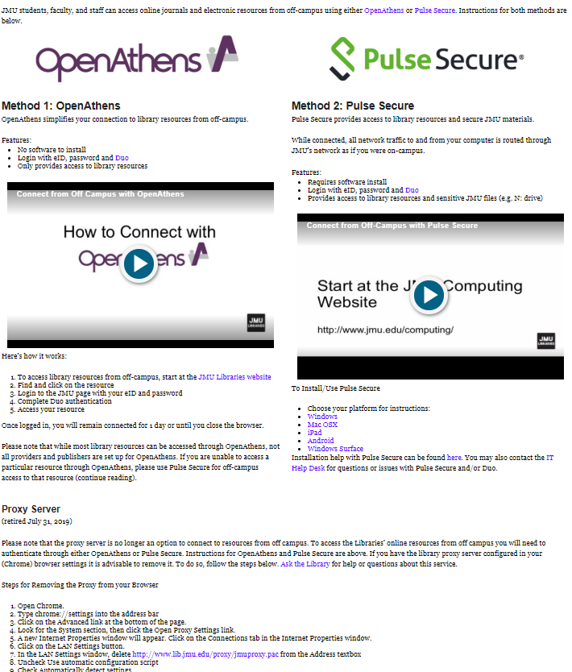
Why Are We Here?
Improve remote access scenarios
Increase in off-campus access
Faulty use case assumptions
Improve usability via a secure, single sign-on solution
Personalized user services capabilities
Enhance user privacy mechanisms
Notes:
Questions: Why in the world do we even need this? Isn’t this a solution looking for a problem? We use EZproxy - it’s only $495 a year and it works just fine.
IP recognition has been around since the 70’s, and library use of IP recognition was developed when off-site access to electronic resources was in its infancy and has changed very little since then.
It wasn’t even designed for remote access, but I was around when this was occurring, and it was a godsend at the time:
I remember how difficult and unwieldy it was trying to get a proxy server setup and then trying to support users trying to make configuration changes to their browser, then needing to remember to undo these.
Chris Zagar saw an opportunity to build a lightweight, easy-to-implement IP-based solution and away we went!
But after 20 years of IP authentication, I think we can now do a better job.
Seamless Access seeks to:
Improve remote access scenarios
Considerable increase in off-campus access to library resources over the years - from a multitude of devices.
With IP authentication we force researchers to start from or at some point circle back through the library’s web site to find a proxy-prefixed URL. This isn’t how researchers research.
Improve usability. Current issues include:
Numerous clicks to get to content behind a paywall
Numerous user credentials scattered over a multitude of platforms; libraries have not kept pace with the consumer web.
If institution is using VPN, Shibboleth, and EZproxy, the user is immediately overwhelmed (see image)
Access is currently so complicated that fully-entitled end-users are turning to alternative resources (e.g. SciHub, ResearchGate, etc.) for more easily-accessed content.
3. Personalized user services capabilities (more later)
4. Enhance user privacy mechanisms (more on that later, too.) (NEXT SLIDE)

Slide 4
Previously seen on …
The Resource Access in the 21st Century project (RA21) initiated in 2016, initially to explore the challenge of remote access.
Stakeholders from the publishing, library, software, and identity communities; input from 60 organizations.
Identified that Federated Identity Management (FIM) held the most promise for providing a robust, scalable solution for remote access to scholarly content.
Investigated barriers to take-up, developed best practices, and piloted technical approaches to simplifying access
Notes:
The Resource Access in the 21st Century project (or RA21) was initiated in 2016, initially to explore the challenge of remote access.
It involved stakeholders from the publishing, library, software, and identity communities; and took input from 60 organizations over 3 years.
It identified that Federated Identity Management (FIM) held the most promise for providing a robust, scalable solution for remote access to scholarly content.
It also investigated barriers to take-up, developed best practices, and piloted technical approaches to simplifying access.

Slide 5
Previously seen on …
Conclusions published as a draft NISO Recommended Practice in April 2019
>200 comments helped identify further areas for investigation and confirm the value of testing a beta service
Final NISO Recommended Practice* published in June 2019.
* Recommended Practices for Improved Access to Institutionally-Provided Information Resources: Results from the Resource Access in the 21st Century (RA21) Project
Notes:
Its conclusions were published as a draft NISO Recommended Practice in April, receiving >200 comments that helped identify further areas for investigation and confirm the value of testing a beta service.
A final NISO Recommended Practice was published in June, and is available at the NISO website with the brevity-challenging name of “Recommended Practices for Improved Access to Institutionally-Provided Information Resources: Results from the Resource Access in the 21st Century (RA21) Project”
Ok, so how I’ll hand over to John to explain WHY we’re here!

Slide 6
Where we are…

Slide 7
What is SeamlessAccess?
Community-driven effort to enable seamless access to information resources, scholarly collaboration tools, and shared research infrastructure.
5 founding organizations (to date): the National Information Standards Organization (NISO), GÉANT, Internet2, ORCID, and the International Association of STM Publishers.
The operational successor to the RA21 project
Deliverables: an operational service + best practices / standards
Notes:
Ok, I’m going to close off this recap session by running through the WHAT, WHO, and WHEN of SeamlessAccess.
First, WHAT are we?
We’re a community-driven effort to enable seamless access to information resources, scholarly collaboration tools, and shared research infrastructure.
To date, we have 5 founding organizations: the National Information Standards Organization (NISO), GÉANT, Internet2, ORCID, and the International Association of STM Publishers. We’re actively seeking a partner to represent the library community.
Think of us as the operational successor to the RA21 project, delivering an operational service + best practices / standards

Slide 8
When is Seamless Access?
Piloting phase RA21
SeamlessAccess Beta Phase Operational
Full service operational
July 2019 – June 2020
July 2020 - onwards
December 2016 – June 2019
Notes:
Here’s an overarching timeline for our activities to date and going forward.
As I mentioned the RA21 project that developed and piloted ideas from the end of 2016 until June this year, when it wrapped up. SeamlessAccess is now in the process of testing these ideas in the light of community feedback and developing best practices around the use of federated identity management. This beta phase is expected to run until June 2020. From July 2020, we expect to have our service fully operational.
Which is a great point to hand over to Emily so she can show you the improved user experience.

Slide 9
BETA

Slide 10
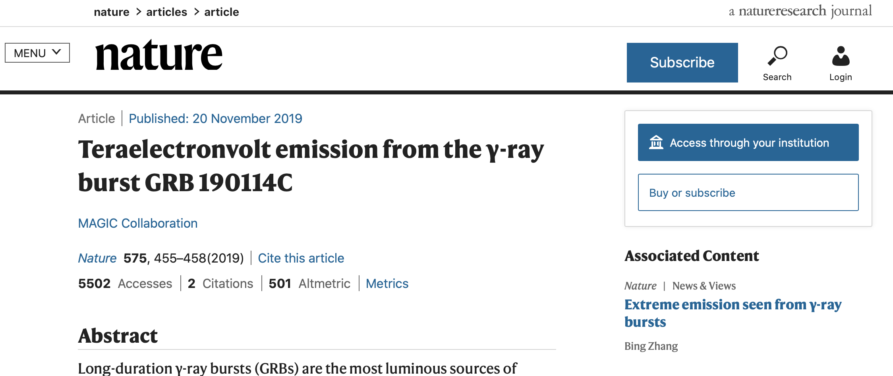

Slide 11
User Experience

Slide 12
How federated access works now

Slide 13
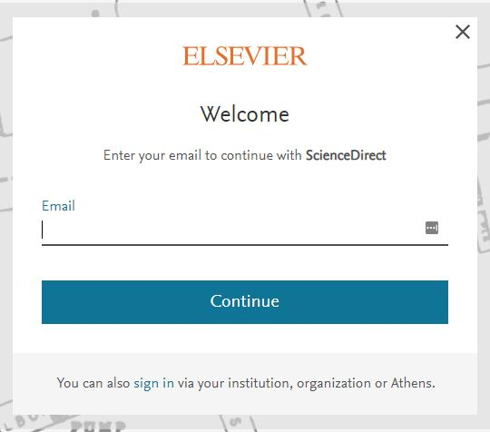
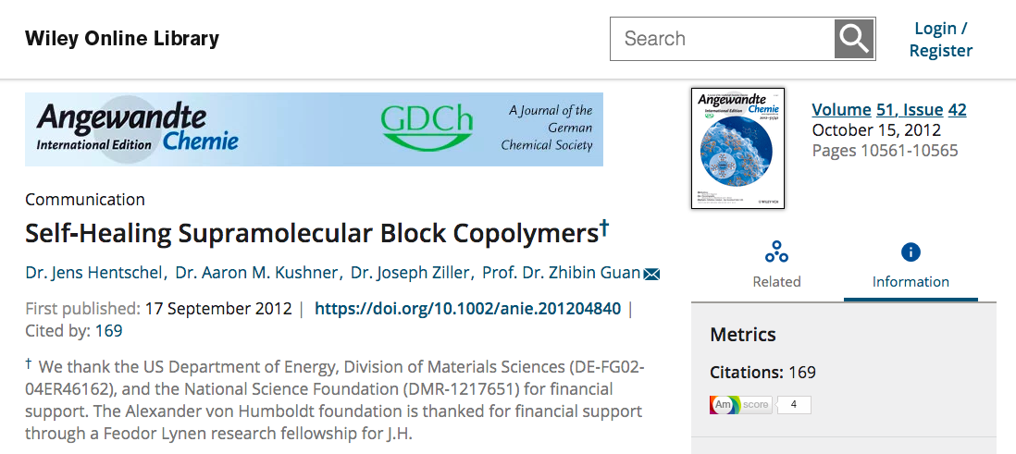
Login placement and language inconsistent across sites
Notes:
Users may not understand terminology like “institutional login”
Institutional login can be hard to find

Slide 14
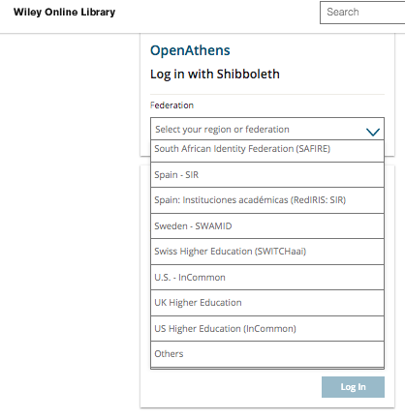
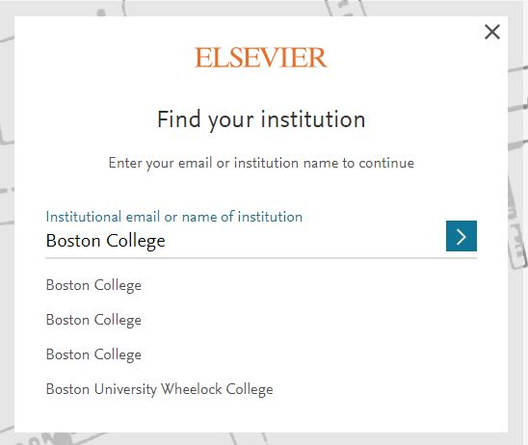
Authentication experience difficult to understand

Slide 15
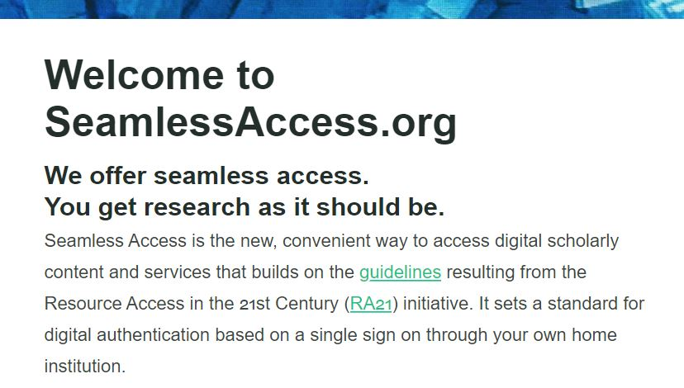

Slide 16
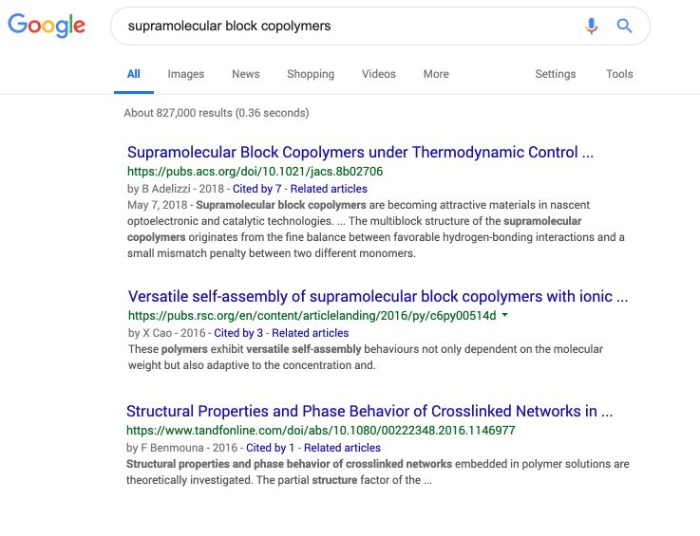
Notes:
(the next 11 slides are all screenshots for the demo, which hopefully will work and so these will all be skipped - Emily )

Slide 17
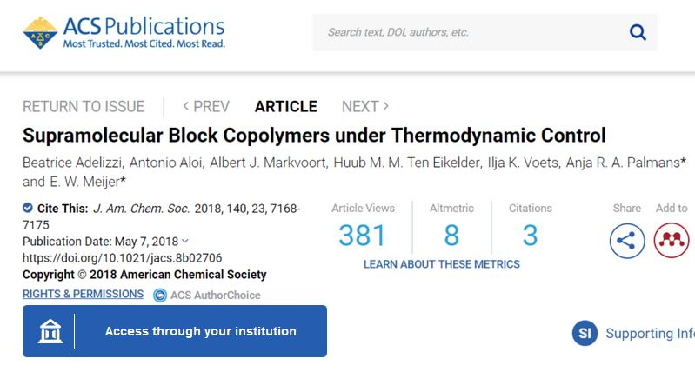

Slide 18
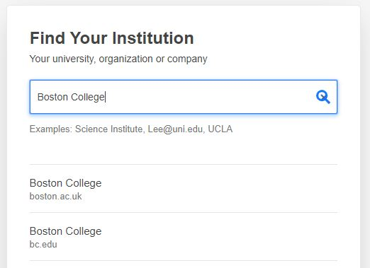

Slide 19
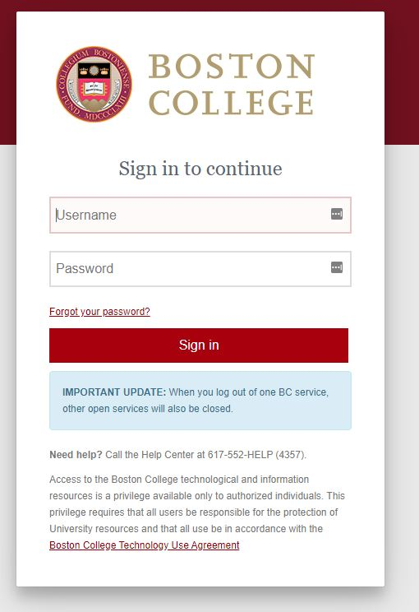

Slide 20
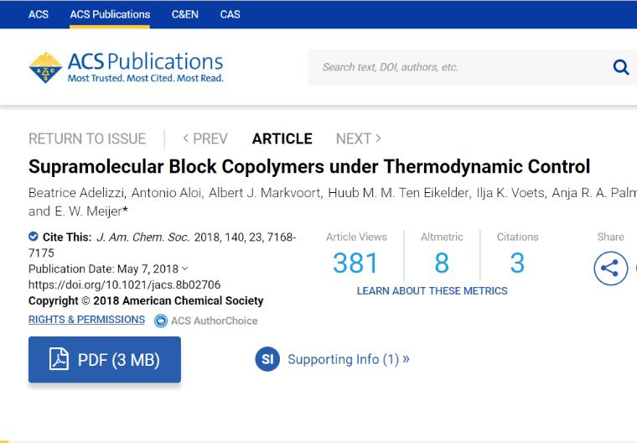

Slide 21
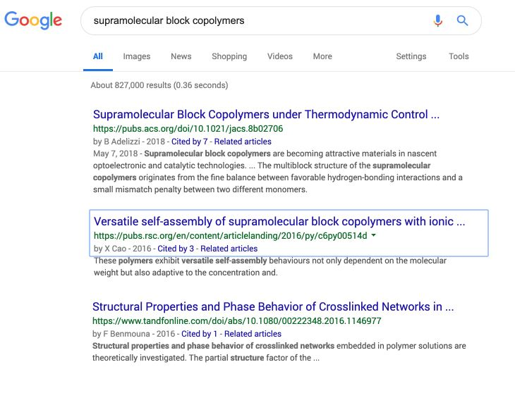

Slide 22
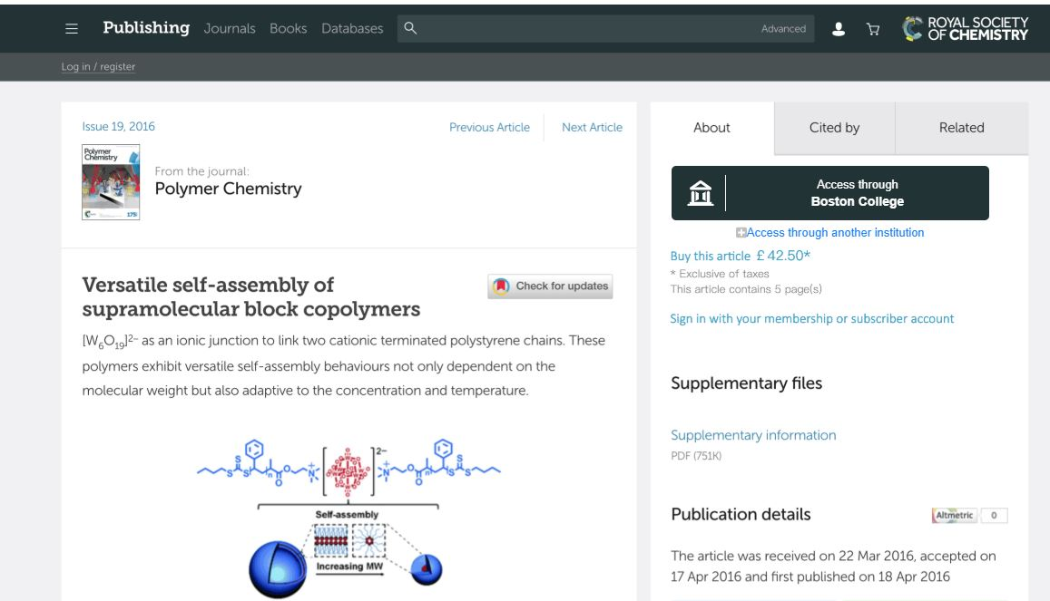

Slide 24
Where We Are Going…

Slide 25
Beta: Going “live”
Springer-Nature – “live”
In Progress
ACS
Elsevier
Digital Science
Committed to Integrate
Wiley
Taylor & Francis
Silverchair
O’Reilly
Notes:
Nature of “beta” means things are changing!

Slide 26
Current Work
Attribute Release Working Group
Determine appropriate Attribute bundles for different use cases
Including library walk-in and other library specific needs
In progress now
Notes:
One of the reasons I became involved with RA21 was, besides a general interest in this initiative, I had concerns over how user privacy was being handled. I am very confident that Seamless Access, building on the work of RA21, is taking security / user privacy very seriously and work in this area is a fundamental tenet of this initiative:
The RA21 Security & Privacy Working Group concluded a technical analysis of any security and privacy risks using industry-standard threat assessment models. This group was comprised of variety of stakeholders from across the information spectrum: librarians, library and university technologists, publishers, NISO, OpenAthens, etc.
Lisa Hinchliffe - Librarian at U. of Illinois at Urbana-Champaign
Jos Westerbeke - IT Specialist at Erasmus University
Peter Reid - Librarian at Bath Spa University
Results:
For security, when applying standard security and data protection practices. No significant risks were found
For data privacy, a data protection impact assessment was performed compliant with the EU’s GDPR to determine if “high risks” were involved. None were found.
2. Full report: https://ra21.org/wp-content/uploads/2018/07/RA21-Security-Privacy-Final-Report.pdf

Slide 27
Ongoing Work
Technical changes being made to timing of access to browser local storage….
Policy updates and usage agreements

Slide 28
Upcoming Work
Contract Language Working Group
Develop contract language templates for library use
Based on Attribute Release/Entity Descriptions from above
Give libraries a mechanism to ensure Attribute Release compliance

Slide 29
Next steps for Libraries
Plan for transition
Is SAML supported at your institution?
Privacy policies and attribute release
Working with IT
Get involved

Slide 30
thank you!
griffey@niso.org

