Slide 1
GeoWeaver: New AI Workflow Management System in New Decade
Ziheng Sun, Liping Di, Annie Burgess
George Mason University, ESIP

Slide 2
Current Progress of AI in Earth System
Earth Science AOI
Earth
Water
Atmosphere
Snow/ice
Land Cover Land Use
Disaster
Agriculture
Biology
AI Game Changer
Autonomous and connected electric vehicles
Low cost sensors
Deep Learning
Reinforcement learning
Natural language processing
Cloud, Cluster, Fog, Quantum and distributed computing to dramatically scale computing
Algorithmic game theory
Soft robotics (workflow automation)
Notes:
Harnessing_Artificial_Intelligence_for_the_Earth_report_2018

Slide 3
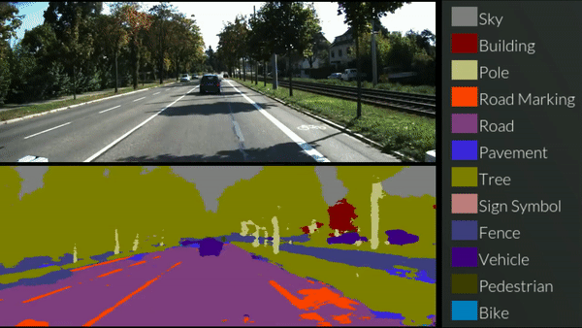
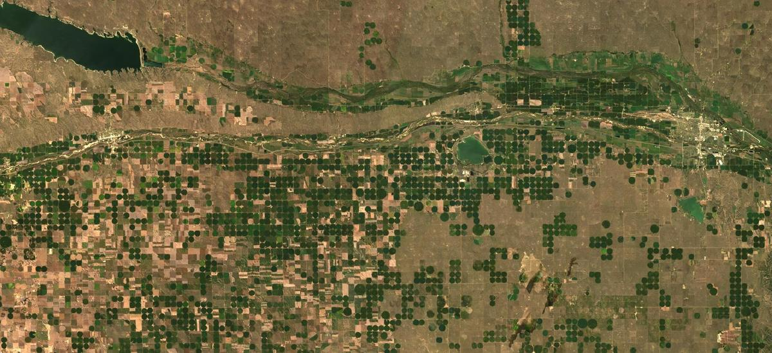
Why my AI model not working?
The Most Fundamental Question in AI
Apple tree question of AI domain
Notes:
https://www.youtube.com/watch?v=CxanE_W46ts

Slide 4
Why are my AI models not working?
There is boundary/range
Big data is “big” problem
Spatial temporal data has very high complexity
Too many possibilities
tree
Deductive Learning? Not Now.
?

Slide 5
Why are my AI models not working? - Engineering
Time-consuming data preprocessing (>60%)
Too much time spent on sorting out resources
Numerous failed attempts
Hyperparameter tuning
Lack of labels
AI model uncertainty
AI learns, but doesn’t understand (machine can’t think)
AI need very careful engineering
A lot of efforts
Expensive software/hardware
Huge training dataset

Slide 6
AI Engineering
How much workload?
How many people an AI team need?
Can AI work be solo?

Slide 7
AI Engineering Workload Formula (deep learning)
Overall AI workload equation:
$$W_{AI}={a×W}_{p}+\left(1−a\right){×W}_{m}$$
Where:
$a$ is the weight of person workload (depend on the market of human resources and machines)
$W_{p}$ is the workload on personnel (P):
$$W_{p}=\sqrt[3]{\frac{\left(T_{p_pre}×N_{class}+T_{p_ttv}×O_{ai}×N_{hp}×P_{dist}+T_{p_post}×N_{class}\right)×N_{tool}×N_{sample}}{A_{w}}}$$
$W_{m}$ is the workload on hardware machines (M):
$$W_{m}=\sqrt[3]{\frac{\left(T_{m_pre}×N_{steps}+T_{m_ttv}×O_{ai}×N_{hp}×P_{dist}+T_{m_post}×N_{step}\right)×N_{tool}×N_{sample}}{I_{ai}×N_{gpu_core}}}$$

Slide 8
AI Engineering Curve
Machine
Workload
Engineer
Project Time Bar

Slide 9
Major Barriers Blocking Our Attempts
#1: Less automatic preprocessing, TTV, postprocessing workflow
#2: Untraceable workflow, cann’t improving learning results
#3: Generalization: Spatial-temporal limits on the trained models
how to generalize the model: overfitting and underfitting
#4: Scale the model on big data using integrated computing power
Under the existing deep learning schema.
The barriers probably change when breakthroughs happen in AI field on self- and deductive learning.

Slide 10
Unsatisfied Needs of Earth Scientists in 2010’s
A tool integrating both public and private resources
A tool reusing the existing code, programs, tools
A tool for creating automatic and well-organized workflows

Slide 11
New Workflow Management Tool
Shield all the invisible unmanageable communications from users
New Workflow Management
Modularize resources and manage them in one place

Slide 12
GeoWeaver – Our Solution
GeoWeaver is a web-based workflow management system ideal for AI workflows on distributed platforms
Open Source, MIT
Comfortable graphical interfaces
FTP, SSH, WebSocket
Shell, Python, Jupyter notebook (experimental), built-in processes

Slide 13
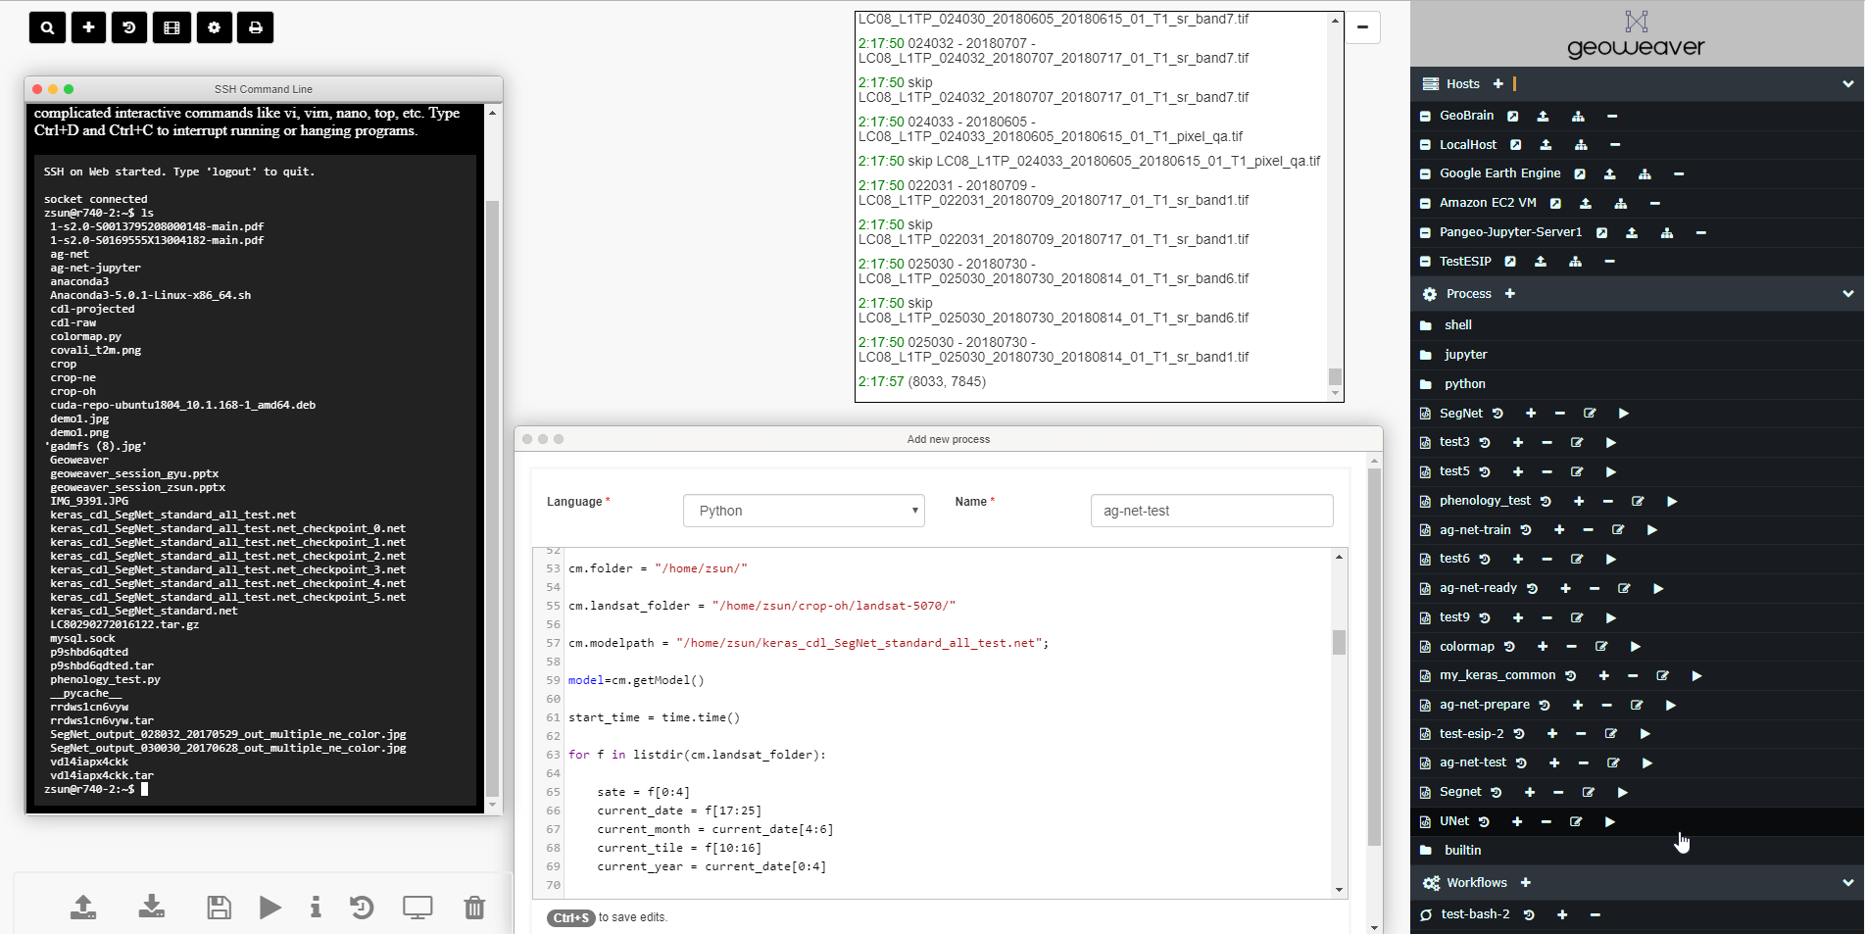

Slide 14
GeoWeaver - Demo

Slide 15
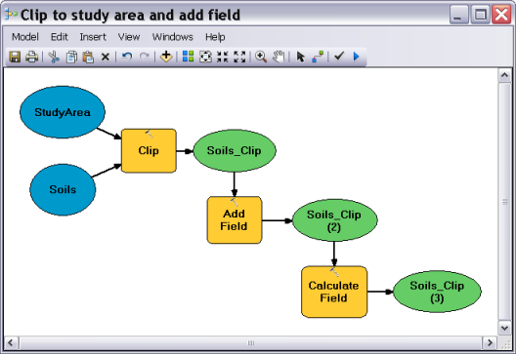
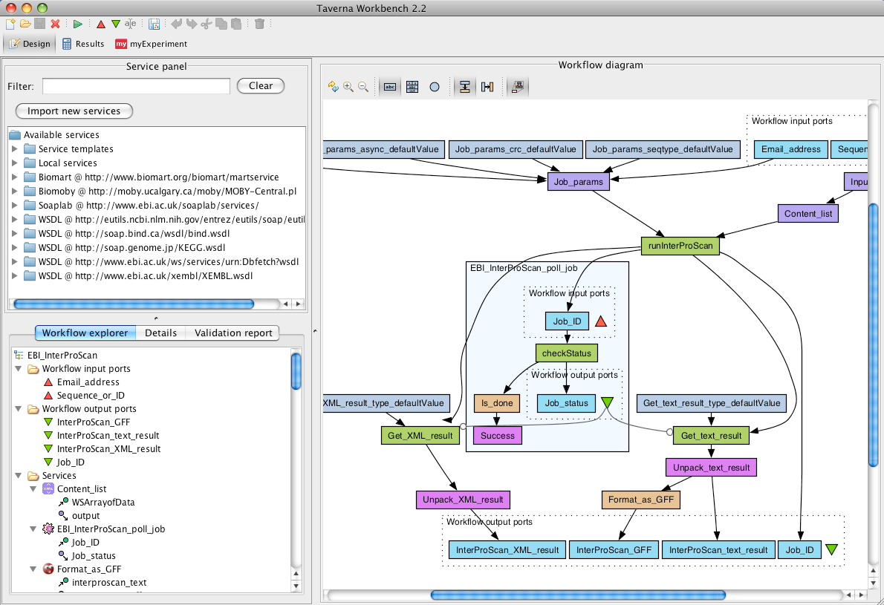
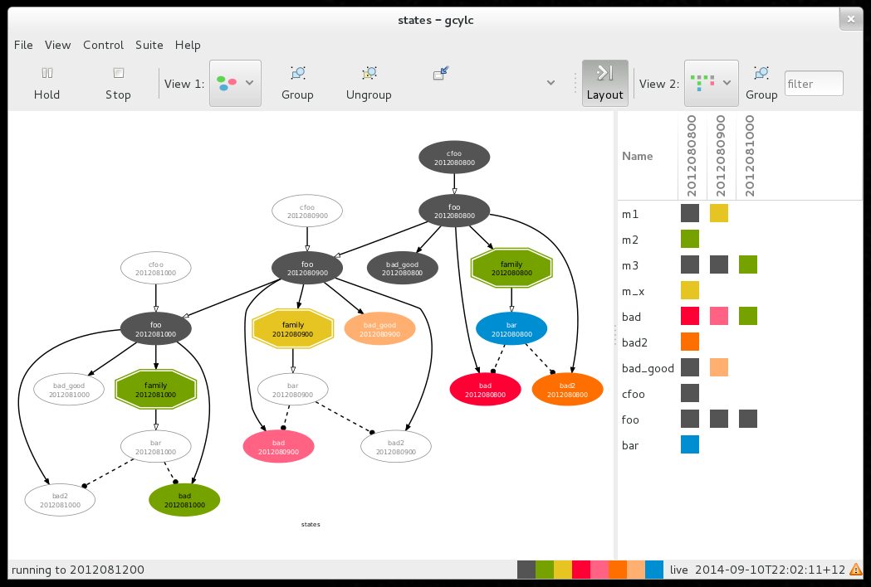
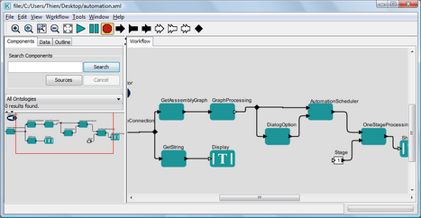
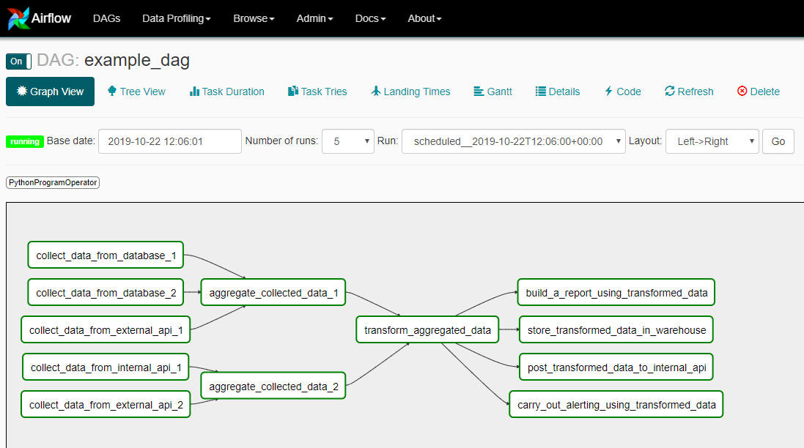
GeoWeaver– A WfMS Live in the Web Browser
WfMS – Workflow Management System
Java, Javascript, HTML5, CSS3
Linux, Mac, Windows
Existing WfMS
ArcGIS Model Builder
Apache Taverna
Kepler
Cylc
Galaxy
Pegasus-WMS
Apache Airflow

Slide 16
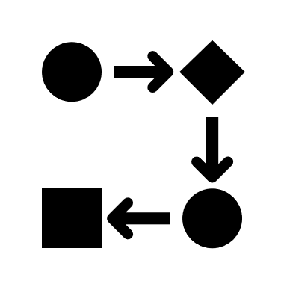
GeoWeaver Capabilities – Processing Workflow
Host: a platform, e.g., a physical Linux server, a AWS instance, a laptop, a workstation, a super computer, a Jupyter server, a Docker instance, a Kubernetes instance, etc
Process: Shell scripts, Python programs, Jupyter notebooks, etc
Workflow: a flow graph of multiple (>=2) linked processes

Slide 17
GeoWeaver Features
A VPN?
A FTP client?
A SSH client?
An integrated developer editor (IDE)?
A workflow system?
An alternative to Jupyter lab?
Yes, all of them.
Too ambitious? No.

Slide 18
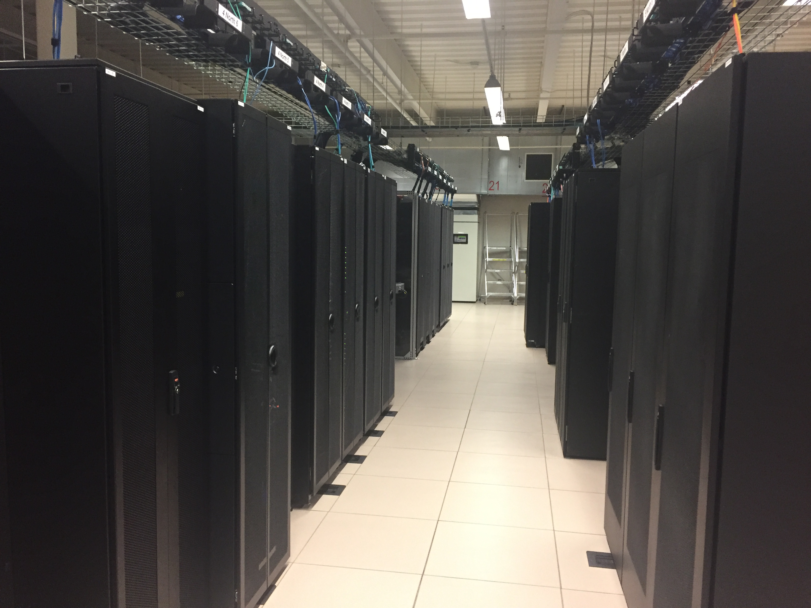
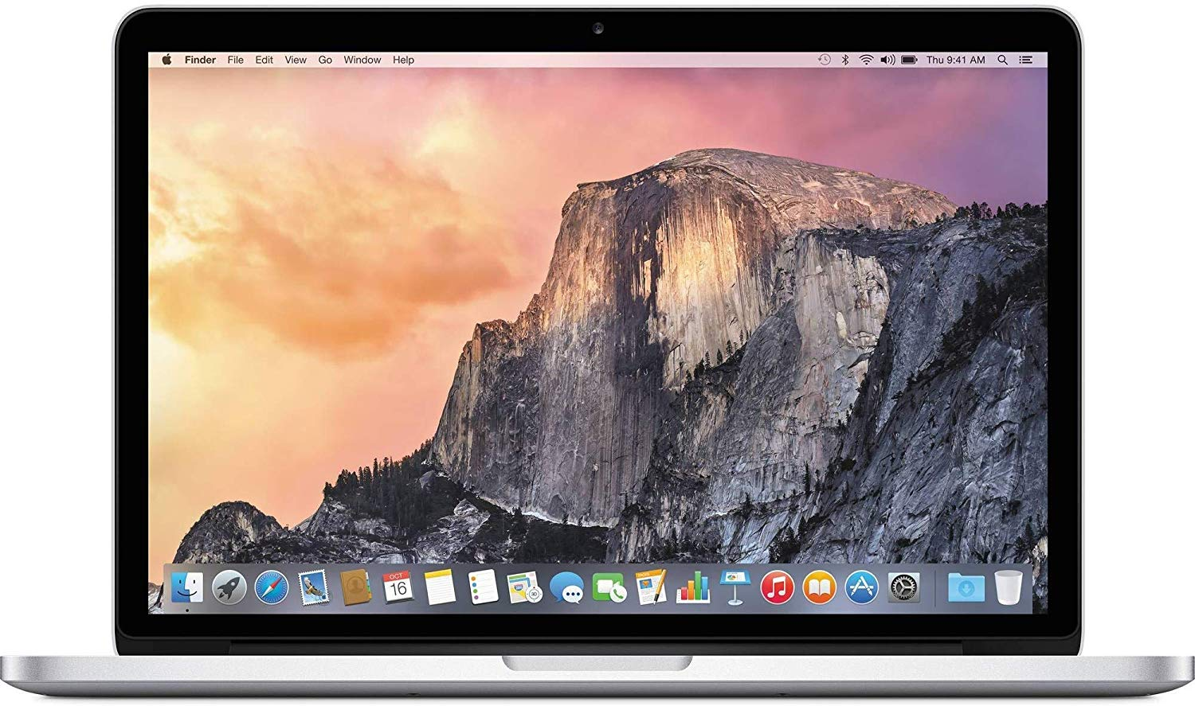
GeoWeaver for Meeting Scientist Needs
#1 Integrating public and private resources

Slide 19
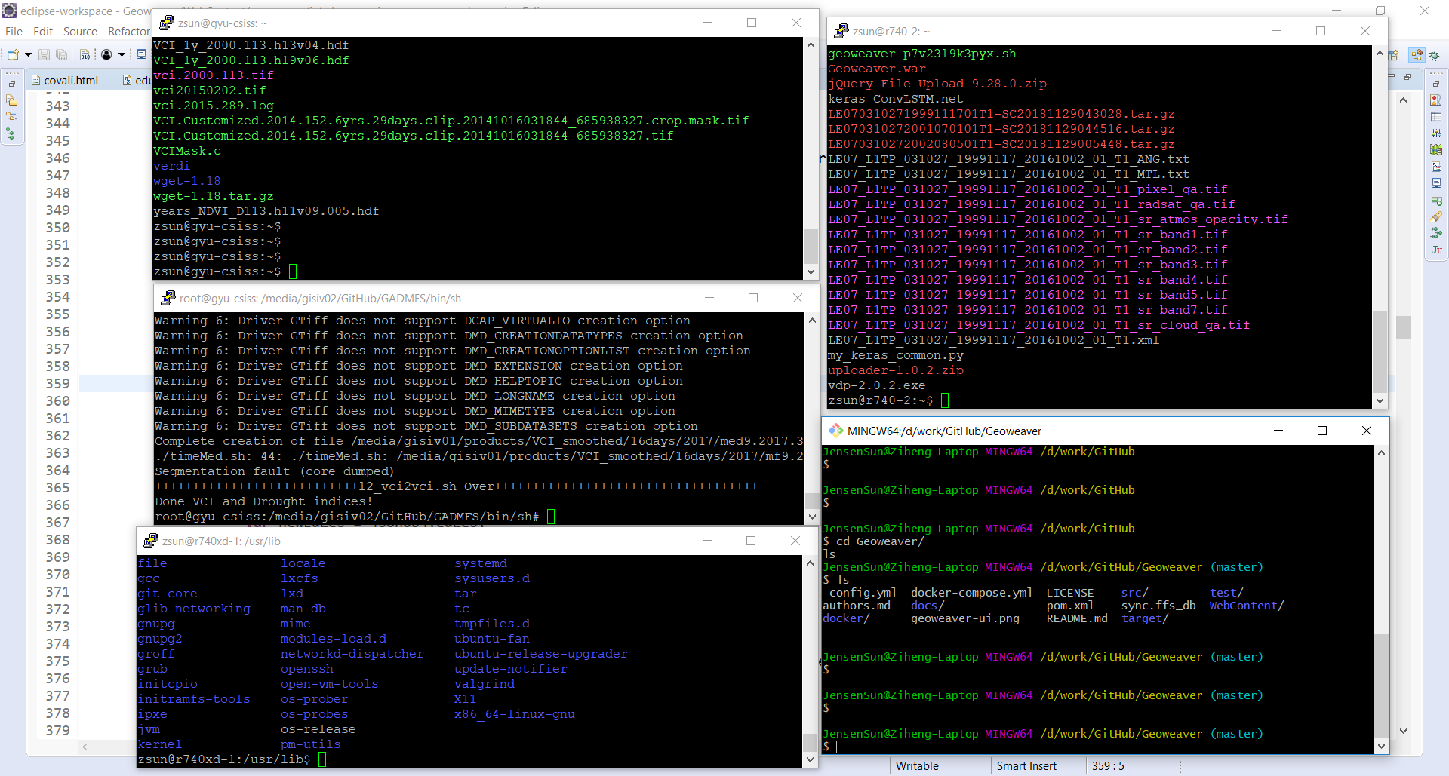
GeoWeaver for Meeting Scientist Needs
#2 Reusing legacy programs, latest libraries, tools

Slide 20
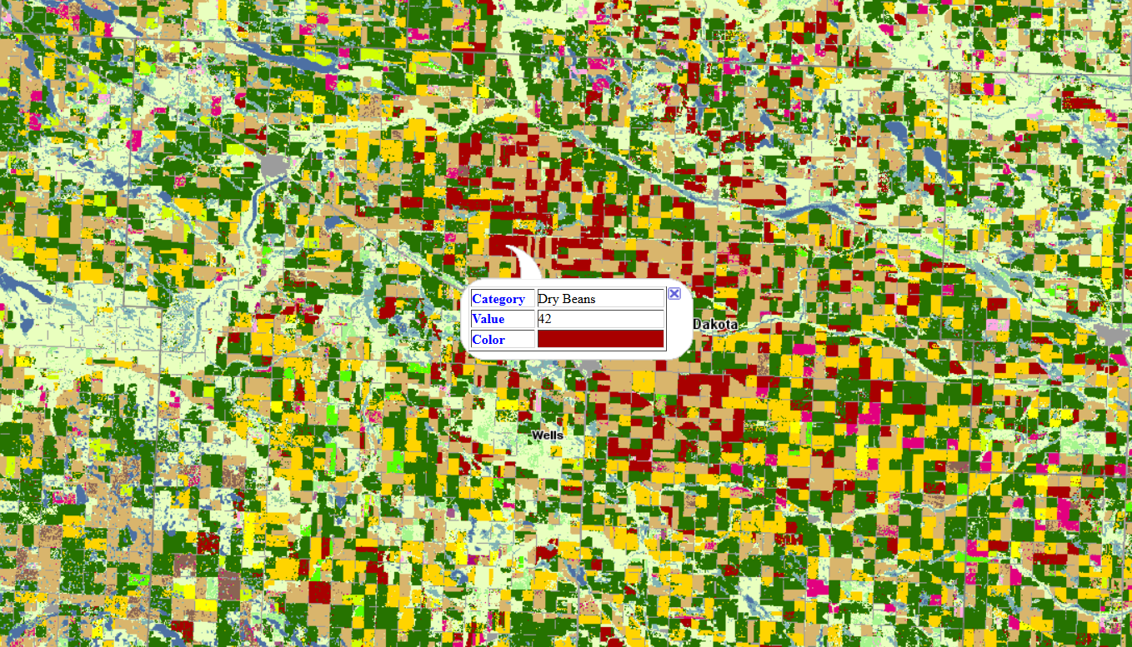
GeoWeaver for Meeting Scientist Needs
#3 Automate AI production workflows

Slide 21
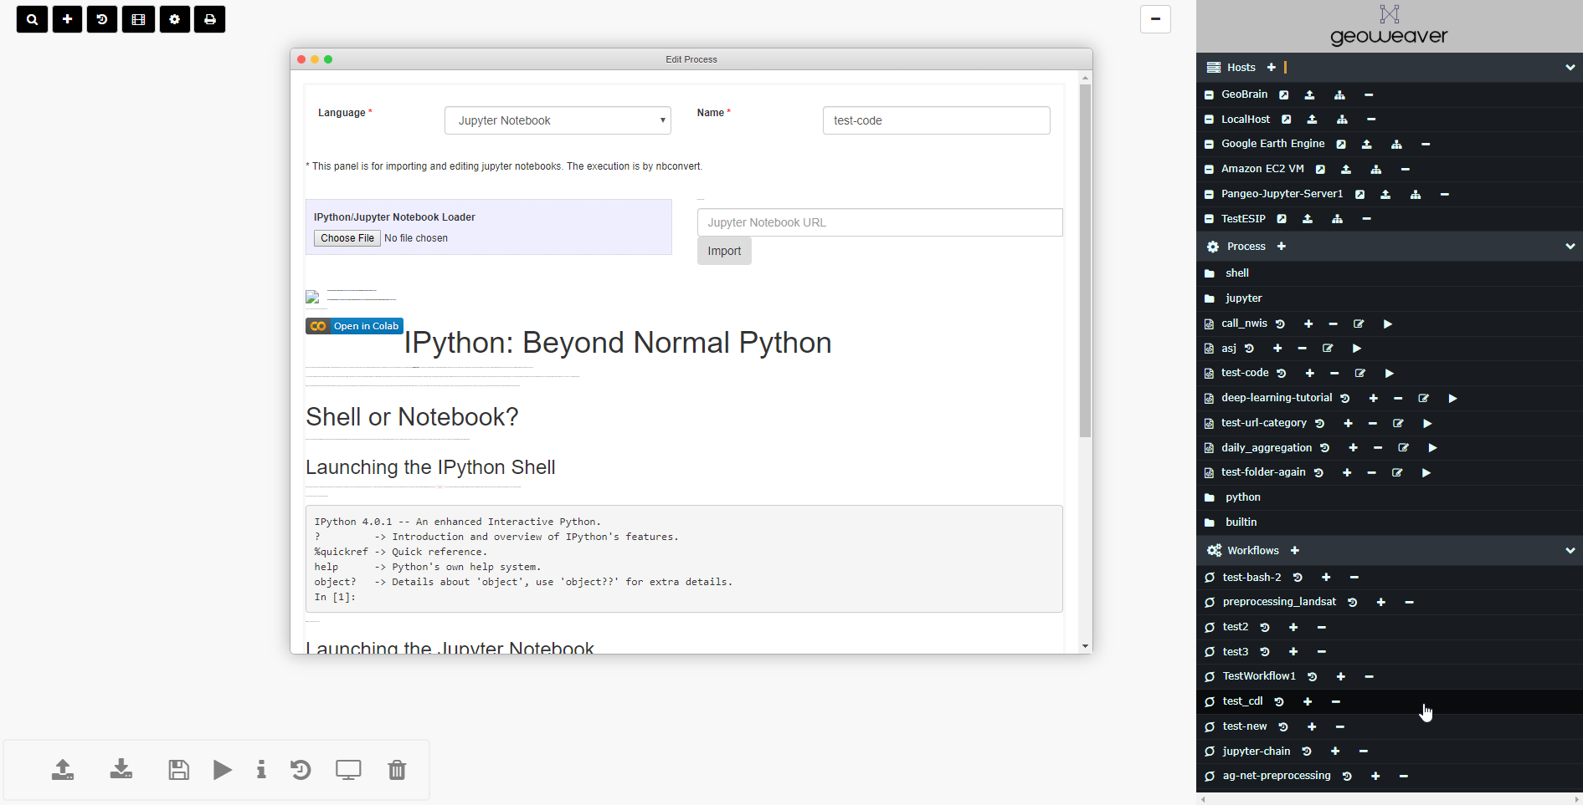
GeoWeaver Benefits
Style Compatibility – Mac Style Windows

Slide 22
GeoWeaver - Benefits
Save money
Reuse existing facilities (servers, laptops, desktops, super computers, etc)
Save migrating some data to cloud/third-party storage
Save time on tuning hyperparameters

Slide 23
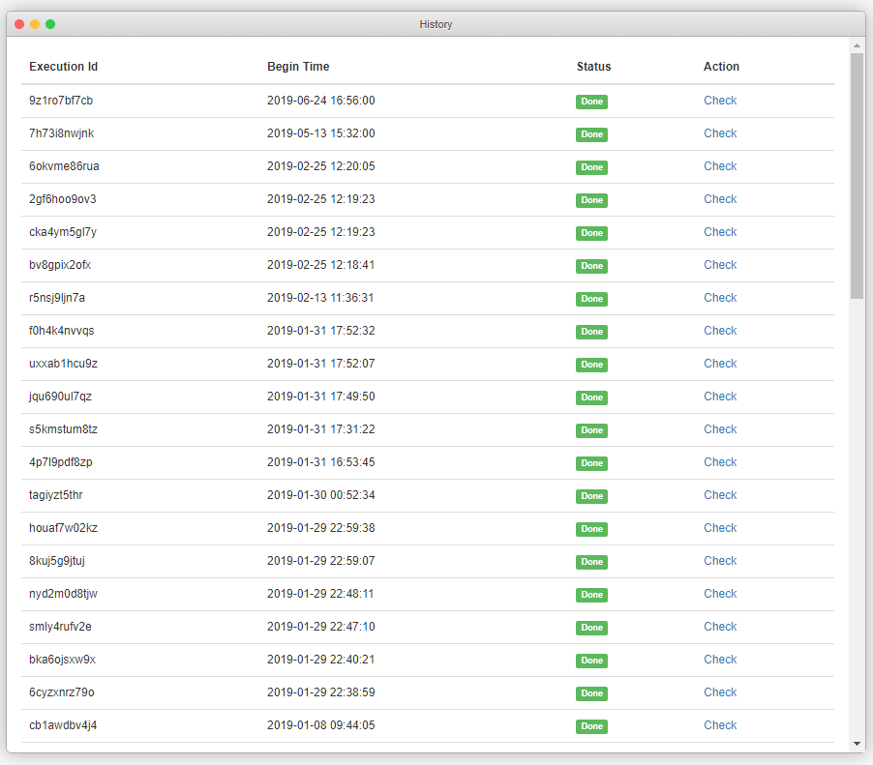
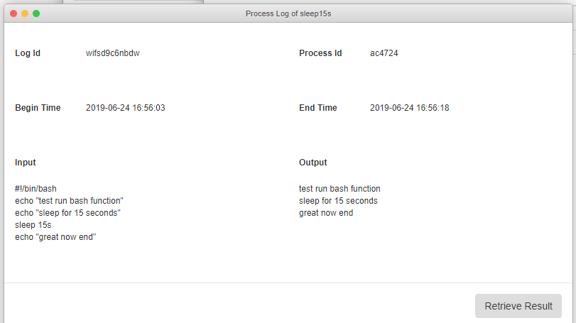
GeoWeaver - Benefits
Reproducible Workflow
native provenance mechanism

Slide 24
Vision of GeoWeaver-managed AI
Efficient AI Engineering
Lower Workload on both Personnel and Machines
Sharable Knowledge and Reproducible Pipelines of AI

Slide 25
Support
ESIP Lab
NSF EarthCube CyberConnector
https://github.com/CSISS/cc
SGCI (Science Gateway Community Institute) Focus Week
Gateways 2020 will be October 19–21 in Bethesda, Maryland
PEARC20 will be July 26-30 in Portland, OR
Next Focus Week June 1-5 at Columbia University in New York, NY
SGCI Consulting Services: Marketing, Developing
AGU

Slide 26
Conclusion
GeoWeaver
A promising, user-friendly, one-stop WfMS for AI workflows in new decade
Links
https://esip.figshare.com/articles/Geoweaver_a_web-based_prototype_system_for_managing_compound_geospatial_workflows_of_large-scale_distributed_deep_networks/7629491
https://www.esipfed.org/lab/geoweaver
https://www.zdnet.com/article/how-scientists-are-using-machine-learning-to-study-the-planet/
https://esip.figshare.com/articles/Some_Basics_of_Deep_Learning_in_Agriculture/7631615/1

Slide 27
Thank You!!!

