Slide 1
ESIPLab Geoweaver Project
Ziheng Sun, Liping Di, Annie Burgess
George Mason University, ESIP
ESIP Winter, Bethesda, MD
1/8/2020

Slide 2
Background Context
Complexity of scientific workflows
Multiple platforms
Multiple servers
Multiple operating systems
Multiple libraries
Multiple software
Multiple versions
Multiple programming languages
Multiple datasets
Multiple formats
Multiple team members
… …
None of the existing workflow systems can satisfy the needs
Existing WfMS
ArcGIS Model Builder
Apache Taverna
Kepler
Cylc
Galaxy
Pegasus-WMS
Apache Airflow

Slide 3
What is GeoWeaver?
GeoWeaver is a ESIPLab-funded web-based scientific workflow management system.
It integrates all the essential capabilities of composing, executing, managing, and disseminating AI workflows on distributed platforms.
Work on local machines!!
Open source Github project, MIT license
https://esipfed.github.io/Geoweaver/

Slide 4
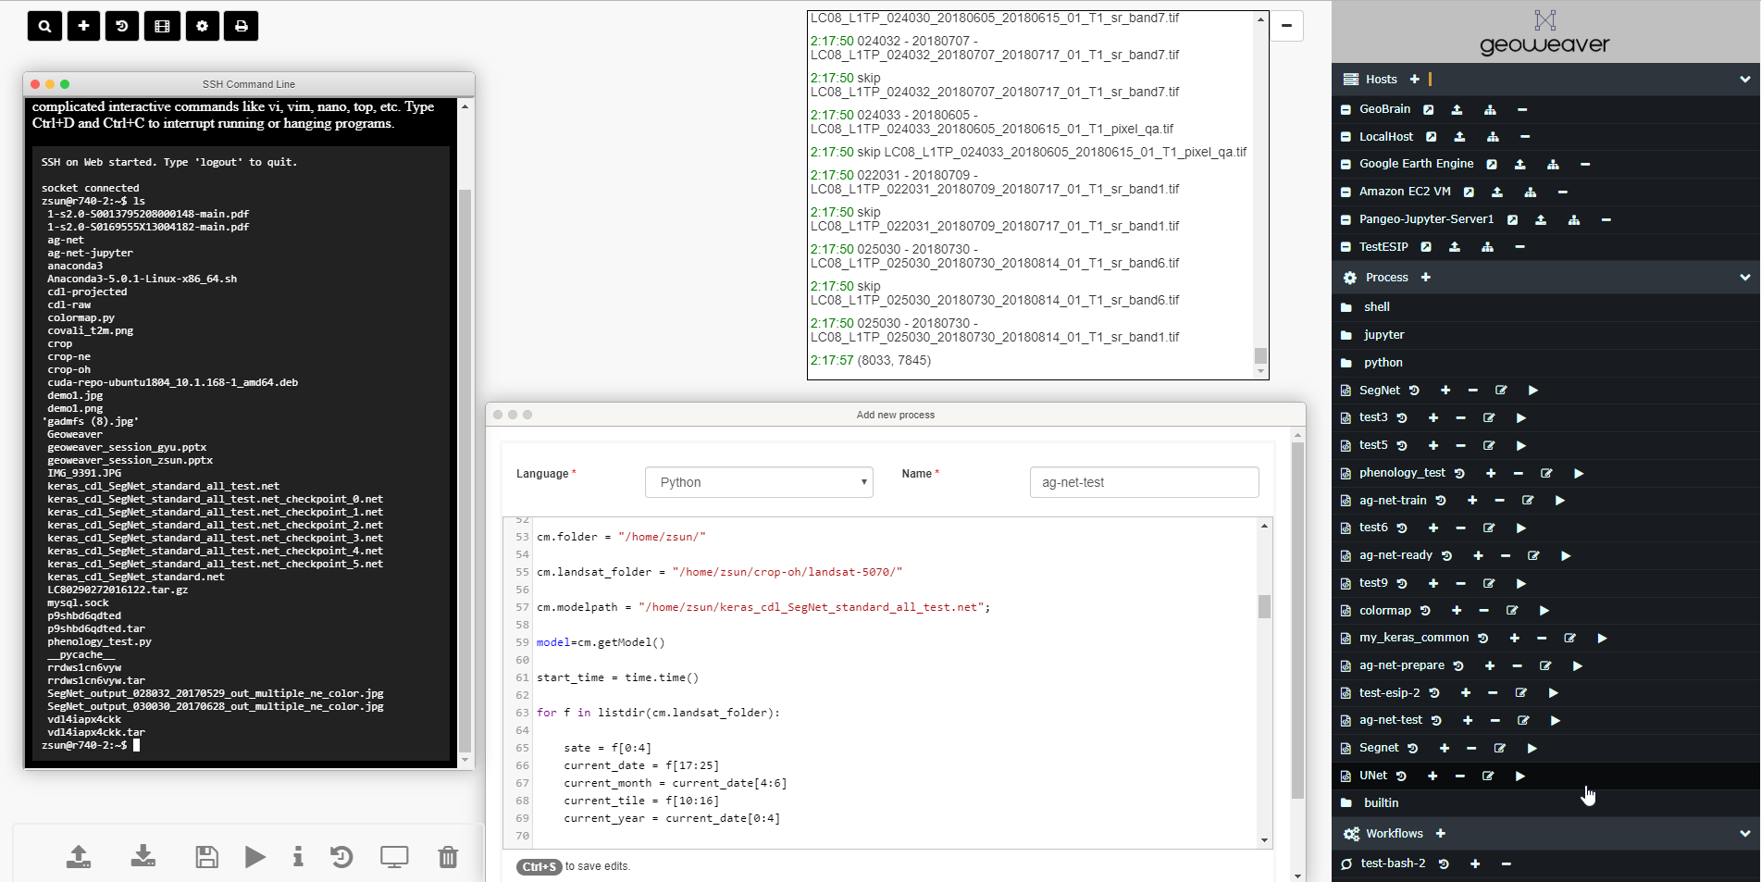

Slide 5
Why we build GeoWeaver?
(1) turning large-scale distributed AI pipelines into manageable modernized workflows;
(2) boosting higher utilization ratio of the existing cyberinfrastructures by separating scientists from tedious technical details;
(3) enhancing the efficiency of AI model life cycles;
(4) enabling the tracking of provenance by recording the execution logs in structured tables to evaluate the quality of the AI results;
(5) proof the effectiveness of operationally using large-scale distributed deep learning models in classifying Landsat image time series.

Slide 6
How does GeoWeaver work?
Operating Systems: Windows, Linux (Debian, Ubuntu), Mac
Step 1: clone the github repo
git clone https://github.com/ESIPFed/Geoweaver.git
Step 2: enter the folder and start the install
cd Geoweaver
chmod 755 install-linux.sh
./install-linux.sh
Once the script stops, the Geoweaver should already be up and running. Enter URL in browser to open it.
http://127.0.0.1:8080/Geoweaver/web/geoweaver

Slide 7
GeoWeaver - Demo

Slide 8
Benefits
Geoweaver will:
automate pre-/post- processing of deep learning
enable large dataset processing for small groups
enhance the reproducibility and replicability of deep learning workflows
Features:
Hybrid workflow
Full accessibility of files
Hidden data flow
Code-machine separation
Process-oriented provenance

Slide 9
Recent Progress
Jupyter Notebook
Pangeo
Workflow/Process Stop/Resume/Cancel
User Management

Slide 10
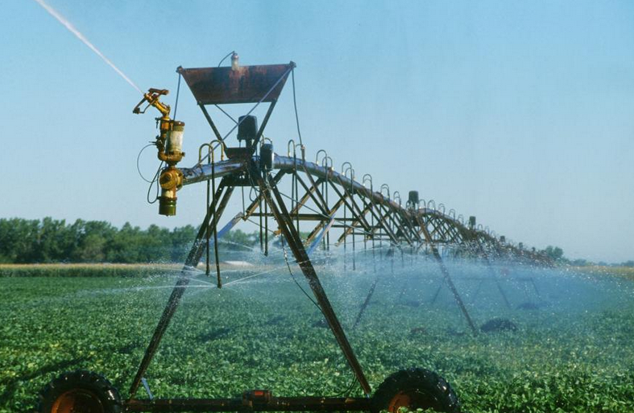
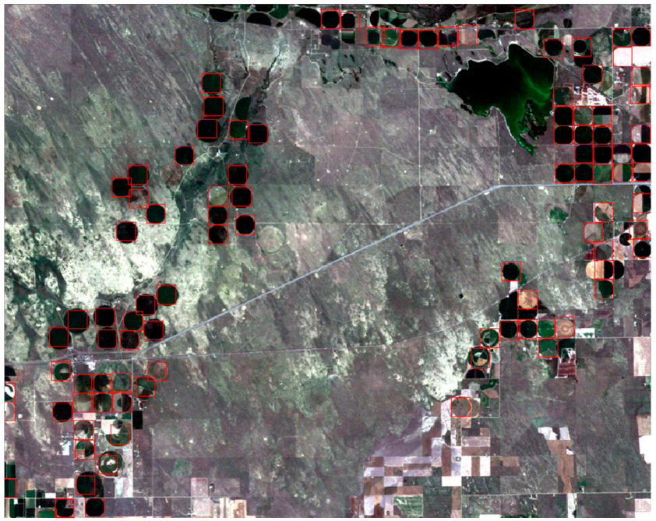
Use Cases
Notes:
https://cropwatch.unl.edu/styles/hero/public/images/hero/2018/center-pivot-irrigation.jpg?itok=hrVg0RW1

Slide 11
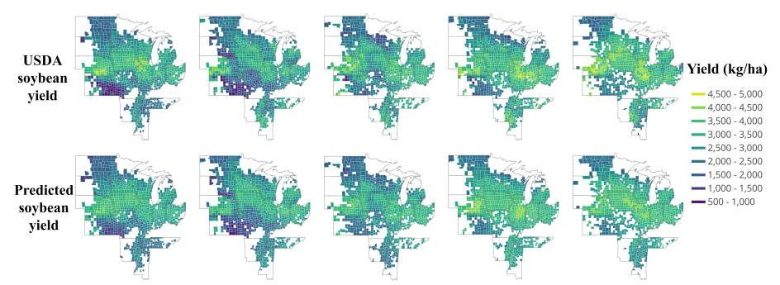
Use Cases
Notes:
https://www.mdpi.com/1424-8220/19/20/4363

Slide 12
Use Case
Notes:
https://gis.csiss.gmu.edu/GADMFS

Slide 13
Future Work
Google Earth Engine/Google Colab
Amazon ML
Apache Spark ML
Apache Spark/Hadoop
Clustering Platform (Supercomputer)

Slide 14
Resources and Support
ESIP Lab
NSF EarthCube CyberConnector
https://github.com/CSISS/cc
SGCI (Science Gateway Community Institute) Focus Week
Gateways 2020 will be October 19–21 in Bethesda, Maryland
PEARC20 will be July 26-30 in Portland, OR
Next Focus Week June 1-5 at Columbia University in New York, NY
SGCI Consulting Services
AGU

Slide 15
Thank You!!!

