Slide 1
Co-create: life’s professional challenges
Day 1

Slide 2
Program Day 1
Introduction
Teambuilding
Mindfulness
Break
Team forming
Decide on a group and think of a group name!
Introduction to the theme
Day 1 evaluation

Slide 3
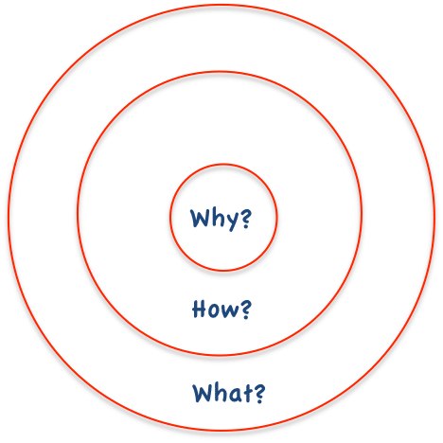
Introduction
Organisation
Michèle Gerbrands
Rutger-Jan Scholtens
Farah Kools
Dimitra Mousa
Heleen van Ravenswaaij
Contact anyone of us with questions etc.!
Team solution to clients problem
Entrepreneurial techniques
Presenting
Reflection
Notes:
Why?
Gap between what is offered at the university which is mostly content and what is expected from students which are also skills.
How?
Different educational method by working with a challenge in teams and also focus on the individual growth.
What?
Reflected in the learning objectives
Develop and report in a team on (a design of a) product that satisfies the requirements of the client regarding the posed problem
Select and use different entrepreneurial techniques
Present to an audience
Reflect on skills and growth during the course

Slide 4
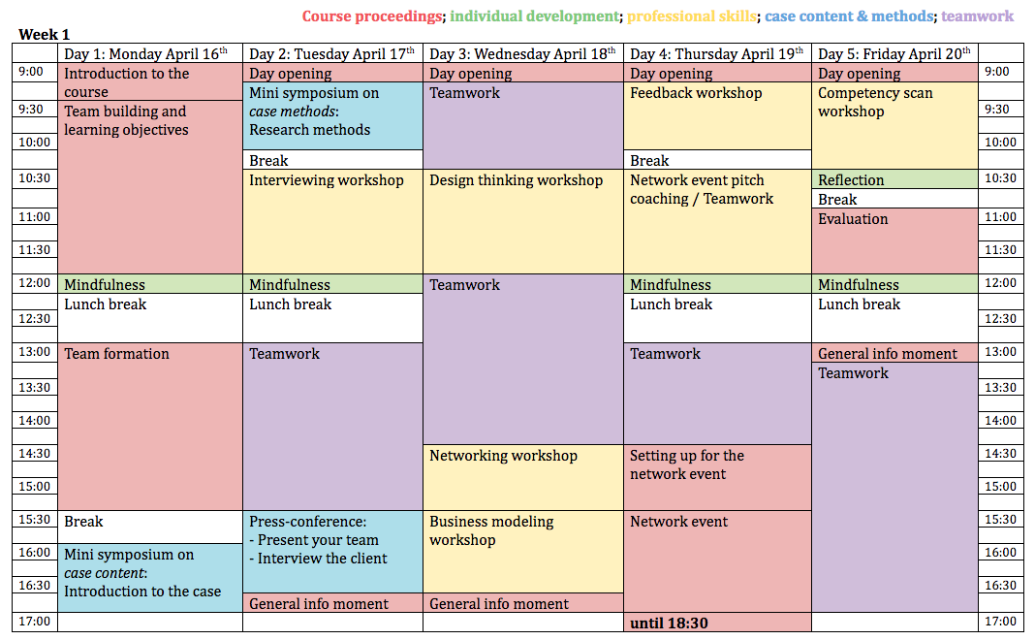
Schedule

Slide 5
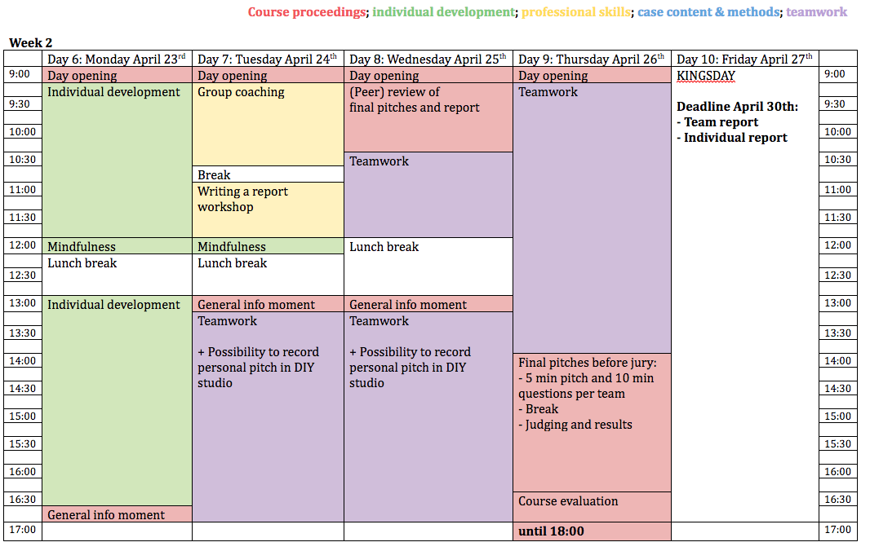
Schedule

Slide 6
Assignments
Team (80%)
Solution: Report + pitch
Contribution: Self + peer
Individual track (20%)
Personal presentation
Growth document
Learning goals
Notes:
Attendance

Slide 7
Digital environment
Link in mail
Interactive wall
Information: links to google drive
Notes:
https://span.nureva.com/9/app/#/canvas/b6a2ee94-e6f2-4ffc-94e2-965e85ddcb5b

Slide 8
Research
Interdisciplinary collaboration and reflection skills in higher education
Pre- and post-questionnaire
Evaluation
Observations
Form: do you agree with using this data (anonymous) for scientific research purposes?

Slide 9
Teambuilding
Rutger-Jan Scholtens
As a Group

Slide 10
Healthy Urban Living
Tamara Rosenbach
‘I love asking good questions and challenging people to expand what they think they know and how they perceive the world.’

