Slide 1
The human vaginal microbiome
and the role of bacterial glycogen metabolism
Rosanne Y. Hertzberger, PhD
VU University Amsterdam
www.REBLAB.org
FigShare.com

Slide 2
BSc &MSc
PhD
Postdoc
Newspaper:
NRC Handelsblad & nrc.next
De Correspondent
books

Slide 3
Part I: Introduction to the vaginal microbiome
Overview from literature

Slide 4
Vagina has lowest bacterial diversity (alpha) of all body sites tested
(Adjusted from)
Human Microbiome consortium
C Huttenhower et al. Nature 486, 207-214 (2012) doi:10.1038/nature11234
The vaginal microbiota has the lowest taxonomic diversity of all niches studied (genus level)
Within one sample
Between samples
Most reproductive age women have one dominant bacterial species.

Slide 5
The human vaginal microbiota: most reproductive age women colonized by Lactobacillus sp.
Ravel et al. PNAS 2011;108
‘Everything is everywhere, but the environment selects’
Baas Becking (1934)
How does the vagina select its lactobacilli?
or
How do lactobacilli tease out all the other species?
Notes:
Ravel et al. PNAS 2010
396 non-pregnant asymptomatic women, 16S pyroseq of V1-V2. 4 different ethnic groups, (100 each)
HMP concludes:
Of all the different body sites, the vaginal microbiota are the lowest in taxonomic diversity (OTU’s/phylotypes)
Within one individual
Between individuals
or
Lactobacillus sp. are most prevalent vaginal bacteria
and
they’re really bad at coexisting with other phylotypes.

Slide 6
Absence of vaginal Lactobacillus: Bacterial vaginosis (BV)
Nugent score = 0
Images from Nugent et al 1991, introducing diagnostic tool: Nugent score
microscopic enumeration of gram positive rods, gram negative, clue cells.
Nugent score = 10
Bacterial vaginosis (BV) → Often asymptomatic
Overgrowth of Gram-negative or variable anaerobic bacteria
Gardnerella, Atopobium, Prevotella, Sneathia, Megasphaera
Symptoms:
Odor, Thin vaginal secretions
pH > 4.5
Exfoliated epithelial cells (clue cells).
Lactobacillus-dominated microbiome
Gram positive rod shaped bacteria.
pH<4
High lactate concentration, up to 150 mM
(O’ Hanlon et al, 2013 PlosONE)

Slide 7
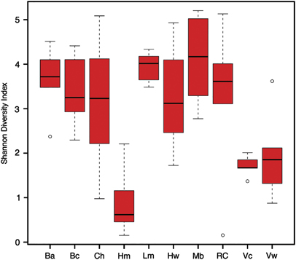
Lactobacillus dominance and low vaginal pH unique to humans sofar
Yildirim, S., et al. (2014). "Primate vaginal microbiomes exhibit species specificity without universal Lactobacillus dominance." The ISME journal 8(12): 2431-2444.
Other apes and monkeys have less diverse microbiota, with lower percentage of Lactobacillus.
Human vaginal pH ~ 3.5 (O’ Hanlon et al. 2013)
Vaginal pH of baboon between 6-8 (Riviera et al 2010)
chimps
humans
Lemur
Mangabey
Olive baboon
Red colobus
Vervets (wild)
Yellow baboon
Vervets (captive)
Black howler
Notes:
Shannon entropy quantifies the uncertainty in predicting the presence of species in an individual that is taken at random from the dataset.
This coincides with a higher vaginale pH for babboons
Some L. crispatus and other lactobacilli

Slide 8
Ethnicity plays a role in vaginal microbial composition.
HELIUS study:
~100 women of major ethnic groups in Amsterdam
BV 2 times more prevalent in communities with African background compared to Dutch background.
Genetics?
Intravaginal practices a confounder?
Borgdorff H, van der Veer C, van Houdt R, Alberts CJ, de Vries HJ, et al. (2017) The association between ethnicity and vaginal microbiota composition in Amsterdam, the Netherlands. PLOS ONE 12(7): e0181135.

Slide 9
Lactobacillus crispatus associated with lower risk of HIV-infection.
“We observed no differences between bacterial communities and demographic factors, condom use, frequency or type of sexual acts, or number of sexual partners.”
Polybacterial
Gardnerella vaginalis metabolizes tenofovir (antiretroviral drug) Klatt, N. R., et al. (2017). "Vaginal bacteria modify HIV tenofovir microbicide efficacy in African women." Science 356(6341): 938-945.
Seropositive women 3,2x more likely to infect male partner in case of BV.
Cohen, C. R., et al. (2012). "Bacterial Vaginosis Associated with Increased Risk of Female-to-Male HIV-1 Transmission: A Prospective Cohort Analysis among African Couples." PLOS Medicine 9(6): e1001251.
G. vaginalis
L. iners
L. crispatus
Gosmann, C., et al. (2017). "Lactobacillus-Deficient Cervicovaginal Bacterial Communities Are Associated with Increased HIV Acquisition in Young South African Women." Immunity 46(1): 29-37.

Slide 10
Pro- and anti-inflammatory effects of vaginal bacteria
Atopobium and Gardnerella invoke innate immune response (IL-6 and IL-8) in cervicovaginal tissue culture.
Libby, E. K., et al. (2008). "Atopobium vaginae triggers an innate immune response in an in vitro model of bacterial vaginosis." Microbes and Infection 10(4): 439-446.
D- and L-lactic acid at low pH (protonated form) prevent production of inflammatory mediators (Il-6, IL-8, RANTES)
Hearps, A. C., et al. (2017). "Vaginal lactic acid elicits an anti-inflammatory response from human cervicovaginal epithelial cells and inhibits production of pro-inflammatory mediators associated with HIV acquisition." Mucosal immunology 10: 1480
“Activated mucosal CD4⁺ T cell numbers are elevated in women with high-risk bacteria”
Gosmann, C., et al. (2017). "Lactobacillus-Deficient Cervicovaginal Bacterial Communities Are Associated with Increased HIV Acquisition in Young South African Women." Immunity 46(1): 29-37.
Polybacterial
G. vaginalis
L. iners
L. crispatus

Slide 11
Women with Lactobacillus more likely to be HPV negative.
55%
38%
49%
37%
44%
58%
43%
54%
The vaginal microbiota, human papillomavirus and cervical dysplasia: a systematic review and network meta‐analysis. BJOG: An International Journal of Obstetrics & Gynaecology, Volume: 127, Issue: 2, Pages: 171-180
NB: common risk factors for both STD, HPV and BV: new and/or multiple sex partners, unprotected intercourse.
Difficult confounder to correct!

Slide 12
Lactobacillus crispatus (and iners?) associated with healthier pregnancies
BV during pregnancy →higher risk of
preterm labor
preterm rupture of membranes (PPROM).
chorioamnionitis
Group B Streptococcus colonization
Labour and inflammation: some of the same mediators.
Preterm birth complications are the leading cause of death among children under 5 years of age, responsible for approximately 1 million deaths in 2015 (source: WHO)
Brown, R. G., et al. (2018). "Establishment of vaginal microbiota composition in early pregnancy and its association with subsequent preterm prelabour rupture of the fetal membranes." Translational Research.

Slide 13
Women with BV lower chances of pregnancy during fertility treatment
Unfavorable profile for IVF or IVF-ICSI:
Using alternative microbiome profiling technique (IS-PRO)
relative Lactobacillus-load <35%
presence of G. vaginalis IST1
Proteobacteria >28%
of total bacterial load.
The vaginal microbiome as a predictor for outcome of in vitro fertilization with or without intracytoplasmic sperm injection: a prospective study (Koedooder et al. 2019)
Company ArtPRED
Unanswered question: How to move women to “favorable profile”?

Slide 14
In general: vaginal microbiome important for sexual and reproductive health
Lactobacillus dominance and low pH in reproductive-age women is unique for humans (as far as we know)
Vaginal microbiome associated in many health issues:
In sexually transmitted disease (HIV)
Cancer-associated infections (HPV)
Infections during pregnancy
Assisted reproductive technique (IVF)
Rethinking the role of bacteria in health&disease:
In vaginal microbiome it is harder to pinpoint the ‘bad guys’ than the ‘good guys’.
Can you think of a bacterial species that is more associated with human health than Lactobacillus crispatus?
Mechanisms at play:
Hormones
Inflammation / immunology
Host genetics and physiology
Hygiene culture, sexual practices and partners
Metabolism?

Slide 15
Part II: vaginal glycogen metabolism
Own experiments, findings, hypotheses

Slide 16
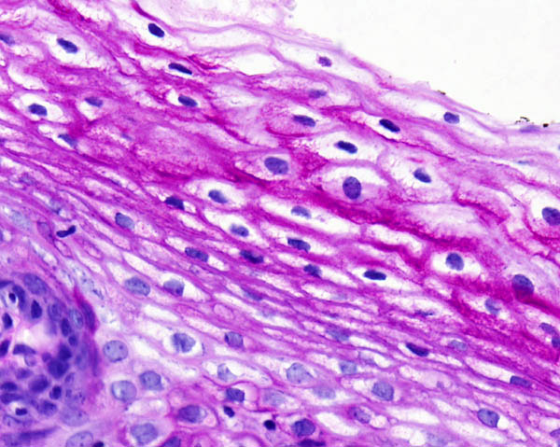
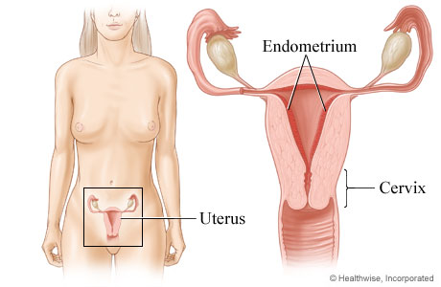
Vaginal epithelium of reproductive age women is rich in glycogen
Human cervicovaginal mucosa: non-keratinized stratified squamous epithelium.
Periodic acid Schiff’s stain (PAS)
Exocervix (PAS)
Corbis images
Histology for Pathologists
Mills S. E. Sternberg S.
Glycogen is also present in the vaginal lumen: free glycogen can be detected on vaginal swabs.
Accumulation is influenced by progesterone → only high during reproductive years
Direct hormone for glycogen synthesis in endometrial epithelial cells in tissue culture is insulin. (Flannery et al. 2018)
Possibly additional stores of glycogen in the endometrium→ only high during secretory phase of the menstrual cycle: bacteria (or enzymes) need passage through cervix
Research question: does vaginal glycogen function as an energy/carbon source for colonization and acidification of vaginal bacteria?
Notes:
Stratified squamous epithelium

Slide 17
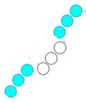
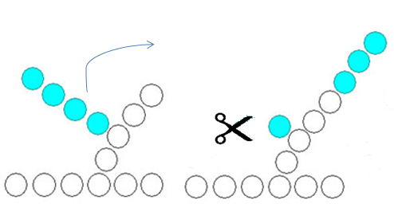
Glycogen: long, branched storage polymers of glucose.
Glycogenin in the center
α1-6
α1-4
α-amylase
pullulanase
Glycogen debranching enzyme
Gluco-amylase
For external glycogen degradation, these enzymes need to be extracellular,
either cell-bound or secreted.

Slide 18
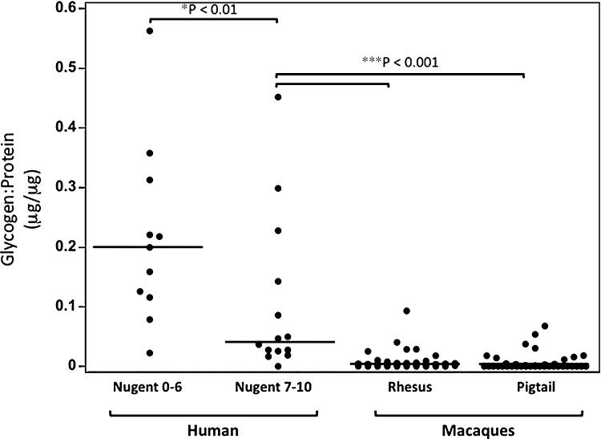
Vaginal glycogen levels associated with Lactobacillus levels.
#57
#25
#34
Mirmonsef, P., et al. (2012). "A comparison of lower genital tract glycogen and lactic acid levels in women and macaques: implications for HIV and SIV susceptibility." AIDS Research and Human Retroviruses 28(1): 76-81.

Slide 19
Vaginal glycogen levels associated with Lactobacillus levels.
Lower in:
Macaques
postmenopausal women & prepubescent girls
women with BV
Low Lactobacillus
Low Lactobacillus
Low Lactobacillus
Common assumption in the field:
Vaginal lactobacilli use glycogen to produce lactic acid and to acidify the vagina
But
Lactobacilli cannot directly metabolize glycogen (jensenii, gasseri, johnsonii) → does the hostess contribute by secreting amylase?
Spear, G. T., et al. (2014). "Human alpha-amylase present in lower-genital-tract mucosal fluid processes glycogen to support vaginal colonization by Lactobacillus." The Journal of infectious diseases 210(7): 1019-1028.
“The fly in the ointment”
Nunn, K. L. and L. J. Forney (2016). "Unraveling the Dynamics of the Human Vaginal Microbiome." The Yale journal of biology and medicine 89(3): 331-337.
Notes:
And you find very similar language in may other reviews and introductions to research papers in the field. However, besides these correlations between Lactobacillus levels and glycogen, there is not actually a lot of data to support this claim.
Now in our lab we are very interested in the glycobiology of the female reproductive tract. And the role of secreted enzymes by vaginal bacteria. We study bacterial breakdown of other host glycans such as hyaluronan and sialidase. So we are pretty interested in this theory of bacterial metabolism of vaginal glycogen. And whether bacteria

Slide 20
Can vaginal bacteria autonomously utilize glycogen as a carbon/energy source?
Representative of 3 jensenii strains
Similar results for L. gasseri strains
Basic growth experiments using NYCIII and anaerobic growth conditions:
water
Not representative!
- ctrl
+ ctrl
Together with Warren Lewis

Slide 21
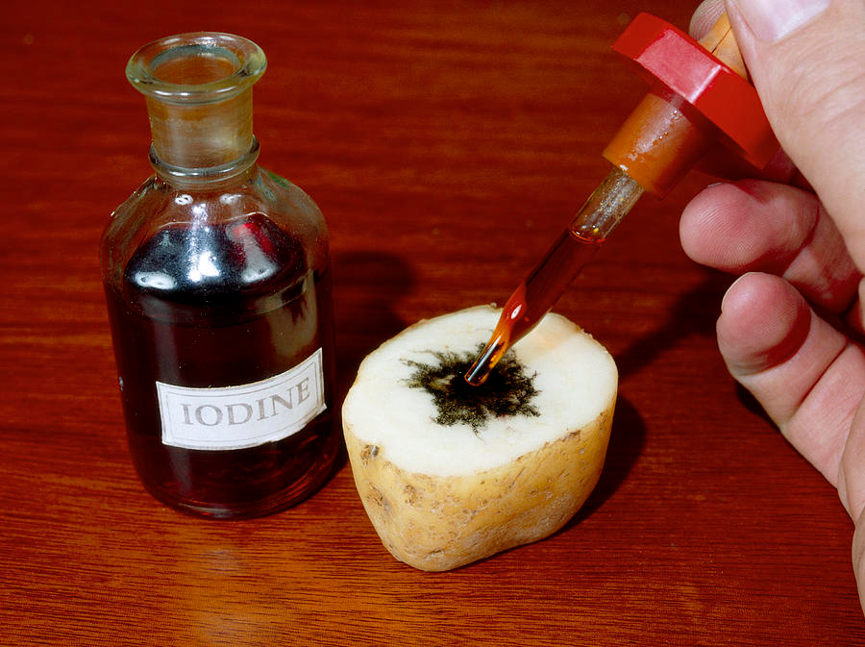
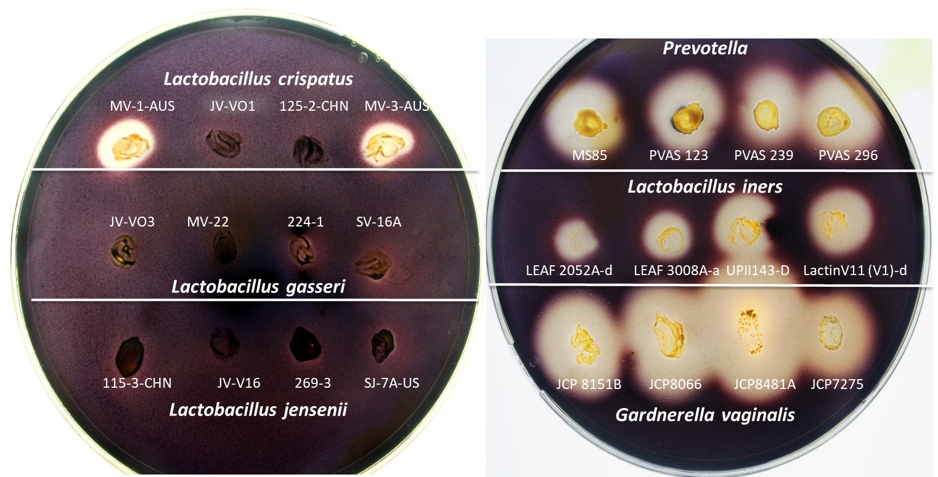
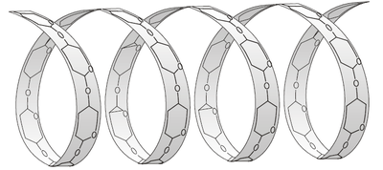
Glycogen: long, branched storage polymers of glucose.
Glycogenin in the center
α1-6
α1-4
Starch: long, branched storage polymers of glucose.
Pectin in the center
+amylose (α1-4 linkages)
α1-6
α1-4
Mega/starch-plates + iodine, visualizing starch clearance zones

Slide 22
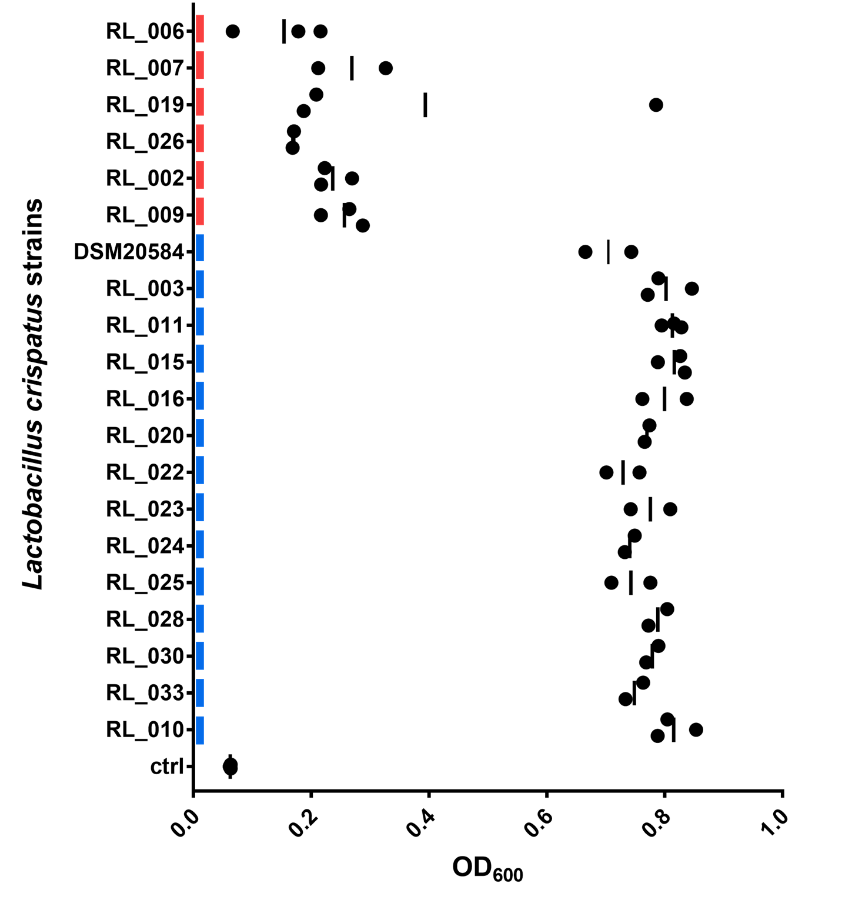
How do vaginal lactobacilli utilize glycogen?
What is the origin and nature of Lactobacillus crispatus glycogen metabolism?
Prof. Remco Kort (VU University): ~20 strains of L. crispatus strains isolated from women with and without BV at Public Health Service Amsterdam (GGD).

Slide 23
Gene absent in L. crispatus
(present in G. vaginalis)
Gluco-amylase
α-amylase
Type 1 pullulanase gene with similarities to:
-GDE of E. coli (AmyX)
-Type 1 pullulanase
L. acidophilus
Glycogen debranching enzyme (GDE)
pullulanase
Variations in N-terminal signal peptide correspond with ability to grow on glycogen.
Finding: growth of L. crispatus dependent on its type 1 pullulanase variant.

Slide 24
Representative of 4 strains tested
Mega/starch-plates + iodine, visualizing starch clearance zones
Conclusion: Many Lactobacillus isolates can use glycogen for growth (and acidification).
But don’t forget BV bacteria, such as Gardnerella!
Representative of 3 strains tested
Overgrowth during BV may explain depleted glycogen.
Together with Warren Lewis

Slide 25
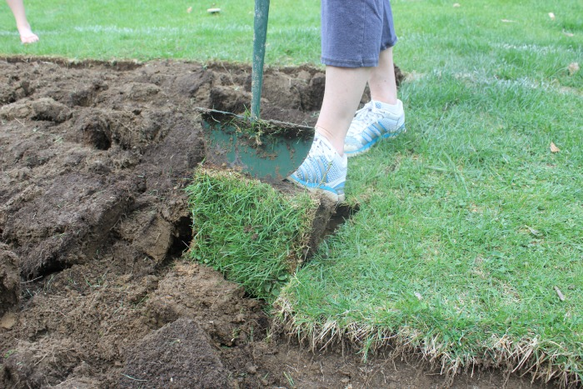
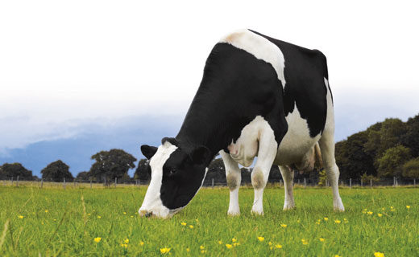
Hypothesis: lactobacilli utilize glycogen to acidify the vagina
BV bacteria?
lactobacilli
Human assistance?

Slide 26
Conclusion
How does Lactobacillus acidify the vagina?
Most Lactobacillus crispatus strains can break down vaginal glycogen. Ability to breakdown is associated with type 1 pullulanase gene variant.
Women with BV: Gardnerella vaginalis and Lactobacillus iners can autonomously utilize glycogen for growth.
Women with L. gasseri and L. jensenii?
Glycogen non-growers may benefit from other glycogen-consuming strains.
These findings may explain lower glycogen in BV-samples:
High levels of Gardnerella vaginalis (overgrowth) may deplete free glycogen.
Difference between glycogen degrading machinery?: amylase (Gardnerella vaginalis) vs type 1 pullulanase (Lactobacillus crispatus).
Speculation:
Link to lower pregnancy rates after embryo transfer in IVF treatment?

Slide 27
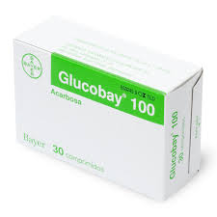
How to move women to “favorable profile”? Some new ideas
Prebiotics
Probiotics
Current standard treatment: metronidazol (local or systemic):
High recurrence!
Antibiotics
Hypothesis: Amylase inhibitors can selectively target glycogen-consuming bacteria in the vaginal community such as G. vaginalis by cutting off access to its preferred energy source.

Slide 28
Acknowledgements
VU
Prof. Remco Kort
Heleen Eising
Alexander Woudstra
Ritesh Panchoe
Deborah Jekel
Jorne Swanenburg
Joke Dols
GGD
Charlotte van der Veer
Sylvia Bruisten
Lewis Lab
Warren Lewis
Mandy Lewis
Wendy Lu
Nicole Gilbert
Lloyd Robinson
Cory Weimer
Valerie O’Brien
Courtney Amegashie
Maria Ruiz

Slide 29
The human vaginal microbiome
and the role of bacterial glycogen metabolism
Rosanne Y. Hertzberger, PhD
VU University Amsterdam
www.REBLAB.org
FigShare.com

Slide 30
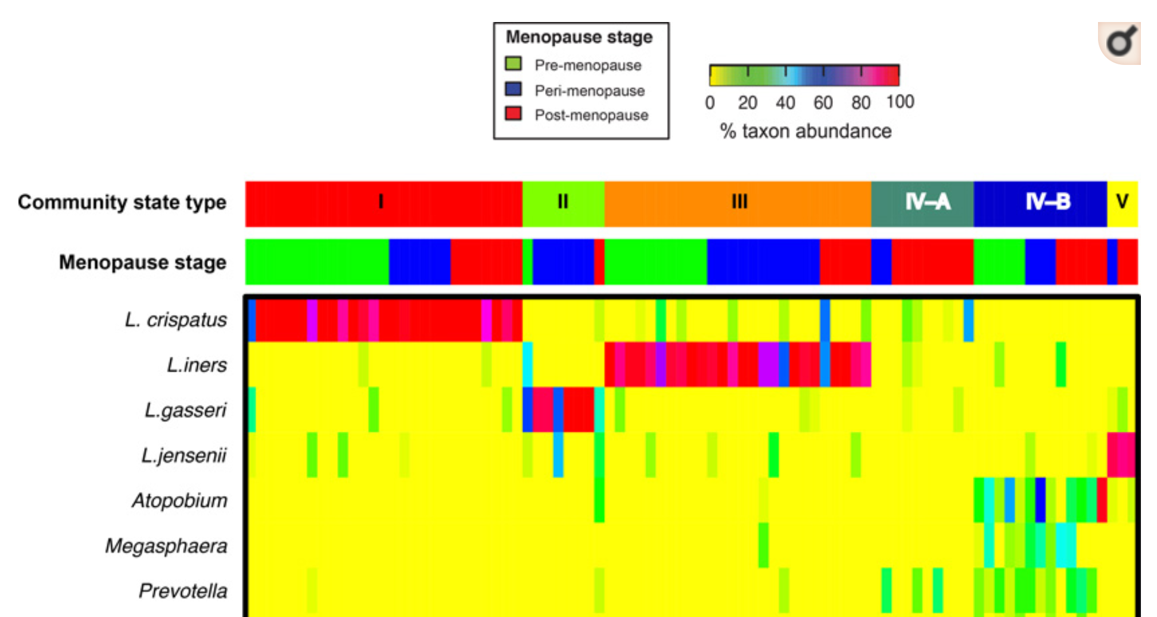
Estrogen/progesterone boost Lactobacillus colonization and vaginal glycogen
Lower Lactobacillus during menopause and prepuberty (more diverse communities).
Lower bacterial counts in general.
Brotman, R. M., et al. (2014). "Association between the vaginal microbiota, menopause status, and signs of vulvovaginal atrophy." Menopause (New York, N.Y.) 21(5): 450-458.

