Slide 1
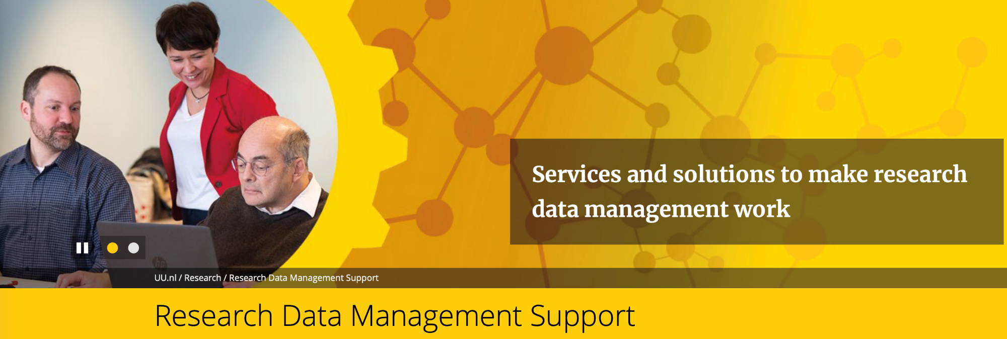
Research Data Management
Conflict Studies and Human Rights
RDM Support – Felix Weijdema – Iris van der Knaap

Slide 2
To find relevant evidence about Sino-Sudanese interactions, first pertinent documents were scouted, and interviews conducted to create a comprehensive data set. This data set contains sources with reports about individual Sino-Sudanese interactions (Figure 2: Step 1). Through coding, individual interactions were extracted from the documents and systematically organised to facilitate the detection of the underlying dynamics of interactions (Figure 2: Step 2). To carry this out, the qualitative data analysis tool NVivo was utilised because it proves to be especially advantageous for analysing large amounts of qualitative data (Altheide and Schneider 2013: 11, 95).
The data collection was conducted in line with …
Tenhaven, R. J. (2019). China’s Non-Intervention in Sudan and South Sudan: Finding Traces of Remote Warfare (Master's thesis).
https://dspace.library.uu.nl/handle/1874/384746

Slide 3
ask for interviews or talk about my research with people who could possibly form a security risk for me.
Before the start of every interview, I verbally guided the informed consent process by telling my interviewees:
- That I would store their data in a confidential and anonymous manner
- That I would use their data in a confidential and anonymous manner in the thesis
- That my participants were in no case obliged to answer questions they did not feel comfortable answering
- That my interviewees could always pause or stop the interview in case they wanted to do so
- That the duration of the interview would average 30-45 minutes
Then, I would ask them whether they gave me permission to record the interviews. In all cases my interviewees agreed. Afterwards, I would start the recorder and asked my interviewees in three separate questions to confirm my explanation of the aforementioned information by saying ‘yes’ [‘si’] aloud as a response to each question.
The personal history of the interviewee relating the …
Wekema, K. J. J. (2019). Confianza and trust building in protracted social conflict as essential parts of peacebuilding: The case of Estados Unidos, Colombia (Master's thesis).
https://dspace.library.uu.nl/handle/1874/384464

Slide 4
This thesis will aim to answer the research question by analysing (1) the Facebook pages of both sides of the campaign, Leave and Remain, and (2) a pro-EU media outlet Facebook page, The Guardian. By analysing Leavers’ activity on a Leave campaign page …
RESEARCH METHOD
Netvizz
To collect the data, I used a Facebook application (app) called Netvizz, which is a ‘a data collection and extraction application that allows researchers to export data in standard file formats from different sections of the Facebook social networking service’.72 The app is free and can be accessed through Facebook, having been in development for the last ten years.73 When using Netvizz, it immediately notes that the application has not passed Facebook’s app review for the ‘Page Public Content Access’, and as such, may stop working. The creator of Netvizz, Bernhard Rieder, explained that this happened because of the stricter terms for Facebook apps, which occurred after the Cambridge Analytica scandal, and thus made independent research a lot harder.74 Rieder explains more about the app and how it is used in his academic paper Studying Facebook via Data Extraction: The Netvizz Application.75
Richter, H. L. S. (2019). A Disunited Kingdom? Brexit, Social Media And The Rise Of Polarisation Through Echo Chambers (Master's thesis).
https://dspace.library.uu.nl/handle/1874/384434

Slide 5
Abstract
This thesis is focused on the strategic use of legitimacy sources in establishing civilian compliance by an armed group. It zooms
…
compliance and governance by armed actors. Its focus on local developments provide a useful approach to avoiding reductionism and advocates for further research into these complex actors, contexts and issues.
Key words: legitimacy, civilian compliance, governance, armed actor, militia, legitimacy sources
2.3.4 Sampling
The sampling methods used in this study are purposive sampling and snowball sampling.
… access and set up meetings with the local and national government representatives and the civil society expert. They also organized and facilitated the two focus group discussions. Through my work at MERI, I got in touch with several NGO experts. I then used snowball sampling to reach out to other potential interviewees. Snowball sampling involves asking previous interviewees to introduce the researcher to potential new interviewees. It works along (personal or professional) networks and is especially applicable to populations who are difficult to reach (Lune & Berg, 2017:39). Through snowball sampling, I was introduced to the youth activists …
Hesselink, E. S. (2019). On Coercion and Persuasion: How militia group Hashd al-Shaabi made strategic use of legitimacy sources in establishing civilian compliance in Ninewa governorate, Iraq, in 2017 and 2018 (Master's thesis).
https://dspace.library.uu.nl/handle/1874/384142

Slide 6
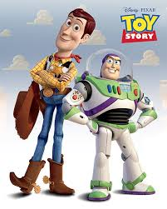
Why worry about research data management?
How Pixar’s Toy Story 2 was deleted twice, once by technology and again for its own good
Panzarino, M. (2012, May 21). How Toy Story 2 Got Deleted Twice, Once on Accident, Again on purpose. Retrieved December 16, 2019, from The Next Web website: https://thenextweb.com/media/2012/05/21/how-pixars-toy-story-2-was-deleted-twice-once-by-technology-and-again-for-its-own-good/
Source: How Toy Story 2 Almost Got Deleted: Stories From Pixar Animation: ENTV. (n.d.). Retrieved from https://www.youtube.com/watch?v=8dhp_20j0Ys

Slide 7
Today
Why is RDM important?
The quick start to RDM
Wrap-up
Notes:
To be adjusted depending on the final presentation

Slide 8
Why is Research Data Management needed?
Data is valuable
Data is fragile and easily lost.
Researchers need to be accountable for the data they produce – Research Integrity
GDPR
Notes:
Annemiek

Slide 9
Research Data Management
Internal and External Requirements
Open Science Program
UU Policy Framework

Slide 10
Research Data Management
Internal and External Requirements
“Publicly funded research data are a public good (…), which should be made openly available with as few restrictions as possible…”
“Quality-assured research data are key building blocks for the research process and should be available for reuse”

Slide 11
Research Data Management
FAIR Principles
By SangyaPundir - Own work, CC BY-SA
F
Findable
It should be possible for others to discover your data (metadata, Persistent Identifiers, etc.).
A
Accessible
It should be possible for humans and machines to gain an access to your data, under specific conditions or restrictions where appropriate.
I
Interoperable
Data and metadata should conform to recognized formats and standards to allow them to be combined and exchanged.
R
Reusable
Lots of documentation is needed to support data and interpretation and reuse.

Slide 12
Research Data Management
External Requirements
NWO
KNAW
ZonMW
H2020
Centered around FAIR?
Yes
Yes
Yes
Yes
DMP requested?
Within 4 months after funding
After funding
After funding
Within 6 months after project starts
DMP template available?
Yes
No
Yes
Yes
What data should be made available?
Relevant for reuse
All research data
All preliminary data & documentation
Needed for validation of publication
OA principles
OA to data, limited only when necessary
As much data open as possible, with the least possible limitations
OA to data
Limited only when necessary
As open as possible, as closed as necessary
Notes:
Not yet relevant, will be very very soon…

Slide 13
Good Research Data Management (RDM)
Ensures the integrity of research.
Allows others to validate and replicate findings.
Helps to meet funders as well as privacy and security requirements.
Supports future use.
Increases the impact of research.
Prevents errors & increases the quality of analyses.
Saves time & resources in the long run.
Notes:
Annemiek

Slide 14
Data Management Plan (DMP)
What does it cover?
Making data available
Data formats/type/size
FAIR data
Using existing data
Licences
Folder structure
Repositories
File naming convensions
Data package
Metadata and documentation
Data loss prevention
Version control
Personal data
Storage solutions
GDPR
Backups
Encryption, pseudonymization & anonymization

Slide 15
Research Data Management Support @UU
One point of contact
CONTACT US >
Notes:
RDM Support is one point of contact for a large network of expertise (general RDM issues, IT solutions, privacy and information security, legal and ethical issues).

Slide 16
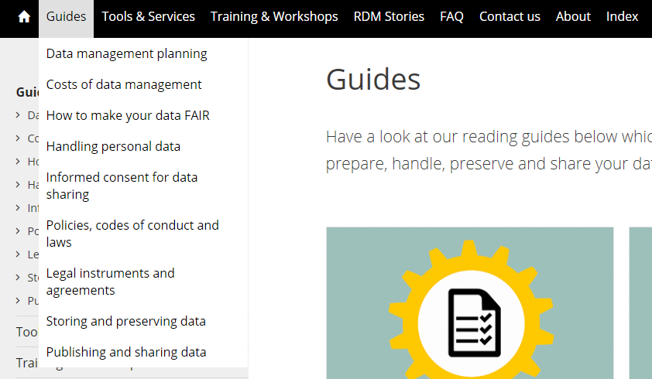
RDM Support online:
Notes:
RDM Support is one point of contact for a large network of expertise (general RDM issues, IT solutions, privacy and information security, legal and ethical issues).

Slide 17
Data Availability for Reuse
Data Collection
Data Selection & Preservation
Data Documentation
Data Security
Data Storage

Slide 18
Data Collection
Data
Preferred formats
Using existing data

Slide 19
What is your data?
https://dmponline.dcc.ac.uk

Slide 20
Data collection: Questions
What type of data?
Which formats?
How many files?
What size of files?
Origin of data?

Slide 21
Data collection: DMP table
Type | Description | Origin /collection | Formats | Software | Total file size | Number of files / samples
Social Media data | Extract from Facebook and Twitter | Web scraping SEP-DEC 2019 | .csv and .txt | Various applications | 400 Mb | 100+
Interviews | Oral interviews – recorded | Collected in the field | Mp3 | Various | 4 GB | 6 (1 per interview)
Lab results | Gene expression and antibody titers | Microarray data and ELISA data | .csv, .Rdata, .chp, .txt | Affymetrix, locally developed tool | 200 Gb | 20 data output files
Bodyweight | Biweekly bodyweight | Stable workers | .csv | NA | Kb’s | 1 output datafile
Statistical analyses | Scripts/codes and output tables and figures | Researcher | .R, .SAS, .csv, .tiff | R, Rstudio, SAS, Excel | 1-50Mb | 5 scripts, 5 table files, 5 figure files
Notes:
Add more relevant example

Slide 22
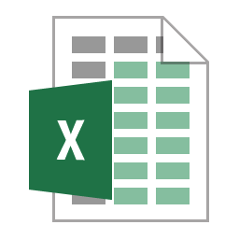
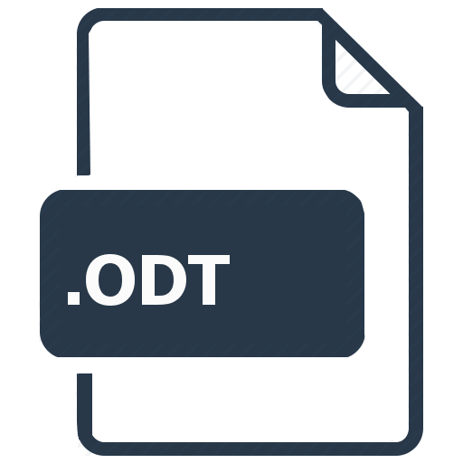
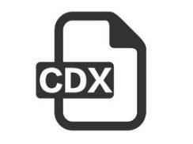
Data formats

Slide 23
Preferred formats
Preferred formats offer the best long term guarantees in terms of usability, accessibility and sustainability.
Preferred Formats Characteristics:
Non-proprietary
Unencrypted
Uncompressed
Commonly used
Interoperable
Open source
Text
Quantitative data
Images
Audio
Video
https://dans.knaw.nl/en/deposit/information-about-depositing-data/before-depositing/file-formats

Slide 24
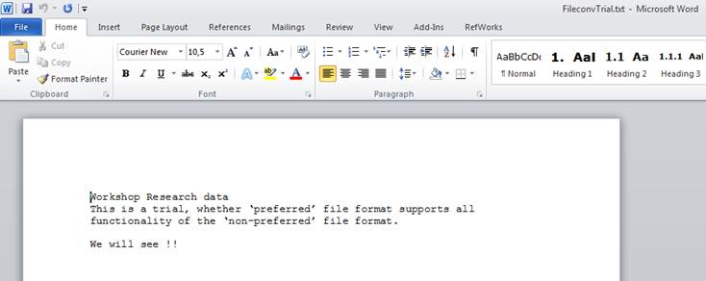
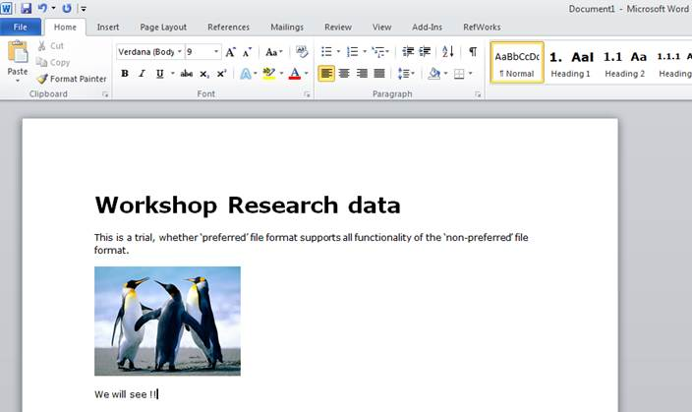
Preferred formats
.txt
.docx
Not all functionality is preserved in a preferred file format!
Preferred is not always 100% compatible
.odt

Slide 25
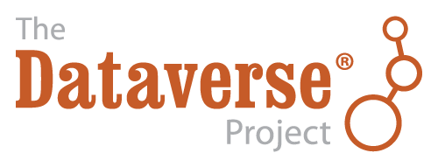
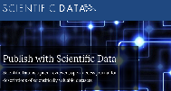
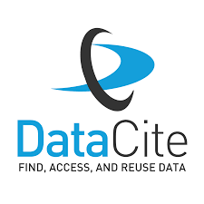
Using existing data
Where to find them?
In large scale collected data in databases
In research data repositories
(institutional, generic, discipline specific)
Data Journals
As tables and figures in research articles
As supplementary files with research articles
As links in websites (personal, institutional, laboratory)
Directly contact colleagues with interesting datasets
YODA
See also: https://www.uu.nl/en/research/research-data-management/tools-services/finding-existing-data
Notes:
Lena: Depending on the time, it might be a good exercise to let the students search through re3data for something related to their topic of interest.
Exercise, have some relevant dataset to show. And add how to cite the data used.

Slide 26
Data Documentation
Folder Structure & File naming conventions
Version Control
Metadata & documentation

Slide 28
Data documentation
REMEMBER
Your filenames and folder structure has to make sense:
to you
to you - after a holiday
to you after graduation
Your research data will be ‘shared’ and used by:
Colleagues within a project
Project leaders / supervisors when contract ends
Etc.

Slide 29
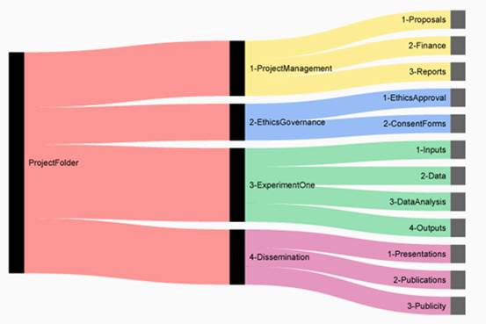
Folder structure
Example folder structure
From: ‘Setting up an Organised Folder Structure for Research Projects’ Posted June 4, 2014 Blog by Nikola Vukovic

Slide 30
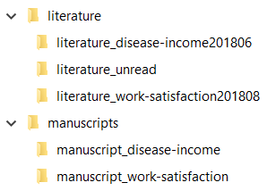
Folder structure

Slide 31
Folder structure advise
Determine in advance what your folder structure should be
Make is logical
From time to time, ‘check the logic’
If you work in a team, describe your structure and files in a ReadMe file
File Renaming Tools
Bulk Rename Utility (for Windows)
Renamer (for MacOS)
PSRenamer (for MacOS, Windows, Unix, Linux)
WildRename (for Windows)

Slide 32
File Naming Do’s
When constructing a file name, consider using one or more of the following:
Project or experiment name or acronym
Location/spatial coordinates
Researcher name/initials
Date or date range of experiment
Type of data
Conditions
Version number of file

Slide 33
File naming Don’ts
DON’Ts
Don’t use
Special characters (&%$#/)
Periods
Whitespace (better ‘-’ OR ‘_’)
> 25 characters
DAY-MONTH-YEAR (better YEAR-MONTH-DAY)
Duplicate files in different folders
Assign file names dependent on the folder structure like data.xls (better AS_NT_2019.xls)

Slide 34
Which of the following file names has all do's and no don'ts?
MA_NTC023_20141031.xls
MA@NTC#23~20141031.xls
MicroArrayData_NetherlandsToxicogenomicsCentreProject023_20141031.xls
microarrayntc02320141031.xls
MA_NTC023_31102014.xls
MA/NTC/Project23/OCT31st/data.xls

Slide 35
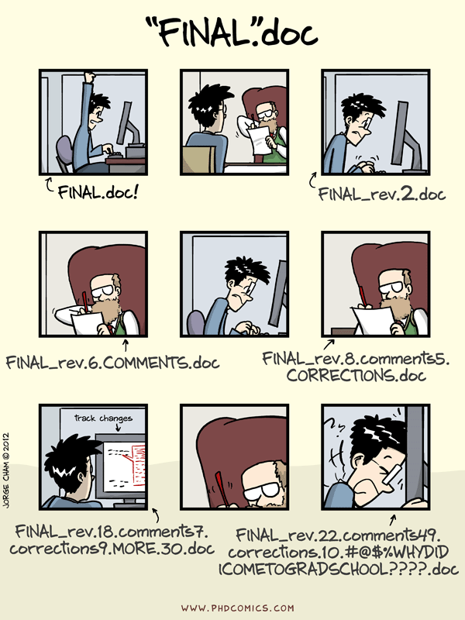
Don’t call your files “FINAL”, “LAST” etc.
Even when you think you are close to finish, be consistent in your file naming, remeber the DO’s and DON’Ts
“Piled Higher and Deeper” by Jorge Cham, http://www.phdcomics.com

Slide 36
Version Control
Version control is the process of managing changes to files.
Manual version control can be as simple as adding a version number or a date (using YYYYMMDD format) to the end of the file name.
Examples:
ASIST_abstract_v3.docx
ASIST_abstract_20180522.docx
Source https://simmons.libguides.com/c.php?g=814790&p=5983200

Slide 37
Automated version control
Can be useful even if you aren’t collaborating with other people.
Some programs offer solutions: Microsoft Word’s Track Changes, Google Docs’ version history, or LibreOffice’s Recording and Displaying Changes.
“Playing back” different sets of changes → different versions of the document.

Slide 38
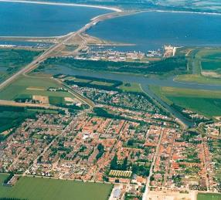
Metadata & Documentation
Metadata is data about data – can be on different levels -
Metadata
Place: Stellendam
Diafragma: 3.2
lighting: 4.3
Source: wikipedia
Description: Pr02_urban_2015.txt
Upload: Bartflikweert
Documentation
Notes:
Leg uit: metadata + concreet foto met diafragma, belichting, etc. Wat is data, wat is metadata? Soms is metadata de data.

Slide 39
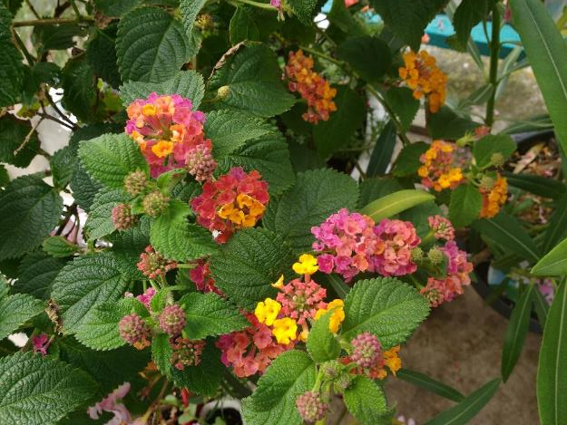
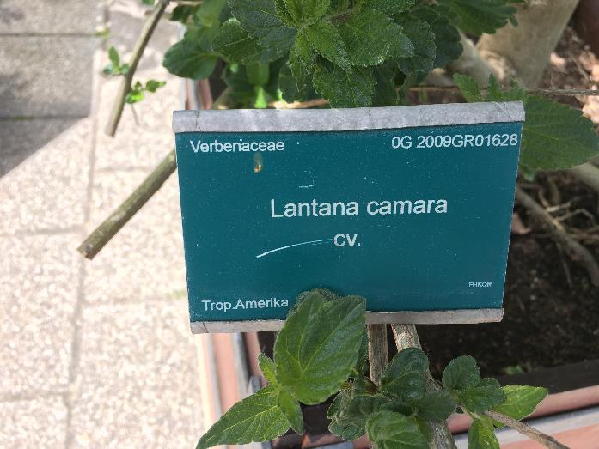
Metadata is information about your data
Metadata & Documentation
Example from the UU Botanical Gardens
i

Slide 40
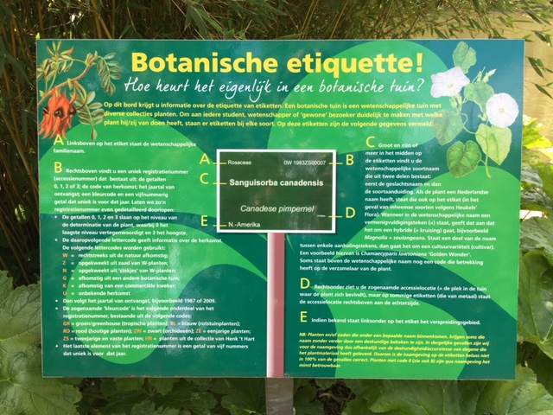
Metadata & Documentation
Explanation (in Dutch) →
i

Slide 41
Data documentation
Prepare
Metadata & Documentation
0 G 2009 GR 01628
0 = level of identification (0-2)
G = from other bot. garden
2009 = year received
GR = Green House
01628 = unique number

Slide 42
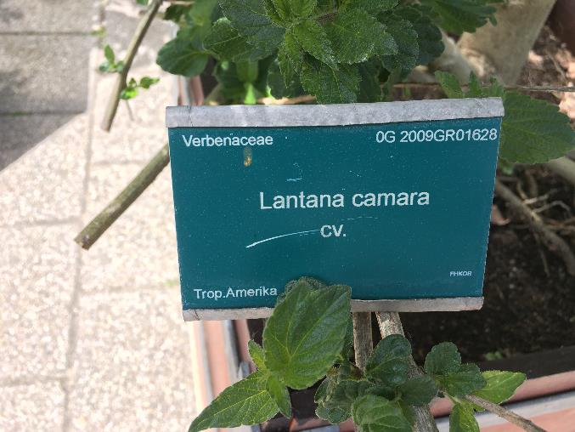
Metadata and data documentation
Data documentation
Prepare
Metadata & Documentation

Slide 43
Metadata and data documentation
Data documentation
Prepare
Metadata & Documentation
Controlled: date format
Locked: top row variable names
Controlled: vocabulary

Slide 44
FAIR Principles highlight the importance of metadata
F
Findable
It should be possible for others to discover your data (metadata, Persistent Identifiers, etc.).
A
Accessible
It should be possible for humans and machines to gain an access to your data, under specific conditions or restrictions where appropriate.
I
Interoperable
Data and metadata should conform to recognized formats and standards to allow them to be combined and exchanged.
R
Reusable
Lots of documentation is needed to support data and interpretation and reuse.

Slide 45
Data Storage
Choosing Storage Options
UU Storage Solutions
Back-ups

Slide 46
What do you consider while choosing storage solution?
Back-up
Price
Storage size
Storage
Sensitive Information
Remote Access
Internal collaboration
Stored at UU
External Collaboration
Geographical location
Transfer Speed
Notes:
Question to participants – what comes to your mind when you think about storage? What do you consider as important?

Slide 47
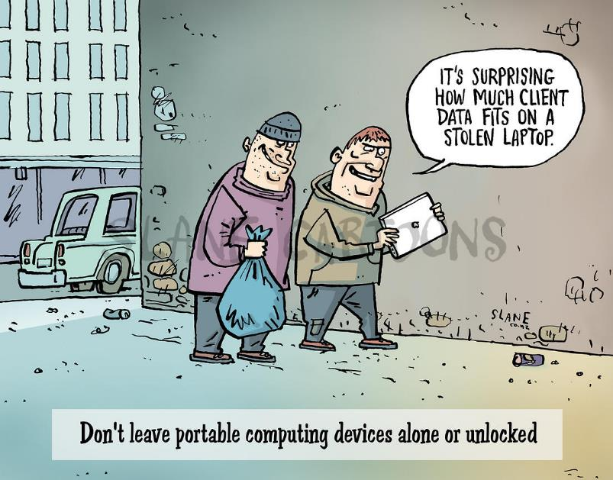
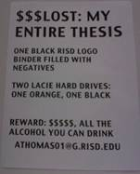
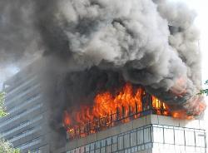
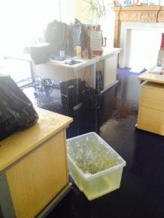
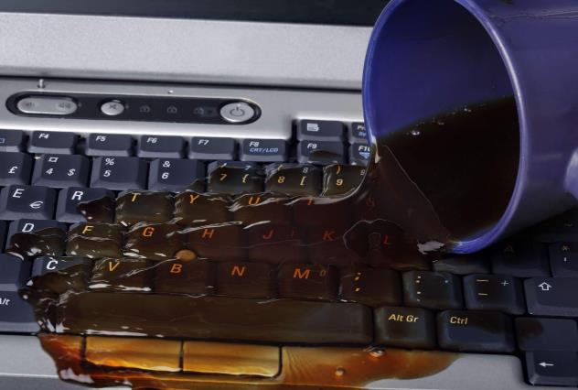
To Backup Or Not To Backup…
http://twitpic.com/45t7vu
Notes:
Keeping backups is probably your most important data management task.
It is recommended that you keep at least three copies of your data on at least two different media. Keep your storage devices in separate locations with at least one off-site, and check that they work regularly. Backups are logically made from the master copy location, which should hold the most recent and correct version.
The backup strategy you choose depends on:
How much time a backup takes;
How much space you have;
How costly it is;
The risk to lose vital information between backups.

Slide 48
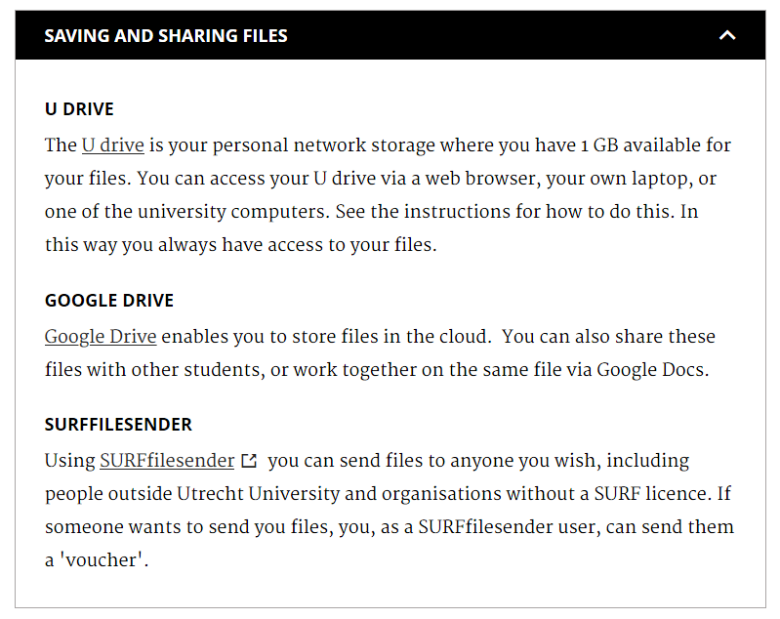
Storage options - summary
Storage need:
You want to:
store your data during the lifetime of your Utrecht University (Solis) ID account;
share the data with
…
Storage Solution: Microsoft "OneDrive for Business" … freely available for every UU employee and student via this link. It integrates seamlessly with other Microsoft Office 365 products.
Back-ups: Yes, with back-up and file (version) recovery for 30 days.
Costs: No costs for Utrecht University staff and Students.
How to get access: As an employee (and student) of Utrecht University, you have direct access to … via this link. Login with your UU email address and password.
Notes:
Lena: This slide repeats the previous slide and can be safely deleted in my oppinion

Slide 49
Data Privacy and Security
Personal Data
Access restricted Data
Do’s and Don’t’s – Sensitive data

Slide 50
Why is data security important?
Data security allows us to
Protect intellectual property rights
Protect commercial interests
Or to keep personal or sensitive information safe

Slide 51
GDPR
General Data Protection Regulation
De Algemene verordening gegevensbescherming (AVG)

Slide 52
The 6 principles of the GDPR
2
1
Purpose Limitation
4
5
Data Accuracy
6
3
Lawfulness
GDPR
Integrity & Confidentiality
Data Minimization
Storage Limitation

Slide 53
Definitions
Term
Definition
Data Subject
An identifiable natural person whose data has been/will be retrieved
Personal Data
Any information relating to an identifiable person (data subject). Directly or indirectly identifiable data such as name, ID #, GPS location, physical, physiological, genetic, economic, cultural
Sensitive personal data
Personal data revealing ethnic origin, political opinions, religious beliefs, sexual orientation and genetic data or biometric data uniquely identifying a data subject
Processing
ANY operation or set of operations which is performed on personal data
Controller
The natural/legal person or other body which, alone or jointly with others, determines the purposes and means of the processing of personal data
Processor
The natural/legal person or other body which processes personal data on behalf of the controller

Slide 54
Security levels
Security of data files
Encryption
Anonymization
Restricted access
Secure transport (SURFilesender)
Complete deletion
Security of computer system
Firewall
Antivirus software
Installing updates
Using secured WIFI
Password-protect
Device encryption
Physical data security
Lock & Lock
Don’t leave unattended
Safe transport

Slide 55
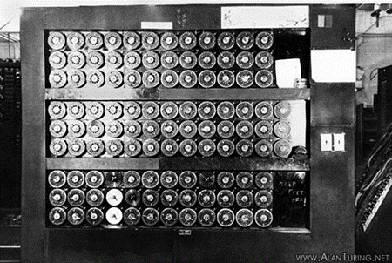
Security of data files
Anonymization
Encryption
Pseudonymization

Slide 56
Restricted Access
Who should have access to your data?
How will you restrict access?
How will you enable access to those authorized?
Where will you describe who gets to access the data?

Slide 57
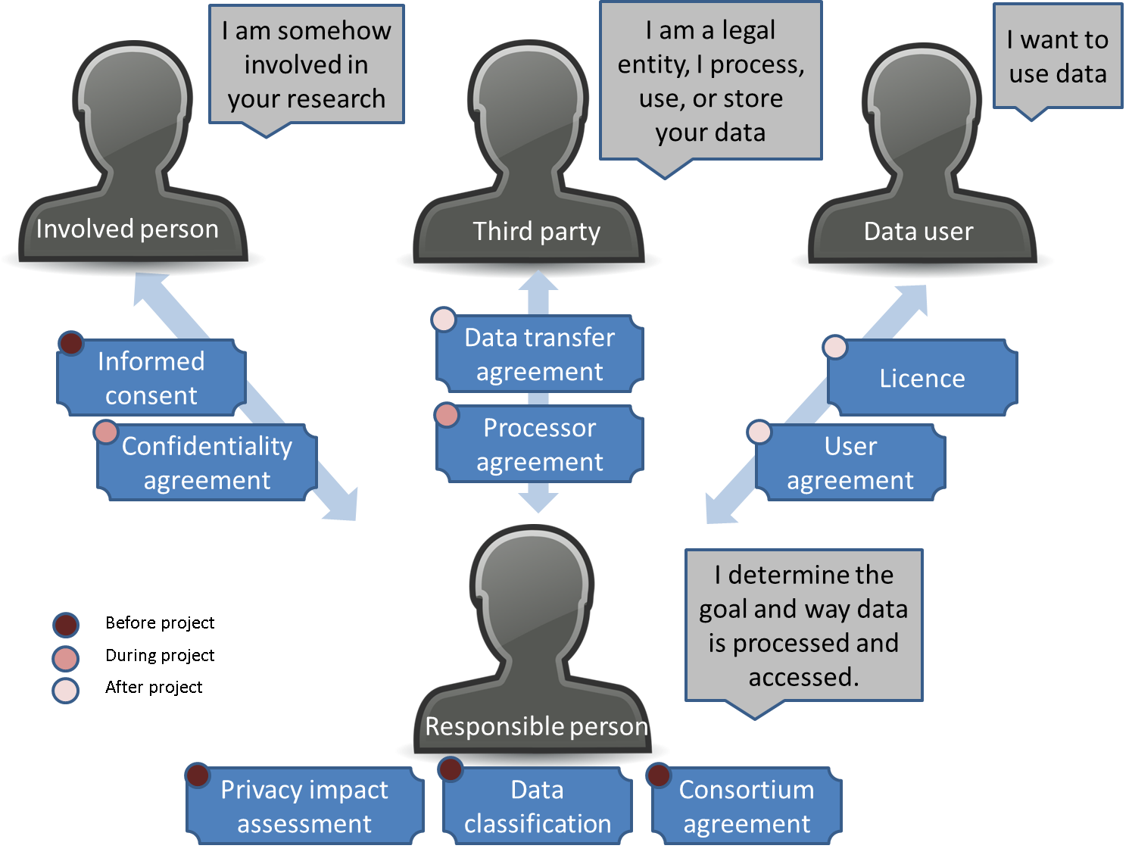
Legal Documents
Notes:
To arrange the security of the research data you work with, in many cases you have to make a (legal) agreement with other people involved. These agreements will make explicit permitted uses, retention time, and agreed upon security measures.
Confidentiality agreement:
When: If data is disclosed to a third party or person, such as student assistants that help collect data, and the information should not be used or spread at all. What: It is a legally binding contract with topics such as scope (who), length of the non-disclosure and possibly penalties for breaches and should be signed before sharing any data.
Data transfer agreement:
When: When (personal) data is transferred between two legal entities and the other party will reuse the data for its own causes. A data transfer agreement is recorded in situations where a risk exists that the data is inappropriately accessed or used. What: In a data transfer agreement statements are made on how data may be handled, who has access, for what exact goal it can be used, etc. It doesn't necessarily differ much from a processor agreement (see below).
Processor agreement:
When: When you ask a third party to process (including storing) your (personal) data and data is transferred between two legal entities. What: In a processor agreement statements are made on how data may be handled, who has access and for what exact goal it can be used.
User agreement:
When: When data is made available for use to specific others (other than your collaborators), criteria for this use should be clear. The user usually has to agree (‘I agree’) with the terms and consequently gains access. What: In a user agreement statements are made on the terms and conditions of use. Very strict usage terms can be set up for access to data for verification purposes only.

Slide 58
Data Protection Impact Assessment (DPIA)
https://youtu.be/1-UlUF5e1aE
Notes:
Lena: I’ve added this one

Slide 59
Data Selection & Preservation
Data package
Selecting Data
Data Loss/deterioration

Slide 60
Raw data from research must be kept available for
a minimum of ten years for verification purposes
…commencing from the date that the research results are published!

Slide 61
Selecting data
Did you publish based on your data?
no
You can store your data, if you want. Think about future publications and reuse.
yes
yes
You have to store your data, for at least ten years.
Are you permitted/is it possible to share that data
no
Put it in a (university-) archive with restricted access
yes
Put data in a public repository to make it accessible and reusable

Slide 62
Data package - Preservation
Contains:
Raw data
Processed data
Protocols
Computer code/scripts
Lab journals
Metadata and/or codebooks describing the data
An overview of the DP contents and how these are related
A reference to any publication which is based on the data
Pixabay ‘pakket’: CC0

Slide 63
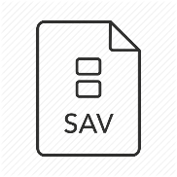
Selecting Data
What would you preserve ?
What would you publish?
What is your replication package?
A
B
C
Raw data ≈ 5GB
Processed data ≈ 500MB
Analyzed data ≈ 500MB
Notes:
Interactive: Make them choose between a combination of A b and C and then have a few explain why. Discuss. Can also discuss the chosen formats.

Slide 64
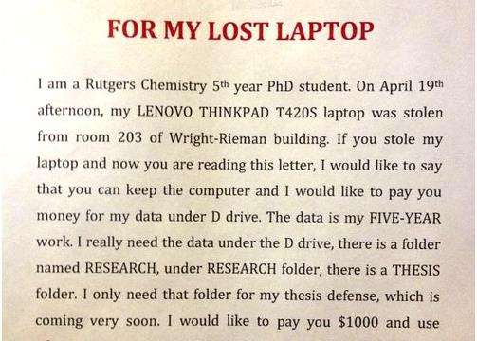
Data Loss/deterioration
01101110101010
01101110111010111
0110111010101111000101101110100
Can digital data deteriorate/corrupt on its own?
Bit rot!
How else can you lose digital data?
Losing laptop/USB
Drive malfunction
Forget encryption password
Strategies to minimize risks:
Replication: keep more than 1 copy
on more than one location
Use checksum to identify faulty copies
Used preferred file formats
Bring to new media/format in time

Slide 65
Data Availability for Reuse
FAIR Data
Making Data Available
Licenses

Slide 66
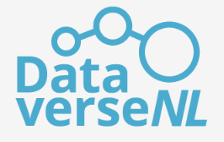
Making data available
4TU.Centre for Research Data
To take into account:
Persistent identifier (PID)
Guarantees for sustainable availability
Quality control
Costs
Physical storage location
Notes:
Make one of these tools link to a relevant dataset!

Slide 67
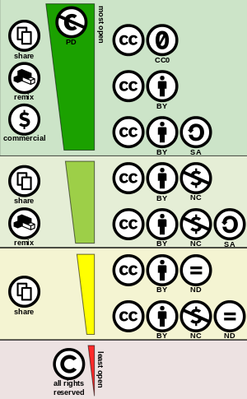
Licensing of data
A license states what a user is allowed to do with your data and creates clarity and certainty for potential users.
CC0 “No Rights Reserved”
BY Attribution: cite the source at reuse
SA (Share Alike): share the work or its derivative under the same license.
NC (Non Commercial): Use not allowed for commercial purposes.
ND (No Derivatives): No derivative works allowed
Source: Creative commons Nederland http://creativecommons.nl/eerste-keer/#gebruiken; http://creativecommons.org

Slide 68
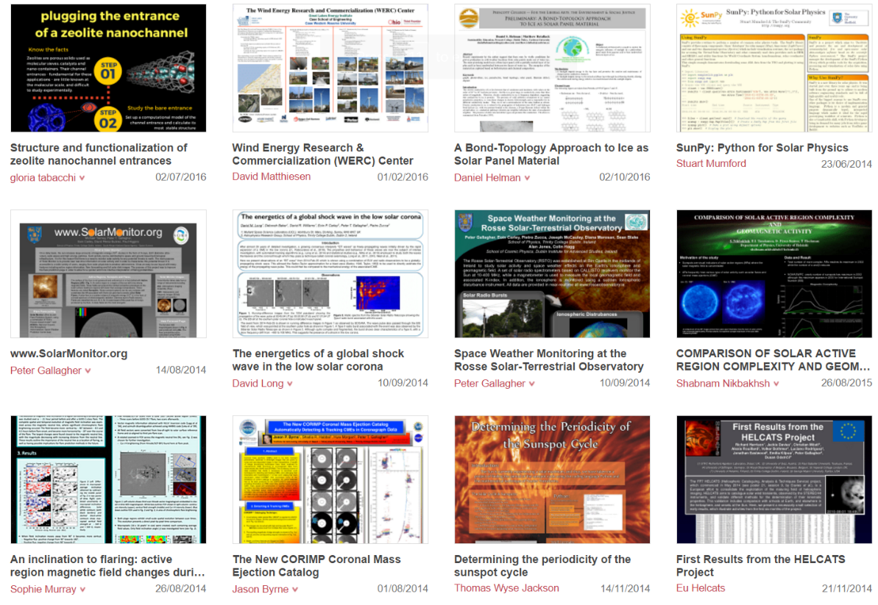
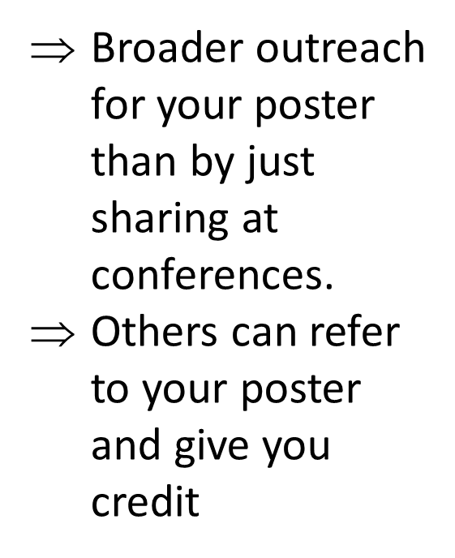
Sharing posters, slides & handouts, e.g. FigShare, Zenodo.

Slide 69
Any questions left?

