Slide 1
Connecting Data and Usage in Climate Assessments
Reid Sherman | GCIS Lead, National Coordination Office | Straughan Environmental, Inc.
January 9, 2020

Slide 2
Why we need Traceable Provenance
Increase credibility
Enable reproducibility
Inform decisions
Demonstrate integrity
Conform to modern scientific standards
Reproducible research
Government transparency
Locate customizable data and information

Slide 3
Surfacing information sources
Traceable Accounts
Sources linked with publication metadata
Figures have data and processes documented

Slide 4
Traceable Accounts
Process Description
For each Key Message:
Description of Evidence Base
Major Uncertainties
Description of Confidence and Likelihood

Slide 5
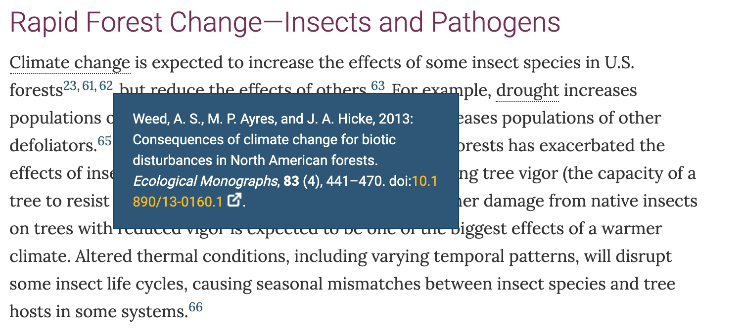
Citations
Notes:
175 out of 182 have a DOI or at least URL in Forest Chapter.

Slide 6
Citations in GCIS

Slide 7
Figure Metadata

Slide 8
Figure Metadata
Notes:
Get dataset or datasets (or citations to source). Also includes Analysis Methods and Tools

Slide 9
GCIS Data Model
Two main structures for describing use of information:
Publication Types:
Report
Chapter
Figure
Article
Dataset
Etc.
Publication
Reference
Publication
Publication
Publication
Activity
derived by
cites
using

Slide 10
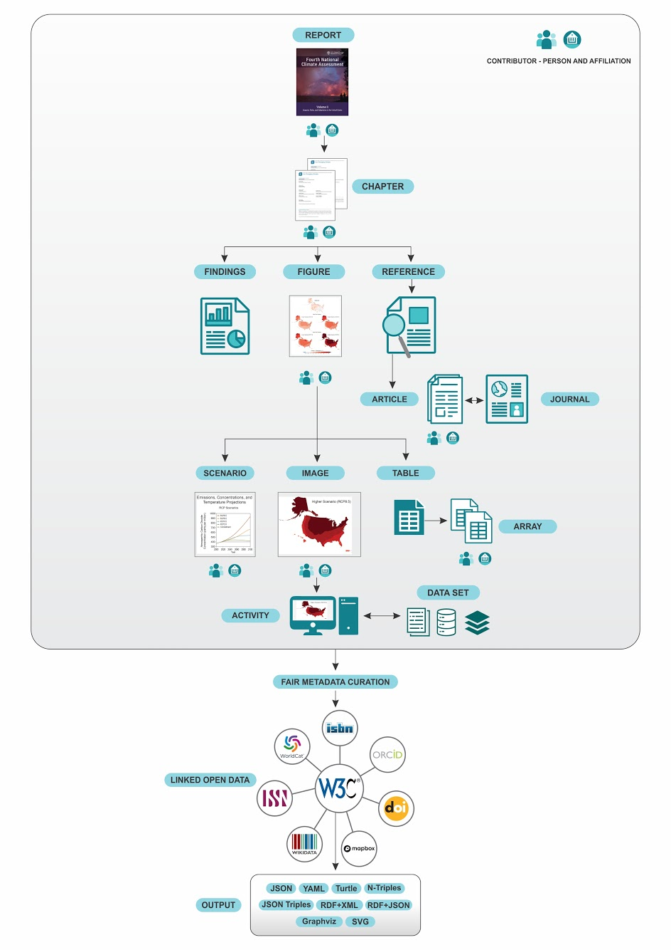

Slide 11
Limits of GCIS Provenance
Result
Article
Dataset
Publisher
Person
Organization
Process
Instrument
Funding Source
Versions
Organization
Person
Dataset
Topics

Slide 12
Planning for NCA5

Slide 13
GCIS planned improvements
Improving metrics to measure our metadata quality
Improving ingestion from report authors
Implementing navigation through topical keywords
Improving our data model and technology
Notes:
Ingestion can nudge to select from curated list for high-quality metadata;
Keywords are attached and surfaced, but no additional functionality yet

Slide 14
Acknowledgments
USGCRP Global Change Information System Team
Amrutha Elamparuthy – Data Manager
Zach Landes – Software Engineer
Reuben Aniekwu – Research Coordinator
Alaina Froh - Intern
NOAA Technical Support Unit – North Carolina Institute for Climate Studies

Slide 15
data.globalchange.gov Reid Sherman rsherman@usgcrp.gov

