Slide 1
Software Sustainability, Discovery and Accreditation
ESIP Winter Meeting, 9 Jan 2020
Daniel S. Katz, Lesley Wyborn, Mike Daniels
(d.katz@ieee.org, http://danielskatz.org, @danielskatz)
Assistant Director for Scientific
Software & Applications
Research Associate Professor,
CS, ECE, iSchool

Slide 2
Why do we care about research software?
Funding
  ~20% of NSF projects over 11 years topically discuss software in their abstracts ($10b)
  2 of 3 main ECP areas are research software (~$4b)
Publications
  Software intensive projects are a majority of current publications
  Most-cited papers are methods and software
Researchers
  >90% of US/UK researchers use research software
  ~65% would not be able to do their research without it
  ~50% develop software as part of their research
Collected from http://www.dia2.org in 2017
Hettrick, https://www.software.ac.uk/blog/2016-09-12-its-impossible-conduct-research-without-software-say-7-out-10-uk-researchers
Nangia & Katz;​ 10.1109/eScience.2017.78
“Top 100-cited papers of all time,” Nature, 2014 10.1038/514550a
Nangia & Katz, 10.6084/m9.figshare.5328442.v1

Slide 3
Open source & software growth
2001: 208K SourceForge users
2017: 20M GitHub users
2019: 37M GitHub users
1998: 180K downloads of Netscape (app) in 2 weeks
2017: 21M downloads of lodash (javascript library) in 2 weeks
2018 survey of scientist-developers found that 82% of respondents felt that they were spending spending “more time” or “much more time” developing software than they did 10 years ago
Credit: “Rebuilding the cathedral” @nayafia for Strange Loop 2017
Pinto at al., “How do scientists develop scientific software? an external replication,” 10.1109/SANER.2018.8330263

Slide 4
Science of research software organizations
Software Sustainability Institute (SSI)
  In third period of funding
  Now funded by all UK research councils
Better Scientific Software (BSSw)
  Clearinghouse to gather, discuss, and disseminate experiences, techniques, tools, and other resources to improve developer productivity and software sustainability
  Currently DOE funded
United States Research Software Sustainability Institute (URSSI)
  Conceptualization project under NSF funding
  Institute proposal planned in 2020
  Interest from private foundations
Australian Research Data Commons (ARDC)
  Provides access to data intensive eInfrastructure, platforms, skills, and data collections to Australian research community & industry
Research Software Alliance (ReSA)
  Intended to coordinate the above & others internationally

Slide 5
Software Sustainability
Software sustainability is the capacity of the software to endure
  Will the software will continue to be available in the future, on new platforms, meeting new needs?
Software sustainability $≡$ sufficient $∆$ software state
  Sufficient to deal with: software collapse, bugs, new features needed
$∆$ software state = (human effort in – human effort out - friction) * efficiency
  Software stops being sustained when human effort out > human effort in over some time
Human effort $⇆$ $
  All human effort works (community open source)
  All $ (salary) works (commercial software, grant funded projects)
  Combined is hard, equation is not completely true, humans are not purely rational

Slide 6
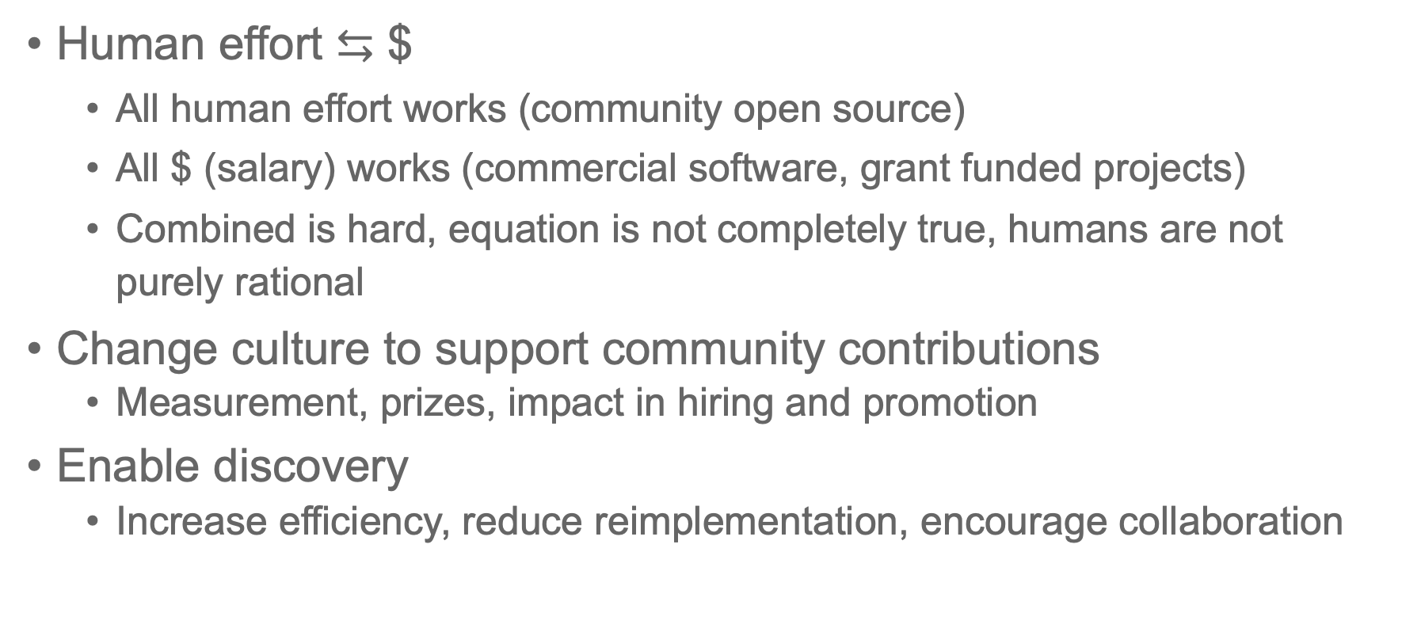
What can we do?
Human effort $⇆$ $
  All human effort works (community open source)
  All $ (salary) works (commercial software, grant funded projects)
  Combined is hard, equation is not completely true, humans are not purely rational
Change culture to support community contributions
  Measurement, prizes, impact in hiring and promotion
Enable discovery
  Increase efficiency, reduce reimplementation, encourage collaboration

