Slide 1
QUIGS PAGES Workshop 2019
Cambridge, UK

Slide 2
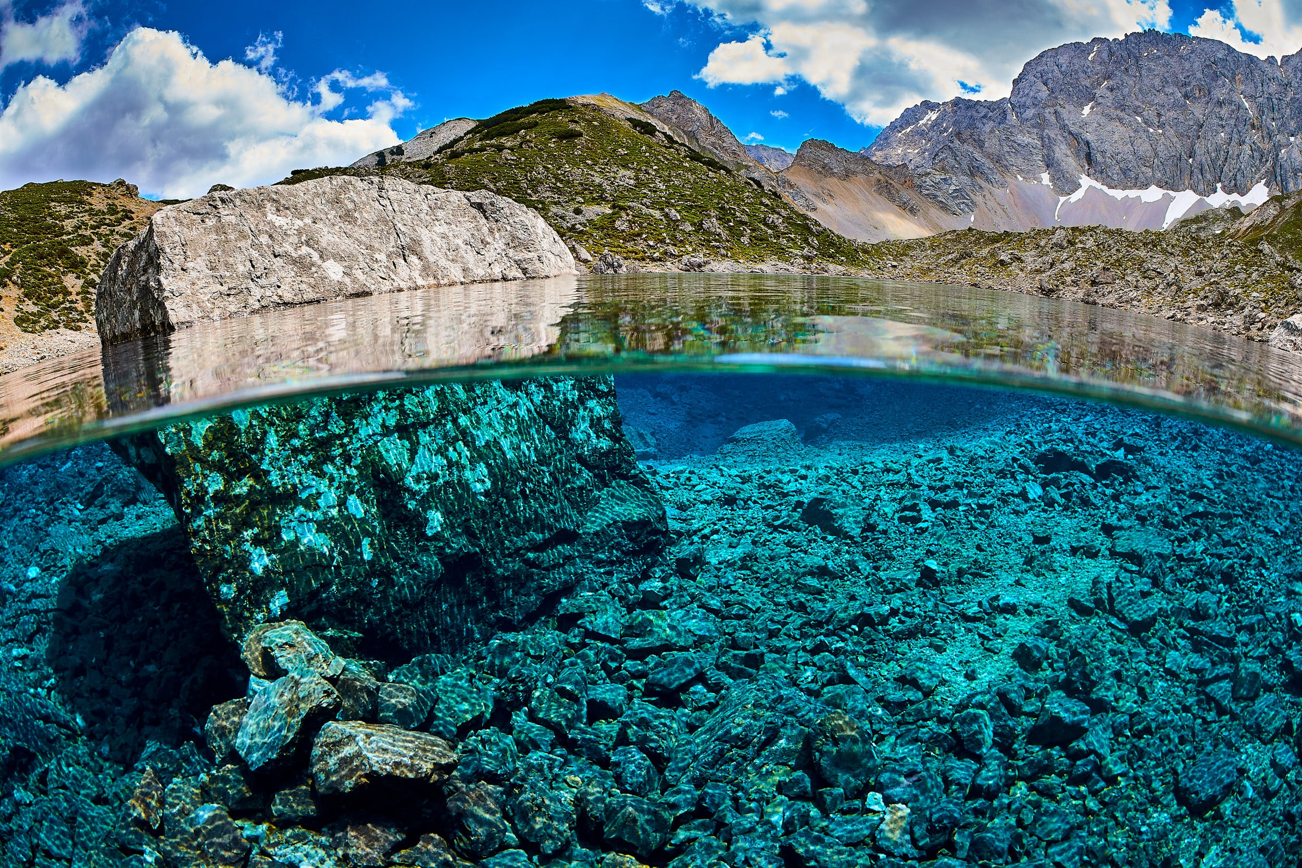




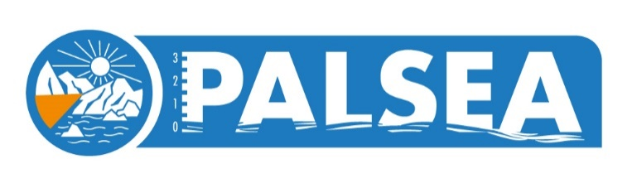



Sea level in the last interglacial
and prospects for MIS 11 and other interglacials
Alessio Rovere & Natasha Barlow
Sea level and extreme waves
in the Last Interglacial
Photo by Jason Steffan from Pexels
The background photo is not licensed under the CC-BY license, please obtain a copy from the links above
INQUA

Slide 3
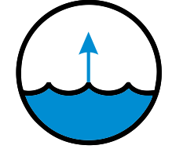

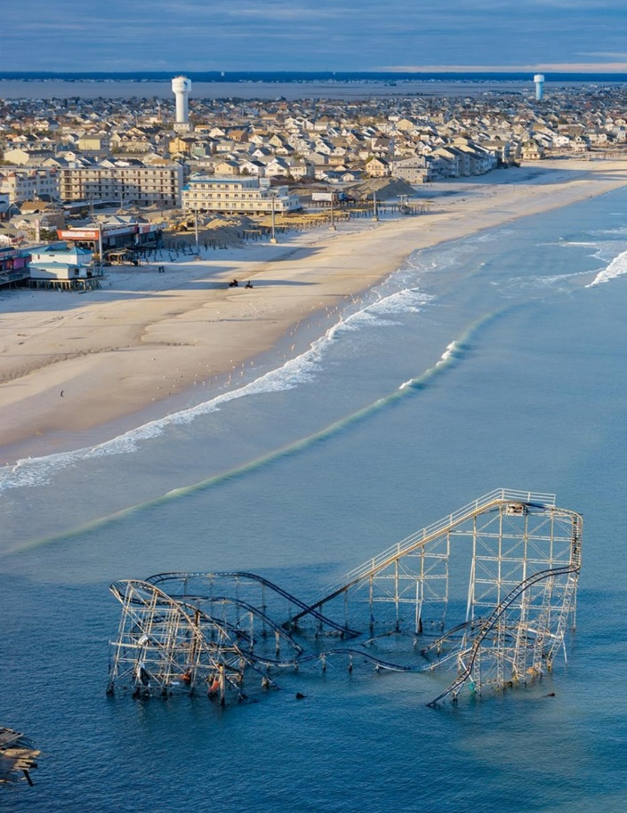
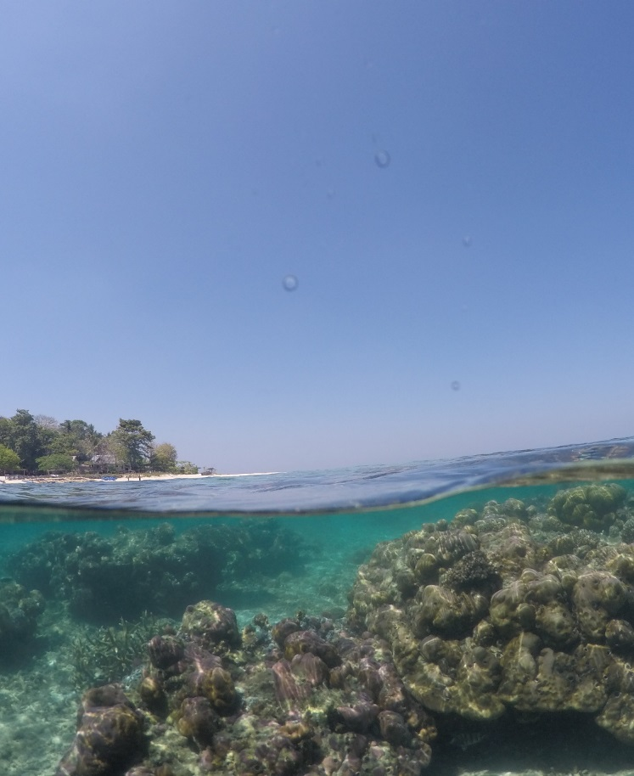
Two big questions
Peak sea level
Sea level variations
Stephen Wilkes - National Geographic; Maren Bender - MARUM
This slide is not released under the creative commons license.

Slide 4
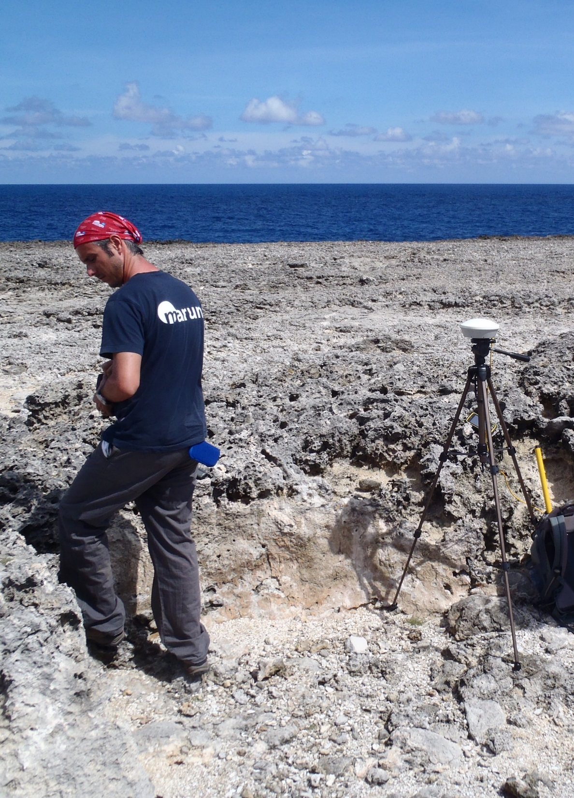
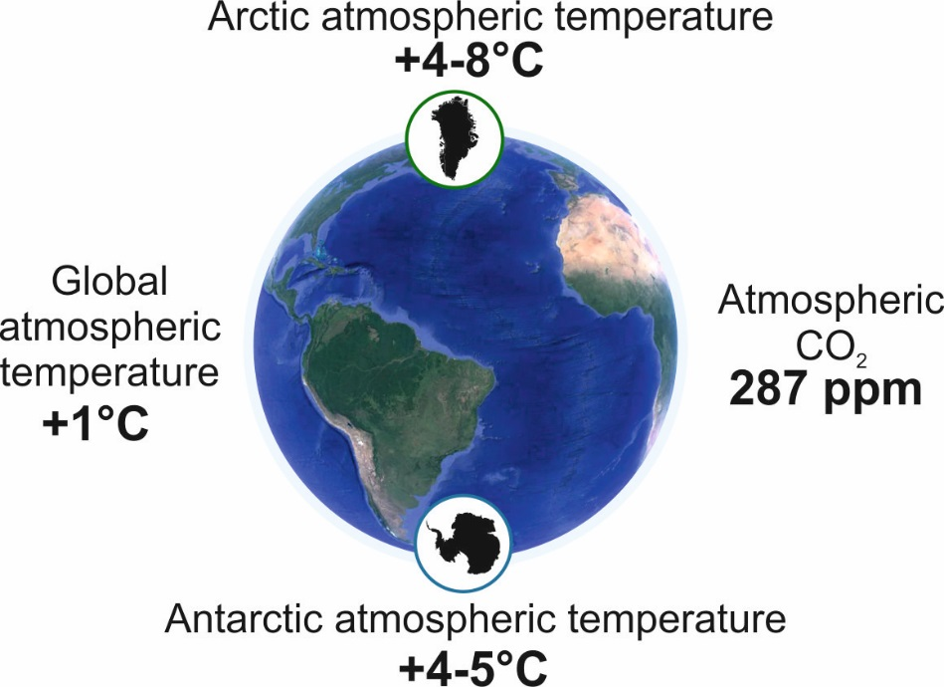
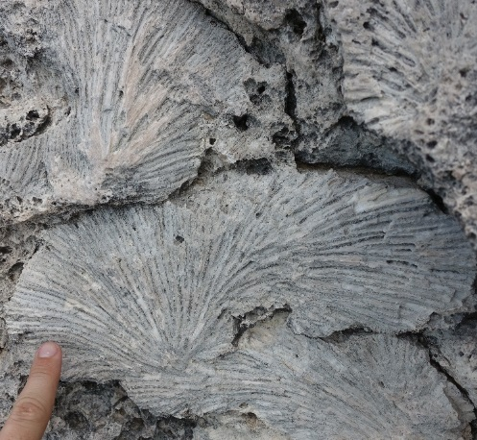

Bonaire, Netherland Antilles
Last Interglacial reef terrace
Last Interglacial
∼125.000 years ago
Source: Dutton et al., 2015 and references therein
7.2 ± 0.1m
Fossil coral
reef
The last time the Earth was slightly warmer than today
Photo by Thomas Lorscheid - MARUM
Notes:
My job is to answer these questions using geologic proxies
In particular I will focus today on the Last Interglacial

Slide 5
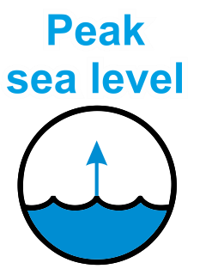
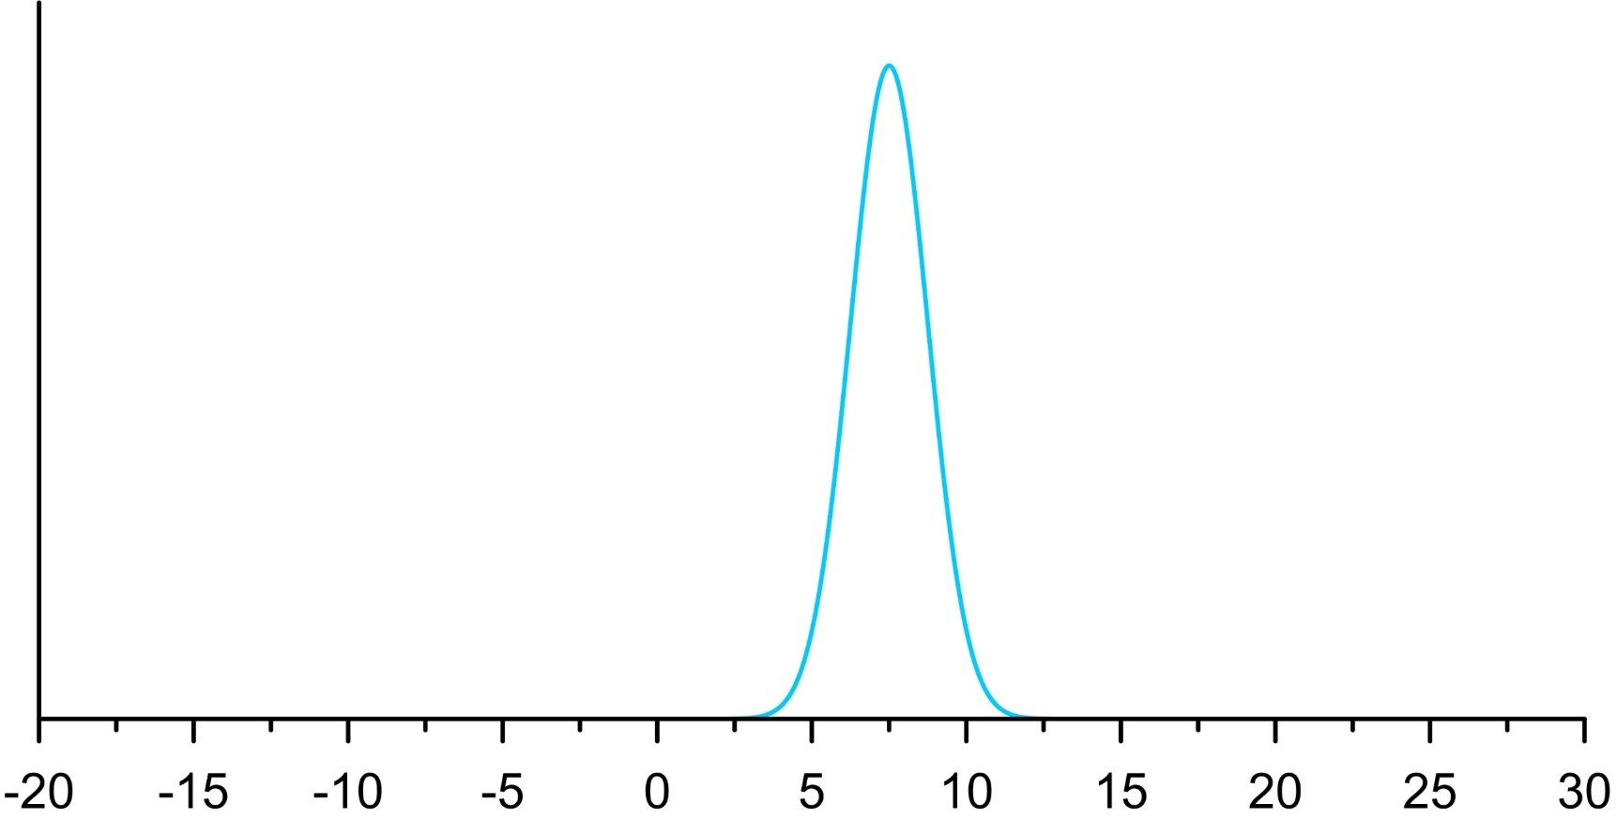
How high was sea level in the
Last Interglacial?
Probability
5-10m Very
high confidence
IPCC AR5
Last Interglacial eustatic sea level [m]
Notes:
So, What do we know? How high was sea level in the Last Interglacial? Until a couple of years ago, we thought we knew with very high confidence that sea level was 5-10m above present. But the work of my research group, in collaboration with other groups, showed that the uncertainties are instead very large. Then, we want to reduce uncertainties.

Slide 6
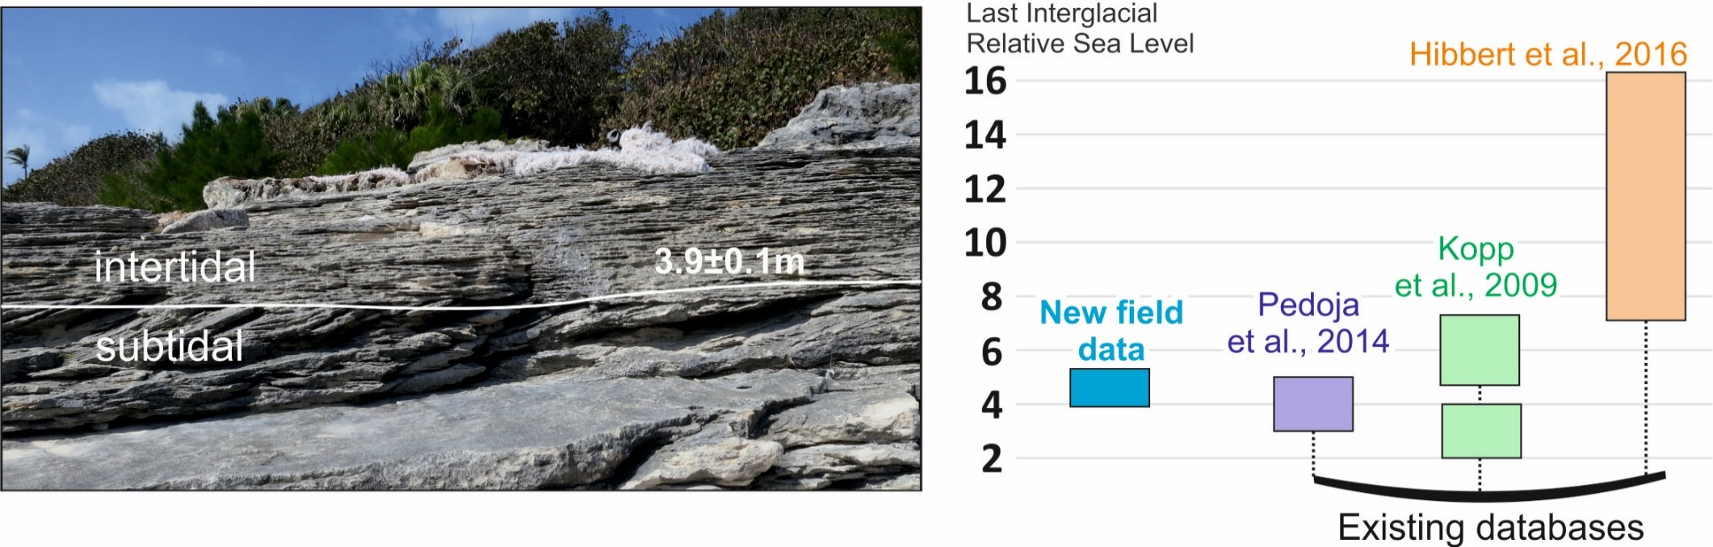
5-10m Very
high confidence
IPCC AR5
How high was sea level in the
Last Interglacial?
Sources of uncertainty
(previously neglected?)
Interpretation of field proxies
Rovere et al., 2016. Earth Science Reviews. Grape Bay, Bermuda
Notes:
So, What do we know? How high was sea level in the Last Interglacial? Until a couple of years ago, we thought we knew with very high confidence that sea level was 5-10m above present. But the work of my research group, in collaboration with other groups, showed that the uncertainties are instead very large. Then, we want to reduce uncertainties.

Slide 7
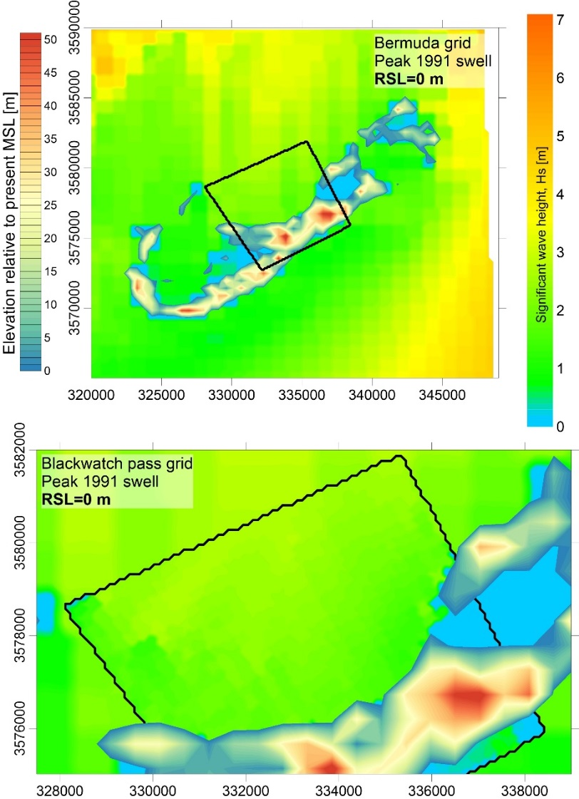
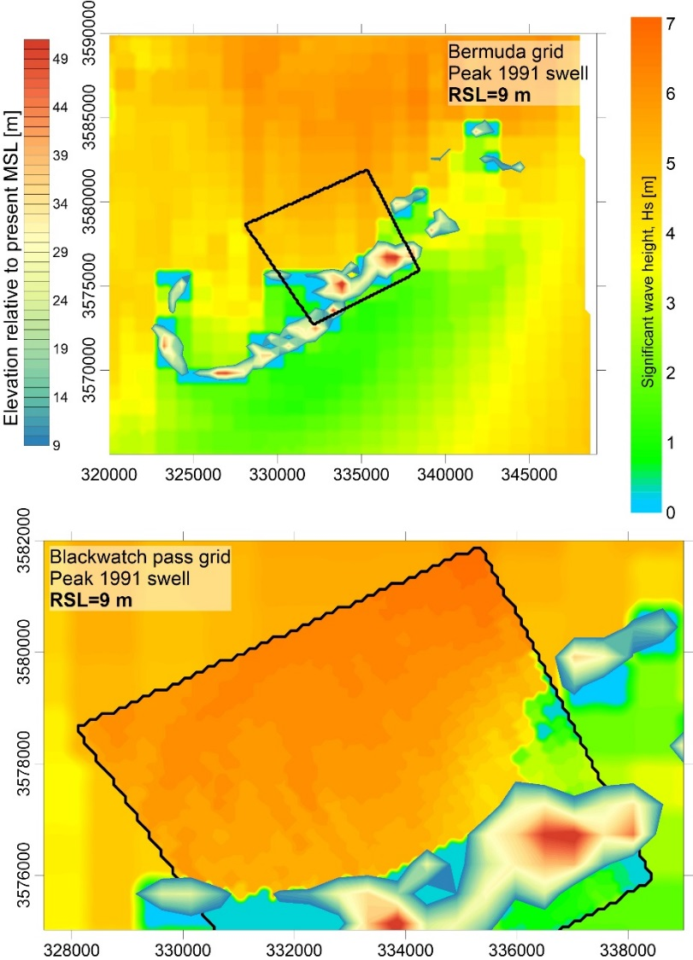
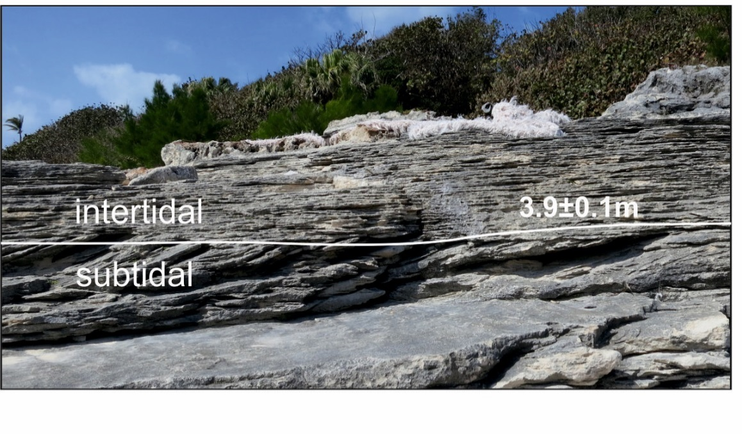
5-10m Very
high confidence
IPCC AR5
How high was sea level in the
Last Interglacial?
Sources of uncertainty
(previously neglected?)
Interpretation of field proxies
Intensity of coastal processes?
Rovere et al., 2016. Earth Science Reviews. Grape Bay, Bermuda
Notes:
So, What do we know? How high was sea level in the Last Interglacial? Until a couple of years ago, we thought we knew with very high confidence that sea level was 5-10m above present. But the work of my research group, in collaboration with other groups, showed that the uncertainties are instead very large. Then, we want to reduce uncertainties.

Slide 8
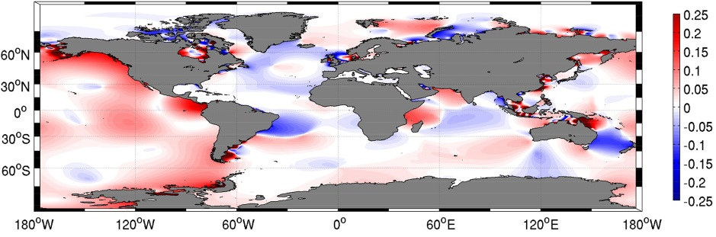
5-10m Very
high confidence
IPCC AR5
How high was sea level in the
Last Interglacial?
Sources of uncertainty
(previously neglected?)
Interpretation of field proxies
Intensity of coastal processes?
Response of the tide to a uniform 5 m SLR
Wilmes et al., 2017, JGR Oceans
This slide is not released under the creative commons license.
Notes:
So, What do we know? How high was sea level in the Last Interglacial? Until a couple of years ago, we thought we knew with very high confidence that sea level was 5-10m above present. But the work of my research group, in collaboration with other groups, showed that the uncertainties are instead very large. Then, we want to reduce uncertainties.

Slide 9
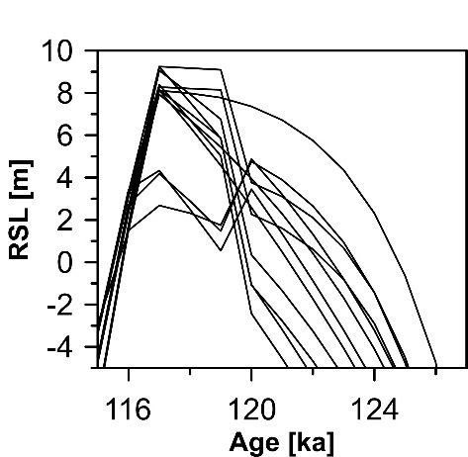
5-10m Very
high confidence
IPCC AR5
How high was sea level in the
Last Interglacial?
Sources of uncertainty
(previously neglected?)
Interpretation of field proxies
Intensity of coastal processes?
Glacial Isostatic Adjustment
4 ESL scenarios x 3 mantle viscosity profiles per scenario
Courtesy of Paolo Stocchi
Rovere et al., 2016. Earth Science Reviews. Grape Bay, Bermuda
Notes:
So, What do we know? How high was sea level in the Last Interglacial? Until a couple of years ago, we thought we knew with very high confidence that sea level was 5-10m above present. But the work of my research group, in collaboration with other groups, showed that the uncertainties are instead very large. Then, we want to reduce uncertainties.

Slide 10
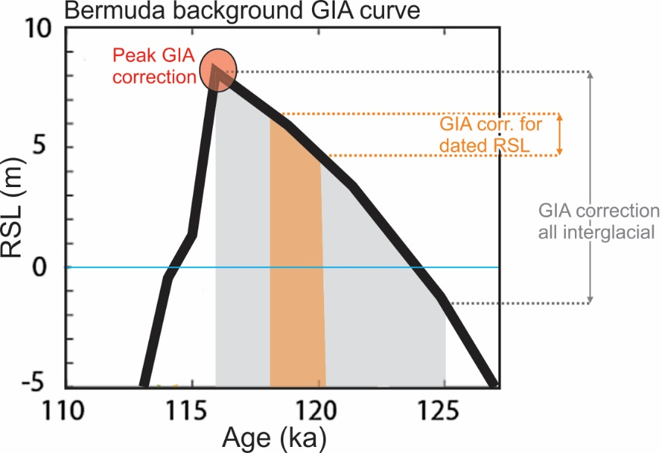
5-10m Very
high confidence
IPCC AR5
How high was sea level in the
Last Interglacial?
Sources of uncertainty
(previously neglected?)
Interpretation of field proxies
Intensity of coastal processes?
Glacial Isostatic Adjustment
Rovere et al., 2016. Earth Science Reviews. Grape Bay, Bermuda
Notes:
So, What do we know? How high was sea level in the Last Interglacial? Until a couple of years ago, we thought we knew with very high confidence that sea level was 5-10m above present. But the work of my research group, in collaboration with other groups, showed that the uncertainties are instead very large. Then, we want to reduce uncertainties.

Slide 11
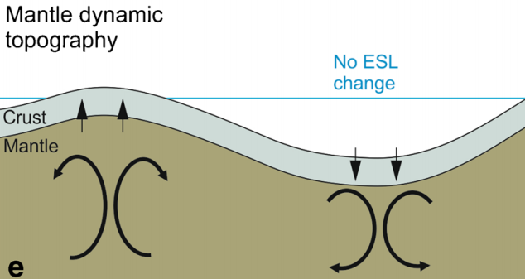
5-10m Very
high confidence
IPCC AR5
How high was sea level in the
Last Interglacial?
Sources of uncertainty
(previously neglected?)
Interpretation of field proxies
Intensity of coastal processes?
Glacial Isostatic Adjustment
Dynamic Topography
Rovere et al., 2016. Curr. Clim. Change Reports
Rovere et al., 2016. Earth Science Reviews. Grape Bay, Bermuda
This slide is not released under the creative commons license.
Notes:
So, What do we know? How high was sea level in the Last Interglacial? Until a couple of years ago, we thought we knew with very high confidence that sea level was 5-10m above present. But the work of my research group, in collaboration with other groups, showed that the uncertainties are instead very large. Then, we want to reduce uncertainties.

Slide 12
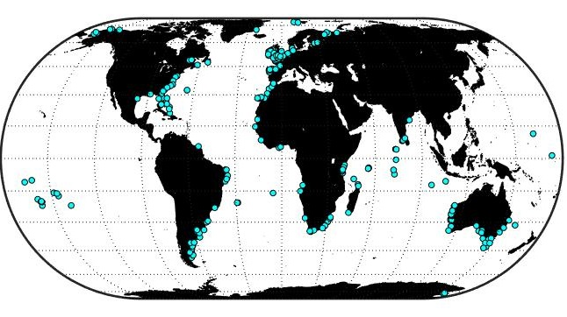
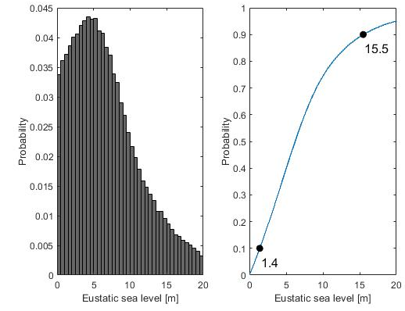
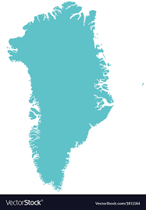
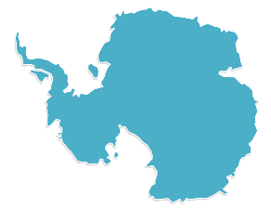
5-10m Very
high confidence
IPCC AR5
How high was sea level in the
Last Interglacial?
Let’s do something bold and assume:
No change in coastal processes
Existing global SL databases
Only passive margins
No further tectonics
DT and GIA corrected
Austermann et al., 2017
Global database
Kopp et al., 2009;Pedoja et al., 2014; Hibbert et al., 2106
H2O
Notes:
So, What do we know? How high was sea level in the Last Interglacial? Until a couple of years ago, we thought we knew with very high confidence that sea level was 5-10m above present. But the work of my research group, in collaboration with other groups, showed that the uncertainties are instead very large. Then, we want to reduce uncertainties.

Slide 13
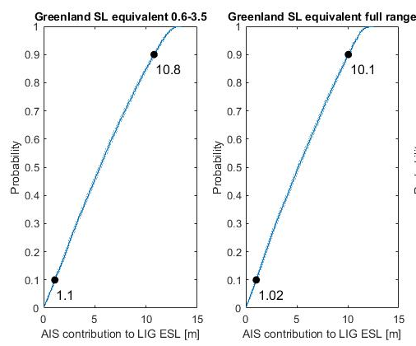
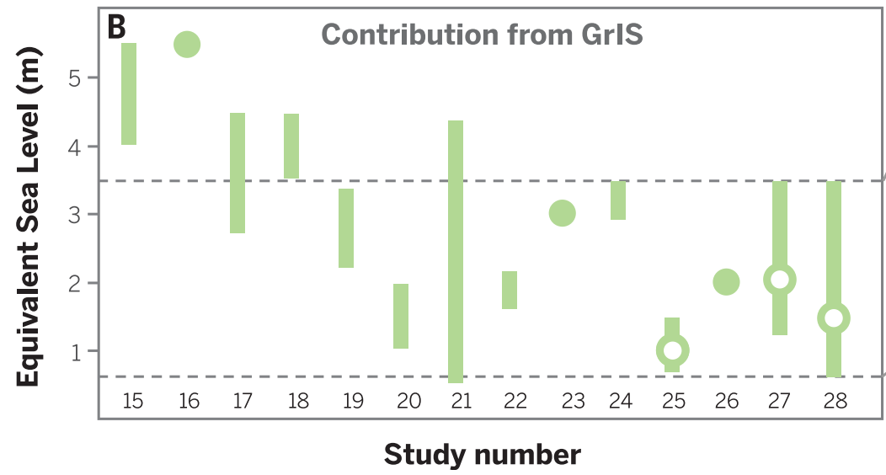
5-10m Very
high confidence
IPCC AR5
How high was sea level in the
Last Interglacial?
Let’s do something bold and assume:
No change in coastal processes
Existing global SL databases
Only passive margins
No further tectonics
Thermal expansion + mountain glaciers =
ca. 1 m
Vaughan et al., 2013; Mackay et al., 2011; Dutton et al., 2015
H2O
Dutton et al., 2015. Science
This slide is not released under the creative commons license.
Notes:
So, What do we know? How high was sea level in the Last Interglacial? Until a couple of years ago, we thought we knew with very high confidence that sea level was 5-10m above present. But the work of my research group, in collaboration with other groups, showed that the uncertainties are instead very large. Then, we want to reduce uncertainties.

Slide 14
5-10m Very
high confidence
IPCC AR5
How high was sea level in the
Last Interglacial?
Let’s do something bold and assume:
No change in coastal processes
Existing global SL databases
Only passive margins
No further tectonics
Thermal expansion + mountain glaciers =
ca. 1 m
Vaughan et al., 2013; Mackay et al., 2011; Dutton et al., 2015
H2O
Dutton et al., 2015. Science
This slide is not released under the creative commons license.
Notes:
So, What do we know? How high was sea level in the Last Interglacial? Until a couple of years ago, we thought we knew with very high confidence that sea level was 5-10m above present. But the work of my research group, in collaboration with other groups, showed that the uncertainties are instead very large. Then, we want to reduce uncertainties.

Slide 15
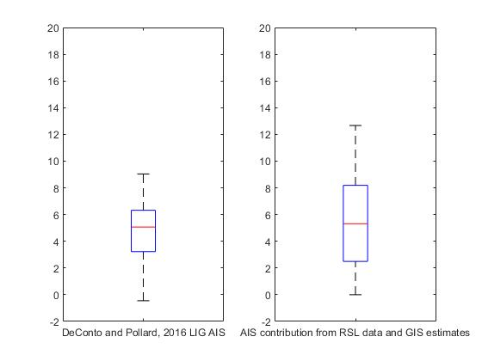
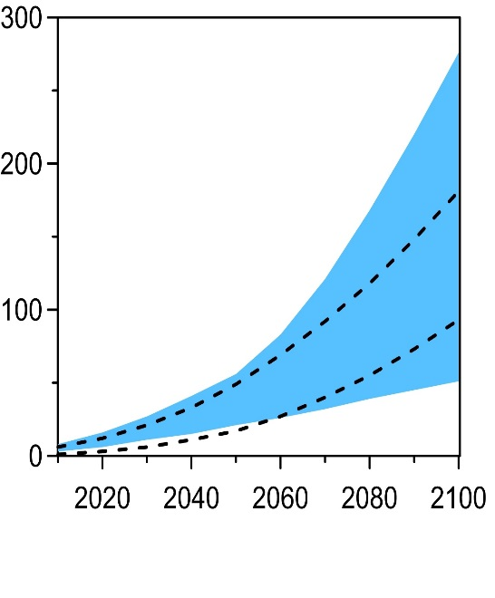
5-10m Very
high confidence
IPCC AR5
How high was sea level in the
Last Interglacial?
Let’s do something bold and assume:
No change in coastal processes
Existing global SL databases
Only passive margins
No further tectonics
AIS model results
AIS
Estimated here
Global mean sea level [cm]
Including ice dynamics
calibrated with
Mid-Pliocene and
LIG sea levels
Deconto and Pollard, 2016
IPCC AR5
Year
Data from Kopp et al., 2017, Earth’s future Representative Concentration Pathway 8.5
Notes:
So, What do we know? How high was sea level in the Last Interglacial? Until a couple of years ago, we thought we knew with very high confidence that sea level was 5-10m above present. But the work of my research group, in collaboration with other groups, showed that the uncertainties are instead very large. Then, we want to reduce uncertainties.

Slide 16
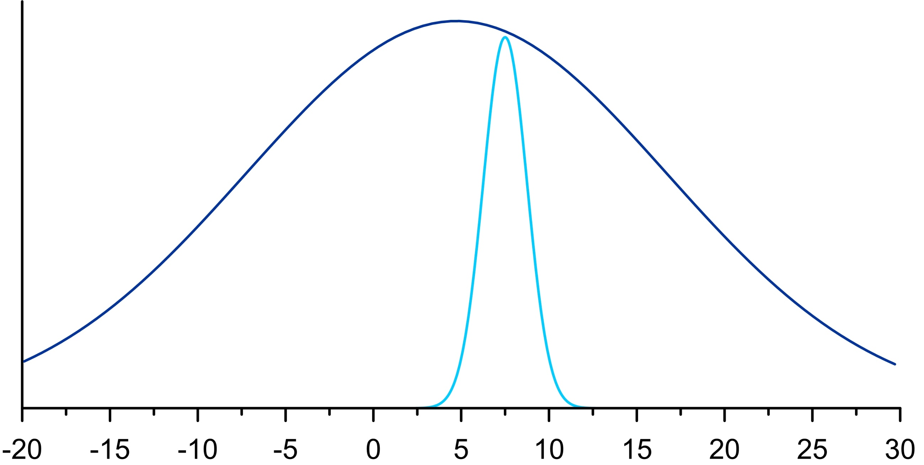
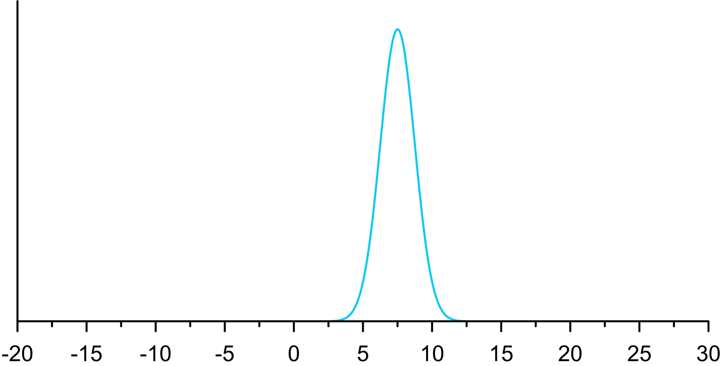
Are we victims of the “Appeal to tradition” fallacy?
"this is right because we've always done it this way."
Probability
Very large uncertainties due to:
Field data
Rovere et al., 2016, Earth Sci. Rev.
Lorscheid et al., 2017 Sci. Reports
Dynamic Topograpy and GIA
Austermann et al., 2017, Science Advances
Stocchi et al., 2018, QSR
5-10m Very
high confidence
IPCC AR5
Last Interglacial Eustatic sea level [m]
Notes:
In the past 10 years, I have been travelling sea level and coastal changes in past warm periods, such as the Last Interglacial. The LIG was the last period of time when earth was warmer than today. In this field, I have been doing global science, leading my own group and pushing to the boundaries of what we know, also disseminating the importance of what I do to the public at large.

Slide 17
Are we victims of the “Appeal to tradition” fallacy?
"this is right because we've always done it this way."
H2O
Unlikely into Mid-Pliocene sea level estimates
Unlikely below
modern sea level
Probability
Last Interglacial Eustatic sea level [m]
Notes:
In the past 10 years, I have been travelling sea level and coastal changes in past warm periods, such as the Last Interglacial. The LIG was the last period of time when earth was warmer than today. In this field, I have been doing global science, leading my own group and pushing to the boundaries of what we know, also disseminating the importance of what I do to the public at large.

Slide 18
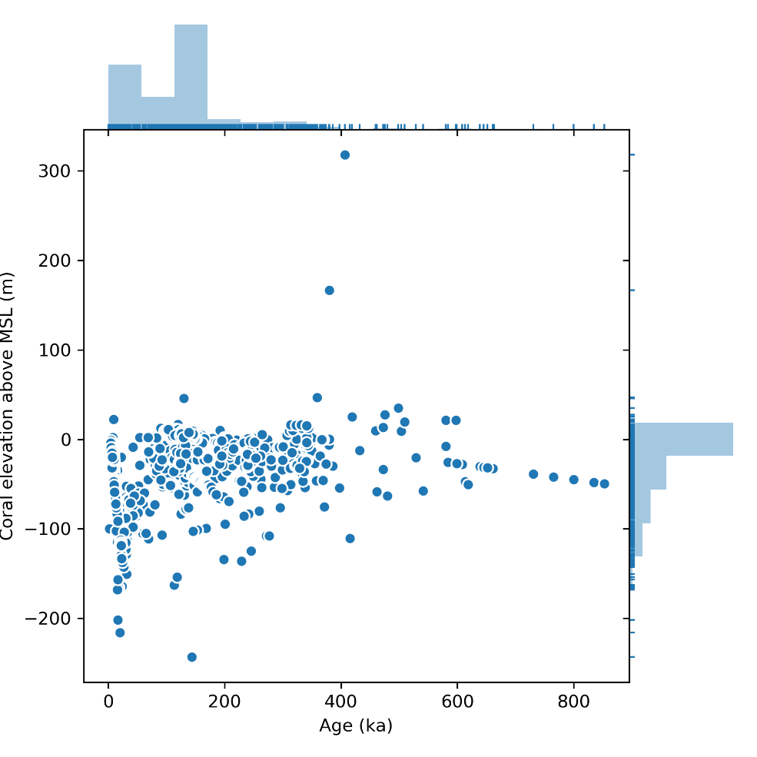
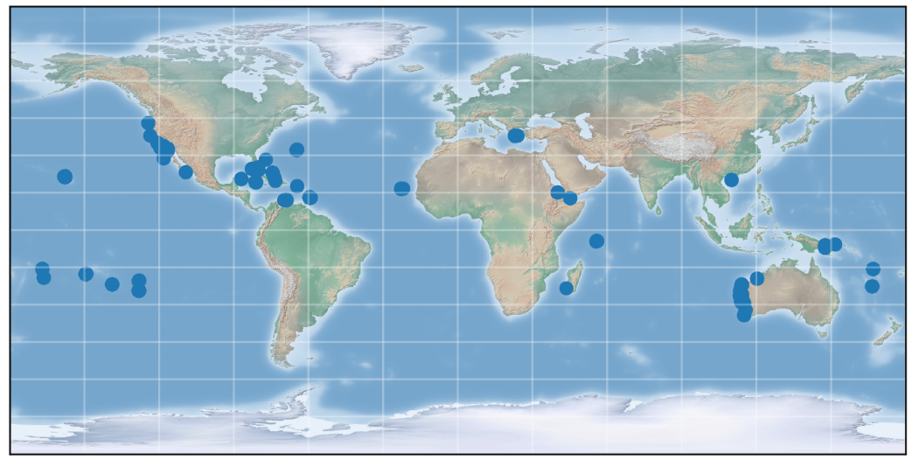
Other interglacials?
Hibbert et al., 2016 – dated reefs
Notes:
So, What do we know? How high was sea level in the Last Interglacial? Until a couple of years ago, we thought we knew with very high confidence that sea level was 5-10m above present. But the work of my research group, in collaboration with other groups, showed that the uncertainties are instead very large. Then, we want to reduce uncertainties.

Slide 19
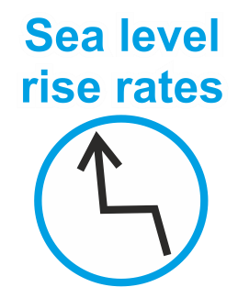
Sea level variability
In the LIG?
Kopp et al, (2017) PAGES magazine
This slide is not released under the creative commons license.
Notes:
So, What do we know? How high was sea level in the Last Interglacial? Until a couple of years ago, we thought we knew with very high confidence that sea level was 5-10m above present. But the work of my research group, in collaboration with other groups, showed that the uncertainties are instead very large. Then, we want to reduce uncertainties.

Slide 20
Bonaire, Netherland Antilles
Last Interglacial reef terrace
Sea level variability
In the LIG?
The challenges
Chronological uncertainties
Interpretation of the stratigraphy
Fossil coral
reef
Rovere et al., 2016. Earth Science Reviews
This slide is not released under the creative commons license.
Notes:
So, What do we know? How high was sea level in the Last Interglacial? Until a couple of years ago, we thought we knew with very high confidence that sea level was 5-10m above present. But the work of my research group, in collaboration with other groups, showed that the uncertainties are instead very large. Then, we want to reduce uncertainties.

Slide 21
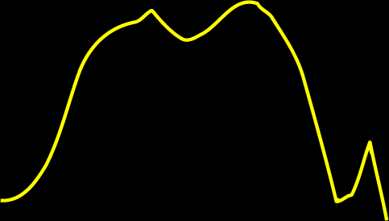
Sea level variability
In the LIG?
The challenges
Chronological uncertainties 3. Producing estimates of global mean sea level
Interpretation of the stratigraphy
Kopp et al., 2009 Nature
1-sigma
Hibbert et al., 2016. Quaternary Science Reviews.
Dusterhus et al., 2016. Geophysical Journal International
This slide is not released under the creative commons license.
Notes:
So, What do we know? How high was sea level in the Last Interglacial? Until a couple of years ago, we thought we knew with very high confidence that sea level was 5-10m above present. But the work of my research group, in collaboration with other groups, showed that the uncertainties are instead very large. Then, we want to reduce uncertainties.

Slide 22
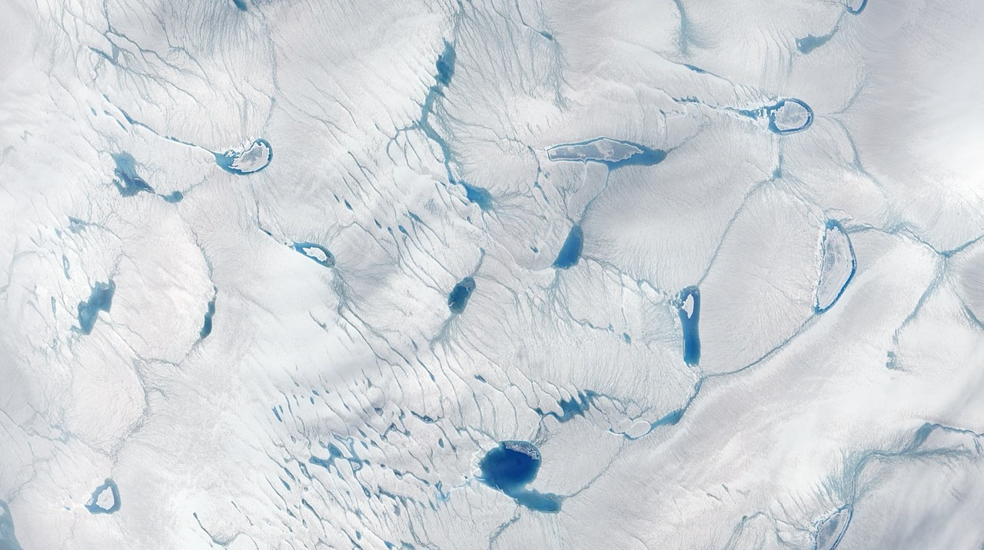
Sea level variability
In the LIG?
Evidence for a large intra-interglacial sea level oscillation?
2.8 – 8.4 m/kyr GMSL sea level fall during LIG (Kopp pers comm)
Requires 1.15 – 3.45 million km³ of net ice volume gain in 1000 years
(73-220 mm/yr thickening rate)
Modern Greenland ice sheet ~2.9 million km³
Out of phase Greenland/Antarctic melt can not explain fall, as must be period of next ice increase (as curve is GIA ‘corrected’)
Image: NASA Earth Observatory image by Jesse Allen, using EO-1 ALI data provided courtesy of the NASA EO-1 team
Values from Barlow et al., 2018. Nature Geoscience
This slide is not released under the creative commons license.
Notes:
So, What do we know? How high was sea level in the Last Interglacial? Until a couple of years ago, we thought we knew with very high confidence that sea level was 5-10m above present. But the work of my research group, in collaboration with other groups, showed that the uncertainties are instead very large. Then, we want to reduce uncertainties.

Slide 23
Sea level variability
In the LIG?
Evidence for a large intra-interglacial
sea level oscillation?
No obvious driver from climate, ice sheet
or offshore records for >4 m GMSL oscillation
But can’t reject idea of smaller (1-2 m?) fluctuations (certainly regionally)
Barlow et al., 2018. Nature Geoscience
This slide is not released under the creative commons license.
Notes:
So, What do we know? How high was sea level in the Last Interglacial? Until a couple of years ago, we thought we knew with very high confidence that sea level was 5-10m above present. But the work of my research group, in collaboration with other groups, showed that the uncertainties are instead very large. Then, we want to reduce uncertainties.

Slide 24
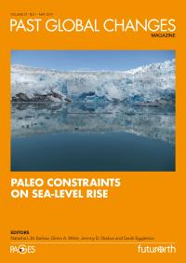
Sea level variability
In the LIG?
Current state of the science
More attention on the stratigraphic record
(see Caroline Quanbeck’s talk)
Dutton and Barlow (2019) PAGES magazine – from Skrivanek et al. 2018 (A – Bahamas) and Vyverberg et al. 2018 (B – Seychelles)
This slide is not released under the creative commons license.
Notes:
So, What do we know? How high was sea level in the Last Interglacial? Until a couple of years ago, we thought we knew with very high confidence that sea level was 5-10m above present. But the work of my research group, in collaboration with other groups, showed that the uncertainties are instead very large. Then, we want to reduce uncertainties.

Slide 25
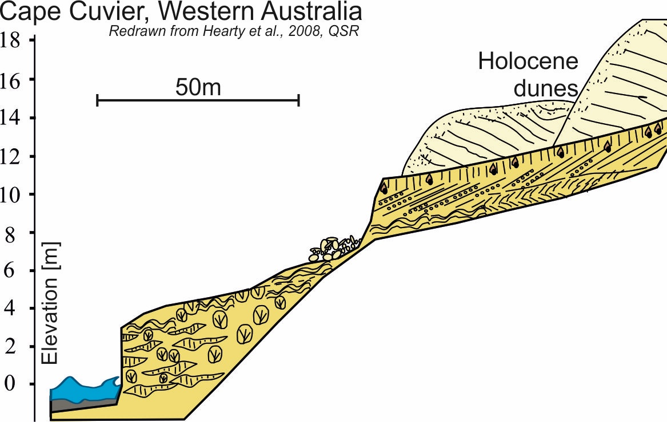
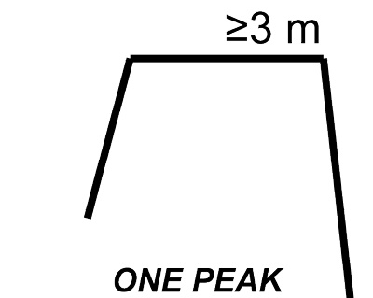
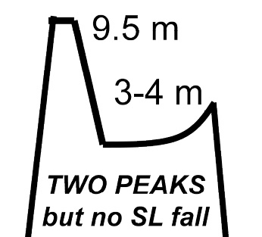
Sea level variability
In the LIG?
Current state of the science
More attention on the stratigraphic record
Conflicting interpretations
Stable
2nd reef
Late LIG
Elevation [m]
1st reef
Early LIG
Abrupt
pulse
Modelling reef stratigraphic evolution under different sea level scenarios: which one is the best match?
This slide is not released under the creative commons license.
Notes:
So, What do we know? How high was sea level in the Last Interglacial? Until a couple of years ago, we thought we knew with very high confidence that sea level was 5-10m above present. But the work of my research group, in collaboration with other groups, showed that the uncertainties are instead very large. Then, we want to reduce uncertainties.

Slide 26
Sea level variability
In the LIG?
Current state of the science
More attention on the stratigraphic record – but don’t extrapolate (example, non-tropical sequence)
Mauz et al, (2018) Quaternary Research – Hergla, Mediterranean
This slide is not released under the creative commons license.
Notes:
So, What do we know? How high was sea level in the Last Interglacial? Until a couple of years ago, we thought we knew with very high confidence that sea level was 5-10m above present. But the work of my research group, in collaboration with other groups, showed that the uncertainties are instead very large. Then, we want to reduce uncertainties.

Slide 27
Sea level variability
In the LIG?
Current state of the science
More attention on the stratigraphic record
Develop improved GIA corrections for GMSL estimates: MIS 6 has big impact on the LIG
Rohling et al. (2017) Quaternary Science Reviews
This slide is not released under the creative commons license.
Notes:
So, What do we know? How high was sea level in the Last Interglacial? Until a couple of years ago, we thought we knew with very high confidence that sea level was 5-10m above present. But the work of my research group, in collaboration with other groups, showed that the uncertainties are instead very large. Then, we want to reduce uncertainties.

Slide 28
Sea level variability
In the LIG?
Current state of the science
More attention on the stratigraphic record
Develop improved GIA corrections for GMSL estimates
Innovative dating techniques to constrain rates from continuous sequences with smaller uncertainties
Notes:
So, What do we know? How high was sea level in the Last Interglacial? Until a couple of years ago, we thought we knew with very high confidence that sea level was 5-10m above present. But the work of my research group, in collaboration with other groups, showed that the uncertainties are instead very large. Then, we want to reduce uncertainties.

Slide 29
Challenges for the
wider community
To improve understanding of LIG (and other interglacial) sea level we need:
Improved MIS 6 ice sheet reconstructions or:
Ice sheet/climate models which permit regional MIS 6 ice sheet reconstructions
Improved chronologies
Understanding of the magnitude of LIG melt from Greenland and Antarctica (from near field ice sheet and climate data/models)
AND See the recommendations in Capron, Rovere et al. (in press) QSR opinion piece from the joint 2019 PALSEA-QUIGS workshop.
Haywood et al. (2019) Earth Systems and Environment – Simulated minimum GIS extent for the LIG for models with multiple forcings
This slide is not released under the creative commons license.
Notes:
So, What do we know? How high was sea level in the Last Interglacial? Until a couple of years ago, we thought we knew with very high confidence that sea level was 5-10m above present. But the work of my research group, in collaboration with other groups, showed that the uncertainties are instead very large. Then, we want to reduce uncertainties.

