Slide 1
PIDs 101
Helena Cousijn (DataCite) & Ivo Wijnbergen (ORCID)
20 November 2019

Slide 2
We will be using Mentimeter throughout this session.
Please go to menti.com to participate in answering questions for slides where you see this logo

Slide 3
Round of introductions
Who are you
What do you do
What are you hoping to learn today

Slide 4
What is a persistent identifier?

Slide 5
persistent identifier
an organization made a promise to keep it alive
globally unique string
(known as PIDs to their friends)

Slide 6
A trustworthy PID system must
be maintained by a dedicated and reliable team,
be based on a transparent sustainable business model,
be provided by a non-profit organisation,
be subject of regular quality assessments by external parties,
be governed by international boards,
be based on open standards,
be based on a redundant and secure architecture,
support a huge address space (comparable or even larger than IPv6) and
support an openly documented API optimally supporting accepted data models.
Notes:
RDA’s recommendations for a trustworthy system

Slide 8
Why are PIDs important to you?

Slide 9
. . . but what can PIDs *do*?

Slide 10
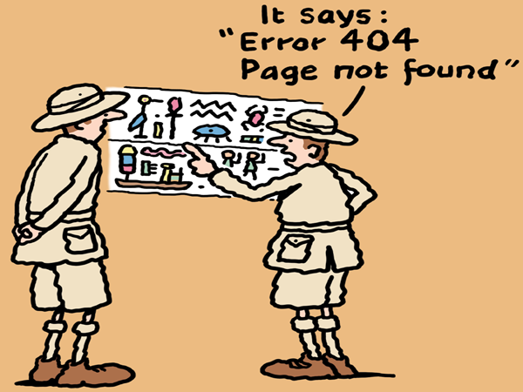

Slide 11
PIDs Disambiguate

Slide 12
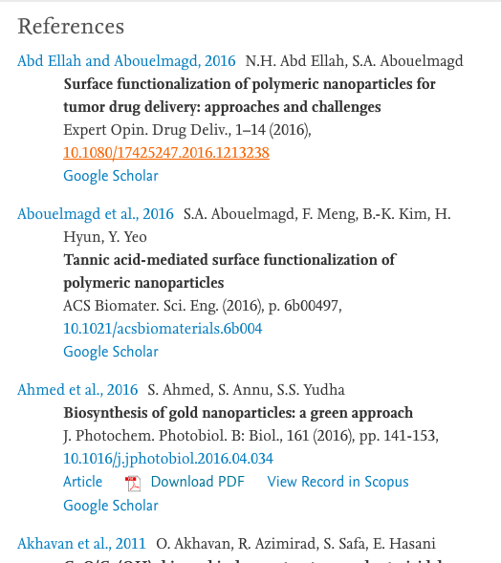
PIDs Link

Slide 13
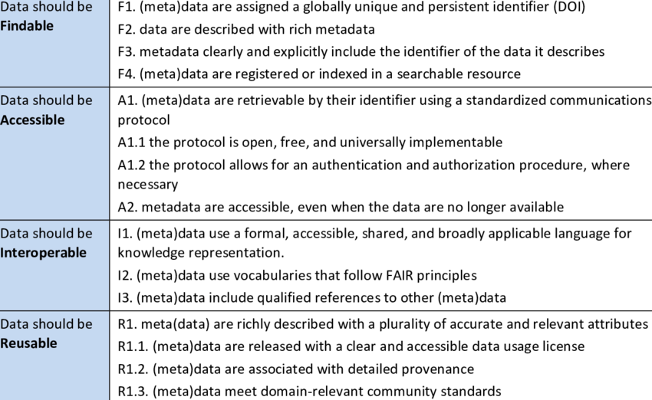
PIDs can make research FAIR

Slide 14
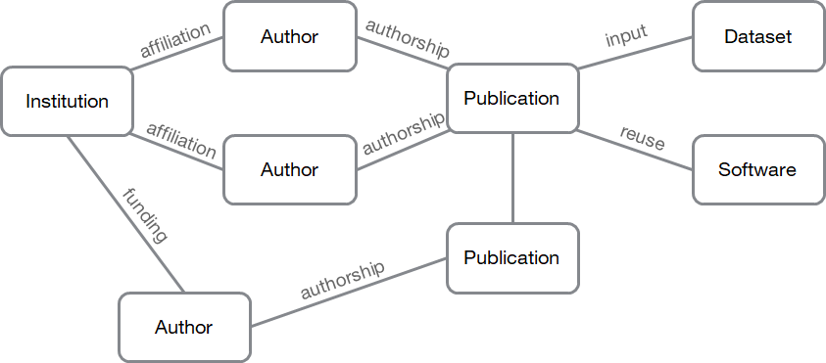
Good start, but we want more
By connecting everything, you can see the true power of PIDs
Researchers, institutions, publications, datasets, and more are already interconnected in real life, and this can be reflected and tracked through PIDs

Slide 15
Author
Dataset
affiliation
authorship
input
Institution
Publication
affiliation
authorship
reuse
Author
Software
funding
Publication
authorship
Author
Connected PIDs form a graph

Slide 16
Who are all the co-authors of a given researcher?
Person
Works
People
Crossref
EMBL-EBI
DataCite
ORCID
ORCID
Show all datasets funded by the European Commission that have been cited by a journal article
Funder
Dataset
Publication
Crossref
Funder ID
DataCite
Which can be used to answer new questions

Slide 17
How can we increase awareness of the importance of PIDs?

Slide 18
PIDs for (almost) everything

Slide 19
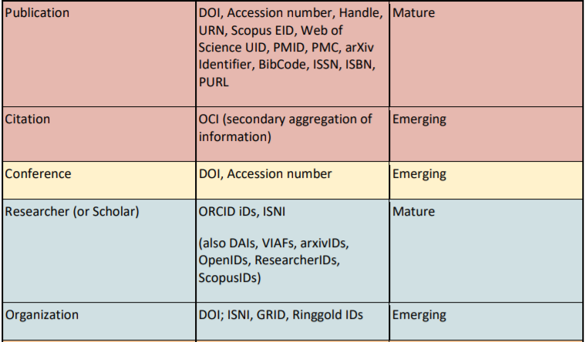
PID types overview and maturity
Source: FREYA deliverable D3.1 Survey of Current PID Services Landscape May 2018 - https://www.project-freya.eu/en/deliverables/freya_d3-1.pdf
Notes:
2018 FREYA - Survey of Current PID Services Landscape - report

Slide 20
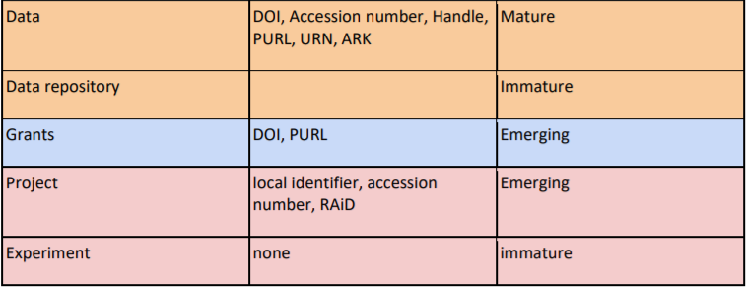
PID types overview and maturity
Source: FREYA deliverable D3.1 Survey of Current PID Services Landscape May 2018 - https://www.project-freya.eu/en/deliverables/freya_d3-1.pdf

Slide 21
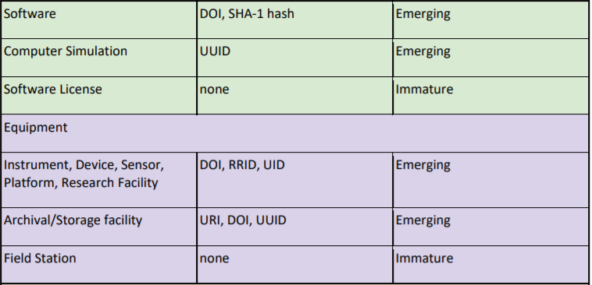
PID types overview and maturity
Source: FREYA deliverable D3.1 Survey of Current PID Services Landscape May 2018 - https://www.project-freya.eu/en/deliverables/freya_d3-1.pdf

Slide 22
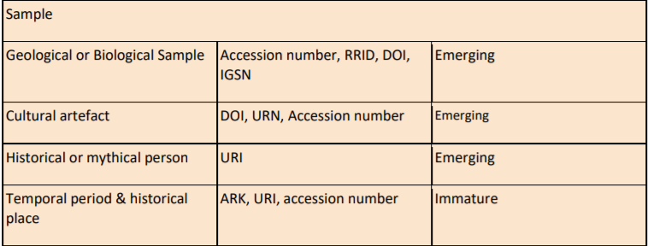
PID types overview and maturity
Source: FREYA deliverable D3.1 Survey of Current PID Services Landscape May 2018 - https://www.project-freya.eu/en/deliverables/freya_d3-1.pdf

Slide 23
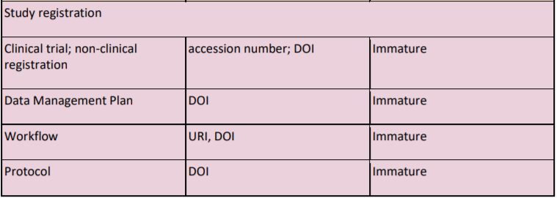
PID types overview and maturity
Source: FREYA deliverable D3.1 Survey of Current PID Services Landscape May 2018 - https://www.project-freya.eu/en/deliverables/freya_d3-1.pdf

Slide 24
People
Persistent identifiers for people include standards such as ISNI and ORCIDs (both non-proprietary identifiers).
ORCID iDs are in fact 16-digit alphanumeric ISNI codes.
The Open Researcher and Contributor ID is used to uniquely identify scientific and other academic authors and contributors throughout their career, across disciplines, locations and time.
ORCID also offers an open and independent registry intended for contributor identification in research and academic publishing, accessible by systems through an API.

Slide 25
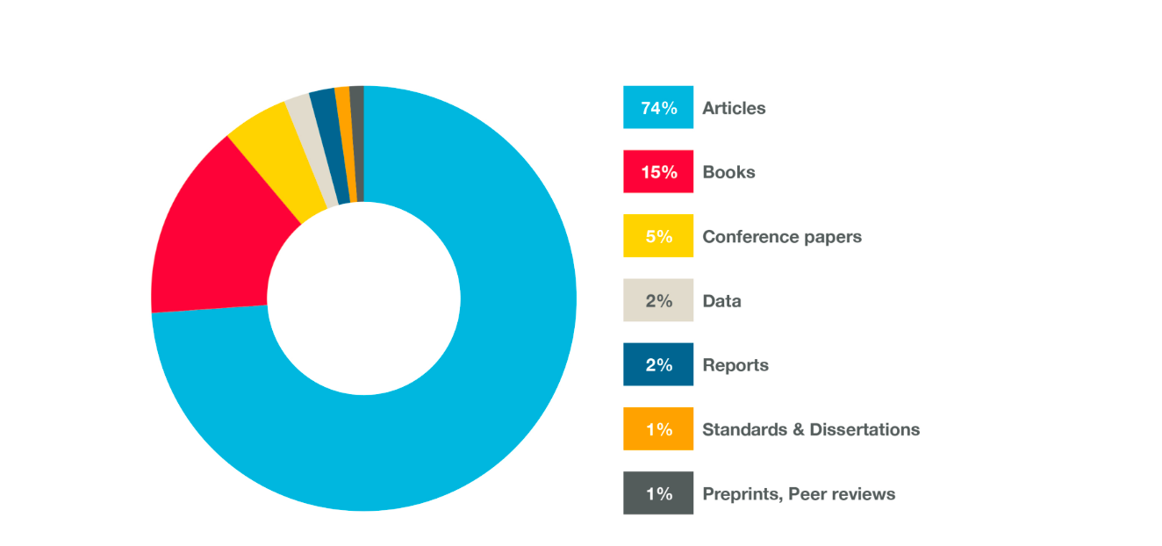
Publications
Crossref DOI’s
Many other smaller systems

Slide 26
Data
Identifier | Stands for | Since when | Does what
ARK | Archival Research Key | 2001 | Access, Policy and Description
URN | Universal Resource Name | 1994 | Joint resolving infrastructure operated by European libraries
PURL | Persistent Uniform Resource Locator | 1995 | Looks just like a URL, except it points to a resolution service
Handles |  | 1994 | Consists of a repository, a resolution system and a registry
DOI | Digital Object Identifier | 1996 | Implementation of handles, run by IDF

Slide 27
What would you like to implement at your organization - in terms of technology?

Slide 28
What would you like to implement at your organization - in terms of policy?

Slide 29
What you should do after this workshop

Slide 30
Step 1: Give PIDs to your stuff
Get an ORCID iD for yourself → https://orcid.org
Give DOIs to your data and software → https://datacite.org, https://guides.github.com/activities/citable-code/
Put your reports and white papers into a repository that gives out PIDs → https://repositoryfinder.datacite.org or your institutional repository

Slide 31
Step 2: Tell your PIDs about your other PIDs
Include relevant related PIDs in the metadata for your software, dataset, and paper PIDs, even if your repository says they’re optional.
In Zenodo (for example), it looks like this:

Slide 32
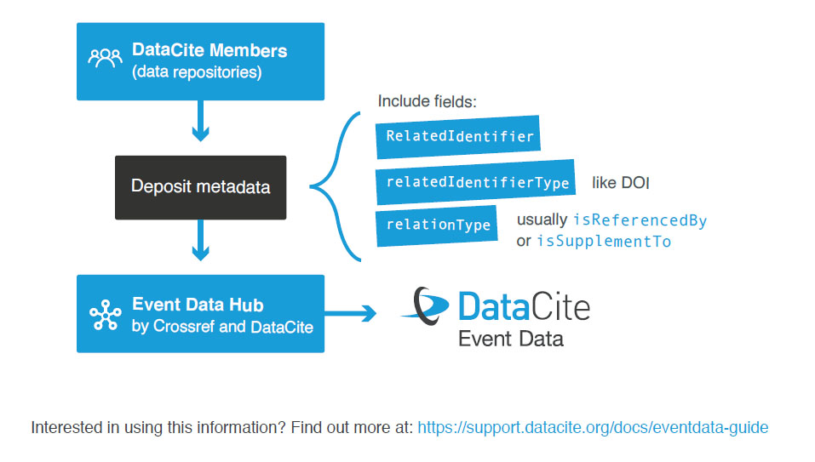
Step 3: Share these connections with the community

Slide 33
What would you like PID providers to do for you?

Slide 34
Thank you!
hcousijn@datacite.org
i.wijnbergen@orcid.org

