Slide 1
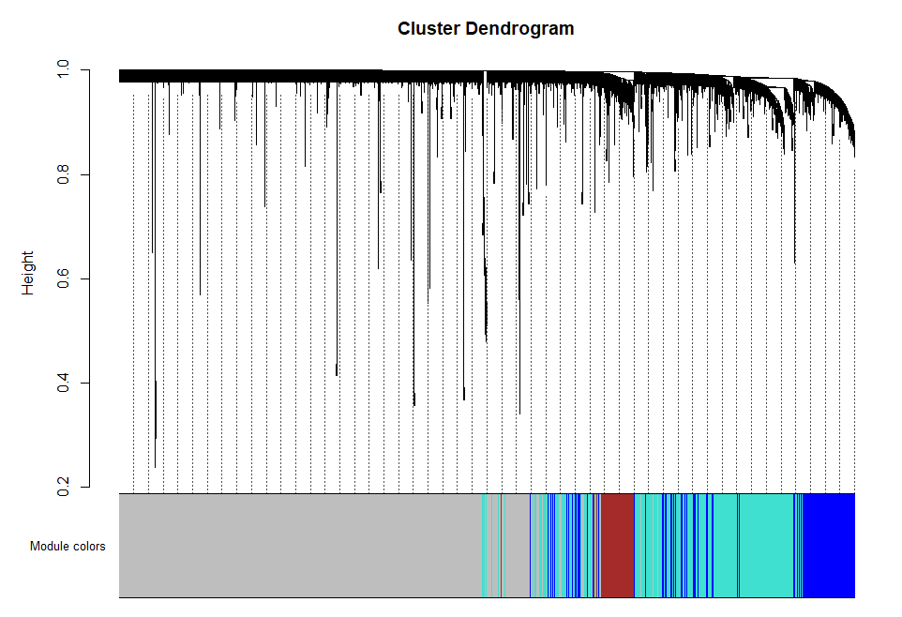
Supplemental Figure S1
Clustering dendrogram of genes for GSE30169, together with assigned module colors

Slide 2
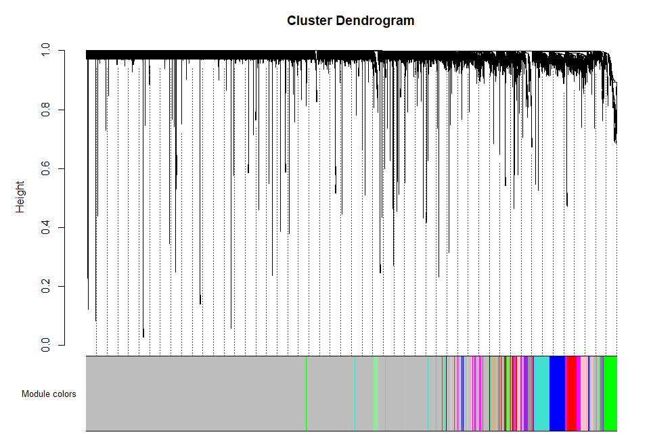
Supplemental Figure S2
Clustering dendrogram of genes for GSE7965, together with assigned module colors

Slide 3
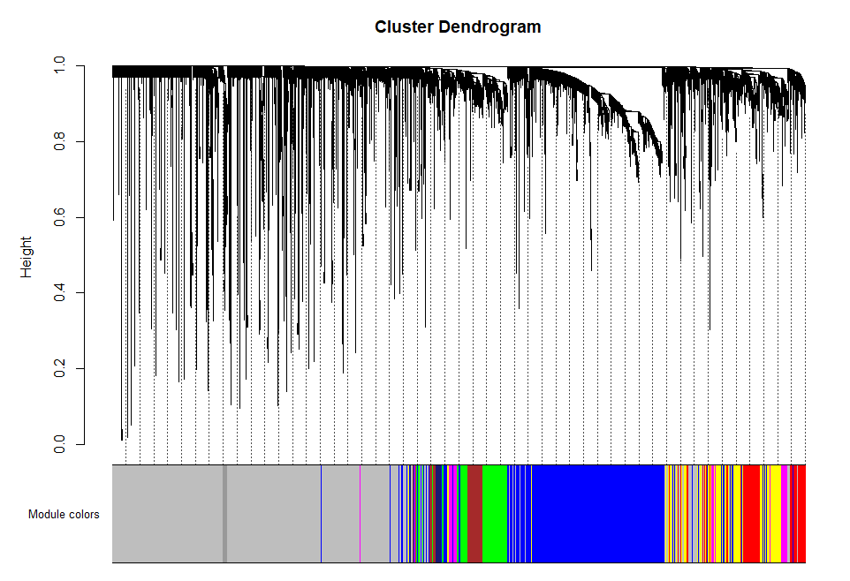
Supplemental Figure S3
Clustering dendrogram of genes for GSE24335, together with assigned module colors

