Slide 1
Critical review of genetics-free high-throughput discovery of cryptic microbial metabolites
Ng Wenfa
Critique presentation, ES5101
18 February 2019

Slide 2
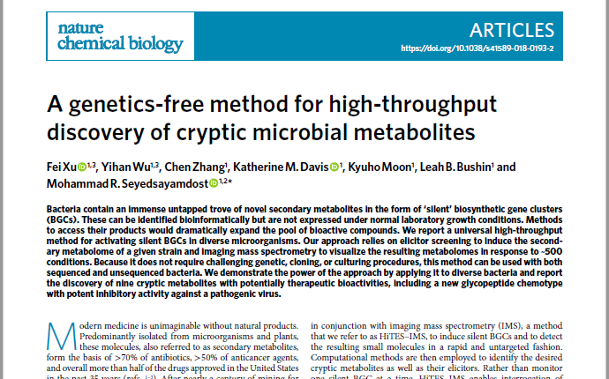
A genetics-free method for high-throughput discovery of cryptic microbial metabolites

Slide 3
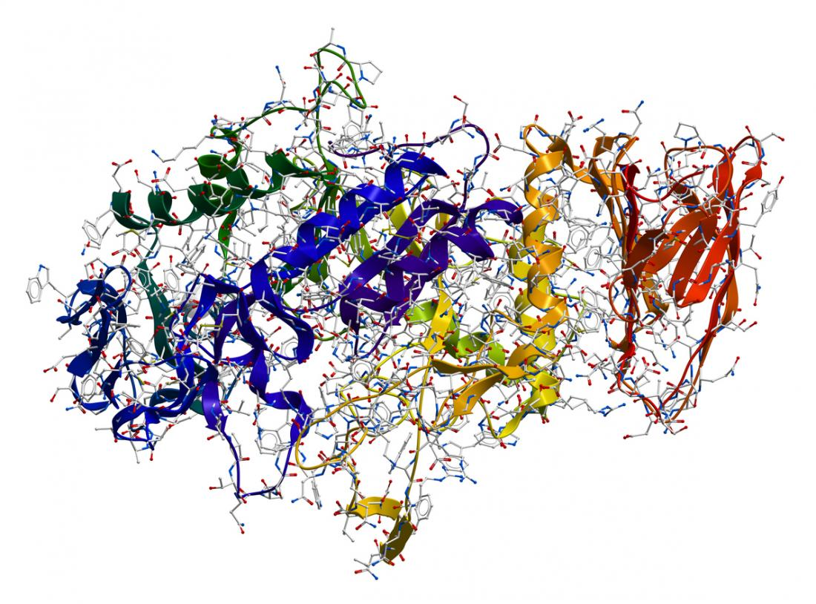
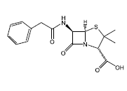
Problem: How to activate silent biosynthetic gene cluster?
Secondary metabolite
Penicillin G
Enzyme
Methods for activating gene expression from silent genes
Expression in another microbe amenable to genetic engineering
Co-culture with another microbe able to secrete compounds that activate expression of silent genes
Screening of nutritional and experimental conditions that induce gene expression
Substrate
Gene X
Biosynthetic gene cluster comprising multiple genes
Genetic engineering and cell cultivation methods are time-consuming

Slide 4
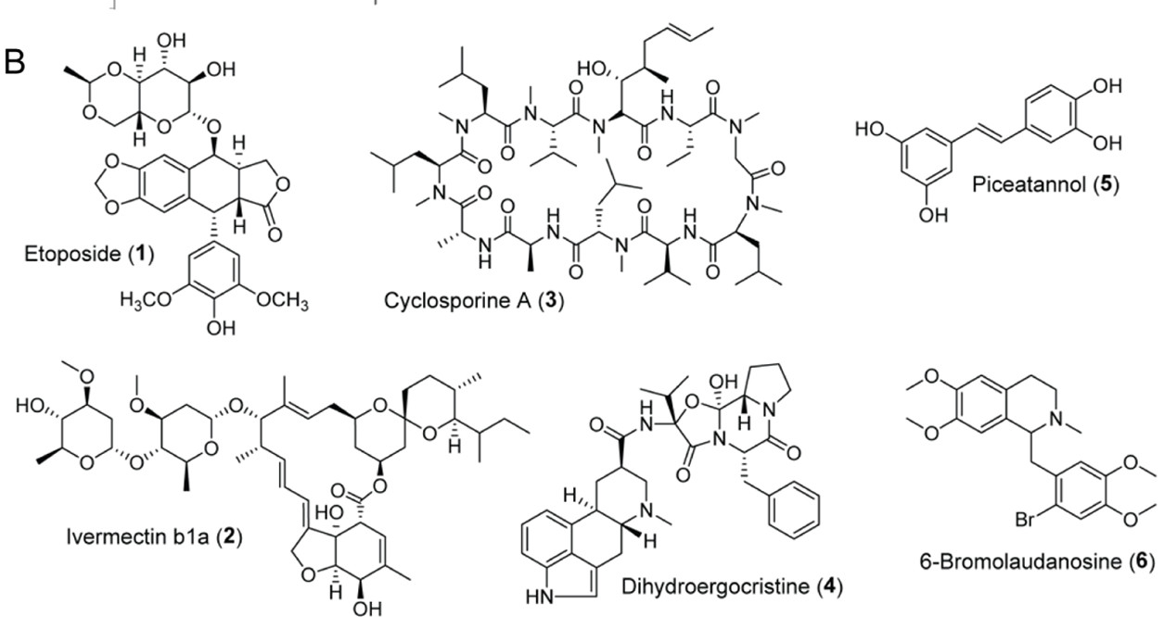
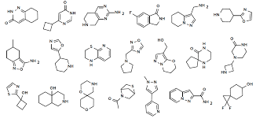

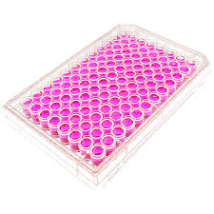
Solution: High throughput elicitor (inducer) screening
Library of inducers
Bacterial cells
Cells are cultivated in 96 well plates
Some elicitors would activate the expression of silent biosynthetic gene cluster that produce secondary metabolites
Cells are exposed to a library of elicitors (inducers)

Slide 5
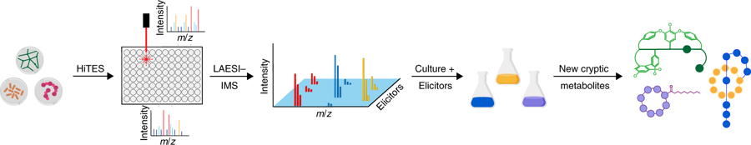
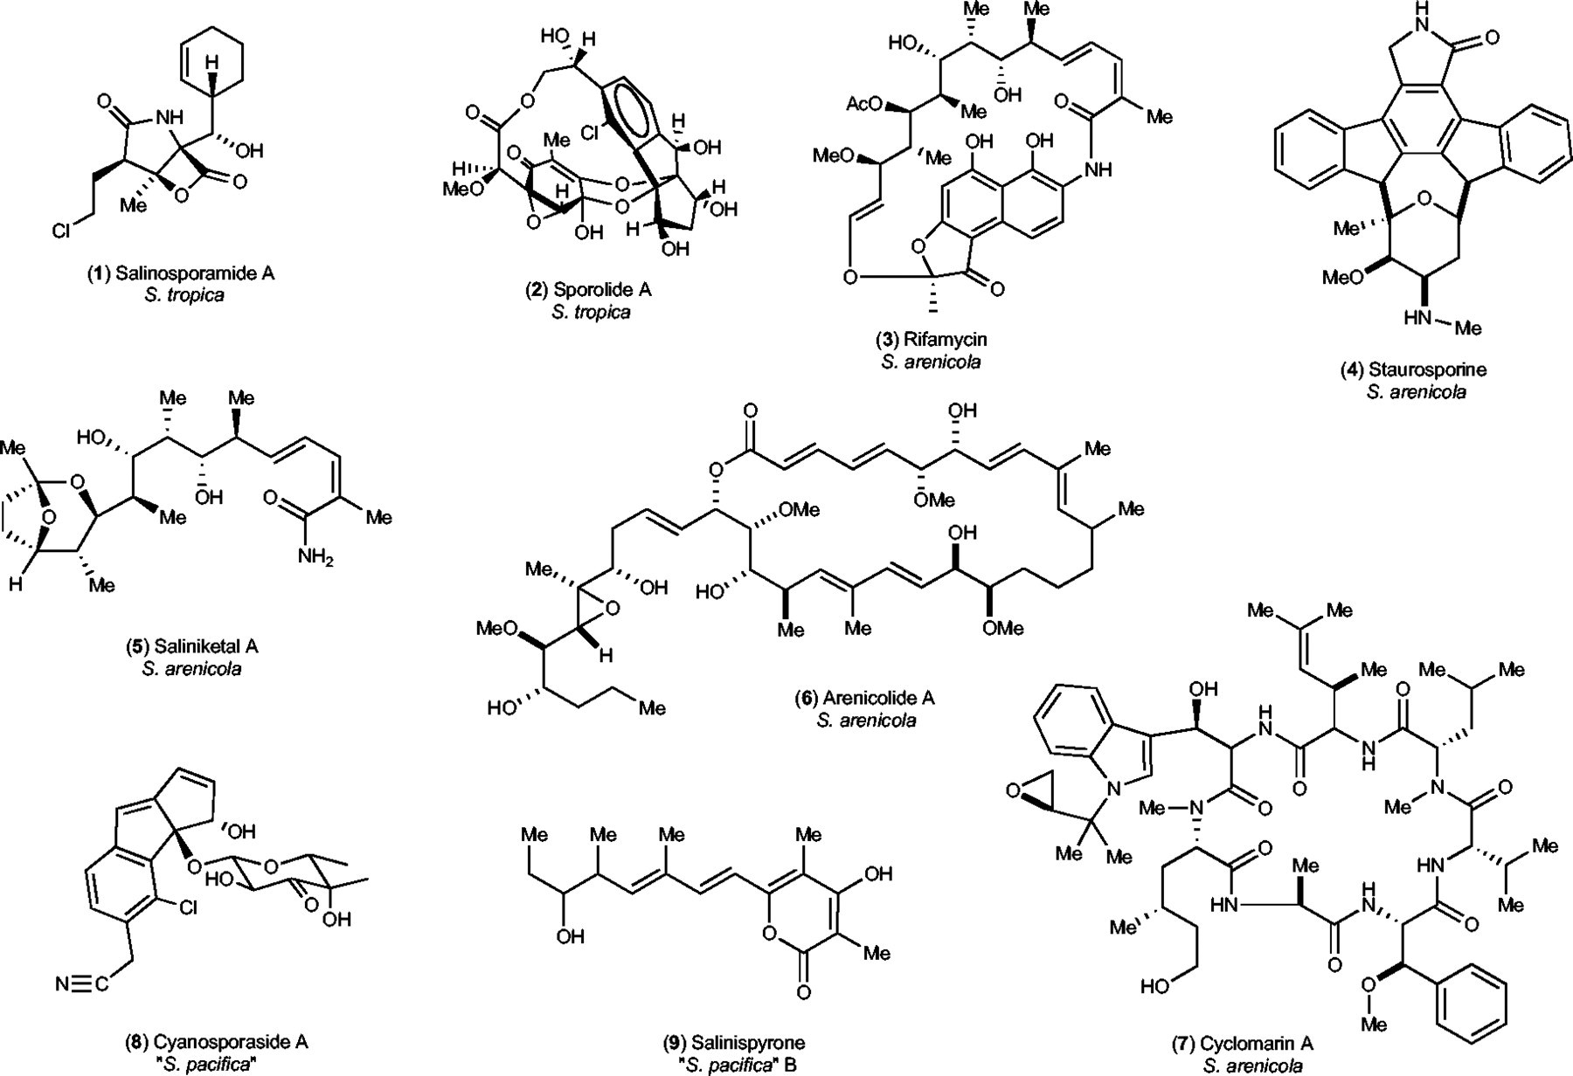
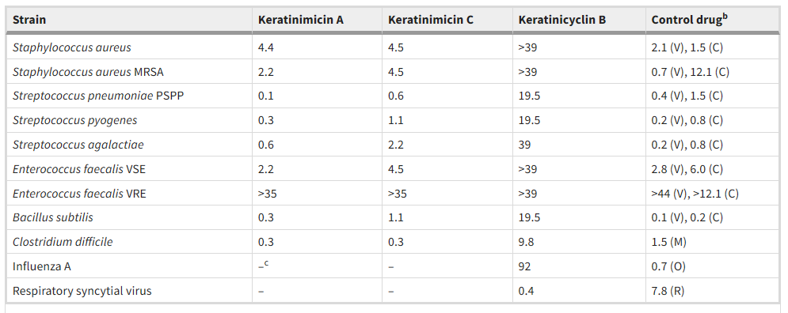
Workflow of paper
Structure determination by ¹H NMR and HR-MS
Antimicrobial activity test of secondary metabolites produced

Slide 6
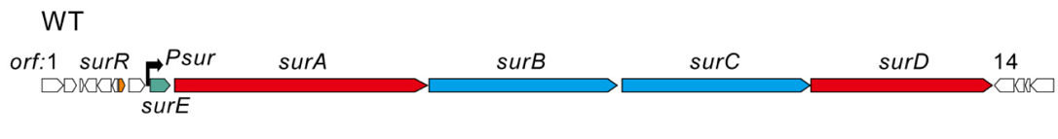
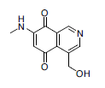

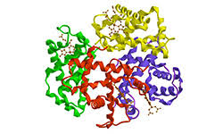
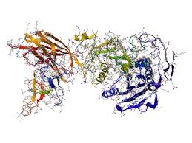

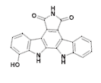
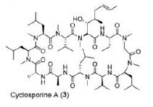
Strength (1): Simultaneous activation of multiple biosynthetic gene clusters
Conventional genetic manipulation
High throughput elicitor screening
Inducer
Insertion of promoter
Biosynthetic gene cluster 1
Silent biosynthetic gene cluster
Inducer
Secondary metabolite 1
Biosynthetic gene cluster 2
Secondary metabolite 2
Enzymes
Inducer
Biosynthetic gene cluster 3
Secondary metabolite 3
Multiple secondary metabolites can be probed at the same time

Slide 7
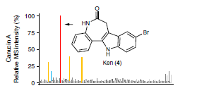
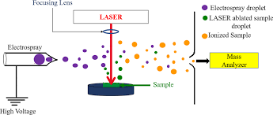
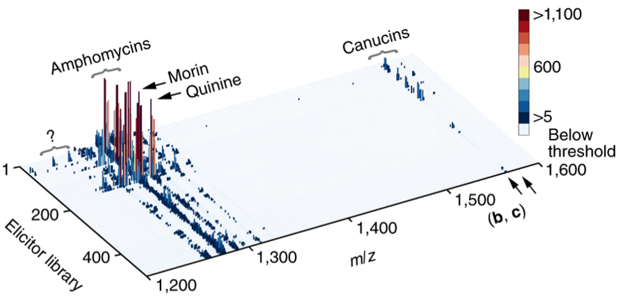
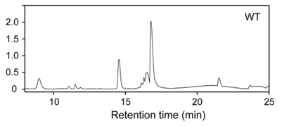
Strength (2): Imaging mass spectrometry enables rapid profiling of synthesized secondary metabolites
Laser pulse direct energy to individual well to ionize all ionizable metabolites
Electrospray ionization confers multiple charges to molecules which allow them to be separated in the mass analyzer
m/z
Novel secondary metabolites could be identified by their unique m/z ratio
MS signal intensity
Conventional HPLC-MS takes tens of minutes per sample – and is too slow
IMS – 96 well plate processed in < 1 hr

Slide 8
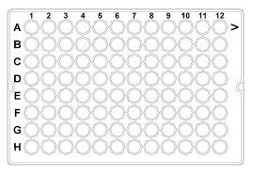
Weakness (1): Use of uniform growth conditions might not be suitable for all inducers
Inducer B12
Lack of secondary metabolite production from inducer working at either the wrong temperature or nutrient conditions.
MS intensity
m/z
Inducer H12
Use of identical growth conditions (temperature, growth medium etc) on each plate might not be conducive to the function of individual inducer
MS intensity
Some inducer might be able to elicit the production of more secondary metabolites under certain growth conditions compared to other inducers.
m/z
Temperature and nutrient conditions may hold the key to unlocking the potential of inducers in eliciting the production of secondary metabolites.
Thus, different growth conditions should be used to expand the secondary metabolome of the cells that could be probed.

Slide 9
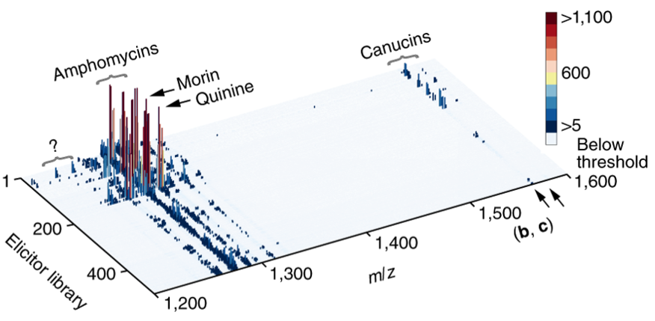
Weakness (2): Ion suppression in imaging mass spectrometry preclude the detection of some secondary metabolites

Slide 10
Conclusions
Solution was found for activating silent biosynthetic gene cluster in a high throughput manner.
High throughput elicitor screening could simultaneously activate multiple biosynthetic gene clusters.
At the same time, imaging mass spectrometry could rapidly profile the secondary metabolome of cells compared to time-consuming HPLC-MS or genetic reporter assay.
One limitation of the approach, however, was the use of uniform growth conditions for all inducers, where some of which might not be functional.
Another problem concerns ion suppression effects from imaging mass spectrometry that precludes the detection of some secondary metabolites.

Slide 11
Thank you for your attention

