Slide 1
Linked Open Data:
Who Cares?!
You should!
But only a little bit.
Matthew Lincoln, PhD
Research Software Engineer
@matthewdlincoln
Notes:
Main title: 40 pt. Arial
Presenter Name: 16 pt. Arial
Presenters Title: 16 pt. Arial Italic

Slide 2
@matthewdlincoln matthewlincoln.net
Once: PhD in art history
Then: Data Research Specialist at the Getty Research Institute
Now: DH Developer / Research Software Engineer at CMU
@matthewdlincoln

Slide 3
Why does LOD matter?
Art historical specialties cover a huge range and are all very unique and special 🦄 🦄 🦄 but:
We often reference the same real-world things: people, places, objects, and events
We’d like to know when someone else is talking about our thing (and maybe harvest their data – but without replacing our own?)
We want others to do the same with our research! #impact
@matthewdlincoln

Slide 4
Today
We will not talk about: triples, RDF, SPARQL, JSON-LD conceptual reference models
We will talk about: why museums & libraries are interested in LOD, end uses for data, how research data can play nice with LOD
@matthewdlincoln

Slide 5
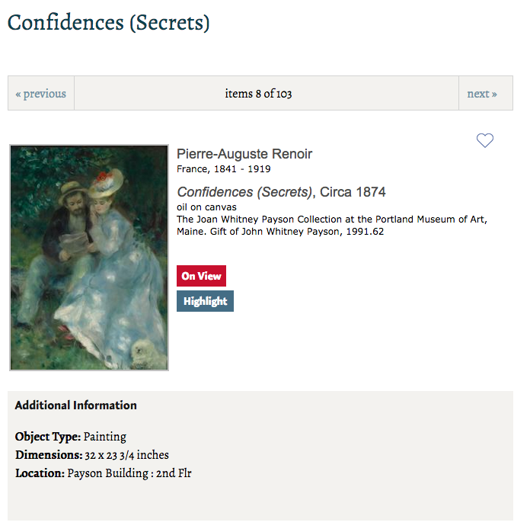
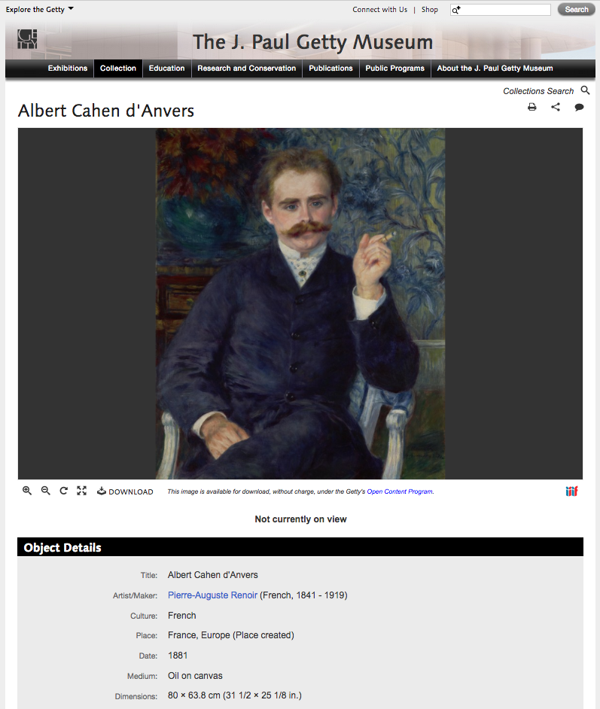
A tale of two Renoirs
Portland Museum of Art
J. Paul Getty Museum
@matthewdlincoln
Notes:
Renoir at the Portland Museum of Art, and a Renoir we have here at the JPGM.

Slide 6
A tale of two Renoirs: What do they share?
Portland Museum of Art
J. Paul Getty Museum
@matthewdlincoln
Notes:
Renoir at the Portland Museum of Art, and a Renoir we have here at the JPGM.

Slide 7
A tale of two Renoirs: How are they different?
Portland Museum of Art
J. Paul Getty Museum
@matthewdlincoln
Notes:
Renoir at the Portland Museum of Art, and a Renoir we have here at the JPGM.

Slide 8
Use shared vocabularies to refer to people, places, objects, events, and concepts
Use shared ontologies to connect those entities together in the same way
Putting the resulting data online openly, so we can treat the accumulated information as one unified knowledge graph
@matthewdlincoln

Slide 9
Shared Vocabularies
(a.k.a. Shared ways of referring to concepts)
Actors (people & corporate bodies)
VIAF
Getty ULAN
Places
Getty TGN
Geonames
Concepts
Getty AAT
Iconclass
LoC Subject Headings
A sampling of most of these = wikidata
@matthewdlincoln

Slide 10
Shared Ontologies
(a.k.a. Shared ways of connecting each resource together)
held_by
Renoir (ulan:500115467)
referenced_by
has_ownership
created
depicts
Albert Cahen d'Anvers (ulan:500354828)
transferred_custody_of
created
has_ownership
referenced_by
held_by
@matthewdlincoln

Slide 11
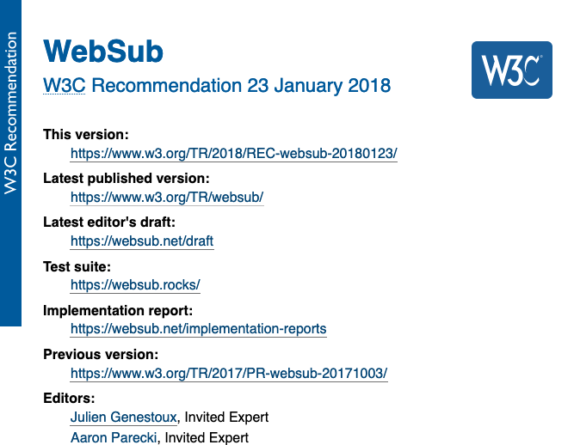
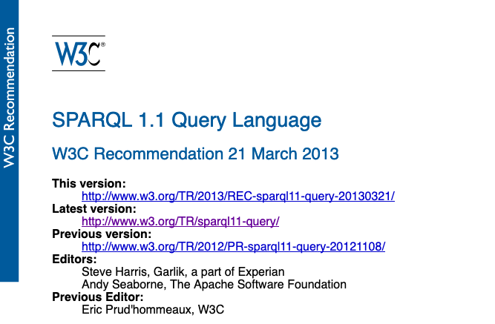
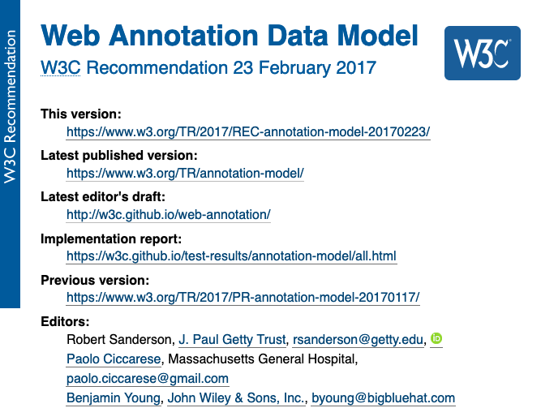
Putting the data online
(tbqh, we’re still working on this)
Make individual records accessible at persistent URLs
Shared onto. + vocab. + online = able to easily merge data from many places
(ideally) be able to subscribe to institutions to know when they have updated their knowledge about an entity
@matthewdlincoln

Slide 12
LOD is for programmers (who build things for everyone else!)
Cross-institution applications
Institution-specific applications
3rd party apps
Internal CMS
Aggregators
Institution-developed apps
Public website
Researchers
@matthewdlincoln

Slide 13
LOD in academic research projects
If you are a lone researcher, probably don’t try to make pure, gold-standard LOD
Our sources usually belong to other institutions (museums, archives)
Our research questions are usually so specialized that they can’t be fully expressed in existing ontologies
Our primary goal is usually not to enrich another institution’s database
@matthewdlincoln

Slide 14
LOD in academic research projects
But! We should try to make LOD-friendly research data
Find the intersections (the “sticky points”) of our data where adding references to shared vocabularies (reconciliation) makes sense
Get a sense of what ontologies are used by major institutions (a.k.a. https://linked.art) so that eventual integration or enhancement may be possible.
@matthewdlincoln

Slide 15
Vocabularies in reality
name | my_uid | ulan
Rembrandt | 1 | 500011051
Jacob van Ruisdael | 2 | 500027077
John Doe III | 3
John Singleton Copley | 4 | 500009177
No vocabulary will cover ALL of the terms in your data
Maintain a local ID alongside an optional vocabulary URI
See contribution guides to ULAN, AAT to add those entities not yet in those vocabularies
@matthewdlincoln

Slide 16
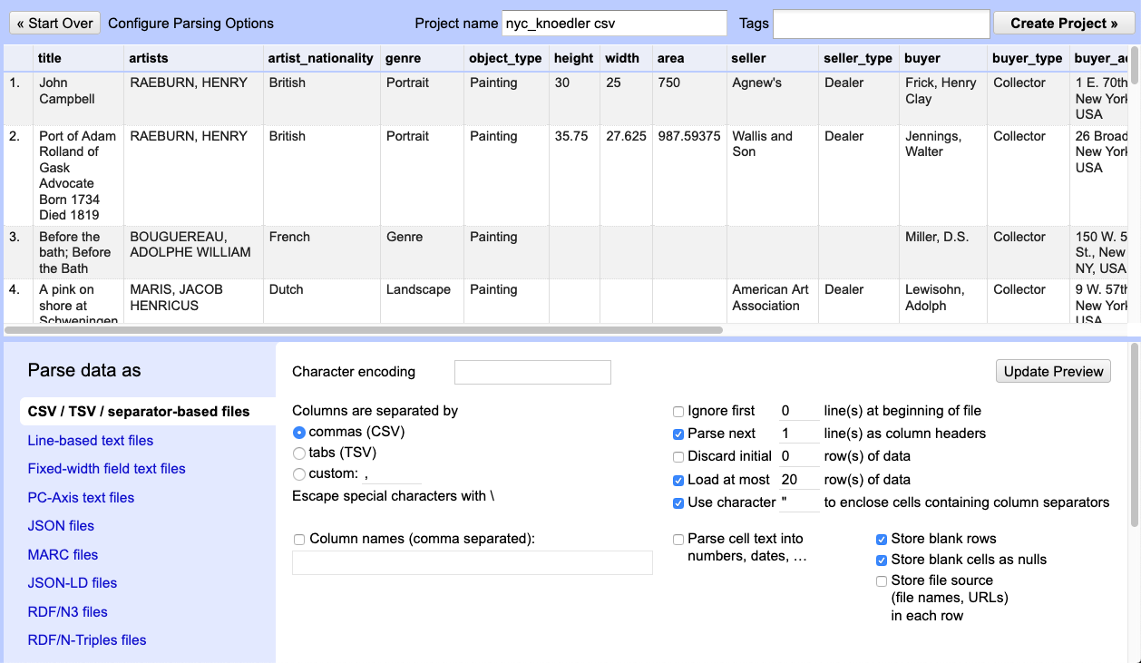
Reconcile in OpenRefine
Load first 20 rows of Knoedler data from yesterday
(OR use your own data, but just a few rows for now)
@matthewdlincoln

Slide 17
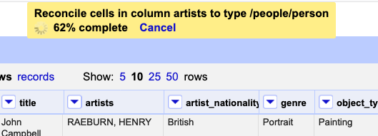
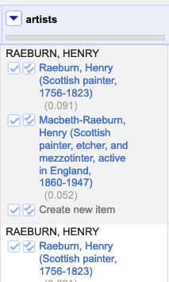
Reconcile in OpenRefine
2. Begin the reconciliation process
You should see something like this if you did the steps right!
1. artists > Reconcile > Start reconciling…
2. Add standard service: http://services.getty.edu/vocab/reconcile> Add service > Start Reconciling
@matthewdlincoln

Slide 18
Reconcile in OpenRefine
3. Make your reconciliation selections
@matthewdlincoln

Slide 19
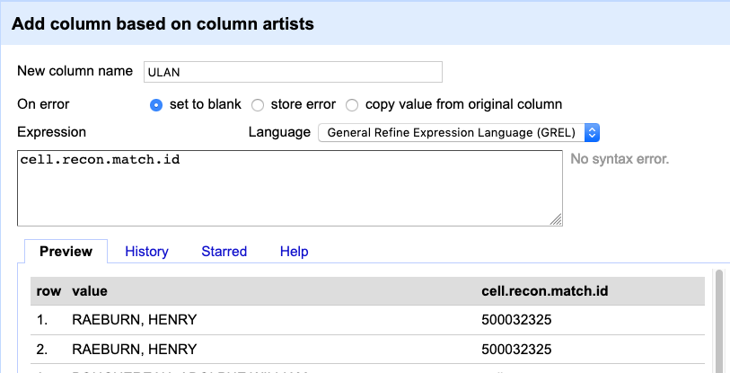
Reconcile in OpenRefine
3. Extract the ULAN ids
1. artists > Edit Column > Add column based on this column…
2. Enter a new column name (e.g. “ULAN”)
3. Expression: cell.recon.match.id
@matthewdlincoln

Slide 20
Final exercise with your project team:
Identify one or two fields in your data you would like to match to a controlled vocabulary
Does a potential vocabulary exist yet? Which one?
Present out to the rest of us.
@matthewdlincoln

Slide 21
Links
LOD principles for museums: https://www.slideshare.net/azaroth42/linked-open-data-at-the-getty
American Art Collaborative Report (excellent “lessons learned” section) http://americanartcollaborative.org/tools/
Intro for historians: https://programminghistorian.org/en/lessons/intro-to-linked-data
How to query LOD using SPARQL: https://programminghistorian.org/en/lessons/graph-databases-and-SPARQL
Linked Art (more technical, example of an ontology for describing art, exhibitions, provenance) https://linked.art
Contribution guidelines for Getty Vocabularies: http://www.getty.edu/research/tools/vocabularies/contribute.html

