Slide 1
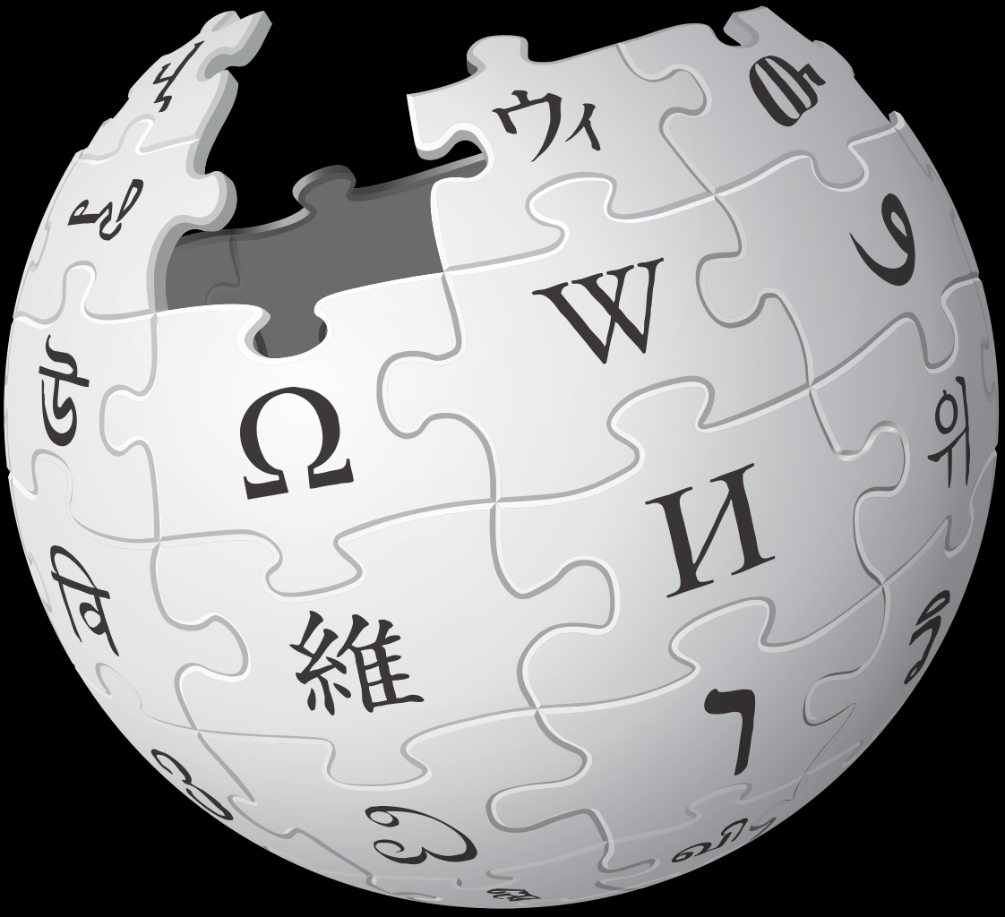
Wikipedia and InfoLit
Ingrid Thomson
WCHELIG

Slide 4
Wikipedia and IL
One of the top five most heavily used websites in the world
(Often) Readers don’t understand how Wikipedia is created and how to use in within a research process and other critical thinking and digital research skills
Yes, there are problems (like the thinking that it is a one-stop shop for all information needs; that anyone can edit and add content; and that vandals deliberately change entries….)
But this is what makes Wikipedia relevant and effective as an IL tool.

Slide 5
Wikipedia and IL
For librarians to use and understand Wikipedia as a pedagogical tool for IL, we need to be familiar with this resource.
We need to know how Wikipedia formats, collects and disseminates information.
We need to understand the components of a Wikipedia article (the notable topic, neutral point of view, no original research, references to solid, reliable, secondary sources and links to other Wikipedia articles

Slide 6
“As librarians, we need to confront the stigma of Wikipedia and learn how to incorporate this resource into our reference and information literacy instruction. The current generation of patrons has been told repeatedly that Wikipedia is untrustworthy and that they cannot use it in their research. By “use it in their research,” I suspect that the instructors are stating that students cannot cite Wikipedia. However, in my experience, it seems that students take this restriction to mean that they should not consult Wikipedia. This approach needs to change, and a few librarians have been able to work Wikipedia into their instruction”
Bernd W. Becker (2015) Research Faux Pas: The Stigma of Wikipedia, Behavioral & Social Sciences Librarian, 34:3, 165-169, DOI: 10.1080/01639269.2015.1062587

Slide 7
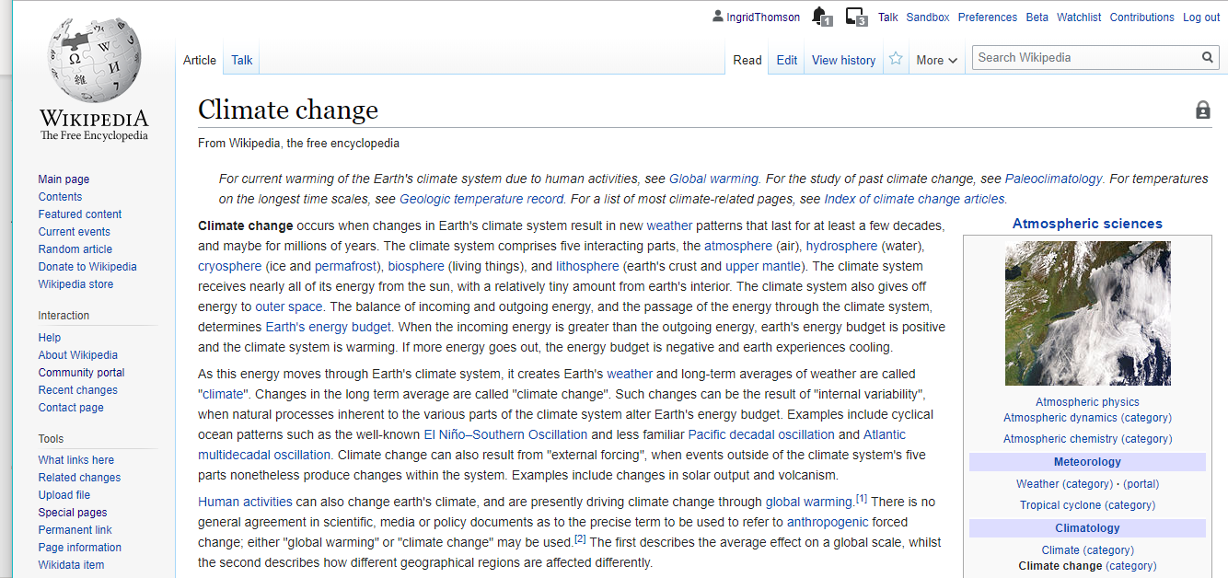
Discussions
History
hyperlinks

Slide 8
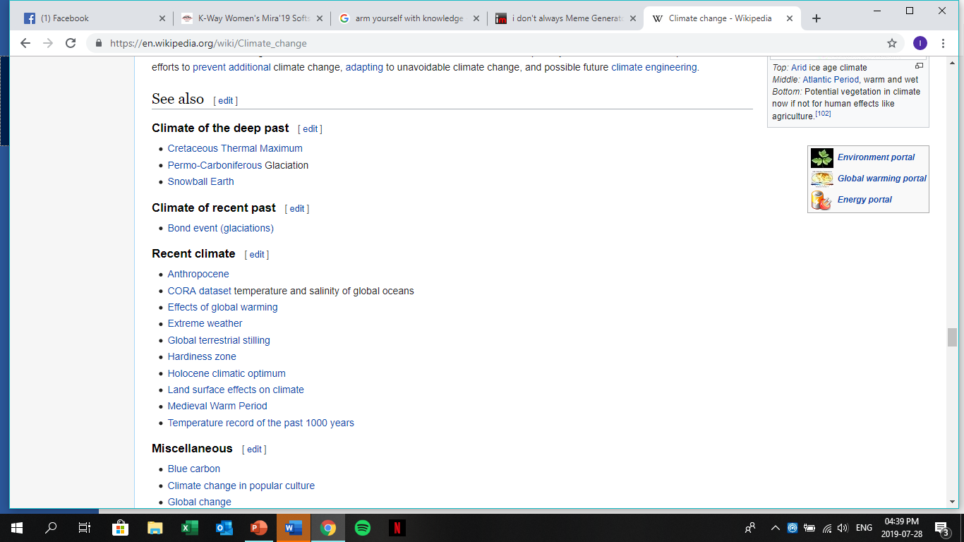
Links to other articles

Slide 9
Templates
Categories

Slide 10
Some strategies to consider using
Teach students how to evaluate Wikipedia, within its editorial standards
Teach students how to use Wikipedia as a starting point for research, showing how to use information, footnotes and external links to guide searches in library resources
Show students how to use article histories and discussion pages to evaluate the articles’ current status within the Wikipedia community.

Slide 11
More reasons ....
Encourages creativity and critical thinking in research and writing online, and requires students to write with a neutral point of view.
Fills gaps in Wikipedia’s content, giving more exposure to typically underrepresented groups and content areas.
Wikipedia gives students first-hand experience with the peer-review process
Allows students to participate in a strong global community and practice effective public engagement.
It gives students the opportunity to “give back” to a resource they’ve benefitted from
Wikipedia editing promotes active-learning, motivation and engagement with research and course content.

Slide 12
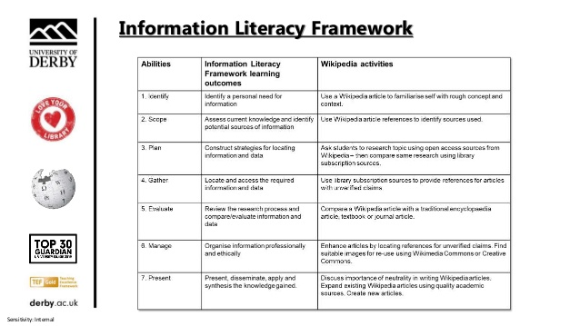
Wikipedia and IL Frameworks: Consider how to Wikipedia to align with the framework of your choosing and its standards
Ball, C., and White, J. (2019)
“Wiki literacy: using Wikipedia
as a teaching tool” [Presentation], LILAC Conference, University of
Nottingham, 24-26 April 2019

Slide 14
FURTHER READING/REFERENCES
Eric Jennings (2008) Using Wikipedia to Teach Information Literacy, College & Undergraduate Libraries, 15:4, 432-437, DOI: 10.1080/10691310802554895
Bernd W. Becker (2015) Research Faux Pas: The Stigma of Wikipedia, Behavioral & Social Sciences Librarian, 34:3, 165-169, DOI: 10.1080/01639269.2015.1062587
Frances Di Lauro & Rebecca Johinke (2017) Employing Wikipedia for good not evil: innovative approaches to collaborative writing assessment, Assessment & Evaluation in Higher Education,42:3, 478-491, DOI: 10.1080/02602938.2015.1127322
Meghan L. Dowell & Laurie M . Bridges(2019) A Perspective on Wikipedia: Your Students Are Here, Why Aren’t You? Journal of Academic Librarianship, 45:2, 81-83, DOI: 10.1016/j.acalib.2019.01.003
Evaluating Wikipedia: Tracing the evolution and evaluating the quality of articles https://en.wikipedia.org/wiki/File:Evaluating_Wikipedia_brochure.pdf
Wikipedia:Research help/Librarians and Teachers https://en.wikipedia.org/wiki/Wikipedia:Research_help/Librarians_and_Teachers
LiAnna Davis (2017) Writing Wikipedia articles teaches information literacy skills, study finds https://blog.wikimedia.org/2017/06/19/wikipedia-information-literacy-study/
Dawe, L. and Robinson, A. (2017), "Wikipedia editing and information literacy: a case study", Information and Learning Sciences, Vol. 118 No. 1/2, pp. 5-16. https://doi.org/10.1108/ILS-09-2016-0067
Oliver, J. (2015), "One-shot Wikipedia: an edit-sprint toward information literacy", Reference Services Review, Vol. 43 No. 1, pp. 81-97. https://doi.org/10.1108/RSR-10-2014-0043

