Slide 1
Social media for scientists
Vaughn Cooper
Microbiology & Molecular Genetics, SOM
Center for Evolutionary Biology and Medicine
http://micropopbio.org @vscooper @Pitt_CEBaM @EvolvingSTEM

Slide 2
My role on twitter
Me, not as a scientist
Science, leadership,
personal identity
My favorite project, our evolution-in-action curriculum

Slide 3
Why tweet? Promote research & opportunity
Check out our paper
Advertising job opportunities
Promoting opportunity for professional society

Slide 4
Why tweet? Micro-blogging and live-tweeting

Slide 5
Why tweet? Job/conference advertisement

Slide 6
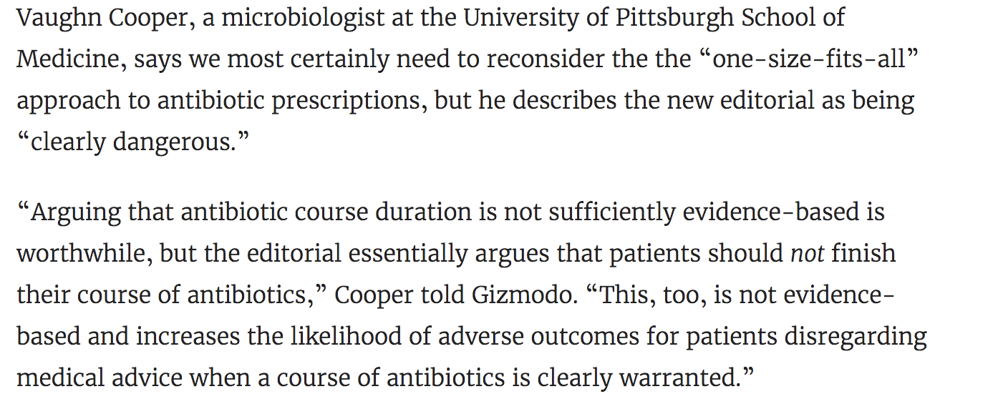
Why tweet? Commentary

Slide 7
Professional networking outcomes
Not alone, but twitter was the catalyst for:
Grants
NSF IOS “Residents, Tourists and Invaders: Identifying Mechanisms that Prevent the Invasion by and Engineering Probiotic Defenders as Countermeasure”
Publications
Jiménez A, Castro JG, Munoz-Price L, de Pascale D, Shimose L, Mustapha M, Spychala CN, Mettus RT, Cooper VS, Doi Y. Outbreak of KPC-producing Citrobacter freundii at a tertiary acute care facility in Miami, Florida. Infect Control Hosp Epidemiol. 2016 Dec 7:1-7
And several others
Inquiries from tech investors
Press
Promoting #openaccess e.g. @ASAP_bio

Slide 8
twitter 101
Your handle: be representative (@yourname, @yourstudyarea @yourorganization
Hashtags # are the connective glue of events, ideas, and wit
#evolution
#microbiology
#ASMicrobe <- meeting
#RedSox
Grow your audience using # and @-mentioning other users…within reason
USE PICTURES

Slide 9
Considerations
Spinland.studio

Slide 10
Social media for scientists
Vaughn Cooper
Microbiology & Molecular Genetics, SOM
Center for Evolutionary Biology and Medicine
http://micropopbio.org @vscooper @Pitt_CEBaM @EvolvingSTEM

